Slide 1
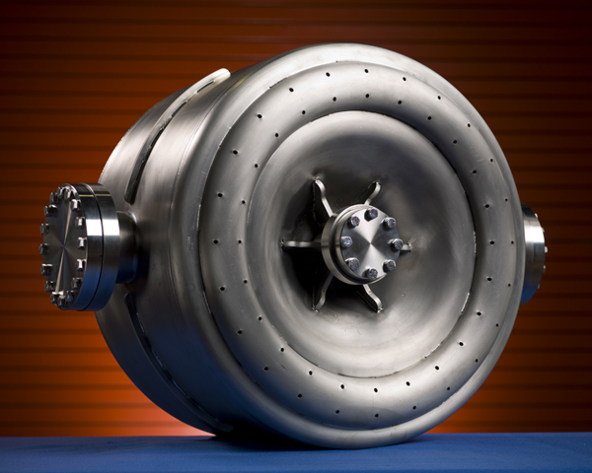
Status of
SSR1 and SSR2
Leonardo Ristori
P2MAC Meeting
9-10 March 2015

Slide 2
Overview
325 MHz section of PIP-II Linac
SSR1 & SSR2 Cryomodules
SSR1 development
  Focusing elements
  SRF cavities
  Tuners
  Couplers
SSR1 schedule
SSR1 collaboration with IUAC
SSR2 design status

Slide 3
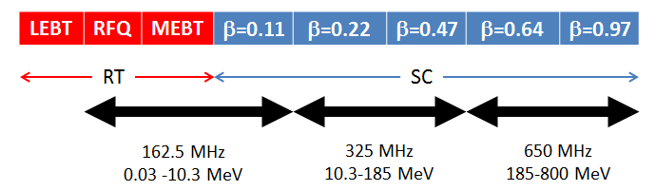
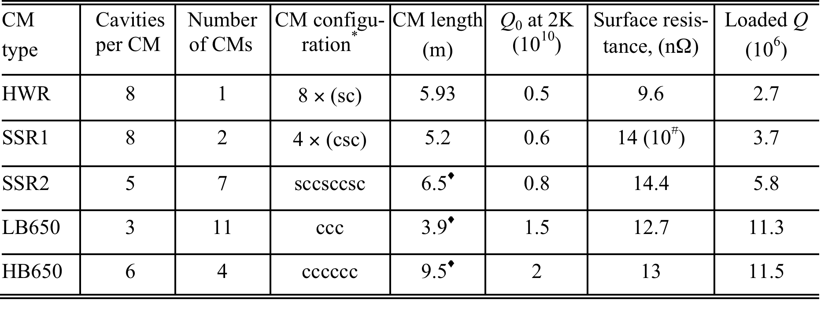
PIP-II Superconducting Linac (RDR 2.1.3)

Slide 4
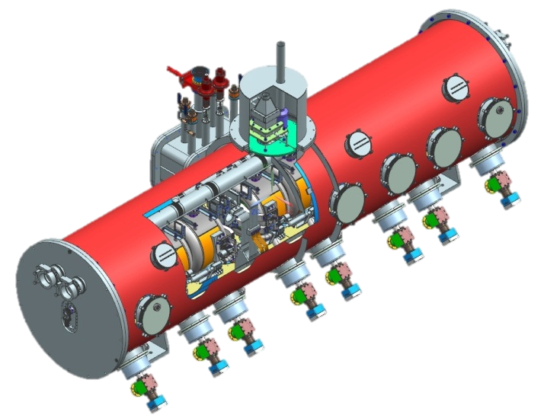
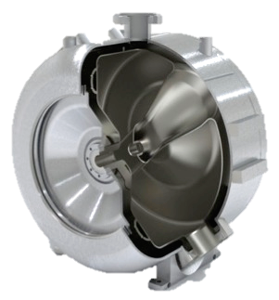
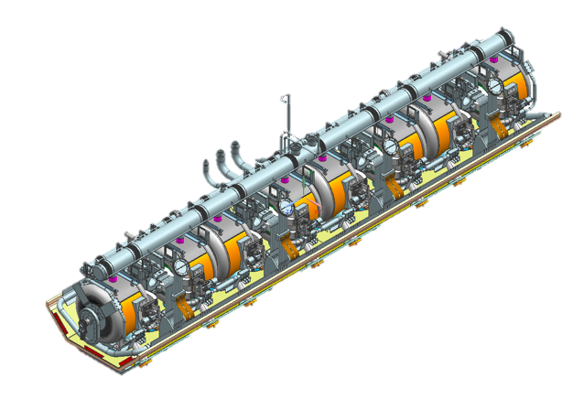
SSR1 Cryomodule
T. Nicol, Y. Orlov
Current leads
Tuner access ports
Alignment
viewports
Couplers
COLD-MASS
5.2 m long
8 Cav + 4 Magnets
Bottom-supported elements with warm strongback

Slide 5
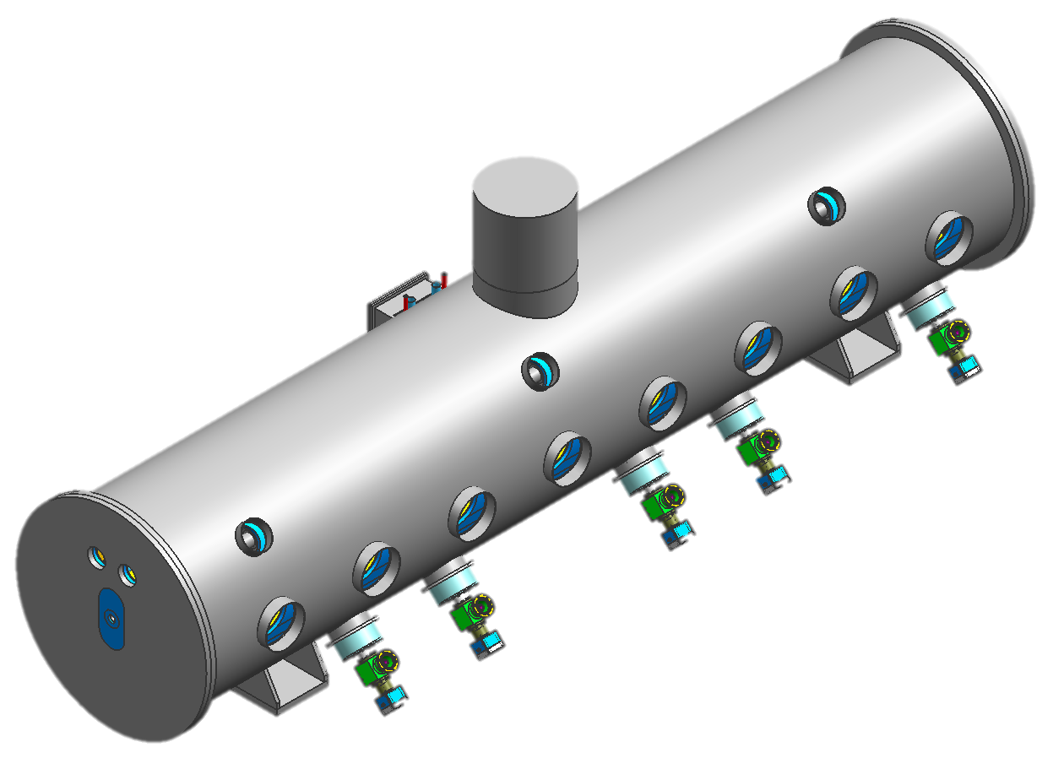
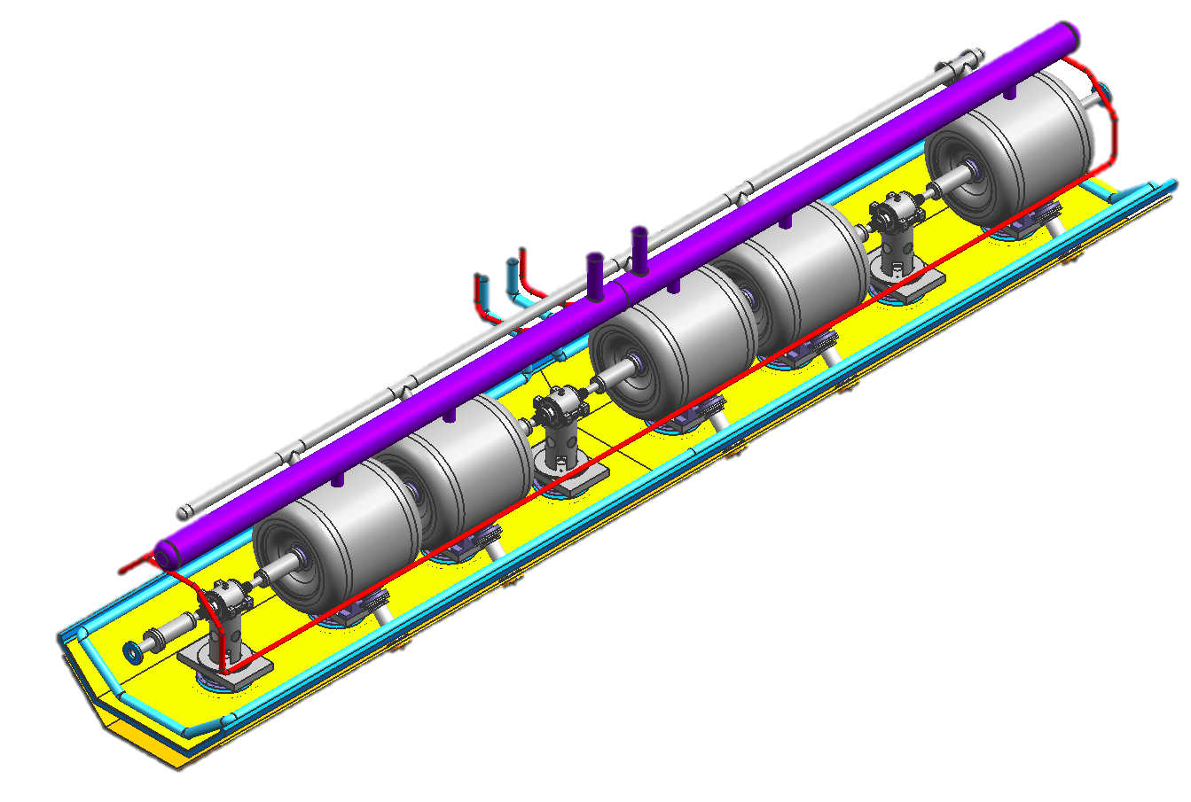
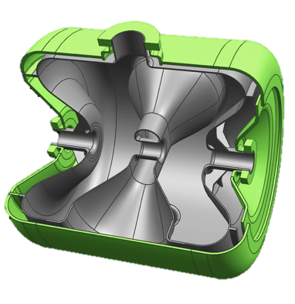
SSR2 cryomodule
6.5 m long
5 Cav + 3 Magnets

Slide 6
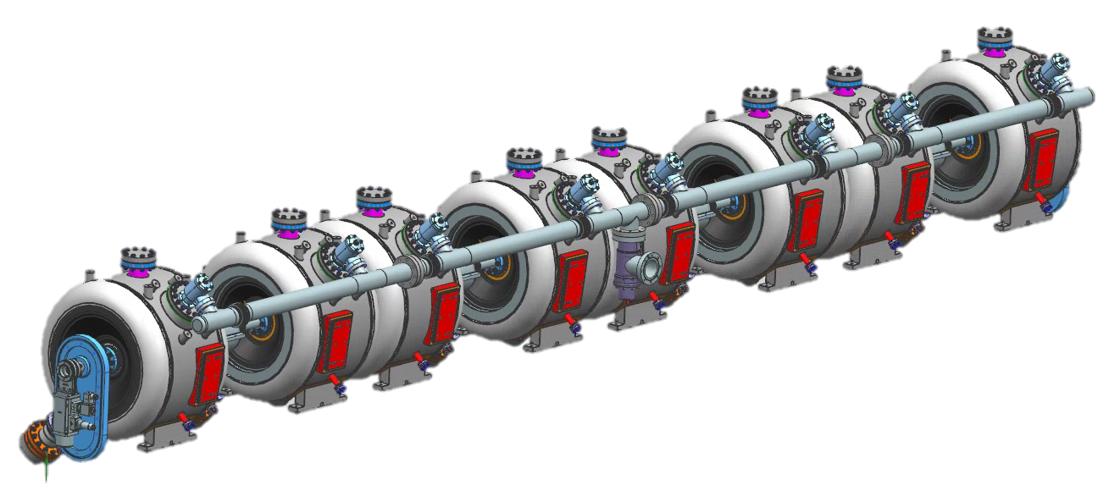
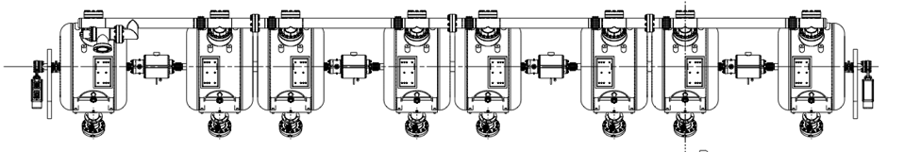
SSR1 CAVITY-MAGNET STRING
T. Nicol, Y. Orlov
2 versions of cavities (A & B)
4 Solenoids+BPM
Vacuum manifold
13 interconnecting bellows (4 types)
CAVITY-MAGNET STRING

Slide 7
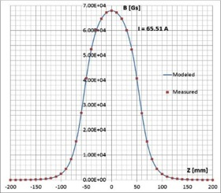
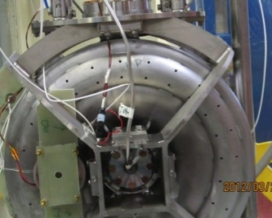
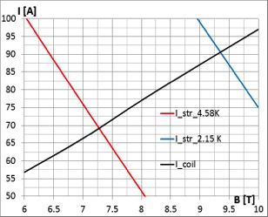
Focusing Elements
I. Terechkine
Lens strength (T2·m) 4
Steering dipole strength (T·m) 2.5·10-3
Insertion length, max. (mm) 160
Ferromagnetic shielding NO
Magnetic field on Cavity, max. (μT) 0.5·Q0 criterion Transverse misalignment (mm) 0.5 RMS
Angular misalignment (mrad) 1 RMS
Excellent agreement between predicted and measured performances
Effects of magnetic field trapping during quenching
Axial Field: Measured vs Predicted
Solenoid installed on SSR1 during VTS tests
Quench Performance at 4 K and 2 K
Cavity Q degradation predicted vs measured

Slide 8
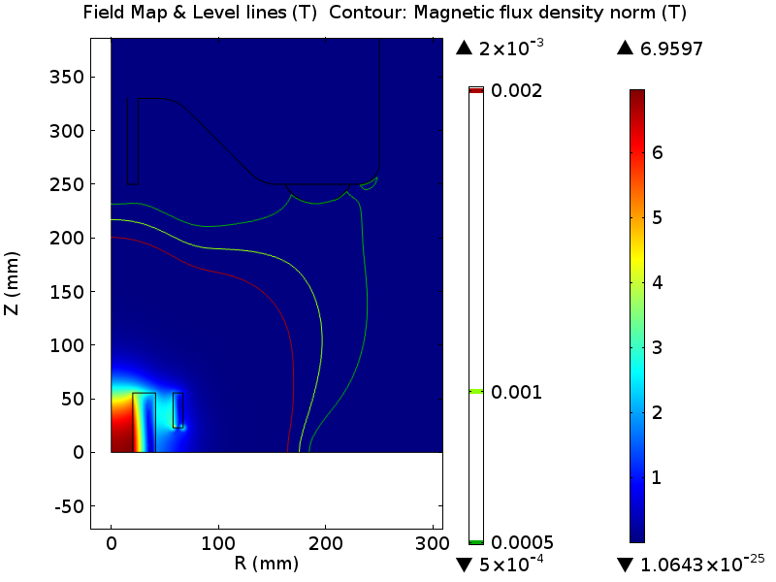
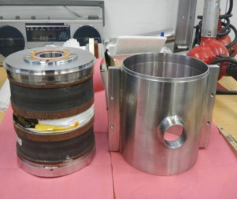
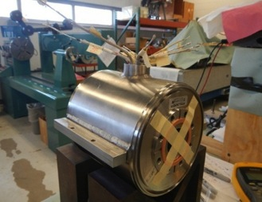
Focusing Elements
I. Terechkine
Production completed, cold tests next month
Prototype FL
Prototype lens’ cold mass procured and tested at 2 K
The lens assembled and re-tested
Position of magnetic axis was measured by the vendor and at Fermilab: ΔR < 0.2 mm; Δα < 0.7 mrad
Maximum field on the surface of the cavity is below 5 G.
Quench protection studies
Voltage to the ground in the main coil
Temperature in quenching bucking coil
Production FL
Four production lenses’ cold masses procured and tested at 4 K by the vendor.
The lenses have been prepared for the final performance test in the VTS at 2 K.

Slide 9
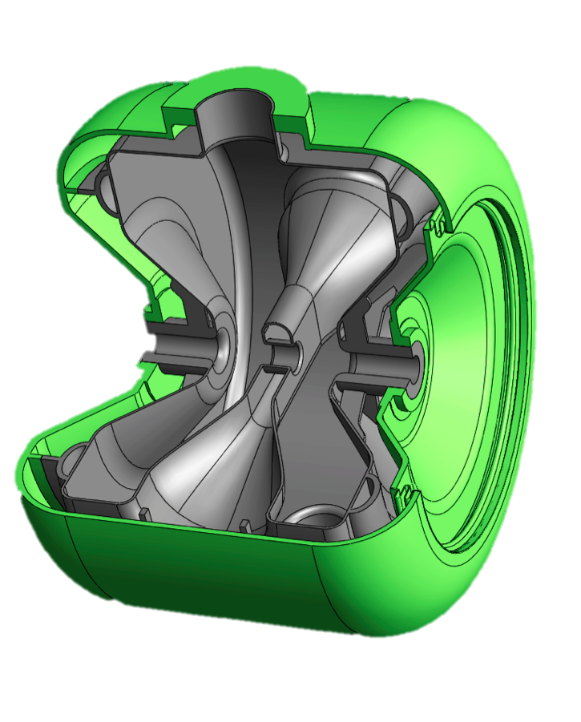
SSR1, SSR2 – Main Requirements
 | SSR1 | SSR2
Frequency | 325 MHz
Operation | Pulsed / CW
β_{OPT} | 0.222 | 0.475
Gain/cav | 2 MeV | 5 MeV
Q₀ at 2K | > 0.6 10¹⁰ | > 0.8 10¹⁰
B_{peak} | 58.1 mT | 64.5 mT
E_{peak} | 38.4 MV/m | 40 MV/m
Surface Res | 14 nΩ | 14 nΩ
L_{EFF} (βλ) | 205 mm | 438 mm
G | 84 Ω | 115 Ω
R/Q | 242 Ω | 296 Ω
LFD sensitivity | < 5 Hz/(MV/m)²
Tuning constant | 40 N/kHz | 90 N/kHz
LHe Sensitivity | < 25 Hz/torr
SSR1

Slide 10
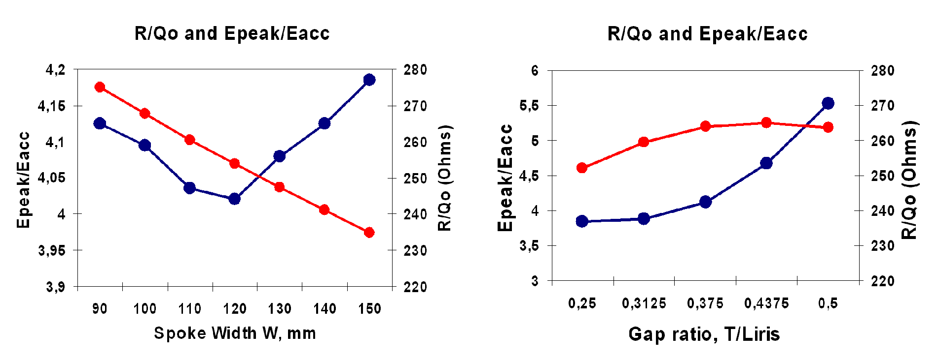
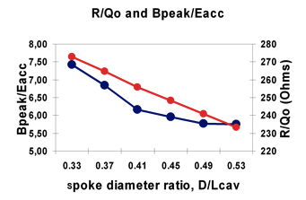
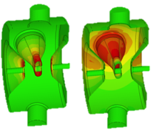
RF design of SSR1
Ivan Gonin

Slide 11
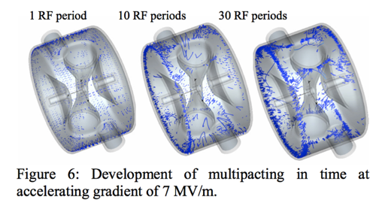
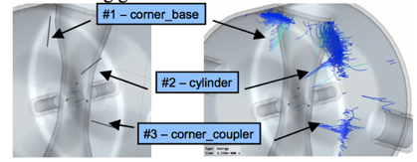
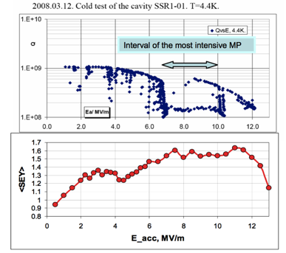
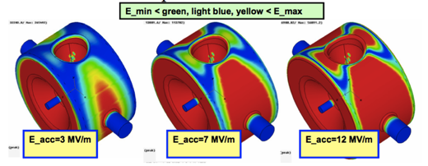
Multipacting studies
Gennady Romanov

Slide 12
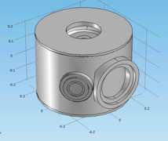
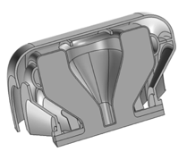
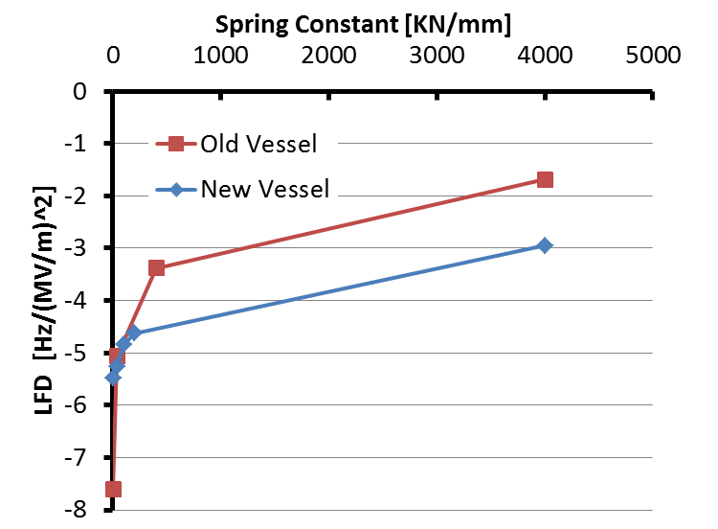
Lorenz-Force Detuning studies
M. Awida Hassan
The LFD factor of SSR1 was studied with various boundary conditions.
In working conditions the predicted LFD factor is less than - 3 Hz/(MV/m)²
The requirement is < 5 Hz/(MV/m)²
Prototype
Production
Spring Const [kN/mm] | LFD [Hz/(MV/m)^2]
∞ | -1.69
4000 | -1.69
400 | -3.38
40 | -5.07
0 | -7.6
Spring Const [kN/mm] | LFD [Hz/(MV/m)^2]
∞ | -2.74
4000 | -2.95
200 | -4.63
100 | -4.85
40 | -5.27
0 | -5.48

Slide 13
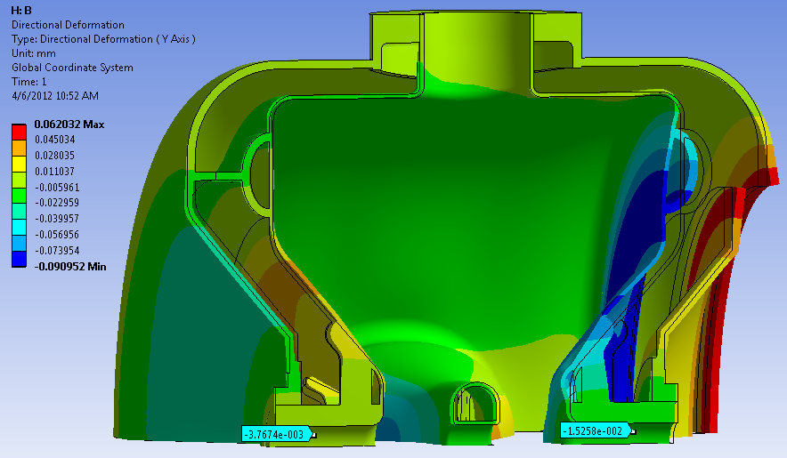
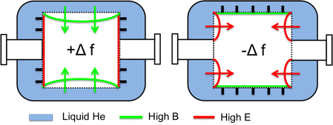
SSR1- Sensitivity to He pressure variations
D. Passarelli
SSR1 must operate within a small bandwidth ± 20 Hz
Pressure of L_{He} can vary by ± 0.5 Torr in the cryomodule
A self-compensating design was developed allowing low sensitivity
Despite non-negligible deformations (see picture), net shift is very low thanks to Slater’s Theorem
Bare cavity ~ 600 Hz/Torr, with He vessel ~ 10 Hz/torr
Ease of tuning 39 N/kHz (bare), 40 N/kHz* (with He vessel)
* It is possible to reduce sensitivity without increasing rigidity
Deformations in high E and B regions balance out resulting in a small frequency shift (Slater’s Theorem)
Tuning

Slide 14
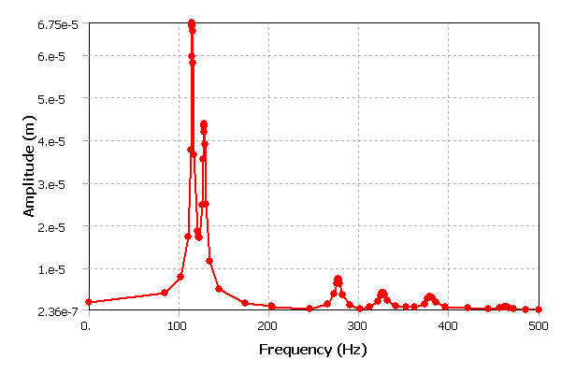
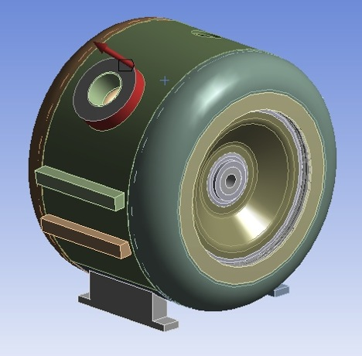
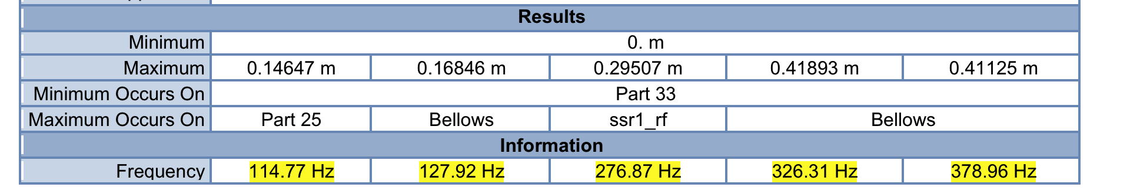
Harmonic Analysis – SSR1
L. Ristori
Oscillating force f (x,y,z)
rigid modes
(not critical)
hazard zone
lowest RF-coupled mode
(well above 100 Hz)

Slide 15
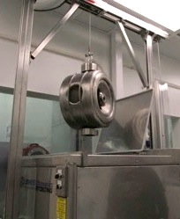
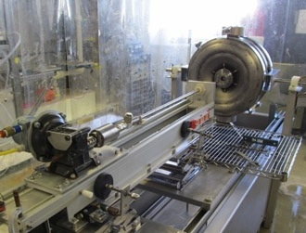
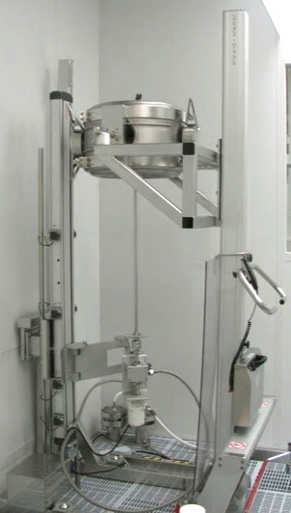
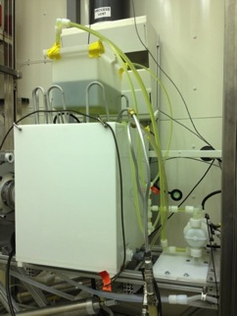
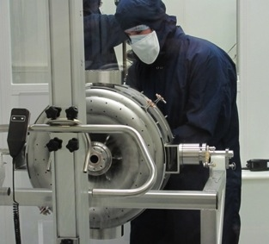
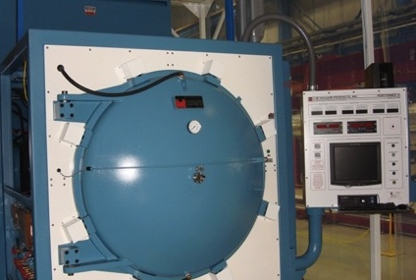
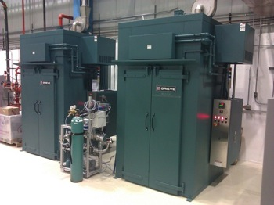
Processing/Testing steps (ANL, FNAL)
1. Inspection – RF & Optical
2. BCP 120-150 μm (flip half-way)
3. HPR
4. 600 °C, 10 h (< 5°C/min ramp rate)
5. RF Tuning
6. BCP 20-30 μm
7. HPR (horiz + vert)
8. Assemble
9. Evacuate + 120 °C, 48 h
10. Vertical Test
11. Helium Vessel Dressing
RF Tuning
13. BCP 20-30 μm
14. HPR
Assemble
Evacuate + 120 °C, 48 h
15. Horizontal Test
16. Ready for String
ANL
ANL
ANL
Bare cavity BCP setup
High-Temp Oven (<1000’C)
FNAL
FNAL
Low-Temp Ovens (<300’C)

Slide 16
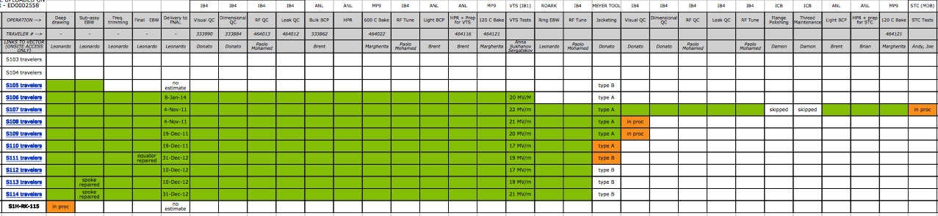
Status of SSR1 cavities
9 of 10
Delivery
(Bare Cavity)
9 of 10
Cold Test
(Bare Cavity)
1 of 10
Cold Test
(Jacketed Cavity)
3 of 10
Jacketing
Most of the 10 production cavities are in the jacketing stage
S107 is leading the group, 2nd test in STC to qualify prototype coupler and tuner
S106 and S105 are trailing due to repairs

Slide 17
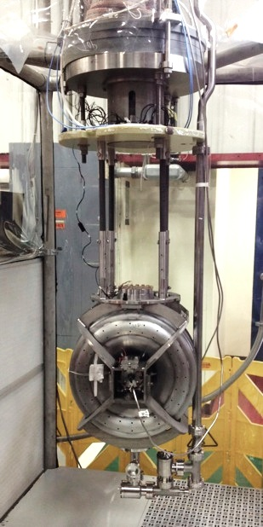
Vertical Test Stand (VTS)
A. Sukhanov
Successful qualification of production cavities for PXIE cryomodule

Slide 18
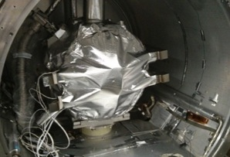
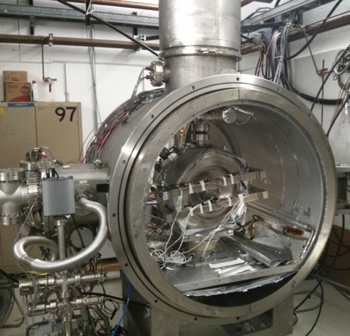
Spoke Test-Cryostat (STC) – S107 Run 1
A. Hocker, A. Sukhanov
Sep-Oct 2014
Successful cold tests of first production SSR1 (S107) and piezo encapsulations

Slide 19
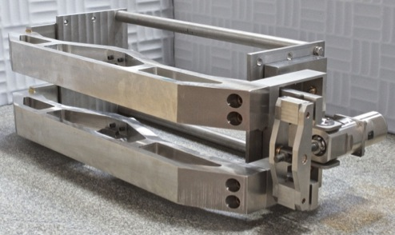
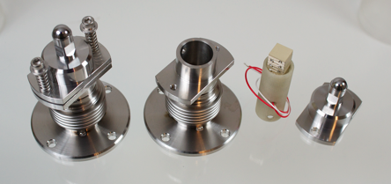
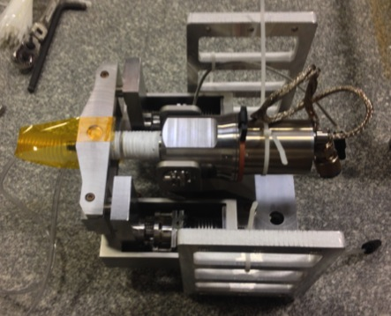
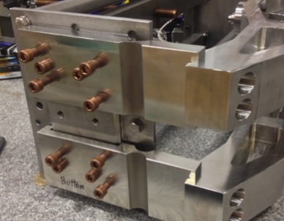
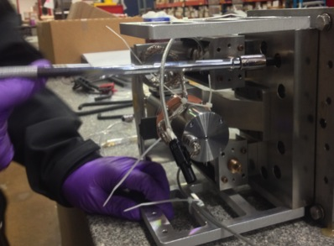
Prototype Tuner
D. Passarelli
Parameter | Req.
Coarse range | > 135 kHz
Fine range | > 1 kHz
Coarse resol. | < 20 Hz
Piezo encapsulations include bellows for retainment
Cartridge with motor and piezos
Alignment system for main arms
Installation of cartridge

Slide 20
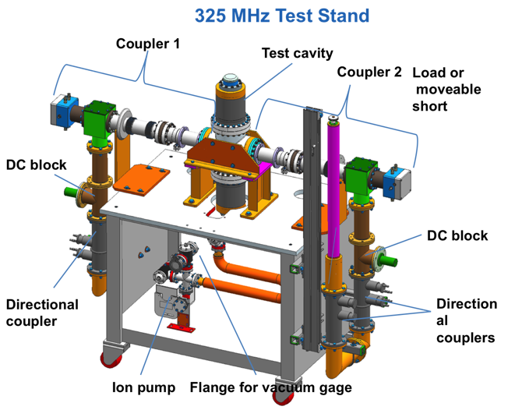

Couplers
S. Kazakov, O. Pronitchev
We have 3 prototypes
  2 installed on RF test stand, 1 installed on first production cavity in STC
Design was changed to address several issues
  upgrade to aluminum seals, increase thickness of electro-deposited bellows,...
All components for 10 production couplers have been ordered
  cold-ends are needed for qualification of cavities

Slide 21




Prototype couplers
Warm Inner conductor
Warm Outer conductor
Electro-deposited bellows
(Cu-Ni layers)
RF test stand
Cold-end assembly

Slide 22




Preparations for Run 2 – Installation of prototype coupler
All work done at MP9
Unity coupler was replaced with prototype high-power coupler

Slide 23

S107 – Run 2
Prototype tuner
mascot
“Pip”
Prototype coupler

Slide 24




Other cryomodule components received as of today..
Vacuum vessel
Focusing Elements
Support Posts
Strong-back

Slide 25

SSR1 Cryomodule Schedule
TODAY
String assembly rehearsal
  July - Aug 2015
Cav. qualifications
  Nov 2015 - Apr 2016
String assembly
  May - July 2016
Cold mass assembly
  Aug - Nov 2016
Cryomodule assembly
  Oct 2016 - May 2017
1/2016
1/2017

Slide 26




SSR1 - Collaboration with IUAC (New Delhi) – P.N. Prakash
IUAC is developing 2 SSR1 cavities
Slightly different process with EP components (intead of BCP)
Interesting to compare results
Delivery this year

Slide 27

RF Design of SSR2 - Multipacting
P. Berrutti
Most severe multipacting take place near transition of cylindrical part to end walls. Several design options of this transition was considered. Most significant improvement was achieved after introducing additional step in the transition are.
SSR2 v1
SSR2 v2.6
SSR2 v2.6
Modification of this transition reduce multipacting in operating range of cavity fields.

Slide 28

SSR2 - Multipacting SEY comparison
P. Berrutti
Parameters | SSR2 v1 | SSR2 v2.6
Optimal beta | 0.471 | 0.475
Epeak/Eacc | 3.45 | 3.69
Bpeak/Eacc [mT/(MV/m)] | 6.107 | 5.95
G [Ohm] | 112.98 | 114.9
R/Q [Ohm] | 289.94 | 295.6
Secondary Emission Yield (SEY)significantly reduced in the operating gradient range of 5-12 MV/m. Comparison with SSR1 cavity demonstrates that multipacting in the modified SSR2 cavity version 2.6 can be processed away easier than in SSR1 cavity.

Slide 29
Summary
Production of SSR1 cryomodule has begun
  All bare cavities tested successfully
  1st Jacketed cavity tested successfully
  Prototype coupler and prototype tuner under testing
  All bare solenoids tested successfully
  Large components received
SSR1 cryomodule estimated to be completed in May 2017
IUAC will deliver (2) SSR1 cavities to FNAL
Design of SSR2 recently changed to address MP

Slide 30

Thank you ...

Slide 31
Backup Slides

Slide 32

SSR1 Prototypes – VTS tests
S101 – 4th test
During cool down, a 7 hr hold at 100 K produced a large Q0 drop, confirming Q disease.
Subsequently baked SSR1-01 at 600 C for 10 hours at Jlab.
S102 – 1st test
Effects of Q disease should not appear on first cooldown.
X-rays increase at MP barriers, then disappear after punch through.

Slide 33

SSR1 Prototype – STC Tests

Slide 34
SSR1 Tuner: Requirements and data
Introduction
Assembly procedure
Meeting the technical specification
Feature of interest

Slide 35





ASME Pressure Rating
D. Passarelli
The table summarizes the results obtained by simulations performed following the Div 2, Part 5 directions. It shows that the desired MAWP is achieved both at RT and CT.
Protection against plastic collapse
GC1 : p_{collapse} = 2.23 bar @ RT (P+D)
GC2 : p_{collapse} = 2.78 bar @ RT (P+D+T₁)
GC2 : p_{collapse} = 8.97 bar @ CT (P+D+T₁+T₂)
    MAWP
    > 2 bar at 293K
> 4 bar at 2K
Protection against local failure
Protection against collapse from buckling
(P+D) p_{collapse} = 13.44 bar
(P+D+T1) p_{collapse} = 13.24 bar
(P+D+T2) p_{collapse} = 11.2 bar
(P+D+T1+T2) p_{collapse} = 11.2 bar
Ratcheting
There is no plastic deformation in the overall dimension of the SSR1 resonator
Protection against cyclic loading
Fatigue Assessment
No fatigue analysis is necessary

Slide 36




Jacketing operations
D. Passarelli, M. Hassan, P. Berrutti
Welding inch-by-inch on 6 mm thick steel
Large fixtures needed to control warping
Thermal cameras insertion tubes (above)
Screenshot of remote connection from FNAL

