Slide 1
Status of 650 MHz cavities for PIP-II
Anna Grassellino
PIP-II Machine Advisory Committee
9-11 March 2015

Slide 2
Outline
Processing/testing infrastructure progress/upgrades
Cavity high Q surface processing results
  120C bake versus N doping
  Flux expulsion/trapping cooling studies
  Also, vendor qualification (PAVAC)
Cavity mechanical design status
Plan forward

Slide 3
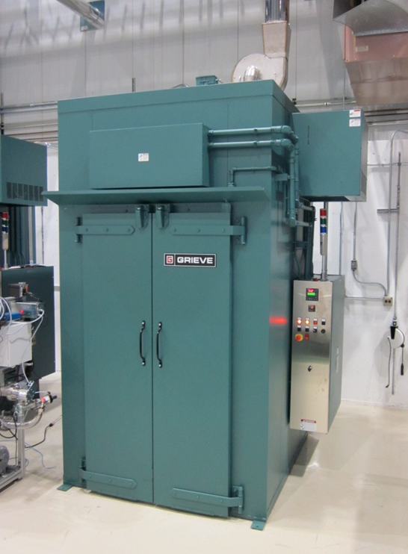
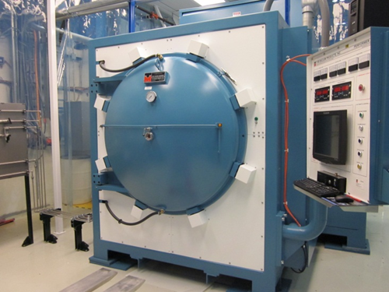
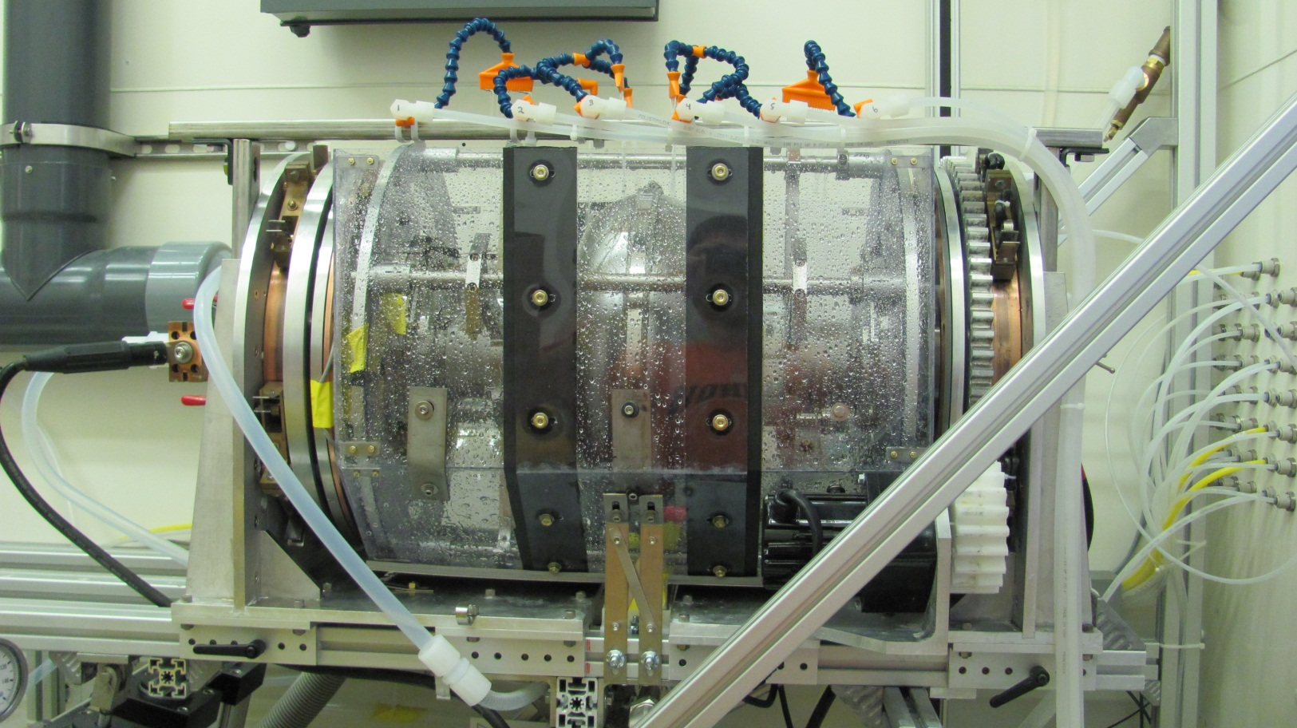
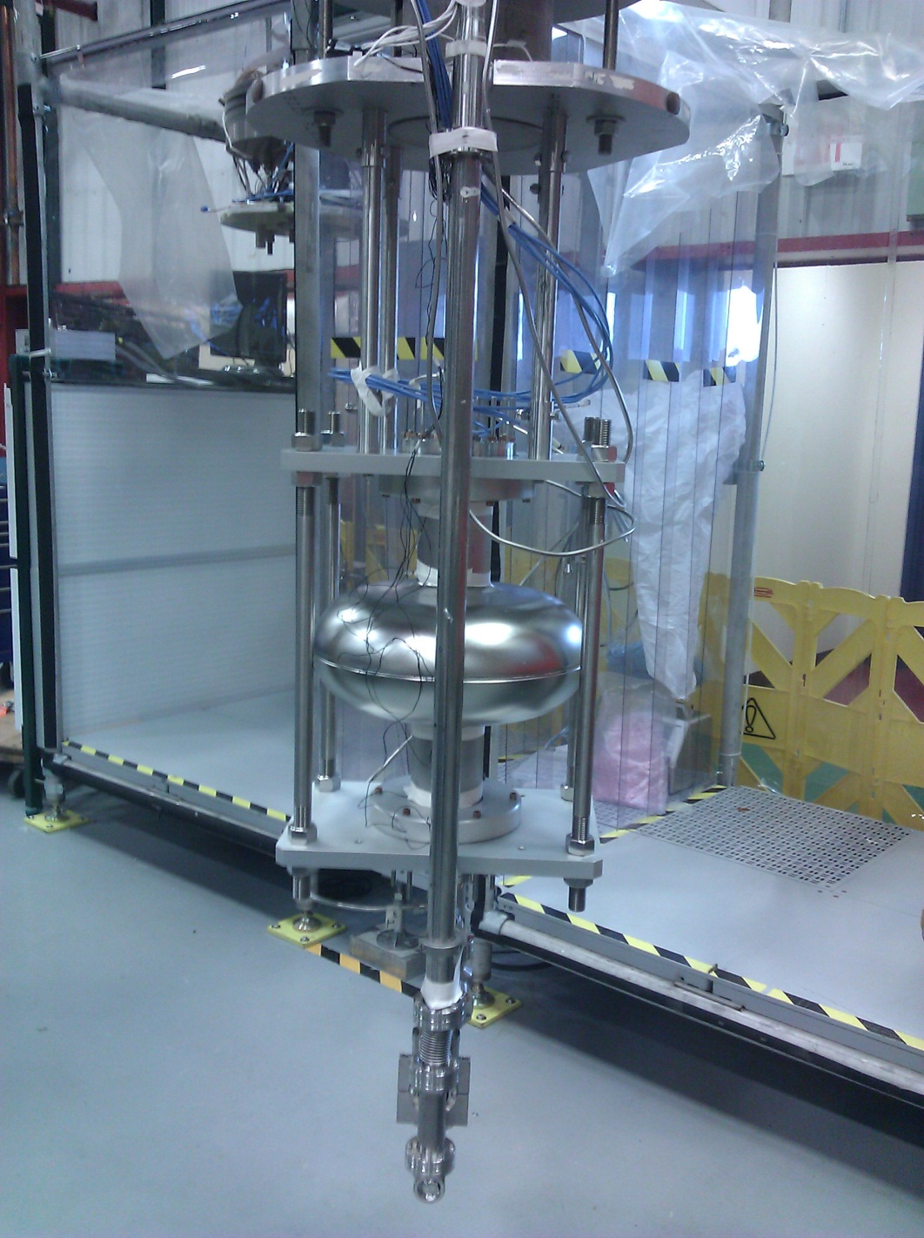
650 MHz testing/processing infrastructure
120-300C ovens—ready and in use
High temperature furnace – ready and in use
EP, HPR tools, ready for 1-cell, not for 5-cell 650 MHz
Work ongoing on upgrading to multicell processing (considering AES for bulk chemistry) – longer term solution for dedicated HPR infrastructure needed to avoid conflicts PIP-2/LCLS-2

Slide 4
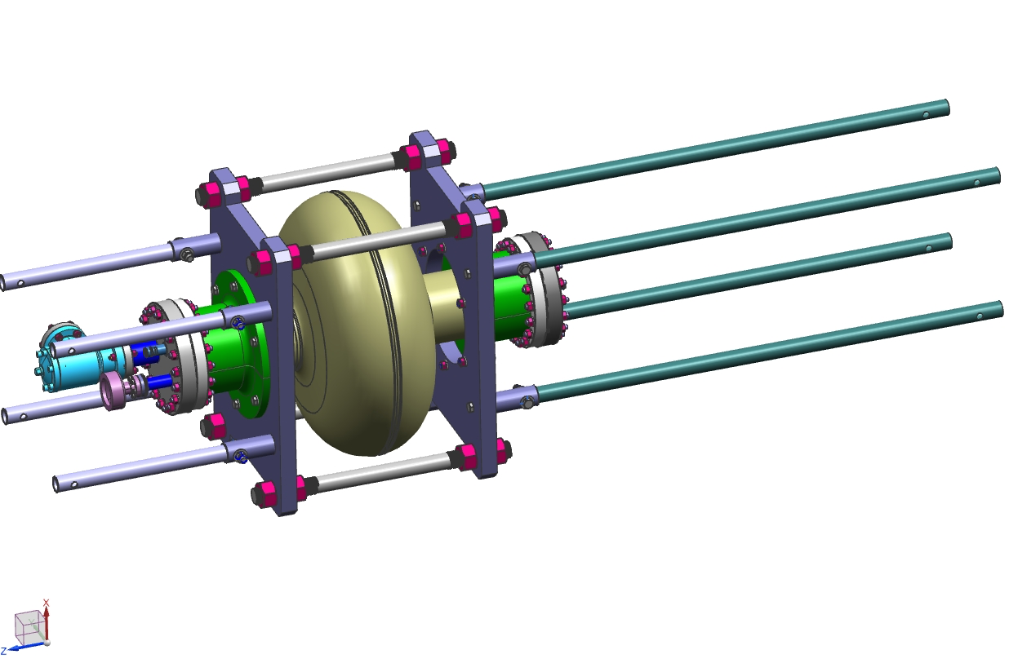
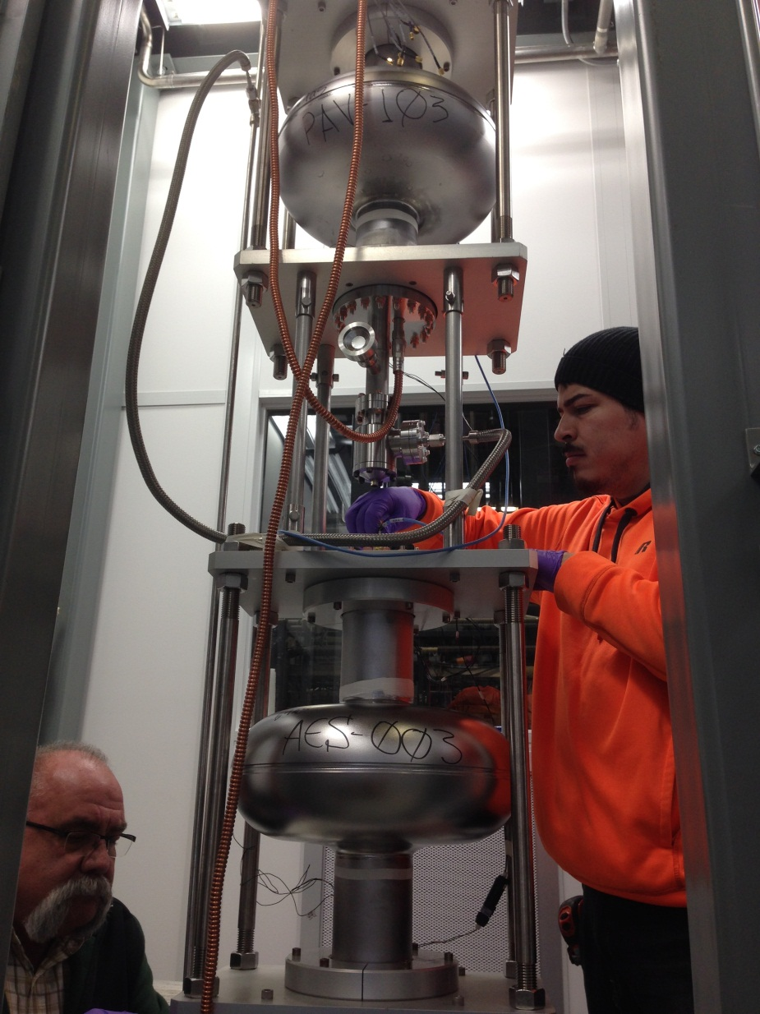
650 MHz Processing/testing infrastructure
VTS Ti four bar frame
H
VTS1—ready for 1-cell 650 MHz, fully instrumented
VTS2,3—commissioned, ready for 5-cell 650 MHz
Fluxgate magnetometers

Slide 5
Summary of accomplishments – cavity surface processing development
Goal: establish surface processing recipe for Q maximization on single cell in FY15 – crucial for making the linac capable of operating CW or high duty factor
Implement by end of FY15 on two multicells
Six high beta 650 MHz single cell cavities processed – 3 PAVAC (also for vendor qualification purposes), 3 AES
Four tested – 1 baseline standard ILC/XFEL recipe (120C bake), 3 high Q recipe development (N doping)
Exceeded specifications a factor of 3.5 with N doping!
Cooling studies for setting mag shielding/cooling specifications in cryomodule ongoing

Slide 6
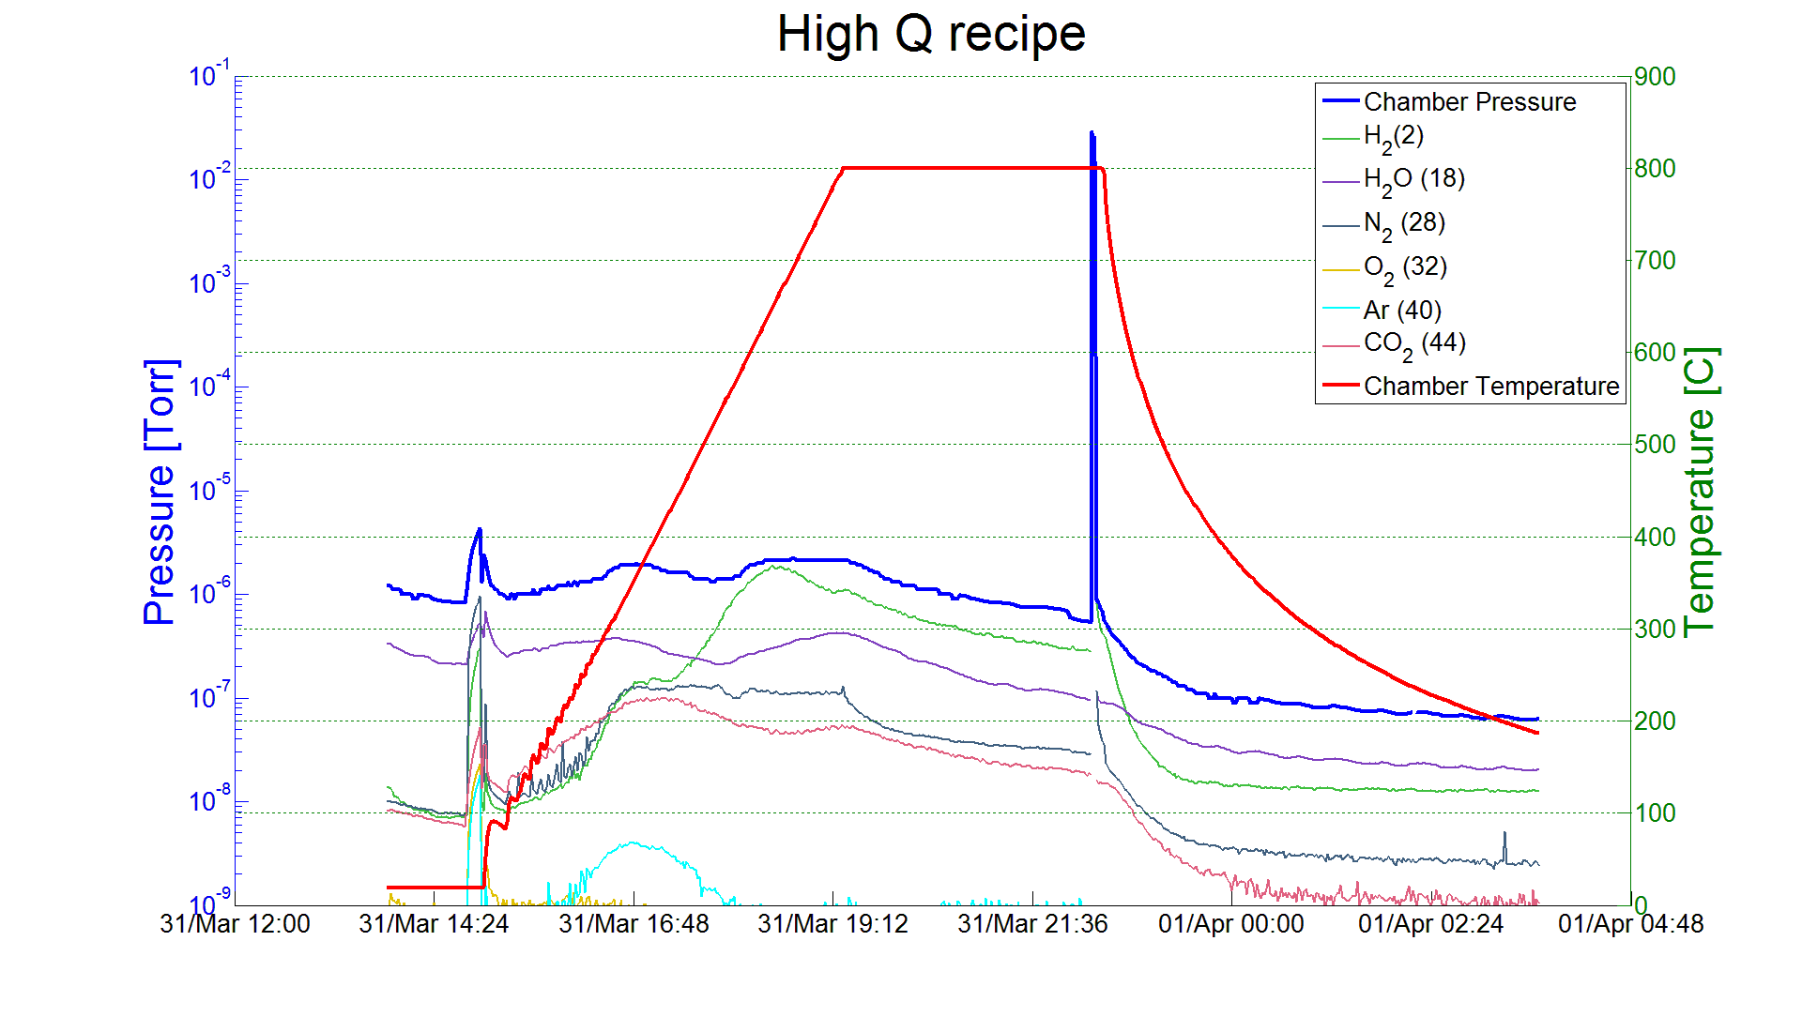
N Doping – small variation from standard ILC treatment
Example from FNAL 2/6 doping process:
Bulk EP
800 C anneal for 2 hours in vacuum
2 minutes @ 800C nitrogen diffusion
800 C for 6 minutes in vacuum
Vacuum cooling
5 microns EP
A. Grassellino et al, 2013 Supercond. Sci. Technol. 26 102001 (Rapid Communication)
Ship to DESY
Cavity after Equator Welding
HOM Tuning
X
EP 140 um
120C bake
Short HPR
Leak Check
External 20 um BCP
Final Assembly
XFEL
Long HPR
Ethanol Rinse
VT Assembly
800C HT Bake
Helium Tank Welding Procedure
RF Tuning
Long HPR
EP 40 um
Ethanol Rinse
HPR

Slide 7
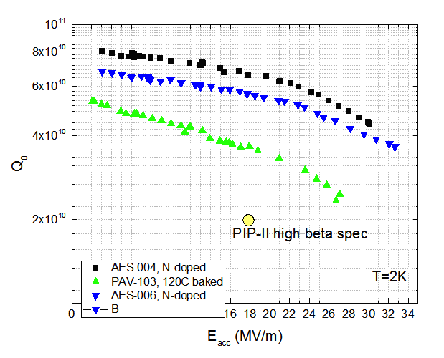
Results – highlights – 120C bake versus N doping
Q~ 7e10 at 2K, 17 MV/m – world record at this frequency!
Applying N doping to 650 MHz (beta=0.9) leads to Q x3 exceeding specs
High duty factor operation (30%) may be possible even with the existing (limited) capacity cryoplant!

Slide 8
Optimal cavity cooling studies
Cooldown rate and thermal gradients around Tc have a drastic impact on the Meissner effect and:
Can drastically degrade residual resistance due to trapped magnetic flux
Can be used to achieve low residual resistances even in high ambient fields
Thermoelectrically induced mag fields could contribute to degrade residual
A. Romanenko, A. Grassellino, O. Melnychuk, D. A. Sergatskov, J. Appl. Phys. 115, 184903 (2014)
A. Romanenko, A. Grassellino, A.Crawford, D. A. Sergatskov, Appl. Phys. Lett. 105, 234103 (2014)
D. Gonnella et al, J. Appl. Phys. 117, 023908 (2015)

Slide 9
Need to cool down fast through Tc to preserve Q
Dressed N doped nine cell cavity vertical test at T=2K
9

Slide 10
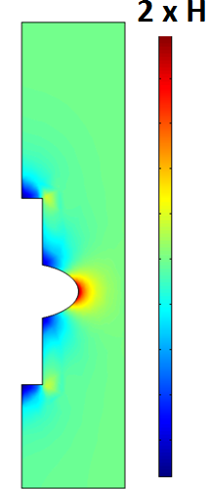
Magnetic probes reveal the new physics
Full expulsion of the magnetic field should increase the field at equator ~2 times when going superconducting
It turns out the expulsion efficiency can be controlled by the cooldown procedure through Tc=9.2K (fast/slow, uniform or not)
H
Efficient flux expulsion
Poor flux expulsion
Fluxgate
magnetometers
Same Meissner behavior for EP, EP+120C, N doping, fine/single grain, cooling is what matters

Slide 11
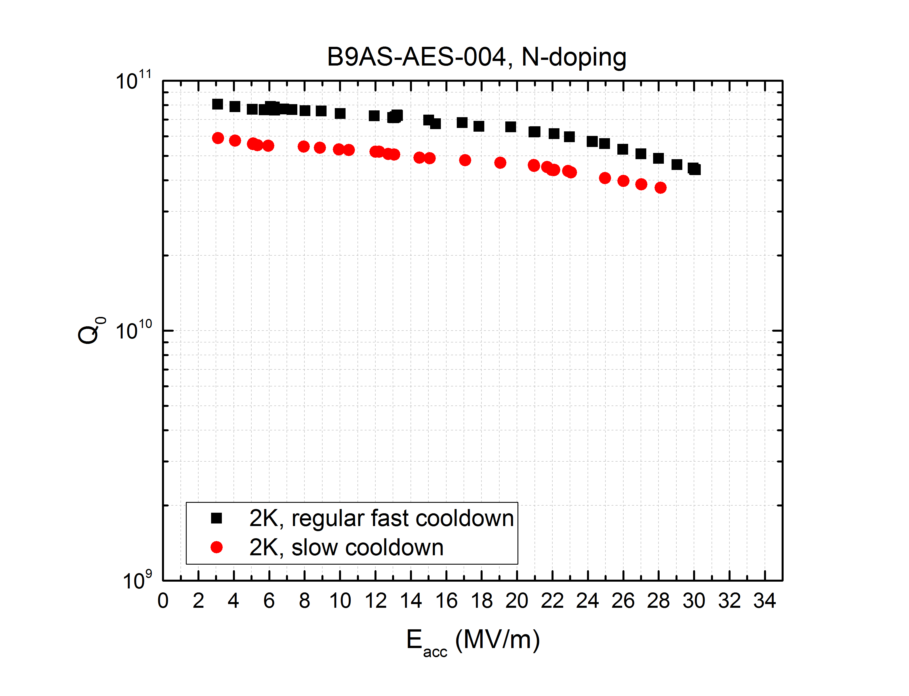
Results on 650MHz – cooling studies – fast vs slow cooling
Cooling details have been shown to play an important role in Q retention
Slow cooling through Tc shown to severely deteriorate Q for 1.3 GHz cavities
At 650 MHz we find a weaker effect, likely to smaller impact of trapped flux at lower frequency
Very promising for Q retention in cryomodule
T=2K
A. Romanenko, A. Grassellino, O. Melnychuk, D. A. Sergatskov, J. Appl. Phys. 115, 184903 (2014)
A. Romanenko, A. Grassellino, A.Crawford, D. A. Sergatskov, Appl. Phys. Lett. 105, 234103 (2014)

Slide 12
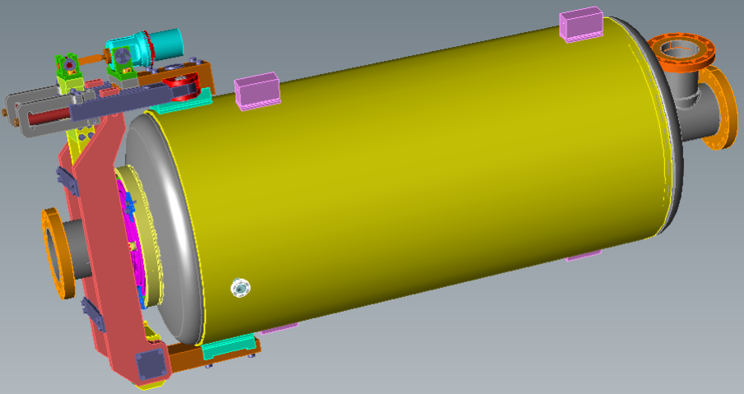
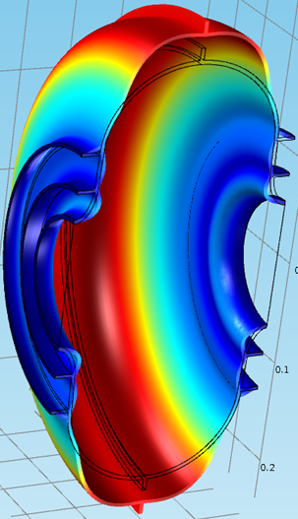
Status of mechanical design of HB 650 dressed cavity*:
RF design is completed;
Concept mechanical design for CW is finished (2013);
Lorentz Force Detuning (LFD) is an issue in a pulsed mode:
Active resonance control (W. Schappert)
“Passive” compensation - modification of the cavity and the He vessel design in order to reduce LFD: work is in progress
*I. Gonin, T. Khabiboulline
Sensitivity to He pressure, df/dP, Hz/Torr | <25
LFD sensitivity, df/dE², Hz/(MV/m)² | -0.5
LFD at nominal voltage (FRS), Hz | -136
Half-bandwidth, Hz | 29
Modification of the cavity in order to reduce LFD.
Upper Ring R=125mm
Stiffness ~10 kN/mm
Lower Ring R=85 mm
LFD ~ - 0.31 Hz/(MV/m)^2

Slide 13
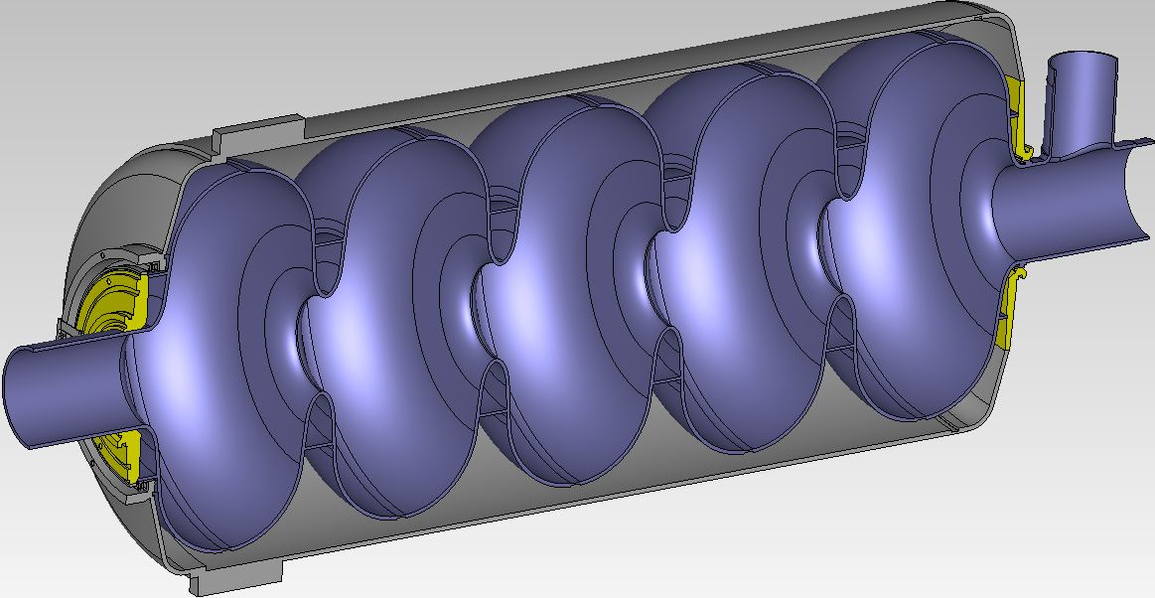
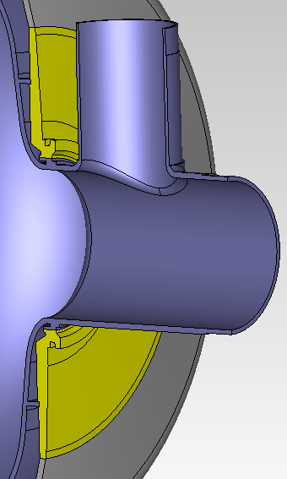
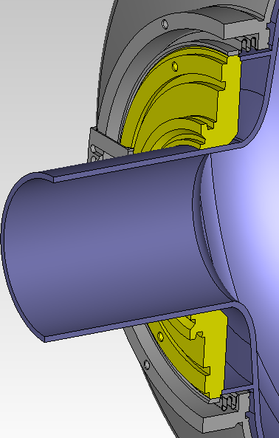
Reducing Sensitivity to Helium Pressure fluctuations, HB cavity
SPRING CONSTANT
FIXED
1030mm
450mm
Name | Value | Unit
Density | 8700 | kg/m^3
Young's modulus | 118e9 | Pa
Poisson's ratio | 0.38 | 1
Niobium
Name | Value | Unit
Density | 4540 | kg/m^3
Young's modulus | 117e9 | Pa
Poisson's ratio | 0.37 | 1
Titanium
Niobium-
Titanium
Name | Value | Unit
Density | 5700 | kg/m^3
Young's modulus | 68e9 | Pa
Poisson's ratio | 0.33 | 1
Design goal |df/dP| < 25 Hz/mbar is achieved
Ivan Gonin

Slide 14
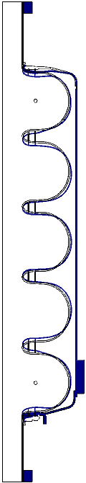
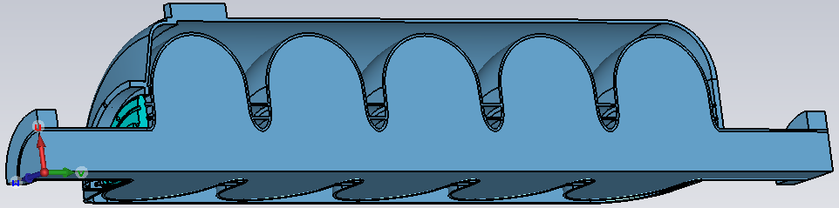
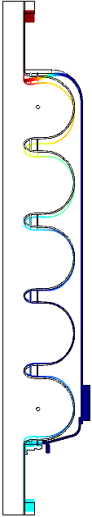
Reducing Lorenz Force Detuning, HB cavity
Fixed
Fixed
R2 = 110 mm, R1 = 83.7 mm K Lfd = -0.277 Hz/(MV/M^2)
Tuner Stiffness 100kN/mm
dL~1.3μm
LFD ~ -0.91 Hz/(MV/m)^2
dL~0.5μm
HV stiffness needs to be increased to reach |LFD| < 0.6 Hz/(MV/m)^2
Ivan Gonin

Slide 15
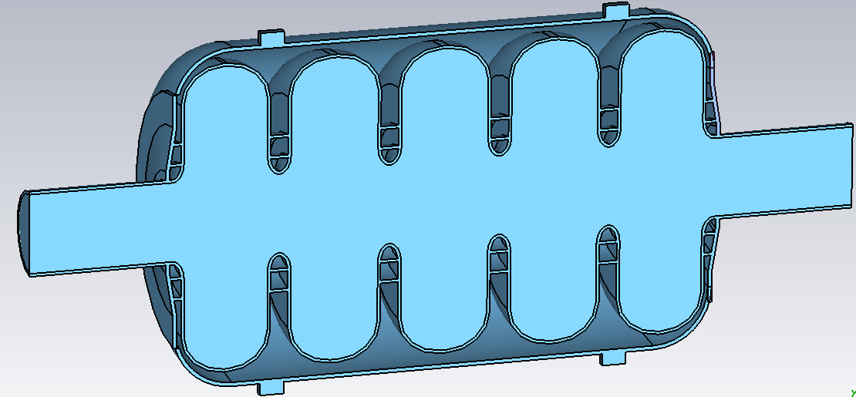
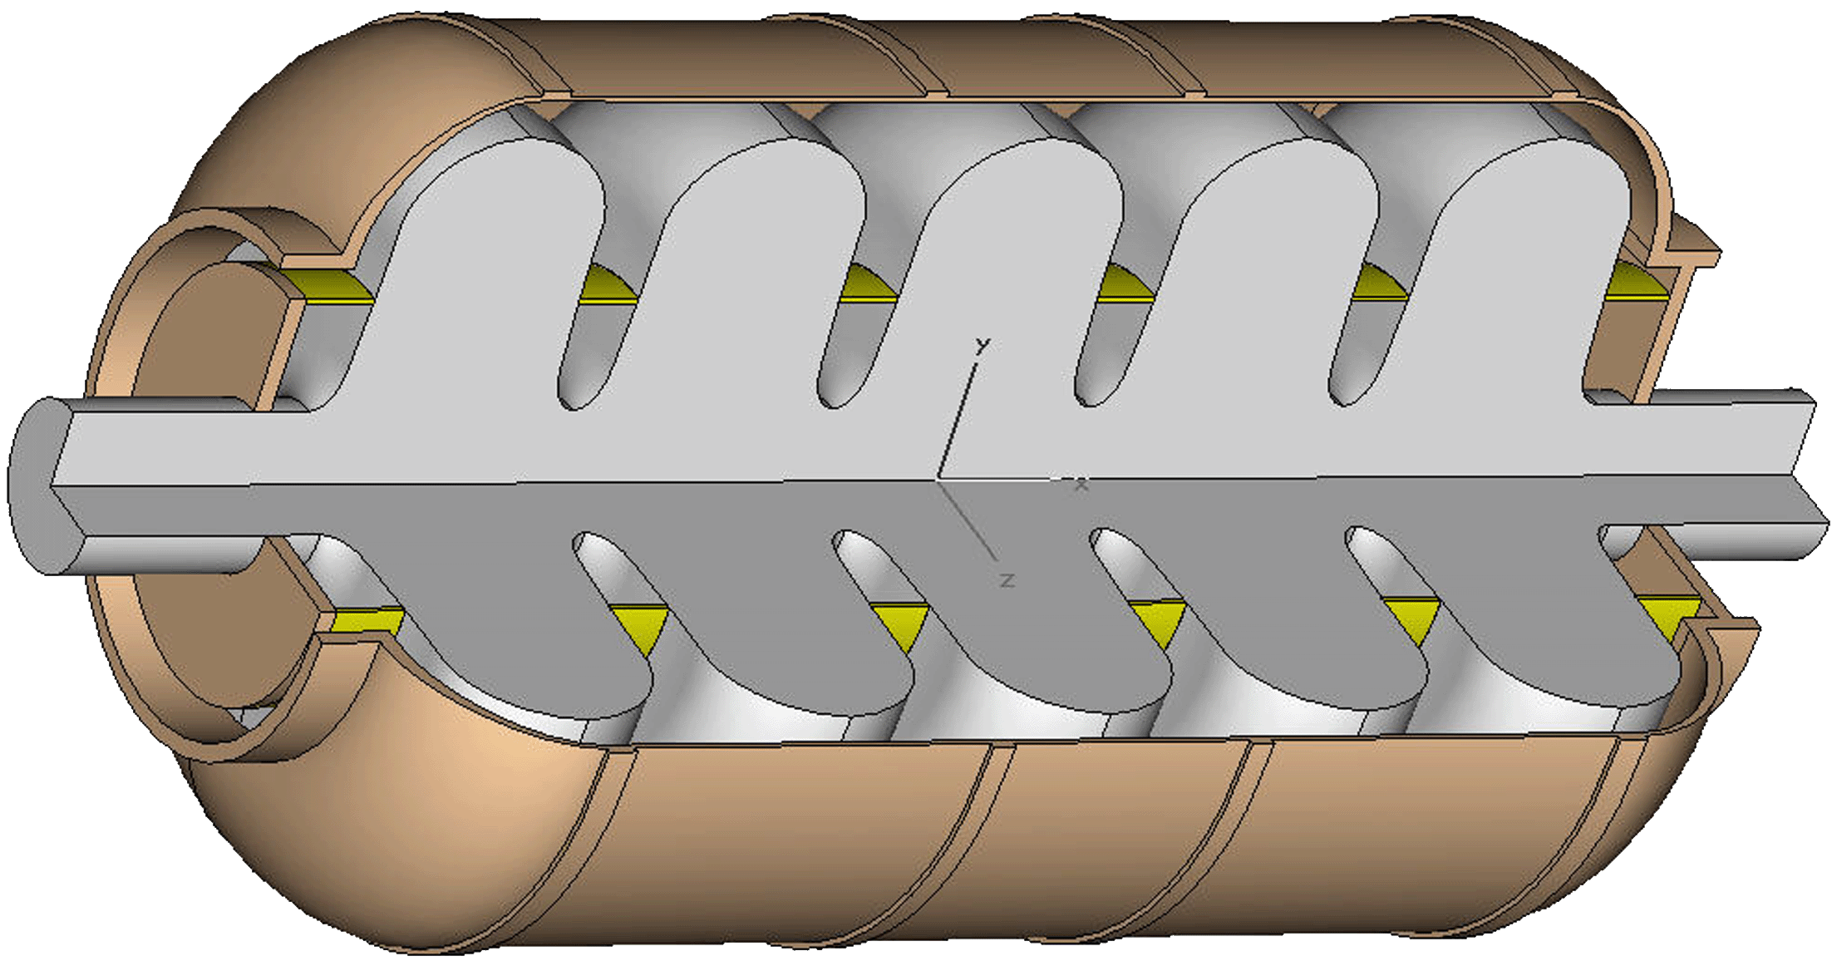
df/dP in LB Cavity for PIP II
fixed
Bellow radius
fixed
Ivan Gonin
Evgeniy Zaplatin
Design goal |df/dP| < 25 Hz/mbar can be achieved

Slide 16
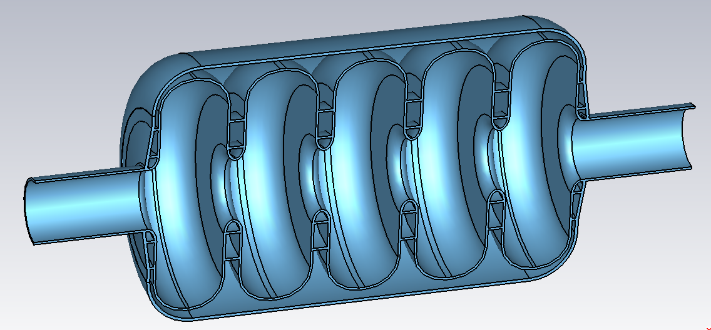
LFD in LB Cavity for PIP II
fixed
R2
fixed
R1
CAVITY Stiffens ~2.7 kN/mm
Ivan Gonin
Evgeniy Zaplatin
|LFD| < 0.6 Hz/(MV/m)^2 can be achieved

Slide 17
Plan forward
Driving milestone: pCM in FY18
Implement high Q best treatment by end of FY15 on two multicells:
  Adapt ANL EP and HPR tools to process multicell, consider using AES for EP
  Work on long term solution for having dedicated processing facilities for production
  Finalize RF and mechanical designs, procure cavities
In FY16, goal is to process 8 multicells to be lined up for dressing
In FY17 horizontal testing program, specify cooling procedure and magnetic shielding requirements, line up cavities for pCM

Slide 18
Conclusions
Cavity processing recipe producing 3.5 times higher quality factor than baseline specifications reproducibly demonstrated on single cells
This translates into an increase to 30% duty factor “for free”, and possibility to operate the linac CW
Q preservation via cooling studies ongoing with very promising results
RF designs of both LB650 and HB650 cavities are completed
Concept mechanical design for CW of HB650 is finished (2013)
Sensitivity to Helium Pressure fluctuations satisfy requirements
Lorentz Force Detuning (LFD) is an issue in a pulsed mode
“Passive” compensation - modification of the cavity and the He vessel design in order to reduce LFD: work is in progress

