Slide 1
800 MeV Linac: Cold Linac
Valeri Lebedev
PIP-II Machine Advisory Committee
9-11 March 2015

Slide 2
Outline
Performance Requirements
Design Concept
Beam Optics
Cavities and Cryo-modules
Requirements to Cryogenics
Requirements to RF power
Required R&D
Conclusions

Slide 3
Performance Requirements
Support Booster operation with increased beam power
  20 Hz repetition rate
  Beam pulse duration, 0.55 ms =290 turns (1.1% duty factor)
  Control bunch structure at single bunch level for injection
    f_{Booster_Inj}=44.7 MHz; f_{Linac}=162.5 MHz (not harmonically related)
    84 RF buckets; 82 bunches; Extraction gap of 2 RF buckets
  2 mA average beam current (~4 mA peak)
  Transverse emittance : <0.3 mm mrad (norm)
    To minimize uncontrolled loss at injection, paint KV-like distribution
  Momentum spread: <3∙10⁻⁴
    To paint longitudinal distribution
      without tails and with minimum peak longitudinal density
      with reduced phase density in the center
        Increases longitudinal Landau damping
  Rms relative energy stability: <10⁻⁴ (required for L. painting)
Be compatible with upgrade to high duty factor (CW) operat.

Slide 4
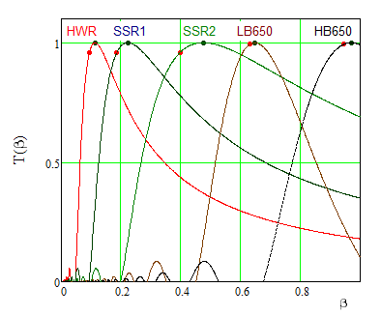
Design Concept
Only SC linac can be compatible with high duty factor operation (≥30%)
Warm frontend
  Bunch-by-bunch chopping
    2.1 MeV beam energy
      high enough for
      beam dynamics
      Low enough to avoid
      residual radiation of
      chopped bunches
SC part
  5 types of SC cavities
    to cover required
    frequency range

Slide 5
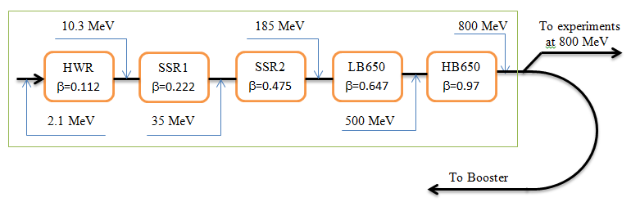
Technology Map for SC part of PIP-II linac
Transition points are chosen to minimize number of cavities/cryomodules (i.e. cost)
Cryomodules/cavities: HWR – 1/8; SSR1 -2/16; SSR2 – 7/35,
LB650 – 11/33; LB – 4/24
Altogether - 25 cryomodules

Slide 6
Design Concept for SC Part
Separate cryomodules with warm interconnects
  Internal solenoidal focusing in HWR, SSR1 and SSR2 (the first 10 cryomodules)
  Allows tightest possible focusing
    to keep space charge and RF defocusing under control
  SC solenoids are inside cryomodules
    BPMs are attached to each solenoid
    Dipole & quadrupole correctors are inside solenoids
Doublet focusing for high energy part
  LB650 and HB650
  Doublets are outside cryomodules
  Two coordinate dipole corrector & BPM near each doublet
Unshielded collimators between cryomodules
Beam instrumentation
  All other beam instrumentation is outside (profile, beam current)

Slide 7
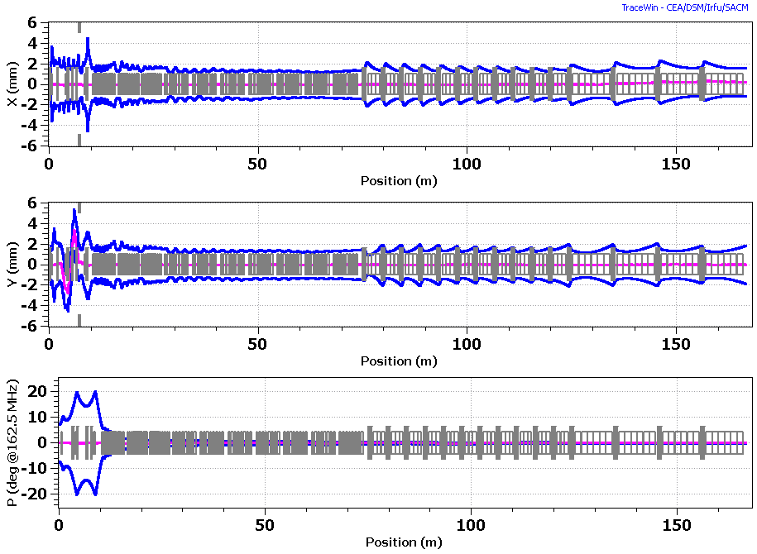
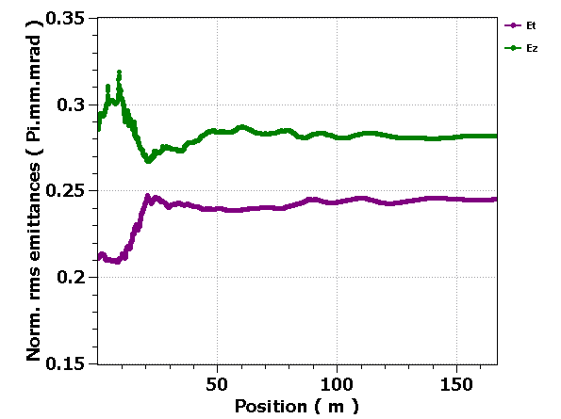
Beam Optics in SC Part
Beam is close to equipartitioning
  Helps to prevent uncontrolled emittance growth
  L to ⊥ emittance
  exchange is found
  in simulations
Strong ⊥ defocusing
due to cavity fields

Slide 8
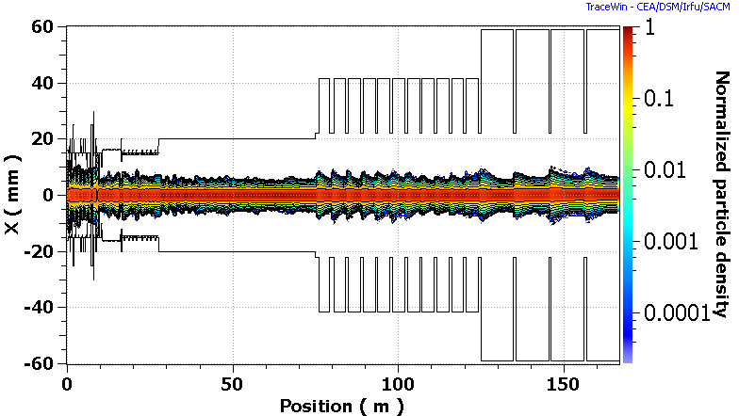
Beam Optics in SC Part (continue)
Simulations do not show dangerous halo growth
  Verified by SNS experience at ~twice larger value of N_{b}/ε⊥
  Ratio of beam size to aperture stays approximately the same downstream of HWR

Slide 9
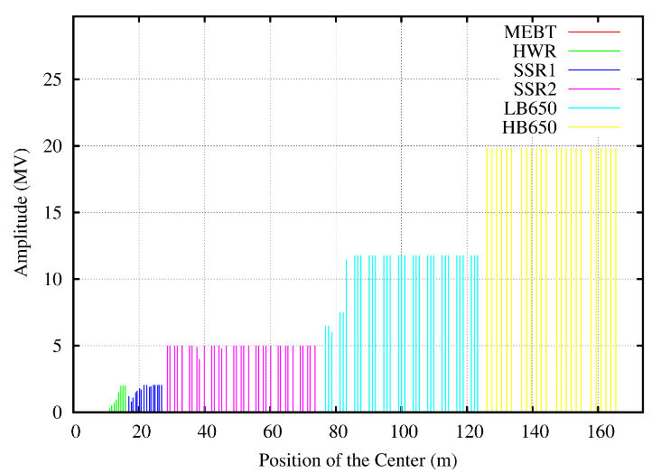
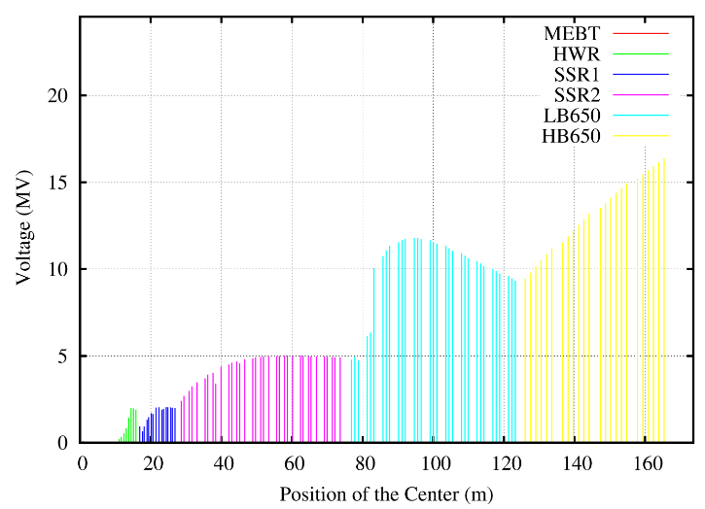
Accelerating Voltage
First HWR cavity has about half of nominal voltage to prevent longitudinal overfocusing
  Slow voltage increase in downstream cavities
Voltage is adjusted at the boundaries between different types of cryomodules
Accelerating voltage per cavity along SC Linac; optics is tuned to 5 mA RFQ beam current;
left – the voltage amplitude at the optimal beta,
right – the voltage amplitude with the transit-time factors accounted

Slide 10
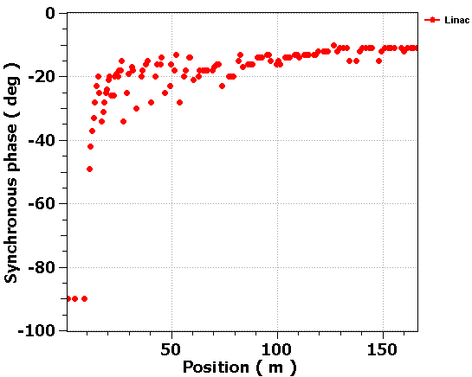
Phases of RF Cavities
Cavity phases are adjusted to control longitudinal beam envelope
MEBT cavities do not accelerate

Slide 11
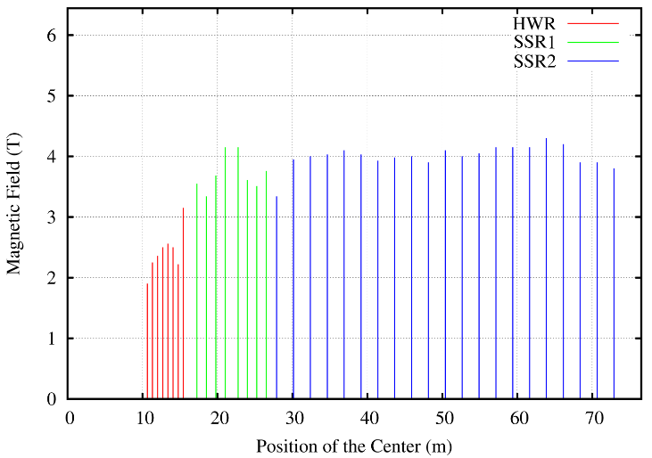
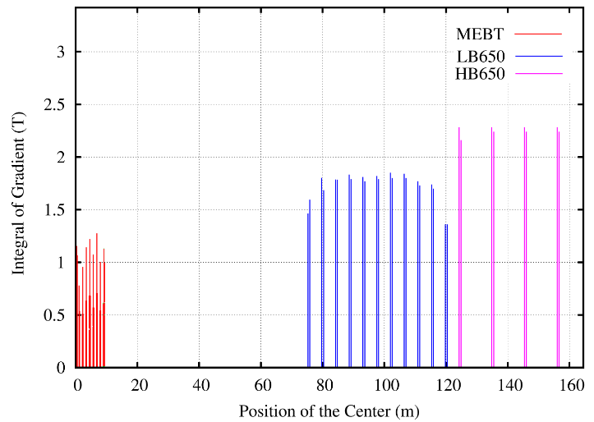
Transverse Focusing Strength
Comparatively small variation of focusing strength along the linac
  Magnets of the same design will be used
Magnetic field of focusing solenoids (left) and integral strength of quadrupoles (right) along the linac (MEBT quads are included). Optics is tuned to 5 mA RFQ beam current

Slide 12
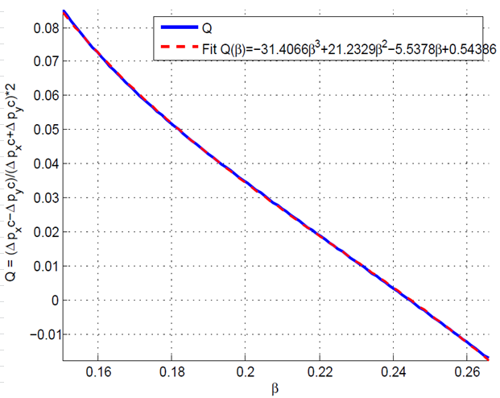
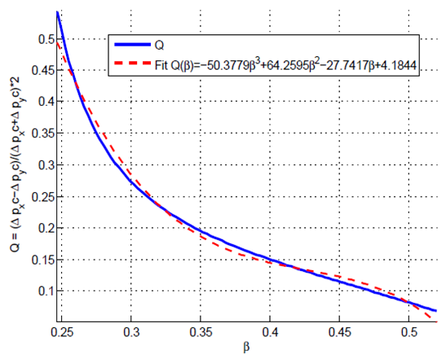
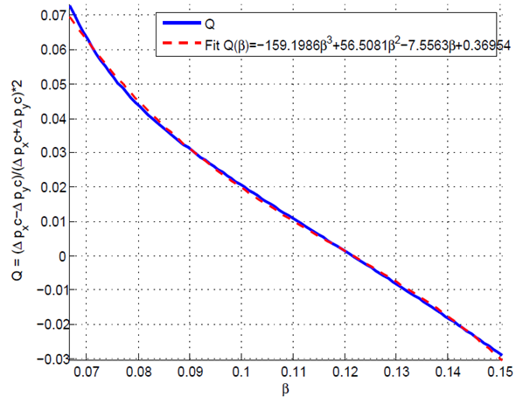
Quadrupole Fields of HWR and SSR cavities
Cavity asymmetry introduces velocity dependent quad fields
  Geometry is adjusted to nullify them in the range center
SSR1 & SSR2 cavities are rolled by 45º to adapt couplers
  Quad -> skew quad
  Skew quad correctors are located inside solenoids (part of dipole correctors package)
HWR SSR1 SSR2
Ratio of quadrupole focusing to axial symmetric focusing versus the particle velocity β in the operating domain

Slide 13
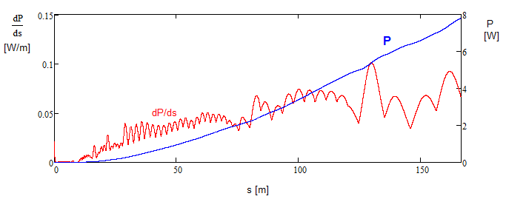
Beam Loss
Intrabeam stripping is the main source of particle loss in the SC linac
  The loss value (<0.1 W/m) for CW beam (2 mA, with 5 mA RFQ) is well within requirements
    Not an issue for PIP-II operating at ~1% duty factor

Slide 14
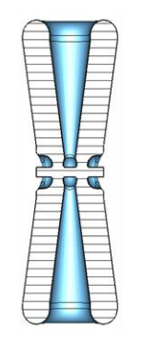
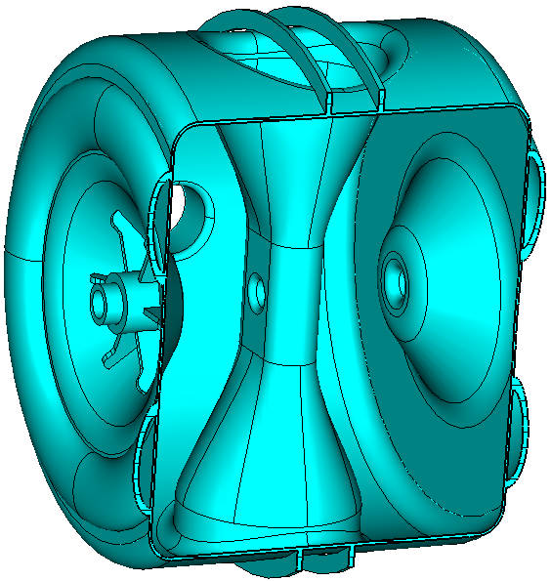
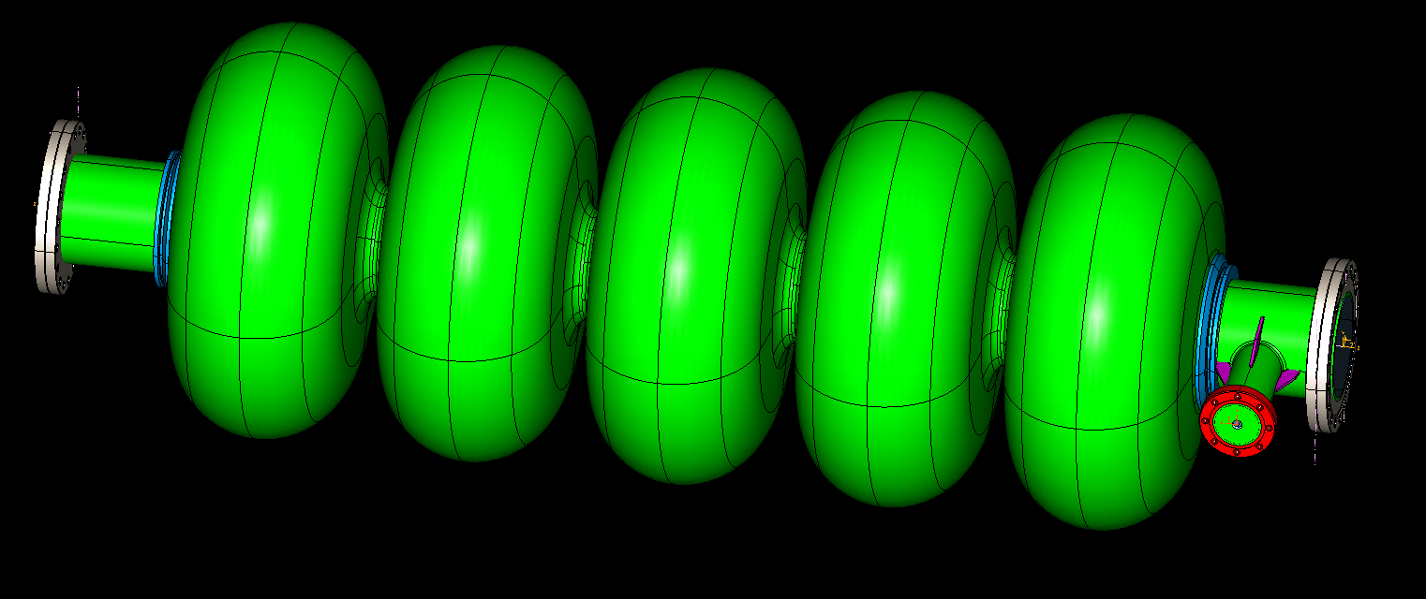
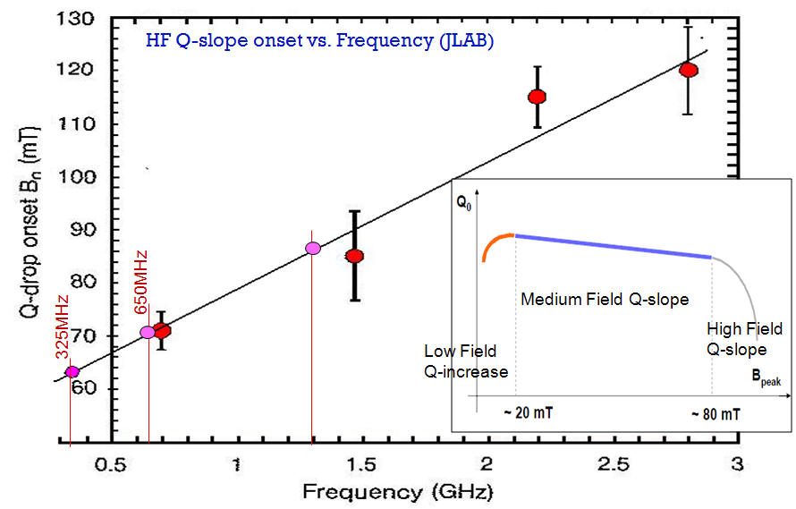
Main parameters of SC cavities
HWR SSR Elliptic
B_{peak} grows with frequency
High field Q slope
Cavity type | Aperture (diameter) (mm) | Energy gain (MV) | Accelerating gradient (MV/m) | E_{peak} (MV/m) | B_{peak} (mT)
HWR | 33 | 2 | 9.7 | 44.9 | 48.3
SSR1 | 30 | 2.05 | 10 | 38.4 | 58.1
SSR2 | 40 | 5 | 11.4 | 40 | 64.5
LB650 | 83 | 11.9 | 15.9 | 38.5 | 72
HB650 | 118 | 19.9 | 17.8 | 38.3 | 72

Slide 15
General Parameters of SC cryomodules
Conservative choice for Q₀ is based on the results obtained in real cryomodules
CM type | Cavities per CM | Number of CMs | CM configu-ration* | CM length (m) | Q₀ at 2K (10¹⁰) | Surface resis-tance, (nW) | Loaded Q (10⁶)
HWR | 8 | 1 | 8 × (sc) | 5.93 | 0.5 | 9.6 (2.75♠ ) | 2.7
SSR1 | 8 | 2 | 4 × (csc) | 5.2 | 0.6 | 14 (10#) | 3.7
SSR2 | 5 | 7 | sccsccsc | 6.5♦ | 0.8 | 14.4 | 5.8
LB650 | 3 | 11 | ccc | 3.9♦ | 1.5 | 12.7 | 11.3
HB650 | 6 | 4 | cccccc | 9.5♦ | 2 | 13 | 11.5
* “c” - denotes accelerating cavity; “s” - focusing solenoid.
♦ This number represents the present estimate of cryomodule length. It will be finalized with advances in the cryomodule design.
♠ Based on recent measurements of two HWR cavities at 2 MV accelerating voltage.
# Based on recent measurements of SSR1 cavities made of CABOT niobium.

Slide 16
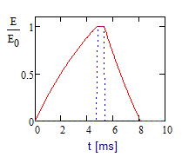
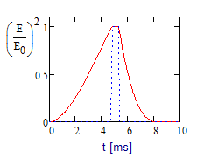
Cryogenic Requirements
Reusing Tevatron cryogenics enables considerable cost reduction
Temperature of cooling circuit, K | 70 | 5 | 2
Cooling power, W | 5720 | 1250 | 490
It requires operation in the pulsed regime
  Beam duty factor – 1.1%
  Fast cavity discharge using RF power with inverted phase
    Cryogenic duty factor ~ 5%
    RF duty factor ~12%
    Four times peak power increase in RF
    couplers at phase flip
  Fast tuner is required for pulsed operation
HWR can operate only in CW (no fast tuner)

Slide 17
Cryogenic Requirements (continue)
Dynamic and static loads are approximately equal
  Solenoids and couplers are included in the static load
Cryo-plant power has sufficient operating margins at all temp.
  Cryo-plant(W) ΣCryo-modules(W)
  70K 5720 2830
  5K 1250 715
  2K 490 276
Rms pressure
fluctuations have
to be <0.1 mbar!!!
  Passive
  microphonics
  suppression
Cryo-loads at 2K
CM type | Static cryo-load (W) | Accelerated cavity discharge
 |  | Cryo-duty factor, % | Dynamic cryo-loads per CM (W)
HWR | 14 | 100 | 37
SSR1 | 12 | 3.8 | 0.88
SSR2 | 9 | 5.3 | 2.8
LB650 | 3 | 5.2 | 4.0
HB650 | 5 | 5.2 | 10.3
Total* | 146 | N/A | 130

Slide 18
Maximum Allowed Heat Loads in Cryomodules
To be CW compatible the cryomodule design anticipates the following maximum cooling power specified by FRSs
  There is sufficient margin for each temperature circuit
Maximum allowed heat loads per cryomodule
CM type | 70 K | 5 K | 2 K
HWR | 250 W | 80 W | 50 W
SSR1 | 250 W | 80 W | 50 W
SSR2 | 250 W | 80 W | 75 W
LB650 | 100 W | 15 W | 100 W
HB650 | 300 W | 25 W | 220 W

Slide 19
Microphonics and LFD
High accelerating gradient and the comparatively small beam current
=> small cavity bandwidth
=> high sensitivity to microphonics and LFD
The major sources of cavity detuning are:
  Variations in He pressure
  Mechanical vibrations driven by external sources
  Lorentz Force Detuning (LFD)

Slide 20
Suppression of Microphonics and LFD
Passive compensation
  Cavity to be designed to minimize sensitivity He pressure variat.
  Cryogenic system design has to limit ΔP below
    0.1 mbar rms
    1 mbar for maximum pressure deviation;
  Cryomodule design has to minimize transmission of external vibrations to the cavities;
  Civil engineering has to minimize vibrations in the tunnel and the transfer of these vibrations to cryomodules.
    Large compressors have to be well isolated from ground and be located far enough from the tunnel
Active compensation
  Resonant frequency correction with fast (piezo) tuner
    Feedforward for LFD + feedback
      First tests with SSR1 showed promising results
  Excessive RF power is required to support LLRF.

Slide 21
Suppression of Microphonics and LFD
Tested HWR & SSR1 demonstrated better than specified df/dP
df/dE² for SSR1 results in Δf_{E} ~5 times larger than the cavity bandwidth
  Cannot operate in pulsed regime without fast (piezo) tuner
Mechanical design of HB650 is initiated
  Aimed at reduction of df/dP and df/dE²
CM type | HWR | SSR1 | SSR2 | LB650 | HB650
Sensitivity to He pressure (FRS), df/dP , Hz/Torr | <25 | <25 | <25 | <25 | <25
… (measurements), df/dP , Hz/Torr | 13 | 4.0 | - | - | -
Estimated LFD sensitivity, df/dE², Hz/(MV/m)² | - | -5.0 | - | -0.8 | -0.5
… (measurements), df/dE², Hz/(MV/m)² | -1.5 | -4.4 | - | - | -
Estimated LFD at nominal voltage (FRS), Hz | - | -500 | - | -192 | -136
… (measurements ) at nominal voltage, Hz | -122.4 | -440 | - | - | -

Slide 22
RF Power Requirements
RF power requirements include
  Up to 20 Hz microphonics driven detuning
  1 dB allowance for regulation
  Power transfer inefficiency:
    0.5dB - HWR&SSR (coaxial);
    0.25 dB – LB&HB (wave guide)
CM type | Power trans-ferred to beam per cav. (kW) | Cavity half-bandwidth, f / 2Q_{L}, (Hz) | Peak RF power per cavity (kW)
HWR | 4 | 33 | 6.5
SSR1 | 4.1 | 43 | 6.1
SSR2 | 10 | 28 | 17
LB 650 | 23.8 | 29 | 38
HB 650 | 39.8 | 29 | 64

Slide 23
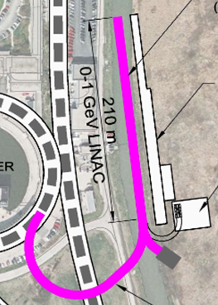
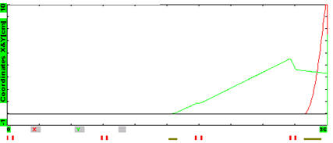
Beam Based Energy Stabilization
Local cavity feedback should stabilize its voltage and phase to better than 0.1% and 0.1º rms
Beam based stabilization
  Beam is sent to the beam dump for 10 - 30 μs
  Time of flight energy measurement is used
  to stabilize energy to 0.01% rms
    4 empty slots are reserved at the linac end,~40m
    Fast kicker and septum switch the beam
    from the beam dump to the Booster
Beam trajectories for the beam switching

Slide 24
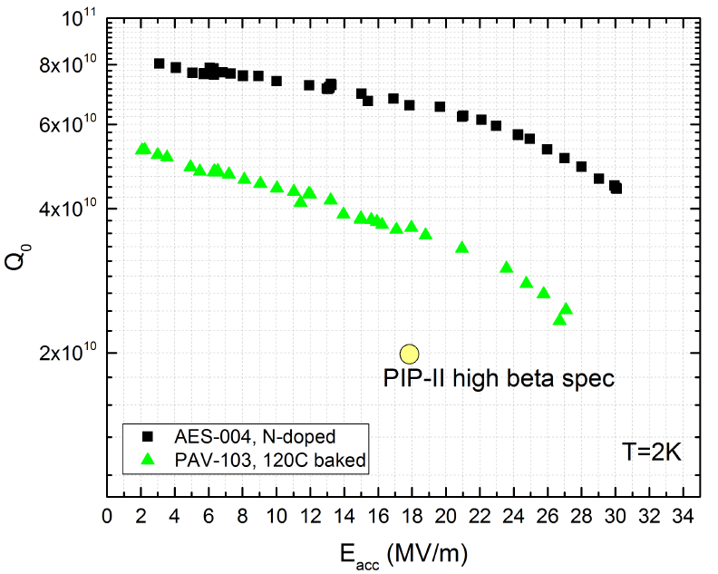
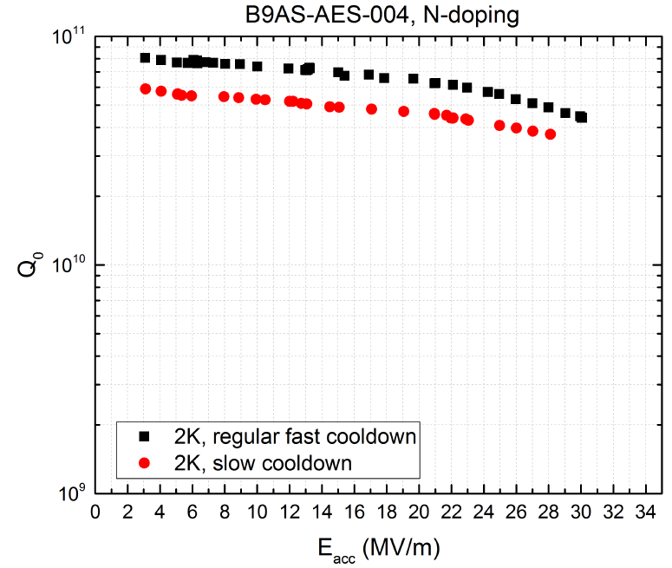
High Q₀ Studies
3 times increase of Q₀ was demonstrated in the vertical tests
  If this increase is transferred to the cryomodule
    10 times increase of beam duty factor from 1% to 10% (for the same cryo-plant)
      Corresponding cryo duty factor changes from 5% to 15%
Dependence of Q₀ on accelerating voltage for (1) 120C baked cavity and (2) N doped cavity; 2K, 650 MHz
Dependence of Q₀ on acc. voltage for N doped 650 MHz cavity for fast and slow cool downs.

Slide 25
Required R&D
PXIE
  Demonstration of the entire frontend,
    LEBT, CW RFQ, chopper, interface SC cavities,
    SSR1 operation in pulsed regime
Cryo-module design
  HB650 is initiated
  SSR2 & LB650 – have to follow
RF power
  Usage magnetron based power amplifiers looks promising
    Lower cost
    Better power efficiency

Slide 26
Conclusions
PXIE is under construction
Design work proceeds quite well
  Although both somewhat slower than it was expected earlier
PIP-II RDR was recently released

Slide 27
Backup Slides

Slide 28
PIP/PIP-II Performance Goals
Performance Parameter | PIP | PIP-II
Linac Beam Energy | 400 | 800 | MeV
Linac Beam Current | 25 | 2 | mA
Linac Beam Pulse Length | 0.03 | 0.5 | msec
Linac Pulse Repetition Rate | 15 | 20 | Hz
Linac Beam Power to Booster | 4 | 18 | kW
Linac Beam Power Capability (@>10% Duty Factor) | 4 | ~200 | kW
Mu2e Upgrade Potential (800 MeV) | NA | >100 | kW
Booster Protons per Pulse | 4.2×10¹² | 6.5×10¹²
Booster Pulse Repetition Rate | 15 | 20 | Hz
Booster Beam Power @ 8 GeV | 80 | 160 | kW
Beam Power to 8 GeV Program (max) | 32 | 80 | kW
Main Injector Protons per Pulse | 4.9×10¹³ | 7.6×10¹³
Main Injector Cycle Time @ 60-120 GeV | 1.33* | 0.7-1.2 | sec
LBNF Beam Power @ 60-120 GeV | 0.7* | 1.0-1.2 | MW
LBNF Upgrade Potential @ 60-120 GeV | NA | >2 | MW
*NOvA operates exclusively at 120 GeV

Slide 29
Beam Optics in MEBT
Goals
  Optimize conditions for chopping (2 kickers, 180º phase advance)
  Differential pumping to prevent residual gas flux to SC part
  Triplet based transverse focusing (compensates strong SC force)
  3 rebunching cavity to control longitudinal phase space

