Slide 1
PIP-II Systems Engineering and Integration
Don Mitchell
PIP-II Systems Engineering and Integration
9 March 2015

Slide 2
Agenda
PIP-II Engineering Documentation
Adherence to the FNAL Engineering Manual
Documentation Requirements
Functional Requirement Specifications
Engineering Process Document Management (EPDM)
Concept to Operation – Next steps
Systems Integration

Slide 3
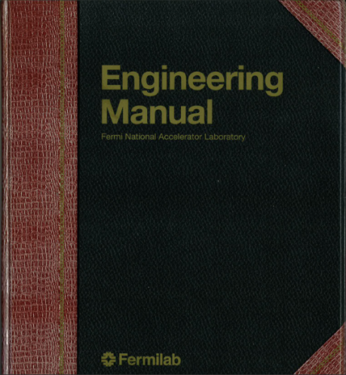
PIP-II Engineering Documentation
Adherence to the FNAL Engineering Manual
Chapter 1 – Requirements and Specifications
Chapter 2 – Engineering Risk Assessment
Chapter 3 – Requirements and Specification Review
Chapter 4 – System Design
Chapter 5 – Engineering Design Review
Chapter 6 – Procurement and Implementation
Chapter 7 – Testing and Validation
Chapter 8 – Release to Operations
Chapter 9 – Final Documentation

Slide 4
PIP-II Engineering Documentation
Typical Documentation
Functional and Technical requirements
Statement of Work
Risk Assessment
ES&H and QA requirements
Various reviews of all requirements
Technical Design Report
CAD models
CAD drawings (electrical, mechanical, P&ID)
Supporting Documents
Engineering and design notes
Design calculations
Assembly and operating procedures
Preliminary Design Review(s)
Systems Integration Review(s)
Final Design Review
Procurement Plan
Presentations
Request for Information
Procurement Specification
Technical Questionnaire
Procurement Readiness Review
Request for Proposal
Vendor Proposal Review
Vendor Selection
Vendor Fabrication Review
Material Certifications
Documentation and Training Requirements
Safety and Health Plan
Fabrication Acceptance Test
Performance Acceptance Test
Installation Plan
Safety Review(s)
Commissioning Plan
Operational Readiness Clearance
This list is not all-inclusive

Slide 5
PIP-II Documentation Requirements
Required documentation is based upon the graded approach
Subject to the results of the required Risk Assessment, the level of required documentation is determined.
At the low end, the following documentation is required:
Risk Assessment
Functional Requirement Specification
Preliminary Design Review
Technical Design Report (recommended)
Final Design Review
Performance Acceptance Test
The rigor applied at this level may be low
Small review panels, maybe even one individual
e-mails captured and put into the EDMS
Informal reports
All data is still captured and put into the EDMS

Slide 6
PIP-II Documentation Requirements
Required documentation is based upon the graded approach
Subject to the results of the required Risk Assessment, the level of required documentation is determined.
At the high end, the following documentation is also required:
Statement of Work
Project Management Plan
Technical Requirement Specification
Specification Review
Systems Integration Review
Up to 10 various Procurement documents
Installation Plan
Safety Review
Commissioning Plan
Operational Readiness Clearance Review
The applied rigor at this level is stringent and formal

Slide 7
PIP-II Documentation Requirements
Required documentation is based upon the graded approach
Subject to the results of the required Risk Assessment, the level of required documentation is determined.
Additionally, supporting documentation is required such as:
Calculations
Purchase Orders
Presentations
Conference Posters
Hazard Analysis
FMEA (Failure Mode and Effects Analysis)
Status reports
Project Goals and Timelines
Status of FTE and M&S for each Level 3 work activity
This data is also maintained within the EDMS

Slide 8
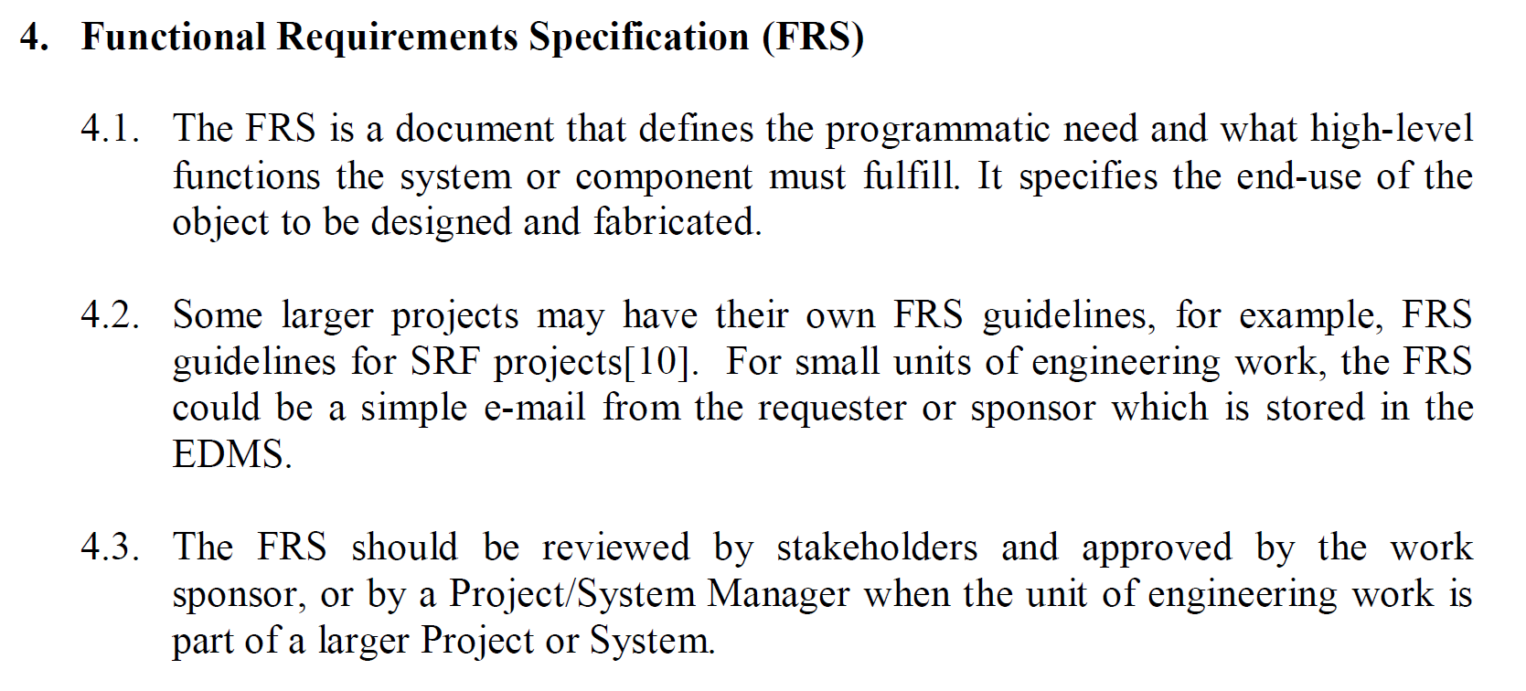
PIP-II Requirement Specifications
TIS: Technical Interface Specification
SOW: Statement of Work
Extracts from the Technical Division Engineering Work Procedures Policy, TD-2300, released 9/5/2013

Slide 9
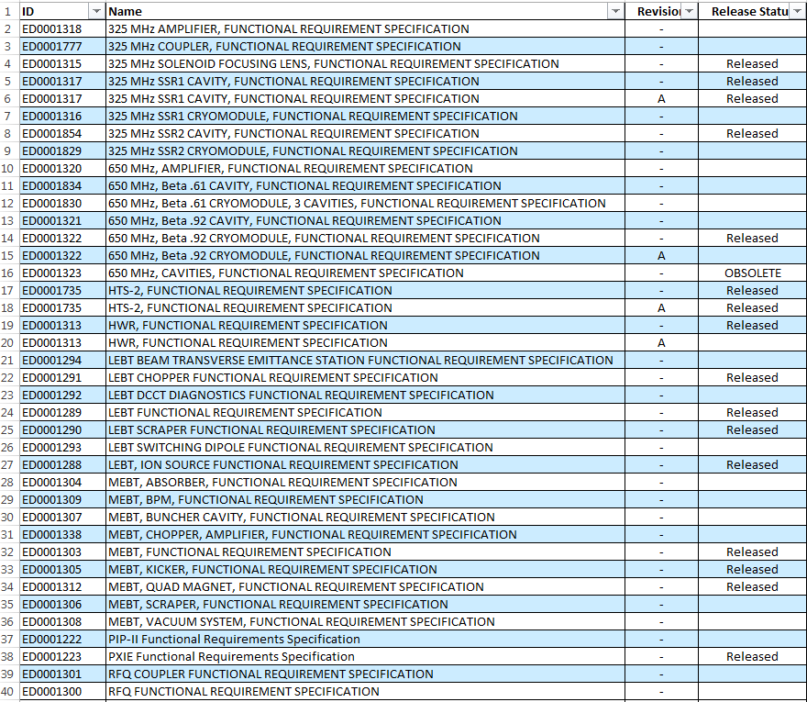
PIP-II Functional Requirement Specifications – Status
35 major systems currently have FRSs.
14 are released.
Focus has been on PXIE
Still needed:
A PIP-II focus
Power Supplies
Infrastructure
Small sub-systems
A FRS is not required until the design process begins.

Slide 10
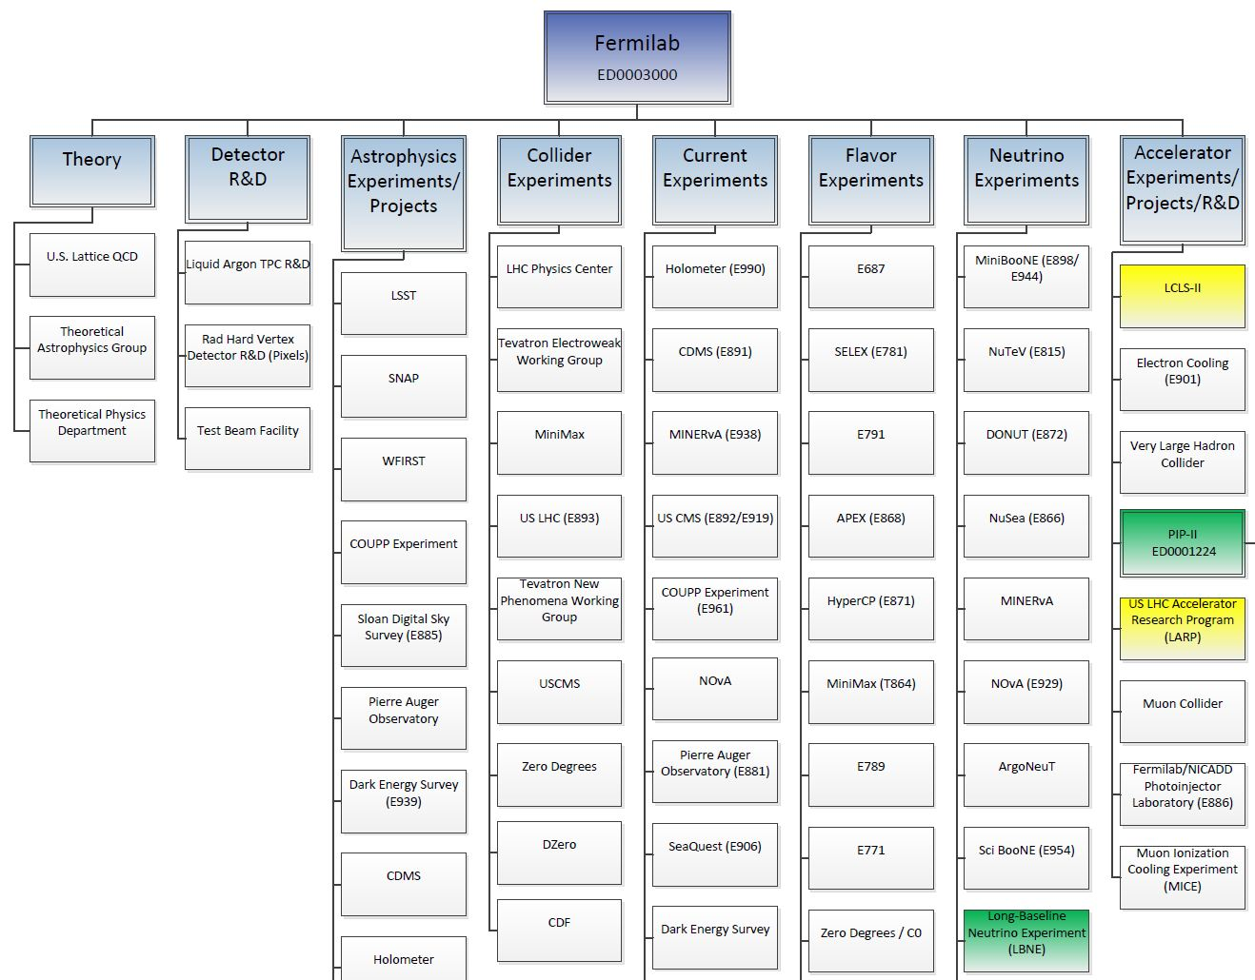
PIP-II Engineering Process Document Management

Slide 11
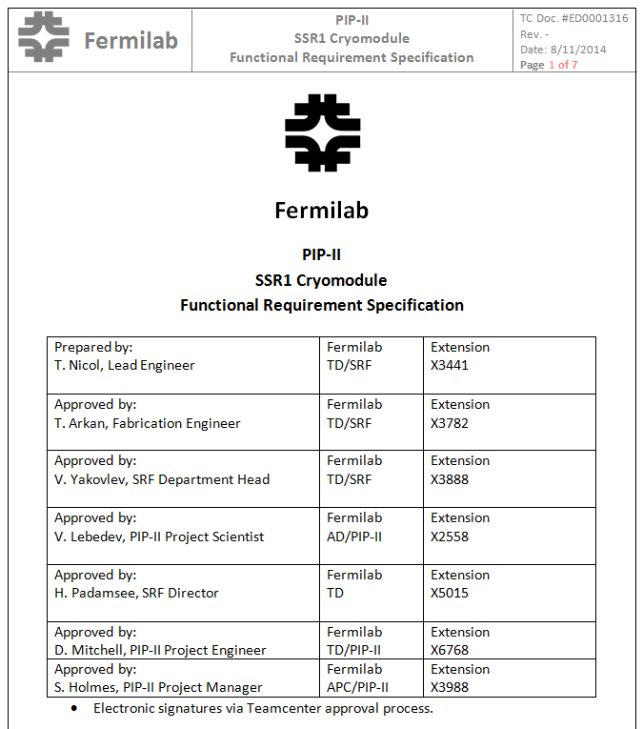
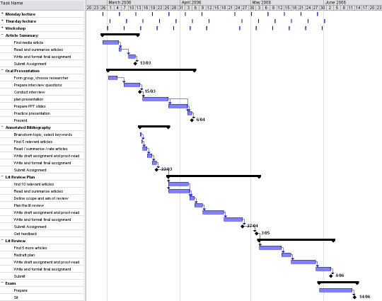
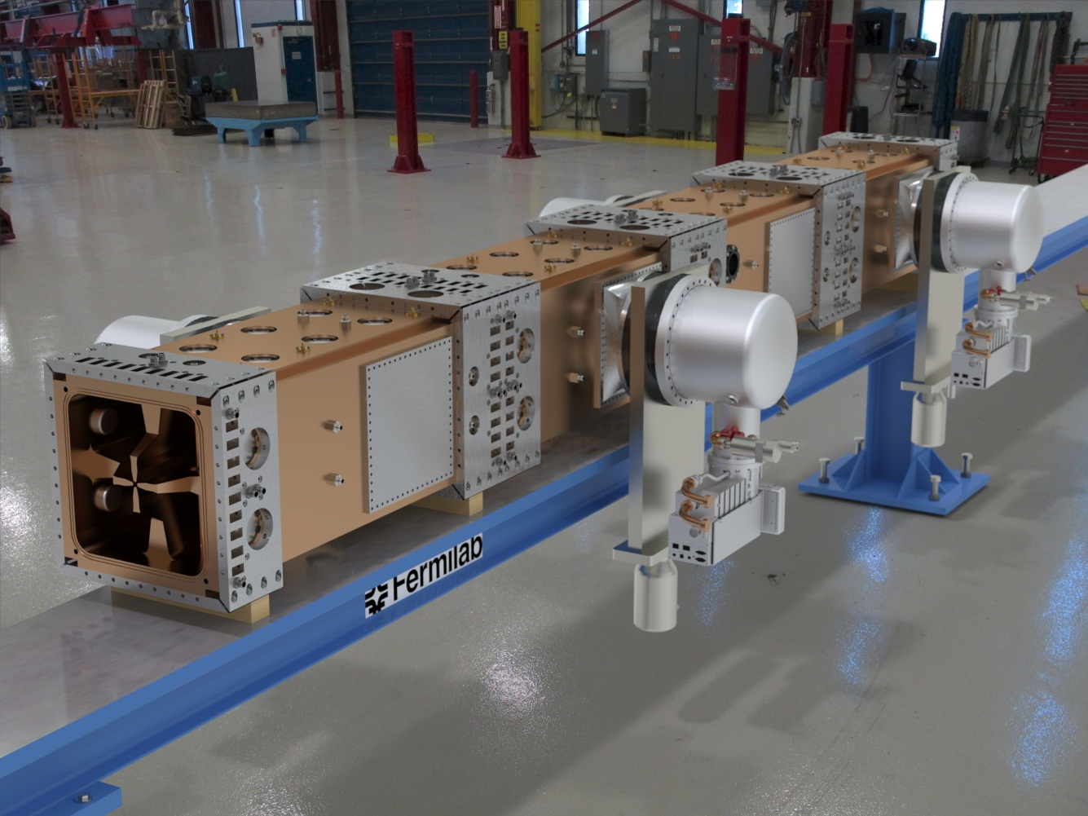
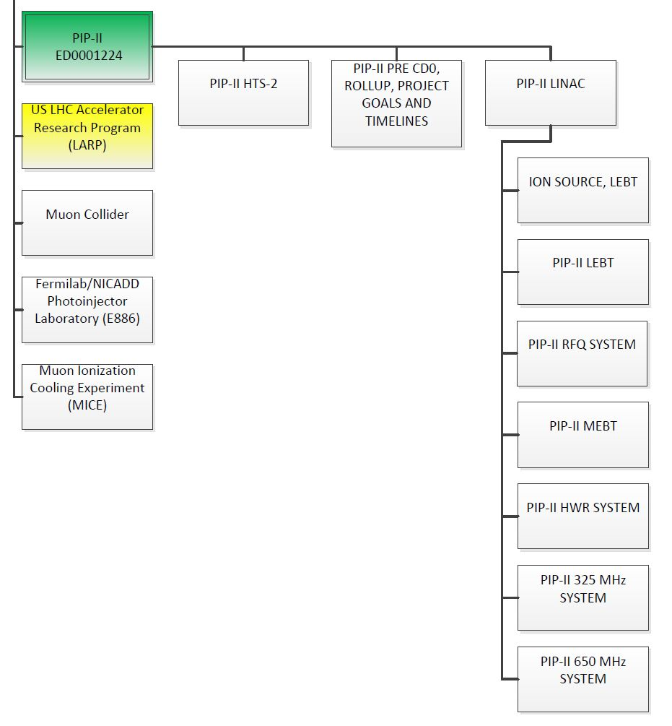
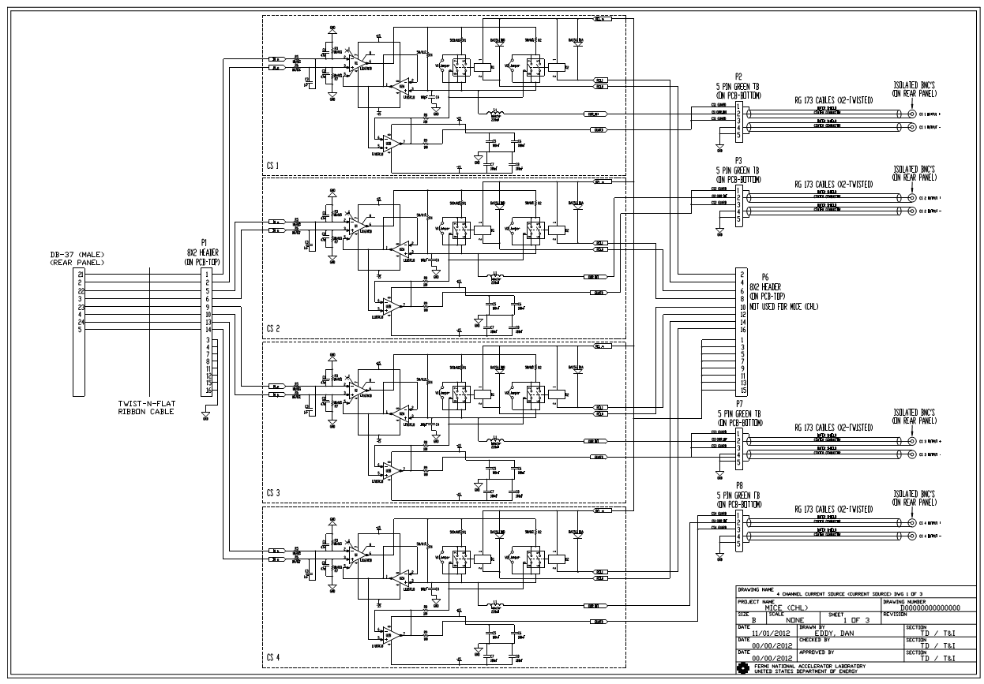
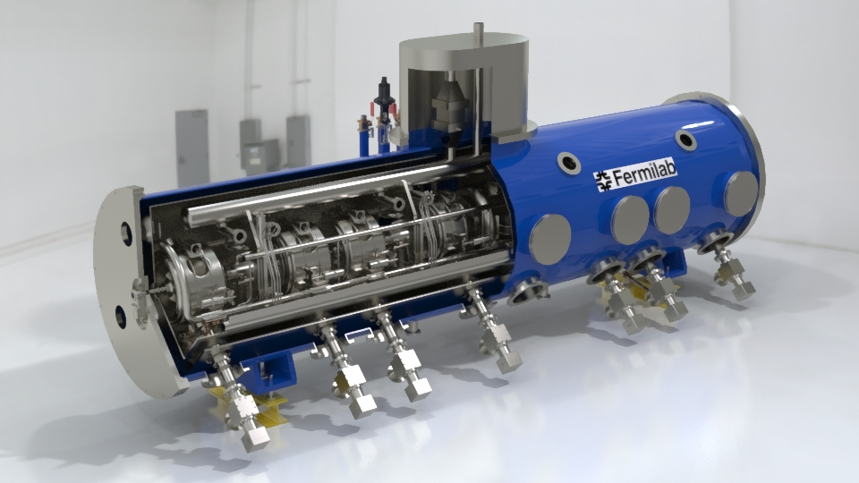
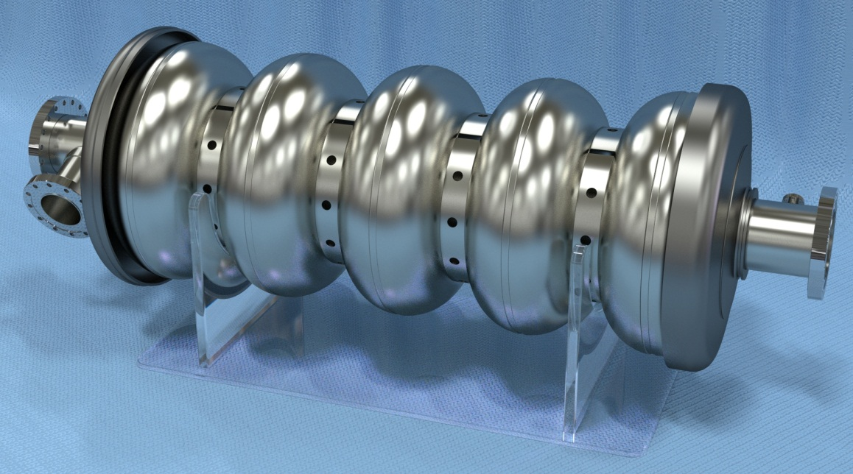

Slide 12
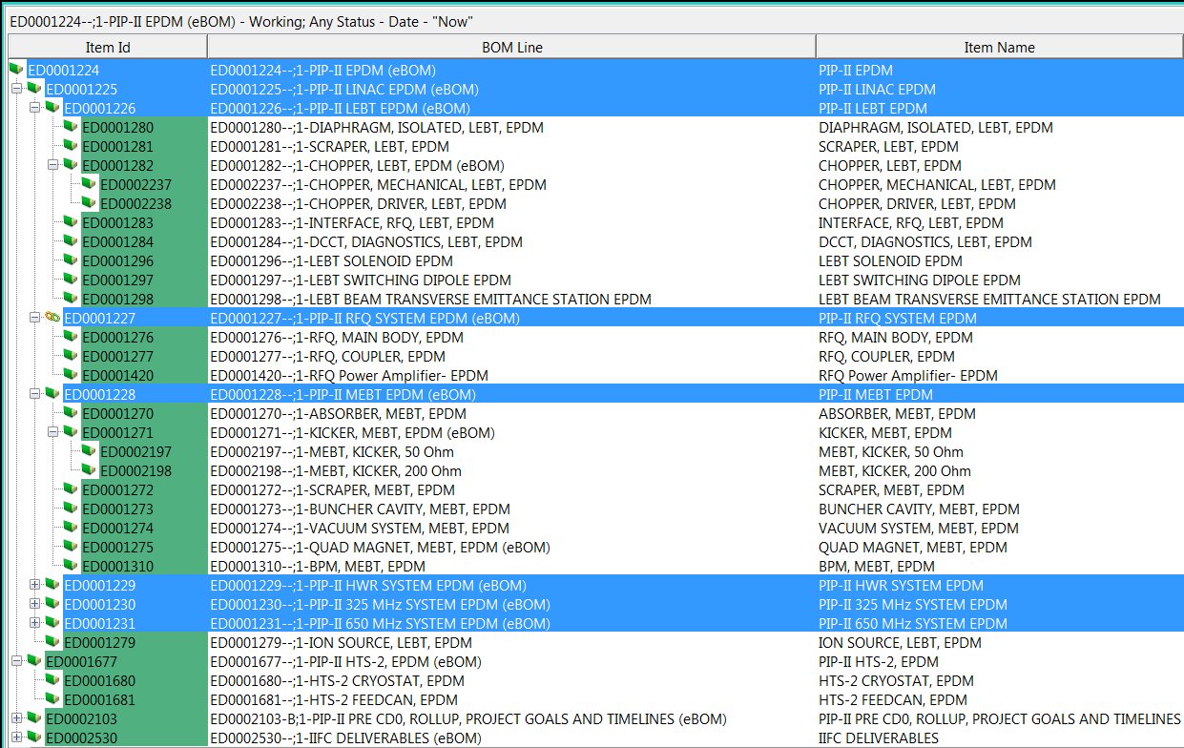
PIP-II Engineering Process Document Management

Slide 13
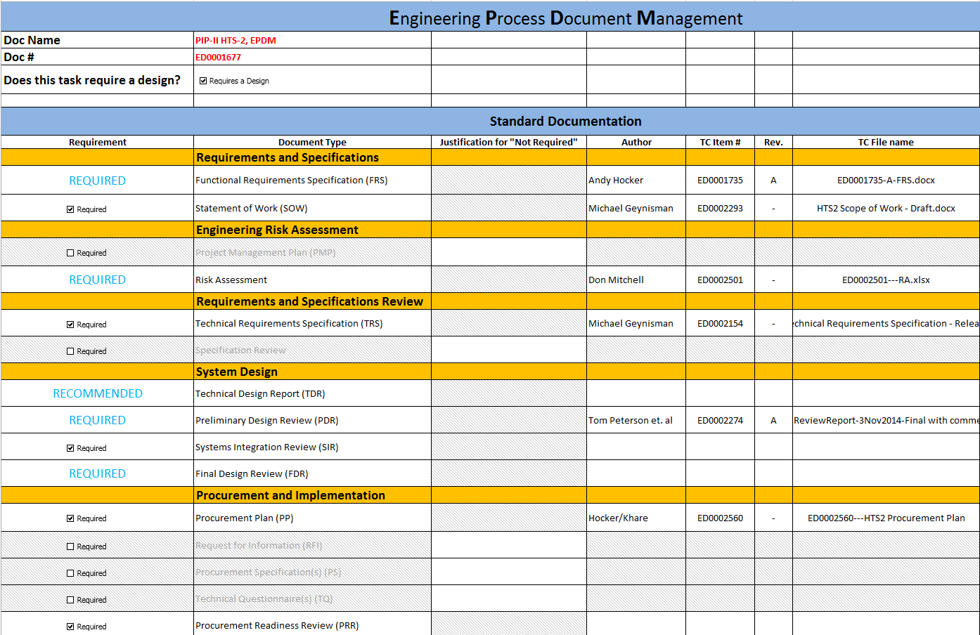
PIP-II Engineering Process Document Management

Slide 14
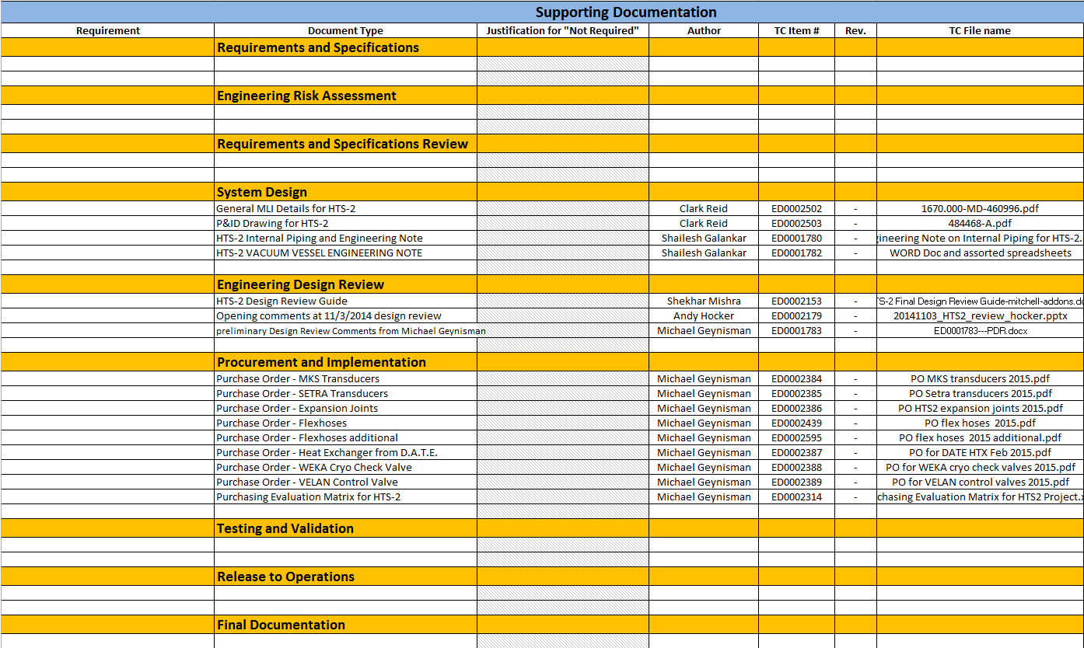
PIP-II Engineering Process Document Management

Slide 15
PIP-II Engineering Process Document Management
One storage location with global access
Integration of all CAD data with all Engineering documentation
Revision controlled
Always up-to-date
Provides easy access for all Users
Provides a consistent process
Well organized
Adherence to the intent of the Fermilab Engineering Manual
The PIP-II chosen EDMS solution is Teamcenter

Slide 16
PIP-II Engineering Steps: From Concept to Operation
Conduct a Risk Assessment
Define the required documentation needed to complete the task
Create a Functional Requirement Specification
Begin the design process and supply all required documents
Develop a Systems Integration Plan if needed
Conduct Design Reviews and secure all approvals
Develop a Procurement Plan
Procure all components
Assemble system components
Test and validate the system
Secure Operational Readiness Clearance if required
Provide operations training
Operate the system

Slide 17
PIP-II Engineering Status
PIP-II is at various stages of the Product Lifecycle depending on the particular system
PXIE (R&D Proof of Concept)
LEBT: nearly fully commissioned, Testing and Validation
RFQ: Fabrication phase
MEBT: Fabrication, Procurement, ongoing Design
HWR: Fabrication phase
SSR1: Fabrication, Procurement, ongoing Design
Power: Fabrication, Procurement, Design, Testing
Controls & Instrumentation: Fabrication, Procurement, Design, Testing
Facilities: Design phase within FESS
SSR2: FRS has been created
HB650 MHz cavity: Design phase, R&D fabrication
LB650 MHz cavity: FRS has been created
2014
2015
2016
2017
2017
On-going
On-going

Slide 18
PIP-II Systems Integration
Each system must be evaluated to identify any areas where multiple engineering disciplines overlap
Electrical
Mechanical
SRF
RF
Water
Pneumatic
Instrumentation
Micro-phonics
Site Facilities
Where there are overlaps, an integration plan must be developed and engineered into a fully functional system
Many PIP-II components require a Technical Integration Specification, a Systems Integration Plan, and a Systems Integration Review

Slide 19
Summary
The Fermilab Engineering Manual is used as a guide to the graded approach in identifying all required documentation.
Functional Requirement Specifications have been authored for nearly every major system. Many have been released.
PIP-II is at various stages of the Product Lifecycle depending on the particular system.
Our current focus in on the related R&D for PXIE.
PIP-II documentation is centrally located and organized by EPDMs within Teamcenter. This facilitates easy and direct access to all PIP-II documentation.
PIP-II engineers utilize an integrated design approach during the design process to minimize rework and schedule delays and to maximize system performance.
PIP-II is on schedule for concluding our R&D effort in 2018.

