Slide 1
RFQ Status and Commissioning Plan
Jim Steimel
PIP-II Machine Advisory Committee
9-11 March 2015

Slide 2
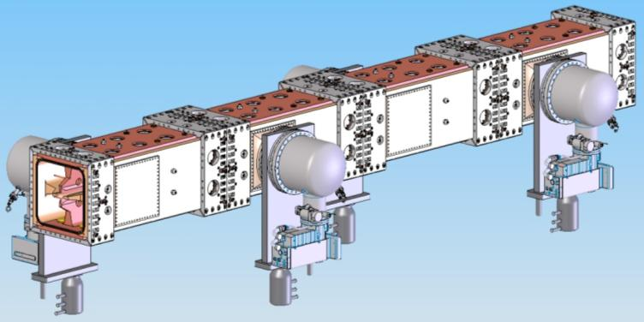
PXIE RFQ Solid Model
D. Li (LBNL) RFQ Design Review 4-12-12
Picture showing solid model of 4-vane x 4-module PXIE RFQ. Design consists of 2 RF power inputs, 8 vacuum pumping ports, and 32 Pi-mode stabilization rods.

Slide 3
Beam Dynamics Requirements
D. Li (LBNL) PXIE RFQ Fabrication Readiness Review 6-26-13
Parameters | PXIE | Unit
Ion Type | H-
Output Energy | 2.1 | MeV
Duty factor | 100 | %
Frequency | 162.5 | MHz
Beam current | 5 (nominal); 1-10 | mA
Transverse Emittance | < 0.25 (norm. rms) | πmm-mrad
Longitudinal Emittance | 0.8-1.0 | keV-nsec
Input energy | 30 | kV
Emittance Growth | < 10 | %
Transmission | > 95 | %
TWISS Parameter αs | Less than 0.2

Slide 4
Design Simulation Results
D. Li (LBNL) PXIE RFQ Fabrication Readiness Review 6-26-13
Simulated beam parameters
Simulated RF and thermal properties
Parameters | Value | Unit
Vane Tip Voltage | 60 | kV
RFQ Length | 4.45 | m
Transmission | 99.8 | %
Transverse Emittance | 0.15 | πmm-mrad
Longitudinal Emittance | 0.70 | keV-nsec
TWISS Parameters α_{x}, α_{y} | 0.187 -0.088
Parameters | PXIE-T | Units
Frequency | 162.493 | MHz
Frequency of dipole mode | 181.99 | MHz
Q factor | 14660
Q factor drop due to everything | -14.7 | %
Power loss per cut-back (In/Out) | 336/392 | watts
Max power loss density at cut-back | 7.9 | W/cm²
Total power loss | 74.6 | kW
H (1/2 of the inner width of the RFQ) | 172.73 | mm

Slide 5
RFQ Resonant Frequency Tuning
There are no adjustable, mechanical tuners in RFQ design.
Resonant frequency tuning controlled by water temperature during CW operation.
Engineering team looking at optimizing water system design for temperature stability and fast, power interruption recovery.
We may use RF pulse width variation as virtual water heater during pulsed beam operations.
Resonant Frequency Shift Thermal Response
A. Lambert (LBNL) RFQ Design Review 4-12-12
Frequency Shift (2D) | Average
Overall (kHz/ºC) | -2.80
Vane (kHz/ºC) | -16.70
Wall (kHz/ºC) | 13.90
Sum of Vane & Wall (kHz/ºC) | -2.80
Theoretical (kHz/ºC) | -2.91
% Error | 3.8%

Slide 6
RFQ Module Construction Status
Two modules brazed and leak tight.
One module needs final, leak sealing braze.
One module final braze complete and awaiting leak test results.
Only final end machining remains (o-ring grooves, RF seal grooves, and final length).

Slide 7
RFQ Support Stand
Final design review completed early last month.
Design includes operational stand and shipping configuration.
All material is on hand and the shop is cutting the material.
Estimate 7-10 weeks for completion.
Bead-pull tuning will begin after modules are mounted on the stand.
M. Hoff (LBNL) RFQ Support Stand Design Review 2-5-15

Slide 8
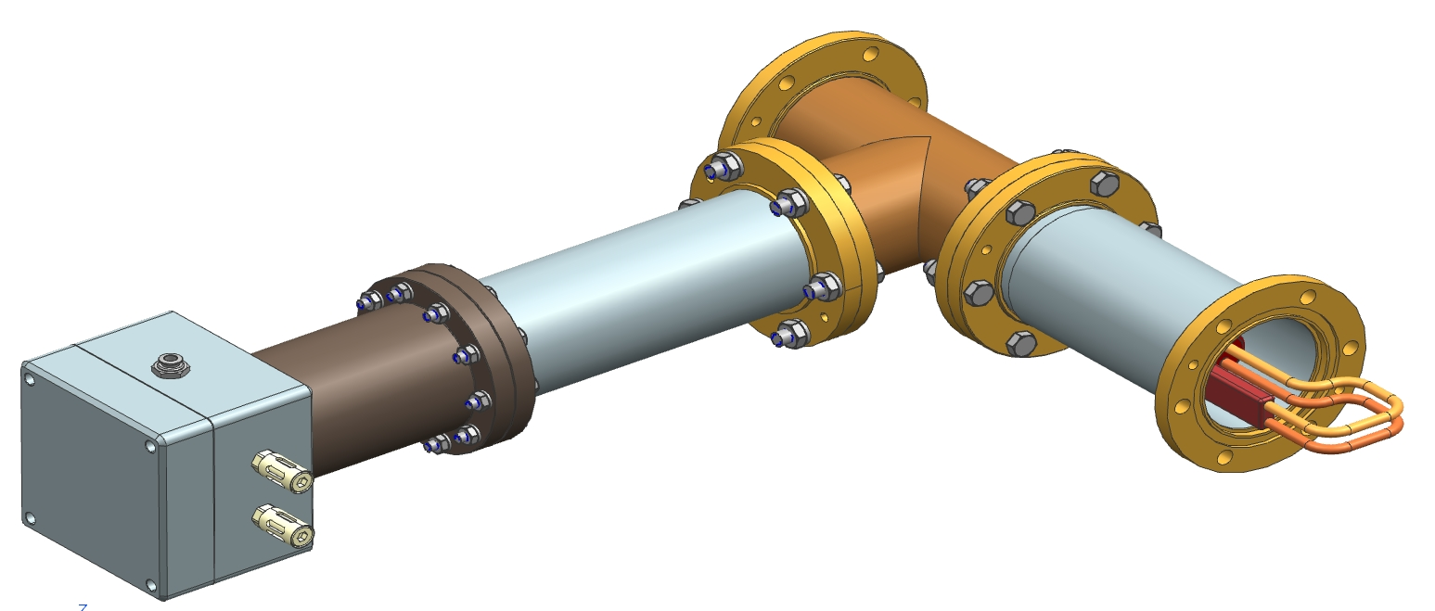
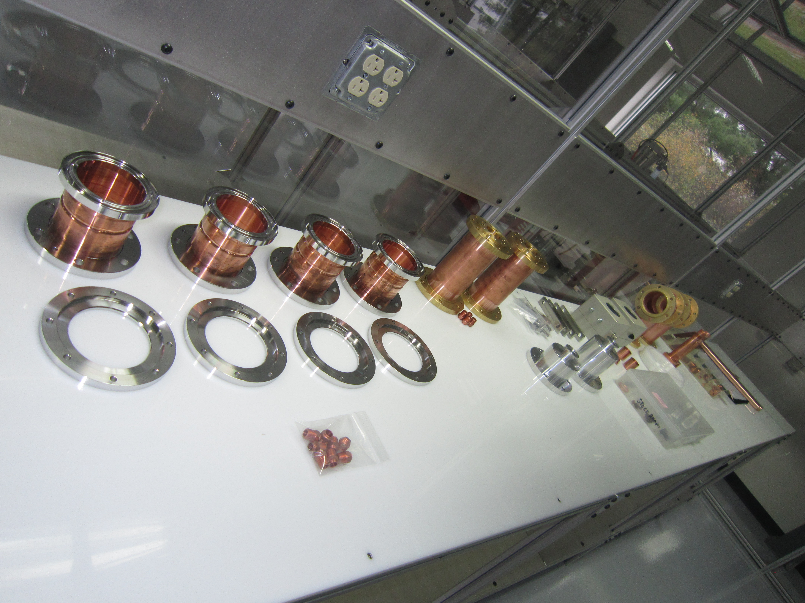
Input Coupler Fabrication
Input coupler design complete and being manufactured by vendor, Mega Inc.
All components have been procured and machined.
Ceramic window braze complete. Now need to work on brazing coupling loop.
Expect delivery in June.

Slide 9
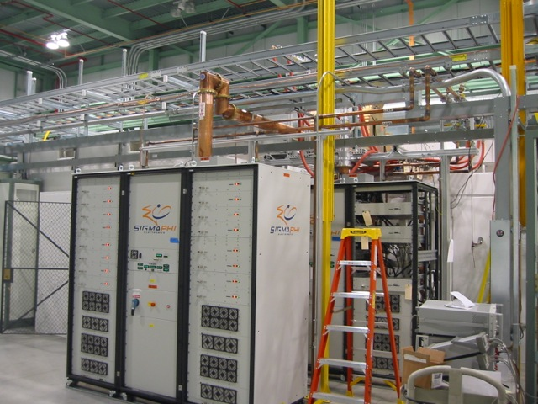
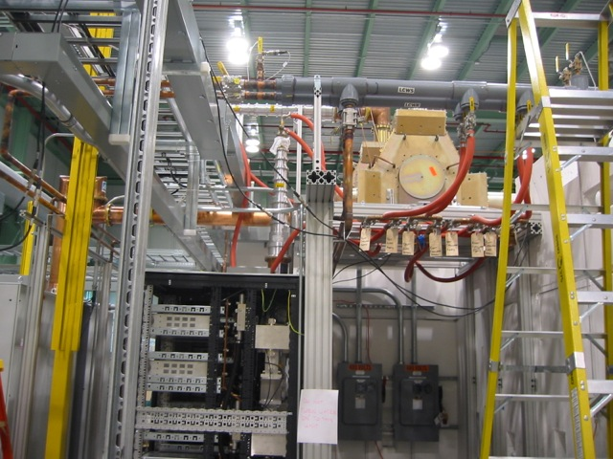
RF Distribution Status
Both 75kW power amplifiers are commissioned to spec and operational.
Circulators are not capable of CW operation into a short, but they will be good enough to protect amplifiers from RFQ filling time and sparks.
Amplifiers are self-protected from highly reactive loads.
RF interlock system for RFQ operation is based on HINS system.

Slide 10
RFQ Beam Commissioning Line - Short MEBT 1_1 (Fall 2015)
Plan to start RFQ beam commissioning with front MEBT section fully assembled, including prototype magnets and cavity
Pulsed mode only (<1 ms, <60 Hz)
Measurement of beam energy, RFQ transmission, bunch length
Commission prototype buncher cavity.
3D model of MEBT 1_1, C. Baffes, S. Oplt.
ToF monitor
LEBT FC with donut
Scrapers
Toroid
Fast Faraday Cup
Ring pickup
Toroid

Slide 11
RFQ Beam Commissioning Line - Short MEBT 1_2 (End of 2015)
First measurements of beam emittance, Twiss functions
May try using the LEBT emittance scanner to compare with measurements by slits/scrapers
First high – power tests
Use HINS beam dump (from SNS)
3D model of MEBT 1_2. C. Baffes, S. Oplt.

Slide 12
RFQ Beam Commissioning Line - Short MEBT 1_3 (2016)
16 kW power with removed “diagnostics section”, to provide larger beam at the dump.
3D model of MEBT 1_3. C. Baffes, S. Oplt.

Slide 13
RFQ Commissioning Schedule (2015)
Here is the estimated completion time of major milestones in the RFQ commissioning process.

Slide 14
Extra Slides

Slide 15
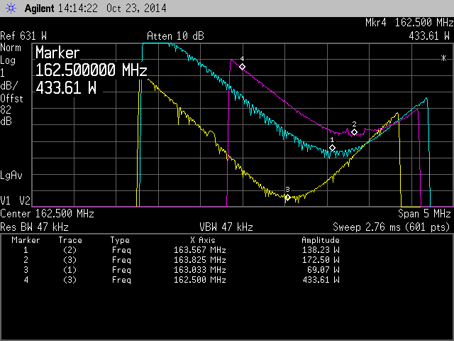
Input Water Temperature = 85 F, yellow 60 kW, blue 70 kW, magenta 75 kW
amp reflected power into a 50 ohm load. (note color scheme different from
previous plots due to operator, i.e.me)

Slide 16
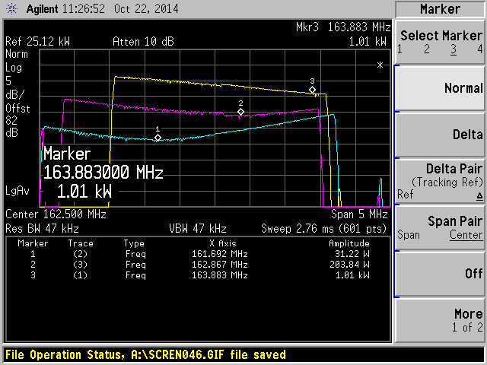
Input Water Temperature = 85 F, short circuit on port 2, amplifier reflected power vs freq. Blue 10 kW, Magenta 20 kW, Yellow 30 kW, markers indicate minimal power and freq. Note there does not appear to be a sharp power minimum.

