Slide 1
PIP-II Overview: Goals, Status, Strategy
Steve Holmes
PIP-II Machine Advisory Committee
9-11 March 2015

Slide 2
Since Last Year’s Meeting
At the time of last year’s meeting we had developed the PIP-II concept, documented the concept in a whitepaper, and presented the concept to P5. Since then…
P5 process completed
  Multiple interactions with P5, primarily on funding requirements and schedules
  P5 report submitted/accepted by HEPAP; strong endorsement of PIP-II:
  Recommendation 14: Upgrade the Fermilab proton accelerator complex to produce higher intensity beams. R&D for the Proton Improvement Plan II (PIP-II) should proceed immediately, followed by construction, to provide proton beams of >1 MW by the time of first operation of the new long-baseline neutrino facility.
PIP-II Reference Design Report complete draft released
Fermilab SRF and PIP-II R&D programs integrated
Fermilab assumes major responsibilities in LCLS-II
Annex I to the U.S. DOE-India DAE Implementing Agreement signed

Slide 3
Outline
Program Goals
Design Strategy and Concept
R&D Program
Project Status and Strategy
Collaboration
Recommendations Responses
Meeting Organization

Slide 4
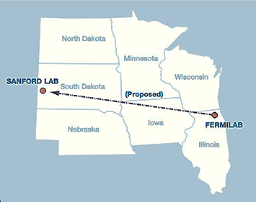
Motivation
Fermilab’s goal is to construct & operate the foremost facility in the world for particle physics research utilizing intense beams.
Neutrinos
  MINOS+, NOvA @700 kW
  LBNF @ >1-2 MW
  SBN @ 10’s kW
Muons
  Muon g-2 @ 17-25 kW
  Mu2e @ 8-100 kW
Longer term opportunities
This requires more protons!
Proton Improvement Plan (PIP) will support initial goals by establishing a base capability of operating the Booster at a 15 Hz beam rate

Slide 5
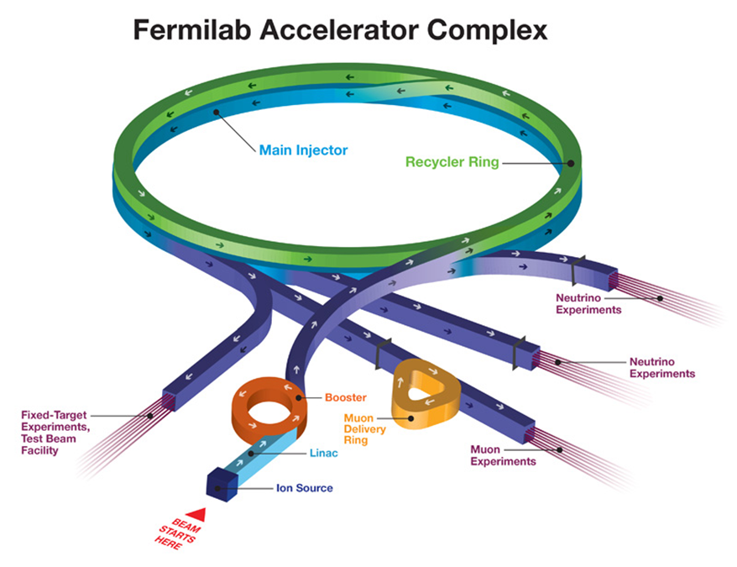
The Fermilab Accelerator Complex Following PIP
The Fermilab complex will deliver protons at both 8 and 120 GeV, in support of the neutrino and muon programs:
  Booster: 4.2×10¹² protons @ 8 GeV @ 15 Hz = 80 kW
  MI: 4.9×10¹³ protons @ 120 GeV @ 0.75 Hz = 700 kW
Limitations
  Booster pulses per second (15 Hz)
    Total power available to 8 GeV
    program limited by the repetition rate
  Booster protons per pulse
    Limited by space-charge forces at
    Booster injection, i.e. the linac energy
  Reliability
    Linac/Booster represent a non-negligible operational risk

Slide 6
PIP-II (Proton Improvement Plan–II)
The PIP-II goal is to support long-term physics research goals by providing increased beam power to LBNF, while providing a platform for the future
Design Criteria (unchanged in last 18 months)
  Deliver >1 MW of proton beam power from the Main Injector over the energy range 60 – 120 GeV, at the start of LBNF operations
  Support the current 8 GeV program including Mu2e, g-2, and short-baseline neutrinos
  Provide an upgrade path for Mu2e
  Provide a platform for extension of beam power to LBNF to >2 MW
  Provide a platform for extension of capability to high duty factor/higher beam power operations
  At an affordable cost to DOE
Goal: Initiate operations in newly-configured complex in ~2024

Slide 7
PIP-II Strategy
Increase Booster/Recycler/Main Injector per pulse intensity by ~50%
  Requires increasing the Booster injection energy to ~800 MeV
    30% reduction in space-charge tune shift w/ 50% increase in beam intensity
Increase Booster repetition rate to 20 Hz
  Maintain 1 MW down to 60 GeV or,
  Provide factor of 2.5 increase in power to 8 GeV program
  Improve slip-stacking efficiency via larger orbit separation
Modest modifications to Booster/Recycler/Main Injector
  Accommodate higher intensities and higher Booster injection energy
Propose: 800 MeV superconducting pulsed linac, extendible to support >2 MW operations to LBNF and upgradable to continuous wave (CW) operations
  Builds on significant existing infrastructure
  Capitalizes on major investment in superconducting RF technologies
  Eliminates significant operational risks inherent in existing 400 MeV linac
    Existing linac removed from service upon completion of PIP-II
  Siting consistent with eventual replacement of the Booster as the source of protons for injection into Main Injector (PIP-III)

Slide 8
PIP/PIP-II Performance Goals
Performance Parameter | PIP | PIP-II
Linac Beam Energy | 400 | 800 | MeV
Linac Beam Current | 25 | 2 | mA
Linac Beam Pulse Length | 0.03 | 0.5 | msec
Linac Pulse Repetition Rate | 15 | 20 | Hz
Linac Beam Power to Booster | 4 | 18 | kW
Linac Beam Power Capability (@>10% Duty Factor) | 4 | ~200 | kW
Mu2e Upgrade Potential (800 MeV) | NA | >100 | kW
Booster Protons per Pulse | 4.2×10¹² | 6.5×10¹²
Booster Pulse Repetition Rate | 15 | 20 | Hz
Booster Beam Power @ 8 GeV | 80 | 160 | kW
Beam Power to 8 GeV Program (max) | 32 | 80 | kW
Main Injector Protons per Pulse | 4.9×10¹³ | 7.6×10¹³
Main Injector Cycle Time @ 60-120 GeV | 1.33* | 0.7-1.2 | sec
LBNF Beam Power @ 60-120 GeV | 0.7* | 1.0-1.2 | MW
LBNF Upgrade Potential @ 60-120 GeV | NA | >2 | MW
*NOvA operates exclusively at 120 GeV

Slide 9
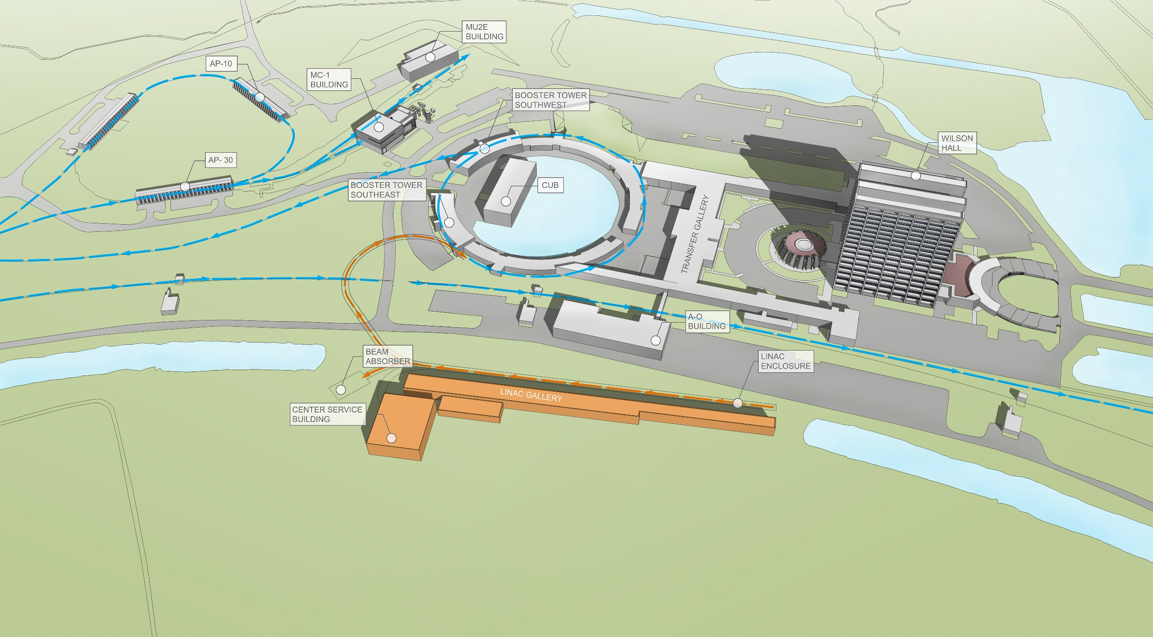
PIP-II Site Layout (provisional)

Slide 10
PIP-II Linac Technology Map
IS
LEBT
RFQ
MEBT
β=0.11
β=0.22
β=0.47
β=0.61
β=0.9
RT
SC
162.5 MHz
0.03-10.3 MeV
325 MHz
10.3-180 MeV
650 MHz
180-800 MeV
Section | Freq | Energy (MeV) | Cav/mag/CM | Type
RFQ | 162.5 | 0.03-2.1
HWR (β_{opt}=0.11) | 162.5 | 2.1-10.3 | 8/8/1 | HWR, solenoid
SSR1 (β_{opt}=0.22) | 325 | 10.3-35 | 16/8/ 2 | SSR, solenoid
SSR2 (β_{opt}=0.47) | 325 | 35-185 | 35/21/7 | SSR, solenoid
LB 650 (β_{opt}=0.65) | 650 | 185-500 | 33/22/11 | 5-cell elliptical, doublet*
HB 650 (β_{opt}=0.97) | 650 | 500-800 | 24/8/4 | 5-cell elliptical, doublet*
*Warm doublets external to cryomodules All components CW-capable
Notes:
Multiple corrections to the table and picture

Slide 11
Booster/Recycler/MI Requirements
Booster
  New injection region to accept 800 MeV H⁻ and enable transverse beam painting
  RF sufficient to support acceleration and transition crossing manipulations (22 cavities total)
  20 Hz operations
  Upgrades to damper and collimator systems
Recycler
  RF sufficient for slip-stacking at cycle times as low as 0.7 sec, i.e. 60 GeV
  New collimators(?)
Main Injector
  RF power upgrade
  Collimator upgrade
Notes:
I am not sure about Collimator upgrade in MI. We will need collimator in Recycler but it should be done before PIP-II

Slide 12
PIP-II R&D Strategy
Goal is to mitigate risk: Technical/cost/schedule
Technical Risks
  Front End (PXIE)
    Complete systems test: Ion Source through SSR1 (25 MeV)
  Operations of (high Q₀) SC Linac in pulsed mode at low current
    Primary issue is resonance control in cavities
    Task force defining options and pursuing development
  Booster/Recycler/Main Injector beam intensity
    50% per pulse increase over current operations
    Longitudinal emittance from Booster for slip-stacking
    Beam loss/activation
Cost Risks
  Superconducting RF
    Cavities, cryomodules, RF sources represent 46% of construction costs
Goal: Be prepared for a construction start in 2019
  R&D deliverables milestones established

Slide 13
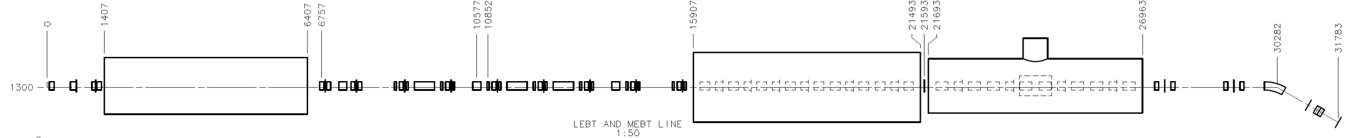
PXIE (PIP-II Injector Experiment)
Now
2015
2016
2017
2018
30 keV
2.1 MeV
10 MeV
25 MeV
RFQ
MEBT
HWR
SSR1
HEBT
LEBT
40 m, ~25 MeV
PXIE will address the address/measure the following:
  LEBT pre-chopping
  Vacuum management in the LEBT/RFQ region
  Validation of chopper performance
  Bunch extinction
  MEBT beam absorber
  MEBT vacuum management
  Operation of HWR in close proximity to 20 kW absorber
  Operation of SSR with beam, including resonance control and LFD compensation in pulsed operations
  Emittance preservation and beam halo formation through the front end
Collaborators
ANL: HWR
LBNL:LEBT, RFQ
SNS: LEBT
BARC: MEBT, SSR1

Slide 14
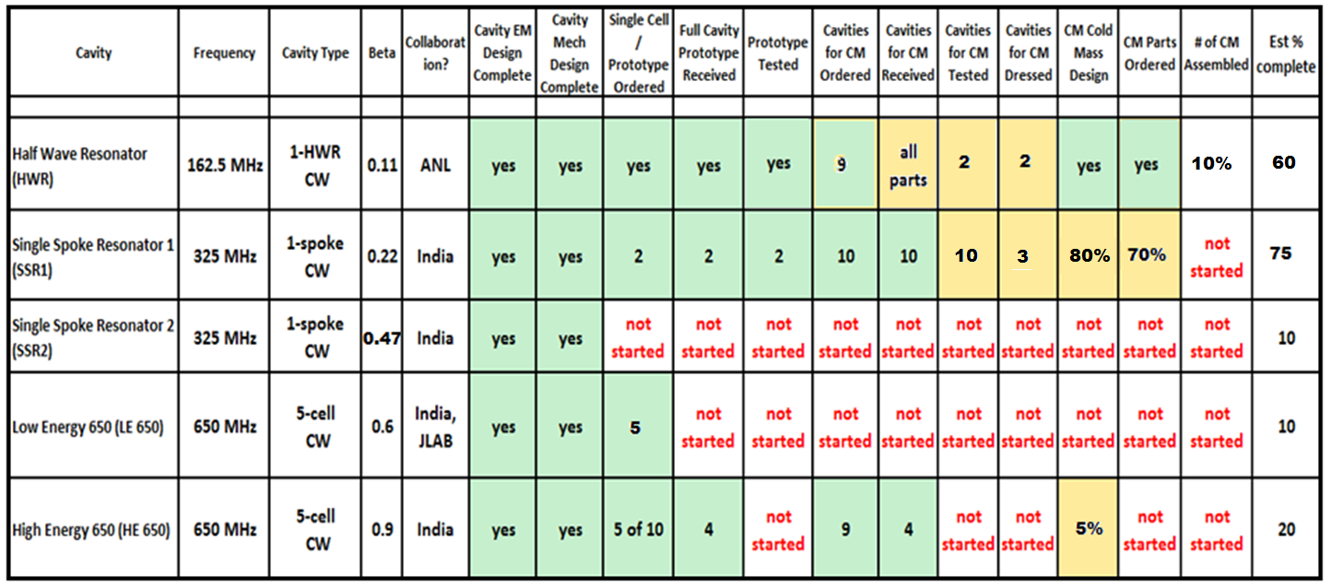
SRF Development Status (2-19-15)

Slide 15
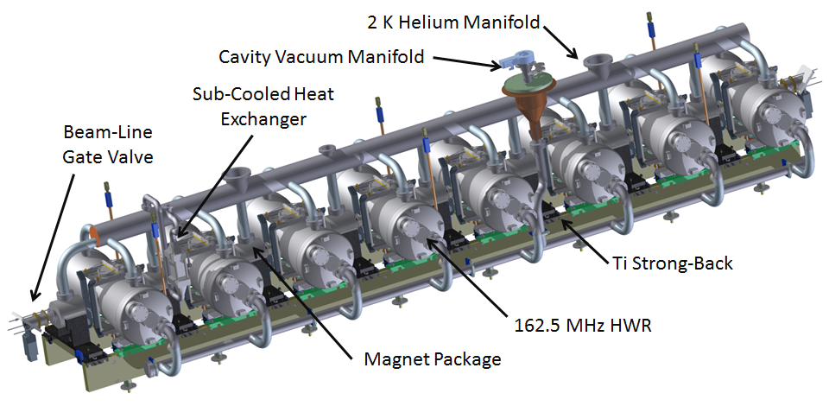
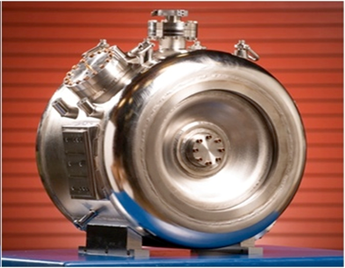
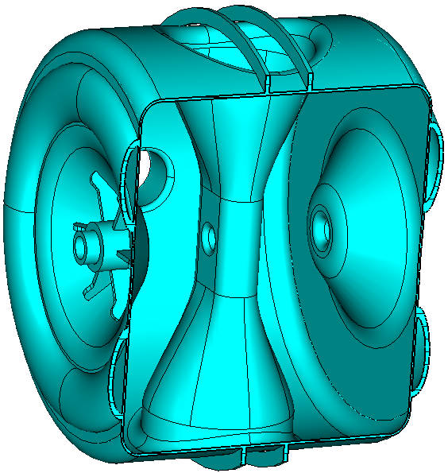
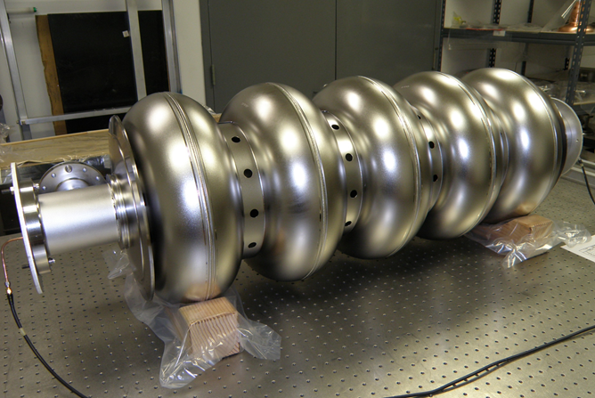
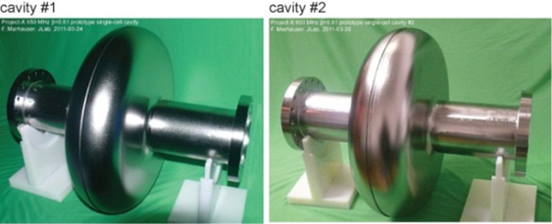
SRF R&D
HWR
SSR1 SSR2
LB650
HB650

Slide 16
PIP-II Project Status and Strategy
PIP-II is in the development phase and is not yet recognized as a formal DOE project
  However, PIP-II has received very strong support from P5, DOE/OHEP, and the Fermilab director
  Expect formalization of project status (CD-0) in the next ~year, followed by ~8-year development + construction period
Goals for FY2015
  Release PIP-II Reference Design Report
  Update current cost estimate as necessary
  Start developing a resource loaded schedule
  Receive RFQ (from LBNL) and initiate commissioning at PXIE
  Keep HWR and SSR1 fabrication on schedule
  Develop deliverables strategy with India (and Europe)
  Support DOE/OHEP in development of Mission Needs Statement
  Establish PIP-II Office

Slide 17
Future Directions
The configuration and siting of the PIP-II linac are chosen to provide opportunities for future performance enhancements to the Fermilab proton complex
  >2 MW to LBNF
  100’s kW for a rare processes program
    CW capability at 0.8 – 3 GeV
  Front end for a muon-based facility
The natural next steps would be upgrading the PIP-II linac to CW operations and replacement of the Booster with higher performance accelerator

Slide 18
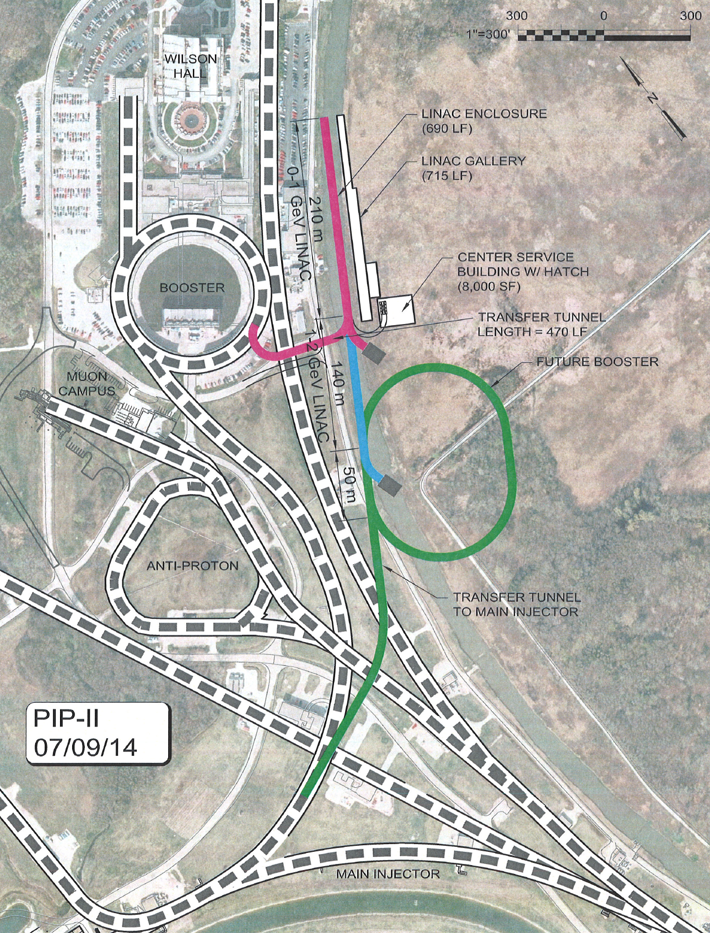
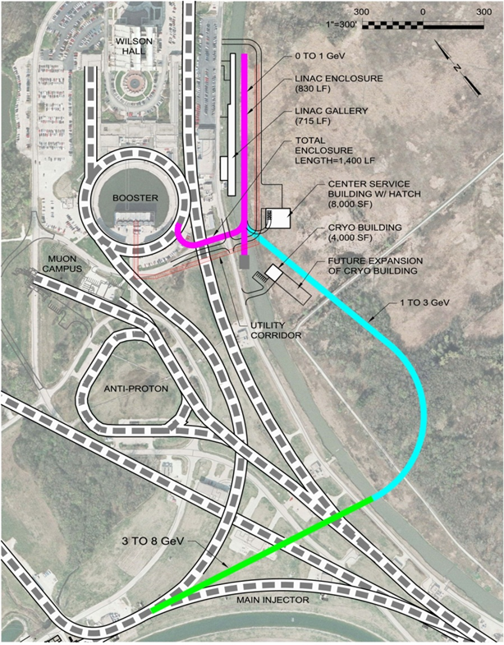
Flexible Platform for the Future
Opportunities for Booster replacement include full energy (8 GeV) linac or RCS
Notes:
ma to mA in 2nd capability bullet

Slide 19
PIP-II Collaboration
Organized as a “national project with international participation”
  Fermilab as lead laboratory
Collaboration MOUs for the development phase (through CD-2) :
  National IIFC
  ANL ORNL/SNS BARC/Mumbai
  BNL PNNL IUAC/Delhi
  Cornell UTenn RRCAT/Indore
  Fermilab TJNAF VECC/Kolkata
  LBNL SLAC
  MSU ILC/ART
  NCSU
Annex I to the U.S. DOE-India DAE Implementing Agreement signed in January 2015
  Significant Indian contribution to PIP-II R&D and construction
  Joint DOE-DAE evaluation of R&D accomplishments in 2018
Ongoing contacts with CERN (SPL), Orsay, RAL/FETS (UK), ESS (Sweden), China/ADS

Slide 20
Cost Estimate/Proposed Budget Profile
Profile based on FY19-23 construction period
  As presented to P5
  All amounts are $M then-year
  Inconsistent with FY15 actual ($20.0M) and FY16 PBR ($19.5M)
Assumes $160M offset from international in-kind contributions
PXIE and SRF are major elements of the R&D program
  Complete set of deliverables established, designed to retire technical risks in advance of the construction start

Slide 21
Response to Last Meeting’s Recommendations
All recommendations have been considered
  Responses are available on the indico site
Selected highlights:
  Integration of PIP and PIP-II.
    Revised strategy on linac power sources and Booster rf cavities
    Transition plan under development
  Development of Recycler/Main Injector strategy
    R&D plan under development
  Implications of Total Loss Monitor (TLM) approach
    ESH&Q Section approval of TLM as an accredited safety system; Accelerator Division working for a final approval during CY15
  Priorities in face of resource shortages
    PXIE is highest priority (includes HWR and SSR1 prototypes)
    HB650 is next highest (includes cavity testing; CM design w/India)

Slide 22
Organization of the Meeting
Design Concept
Dinner @ Chez Leon
R&D Program
Executive Session/Closeout

Slide 23
Summary
Fermilab is committed to establishing LBNF as the leading long-baseline program in the world, with >1 MW at startup
PIP-II is a complete, integrated, cost effective concept, that meets this goal, while
  Building on the accomplishments of PIP
  Leveraging U.S. superconducting rf investment,
  Attracting international partners,
  Providing a platform for the long-term future
  Documented in the Reference Design Report
PIP-II represents a first step in the realization of the full potential of the Fermilab complex
  LBNF >2 MW
  Mu2e sensitivity ×10
  MW-class, high duty factor beams for future experiments
The PIP-II R&D program targets primary technical and cost risks
  Organized to support a 2019 construction start
We are looking for your input, with particular attention to the charge elements

Slide 24
Backups

Slide 25
PIP-II & LCLS-II: The PIP-II Perspective
Pluses
  PIP-II will inherit a work force and associated infrastructure capable of producing cryomodules efficiently
  LCLS-II production experience will reduce PIP-II risk, and will lend credibility to the PIP-II construction schedule
But: Need to complete prototype SSR1 + HB650 CMs, and install cryo distribution at PXIE prior to LCLS-II completion
  Competition for infrastructure during LCLS-II construction phase
    Plan for assembly of SSR1 CM in Lab 2
    Utilize space either in Lab2 or ICB-A for HB650 CM
    In either event we need an additional HPR facility
  Competition for people during LCLS-II construction phase
    Peaks in 2016-17
Minimal impact on HWR (ANL)

Slide 26
Preliminary Working Schedule

Slide 27
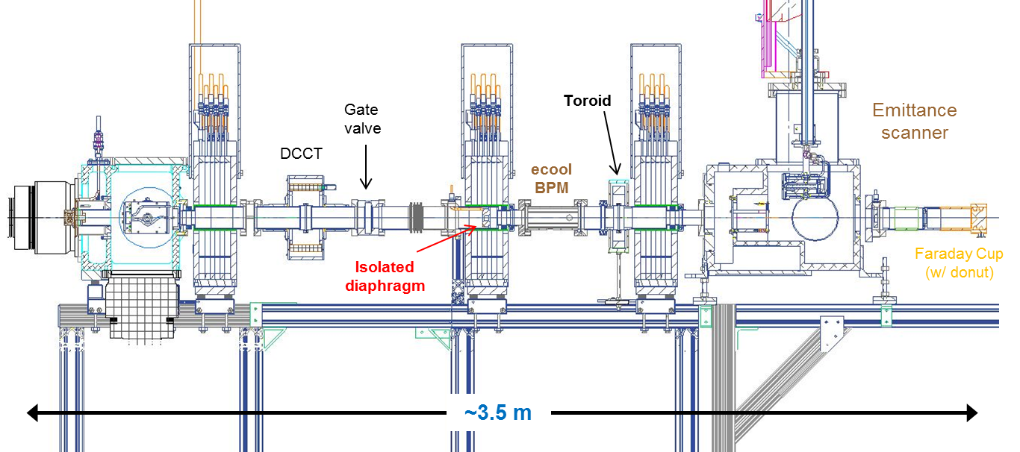
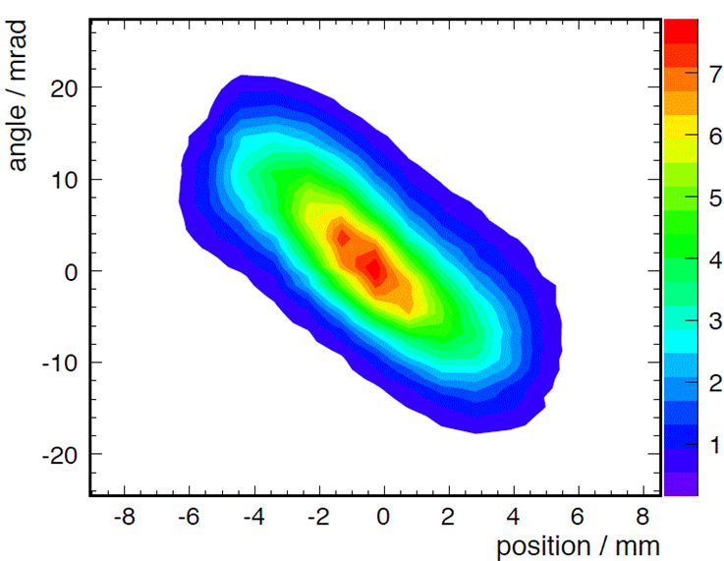
PXIE Current Configuration
IS and LEBT installed and commissioned with beam
  Beam characterized at RFQ entrance (emittance scanner)
  CW/pulsed (400 μsec x 10 Hz) operations @ 5 mA
    Emittance =0.13/0.12 mm-mrad
    Consistent with RFQ requirements

Slide 28
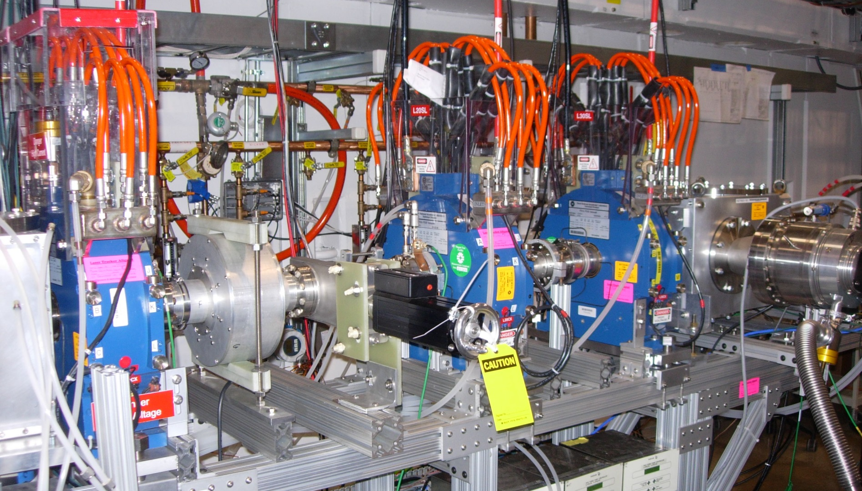
PXIE Current Configuration
Isolated diaphragm #2
Emittance Scanner
Turbo pump
Ion Source
Ceramic break (for toroid)
Gate valve
DCCT

Slide 29
R&D Deliverables (Needs update after agreement)
Deliverable | Date
Reference Design Report | Q1FY15
HB650 Cavity (8, TESLA shape) Vertical Test (US) | Q4FY15
HB650 Dressed Cavity (3) Horizontal Test (US) | Q4FY16
HB650 Dressed Cavity (4) Horizontal Test (India) | Q2FY17
LB650 Dressed Cavity (3) Horizontal Test (US) | Q3FY17
LB650 Dressed Cavity (2) Horizontal Test (India) | Q3FY17
HB650 Cryomodule Design (US, India) | Q2FY16
HB650 Cryomodule Power Test (US) | Q4FY17
650 MHz/30 kW rf Power Test (India) | Q4FY15
SSR1 Dressed Cavity (2) Horizontal Test (India) | Q4FY15
SSR1 Cryomodule Power Test (U.S.) | Q3FY17
SSR2 Dressed Cavity (2) Horizontal Test (India) | Q2FY17
SSR2 Cavity (2) Vertical Test (US) | Q4FY17
SSR2 Dressed Cavity (1) Horizontal Test (US) | Q4FY17
325 MHz/10 kW rf Power Test (India) | Q4FY15
650 MHz Horizontal Test Stand (US & India) | Q3FY16
HWR Cryomodule Test with Beam | Q2FY18
Front End Systems Test (warm components) | Q3FY16

Slide 30
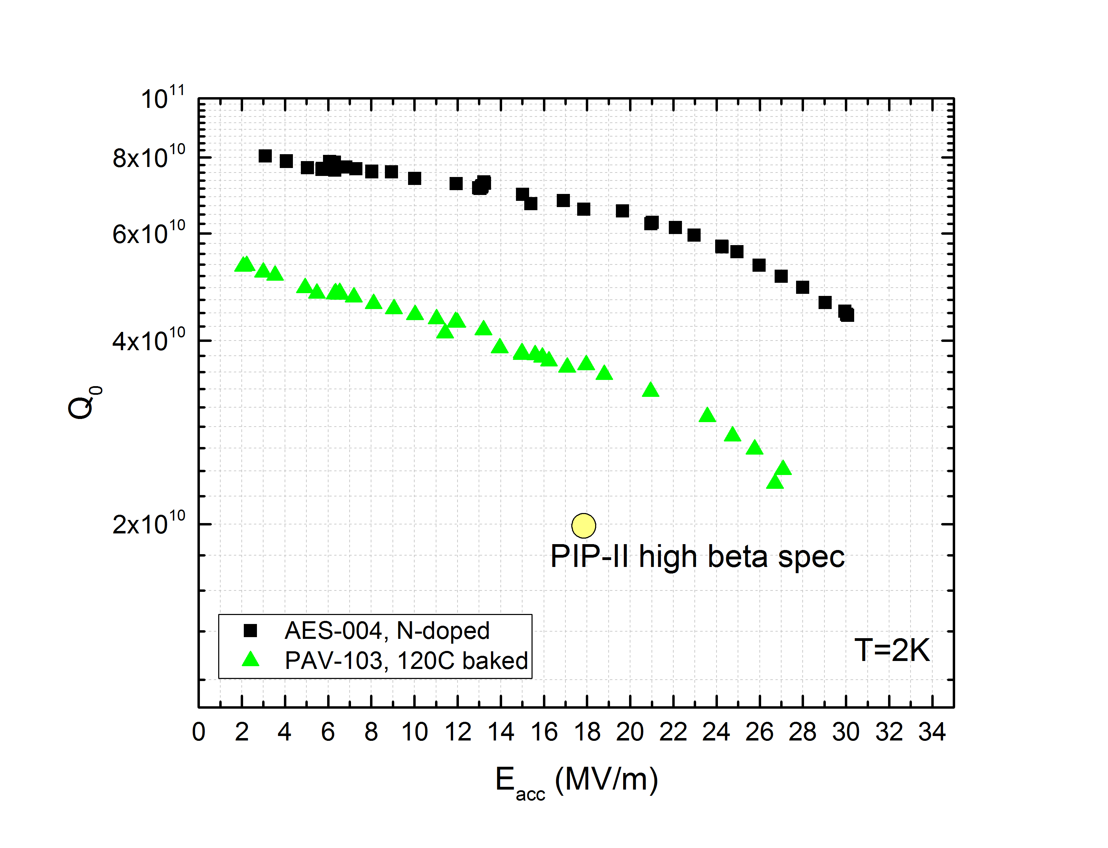
N2 Doping for High Q0
N₂ gas introduced during vacuum bake:
  Q₀=7E10 @ 17 MV/m (!)
Single-cell HB650 cavity @ 2K

Slide 31
Cryogenic System
Required to support 5% cryogenic duty factor
  Configuration capable of 10-15% with more pumping
  160 – 240 kW beam power at 800 MeV

Slide 32
PIP-II Options
Plan A - Superconducting Linac
  800 MeV pulsed SC linac
  Constructed from CW-capable accelerating modules
  Operated initially at low duty factor
  Sited in close proximity to Booster and to significant existing infrastructure
Plan B - Afterburner
  400 MeV pulsed linac appended to existing 400 MeV linac
  805 MHz accelerating modules
  Requires physical relocation of existing linac upstream ~50 m
  ~1 year interruption to operations
  Less expensive than Plan A

Slide 33
Pluses and Minuses
 | Plan A: PIP-II | Plan B
Beam power to LBNE | 1.2 MW | 1.2 MW
Cost to DOE (FY2020 $M) | ~$400 | ~$250
R&D aligned with efforts to date | Y | N
Upgradable to 2 MW to LBNE | Y | Y
High Duty Factor Capable | Y | N
Proton Driver for Muon Facility | Y | N
Upgrade paths utilize 1.3 GHz infrastructure & capabilities | Y | N
Retires significant reliability risks | Y | N
Interruption to operations | ~2 months | >12 months
International contribution & collaboration | Significant | Minimal
Reutilization of existing infrastructure | Significant | Modest
Status of technical development/understanding | Advanced conceptual | Pre-conceptual

Slide 34
Future Directions
The strategy for next step(s) beyond PIP-II will be developed in consideration of the following:
  Slip-stacking in the Recycler is not possible at intensities beyond PIP-II
  The Booster cannot be upgraded to support intensities beyond ~7×10¹² ppp, no matter what the injection energy
  A new 8-GeV rapid cycling synchrotron (RCS) could meet the needs of the neutrino program
    Beam power @ 8 GeV ~600kW
    Injection energy ~2 GeV
  Construction of an RCS may require long-term utilization of the Recycler for proton accumulation
  An extension of the PIP-II linac to 6-8 GeV may be required to remove the Recycler from service and/or to achieve the 1-4 MW required to support a muon-based facility
The strategy will likely be determined on the basis of programmatic choices once PIP-II construction is underway
In all scenarios it will be necessary to extend the PIP-II linac to at least 2 GeV and to retire the existing Booster
  Unless realization of “smart RCS” with lower (800 MeV) injection energy

Slide 35
Example: 2+ MW @ 60-120 GeV
2.4 MW requires 1.5×10¹⁴ protons from Main Injector every 1.2 s @ 120 GeV
  Every 0.6 sec @ 60 GeV
Accumulation requires either:
  Box-car stack (in Recycler) six batches of 2.5×10¹³ protons in ≤ 0.6 sec
    >10 Hz rep-rate RCS
  Or inject a long (linac) pulse containing 1.5×10¹⁴ protons directly into Main Injector
  Strategy TBD

Slide 36
2+ MW @ 60-120 GeV
Booster is not capable of accelerating 2.5×10¹³ no matter what the injection energy, or how it is upgraded:
  Requires ~0.1% beam loss
  High impedance
  Transition crossing
  Poor magnetic field quality
  Poor vacuum
  Inadequate shielding

Slide 37
Possible Parameters for post-PIP-II Complex
Proton Source | RCS | Linac
Particle Type | p | H- | GeV
Beam Kinetic Energy | 8.0 | 8.0 | GeV
Protons per Pulse | 2.6×10¹³ | 1.5×10¹⁴
Beam Pulse Length | 0.0016 | 10 | msec
Pulse Repetition Rate | 20 | 20 | Hz
Pulses to Recycler | 6 | NA
Pulses to Main Injector | NA | 1
Beam Power at 8 GeV (Total) | 660 | 3960 | kW
Beam Power to Main Injector* | 160/280 | 160/280 | kW
Beam Power Available for 8 GeV Program* | 500/380 | 3800/3680 | kW
Main Injector
Beam Kinetic Energy* | 120/60 | 120/60 | GeV
Main Injector Protons per Pulse | 1.5×10¹⁴ | 1.5×10¹⁴
Main Injector Cycle Time* | 1.2/0.7 | 1.2/0.7 | sec
LBNF Beam Power* | 2.4/2.1 | 2.4/2.1 | MW
*First number refers to 120 GeV MI operations; second to 60 GeV

Slide 38
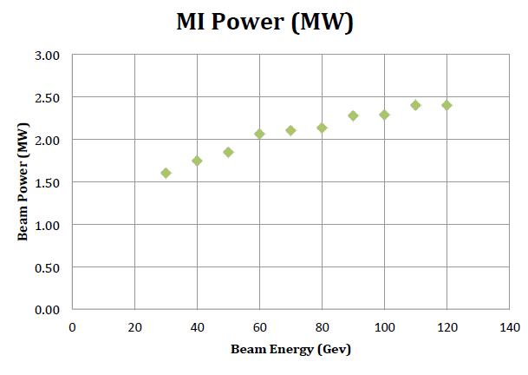
Possible Parameters for post-PIP-II Complex

Slide 39
Proton Driver for Muon-based Facilties
Previous work based on Project X
  8 GeV H- linac delivering 4 MW
  Accumulation Ring to convert H- to protons and reformat beam into a few (~4)intense bunches
  Compressor Ring bunch to shorten bunches
  Delivery beam lines to deliver multiple bunches to target
Strategy built upon PIP-II is incorporated within MASS
  6.75 GeV H- linac delivering 1 MW
    5 mA × 50% chopping × 4 ms × 15 Hz × 6.75 GeV = 1 MW
    3-6.75 GeV dual use: proton and muon acceleration
  Basic Accumulator/Compressor/multi-bunch targeting scheme retained

Slide 40
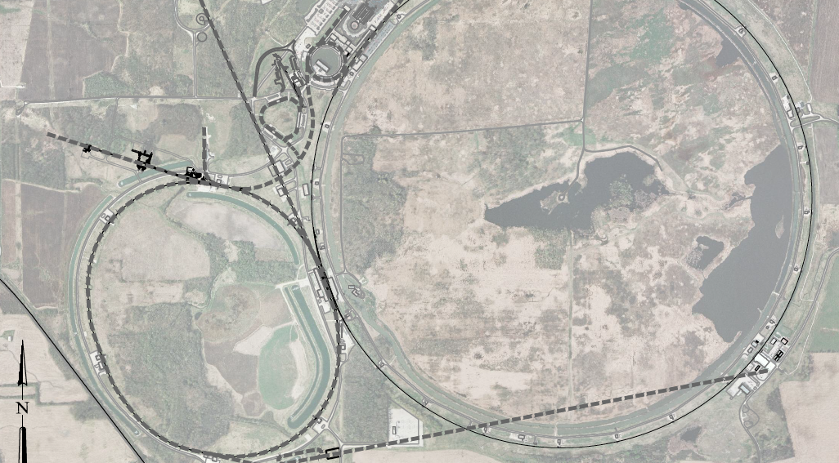
Muon Facility Possible Layout
1 GeV Proton
Linac
Accumulator
&
Compressor
Rings
Front
End
1-3 GeV Proton
Linac
To
SURF
Target
Final
Cool
NuMAX:
νs to SURF
6D
Cool
Initial
Cool
1 GeV Muon
Linac (325MHz)
RLA to 63 GeV
3-6.75 GeV Proton &
1.25-5 GeV Muon
Dual Use Linac
300m Higgs Factory
Muon Collider

