Slide 1
Cryo-Module Test System (CMTS-I)
for
1.3GHz Cryomodule
Under IIFC

Slide 2
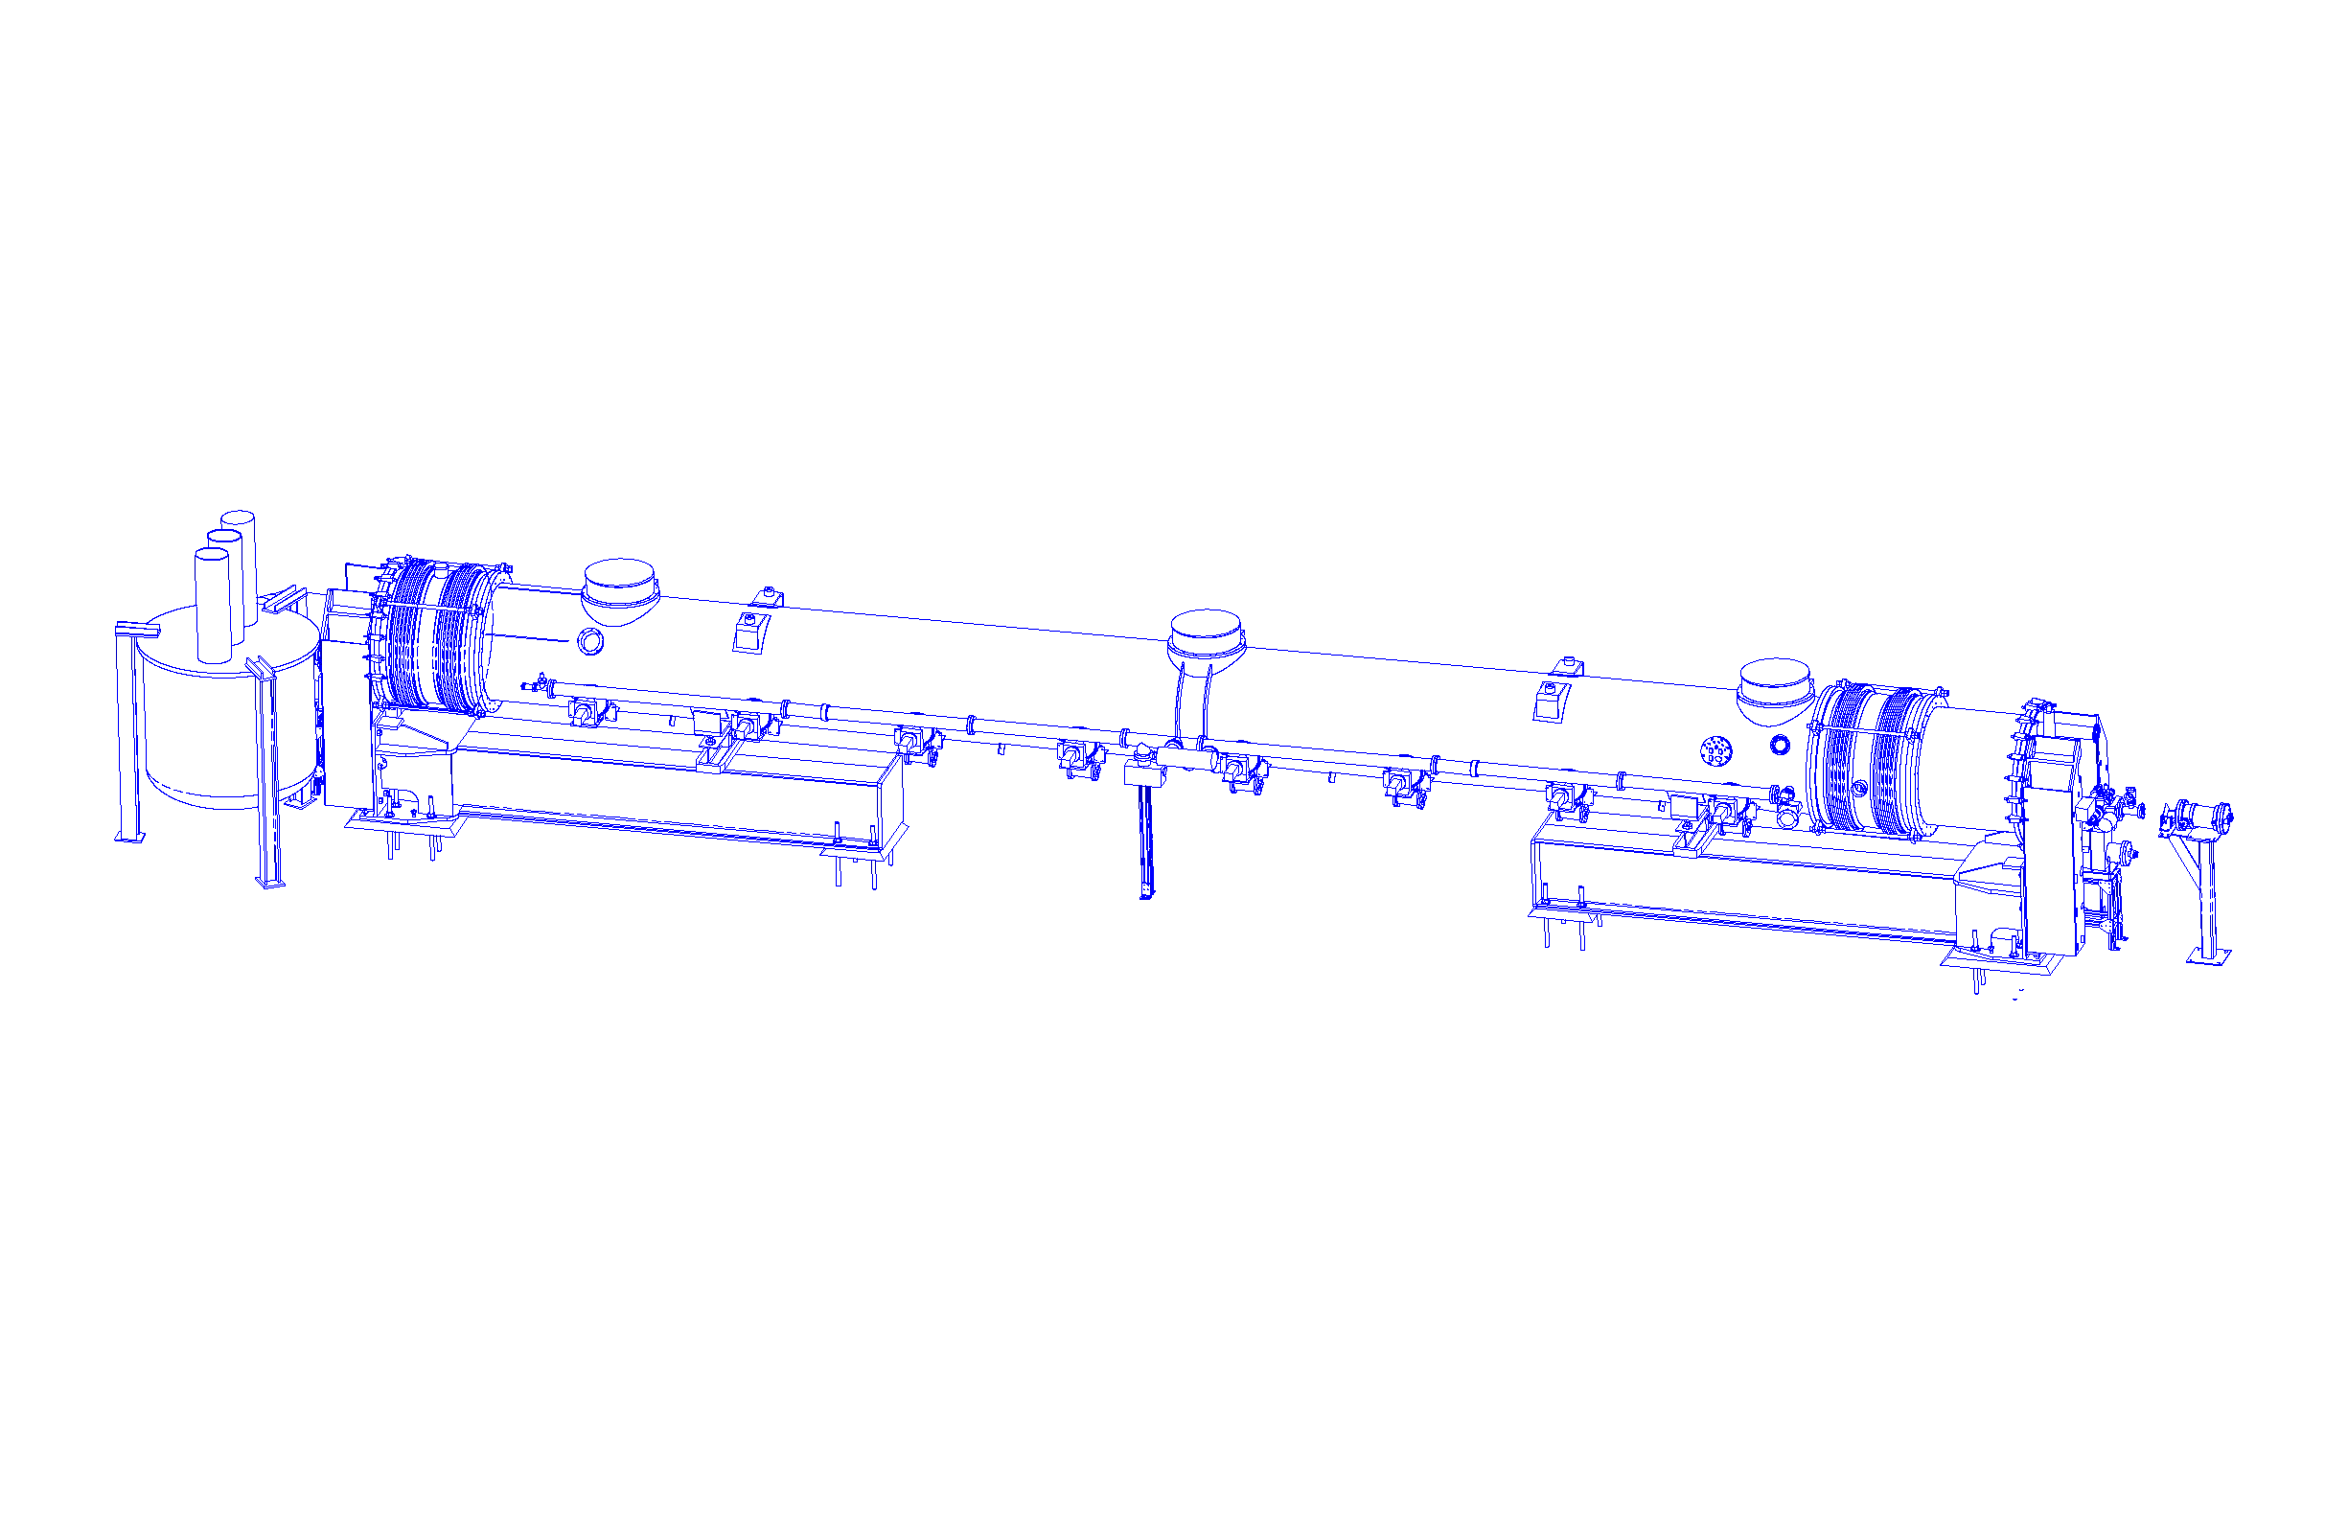
Schematic of CMTS-I for FNAL
Transfer line
Feed Cap
Cryomodule
End Cap
Feed Box
Upstream support
Downstream support
1.3 GHz Cryo-module Test Facility is to be built at FNAL.
Under IIFC BARC will design, manufacture and supply Feed Box,
Feed Cap and End Cap.(Items shown in green & blue)
Feed Cap & End Cap-Delivery by May 15. (Items shown in blue)
Feed Box - Delivery by Oct 15 .(Items shown in green)
Items shown in red are under scope of FNAL.

Slide 3
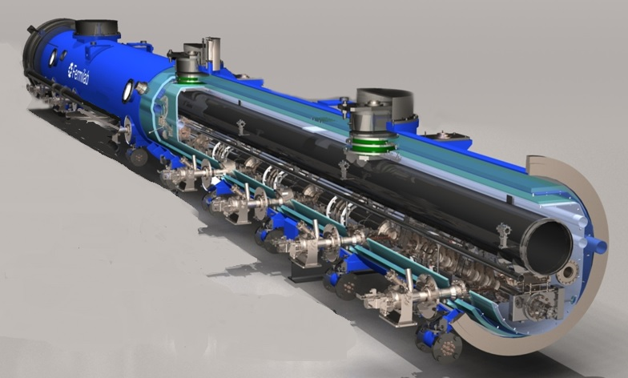
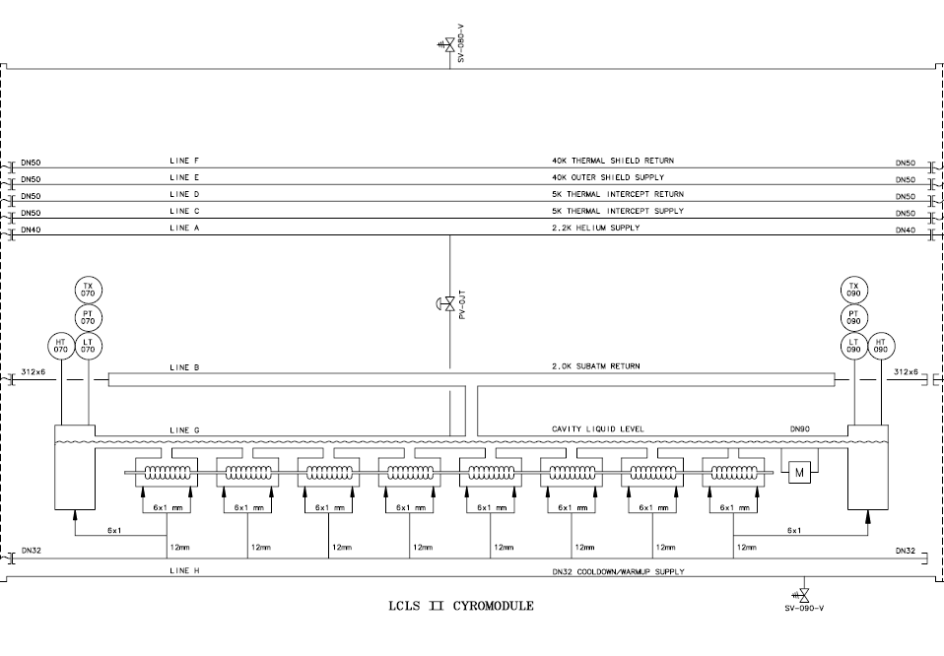
Cryo-Module to be Tested with CMTS-I
T4CM - 1.3GHz Cryomodule for NML, FNAL
LCLSII Cryomodule
for SLAC (Stanford, CA)

Slide 4
Stages of Development of CMTS-I
SN | Description | Status
1 | Complete 3D Modeling of CMTS which consist of Feed Box, Feed Cap and End Cap subassembly
2 | Detailed engineering design of various system, subsystem and components as per established code i.e. ASME BPVC, ANSI B31.3 piping code, EJMA and NAHAD
3 | Detailed Engineering drawings were prepared and jointly approved by FNAL and BARC
4 | Following Procedures are prepared and jointly approved by FNAL and BARC Quality Assurance Plan (QAP) WPS, PQR Chemical Cleaning Procedure Temperature Sensors Mounting Procedure Ecco bond Preparation Procedure HELT(Vacuum & Pressure) Procedure MLI Wrapping Procedure Assembly Procedure Test Setup I&II
5 | Process Flow Sheet for manufacturing is prepared for each components

Slide 5
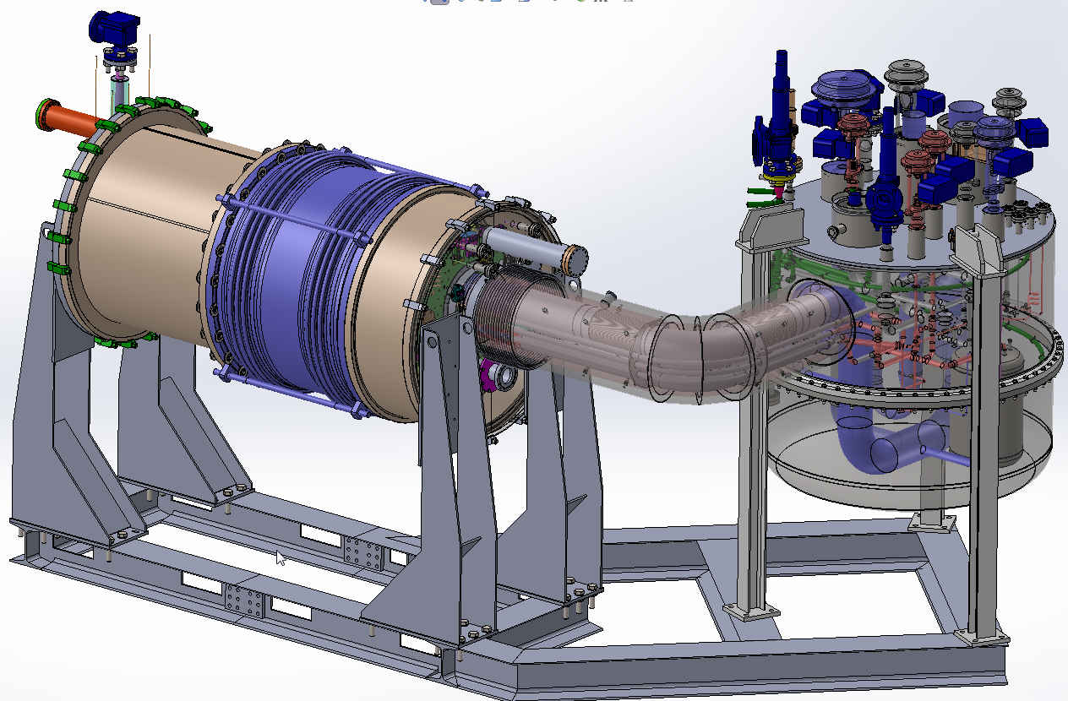
Cryo-Module Test System-I for 1.3GHz Cryo-Module
Feed Box
Dec 2015
End Cap
June 2015
Feed Cap
June 2015
Transfer line

Slide 6
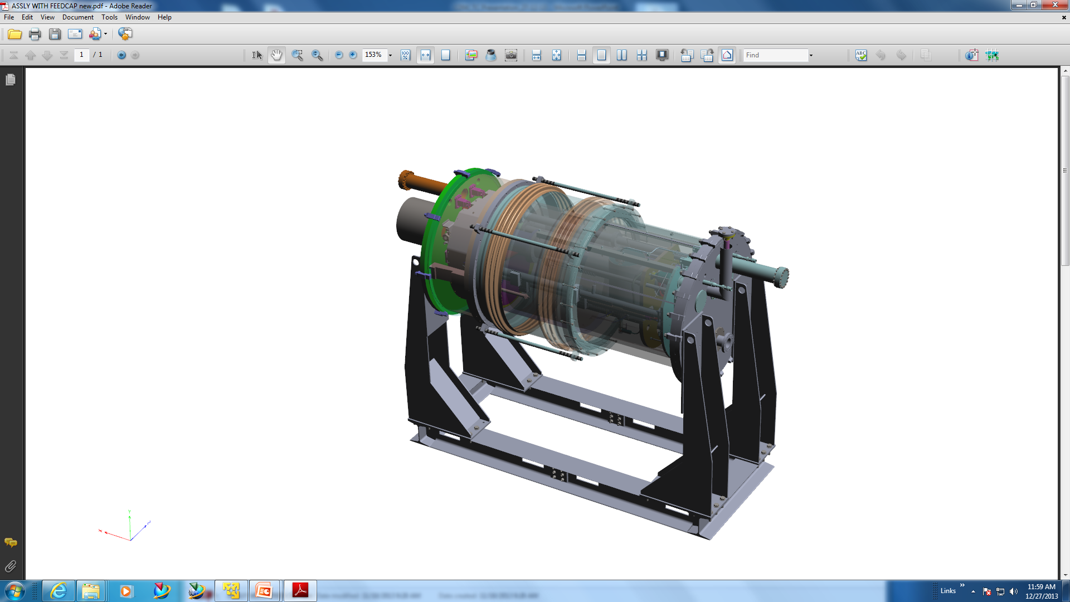
Feed Cap- End Cap Subassembly
Feed Cap & End Cap assembly - Delivery by June15.

Slide 7
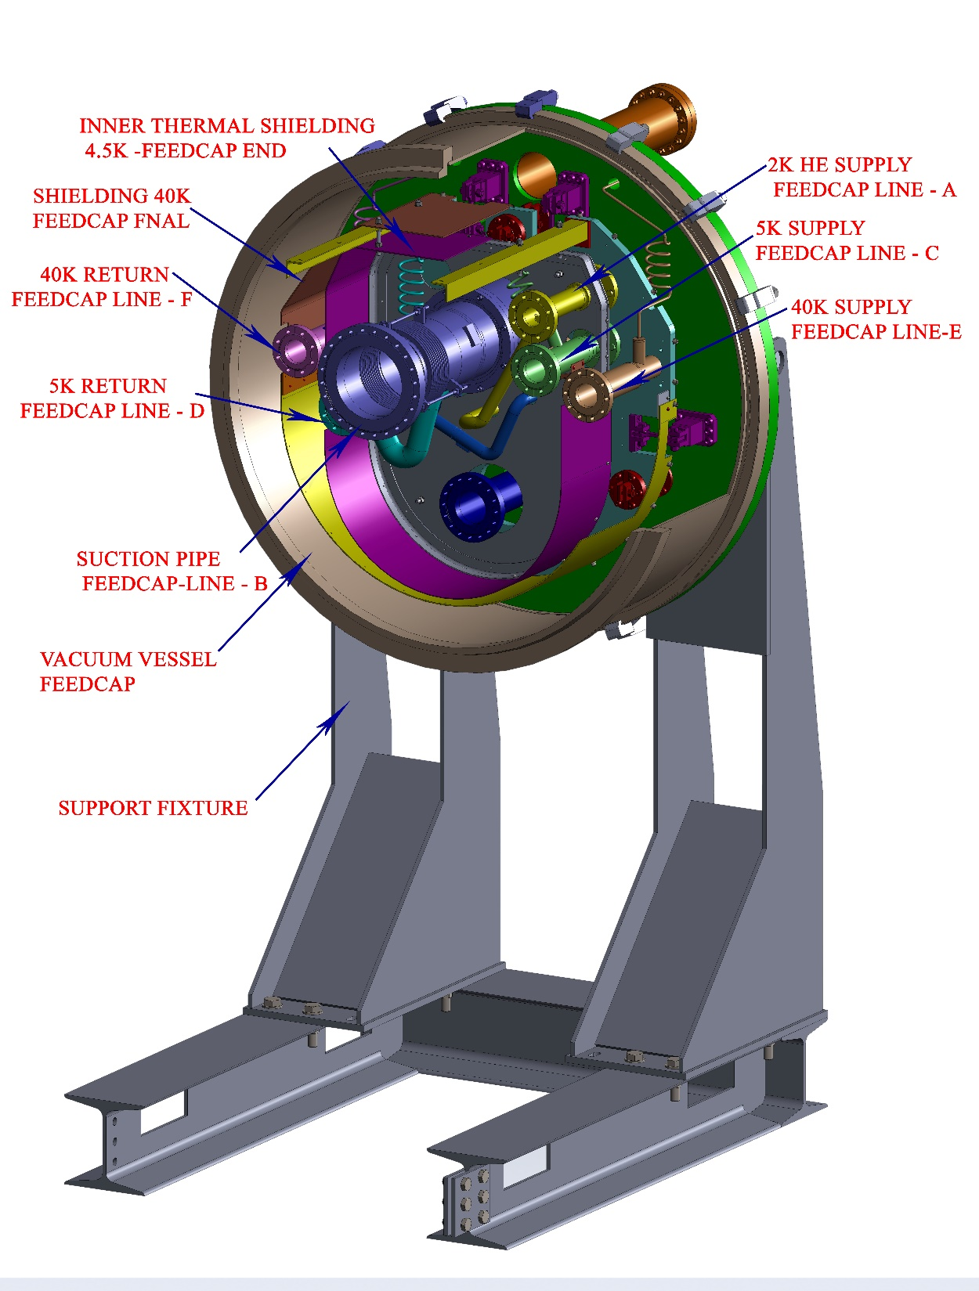
Feed Cap Subassembly

Slide 8
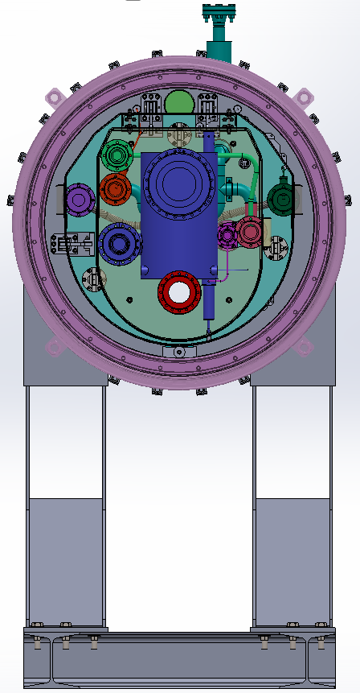
End Cap Subassembly

Slide 9
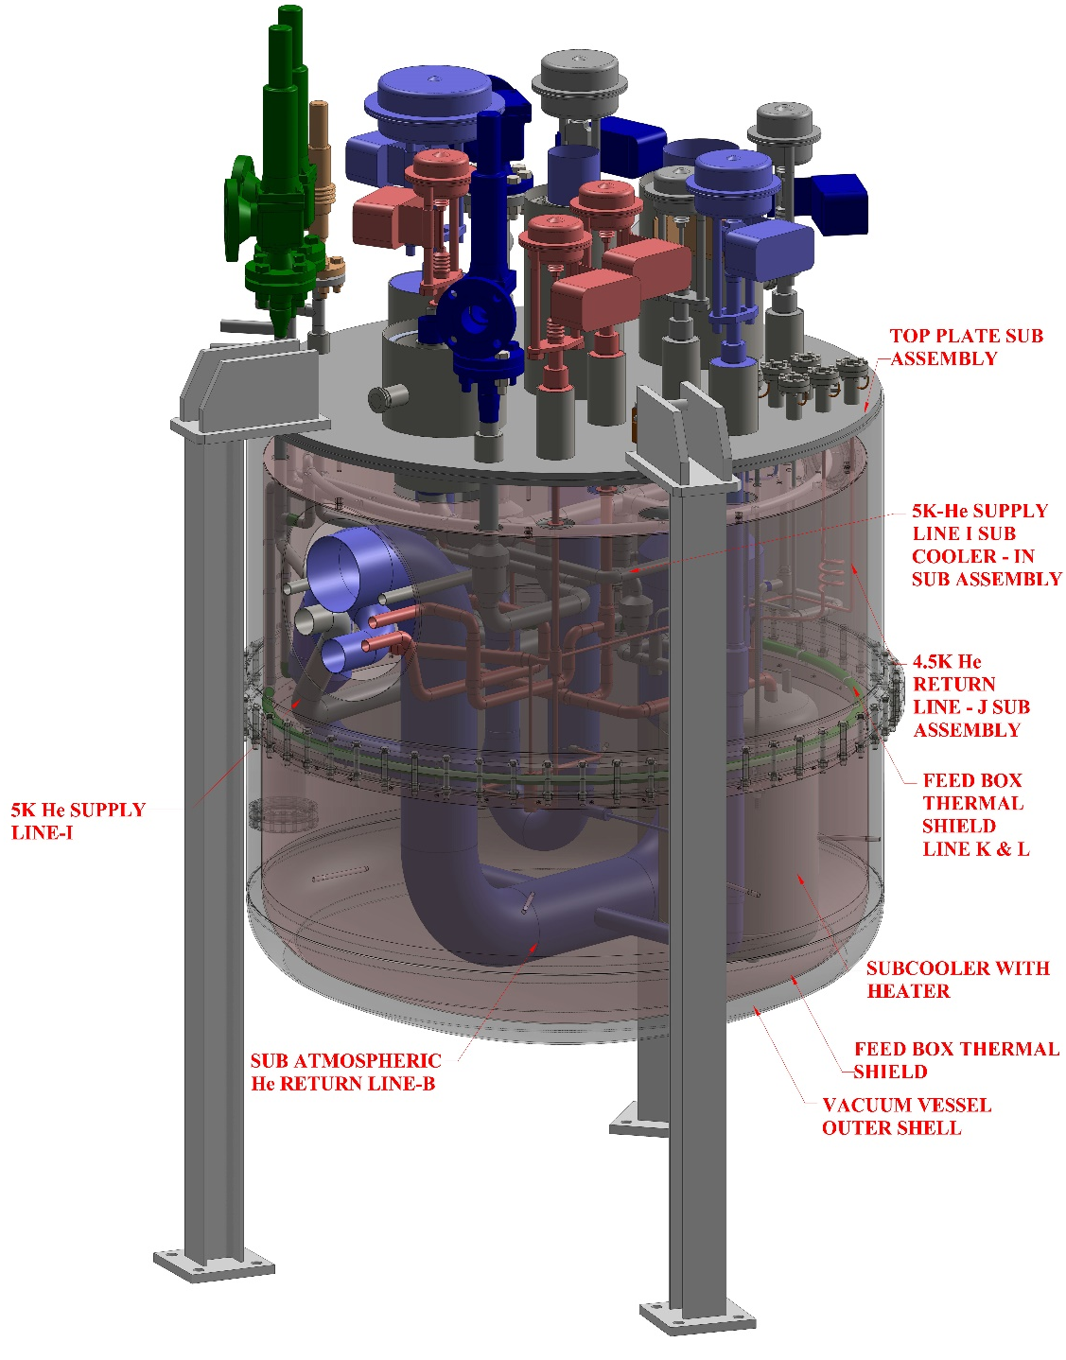
Feed Box Subassembly
Feed Box & Transfer Lines assembly- Delivery by Oct 15.

Slide 10
CMTS-I Status Feed Cap & End Cap
S.N. | Description | Status
1 | 3D Modeling, Design, Detailed Engineering & Manufacturing Drawings | Completed
2 | Status of Procurements for CMTS-I
3 | Status of Manufacturing Activities Feed Cap: All Component manufacture completed =141 All subassys. Welding completed = 30 End Cap: All Component manufacture completed =130 All subassys. Welding completed = 27 | Completed Completed
 | Final Assembly of Feed cap & Feed cap Assembly: Main Assembly – Under progress (30% completed) Expected date of completion of final Assembly – 31/03/2015 Expected date of completion of testing of final Assembly - 30/04/2015 Expected date of completion of Packing & dispatch – 30/06/15

Slide 11
Procurement through Indent (Feed Cap & End Cap)
SN | Item description | Status | Remarks
1 | Cryogenic inline check valves | PO Placed. | L/C is to be opened. One no. received from FNAL.
2 | Safety relief valves | PO to be Placed. | Expected delivery by June-15.
3 | Cerama seal Feed Thrus | Items received.
4 | ETP Copper Plates and Tubes | PO Placed. | Work Completed with available stock.
5 | Structural Raw Materials : SS-H Beam, IS angles, MS H-Beam | PO Placed. | Work Completed with available stock.
6 | Standard Fastners | Items received.
7 | SS304L Plates/Sheets Conforming to ASTM A240 | Items received.

Slide 12
Minor Fabrications (Feed Cap & End Cap)
S.N. | Item description | Status | Expected date of receipt
1 | 304L Drawn Tubes | Item received.
2 | Flexible Bellows and Interconnects | WO placed. | Mar-15
3 | Pipe Fittings | Item received.

Slide 13
Cash Purchase (Feed Cap & End Cap)
S.N. | Item description | Status
1 | Fischer Multipin Connectors | Item received.
2 | O-rings (Large size of Viton) | Item received.
3 | Clamps + Self Tapping Screws | Item received.
4 | Components of G10 Materials | Items received.

Slide 14
To be supplied by FNAL, USA (Feed Cap & End Cap)
S.N. | Item description | Needed By | Received on
1 | Ecco Bond Adhesive & Catalyst | Nov 14 | 20th Jan 15
4 | Temperature Sensors | Nov 14 | 20th Jan 15
3 | Finned Tubes (for Feed Box) | Jul 15 | Not Received
4 | Shock Monitors (for shipping) | Mar 15 | Not Received
5 | Gasket(E-600) | Feb 15 | 20th Jan 15
6 | SS Spherical Plain Bearings | Nov 14 | 20th Jan 15

Slide 15
Manufacturing Status Of Feed Cap & End Cap of CMTS-1
S.N. | Item description | Total No. | Completed No
1 | S.S Components | 65 + 56 | 65+ 56 (completed)
4 | S.S Tube Components | 32 + 26 | 32+ 26 (completed)
3 | Cu. components | 14 + 21 | 14+ 21 (completed)
4 | Welded Sub assembly | 12 + 17 | 12+ 17 (completed)
5 | Welded & Finish machined Sub Assembly | 18 + 10 | 18+ 10 (completed)
6 | Final Assembly | 1 | Under Progress ( 30% completed)

Slide 16
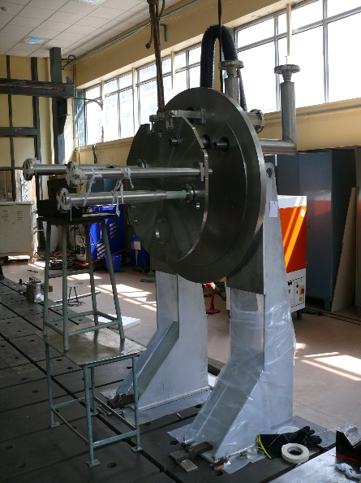
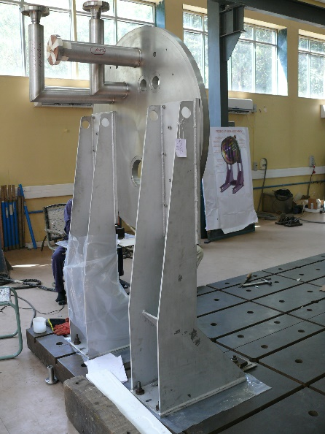
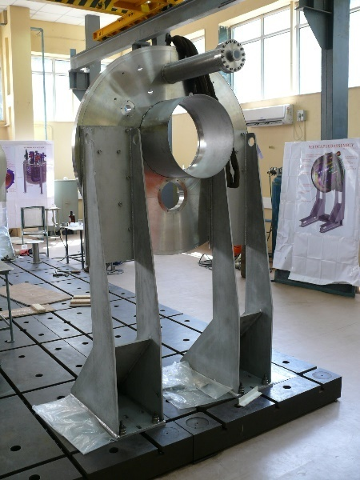
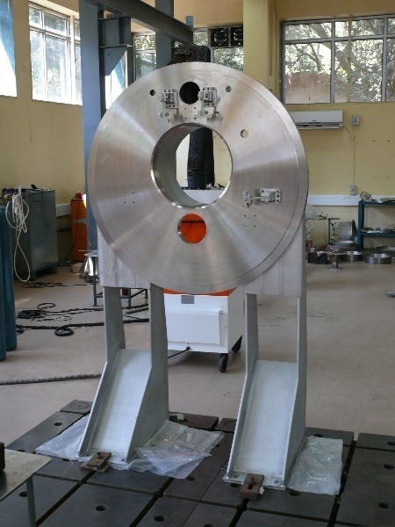
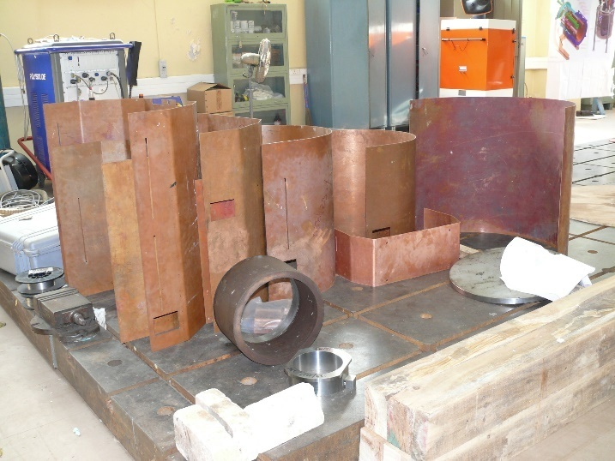
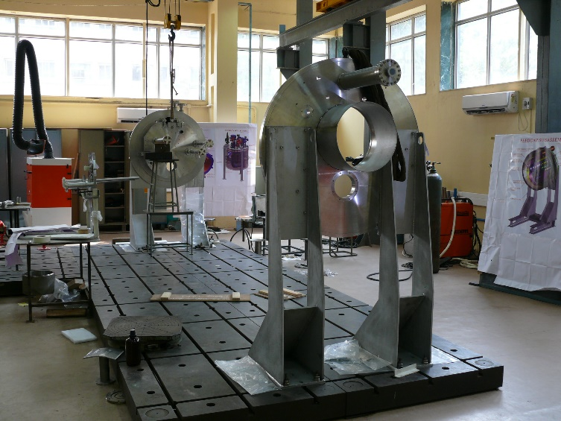
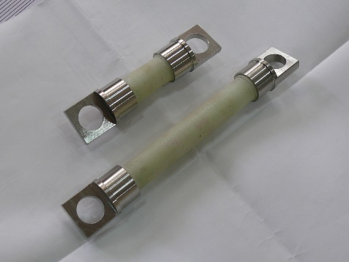
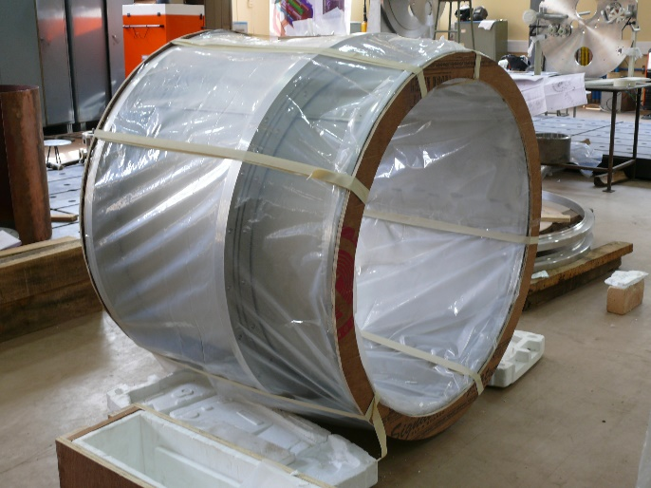
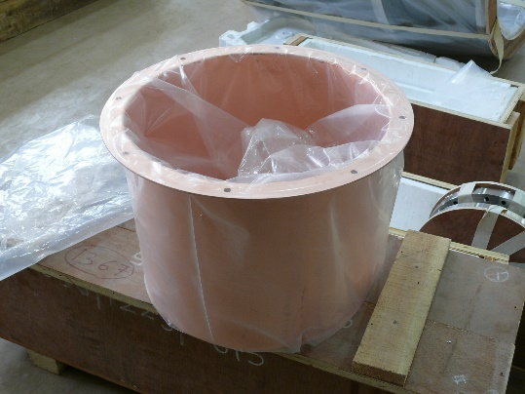
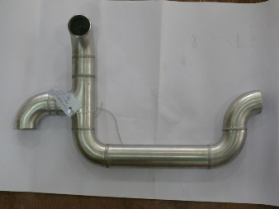
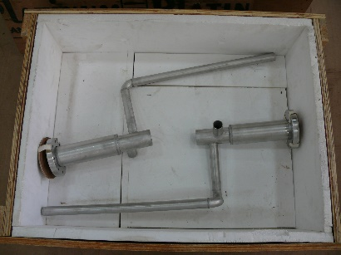

Slide 17
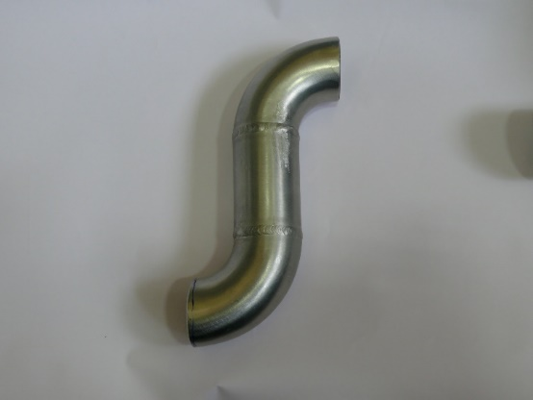
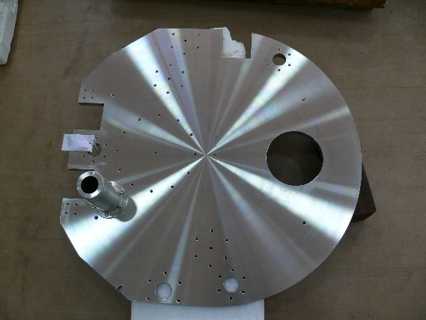
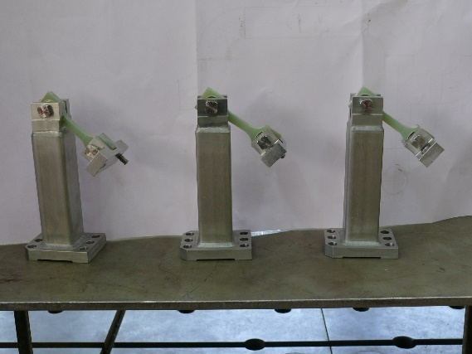
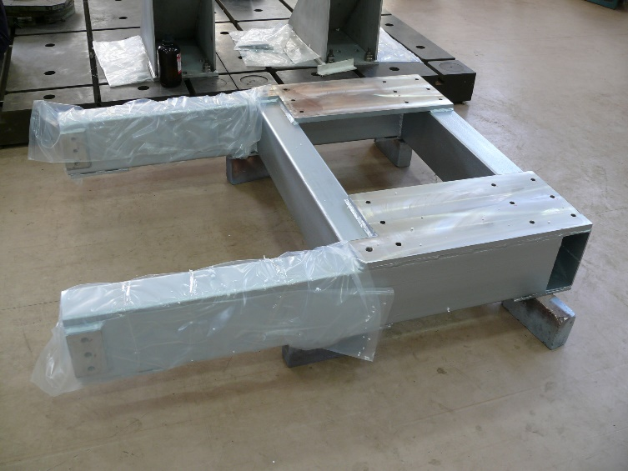
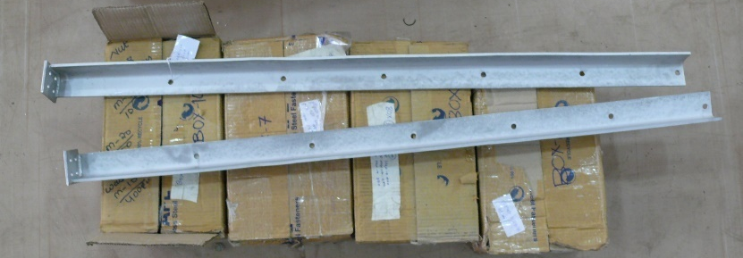
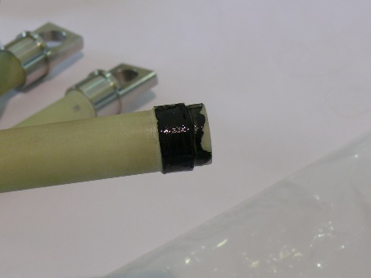
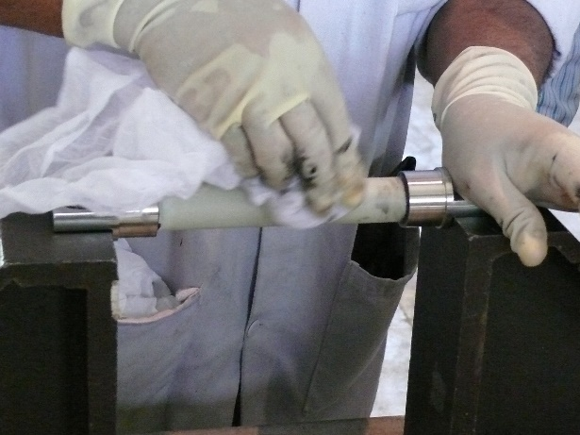
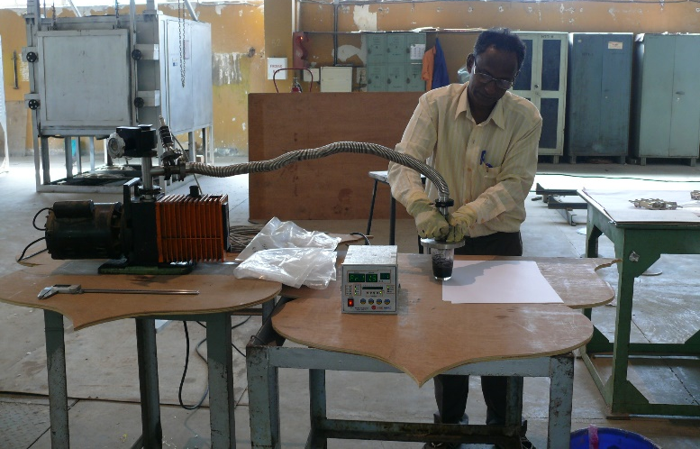
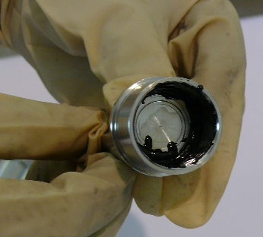

Slide 18
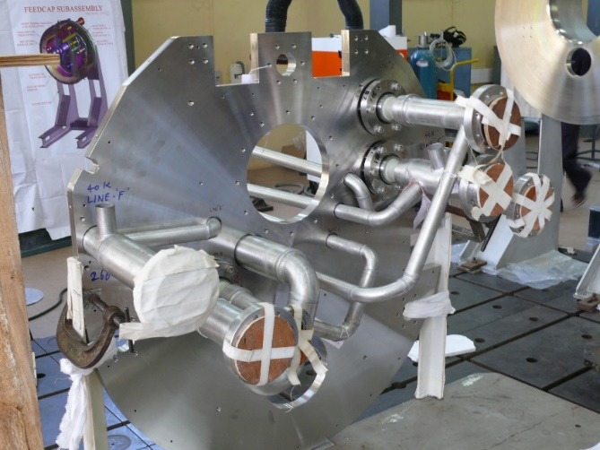
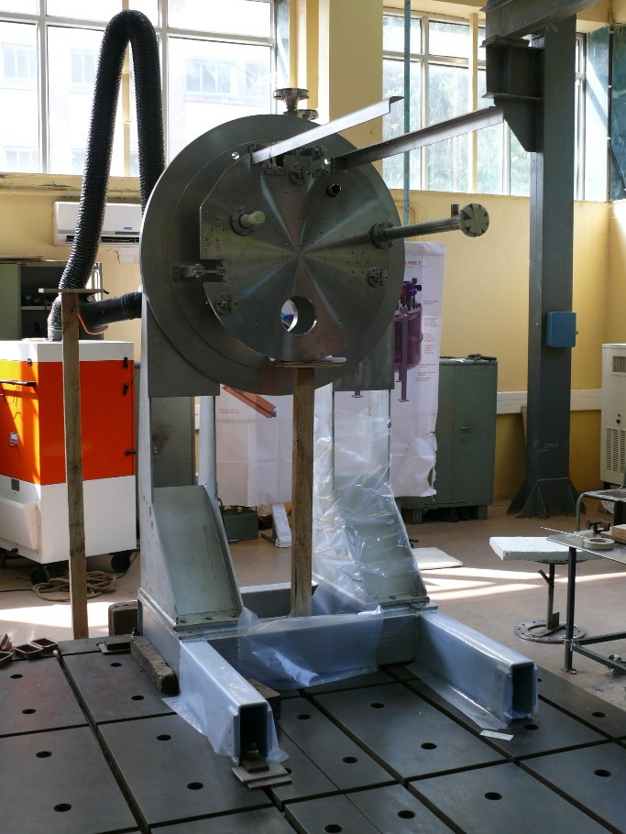
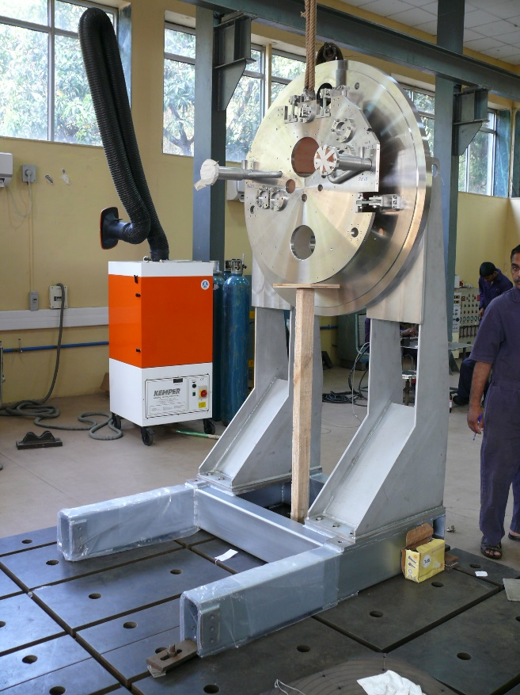
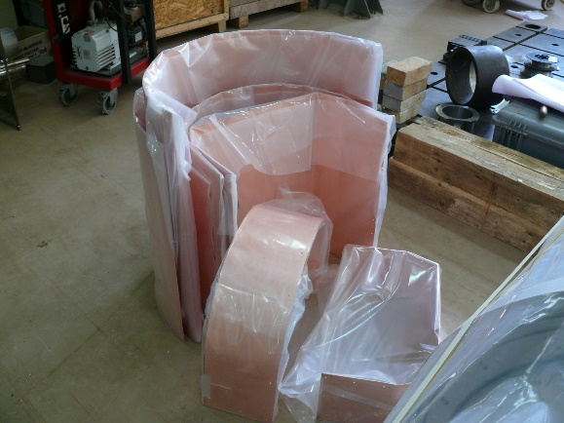
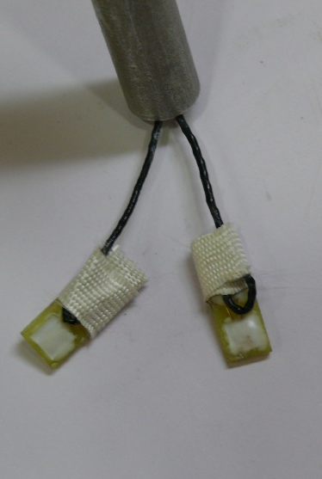
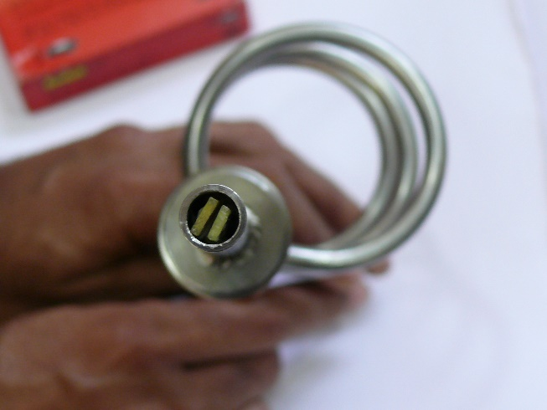
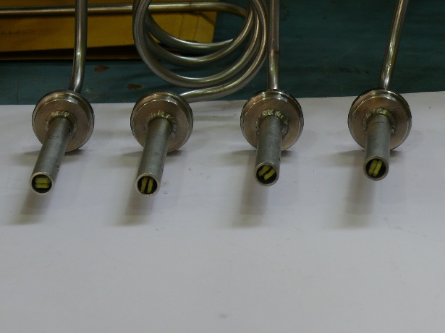
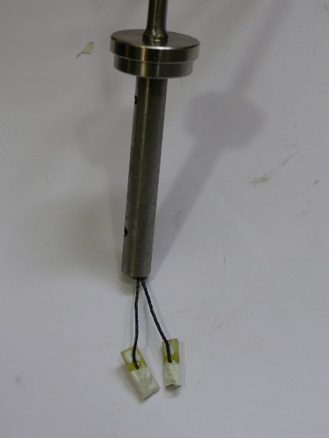

Slide 19
Revised Updated Schedule

Slide 20
Thank you

