Slide 1
PIP-II: Goals, Strategy, and Status
Paul Derwent
26 February, 2015

Slide 2
Outline
Program Goals
Design Strategy and Concept
R&D Program
Project Status and Strategy
Future Options
Collaboration

Slide 3
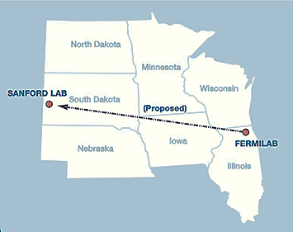
Motivation
Fermilab’s goal is to construct & operate the foremost facility in the world for particle physics research utilizing intense beams.
Neutrinos
  MINOS+, NOvA @700 kW
  LBNF @ >1-2 MW
  SBN @ 10’s kW
Muons
  Muon g-2 @ 17-25 kW
  Mu2e @ 8-100 kW
Longer term opportunities
This requires more protons!
Ongoing Proton Improvement Plan will support initial goals by establishing a base capability of operating the Booster at a 15 Hz beam rate

Slide 4
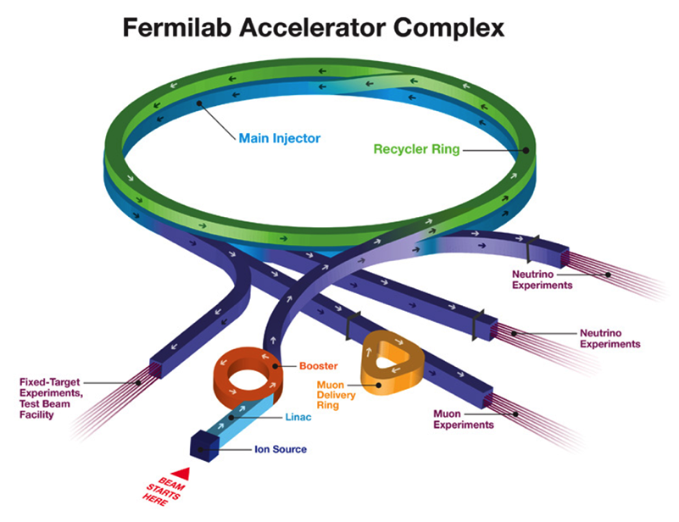
The Fermilab Accelerator Complex ~2016
The Fermilab complex will deliver protons at both 8 and 120 GeV, in support of the neutrino and muon programs:
  Booster: 4.2×10¹² protons @ 8 GeV @ 15 Hz = 80 kW
  MI: 4.9×10¹³ protons @ 120 GeV @ 0.75 Hz = 700 kW
Limitations
  Booster pulses per second (15 Hz)
    Total power available to 8 GeV
    program limited by the repetition rate
  Booster protons per pulse
    Limited by space-charge forces at
    Booster injection, i.e. the linac energy
  Reliability
    Linac/Booster represent a non-negligible operational risk

Slide 5
PIP-II
PIP-II builds upon Proton Improvement Plan (PIP) to support long-term physics research goals by providing increased beam power to LBNF, while providing a platform for the future
Design Criteria
  Deliver >1 MW of proton beam power from the Main Injector over the energy range 60 – 120 GeV, at the start of LBNF operations
  Support the current 8 GeV program including Mu2e, g-2, and short-baseline neutrinos
  Provide an upgrade path for Mu2e
  Provide a platform for extension of beam power to LBNF to >2 MW
  Provide a platform for extension of capability to high duty factor/higher beam power operations
  At an affordable cost to the US Department of Energy
Goal is to initiate operations in newly-configured complex in ~2024

Slide 6
PIP-II Strategy
Increase Booster/Recycler/Main Injector per pulse intensity by ~50%
  Requires increasing the Booster injection energy to ~800 MeV
    30% reduction in space-charge tune shift w/ 50% increase in beam intensity
Increase Booster repetition rate to 20 Hz
  Maintain 1 MW down to 60 GeV or,
  Provide factor of 2.5 increase in power to 8 GeV program
  Improve slip-stacking efficiency via larger orbit separation
Modest modifications to Booster/Recycler/Main Injector
  Accommodate higher intensities and higher Booster injection energy
Cost effective solution: 800 MeV superconducting pulsed linac, extendible to support >2 MW operations to LBNF and upgradable to continuous wave (CW) operations
  Builds on significant existing infrastructure
  Capitalizes on major investment in superconducting RF technologies
  Eliminates significant operational risks inherent in existing 400 MeV linac
    Existing linac removed from service upon completion of PIP-II
  Siting consistent with eventual replacement of the Booster as the source of protons for injection into Main Injector

Slide 7
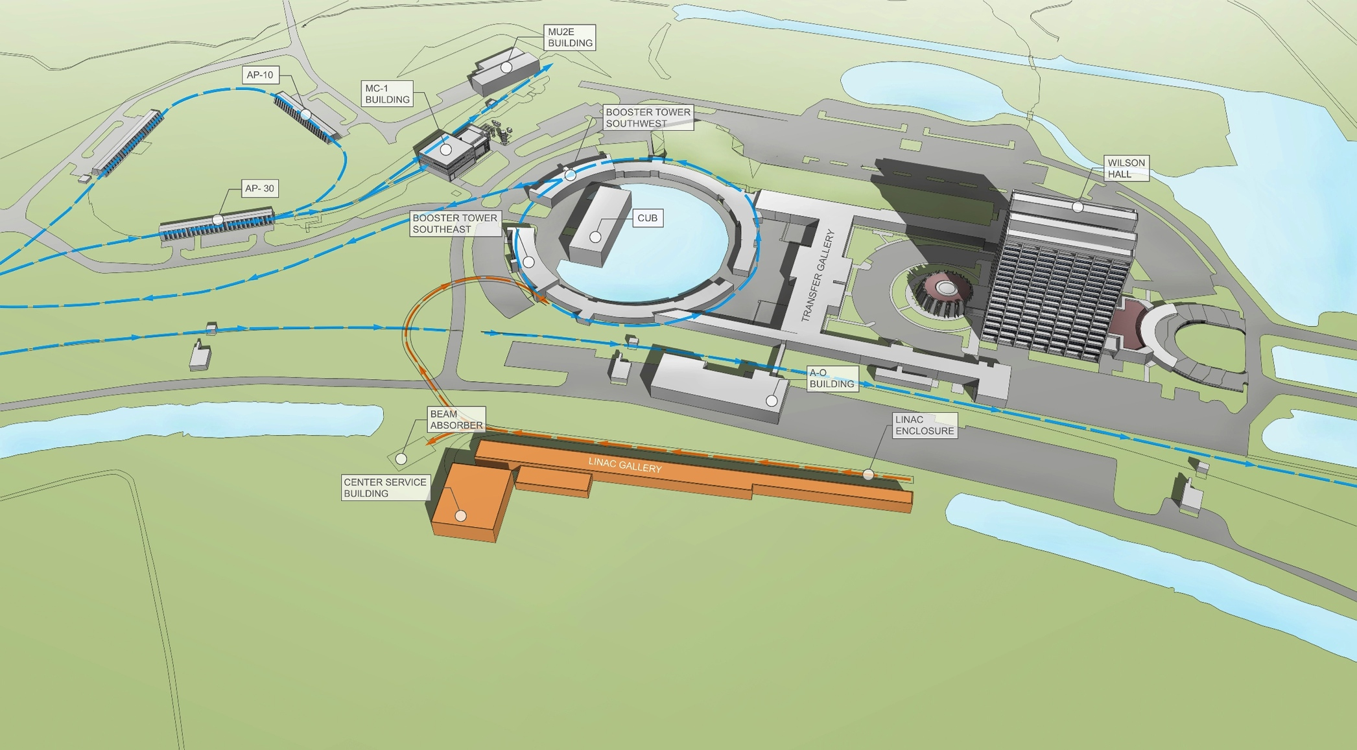
PIP-II Site Layout (provisional)

Slide 8
PIP/PIP-II Performance Goals
Performance Parameter | PIP | PIP-II
Linac Beam Energy | 400 | 800 | MeV
Linac Beam Current | 25 | 2 | mA
Linac Beam Pulse Length | 0.03 | 0.5 | msec
Linac Pulse Repetition Rate | 15 | 20 | Hz
Linac Beam Power to Booster | 4 | 13 | kW
Linac Beam Power Capability (@>10% Duty Factor) | 4 | ~200 | kW
Mu2e Upgrade Potential (800 MeV) | NA | >100 | kW
Booster Protons per Pulse | 4.2×10¹² | 6.5×10¹²
Booster Pulse Repetition Rate | 15 | 20 | Hz
Booster Beam Power @ 8 GeV | 80 | 160 | kW
Beam Power to 8 GeV Program (max) | 32 | 80 | kW
Main Injector Protons per Pulse | 4.9×10¹³ | 7.6×10¹³
Main Injector Cycle Time @ 60-120 GeV | 1.33* | 0.7-1.2 | sec
LBNF Beam Power @ 60-120 GeV | 0.7* | 1.0-1.2 | MW
LBNF Upgrade Potential @ 60-120 GeV | NA | >2 | MW
*NOvA operates exclusively at 120 GeV

Slide 9
PIP-II Linac Technology Map
IS
LEBT
RFQ
MEBT
β=0.11
β=0.22
β=0.51
β=0.61
β=0.9
RT
SC
162.5 MHz
0.03-11 MeV
325 MHz
11-177 MeV
650 MHz
177-800 MeV
Section | Freq | Energy (MeV) | Cav/mag/CM | Type
RFQ | 162.5 | 0.03-2.1
HWR (β_{opt}=0.11) | 162.5 | 2.1-11 | 8/8/1 | HWR, solenoid
SSR1 (β_{opt}=0.22) | 325 | 11-38 | 16/8/ 2 | SSR, solenoid
SSR2 (β_{opt}=0.51) | 325 | 38-177 | 35/21/7 | SSR, solenoid
LB 650 (β_{G}=0.61) | 650 | 177-480 | 33/22/11 | 5-cell elliptical, doublet*
HB 650 (β_{G}=0.9) | 650 | 480-800 | 24/8/4 | 5-cell elliptical, doublet*
*Warm doublets external to cryomodules All components CW-capable

Slide 10
PIP-II R&D Strategy
Goal is to mitigate risk: Technical/cost/schedule
Technical Risks
  Front End (PXIE)
    Complete systems test: Ion Source through SSR1 (25 MeV)
  Operations of (high Q₀) sc linac in pulsed mode at low current
    Primary issue is resonance control in cavities
    Task force defining options and pursuing development
  Booster/Recycler/Main Injector beam intensity
    50% per pulse increase over current operations
    Longitudinal emittance from Booster for slip-stacking
    Beam loss/activation
Cost Risks
  Superconducting RF
    Cavities, cryomodules, RF sources represent 46% of construction costs
Goal: Be prepared for a construction start in 2019

Slide 11
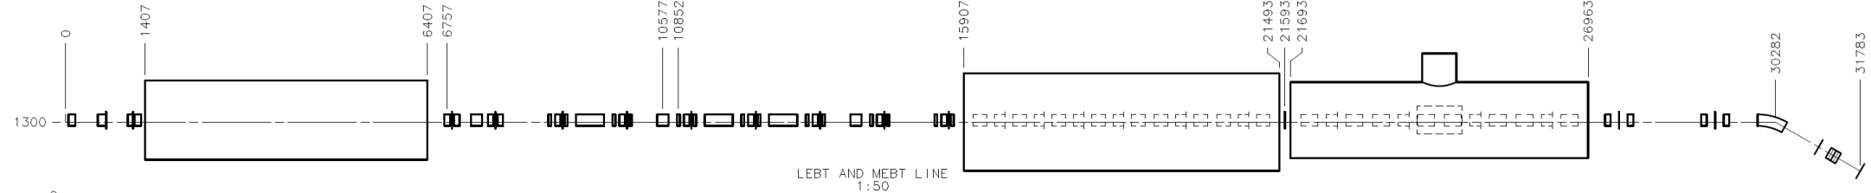
PXIE (PIP-II Injector Experiment)
Now
2015
2016
2017
2018
30 keV
2.1 MeV
10 MeV
25 MeV
RFQ
MEBT
HWR
SSR1
HEBT
LEBT
40 m, ~25 MeV
PXIE will address the address/measure the following:
  LEBT pre-chopping
  Vacuum management in the LEBT/RFQ region
  Validation of chopper performance
  Bunch extinction
  MEBT beam absorber
  MEBT vacuum management
  Operation of HWR in close proximity to 10 kW absorber
  Operation of SSR with beam, including resonance control and LFD compensation in pulsed operations
  Emittance preservation and beam halo formation through the front end
Collaborators
ANL: HWR
LBNL:LEBT, RFQ
SNS: LEBT
BARC, RRCAT, IUAC, VECC: MEBT, SSR1

Slide 12
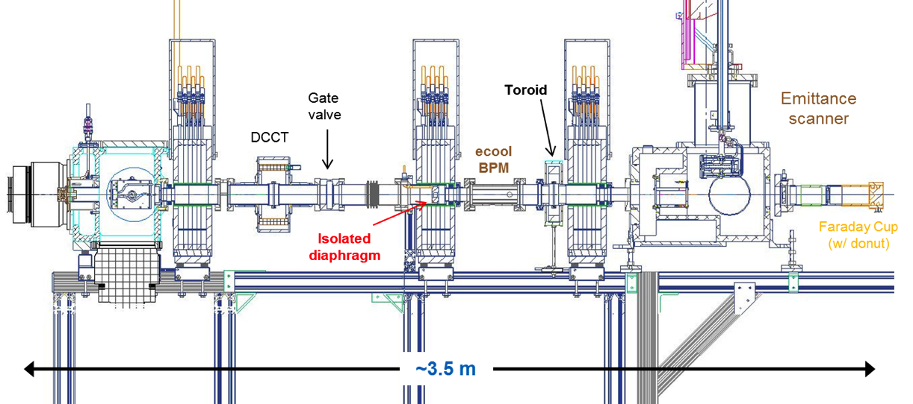
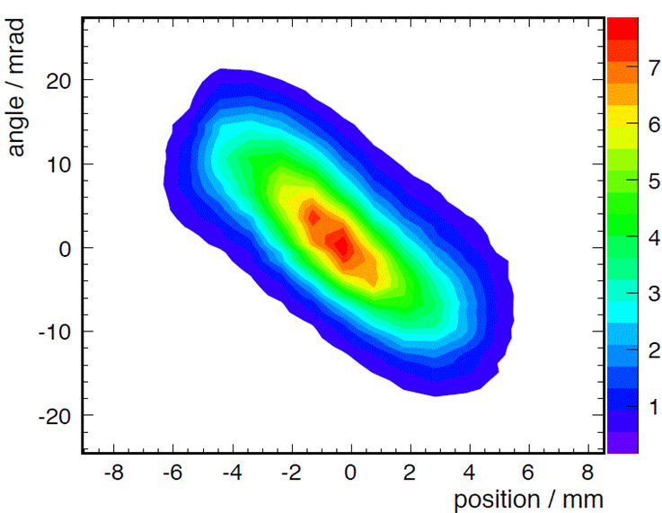
PXIE Current Configuration
IS and LEBT installed and commissioned with beam
  Beam characterized at RFQ entrance (emittance scanner)
  CW/pulsed (400 μsec x 10 Hz) operations @ 5 mA
    Emittance =0.13/0.12 mm-mrad
    Consistent with RFQ requirements

Slide 13
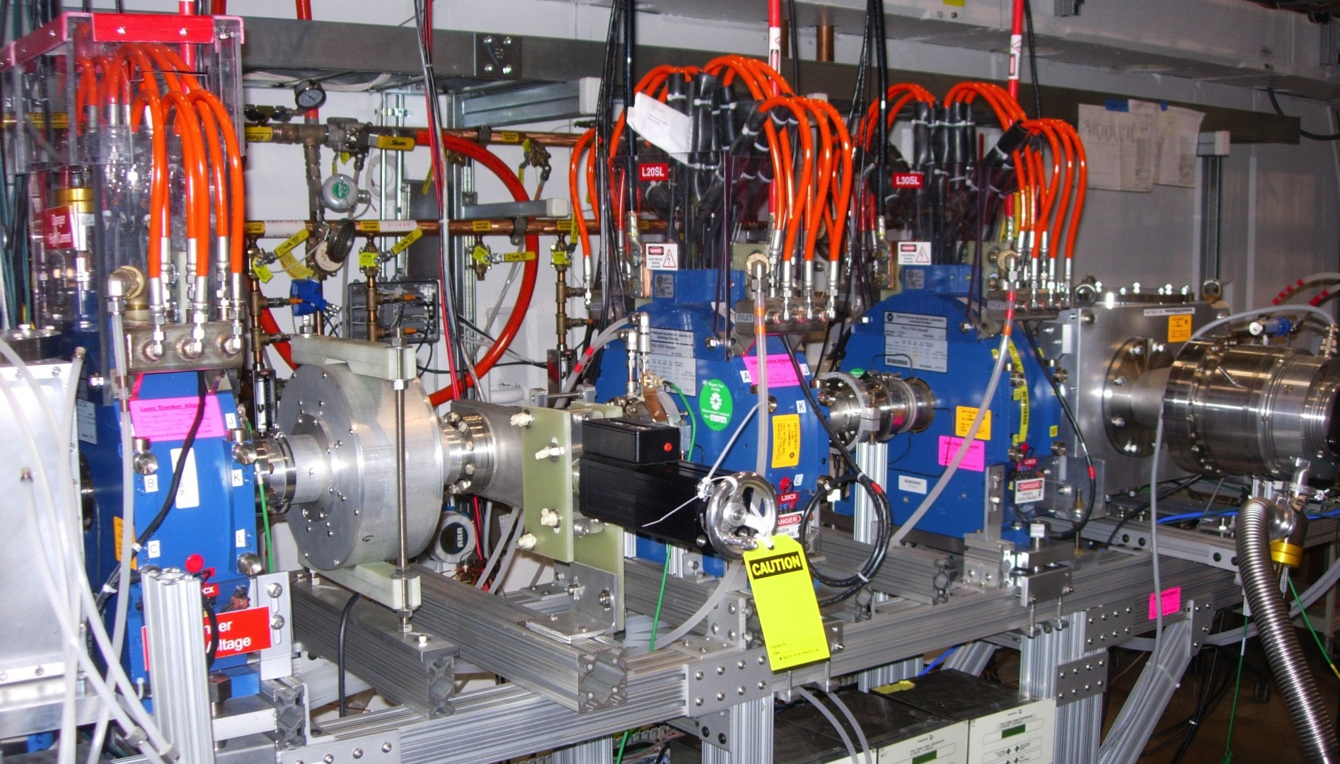
PXIE Current Configuration
Isolated diaphragm #2
Emittance Scanner
Turbo pump
Ion Source
Ceramic break (for toroid)
Gate valve
DCCT

Slide 14
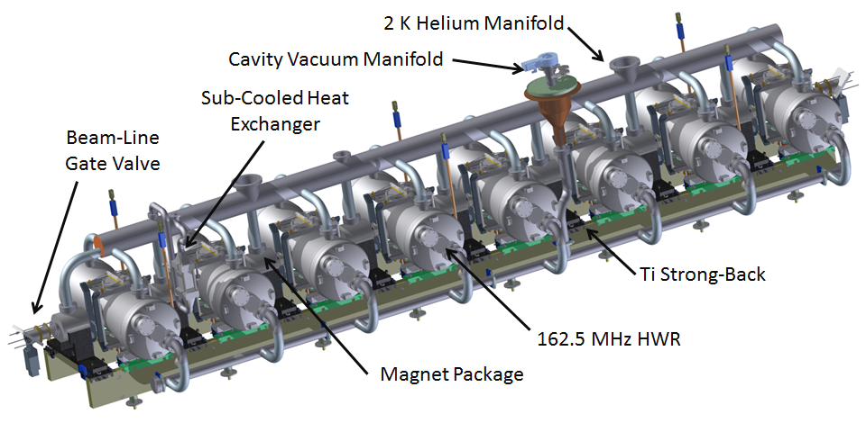
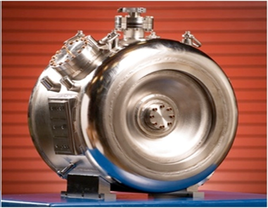
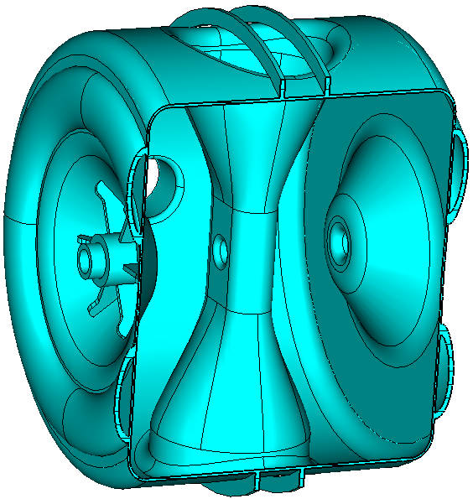
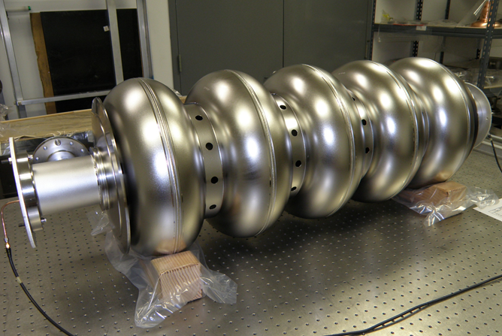
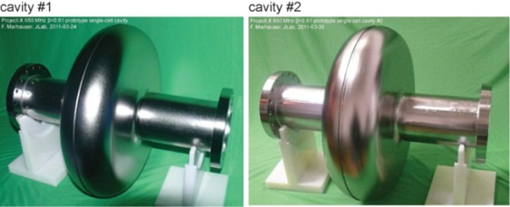
SRF R&D
HWR
SSR1 SSR2
LB650
HB650

Slide 15
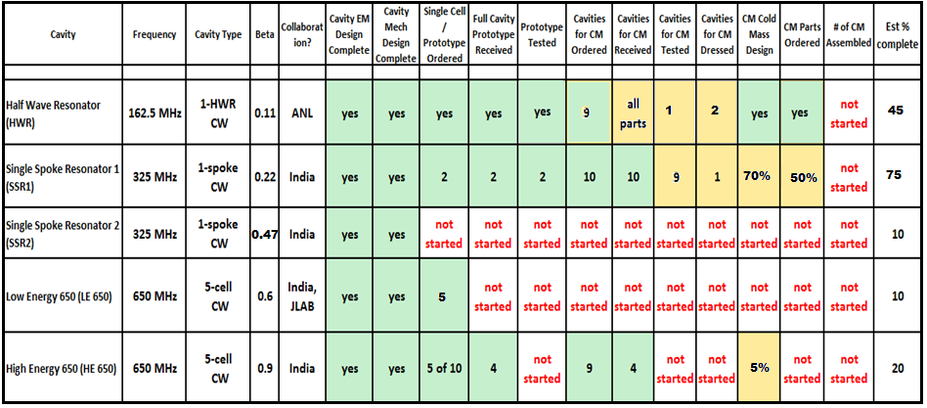
SRF Development Status (10-9-14)

Slide 16
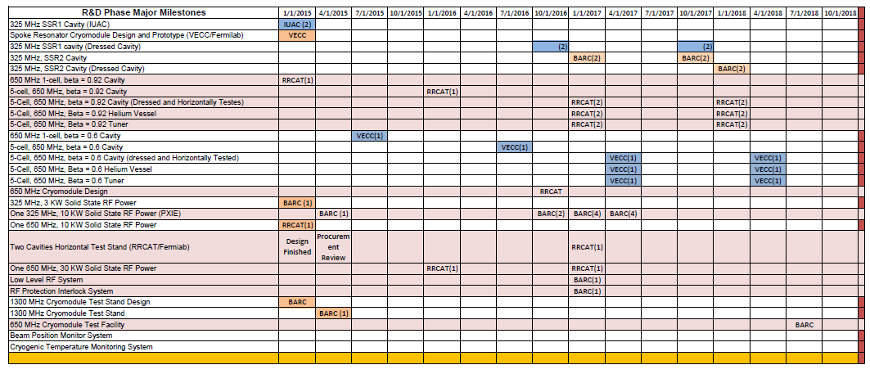
Integrated (Fermilab + IIFC) R&D Schedule
Successful completion will require assignment of adequate resources and close coordination between all IIFC institutions.

Slide 17
R&D Deliverables
Deliverable | Date | New Dates | Comments
Reference Design Report | Q1FY15
HB650 Cavity (8, TESLA shape) Vertical Test (US) | Q4FY15
Integrated Horizontal Test Stand Delivered from India |  | Q1CY17 | Cryostat+RF System
HB650 Dressed Cavity (3) Horizontal Test (US) | Q4FY16 | Q4CY17
HB650 Dressed Cavity (4) Horizontal Test (India) | Q2FY17 | Q4CY17
LB650 Dressed Cavity (3) Horizontal Test (US) | Q3FY17 | Q2CY18
LB650 Dressed Cavity (2) Horizontal Test (India) | Q3FY17 | Q2CY18
HB650 Cryomodule Design (US, India) | Q2FY16 | Q3CY16
HB650 Cryomodule Power Test (US) | Q4FY17 | Q4CY18
650 MHz/30 kW rf Power Test (India) | Q4FY15 | Q1CY16
SSR1 Dressed Cavity (2) Horizontal Test (India) | Q4FY15 |  | Do we want to do this?
SSR1 Cryomodule Power Test (U.S.) | Q3FY17 | Q2CY17
SSR2 Dressed Cavity (2) Horizontal Test (India) | Q2FY17 | Q1CY18
SSR2 Cavity (2) Vertical Test (US) | Q4FY17 | Q1CY18
SSR2 Dressed Cavity (1) Horizontal Test (US) | Q4FY17 | Q4CY18 | Need Time to Dress
325 MHz/10 kW rf Power Test (India) | Q4FY15 | Q4CY16 (10 for PXIE)
650 MHz Cryomodule Test Stand (US & India) | Q3FY16 | Q2CY18 | Cryo-feed + RF System
650 MHz 30kw rf Power Sustem (8 for CMTF) |  | Q4CY17 | RF System (integrated)
HWR Cryomodule Test with Beam | Q2FY18
Front End Systems Test (warm components) | Q3FY16

Slide 18
PIP-II Project Status and Strategy
PIP-II is in the development phase and is not yet recognized as a formal DOE project
  However, PIP-II has received very strong support from P5*, DOE/OHEP^, and the Fermilab director
  Expect formalization of project status (CD-0) in the next ~year, followed by ~8-year development + construction period
Goals for FY2015
  Release PIP-II Reference Design Report
  Update current cost estimate as necessary
  Start developing a resource loaded schedule
  Receive RFQ (from LBNL) and initiate commissioning at PXIE
  Keep HWR and SSR1 fabrication on schedule
  Develop deliverables strategy with India (and Europe)
  Support DOE/OHEP in development of Mission Needs Statement
  Establish PIP-II Office
*Particle Physics Project Prioritization Panel
^Office of High Energy Physics

Slide 19
PIP-II Collaboration
Organized as a “national project with international participation”
  Fermilab as lead laboratory
Collaboration MOUs for the development phase (through CD-2) :
  National IIFC
  ANL ORNL/SNS BARC/Mumbai
  BNL PNNL IUAC/Delhi
  Cornell UTenn RRCAT/Indore
  Fermilab TJNAF VECC/Kolkata
  LBNL SLAC
  MSU ILC/ART
  NCSU
Ongoing contacts with CERN (SPL), Orsay, RAL/FETS (UK), ESS (Sweden)
Annual Collaboration Meeting (June 3-4, 2014 at Fermilab)
https://indico.fnal.gov/conferenceDisplay.py?confId=8365

Slide 20
Indian Institutions – Fermilab Collaboration
IIFC established for joint R&D on high intensity superconducting proton accelerators
  All major systems covered
  Annex I offers the opportunity to extend into the construction phase.
Indian delivery to Fermilab of prototype components:
  MEBT prototype dipole and quadrupole delivered and accepted; production initiated at BARC
  325 MHz/3 kW rf amplifier delivered and tested; identified issues under joint resolution
  These components are required in PXIE.
  1.3 GHz 5-cell cavity successfully processed and tested, with appropriate feedback to Indian collaborators
Guest Engineers: We are currently transitioning 2+ year assignments
  6 engineers to be embedded in critical joint development projects
Indian-Fermilab partnership is key to successful completion of the R&D phase and transition to construction

Slide 21
Summary
Fermilab is committed to establishing LBNF as the leading long-baseline program in the world, with >1 MW at startup
PIP-II is a complete, integrated, cost effective concept, that meets this goal
  Strongly supported by the U.S. HEP community, the U.S. DOE and the Fermilab Director
  Moving toward formal project status later this year
The R&D program targets primary technical and cost risks
  Undertaken by U.S. and Indian partners
Completion of the R&D phase will allow launch of the construction phase with high confidence of success, prior to the end of this decade
We anticipate PIP-II will be operational, providing >1MW to LBNF, in ~2024

Slide 22
Backups

Slide 23
Future Directions
The configuration and siting of the PIP-II linac are chosen to provide opportunities for future performance enhancements to the Fermilab proton complex
  >2 MW to LBNF
  100’s kW for a rare processes program
    CW capability at 0.8 – 3 GeV
    Muons
    Kaons
    Neutrons
  Front end for a muon-based facility

Slide 24
Future Directions
The strategy for next step(s) beyond PIP-II will be developed in consideration of the following:
  Slip-stacking in the Recycler is not possible at intensities beyond PIP-II
  The Booster cannot be upgraded to support intensities beyond ~7×10¹² ppp, no matter what the injection energy
  A new 8-GeV rapid cycling synchrotron (RCS) could meet the needs of the neutrino program
    Beam power @ 8 GeV ~600kW
    Injection energy ~2 GeV
  Construction of an RCS may require long-term utilization of the Recycler for proton accumulation
  An extension of the PIP-II linac to 6-8 GeV may be required to remove the Recycler from service and/or to achieve the 1-4 MW required to support a muon-based facility
The strategy will likely be determined on the basis of programmatic choices once PIP-II construction is underway
In all scenarios it will be necessary to extend the PIP-II linac to at least 2 GeV and to retire the existing Booster
  Unless realization of “smart RCS” with lower (800 MeV) injection energy

Slide 25
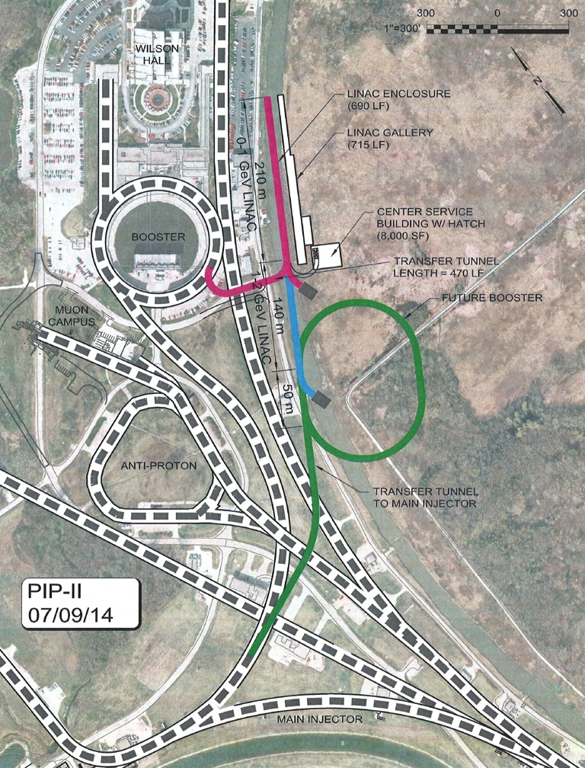
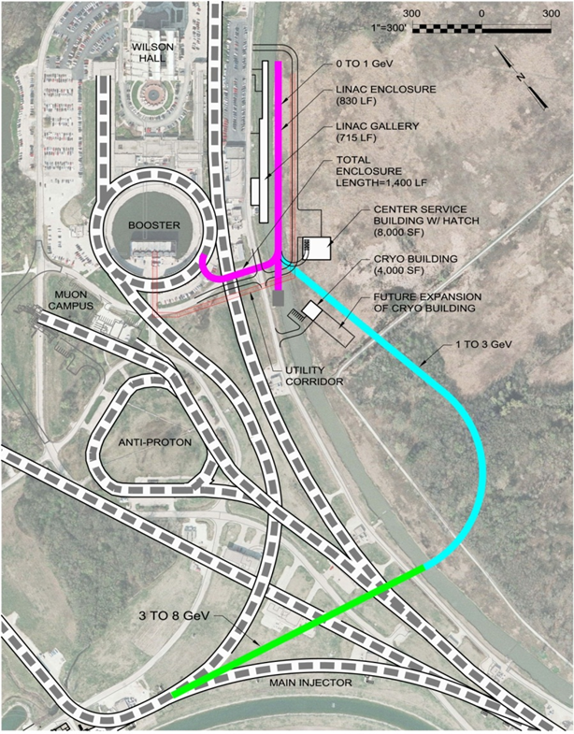
Flexible Platform for the Future
Opportunities for Booster replacement include full energy (8 GeV) linac or RCS
Notes:
ma to mA in 2nd capability bullet

Slide 26
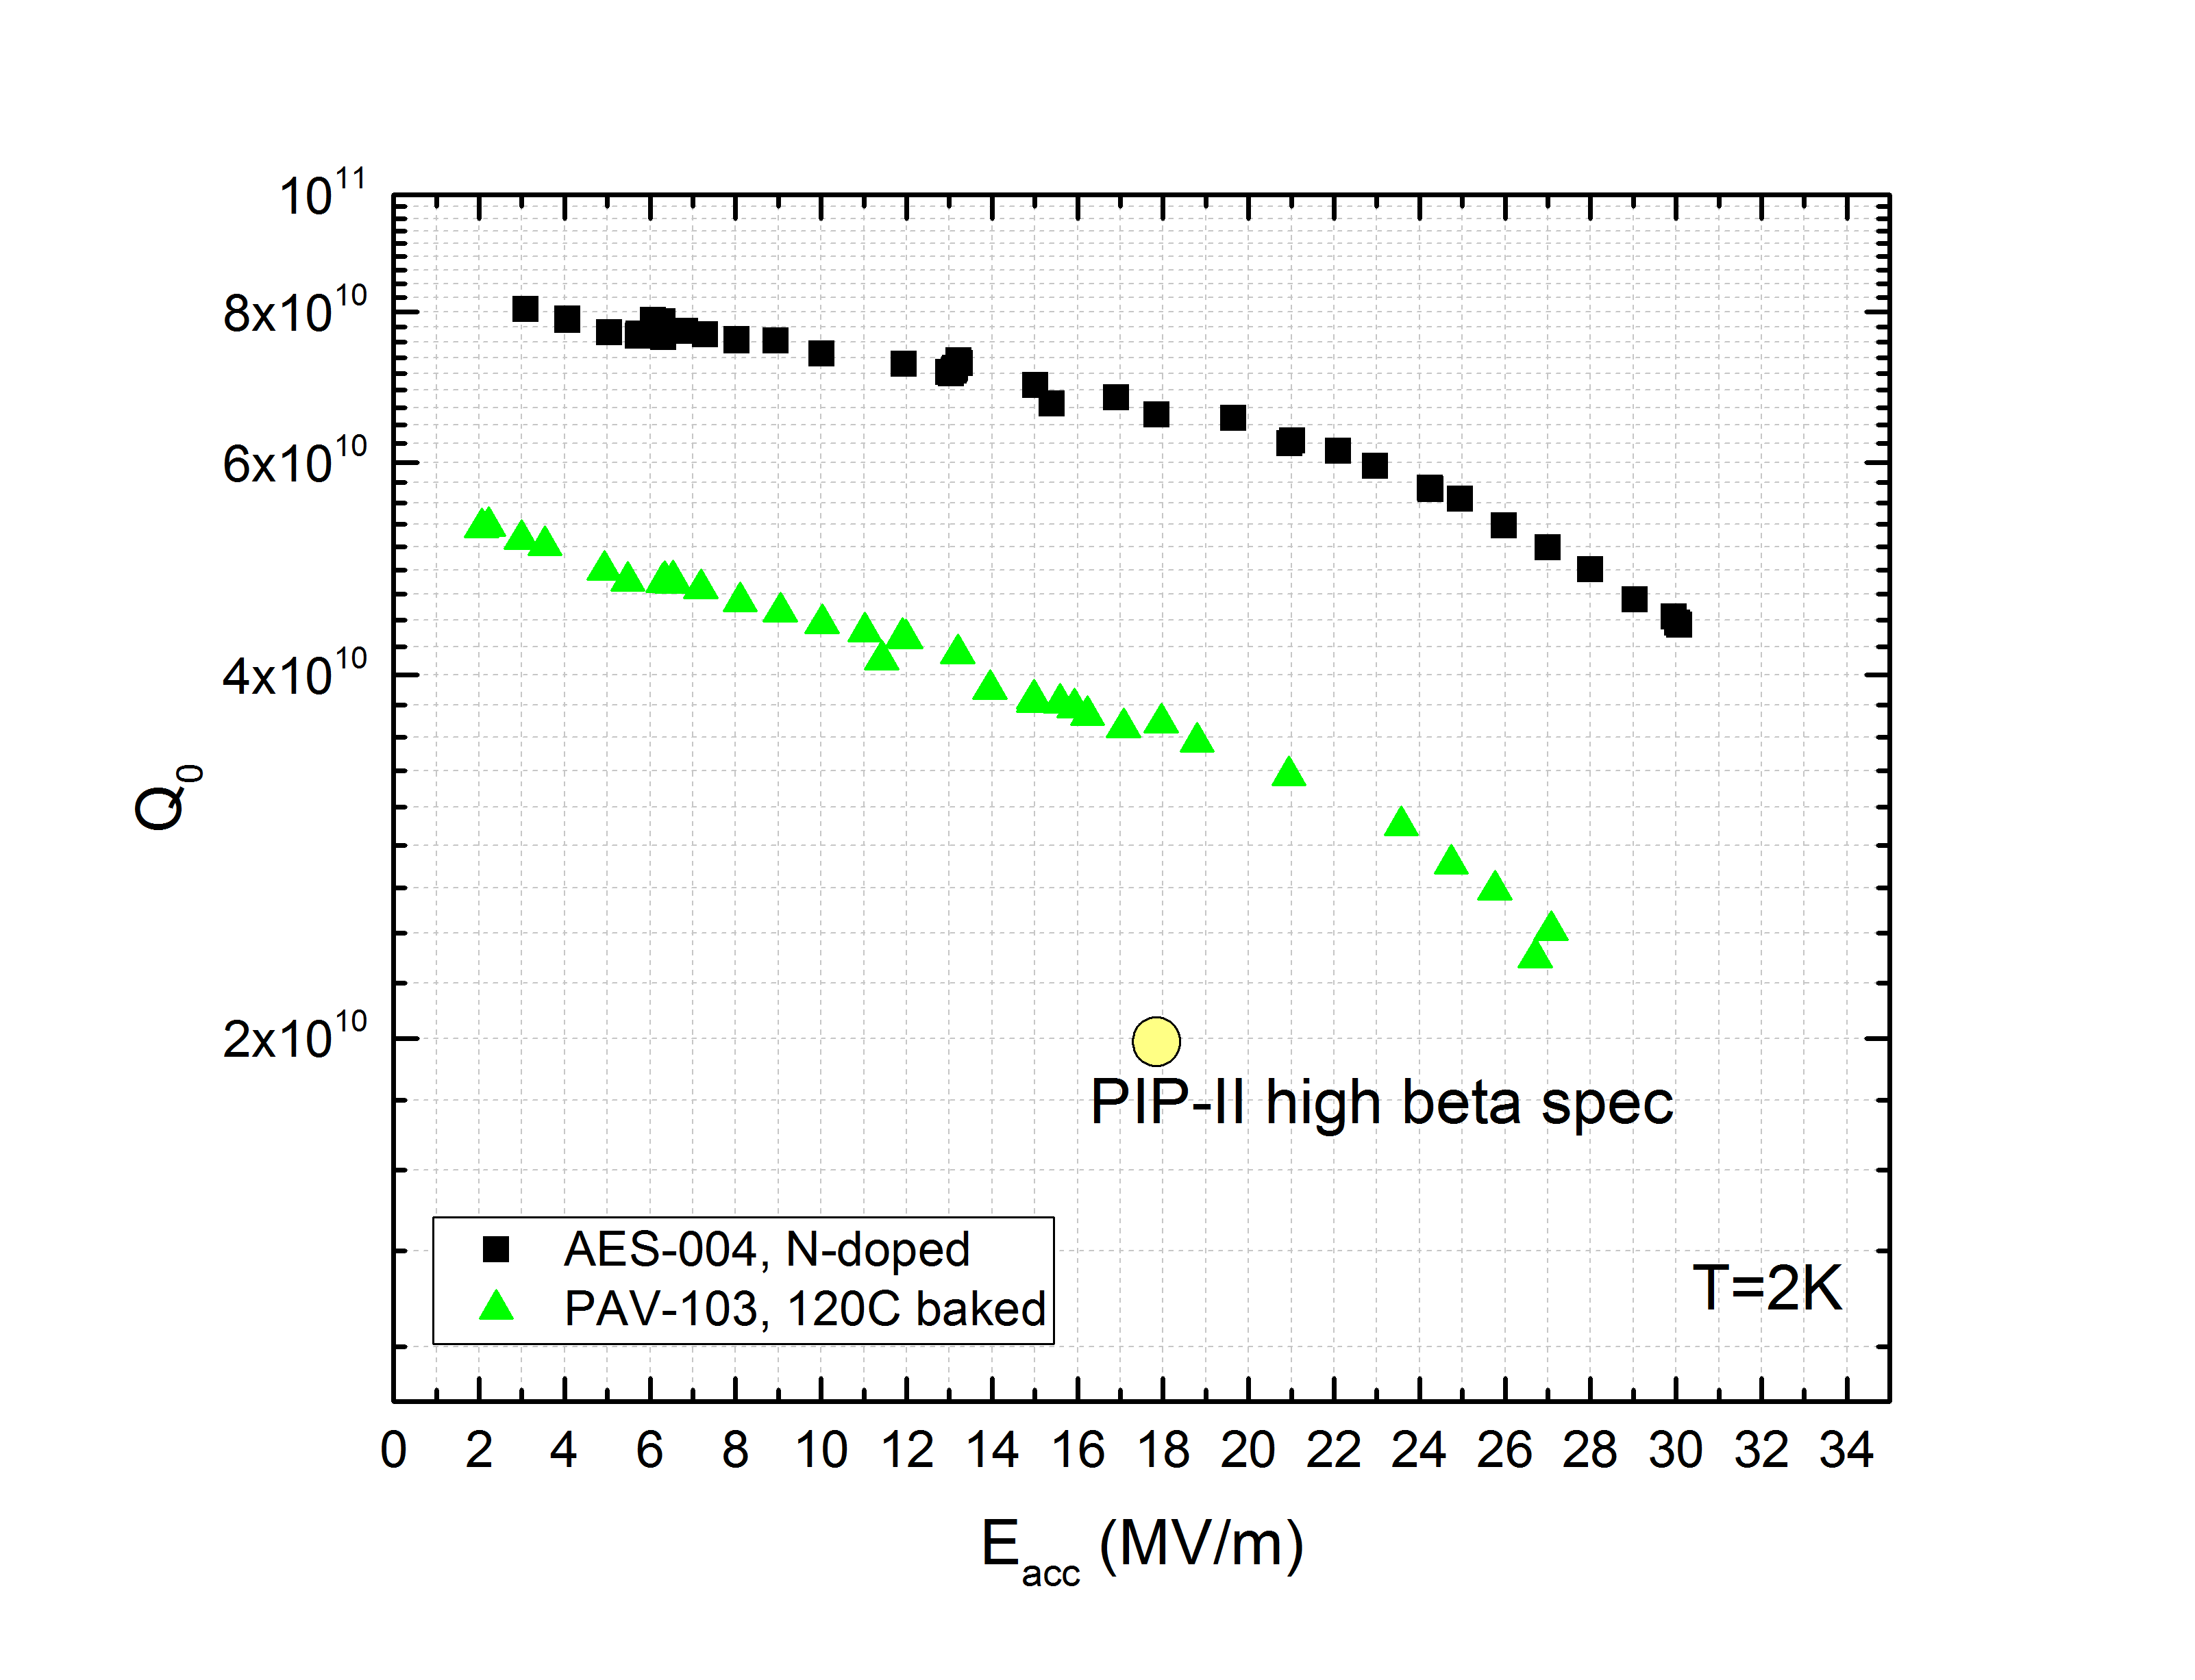
N2 Doping for High Q0
N₂ gas introduced during vacuum bake:
  Q₀=7E10 @ 17 MV/m (!)
Single-cell HB650 cavity @ 2K

Slide 27
Cryogenic System
Required to support 5% cryogenic duty factor
  Configuration capable of 10-15% with more pumping
  160 – 240 kW beam power at 800 MeV

Slide 28
Example: 2+ MW @ 60-120 GeV
2.4 MW requires 1.5×10¹⁴ protons from Main Injector every 1.2 s @ 120 GeV
  Every 0.6 sec @ 60 GeV
Accumulation requires either:
  Box-car stack (in Recycler) six batches of 2.5×10¹³ protons in ≤ 0.6 sec
    >10 Hz rep-rate RCS
  Or inject a long (linac) pulse containing 1.5×10¹⁴ protons directly into Main Injector
  Strategy TBD

Slide 29
2+ MW @ 60-120 GeV
Booster is not capable of accelerating 2.5×10¹³ no matter what the injection energy, or how it is upgraded:
  Requires ~0.1% beam loss
  High impedance
  Transition crossing
  Poor magnetic field quality
  Poor vacuum
  Inadequate shielding

Slide 30
Possible Parameters for post-PIP-II Complex
Proton Source | RCS | Linac
Particle Type | p | H- | GeV
Beam Kinetic Energy | 8.0 | 8.0 | GeV
Protons per Pulse | 2.6×10¹³ | 1.5×10¹⁴
Beam Pulse Length | 0.0016 | 10 | msec
Pulse Repetition Rate | 20 | 20 | Hz
Pulses to Recycler | 6 | NA
Pulses to Main Injector | NA | 1
Beam Power at 8 GeV (Total) | 660 | 3960 | kW
Beam Power to Main Injector* | 160/280 | 160/280 | kW
Beam Power Available for 8 GeV Program* | 500/380 | 3800/3680 | kW
Main Injector
Beam Kinetic Energy* | 120/60 | 120/60 | GeV
Main Injector Protons per Pulse | 1.5×10¹⁴ | 1.5×10¹⁴
Main Injector Cycle Time* | 1.2/0.7 | 1.2/0.7 | sec
LBNF Beam Power* | 2.4/2.1 | 2.4/2.1 | MW
*First number refers to 120 GeV MI operations; second to 60 GeV

Slide 31
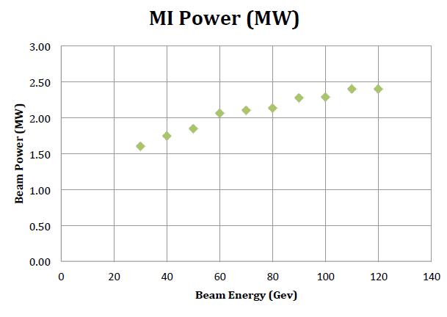
Possible Parameters for post-PIP-II Complex

