Slide 1
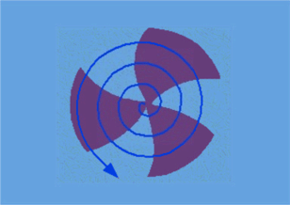
SRF CAVITY ACTIVITIES AT VECC
(650 MHz, β=0.61)
(under IIFC)
Sumit Som
(on behalf of scientists/engineers working in this project)
Variable Energy Cyclotron Centre
Kolkata, India
IIFC meeting at BARC Mumbai on Feb 26-27, 2015

Slide 2
OUTLINE
SRF Cavity 650 MHz, β=0.61
Helium jacket for SSR1
Summary

Slide 3
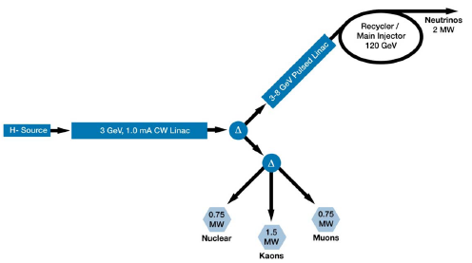
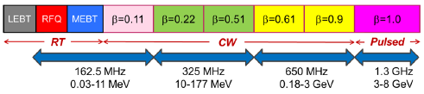
Introduction
A GeV range high intensity proton linear accelerator is intended to be developed at Fermilab, USA in collaboration with various American labs and Indian laboratories as well.
In stage- I & II of the project, the CW linac structures with different velocity factor (beta) accelerate proton up to 3 GeV at an average beam current of 1 mA.
Acceleration from 177 MeV to 3 GeV, will be provided by two families of 5-cell SRF cavities operating at 650 MHz and designed to β_{G}=0.61 and β_{G}=0.92.

Slide 4
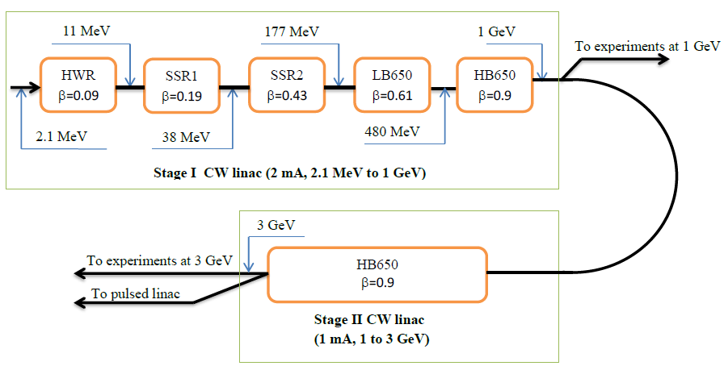
SRF Technology map for CW Proton Linac
β refers to the cavity optimum β for HWR, SSR1, and SSR2 and the cavity geometrical β for LB650 and HB650.
Cavity shape is optimized to decrease the field enhancement factors (magnetic and electric) in order to improve the interaction between the beam and the cavities.
The cavity aperture should be as small as possible subject to following considerations: Field flatness, Beam losses, Mechanical stability, Reliable surface processing.

Slide 5
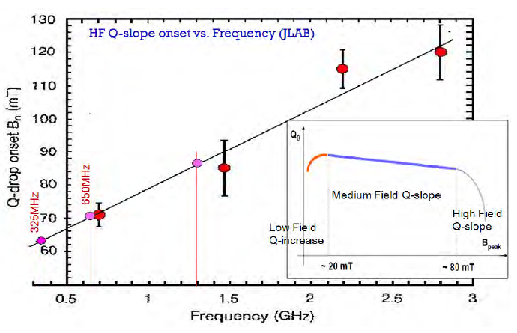
LB650 Cavity parameters
Working gradient chosen as 17 MV/m to provide the peak surface magnetic field (B_{p}) that allows operation below high-field Q-slope;
For frequency of 650 MHz, B_{p} ≤ 80 mT.
E_{p} ≤ 55 MV/m, in order to avoid the risk of strong field emission.
High-field Q-slope vs. Frequency

Slide 6
LB650 Cavity parameters
According to Linear perturbation theory – for a given relative error in the frequencies of the cavity cells the field flatness is determined by δf, between the operating frequencies (f_{π}) of the neighbouring cells.
Field flatness factor, f_{π} /δf ≈ N² / k [ k = cell to cell coupling, N = no. of cell ]
Cavity with fewer cells shows a smaller coupling coefficient for a given field flatness
For 650 MHz cavity, δf / f_{π} =5 x 10⁻⁴ → k > 1.25%
The aperture selected for the cavity represents a trade-off between requirements related to the cell-to-cell coupling and beam loss. The experiences with other labs determine that these cavities can operate with tolerable beam loss within 100 mm. aperture. So, we have adopted 96 mm. aperture for 650 MHz, β=0.61 cavity.

Slide 7
β_{G}=0.61
If this cavity is to be operated for the beam with velocity factor, β ranging from 0.55 to 0.75 (177 MeV to 480 MeV),
Transit time factor : (end cells tuning)
0.55 (at β=0.55)
0.55 (at β=0.75)
0.70 (at β=0.61)
Transit time factor : (no end cells tuning)
0.60 (at β=0.55)
0.65 (at β=0.75)
0.72 (at β=0.61)
However, end cell tuning is required to achieve good field flatness !

Slide 8
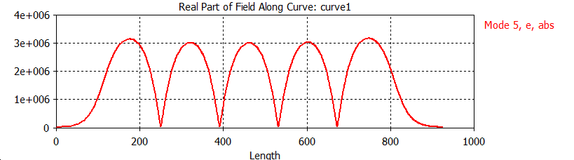
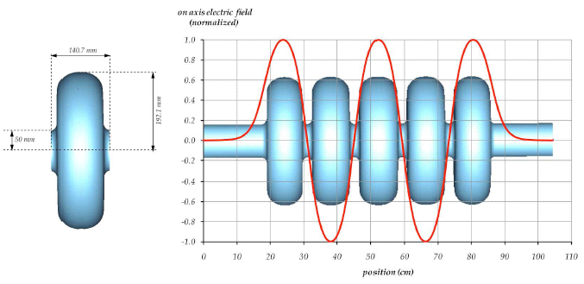
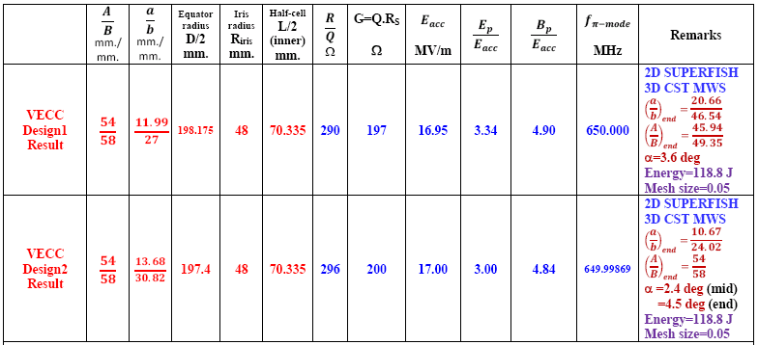
650 MHz, β=0.61, elliptical cavity simulation
Accelerating mode
Field flatness:
Very good!
Data:
Generated by VECC
Results:
Very good!
kc = 1.24%
( R_{iris}=48 mm.)

Slide 9
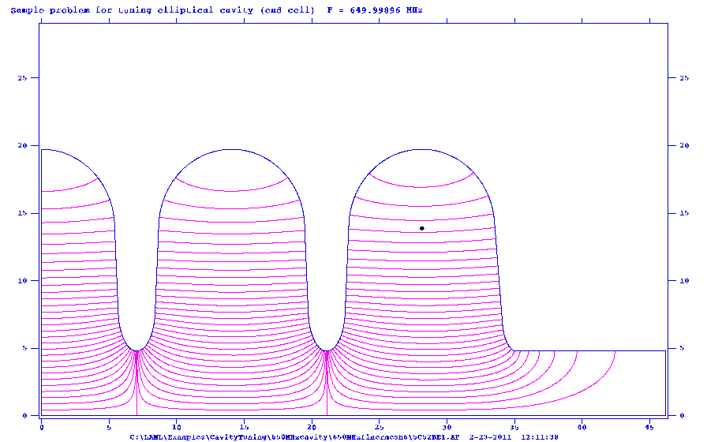
Electric field lines for accelerating mode (π-mode) elliptical shape
5-cell cavity ( ¼ geometry shown )

Slide 10
Electric field lines for other four modes of elliptical shape
5-cell cavity ( ¼ geometry shown )

Slide 11
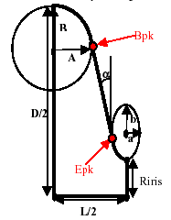
Design Criteria for Elliptical cavity
Elliptical structures with β<0.5 are inefficient, because of filling and transit time factors
For cavity inner cell design,
  Minimize E_{pk}, B_{pk}
  Provide reasonable mechanical stiffness
  Maximize R/Q
  Achieve a reasonable inter-cell coupling coefficient
Influence of Cell geometry
Cavity Shape Parametrization

Slide 12
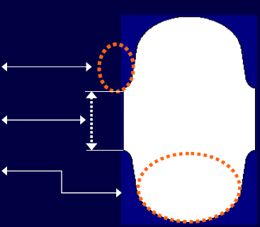
CRITERIA FOR INNER CELL OPTIMIZATION
RF Parameters:
Figure of Merits: (R/Q), G, E_{pk}/E_{acc}, B_{pk}/E_{acc}, k_{cc}
GEOMETRY:
Iris ellipse: a, b
Iris radius: R_{iris}
Equator ellipse: A, B

Slide 13
CRITERIA FOR INNER CELL OPTIMIZATION
Criteria | RF parameters | Improves when
Operation at high gradients | E_{Pk}/E_{acc} B_{Pk}/E_{acc} | R_{iris} Iris, Equator shape
Low cryogenic losses | (R/Q).G | R_{iris} Equator shape
R_{iris} is a Powerful knob to trim RF parameters
Why for smaller aperture (R_{iris})?
(R/Q) ---- bigger (desirable !)
E_{Pk}/E_{acc}, B_{Pk}/E_{acc} ---- lower (desirable !)
E_{acc} is higher at the same stored energy in the cell.

Slide 15
R_{iris} E_{acc} (at the end cells)
R_{iris} E_{acc} (at the end cells)
So, R_{iris} is kept at 48 mm.

Slide 17
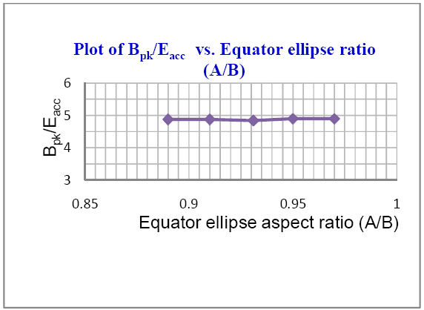
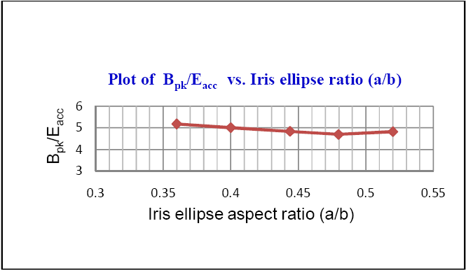

Slide 18
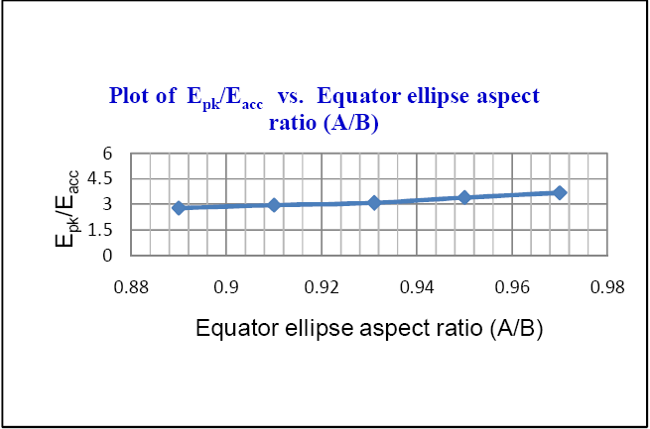
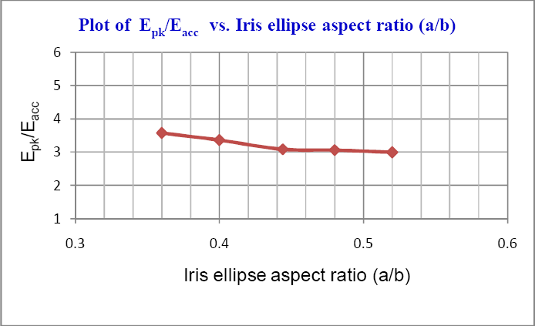

Slide 19
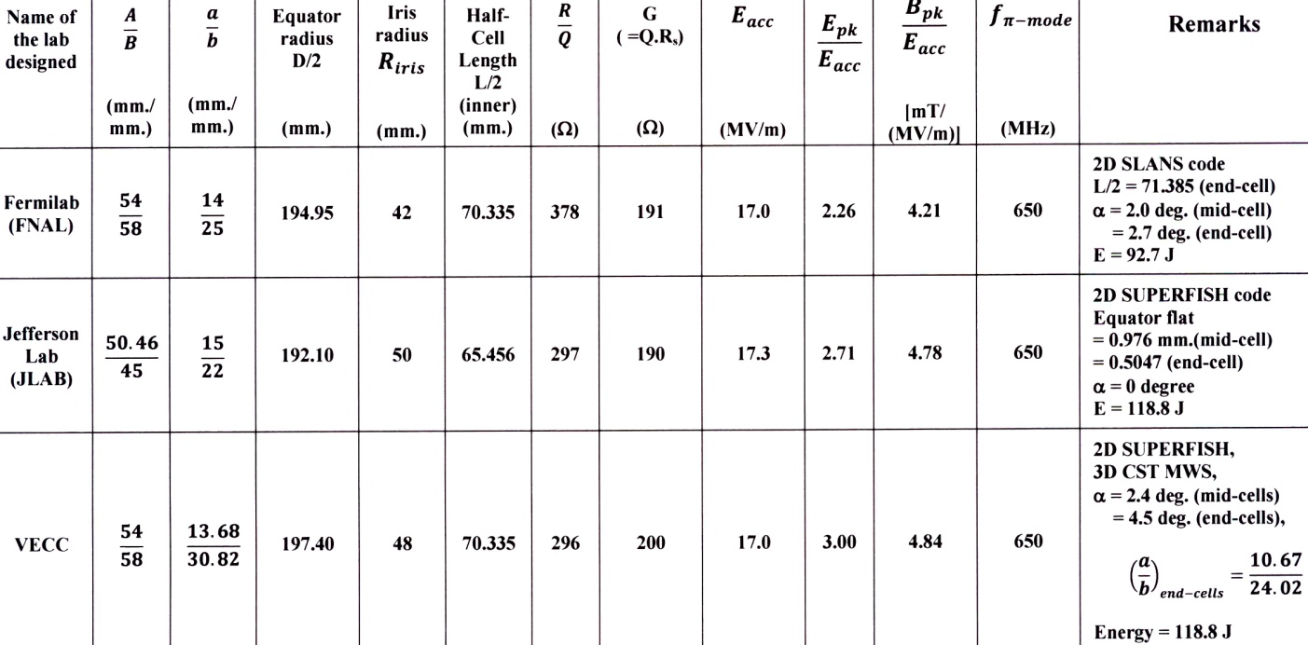
Comparative Chart for Design Parameters for LB650 Cavity
A small cavity wall slope (α) gives more freedom to decrease the field enhancement factor. However, α value is limited by surface processing and mechanical stability requirements.
In mid-cells, α=2.4⁰ selected to maintain low field enhancement factor.

Slide 20
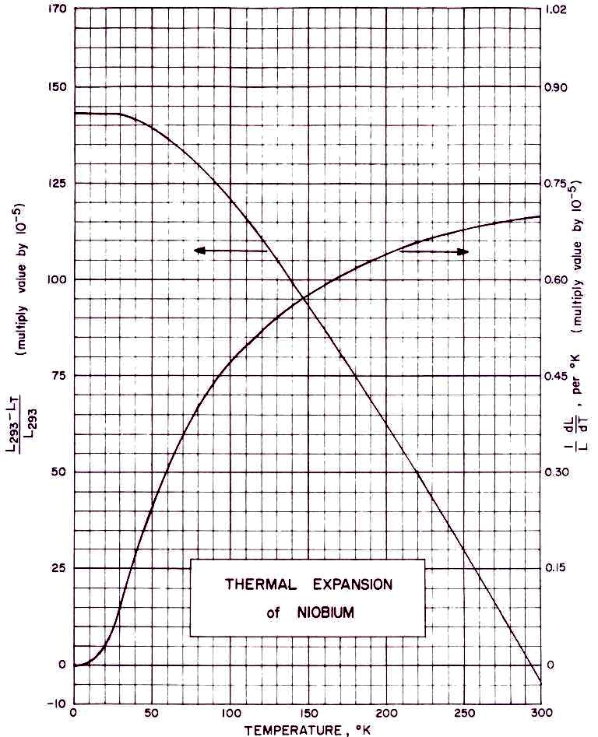

CAVITY SHRINKAGE
DUE TO Thermal contraction of Niobium
The dimensions of the cavity are adjusted taking into account the 150μm total chemical treatment and thermal shrinkage from room temperature to 2K.
Due to BCP, 150μm of material will be removed.
The aperture and equator radius are decreased by 150μm.
Ellipse centres and half cell length do not change appreciably.
Half axis in Iris area are increased by 150μm.
Half axis in equator area are decreased by 150μm
Linear thermal expansion/contraction coefficient (α_{Nb}) of niobium is,
α_{Nb} = (L₂₉₃ – L₂)/L₂₉₃ = 142 x 10⁻⁵ /⁰K
α_{Nb} Non-linear !!

Slide 21
Plot of percentage linear thermal expansion [ ΔL/L = (L_{T}-L₂₉₃)/L₂₉₃ ]
of common metals including niobium
(compiled by Clark 1983 from Data of Corruccini and Gniewek 1961, and Hann 1970)

Slide 22
Dimensions of 650 MHz, 5-cell, β=0.61, Niobium Cavity
Dimensional Parameters | COLD Dimension (inside) (as designed) (mm.) | COLD Dimension Pre- BCP treatment of 150 μm (mm.) | WARM Dimension inside (as Fabricated) (mm.)
Equator radius | 197.400 | 197.250 | 197.53
Iris radius | 48.000 | 47.850 | 47.92
A | 54.000 | 53.850 | 53.93
B | 58.000 | 57.850 | 57.93
a | 13.680 | 13.830 | 13.85
b | 30.820 | 30.970 | 31.01
a (for end cell) | 10.670 | 10.820 | 10.84
b (for end cell) | 24.020 | 24.170 | 24.21
Half cell length (L/2) | 70.335 | 70.335 | 70.44

Slide 23
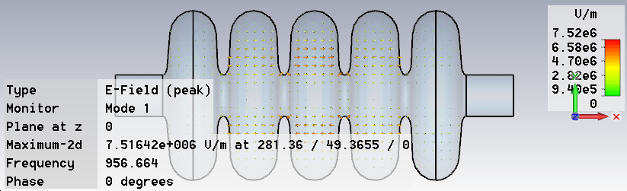
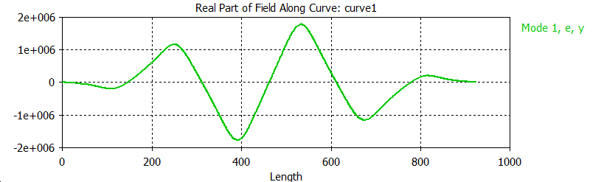
Transverse Higher Order Mode (HOM)
CST MWS RESULTS
-------
Frequency:956.664 MHz
Effective Transverse impedance: 0.035434
Ω.cm⁻²

Slide 24
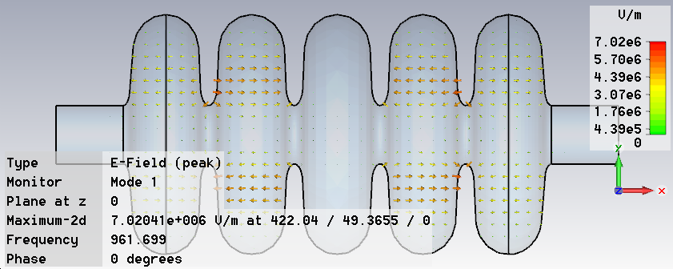
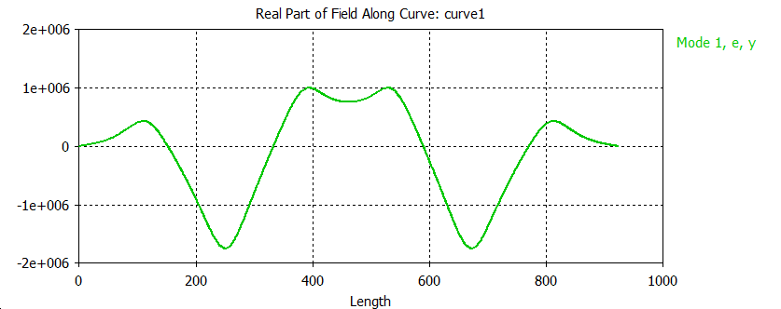
Transverse Higher Order Mode (HOM)
CST MWS RESULTS
-------
Frequency:
961.669
MHz
Effective Transverse impedance: 1.02762
Ω.cm⁻²

Slide 25
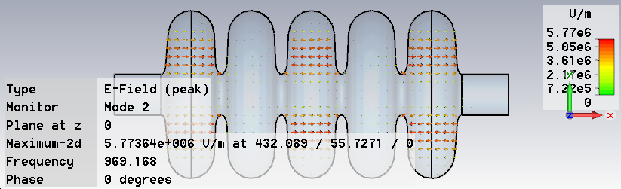
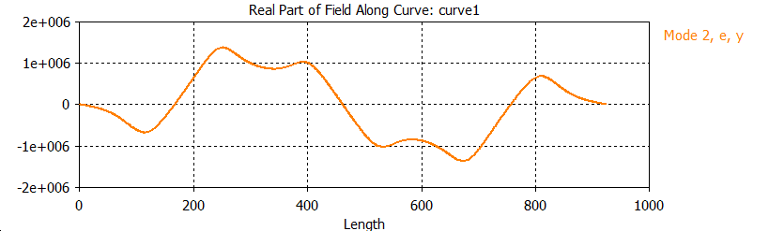
Transverse Higher Order Mode (HOM)
CST MWS RESULTS
-------
Frequency:
969.168
MHz
Effective Transverse impedance: 1.915332
Ω.cm⁻²

Slide 26
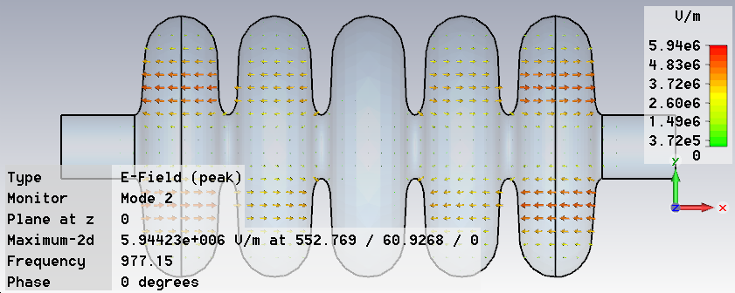
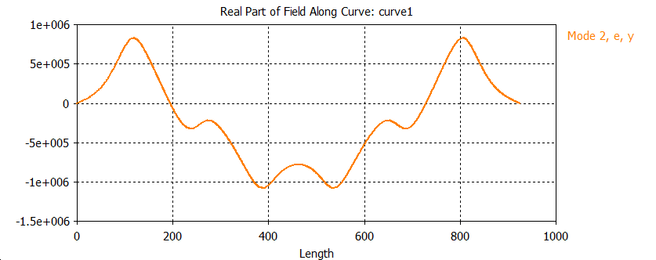
Transverse Higher Order Mode (HOM)
CST MWS RESULTS
-------
Frequency:
977.15
MHz
Effective Transverse impedance: 0.43999
Ω.cm⁻²

Slide 27
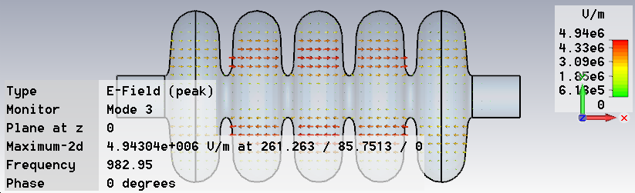
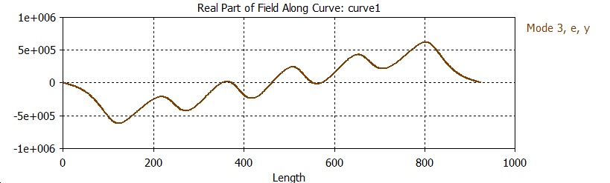
Transverse Higher Order Mode (HOM)
CST MWS RESULTS
-------
Frequency:
982.95
MHz
Effective Transverse impedance: 0.018686
Ω.cm⁻²

Slide 29
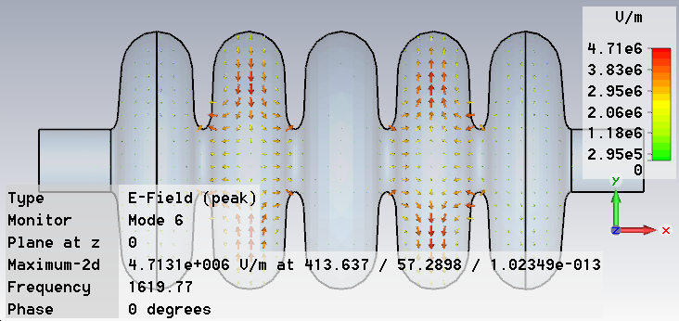
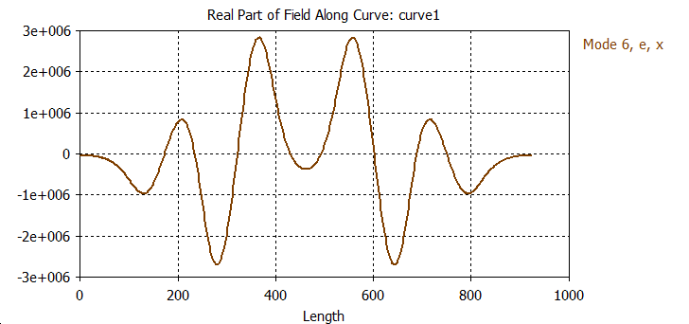
Longitudinal Higher Order Mode (HOM)
CST MWS
RESULTS
-------
Frequency:
1619.77
MHz
Effective
Longitudinal
impedance:
1.66 Ω (β=0.61)
0.135 Ω (β=0.75)

Slide 30
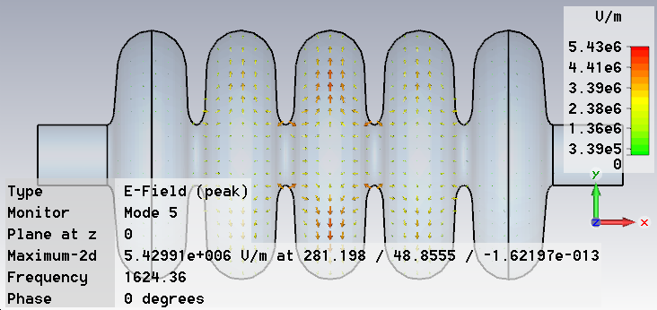
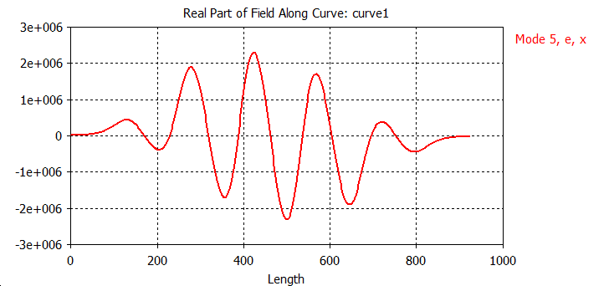
Longitudinal Higher Order Mode (HOM)
CST MWS
RESULTS
-------
Frequency:
1624.36
MHz
Effective
Longitudinal
impedance:
3.370 Ω (β=0.61)
18.756 Ω (β=0.75)

Slide 32
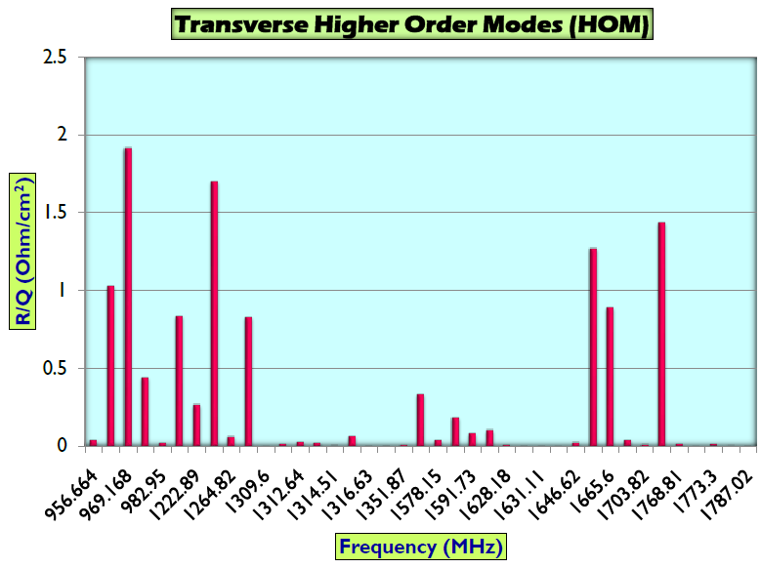
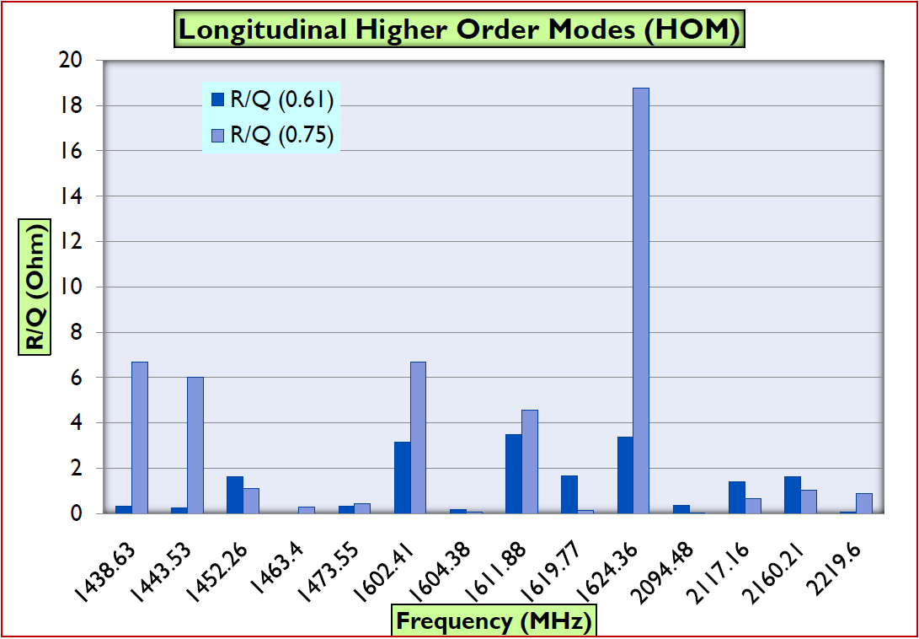
Higher order modes (HOMs)
Transverse and longitudinal HOMs for the cavity at 650 MHz, β=0.61--analysis done
No trapped mode with high effective impedance observed.
HOM dampers are not necessary for required beam current (~ 1 - 2 mA).

Slide 33
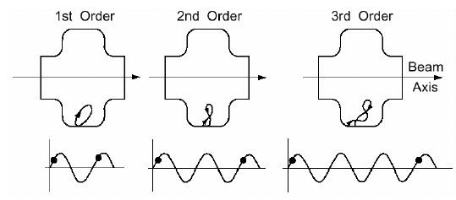
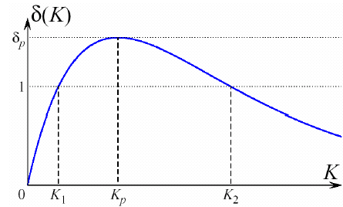
MULTIPACTING IN A CAVITY
Exponential growth in no. of electrons in a cavity
Requires two conditions:
  Electron motion is periodic (resonance condition)
  Impact energy is such that Secondary electron emission coefficient >1
High Field
Low Field
Kinetic energy

Slide 34
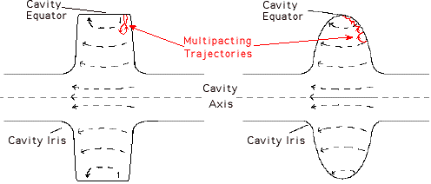
MULTIPACTING IN SCRF CAVITY
Resonant electron loading ⇒ strongly depends on geometry
e⁻ emitted from the RF surface into the cavity follow a trajectory such that they impact back at the surface of the cavity an integral number of RF cycles after emission. The impacting electron then frees further electrons which repeat the cycle causing an avalanche effect, until all available power goes into this process
key to eliminate multipacting ⇒ the fields should be such that emitted e⁻ will drift towards the equator (E field not strong enough for secondary emission to recur)⇒ stops avalanche effect
Rectangular shape ⇒ spherical or elliptical shape
If Electrons are drifted to equator,
Electric field at equator is ≈ 0
MP electrons don’t gain energy
MP stops.

Slide 35
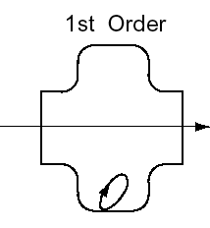




MULTIPACTING
Cyclotron frequency
Resonance condition:
Cavity frequency (ω_{g}) = n x cyclotron frequency
Possible MP barriers given by
Electrons are accelerated by the electric field while the magnetic field turns them around, their impact energy scales as
( is magnitude of the component of E perpendicular to the surface).

Slide 36
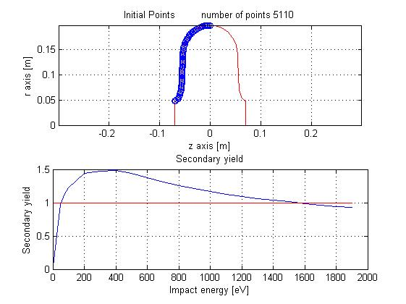
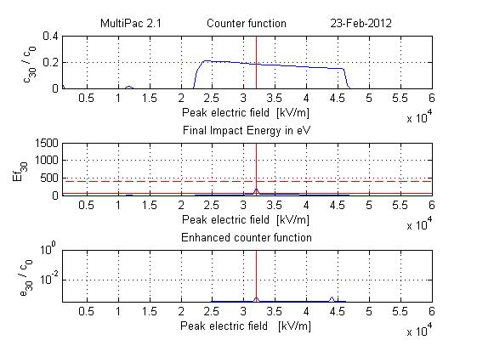
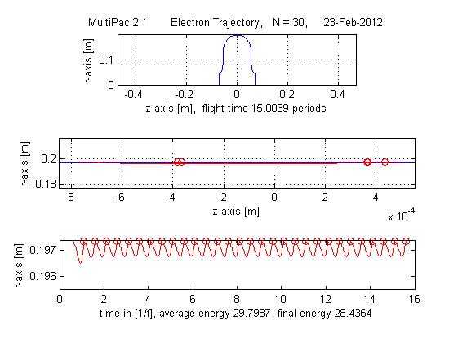
Multipacting Analysis of 650MHz Cavity
A preliminary study of Multipacting Analysis for 650 MHz elliptical cavity has been carried out using 2D software Multipac2.1,windows version
Multipacting analysis is done for both Mid-cells and End -cells
Results for Mid-cell Cavity (Equator)
Input for Mid-cell Cavity
Results for Mid-cell Cavity
c₃₀/c₀ : Counter function - ratio of # of particles after 30th impact to the initial number of
particles (without taking into account the secondary yield);
e₃₀/c₀: Enhanced counter function- ratio of the number of particles after the 20th
impact to the initial number of particles, taking into account the secondary yield
that depends on the impact energy)
Impact Energy: physical condition for multipacting, should be > 50 eV for the
secondary yield > 1

Slide 37
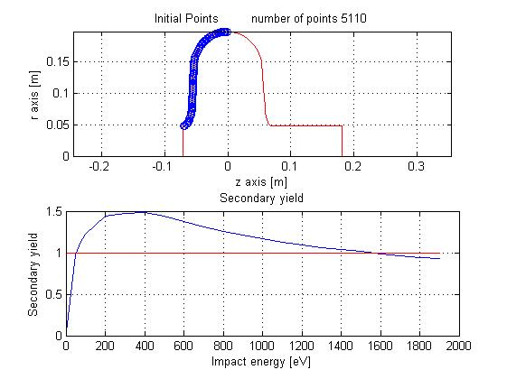
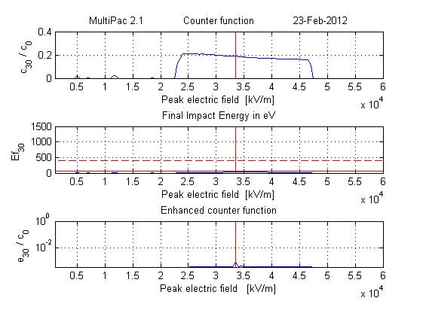
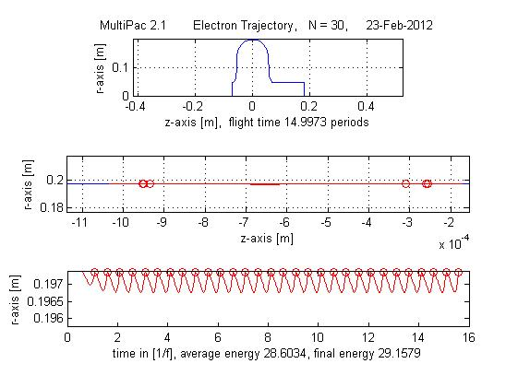
Multipacting Analysis of 650MHz Cavity (……... Contd.)
Input for end-cell Cavity
Results for end-cell Cavity
end-cell Cavity (Equator)
It is observed that impact energy is less than 50 eV for all peak electric fields except a
small region between 30 to 35 MV/m, where it is around 200 eV.
However, we can conclude that no multipacting can take place in the said cavity as the
relative enhanced electron counter function is less than 1 for the whole range of peak
electric field up to 60 MV/m
It is observed for mid-cells and end-cells that even after 30 impacts of electrons at the
equator region (at the radius of 197 mm.) of the cavity, the final impact energy is
28.4364 eV, which is well below 50eV
unlikely to cross secondary electron emission yield for producing multipacting.
Analysis using CST Particle Studio (3D) code is being carried out for further
investigation!

Slide 38
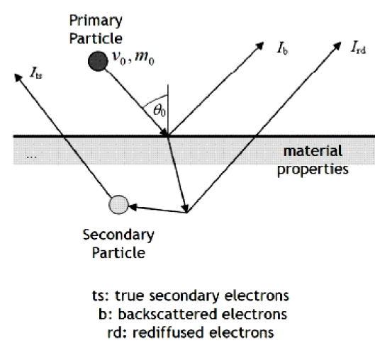
Multipacting simulation using 3D CST Particle Studio
Furman Model of Secondary Electron emission (consisting of three types of scattering particles ) has been taken into account in CST code.
Secondary emission:
A primary particle hitting a metal
surface can cause the emission of
so-called secondary particles.
  Depends on kinetic energy and material properties
  Self consistent model according to Furman.
[M.A. Furman, M.T.F. Pivi, “Simulation of secondary electron emission based on a phenomenological probabilistic model”,
LBNL-52807, SLAC-PUB-9912]
  Statistical behaviour.

Slide 39
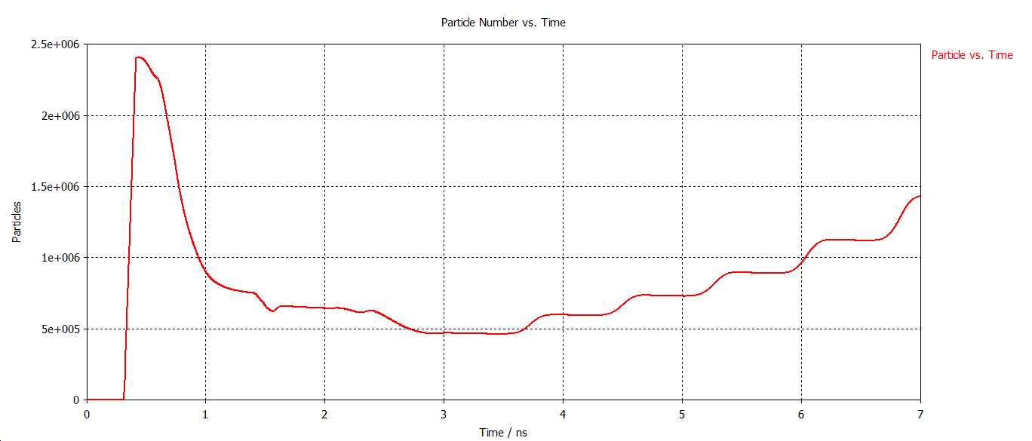
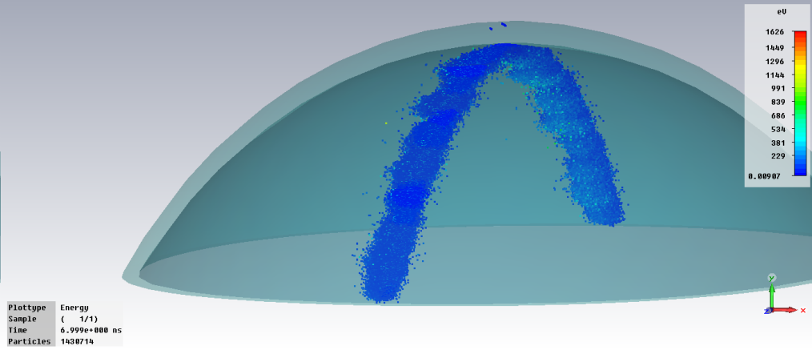
Multipacting simulation data for 650MHz, β=.61Cavity using CST Particle Studio
30 mm. of equator region has been simulated.
Mesh: min 0.37 mm., max 0.74mm.
Multipacting has been found between 5.8 MV/m to 11.5 MV/m
Multipacting rate is very high in the region of 6.8 MV/m.
At 11.6 MV/m, increase in partcle due to multipacting is very low.
Particle vs. time(ns) at 5.8 MV/m
Particles after 7ns at 5.8 MV/m

Slide 40
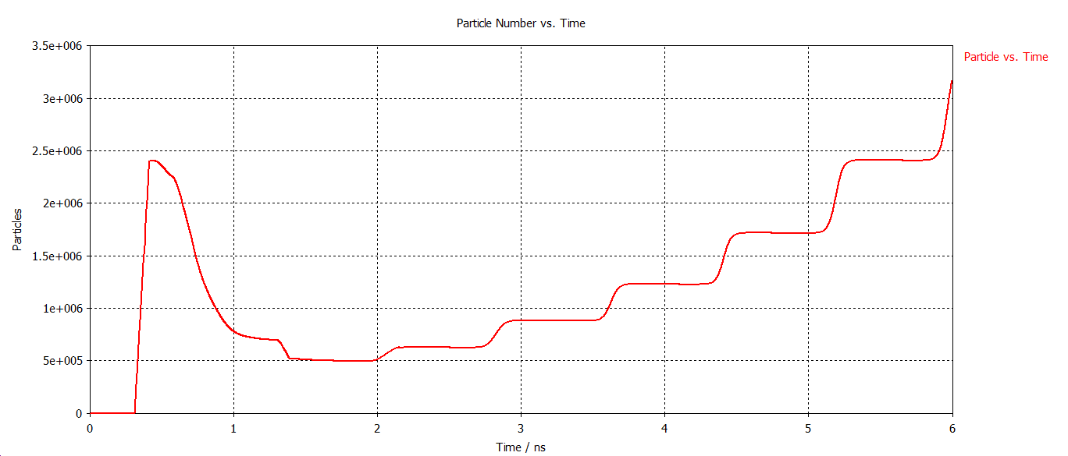
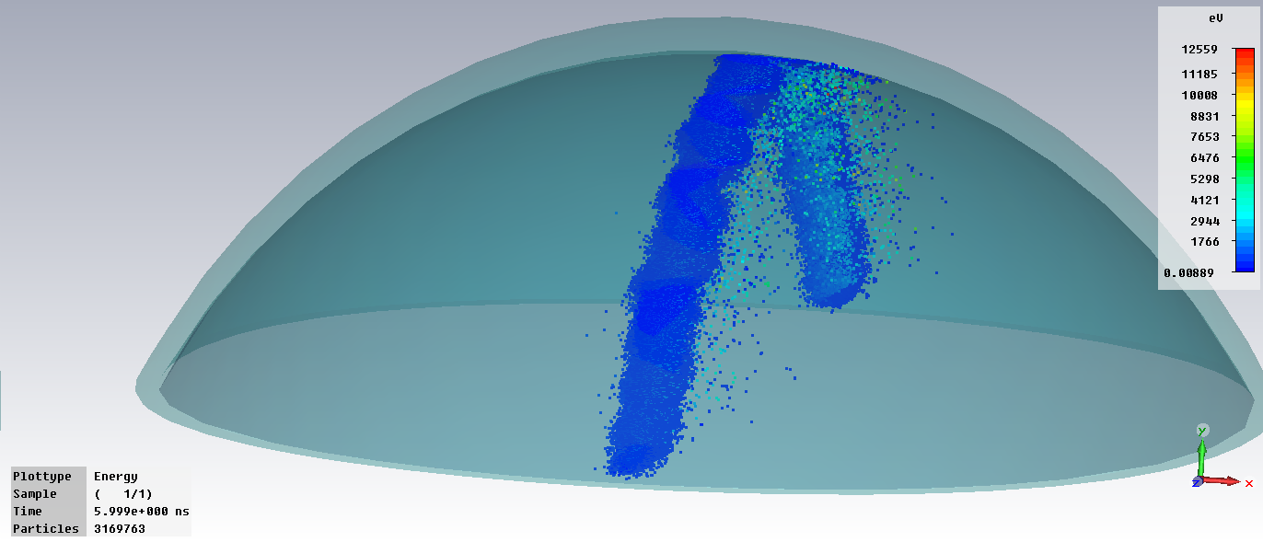
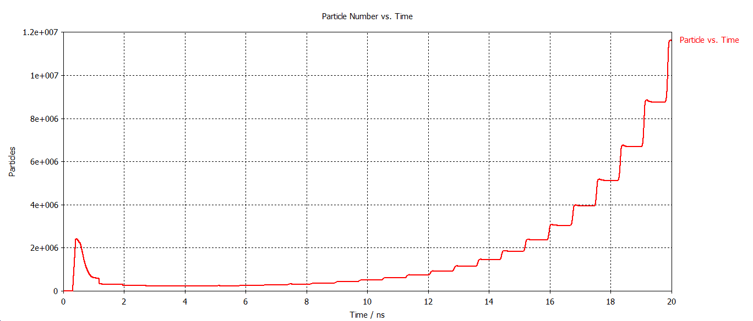
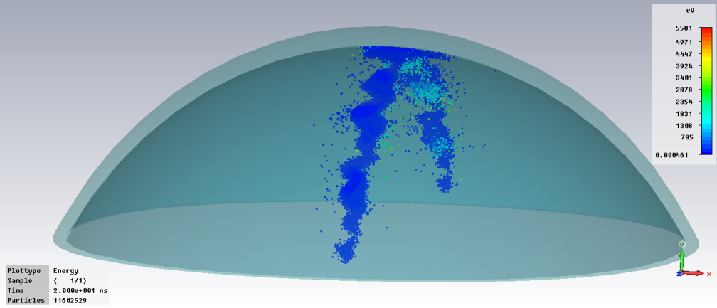
Multipacting simulation result for 650MHz, β=.61Cavity using
CST Particle Studio
Particle Vs time(ns) at 6.8MV/m
(Strong Multipacting)
Particle after 6ns at 6.8MV/m
Particle Vs time(ns) at 9MV/m
Particle after 20ns at 9MV/m

Slide 41




Multipacting simulation data for 650MHz, β=.61 Cavity using CST Particle Studio
Particle Vs time(ns) at 11.5 MV/m
(slow multipacting)
Particle after 50ns at 11.5MV/m
Particle Vs time(ns) at 4.5MV/m
(No Multipacting)
Particle Vs time(ns) at 22.5MV/m
(No Multipacting)

Slide 42

Multipacting (MP) in 650MHz, β=0.61 Cavity
A small convexity in the equator region suppresses the multipacting significantly.
However, the convexity does not change the cavity parameters, like, peak surface fields, quality factor, R/Q etc.
Practically, this small convexity is gets introduced automatically during electron beam welding, which in turn may become beneficial.

Slide 43
MECHANICAL DESIGN OF CAVITIES
SC Cavity should withstand mechanical stress induced by –
  Differential Pressure between beam pipe vacuum and pressure in LHe vessel
  Cooldown from 300K to 2K
  Tuner mechanism operation
Stress ≤ Yield Strength
Choice of WALL THICKNESS is very important !
If very thick –
Poor heat removal from inner cavity surface
More parasitic heat leak from warmer parts of cryo-module

Slide 44



Cavity structural analysis: formulation detail
SRF Cavity is subjected to cryogenic temperature and external pressure under operating conditions
Loading:
Uniform Temperature=2K
External Pressure=3 atm
Boundary Condition: Both end fixed
Finite Element Axisymetric modeling
for 5-cell SRF cavity

Slide 45


Primary stress linearization along the thickness of iris (where the stress intensity value is maximum)
Primary membrane stress integral intensity is 44 MPa, which is well within the allowable limit of 103 MPa .
Combined stress intensity of primary membrane and bending is 120 MPa, which is well within allowable limit of 154 MPa (=1.5 x 103 MPa).
Combined stress integral intensity (=primary membrane stress +bending stress +secondary stress) of 4 mm. thick niobium sheet is 131 MPa, which is well within the allowable limit of 309 MPa (=3 x 103 MPa), as per ASME code.
Various stress plots indicate that they are within allowable limits.
Stress Plot
Mechanical properties of niobium
Temperature (K) | Young's Modulii (GPa) | Yield Strength (MPa) | Tensile Strength (MPa) | Design Allowable Strength (MPa)
295 | 97.9 | 50 | 100 | 33.33
2 | 97.9 | 310 | 310 | 103.3

Slide 46
Results :Different Stress Plot
Stress calculations as per ASME Pressure Vessel Code Section-III for niobium
Stress intensity (at Iris) across the thickness of
5-cell, 650 MHz, β=0.61, cavity

Slide 47

Deformation
The maximum deformation due to combined loading is obtained as 0.465 mm.
Plot of deformation for
5-cell, 650 MHz, β=0.61 cavity

Slide 48
    LIMIT LOAD ANALYSIS OF THE CAVITY
Non-Linear axis symmetric analysis of the cavity half-cell (with and without stiffener) is performed using Bilinear Kinematic Hardening Model
Young Modulus = 80000 Mpa
Tangent Modulus= 166.67 Mpa
Plastic deformation without stiffener starts at 0.14 Mpa.
Plastic deformation for the cavity with stiffener starts at 0.25 MPa.
Significant Collapse Starts only after 3 bar.

Slide 49

Mechanical modal analysis of 650 MHz SCRF Cavity
Structural analysis carried out using ANSYS 3D code.
Stresses are within the allowable limit.
Mechanical modal analysis (without stiffener) shows frequency within 100 Hz.
Mechanical modal analysis
(without stiffener)

Slide 50


Mechanical modal analysis of 650 MHz SCRF Cavity
The natural frequencies and mode shapes are determined for the 5-cell cavity alone for different end support condition.

Slide 51


    Stiffened cavity modal analysis

Slide 52

Engineering drawing for half-cell (mid-cell)

Slide 53

Engineering drawing for half-cell (End-cell)

Slide 54


    PROTOTYPE CAVITY FABRICATION & CMM MEASUREMENT
Fabrication of prototype aluminum cavity half-cells for 1-cell & 5-cell (Full scale) done
Die/Punch assembly developed.
CMM (laser Faro) inspection successfully done.
Low power RF test on half-cell using VNA done & Bead-pull measurement on single-cell and five-cell prototype cavities carried out.
RF Test on Half Cell using VNA

Slide 55




Fabrication of 650 MHz Aluminum prototype Cavity

Slide 56


RF Test on Half Cell using VNA
Fixtures drawings required for EB welding process has been prepared in consultation with IUAC, New Delhi and those fixtures are fabricated at VECC.
Dimensional measurement using CMM (Laser)

Slide 57


Slide 58


Slide 59


Single cell prototype cavity-- VNA measurement
Resonant frequency, f₀ = 645.86350 MHz
Q=20700
Half power (−3dB) Bandwidth,
Δf = f₂ − f₁ = 31.2 kHz.
[ f₁ = 645.84860 MHz;
f₂ = 645.87980 MHz ]
Q = f₀ / Δf = 20700.

Slide 60






Bead-pull measurement set-up
Using Phase-shift technique instead of frequency-shift
  In manufacturing or tuning multi-cell cavity, it is required to investigate the field profile inside the cavity
  The Field can be sampled by introducing a perturbing object and measuring its change in f₀
  The object must be very small so that the field does not vary significantly over its largest linear dimension: it is a perturbation method
  Phase deviation is much easier to observe than frequency change especially for small perturbation.
PHASE (Degrees)
IMPEDANCE

Slide 61

5-cell, 650 MHz, β=0.61, Prototype Copper cavity
Bead-pull measurement

Slide 63
5-cell, 650 MHz, β=0.61, Prototype Copper cavity
Bead-pull measurement

Slide 64


Niobium sheet (600 mm. x 600 mm. x 4 mm.)
machining at VECC workshop
before deep drawing

Slide 65




Niobium half-cell formed at Kolkata
(for 650 MHz, β=0.61 cavity)
Dimensional measurement of Aluminium half-cell using Laser FARO
CMM measurement of Niobium
half-cell using CMM

Slide 66


650 MHz, β=0.61, Niobium cavity
Niobium Half cells , beam pipes and necessary fixtures

Slide 67




Slide 68

Fixtures for EBW of Cavity

Slide 69

Mock assembly of single cell Nb cavity with welding fixtures

Slide 70

Mock assembly of single cell Nb cavity with welding fixtures

Slide 71


Machining of formed Nb half-cell on fixture

Slide 72

Rolled beam tube , formed Nb half cell with fixtures

Slide 73

Rolled beam tube , formed Nb half cell with fixtures

Slide 74

beam tube on formed Nb half cell (not welded yet, trial positioning only)

Slide 75


Slide 76
Publications:
"RF Design, Analysis and Multipacting Studies of 650 MHz, β=0.61 SCRF Cavity", by Sumit Som, Sudeshna Seth, Aditya Mandal, Surajit Ghosh, Indian Journal of Pure and Applied Physics. (accepted and to be published soon!)
"Development of 650 MHz Cavities for the GeV Proton Accelerator in Project-X", by Sumit Som, Proceedings of the 16th International Conference on RF Superconductivity (SRF-2013) held in Paris, France during 23−27 September, 2013 (p.1193).
"Multipacting Analysis on 650 MHz, beta=0.61 Superconducting RF Linac Cavity", by Sudeshna Seth, Sumit Som, A. Mandal, S. Ghosh, S. Saha, Proceedings of DAE-BRNS Indian Particle Accelerator Conference (InPac-2013) held at VECC, Kolkata during Nov 19-22, 2013 (p.246).
"Structural Design of 650MHz β=0.6 Superconducting Radio-Frequency Cavity" , by Pranab Bhattacharyya, Javed Akhtar, Chinmay Nandi, Anjan Duttagupta, Sumit Som, Gautam Pal, Alok Chakraborty, Proceedings of National Symposium on Cryogenics held at IPR, Ahmedabad, during January 21-24, 2013.
"Bead-pull measurement using phase-shift technique in multi-cell elliptical cavity", by Sumit Som, Sudeshna Seth, Aditya mandal, Surajit Ghosh, Proceedings of 2nd International Particle Accelerator Conference (IPAC-2011) held at Kursaal, San Sebastian, Spain, during September 4-9, 2011 (p.280).
“RF characterization and measurement of a full scale copper prototype of 5-cell elliptical shape Superconducting RF linac cavity", by S. Seth, Sumit Som, Aditya Mandal, Proceedings of Indian Particle Accelerator Conference (InPac-2011) held at IUAC, New Delhi during Feb 15-18, 2011 (paper id: 207).
“Design study on 650 MHz, high-β multi-cell elliptical shape superconducting RF linac cavity”, by S. Seth, Sumit Som, Aditya Mandal, Proceedings of Indian Particle Accelerator Conference (InPac-2011) held at IUAC, New Delhi during Feb 15-18, 2011 (paper id: 208).
“Testing of inductive output tube based RF amplifier for 650 MHz SRF cavities”, Aditya Mandal, Sumit Som, S.K. Manna, Surajit Ghosh, Sudeshna Seth, S.K. Thakur, S. Saha, Uma Shankar Panda, 9th International Workshop on Personal Computers and Particle Accelerator Controls (PCaPAC2012) held at VECC from December 4-7, 2012.
"Comparative Design study and Analysis of 650 MHz, beta=0.61 SCRF Cavity", Sumit Som, Sudeshna Seth, Aditya Mandal, Surajit Ghosh, 2nd International Workshop on Accelerator Driven Sub-critical Systems & thorium Utilization, held at BARC, Mumbai during December 11−14, 2011.

Slide 77

Infrastructure Development: Vertical test cryostat

Slide 78

PROPOSED CLEAN-ROOM FACILITY AT VECC (Rajarhat campus)

Slide 79
SSR1 Cryomodule: Strongback

Slide 80


Equivalent Emissivity including the resistance of MLI
, if assumed

Slide 81

i.e. Z-direction temp. variation not included

Slide 82

Result of the analysis using ANSYS
Temp. of strong back

Slide 83

Analytical solution !
integral Kdt from 300-294 K
integral Kdt from 294 -80 K
First started with assumed T, accordingly Chosen
Kss_DT & KG11_DT;
Finally aimed to match the heat in & Heat out Value for certain T
15 No MLI
Now heat flux
is coming around
1.478W/sqm

Slide 84


Strong Back Temperature distribution: 3D Analysis
Loading Details
Radiation-conduction boundary conditions are applied
Equivalent emissivity between the surfaces are used to include the effect of multilayer insulations.
Average thermal conductivities are used
Non-linear material properties will be included in further analysis

Slide 85


Strong Back Temperature distribution
Details analysis is being done to find out the temperature
Temperature plot shows that the maximum thermal gradient is at the support posts

Slide 86

Strong Back Temperature distribution
Strong back material is taken as Stainless steel
Maximum temperature : 298 K
Minimum temperature : 296 K

Slide 87


STRONG BACK Al Vs. SS
Thermal conductivity of Aluminium is higher than SS.
Hence Al has more uniform temperature distribution.
For the same reason, steady state temperature of Aluminium is very nearer to room temperature.

Slide 88

Structural Analysis
The temperature distribution result of the model has been transported to structural analysis platform for subsequent coupled analysis.
OVC end of the SS support pin is assumed to be fixed.
Conservative approximation of dead load of helium vessel, helium, cavity, solenoid, thermal shield, associated cryogenic piping has been considered for structural analysis. Total approximate load of 24000N will act on 12 nos. of G11 support post having cross section area of 1551 mm². The whole load is converted to equivalent pressure load on each G11 support post and amounts to 1.3 MPa.

Slide 89

STRONG BACK Al vs. SS
Deformation is inversely
proportional to Young's
modulus for mechanical
loading.
For Aluminium 'E' Value is
less than SS.
For thermal loading
deformation is proportional
to thermal expansion co-
efficient, which is high for Al
in comparison to SS.
Hence Aluminium shows
higher total deformation
even though the ∆T is less
for Aluminum.

Slide 90

STRONG BACK Al vs. SS
Stress is because of dead load & thermal loading.
Thermal stress is dependent on E, thermal expansion co-efficient and temperature difference.
For SS though the thermal expansion co-efficient is less than Al, but other two factors are higher, hence stress value is high.
For the above graphs, higher value of stress is due to presence of local holes in the path. Average stress is within safe limit.

Slide 91


Helium vessel for SSR1

Slide 92





CASE-I
CASE-I (2 bar at room temperature during initial cool down)
Case-II (4 bar external pressure+ low temperature, 2K)
Figure: Stress Linearisation of
primary stress:
Pm = 8.8 Mpa < Sm = 33 MPa
Pm+Pb = 17 Mpa < 1.5 Sm = 48 MPa
CASE-II
Figure: Stress Linearisation of primary stress
Pm+Pb+Q = 16 Mpa < 3 Sm = 309 MPa

Slide 93
summary
650 MHz, β=0.61 cavity design done.
Die-punch assembly made.
Two niobium half cells already formed, machined.
Necessary fixtures (as suggested by IUAC) for EB welding are ready.
EB welding process is expected to start in Mar’2015
The first single cell cavity will be tested at Fermilab.
Our Vertical Test Stand is expected to be delivered by Q1 of
FY 2015-’16 and will be commissioned at VECC Rajarhat campus.
Clean room facility at Rajarhat campus is in the tendering stage and expected to be ready by Q4 of FY 2015-’16.
SS jacket for SSR1: as soon as final drawing is provided by IUAC/Fermilab, we will start procurement and proceed further for its fabrication.

Slide 94

Essential inputs (information) required by VECC from Fermilab

Slide 95

Essential inputs (information) required by VECC from Fermilab

Slide 96
ACKNOWLEDGEMENT
Thanks to all our colleagues for their constant effort in the SRF cavity activities. Especially, the author is thankful to the following persons from VECC:
Sudeshna Seth
Aditya Mandal
Pranab Bhattacharyay
Surajit Ghosh
Anjan Duttagupta
P.R. Raj

Slide 97


