Slide 1
Establishment of Engineering Data Management System in India based on Teamcenter
Computer Division, BARC
27 Feb, 2015

Slide 2
Teamcenter Overview

Slide 3
1-Lab Vision
All projects should:
  Utilize one database for all engineering related data
  Utilize a consistent set of tools and forms
  Provide quick access to all data
  Be a truly collaborative environment
  Provide revision control
  Allow users to easily view data
  Integrate requirements, mCAD, eCAD, engineering, and financial documents

Slide 4
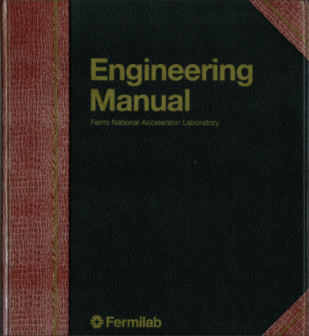
Engineering Manual
    Functional and Technical requirements
    Statement of Work
    Risk Assessment
    ES&H and QA requirements
    Various reviews of all requirements
    Technical Design Report
    CAD models
    CAD drawings (electrical, mechanical, P&ID)
    Supporting Documents
    Engineering and design notes
    Design calculations
    Assembly and operating procedures
    Preliminary Design Review(s)
    Systems Integration Review(s)
    Final Design Review
    Procurement Plan
    Presentation
    Request for Information
    Procurement Specification
    Technical Questionnaire
    Procurement Readiness Review
    Request for Proposal
    Vendor Proposal Review
    Vendor Selection
    Vendor Fabrication Review
    Material Certifications
    Documentation and Training Requirements
    Safety and Health Plan
    Fabrication Acceptance Test
    Performance Acceptance Test
    Installation Plan
    Safety Review(s)
    Commissioning Plan
    Operational Readiness Clearance
This list is not all-inclusive

Slide 5
Teamcenter Functionality and Topics
Engineering Docs
  Risk Assessments
  Specifications
  Work Requests
  Product Order Forms
  Budget Tracking Reports
  Functional Requirements
  And more…
CAD
  3-D Mechanical w/ NX
  2-D Mechanical w/ NX
  Electrical
  P&ID
  Multi-CAD integration
  CAD file Viewing
  Structure Manager for Assemblies
  30,000 common parts library
Teamcenter Topics
  Accounts / licensing
  Cost
  Citrix
  Collaborations
Workflows
  Review and Approve
  Eng Order Forms
  Job Requests
  Quick Release
Document Management
  Requirements Module
  Eng Process Doc Management
  Structure Manager for Docs
Training
  PDF instructions
  Video instructions
  On-site support
Financial
  Budget Reporting
  Project Goals and Timelines
  Funding Change Requests

Slide 6
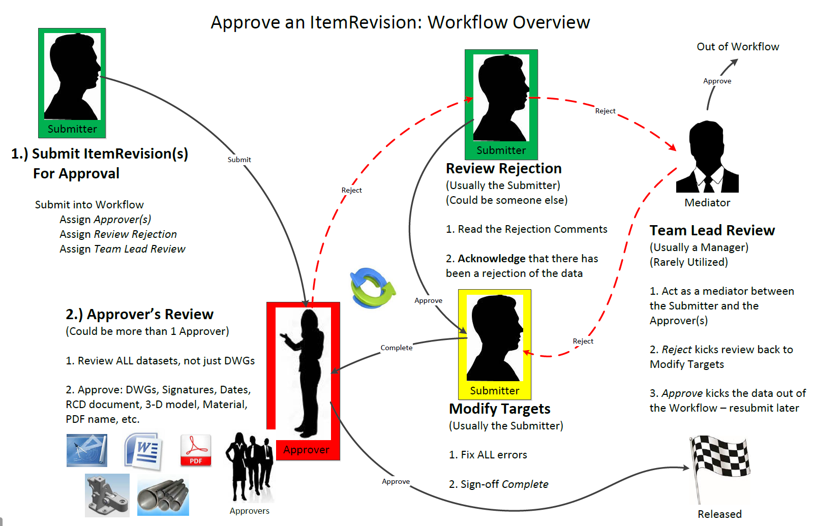

Slide 7
EDMS System in India for IIFC collaboration

Slide 8
EDMS system in India
Proposal out of BARC and Fermilab discussions:
  Establish an Engineering Document Management System (EDMS) hub in India based on Teamcenter software for online data sharing among IIFC collaboration partners
Scheme:
  The hub will act as a local node for Indian collaborators for managing their engineering work,
  Hub will operate in collaboration mode with the EDMS system at Fermilab

Slide 9
Logical view of the setup
Internet Connection of the unit
Data
Synchronization
over Internet
USERS
IUAC
LAN
FIREWALL
TEAMCENTER
HUB
IN INDIA
TEAMCENTER
SYSTEM
AT
FERMILAB
USERS
IGCAR
LAN
FIREWALL
USERS
VECC
LAN
FIREWALL
USERS
RRCAT
LAN
FIREWALL
USERS
BARC
LAN
FIREWALL

Slide 10
System Requirements
Fermilab worked with Siemens for a technical proposal on the EDMS system and shared the details with BARC.
Software
UGNX
Teamcentre
Oracle
Windows server OS
Hardware
Servers
Network connectivity
Internet connection at each site for users
Internet connection between India Hub and FNAL
Network switches

Slide 11
Proposed Execution Plan
Software licenses with maintenance support for 10 years will be procured through Fermilab procurement channel.
Hardware items will be procured by BARC based on specifications provided by Fermilab.
The equipment will be commissioned @HBNI with Internet connectivity for giving access to users and enabling data synchronization between India hub and Fermilab EDMS.

Slide 12
Software Items
S.No | Description | Quantity
1 | NX MACH 2 Licenses (NX12100) | 15
2 | Technical consultancy, onsite Installation & configuration & testing, training and onsite maintenance for item-1 (15 licenses) for 10 years | -
3 | NX MACH 3 Licenses (NX13100) | 5
4 | Technical consultancy, onsite Installation & configuration & testing, training and onsite maintenance for item-3 (5 licenses) for 10 years | -
5 | Teamcenter Author - (TC10101) | 20
6 | Technical consultancy, onsite Installation & configuration & testing, training and onsite maintenance for item-5 (20 licenses) for 10 years | -
7 | Teamcenter Consumer - (Tc10102) | 5
8 | Technical consultancy, onsite Installation & configuration & testing, training and onsite maintenance for item-7 (5 licenses) for 10 years | -
9 | Oracle Named User (Tc050) | 25
10 | Technical consultancy, onsite Installation & configuration & testing, training and onsite maintenance for item-9 (25 licenses) for 10 years | -
11 | Multi-Site Collab - (TC10408) | 2
12 | Technical consultancy, onsite Installation & configuration & testing, training and onsite maintenance for item-11 (2 licenses) for 10 years | -
13 | Teamcenter Deployment - (TC1DOTC) at HBNI, Mumbai and corresponding Technical consultancy and training | -

Slide 13
Status after signing Annexure-I
The work of setting up the hub in India is being expedited with priority. A number of communications have been exchanged.
Fermilab re-engaged with Siemens on this matter.
Siemens reviewed the earlier technical proposal and raised a number of queries to work out a solution vis-à-vis any changed requirements.

Slide 14
Siemens queries & proposals and DAE preferences
Are the quantities of the licenses the same?
  The user licenses NX MACH 2, NX MACH 3 and Teamcenter author licenses are based on
    BARC – 6 users
    RRCAT – 7 users
    IUAC – 1 user
    VECC – 1 user
    The above will remain same.
  Other software items are basically for HUB and Fermilab EDMS communication. Quantity of licenses for them may be reviewed by Siemens.

Slide 15
Siemens queries & proposals and DAE preferences
Do we have to quote 5-10 years of maintenance?
  DAE requires maintenance for 10 years
Is Fermi securing the HW of BARC?
    DAE prefers procurement of hardware in India as it allows easy maintenance.
All installation services and installation set up will be done @ Fermi
    Which hardware will be used for the installation assuming hardware is procured in India?
Siemens India will install the configured system @ BARC
  The installation will be done @HBNI.

Slide 16
Queries from DAE
Recently Fermilab changed to CITRIX based remote access for giving FNAL Teamcenter access from India. Will BARC/RRCAT/IUAC/VECC use the same scheme for accessing India hub also?
  If YES, what are the software + hardware requirements?
Right now BARC users are accessing FNAL CITRIX server using CISCO based VPN. Will BARC/RRCAT/IUAC/VECC use the same scheme for accessing India hub also?
  If YES, what are the software + hardware requirements?
  Can we use OPENVPN software for this?

Slide 17
Thank You

