Slide 1
RF Couplers & Tuners
Rajesh Kumar
SO/G, IADD
Extn. 23579 krajesh@barc.gov.in

Slide 2
Plan of the talk
Introduction
High Power Coupler requirements for 1 GeV Accelerator
RF Coupler design
Tuners
RF Test set-up for couplers
RF Couplers and test system for LEHIPA and deuteron accelerator
Summary

Slide 3
Introduction
RF power Couplers are coaxial or waveguide structures and are used to feed power to the cavity without any reflections
Couplers provide impedance matching between cavity and incoming RF line and protect the cavity vacuum from air side
RF power per coupler is high for room temperature cavities ( eg. LEHIPA Couplers for RFQ and DTL cavities are being developed at 250 kW CW, 352.2 MHz).
For Superconducting cavities of 1 GeV- 30 mA, proton accelerator, power requirement per cavity will range from few tens of kWs to several hundred kWs per coupler

Slide 4
RF Coupler requirements for 1 GeV Accelerator
Cavity | RF Power * ( CW) | Nos. Required | Remarks* (Max. power requirement for 30 mA)
325 MHz, SSR0 (3- 10 MeV) | 30kW | 19 | 60 kW for 2 MeV gain per cavity
325 MHz, SSR1 (10-32 MeV) (10-50) | 30 kW max. | 10 (26) | 60 kW for 2MeV gain per cavity
325 MHz, SSR2 (32- 160 MeV) 50-205) | 30 kW max. | 20 (53) | ~ 90 kW for 3 MeV gain per cavity
650 MHz, elliptical-beta=.6 (205-440) 1 | 120 kW max. | 18( 48) | ~180 kW for 6 MeV gain per cavity
650 MHz, elliptical-beta=.9 (.8) 440-1GeV ( up to 1 GeV) | 120 kW max. | 23(63) | ~300 kW for 10 MeV gain per cavity
650 MHz, elliptical-beta=.9 (1-3 GeV) | 120 kW max. | 66 | For BARC and RRCAT 1 GeV accelerators, couplers are required up to 1 GeV only
Total couplers per accelerator |  | 137(~209)

Slide 5
Schedule for Coupler development
Component | Design studies | Material Procurement | Fabrication of first Prototype | Remarks
325 MHz RF* Coupler | To be completed by June 2015 | Started | June 2015-June 2016 | Alumina windows being purchased
650 MHz RF* Coupler | To be completed by Dec. 2015 | Started | By 2016 end. | Alumina windows being purchased
Room temperature Test stand for 325 MHz Couplers | Initiated | Started | By June 2016
Room temperature Test stand for 650 MHz Couplers | To be started | To be started | By June 2017
* 325 MHz and 650 MHz Couplers will need to be tested on HTS as well. The delivery of RF Couplers to Fermilab is scheduled from 2018-2021

Slide 6
High power RF coupler development under IIFC
Following activities have been carried out for coupler development under IIFC.
Electromagnetic design simulations of 30 kW, 325 MHz Project-X (PX 325 ) and 650 MHz, 120 kW Project-X (PX 650) Coupler designs
Multipacting simulations of Project X Couplers
Static and dynamic thermal analysis of Project X Couplers
Identifying Vendors for fabrication of one prototype each of 30 kW, 325 MHz and 120 kW, 650 MHz couplers
High purity Alumina discs being procured for prototypes

Slide 7
RF coupling mechanisms
Ref. Davide Alesini,“ Power Coupling”, in CERN Accelerator school, Elbeltoft, Denmark, 2010.
Coupler design starts with the choice of coupling mechanism and coupling coefficient calculations using analytical methods and numerical EM Solvers. Further, design of impedance matching, multipacting, thermal, mechanical , fabrication and testing are important.

Slide 8
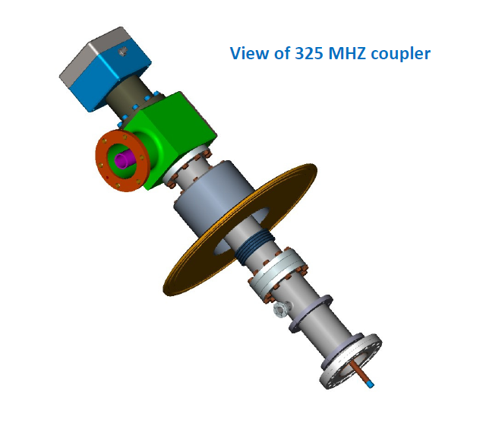
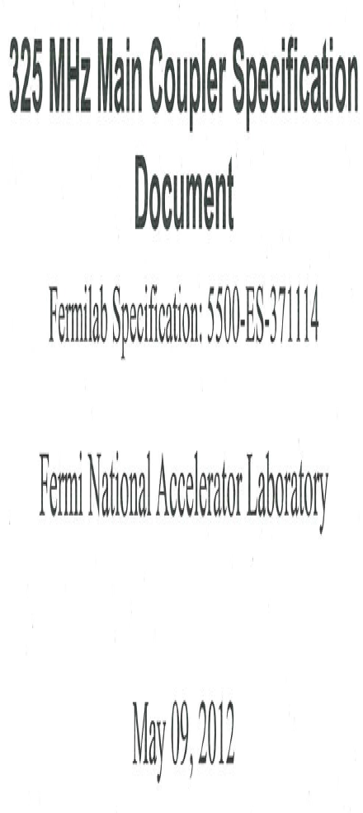
325 MHz Coupler
Material:
Coaxial coupler parts, antenna : OFE Copper, ETP Copper, brass
Vacuum Flanges facing cryogenic system: SS 316LN
928 mm
3 1/8 inch Coaxial line ( 79.3 mm OD)
Coupler part under cavity vacuum and cryogenic system

Slide 9
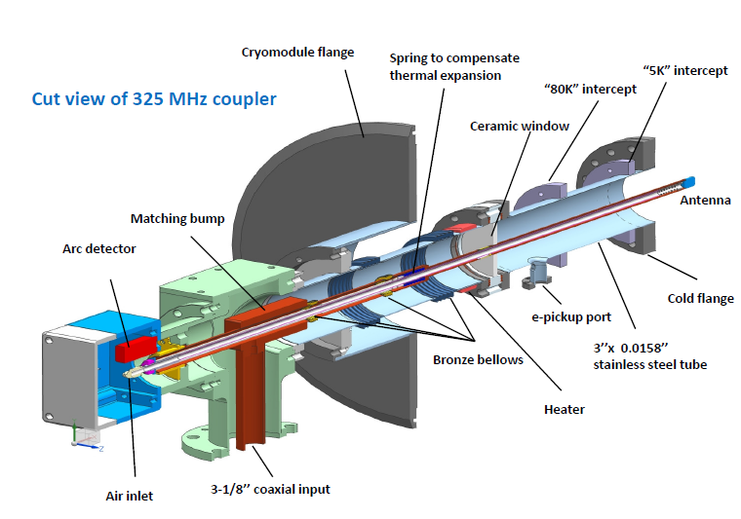
Cut view of 325 MHz Coupler

Slide 10
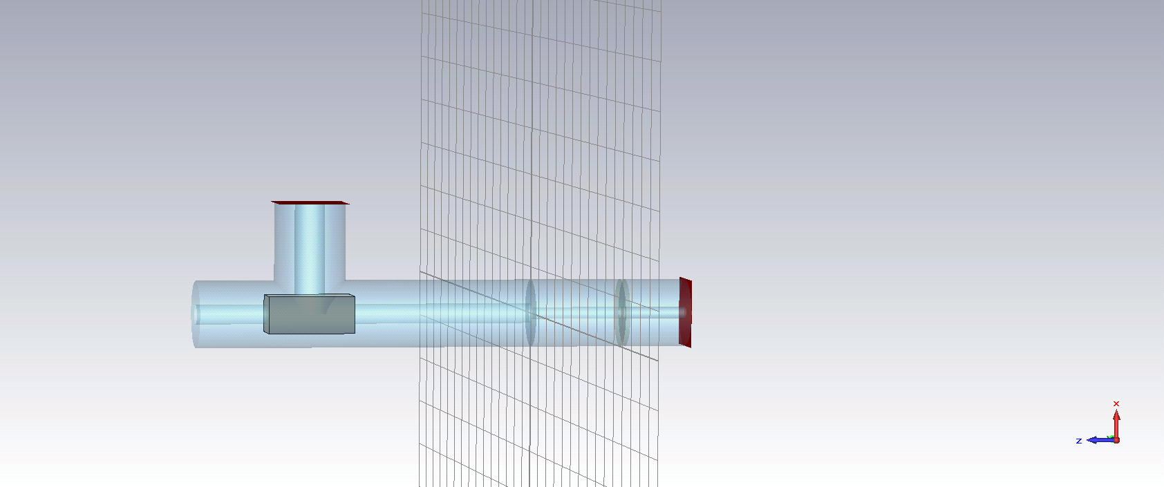
Simulation model of 325 MHz Coupler
RF in
To RF cavity
Standard 3 1/8”line, Zo= 50 Ohm
Coax. OD: 72.3 mm, ID: 12.7 mm, Zo= 100 Ohm

Slide 11
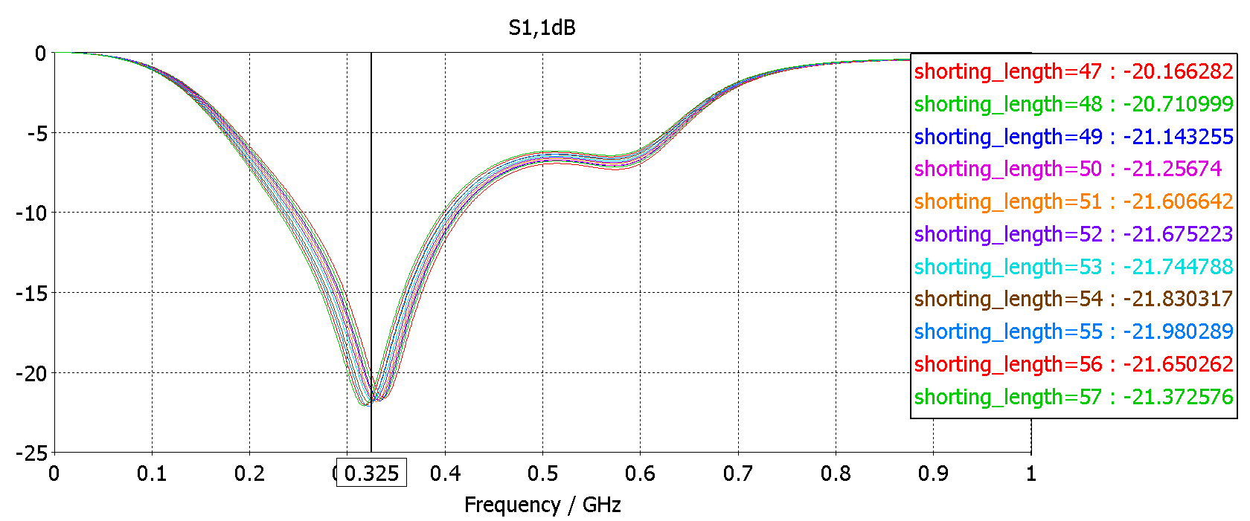
RF simulations on 325 MHz Coupler

Slide 12
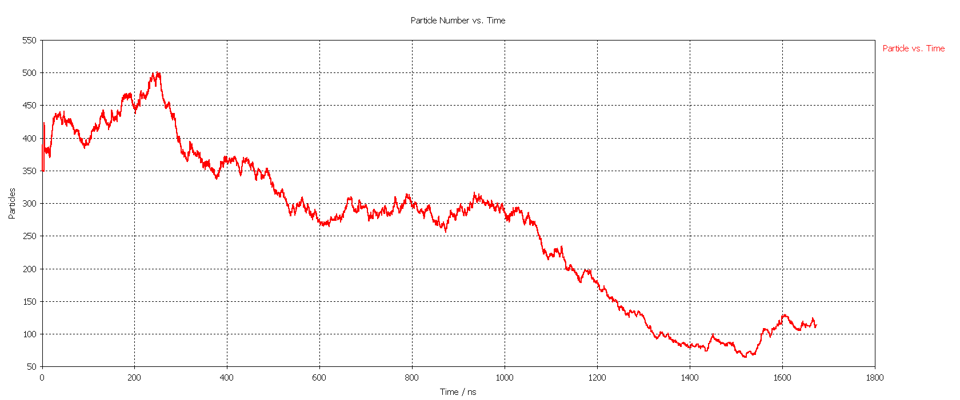
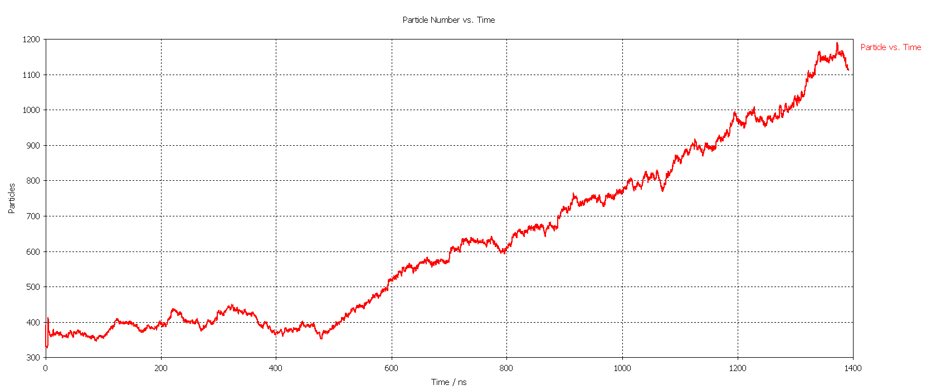
Multipacting simulation on 325 MHz Coupler
Pin = 7.2kW
Pin= 8.4 kW
Multipacting is a resonant electron multiplication in RF fields under vacuum and it can cause undesired effects like reflections, arcing, temperature rise etc. in couplers and cavities.

Slide 13
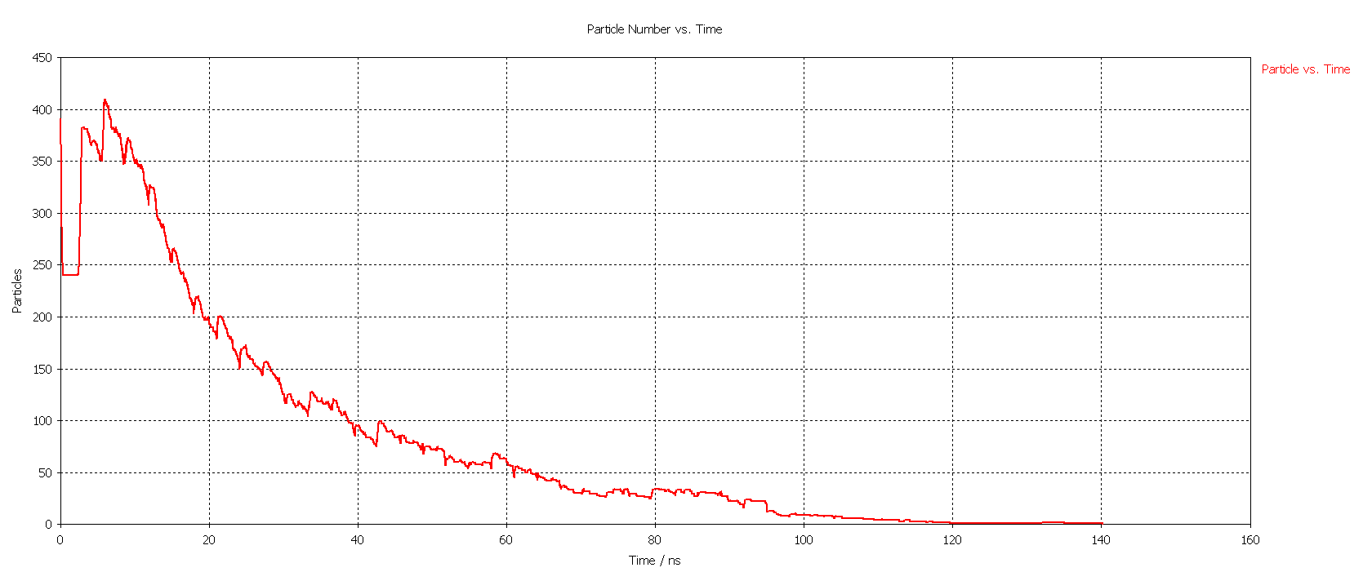
Multipacting simulation on 325 MHz Coupler contd.
One point
Two point
Pin= 270 kW
It is observed that multipacting will take place for the power levels in the range of approximately 8 kW to 270 kW for 325 MHz coupler .

Slide 14
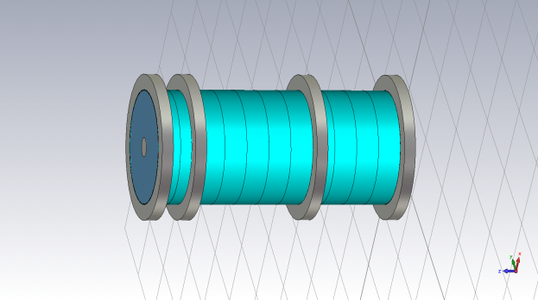
Heat load studies
2 K
15 K
125 K
300 K
d1
d2
d3
Cavity end
warm side
CST Microwave Studio Simulation model
Thermal straps to be located at 15 K and 80 K
Double window design is also under consideration at Fermilab
325 MHz coupler developed by Fermilab as per their design has recently been tested up to 7 kW CW.

Slide 15
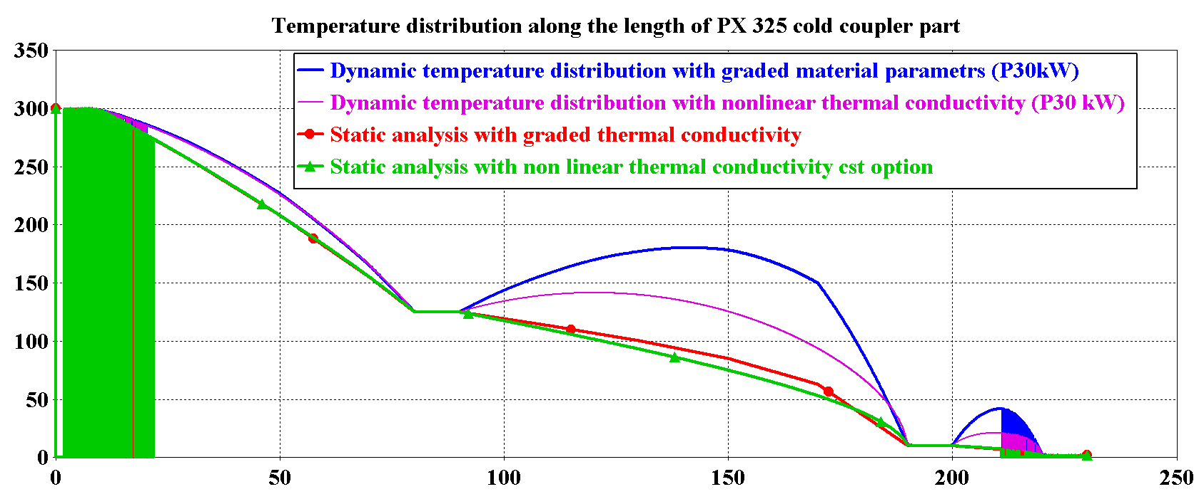
Temperature distribution along coupler length

Slide 16
Comparison with Fermilab studies
PX-325 | 2K | 10 K | 125 K | 300 K | Remarks
P= 0 kW | .017 .0173 | .687 .687 | 2.26 2.497 | 2.96 3.20 | Nonlinear Including inner conductor+ window
 | .018 | .511 | 2.28 | 2.87 | Graded
 | .023 | .63 | 2.01 | 2.66 | * Existing Fermilab Reports
P=30 kW | .422 | 3.077 | 5.547 | RF Loss=7.64 W | Nonlinear PX_325_dynamic_nonlinear With inner conductor+window
 | .35 | 2.358 | 6.206 | RF Loss=7.64 W | Nonlinear+Graded
 | .46 | 2.87 | 5.36 | RF Loss=6.03 W | * Existing Fermi lab Report

Slide 17
Non linearity in material conductivities
W/mK
S/m
T (K)
T (K)
Non linear EM Solver
2 way coupling?
Non linear Thermal Solver

Slide 18
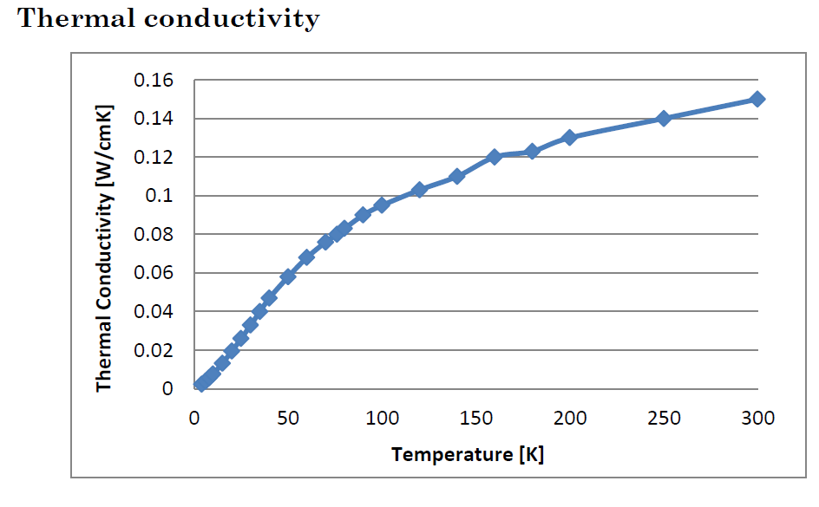
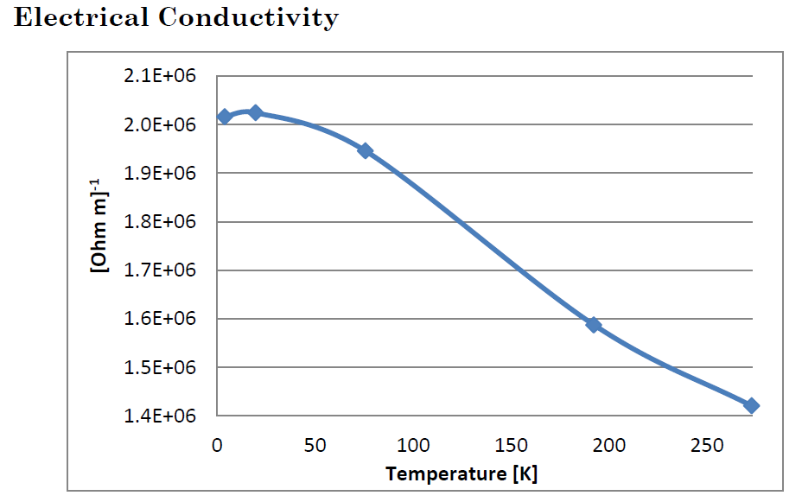
Conductivities of SS304
Thermal Conductivity
Electrical Conductivity

Slide 19
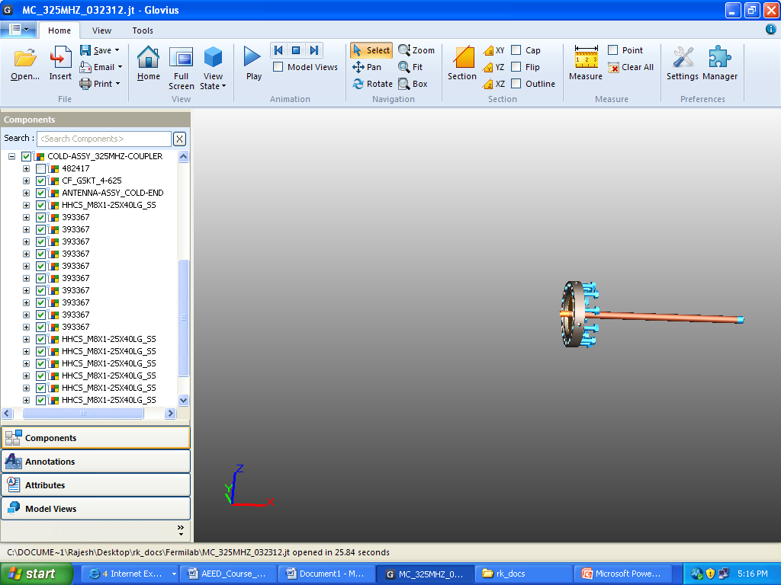
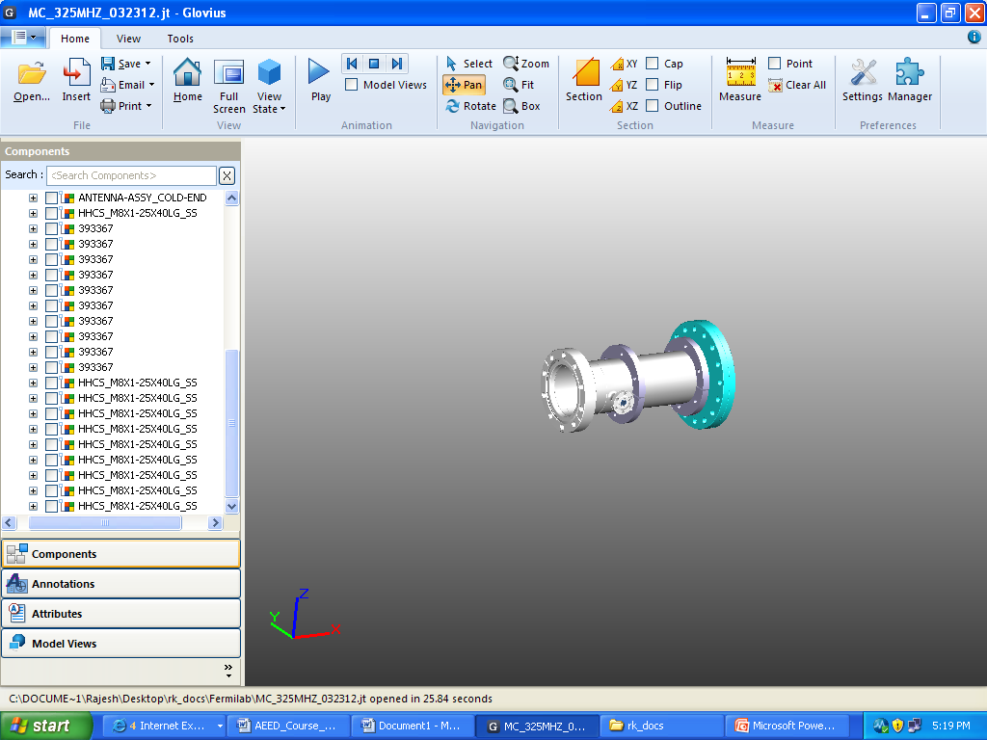
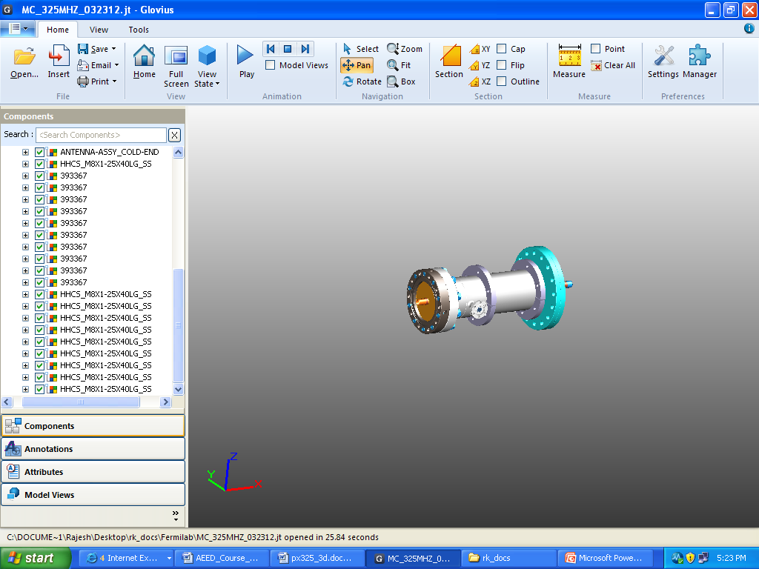
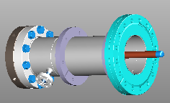
Development of RF Couplers for SC cavities
+
250 mm
It is planned to fabricate the cold coupler part including the alumina window first. The remaining warm parts of coupler can be machined in parallel and brazed/joined at later stages .

Slide 20
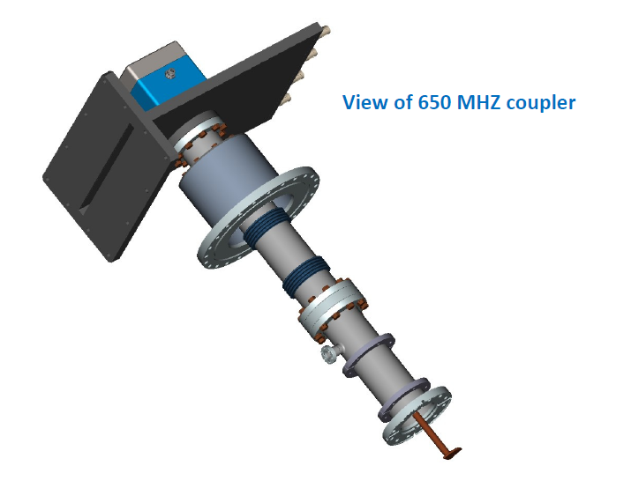
650 MHz Coupler
The overall coupler size is almost same to 325 MHz except rectangular waveguide section and antenna
Waveguide input 146.05 mm by 23 mm

Slide 21
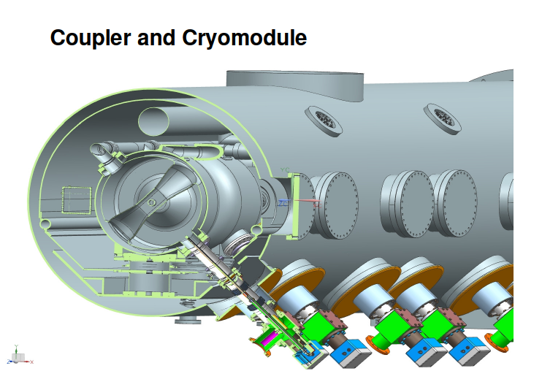
RF Couplers (325 MHz) mounted on Cryomodule
Spoke resonator Cryomodule
RF Couplers

Slide 22
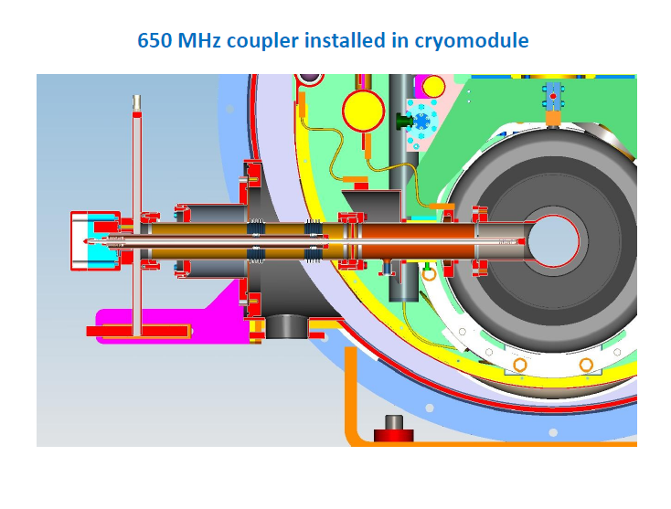
650 MHz Coupler mounted on Cryomodule

Slide 23
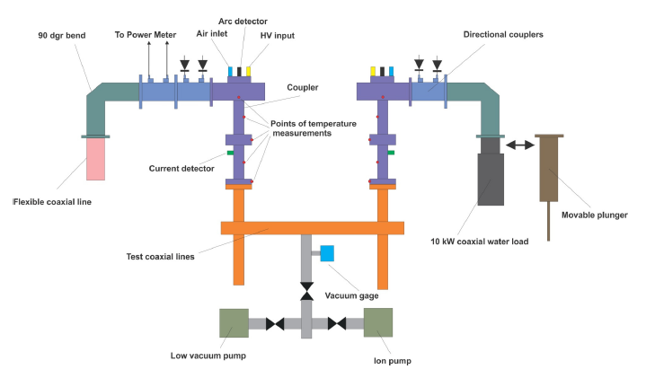
Typical Test stand for 325 MHz coupler testing at room temperature
Approx. 3 meter

Slide 24
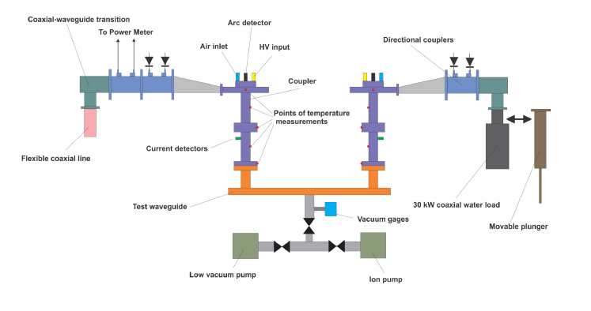
Typical Test stand for 650 MHz coupler testing at room temperature

Slide 25
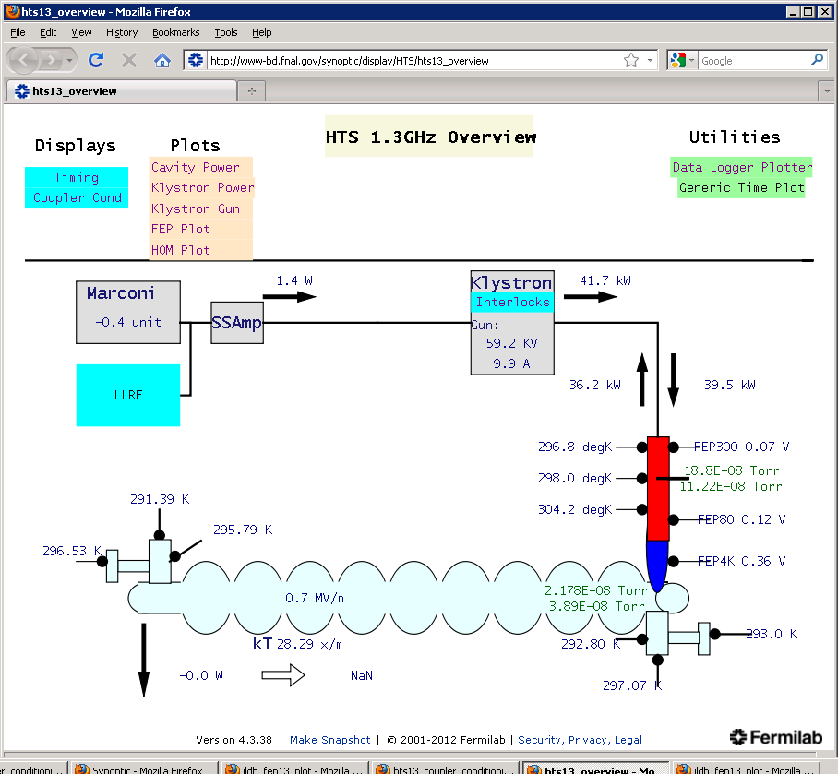
Horizontal Test stand for 1.3 GHz cavity and coupler at Fermilab

Slide 26
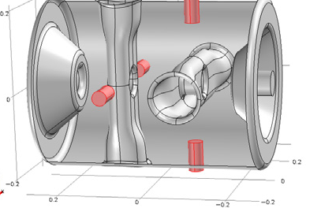
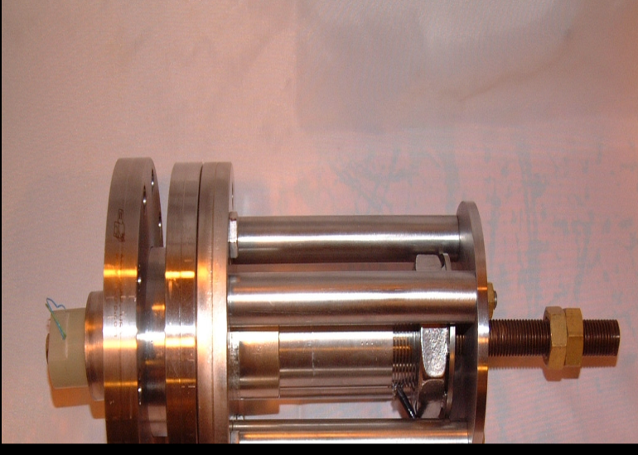
Tuners for Spoke resonators
Plunger based tuners with 20- 50 mm dia. made up of niobium ( slow tuners)
Piezoelectric fast tuner to compensate microphonics ( external vibrations related frequency disturbance)
Tuners are required to compensate for microphonics, Lorentz force detuning and fabrication errors
Ref. J.L Munoz et.al. “ Studies on a Plunger tuner system for double spoke cavity model, SRF 2011, Chicago, USA

Slide 27
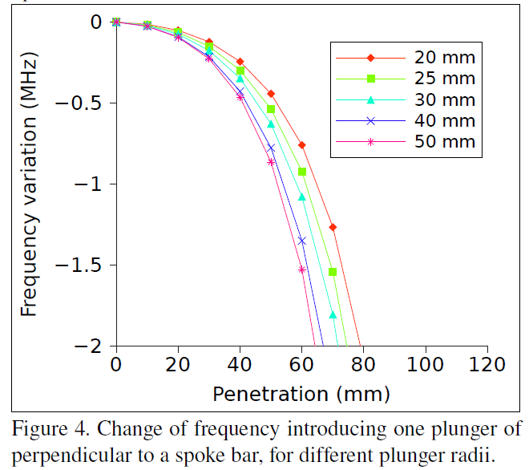
Tuners for Spoke resonators
Ref. J.L Munoz et.al. “ Studies on a Plunger tuner system for double spoke cavity model, SRF 2011, Chicago, USA

Slide 28
High Power Coupler development for LEHIPA at BARC

Slide 29
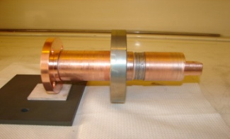
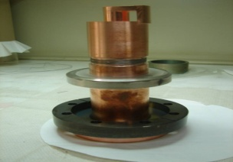
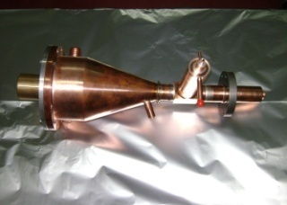
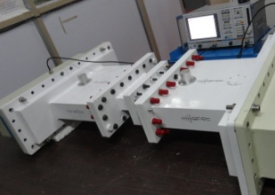
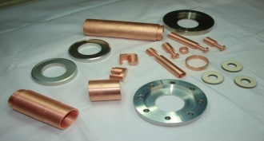
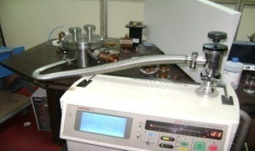
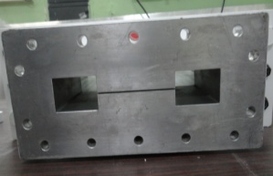
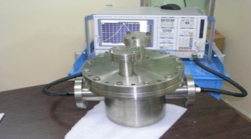
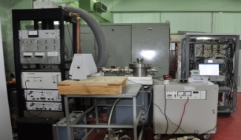
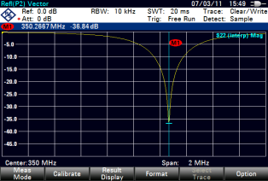
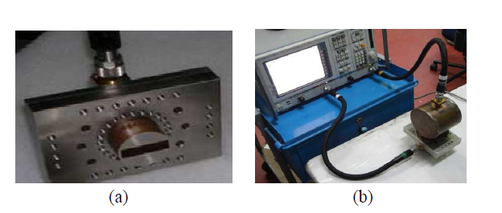
Technology development of
high power RF couplers for LEHIPA
Coaxial loop type couplers : 50 kW, 350 MHz
Coaxial quarter wave cavity : 50 kW, 350 MHz
Ridge waveguide couplers: 250 kW, 352.2 MHz
Novel tuning and coupling schemes
Coaxial couplers fabricated in collaboration with CEERI-PILANI
50 kW Peak power coaxial coupler with RF window
50 kW Peak power coupler - Three part design
50 kW CW, 350 MHz Coaxial Coupler
RF experiments on proposed method of coupling variation by iris rotation
50 kW CW coupler parts before brazing
Quarter wave 350 MHz coaxial resonator for coupler Testing
Vacuum leak testing of resonator
End ridge waveguide for iris coupling
Coupler cavity system undergoing high power RF conditioning
Return loss of critically coupled coupler-cavity system
Tunable couplers
connected for RF Characterization

Slide 30
Schematic of 50 kW CW, 350 MHz Coaxial Coupler
Rotation possibility without changing the flange location and axis
Shorted stub
Cu gasket
61/8” to 15/8” tapered transition
61/8” line from Input
Cavity flange
Notes:
30

Slide 31
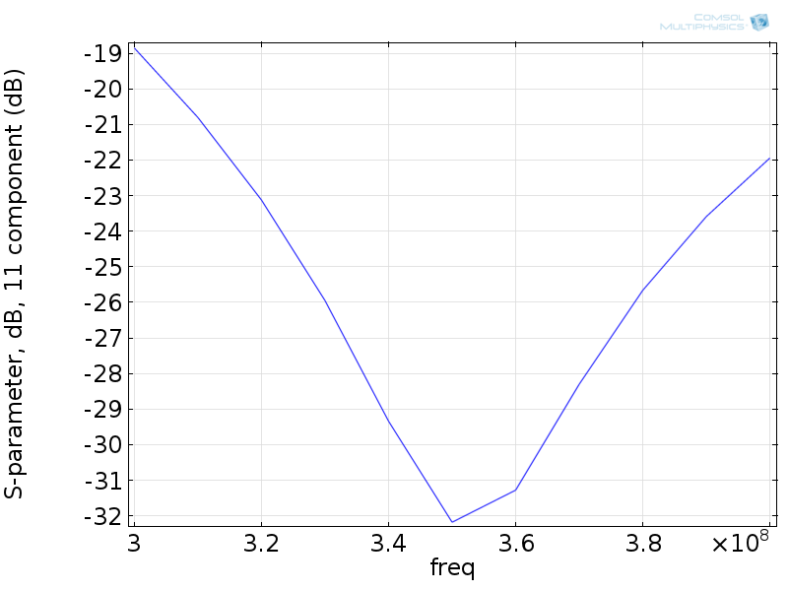
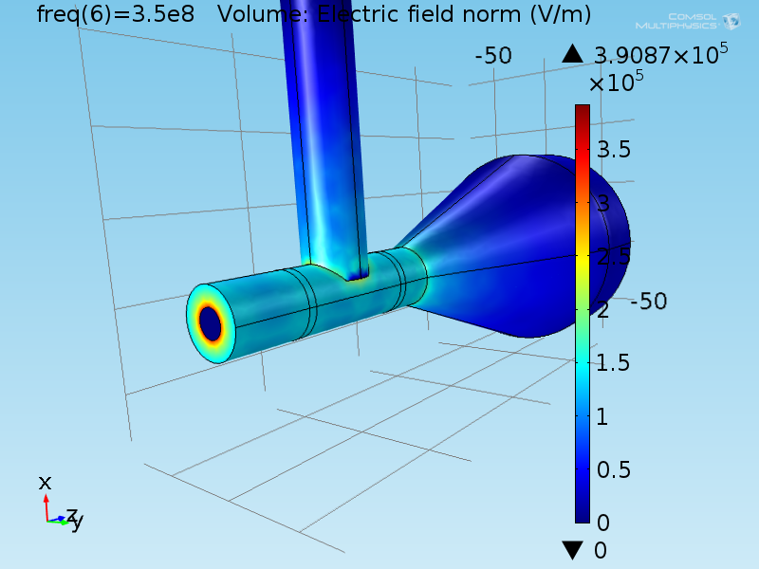
RF simulations on RF couplers
Electric fields at 50 kW input from COMSOL Multiphysics model
Return loss vs Frequency plot

Slide 32
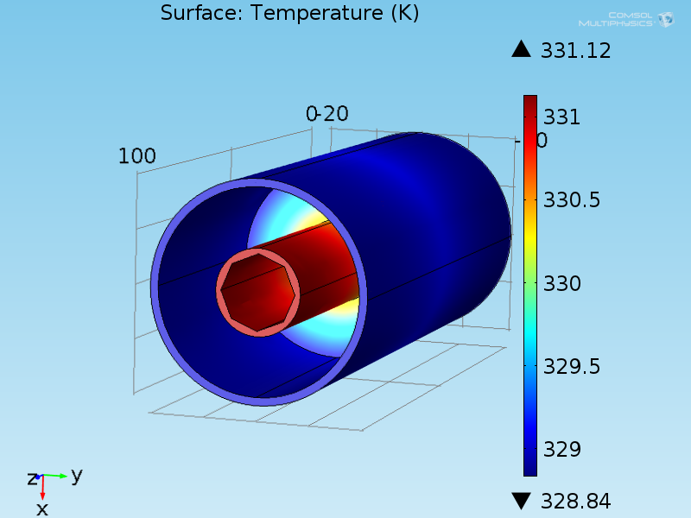
RF simulations on RF couplers contd.
10 kW, 27 W m/K, 1E-4
Temperature distribution for 10 kW input power ( loss tangent = 1E-4)

Slide 33
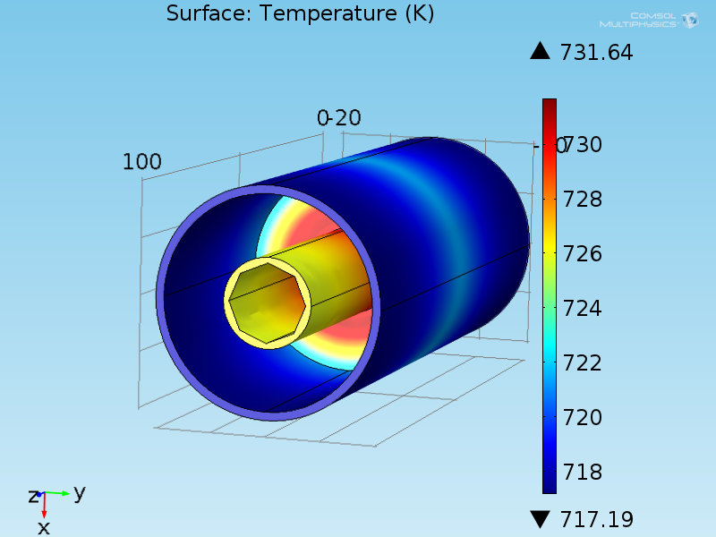
RF simulations on RF couplers contd.
10 kW, 27 W m/K, 1E-2
Temperature distribution for 10 kW input power ( loss tangent = 1E-2)

Slide 34
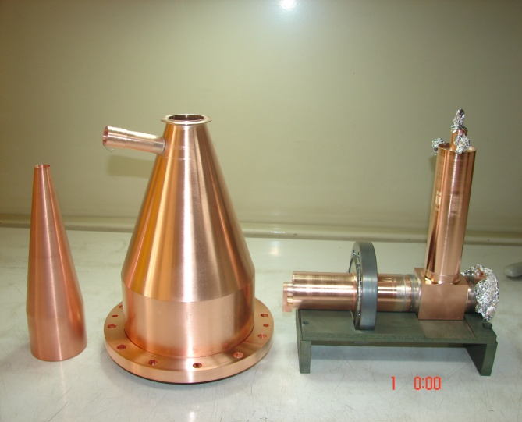

50 kW coaxial coupler with coolant channels
Coaxial Coupler parts before brazing of final assembly
Coaxial coupler assembly after brazing

Slide 35

High power testing of coaxial coupler
Coaxial Couplers have been tested up to 58 kW RF power at 1 ms, 1 Hz duty cycle
( for deuteron beam
experiments from RFQ)
CW Power has been raised up to 1 kW
50 kW, CW, 350 MHz RF Power Coupler developed in collaboration with CEERI PILANI

Slide 36
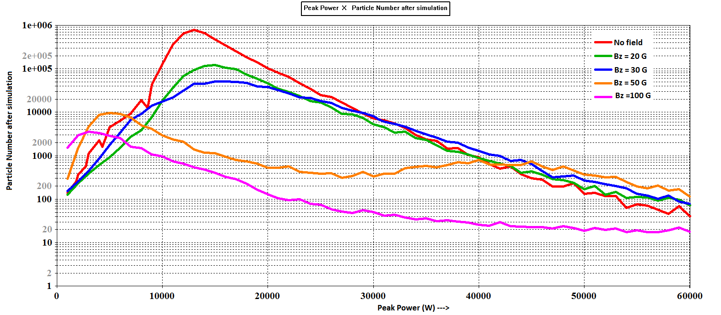
Multipacting suppression studies using magnetic field in coaxial coupler
For Axial B Field

Slide 37
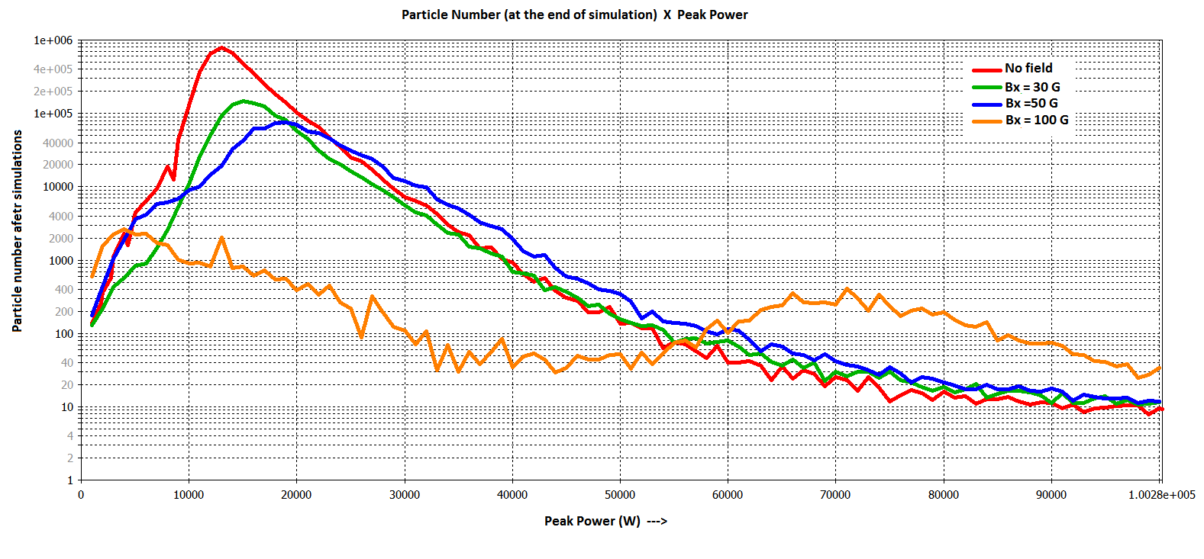
Multipacting suppression studies using magnetic field in coaxial coupler contd.
For transverse B Field

Slide 38

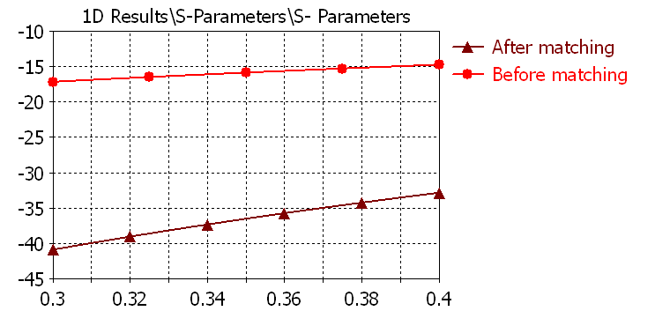
Coupler Fabrication and Testing status
50 kW Peak power Coaxial coupler used during beam acceleration from RFQ

Slide 39
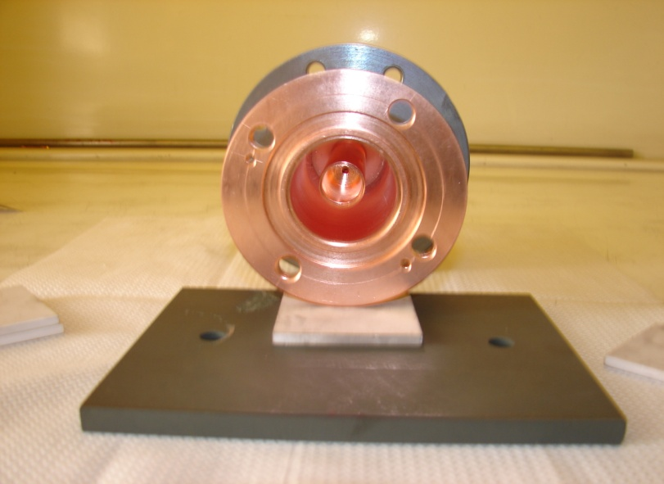
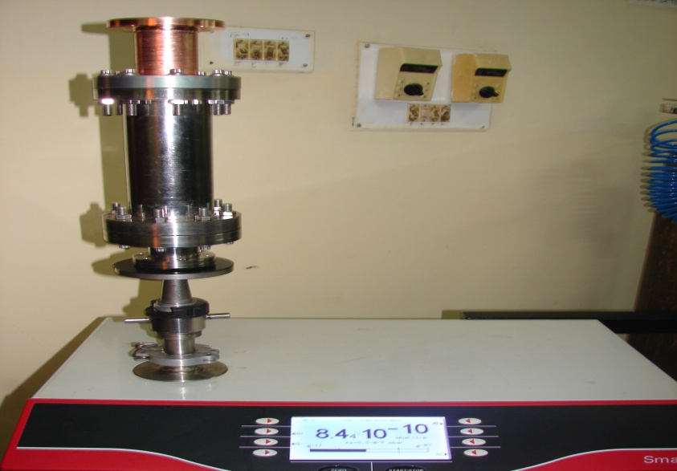
Coupler Fabrication and Testing status contd.
Coupler view from window side
Vacuum Leak Testing at CEERI-PILANI

Slide 40

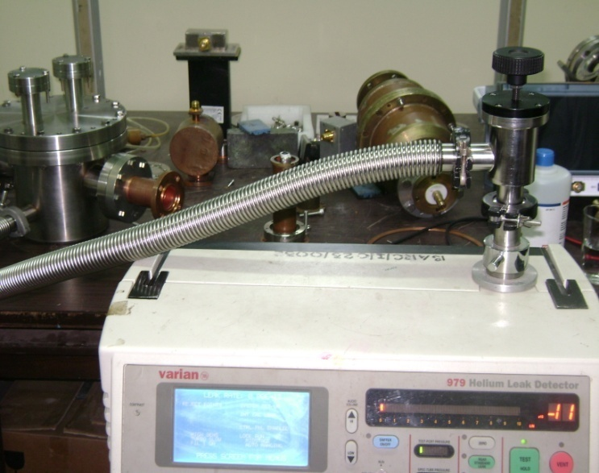
RF cavity for coupler testing
RF Cavity developed for Coaxial Coupler Conditioning
RF Coupler leak tested at LEHIPA, BARC
Notes:
40

Slide 41
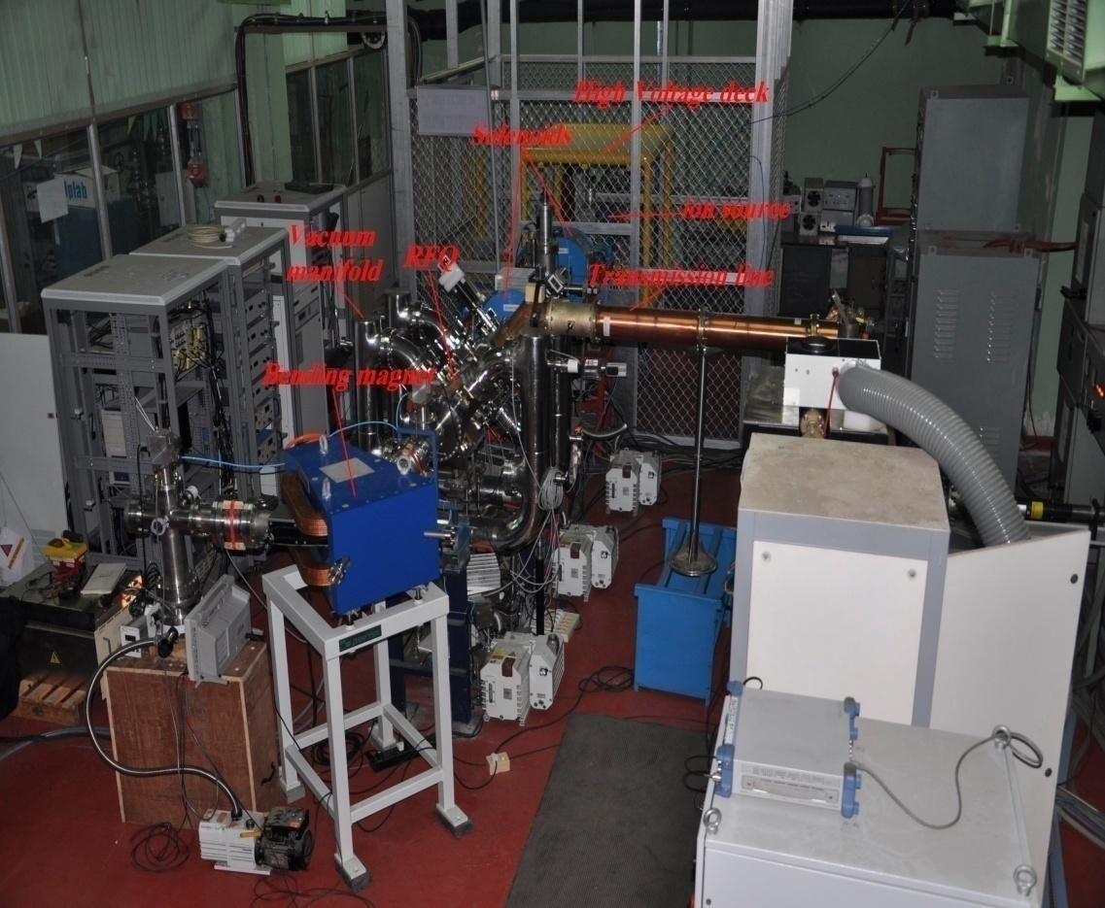
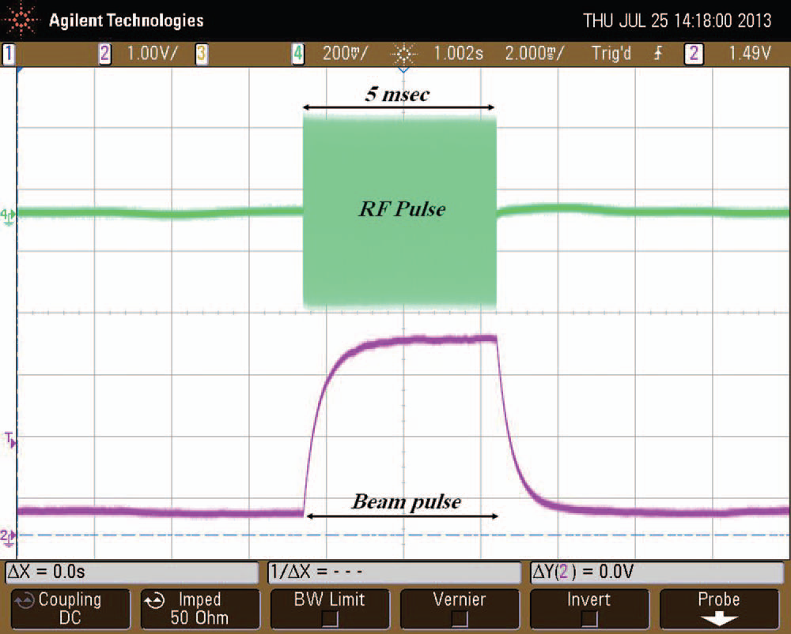
Coaxial couplers testing on RFQ cavity
RF Coupler, tested up to 15 kW, with 0.5% duty cycle & 58 kW, 350 MHz with 0.1 % duty cycle

Slide 42
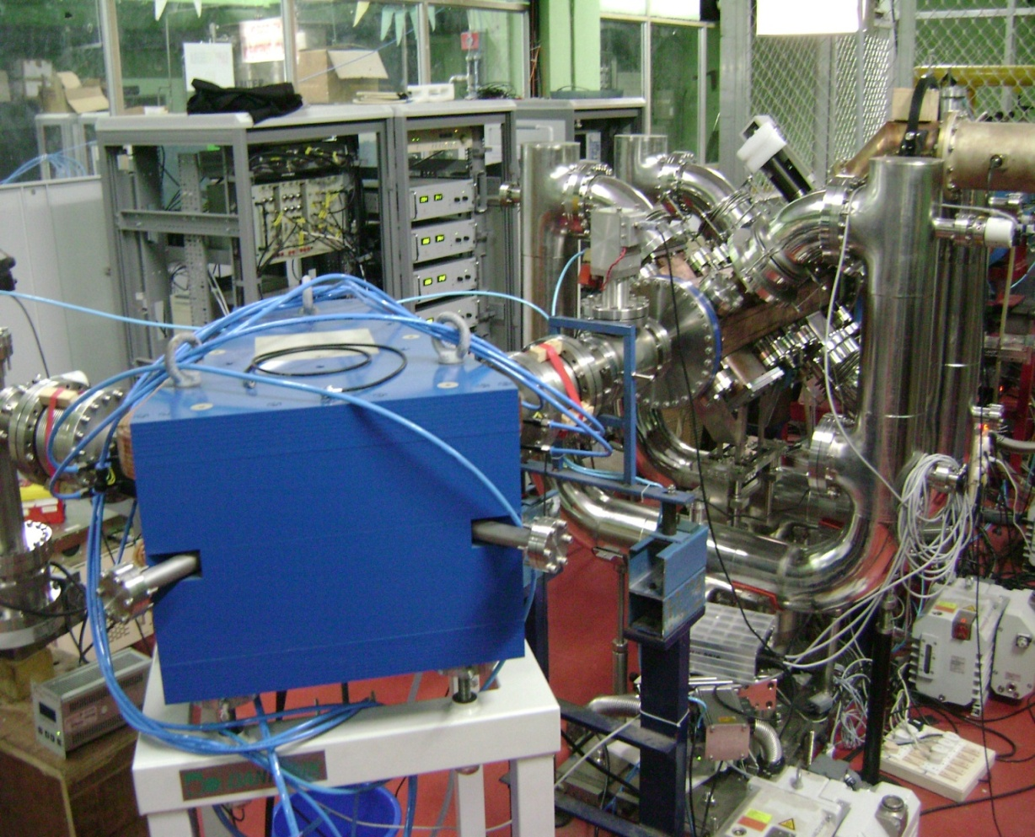
Coaxial Coupler feeding power to RFQ cavity
Proton beam acceleration from RFQ at 15 kW, 1 ms 1 Hz RF Power
Deuteron beam experiments from RFQ at 58 kW, 1 ms, 1 Hz RF Power

Slide 43
Straight ridge transition based coupler for 352.2 MHz
Top view of the coupler Cross-section view of coupler

Slide 44


Proposed tuners on straight ridge transition based coupler
CST Microwave studio model of coupler with tuners Return loss variation with frequency

Slide 45


Prototypes of ridge waveguide couplers
250 kW, 352.2 MHz ridge loaded waveguide iris coupler prototypes for RFQ and DTL cavities

Slide 46

RF Measurements on ridge waveguide couplers ( with out tuners )

Slide 47

RF Measurements on ridge waveguide couplers ( with tuners )

Slide 48


Thermal analysis of high power waveguide couplers for LEHIPA
Ref. Vishnu Verma and R. K. Singh, Reactor Safety Division, BARC
Temperature plot in the Iris and end ridge waveguide (flow velocity 2.0m/sec, material Copper)

Slide 49

Waveguide coupler (250 kW, 352.2 MHZ ) for 20 MeV proton accelerator LEHIPA
250 kW, CW, 352 MHz RF waveguide Coupler under development

Slide 50


Coupling coefficient tuning using iris rotation
A coupling coefficient adjustment scheme based on iris rotation is proposed.

Slide 51
Recent Publications on RF Couplers
Journal Publications:
Rajesh Kumar, “A novel method for variable coupling using iris rotation in RF couplers”, Nuclear Instruments and Methods in Physics Research A, Vol. 600, 534-537 (2009)
Rajesh Kumar, P.Singh, Divya Unnikrishanan and Girish Kumar, “A tunable waveguide to cavity coupler for high power accelerator cavities”, Nuclear Instruments and Methods in Physics Research A,Vol. 664, 203-213 (2012)
Rajesh Kumar, P. Singh, M.S Bhatia and Girish Kumar, “Analytical Method for coupling calculations of rotated iris coupled resonator cavity”, Progress In Electromagnetics Research B, Vol. 44,223-239 (2012)
Rajesh Kumar, P. Singh, Pratigya Mathur and Girish Kumar, “Comparative electromagnetic analysis of ridge waveguide couplers for accelerator cavities, Nuclear Instruments and Methods in Physics Research A,Vol. 736,99-106 (2014)
Conference Publications :
Rajesh Kumar, P. Jain, S.V.L.S Rao, Manish Kumar, P.K Biswas, S.B Jawale and P.Singh, “High power RF Coupler development for LEHIPA”, Indian Particle accelerator conference (INPAC-2009),-RRCAT-Indore Jan.-2009
Rajesh Kumar, G.N Singh and P Singh, “ Development of 350 MHz quarter wave coaxial resonator for power coupler testing”, IEEE Applied Electromagnetic conference –IEEE-AEMC09 Dec 14-16-2009, Kolkata, India
Rajesh Kumar, P. Singh and L.M. Joshi, “Development of under-cut type RF window for 50 kW Power coupler”, IEEE Applied Electromagnetic conference –IEEE-AEMC11, Dec 18-21,2011 Kolkata, India

Slide 52
Summary
325 MHz couple design has been provided by Fermilab to BARC. Its preliminary design aspects have been studied here and detailed analysis is in progress.
The coupler prototype fabrication related efforts have been initiated and first coupler prototype should be ready by June 2016.
650 MHz design details will be discussed further and obtained from Fermilab in due course of time. Material procurement for first prototypes is initiated.
Tuners design and development need to be explored and discussed further with Fermilab along with cavity development

Slide 53
Thanks

