Slide 1
Physics design of 1 GeV Accelerator
S.V.L.S Rao
On behalf of our IADD

Slide 2
Outline of talk
Purpose of doing these studies
LEHIPA parameters
1 GeV Linac simulations
Future studies

Slide 3
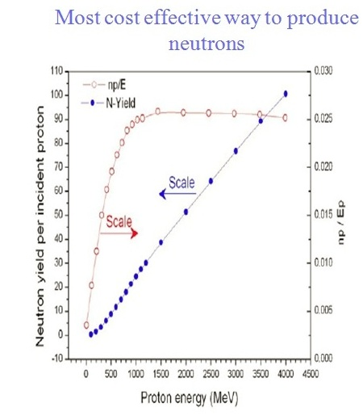
ADS
High energy proton accelerator
Spallation target
Sub-Critical reactor

Slide 4
Beam current requirement
P_{th} (MW) | I (mA) k=0.95
1000 | 29.2
1500 | 43.9
2000 | 58.5
2500 | 73.1
3000 | 87.7
I (mA) k=0.98
10.2
15.3
20.4
25.5
30.6
Proton Energy : 1 GeV
ν_{s} = 25 neutrons/proton
ν = 2.5 neutrons/fission

Slide 5
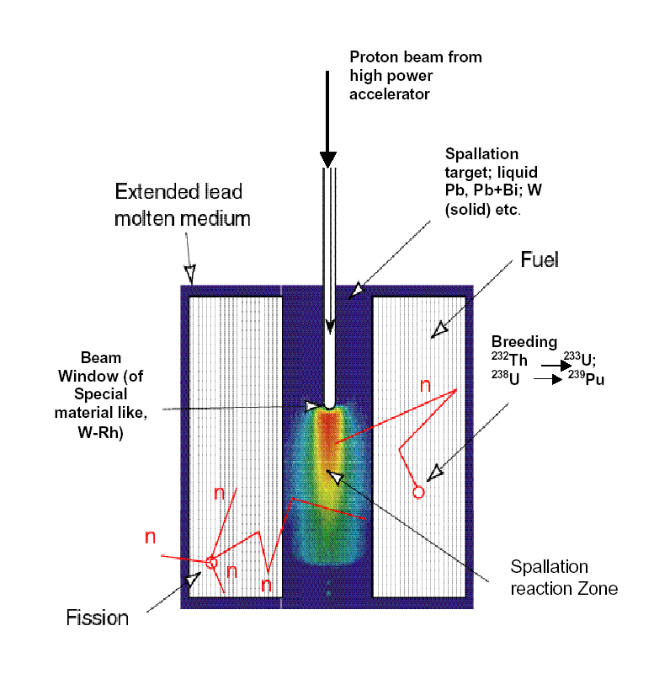
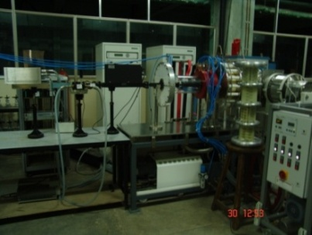
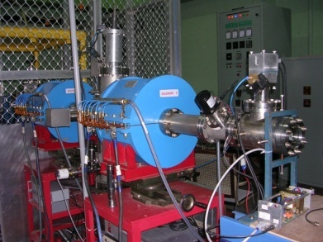
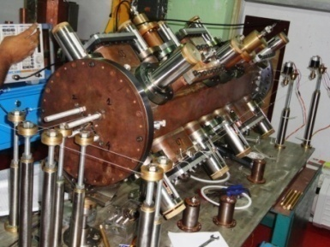
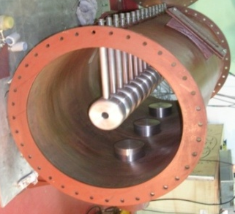
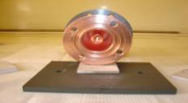
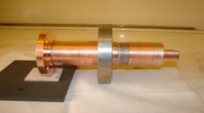
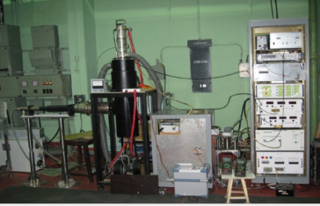
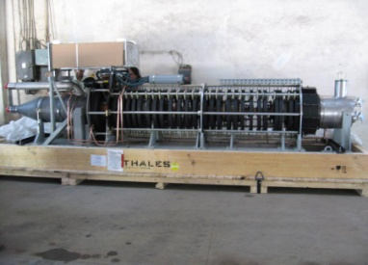
Schematic of Accelerator Development
LEHIPA
Normal Conducting
Phase III
High current injector 20 MeV, 30 mA
DTL/
CCDTL
SC Linac
Proton IS
50 keV
RFQ
3 MeV
DTL
20 MeV
200 MeV
Phase II
Phase 1
Super-
conducting
Design completed & fabrication is in progress
1 GeV
ECR Ion Source
LEBT
RFQ
Drift Tube Linac
50 kW RF Coupler
60 kW RF System
1.3 MW Klystron

Slide 6

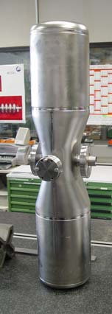


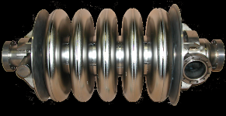
Schematic of New 1 GeV accelerator
IS
RFQ
MEBT
HWR,
SSR
Elliptical
Cavities
Elliptical Cavities
LEBT
50 keV
3 MeV
150 MeV
200 MeV
1 GeV

Slide 7
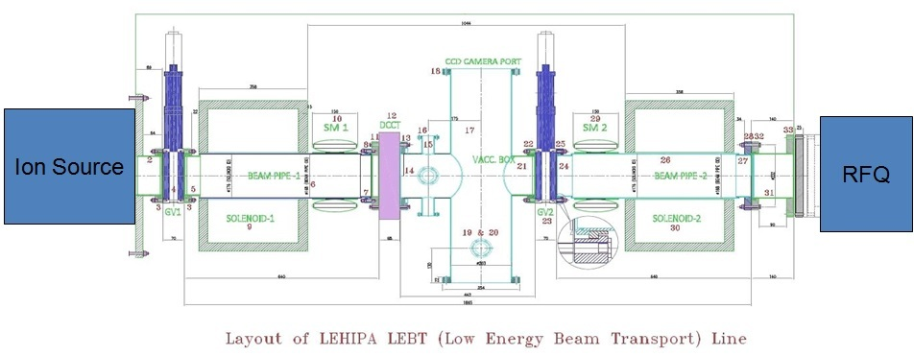
LEHIPA parameters:
Element | Length (cm) | Strength (G)
Drift | 110
Solenoid | 30 | 1481
Drift | 140
Solenoid | 30 | 2004
Drift | 20
Parameters of the RFQ
Layout of MEBT
Frequency | 352.21 MHz
Energy | 50 keV/ 3 MeV
Input current | 30 mA
Vane voltage | 68 kV
Avg. Aperture R₀ | 3.063 mm
_{Modulations} | 1-1.81
Length | 4 m
Total RF power (1.37SF) | 470 kW
Transmission* | 96%
21
8
5
8
10
7
10
8
5
8
25.5
D
EMQ₁
EMQ₂
EMQ₃
EMQ₄
D
BC
115.5 cm
EMQ No | B Field Gradient (T/m) | Eff. Length (cm)
1 | -24.18 | 8
2 | 18.69 | 8
3 | 19.20 | 8
4 | -23.49 | 8

Slide 8
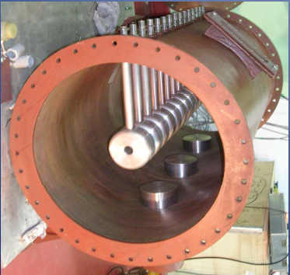
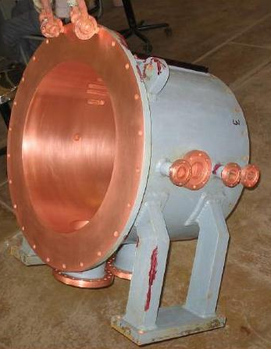
DTL parameters:
Parameters |  | Tank 1 | Tank 2 | Tank 3 | Tank 4
Input Energy (MeV) |  | 3.03 | 6.86 | 11.26 | 15.75
Output Energy (MeV) |  | 6.86 | 11.26 | 15.75 | 20.23
No. of cells |  | 36 | 28 | 23 | 20
Lattice period |  | 4 βλ | 4 βλ | 4 βλ | 4 βλ
Current (mA) |  | 29.38 | 29.38 | 29.38 | 29.38
Eff. Length of quad (cm) |  | 4.715 | 4.715 | 4.715 | 4.715
No. of quads. |  | 37 | 29 | 24 | 21
Aperture radius (cm) |  | 1.2 | 1.2 | 1.2 | 1.2
Synchronous phase |  | -30 | -30 | -30 | -30
Acc. Field grad. (MV/m) |  | 2.14 | 2.14 | 2.14 | 2.14
Dissipated Power (kW) |  | 284.14 | 285.14 | 279.85 | 277.7
Tank Length (m) |  | 3.05 | 3.26 | 3.27 | 3.28
Drift space after tank (cm) |  | 5.553 | 8.388 | 10.684
No. of Post Couplers |  | 12 | 14 | 11 | 10
No. of tuners |  | 6 | 6 | 6 | 6
No. of rf ports |  | 2 | 2 | 2 | 2
No. of Vacuum ports |  | 2 | 2 | 2 | 2
Norm. RMS Emittance | x(π cm mrad) | 0.02134- 0.02113 | 0.02107 | 0.02102 | 0.02119
 | y(π cm mrad) | 0.02037-0.02062 | 0.02091 | 0.02111 | 0.02123
Long. Emittance(deg. MeV) |  | 0.10392- 0.11131 | 0.11211 | 0.11335 | 0.11536
1.2 m long prototype DTL

Slide 9
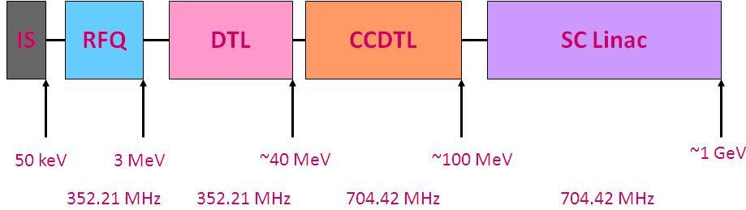
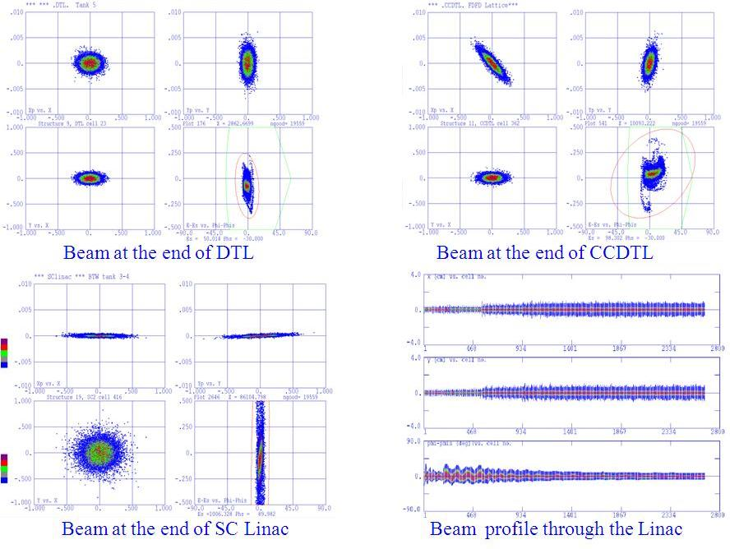
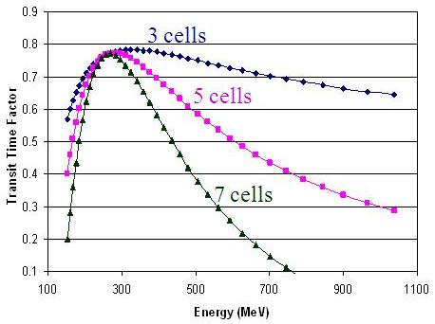
Old 1 GeV Linac:
Beta: 0.49,0.62 and 0.8
Computer codes:
Lidos and Parmila

Slide 10
New 1 GeV Linac Layout
MEBT
ECR Ion source
RFQ (NC)
(SRF Linac)
325 MHz, 30 mA
325, 650 MHz
Spoke and elliptical
3 MeV
RFQ designs:
computer code Toutatis is used
3 MeV 325 MHz RFQ (LANL type design)
  Shaper section has modified
3 MeV 162.5 MHz RFQ

Slide 11
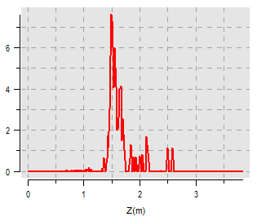
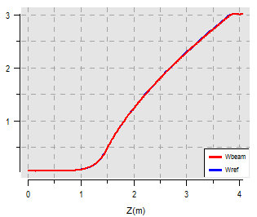
RFQ for 200 MeV Linac:
Requirement:
Good beam quality
(Long emittance should be less)
Maximize the Transmission
Results:
Length of RFQ : 4 m
Transmission : 99.6 %
Accelerated : 99.3 %
(3+/-0.072 MeV)
RMS emittances at exit of RFQ:
O/P T emit: 0.02 cm-mrad
O/P L emit: 0.03 cm-mrad

Slide 12
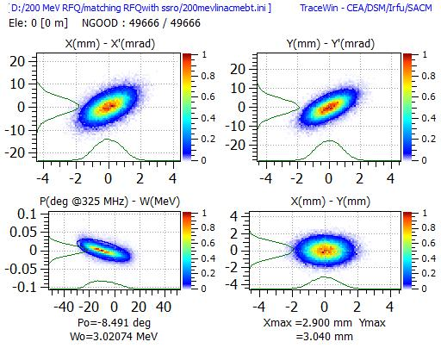
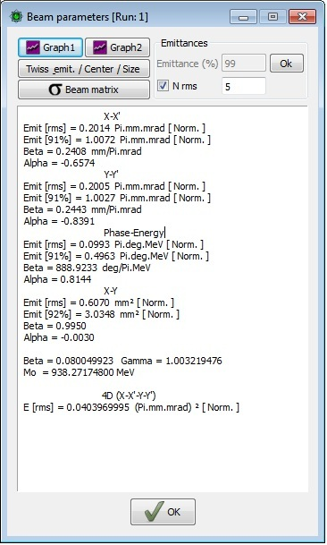
Input distribution to MEBT:
Input distribution to RFQ is 6 sigma gaussian

Slide 13
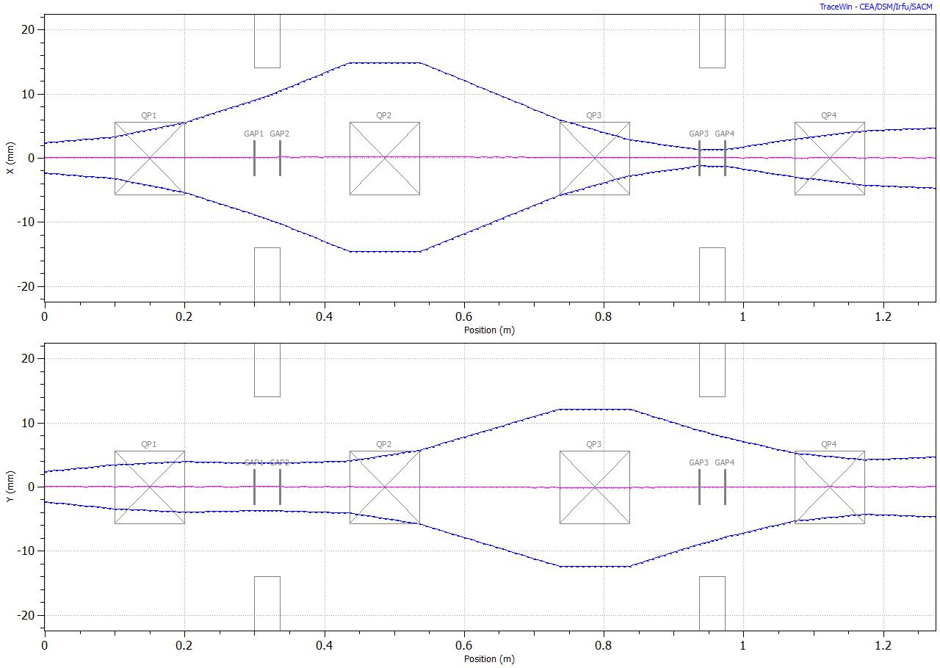
Medium Energy Beam Transport (MEBT):

Slide 14
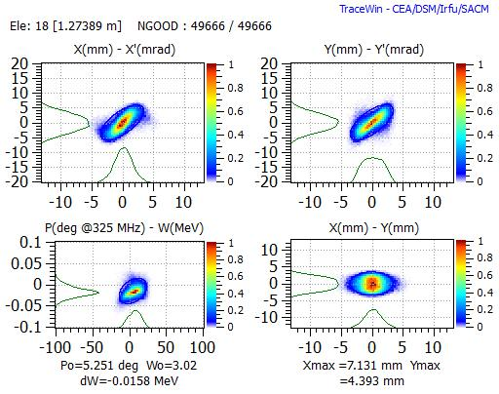
Rms emittance:
Transverse : 0.245 mm mrad
Longitudinal : 0.286 mm mrad

Slide 15
SRF Linac Layout
SSR0
SSR1
SSR2
Ell 0.6
Ell 0.8
Section | β_{G} | Frequency (MHz) | Energy (MeV) | No. of cavities | Length (m) | Focusing
SSR0 | 0.11 | 325 | 3-10.51 | 19 | 13.71 | SC Solenoids
SSR1 | 0.21 | 325 | 10.51-50.05 | 26 | 23.24
SSR2 | 0.4 | 325 | 50.05-205.17 | 53 | 51.36
Ell 0.6 | 0.6 | 650 | 205.17-440.35 | 48 | 129.45 | Warm Quad doublets
Ell 0.8 | 0.8 | 650 | 440.35-1001.5 | 63 | 120.06
Total Length = 337.86
Computer codes:
Toutatis, GenlinWin and TraceWin

Slide 16
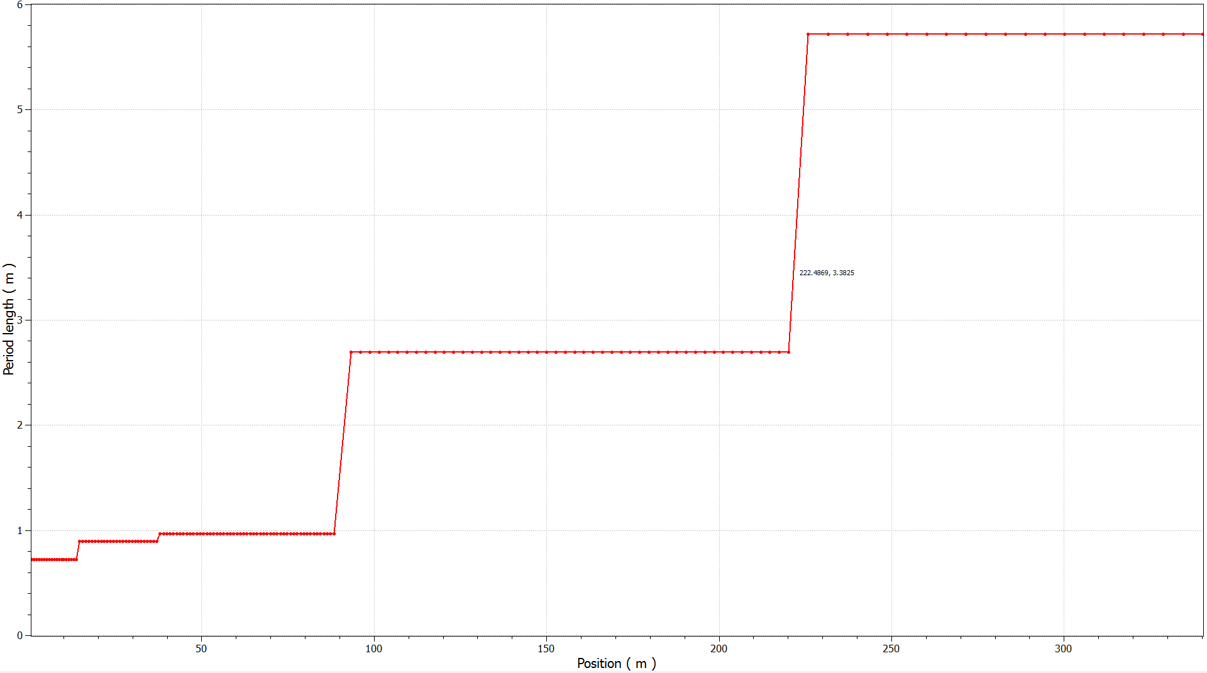
Period Length & Lattice Type
SSR : Solenoid Cavity Solenoid
Ell 0.6 : Quad Doublet Cavity Quad Doublet
Ell 0.8 : Quad Doublet Cavity Cavity Cavity Quad Doublet

Slide 17
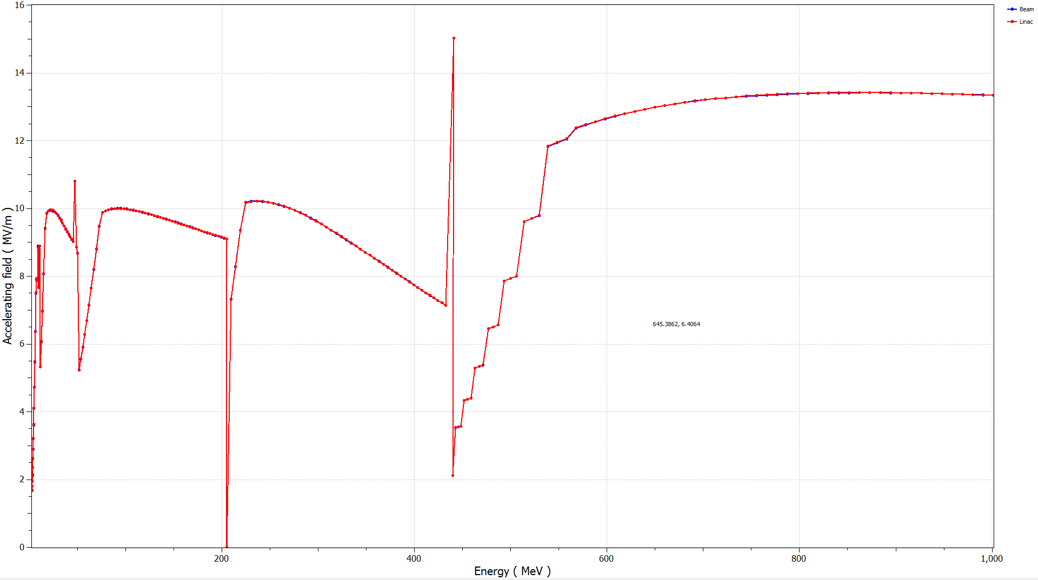
Accelerating field Gradient in SRF Linac cavities

Slide 18
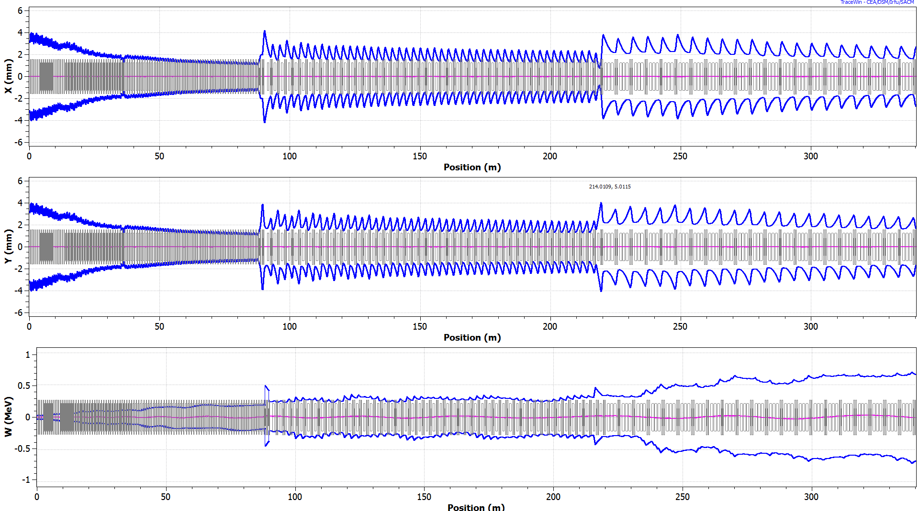
Beam Envelopes for 30 mA beam

Slide 19
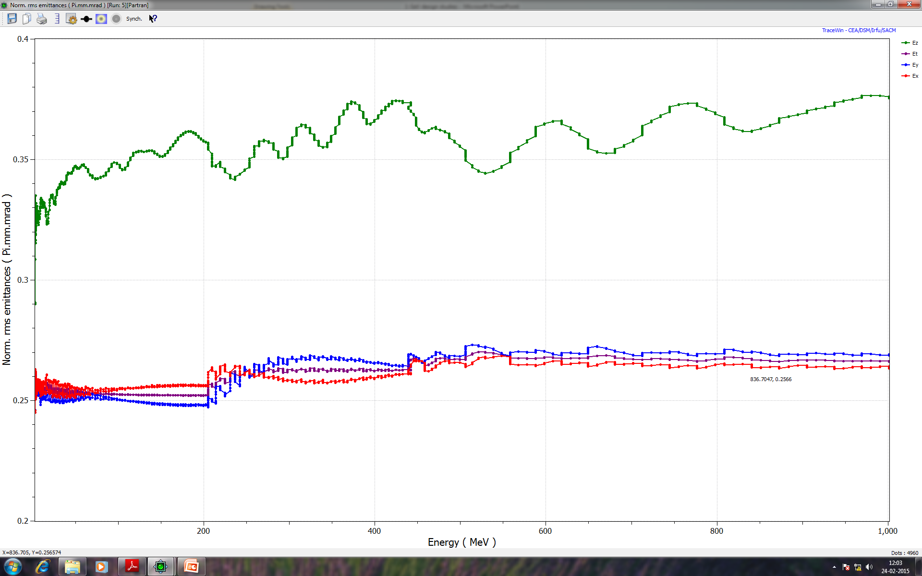
Evolution of Beam emittances along the SRF Linac:
Input emittance:
ε_{x} = 0.245 π mm mrad
ε_{y} = 0.245 π mm mrad
ε_{z} = 0.29 π mm mrad
= 0.106 π deg MeV
Output emittance:
ε_{x} = 0.263 π mm mrad
ε_{y} = 0.269 π mm mrad
ε_{z} = 0.376 π mm mrad
= 0.138 π deg MeV

Slide 20
Maximum Power required for SRF cavities
Cavity | Max Energy gain (MeV/cavity) | Max Beam power (kW/cavity)
SSR0 | 1.65 | 50
SSR1 | 1.65 | 50
SSR2 | 3.00 | 90
Elliptical (beta=0.6) | 6.00 | 180
Elliptical (beta=0.8) | 10.00 | 300

Slide 21
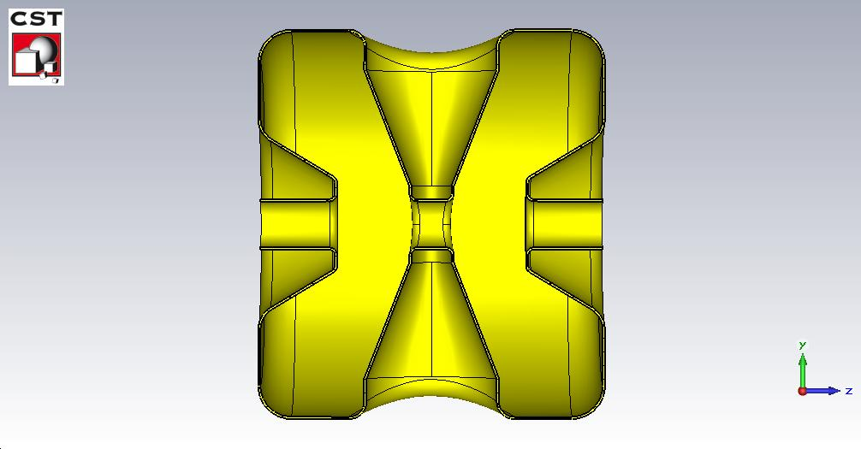
SSR1 cavity design studies:
CST Microwave studio
D
Parameters | Value | Units
Frequency | 325 | MHz
Geometric beta | 0.21
Beta (opt) | 0.22
Aperture (dia) | 30 | mm
R/Q | 255 | Ohm
Transit time factor | 0.84
Ep/Eacc | 4.28
Bp/Eacc | 7.24 | mT/MV/m
Height of spoke | 48.9 | cm
Thickness of spoke near beam axis | 4.08 | cm
Lcav
H
T
Liris
Sectional view of SSR cavity

Slide 22
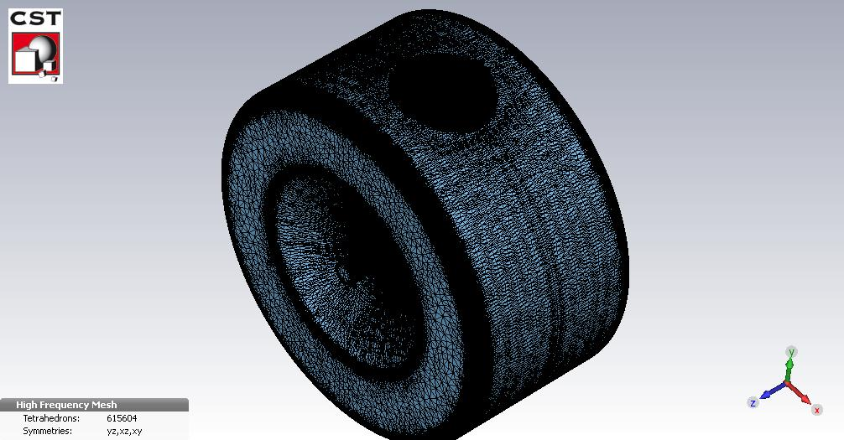
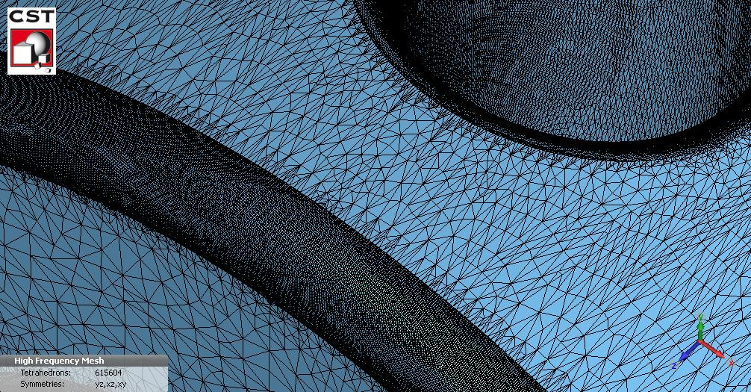
CST Tetrahedral mesh:
Ratio of Ep to Eacc
Transit time factor

Slide 23
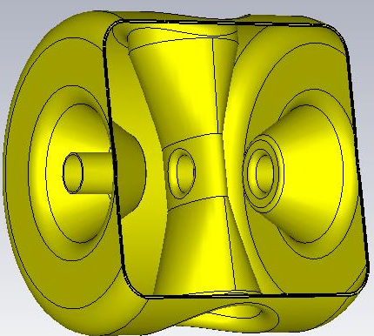
Parameters of SSR2 cavity:
Parameters | Value | Units
Frequency | 325 | MHz
Geometric beta | 0.4
Beta (opt) | 0.4
Aperture (dia) | 60 | mm
R/Q | 271 | Ohm
Transit time factor | 0.81
Ep/Eacc | 5.54
Bp/Eacc | 7.87 | mT/MV/m
Height of spoke | 50.25 | Cm
Thickness of spoke near beam axis | 5.83 | Cm
Transit time factor vs beta (v/c)

Slide 24
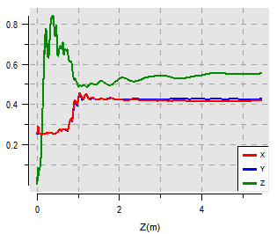
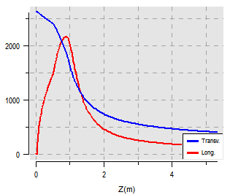
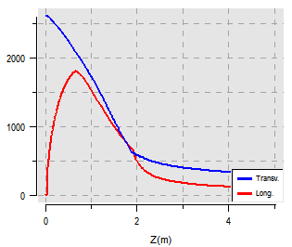
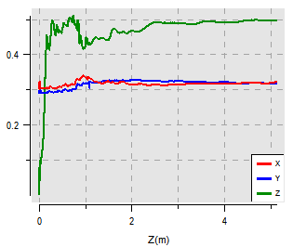
162.5 MHz RFQ design studies
No. of particles in a bunch
  5.7e8 (30 mA, 325 MHz)
  5.7e8 (15 mA, 162.5 MHz)

Slide 25
Parameters of 162.5 MHz RFQ
Parameters | BARC (RFQ) | PXIE RFQ
Frequency | 162.5 MHz | 162.5 MHz
I/O energy | 0.03/2.1 MeV | 0.03/2.1 MeV
Beam current | 15 mA | 5 mA
Vane voltage | 60 kV | 60 kV
Length | 5.15 m | 4.35 m
I/O Rms emittance | 0.3/0.32 mm-mrad | 0.11/0.14 mm mrad
Long* | 0.50/0.09/1.54 | 0.22/0.04/0.68
Transmission | 99 % | 99.8 %
Acceleration efficiency | 0.58 | 0.69
* Longitudinal emittance: mm-mrad/MeV-deg/kev-nsec

Slide 26
Future studies:
Beam dynamics
  End-to-end simulations
  Complete error analysis
  Fault-tolerance studies
Cavity design
  Effect of HOM in the superconducting cavities (spoke and elliptical cavities)
  Lorentz force detuning and its compensation

Slide 27


