Slide 1
RF Control and Instrumentation for IIFC
Electronics Division
BARC
27th February, 2015

Slide 2
IIFC: Areas of C&I Collaboration
As part of Addendum VII to MoU on Instrumentation and Control
C&I for CMTS
  RF Protection Interlock System ( RFPI )
  LLRF
  Cryogenic Temperature Monitoring System
  Software for the integrated operation of the CMTF
Beam Position Monitor (BPM)
  It was decided to take up RF Protection Interlock System in the first phase

Slide 3
RF Protection Interlock System - Overview
Protects high power RF system under fault conditions
Consists of a number of Mixed Signal Modules
RF Power Coupler
RF Power Amplifier
PMT
PMT
Circulator
RF-In from LLRF
GaAs-Switch
FWD
REFL
FWD
REFL
FEP
Modulator
Enable
RFPI Electronics
CAVITY
RF Interlock System Controller
Multi-Trip
module
PMT
Module
FEP
Module
Reset
RF Enable

Slide 4
RF Protection Interlock
Interactions with Fermilab
  Two Visits of BARC engineers to Fermilab and One visit of Fermilab Engineers to BARC (2011 and 2012)
  Received Documentation of the existing system -Schematics, PCB files
  In depth discussions on all technical aspects of the existing system -
    Sensor Characteristics, Design of the circuit boards, Overall System
    The next generation of the system to be developed at BARC discussed in detail –
      Inclusion of the Digitiser on the cards, Analog Front-end on a Mezzanine Card, Common base board, increase in the the number of inputs in Multi-trip board and Contact – TTL inputs, integration of the signal-conditioning of slow varying inputs, reduction of back panel cabling, etc.

Slide 5
RF Protection Interlock
Existing system at Fermilab
Consists of a number of mixed signal boards in a VME chasis
Typical architecture of an RFPI board:
Two Sections:
Analog-
signal conditioning,
comparison with settable (both manual and computer controlled) limits
Check for cable connection, …
Digital-
Logic for generating the interlock,
Settable Limit,
Interface to VME Bus, …

Slide 6
RF Protection Interlock –
Existing system different modules
Multi-Trip Module: Monitors the forward /Reflected power from various locations.
PMT Module: Monitors arcs in coupler and waveguide window, klystron.
FEP Module: Monitors the ionisation build-up within High Power RF system.
Digital I/O Module: Monitors and actuates various digital signals from/to field instruments.
System Control Module: Generates the final trip signal to inhibit the RF connection from LLRF to Klystron or inhibits pulses from Klystron modulator.

Slide 7
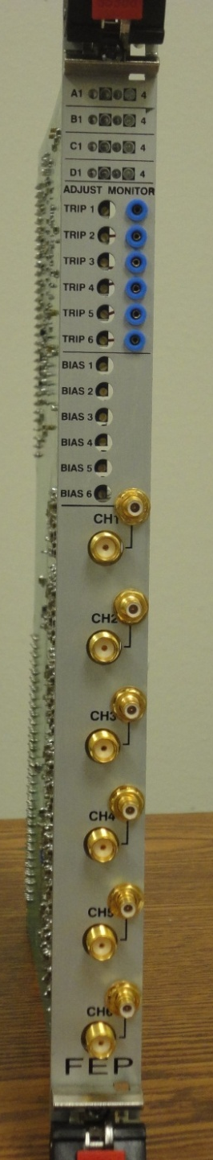
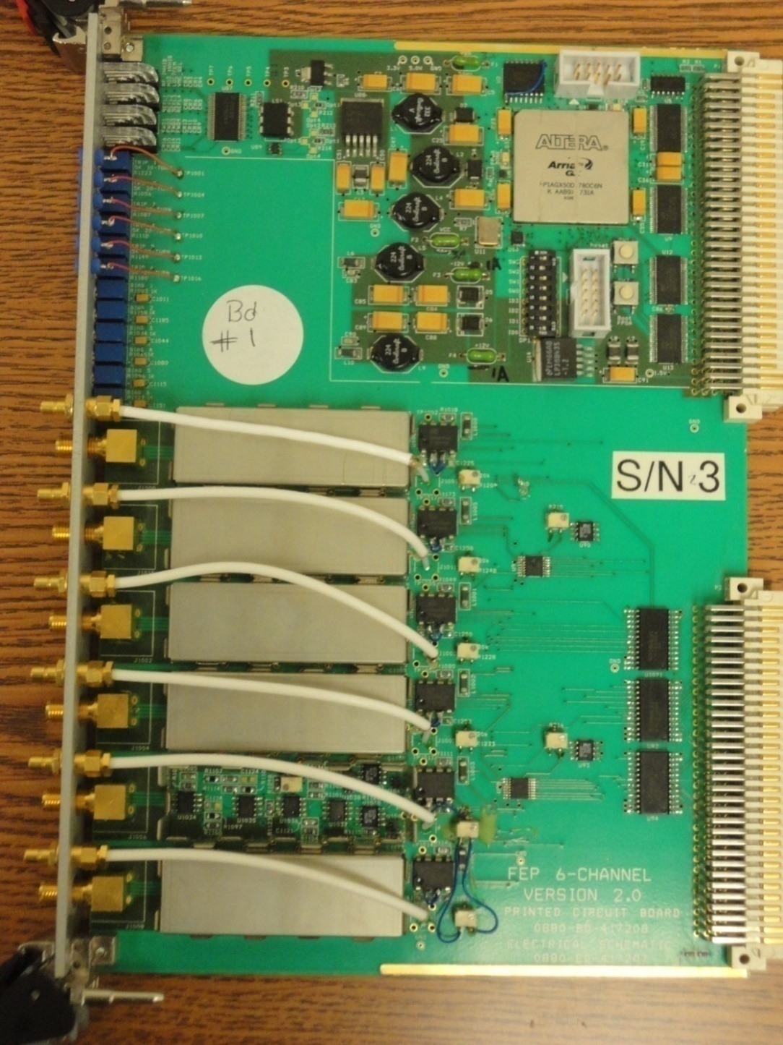
Field Emission Probe Board (Fermilab)

Slide 8
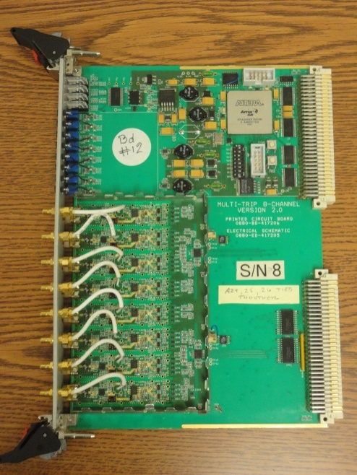
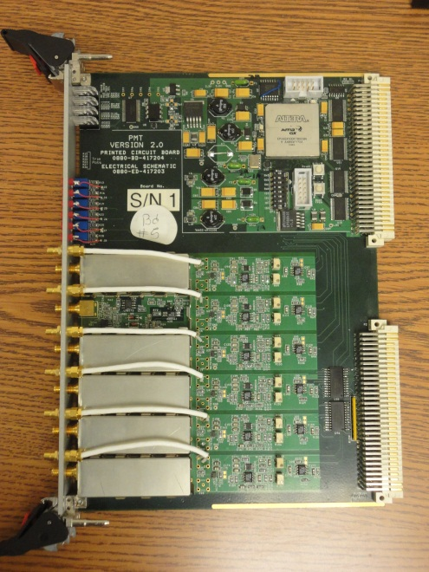
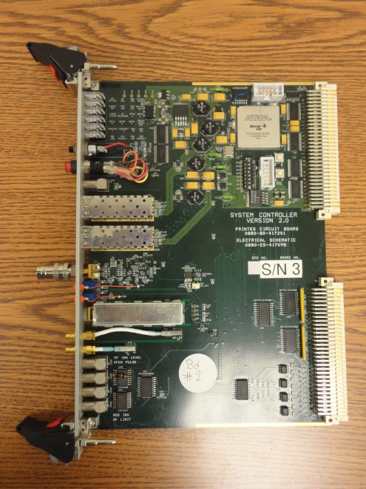
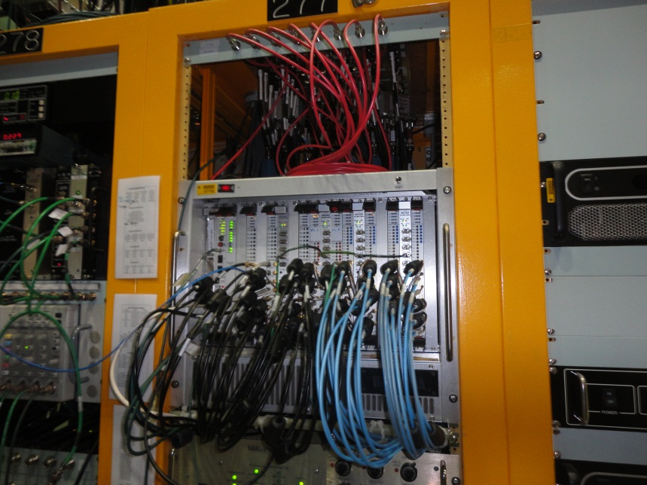
Photo Multiplier Tube
Multi- Trip
System Control Board
RF Interlock System – boards in a VME bin at NML, Fermilab

Slide 9
Proposed Modifications
Provision of on-board digitiser: Eight channels of 14bit, 10-80MHz ADC and 64 MWord DDR2 RAM on each board will eliminate the need of a separate digitiser card and allow capture of longer duration events.
Remote update of FPGA via VME Bus:
VME64X slave interface: Full feature VME64X slave interface supporting multiple interrupts, DMA, block transfer
Modifications in analog sections:
  FEP Trip Module: use of higher supply voltage JFET amplifier thereby eliminating DC/DC converter stage.
  PMT Trip Module: Dark current detection stage is used only for cable connect confirmation. Can it be removed if a reliable cable sense mechanism is developed?
  No of input channels to be increased to sixteen in Relay /Contact Module:

Slide 10
Proposed Modifications contd.
Mezzanine board approach-
  Common VME64X carrier Board: One carrier board for all modules, handling VME64X interface and digital logic common to all cards.
  Analog section unique to each module can be on Mezzanine board –
  The challenge here is accommodating RF connectors on Mezzanine card facia and shielding within one slot width of card.
  Feasibility of integrating Relay/contact module with System Control Module to be studied.
Mechanical arrangement for cable sense logic: The mechanical arrangement for cable connect detection logic to be improved for more reliable operation.

Slide 11
Proposed Modifications Contd.
  General purpose analog signal conditioning modules and low speed ADC are required for eliminating the PLCs.
Eliminating interconnect cables among module: Open collector logic based FRC cable interconnect on the rear I/O card for additional functionality can be used for adding more signals to the Interlock.
Eliminate cables and expensive LEMO connector?

Slide 12
RF Protection Interlock System-
Under development at BARC
Mezzanine card based system -
Common sections on base board
Application specific sections on mezzanine card
More functionalities –
      on-board digitizer with memory,
          low speed analog and digital I/O
Modular Approach –
          reduces inventory,
          reconfigurable,
          ease of migration to new technology

Slide 13
Mezzanine Card Based RFPI System – Hardware Architecture

Slide 14
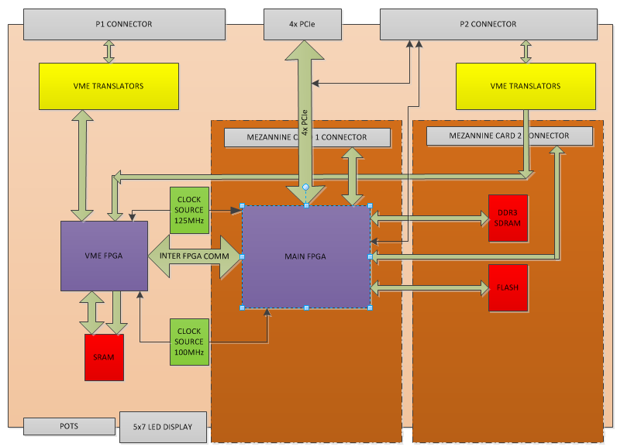
Overview of VME64x Carrier Board - Functionalities
Mezzanine card 2
Mezzanine card 1

Slide 15
VME64x Carrier board
Two mezzanine slots for populating PMT, MT, FEP, Optical or a System Control Mezzanine card.
Different types of cards can be accommodated on the same carrier board.
The main FPGAs handle signals from the mezzanine cards, DDR3 memory and Rear Carrier Board.
The carrier board has 256 MWord of DDR3 Memory for storing digitized signals.
The whole assembly is accommodated in a single slot width.

Slide 16
VME64x Carrier board – contd.
The board has on-board 125MHz and 100MHz LVDS clock sources.
The main FPGA has 1GB of NOR flash for the NIOS II soft-core firmware.
The main FPGA supports 4x PCIe interface for high speed data transfer without involving VME64x bus. The connector is provided on the rear side.
The VME64x slave controller is implemented on a separate FPGA with 2MB of external static RAM for CR/CSR space.

Slide 17
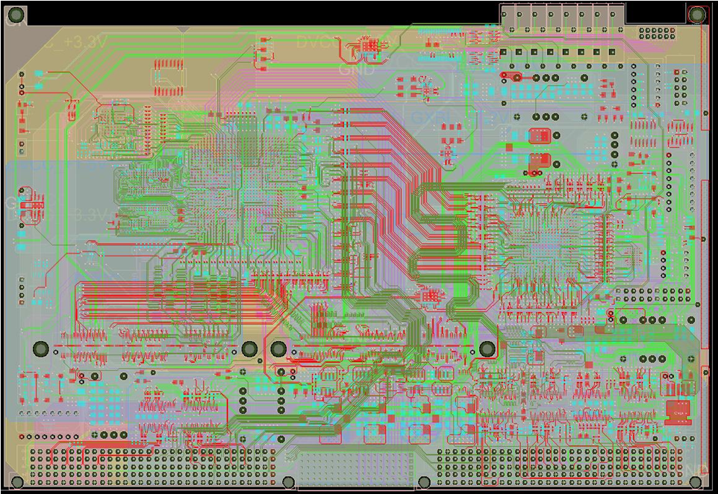
VME64x Carrier board – contd.
Screen Shot of the Layout

Slide 18
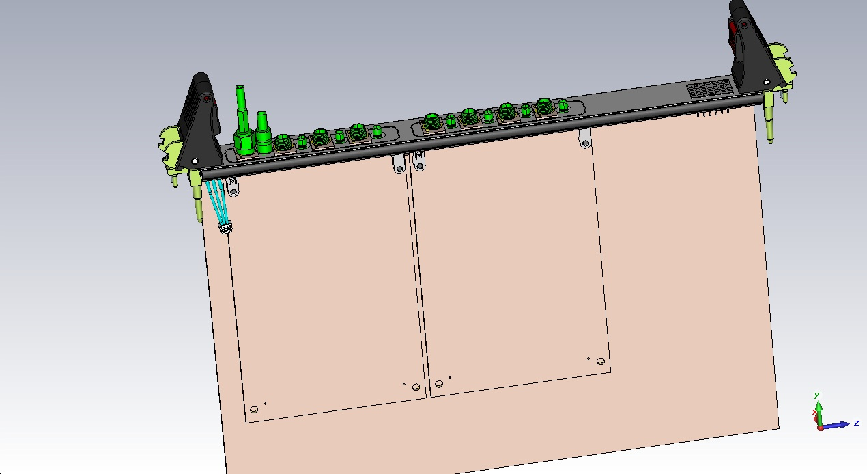
Isometric view of VME64x Board
  Common VME64X carrier board
Application specific functionality on mezzanine card
SMB Connector
SMA Connector
Mezzanine cards
carrier Board

Slide 19
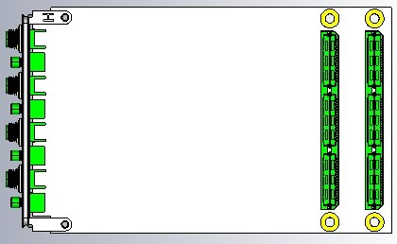


View of VME64x Board and mezzanine card
78 mm
Side view of the mezzanine card assembly
(5mm clear gap)
120mm
Rear view of the Mezzanine card
Front view of Facia
(Without the Mezzanine Card)

Slide 20
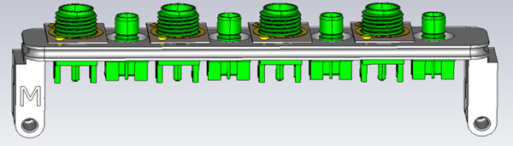
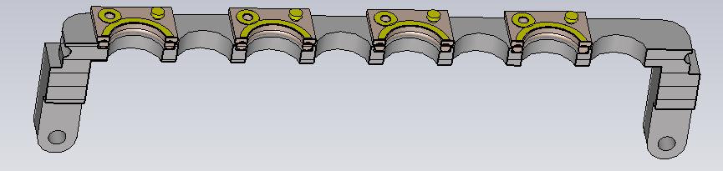
Cable Sense Assembly
PCB
Size 10 O-Ring

Slide 21
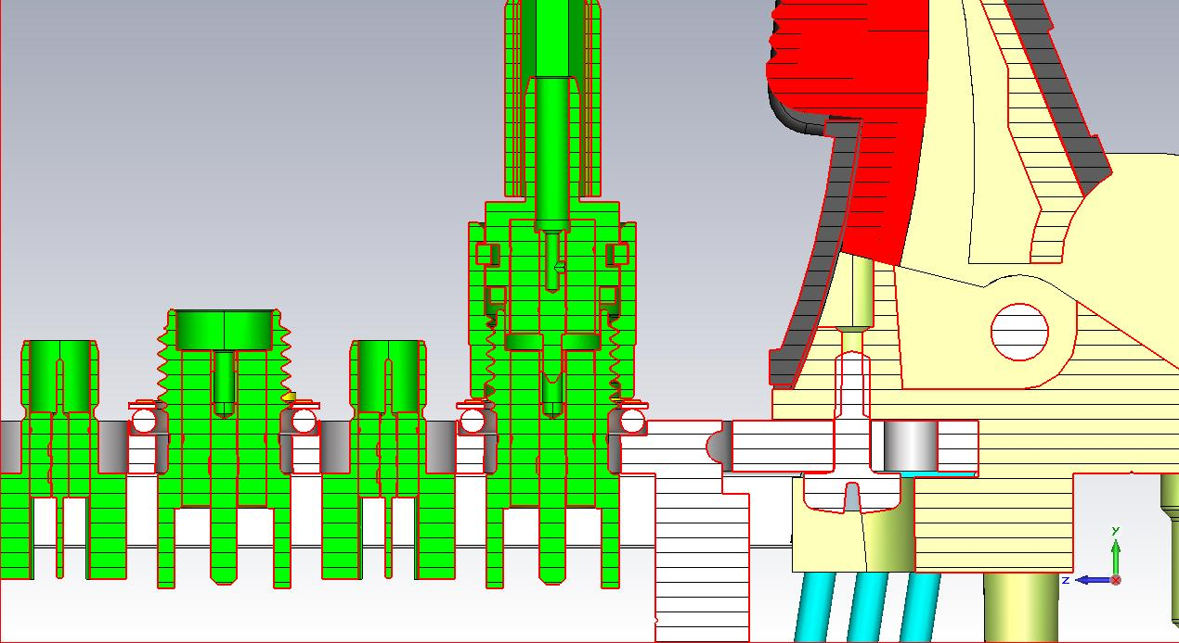
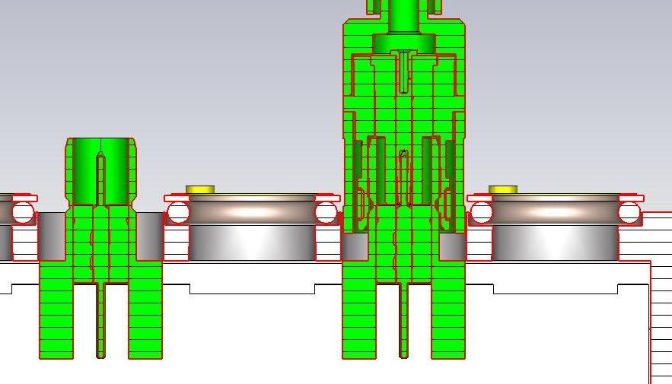
SMA and SMB Connections
SMB Plug
Positive Contact
SMA Plug

Slide 22
Mezzanine cards
Seven types of cards being developed:
Multi-trip
PMT
FEP
Photo-diode
System Control
Analog (Rear Carrier Board)
Digital (Rear Carrier Board)

Slide 23
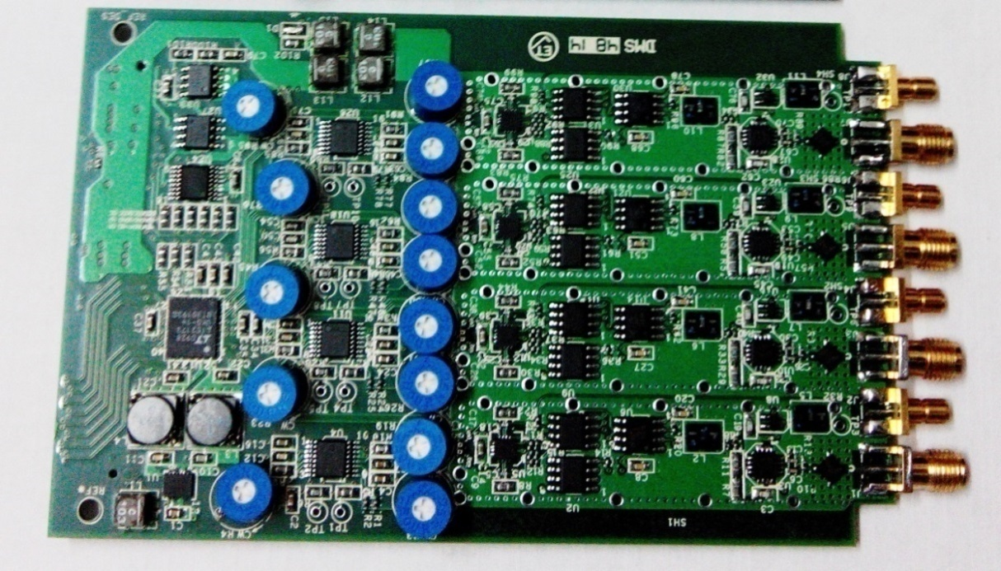
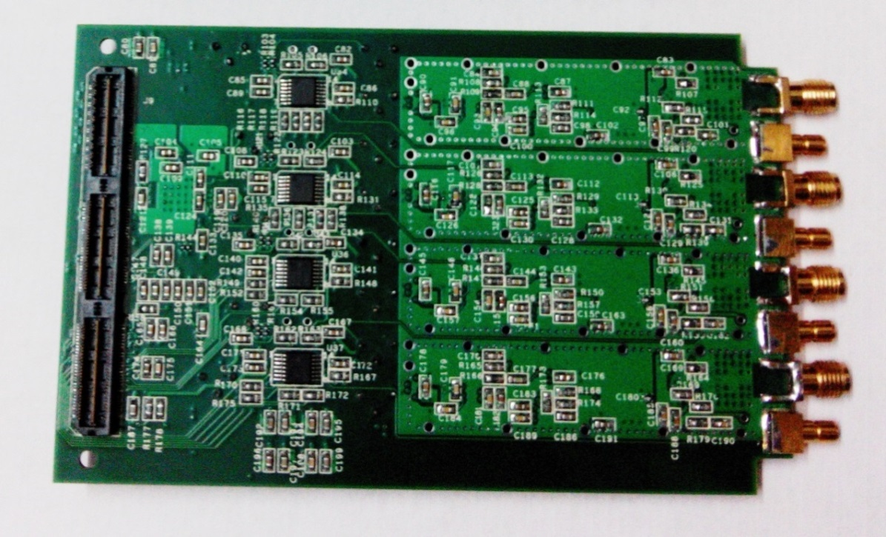
Multi-trip Mezzanine card
4 Channels per board
Input via SMA connector
Cable sense mechanism on SMA
80MSPS 14Bit ADC LVDS output
Monitor output via SMB
Trip limit reference adjust via POT
Trip limit reference adjust via DAC
EEPROM for card identification and card specific data
Top side view of Multi-trip carrier board
Bottom side view of Multi-trip carrier board

Slide 24
Multi-trip Mezzanine card
There are four such channels on single mezzanine card.

Slide 25
PMT Mezzanine card
There are four such channels on single mezzanine card.
When cable is present, the inverter output goes high, enabling AND gates.
The fault condition is active low signal
.

Slide 26
Photo-diode Mezzanine Card
FSMA 905
There are four such channels on single mezzanine card

Slide 27
FEP Mezzanine card
There are four such channels on single mezzanine card

Slide 28
System Control Mezzanine Card

Slide 29
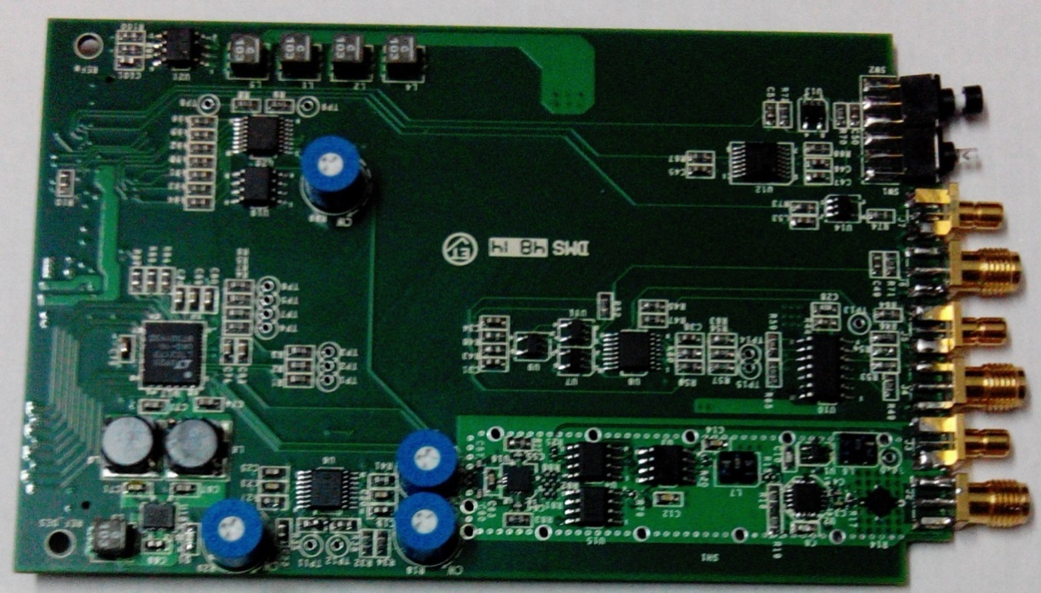
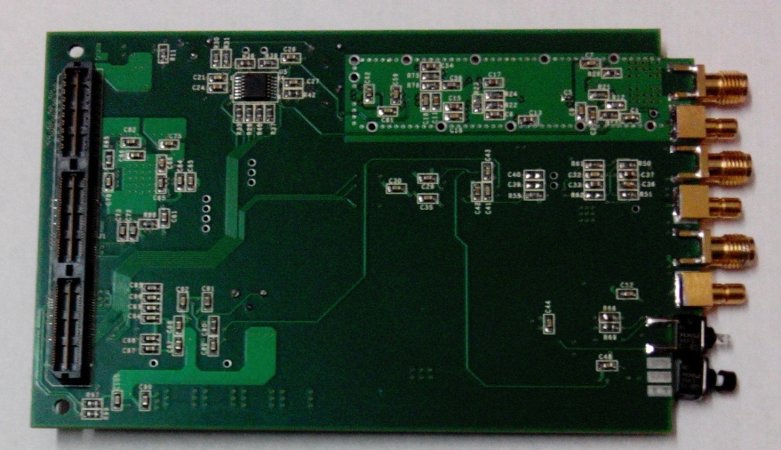
System Control Mezzanine card
One channel for RF leakage antenna
Cable sense mechanism on SMA
80MSPS 14Bit ADC with LVDS output
Video signal processing channel
System reset via SMA
System Reset via switch
RF enable via Switch
EEPROM for card identification and card specific data
Top side view of System Control board
Bottom side view of System Control board

Slide 30
Rear Carrier Board - Functionalities

Slide 31
Rear Carrier Board
The Rear Carrier board has two mezzanine cards
  Analog Mezzanine card
    Optically isolated eight analog inputs
    Optically isolated eight analog outputs
  Digital Mezzanine card
    Optically isolated sixteen digital inputs
    Optically isolated sixteen digital outputs
  It also has
  Inter Card Communication Bus
    Eight open collector lines for trip annunciation
    Eight open collector lines for fault annunciation
    Eight open collector lines for feature expansion
    Eight LVTTL lines for critical timing signals
  Four LEMO connections for card specific interface

Slide 32
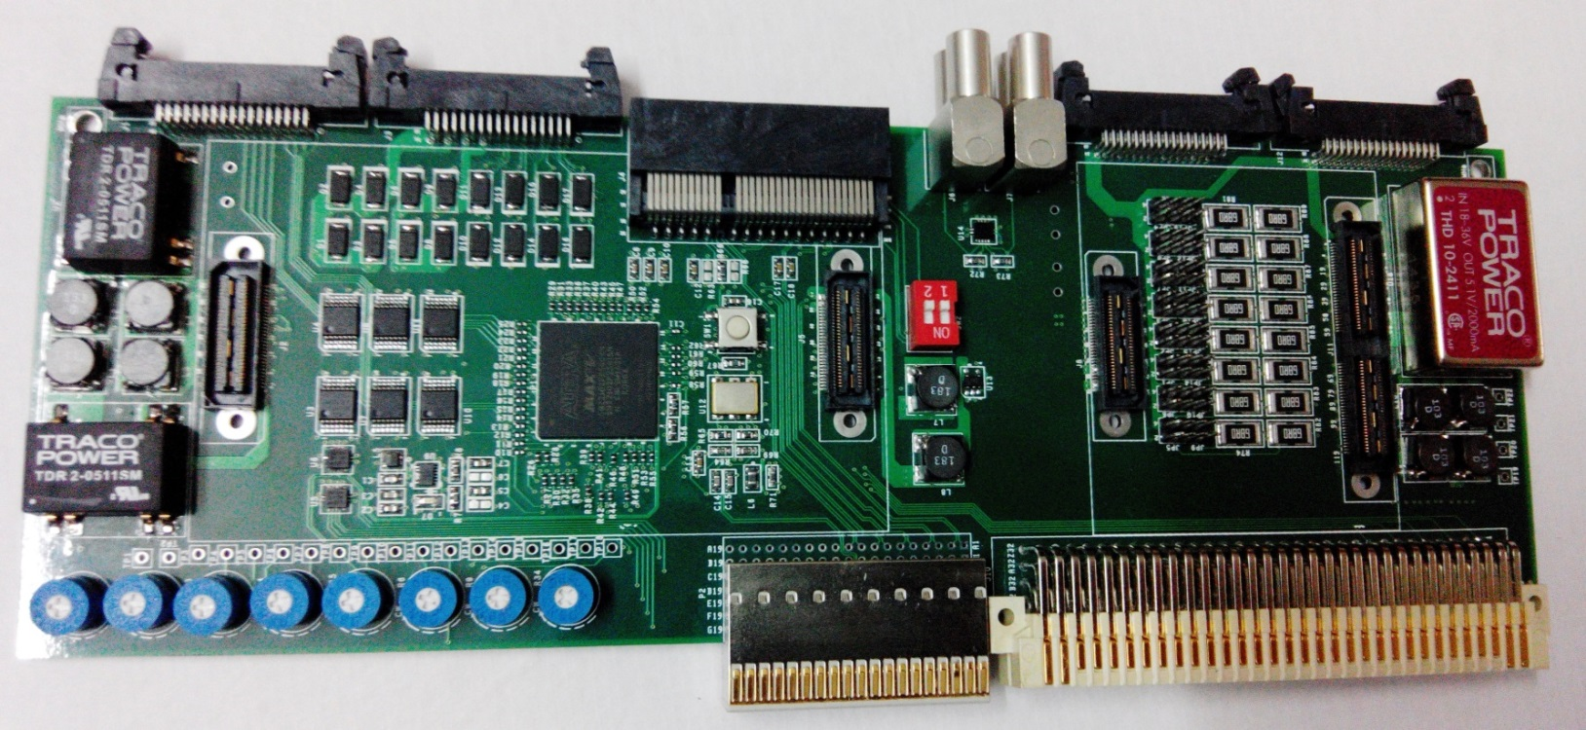
Rear Carrier Board
Isolated power Supplies for Analog I/O board
R-C-TVS Diode protection for Analog I/O board
Isolated power Supply for Digital I/O board
Diode protection for Digital I/O board
CPLD for processing Analog I/O and Digital I/O
LEMO for card specific I/O
4X PCIe Connector (signals via P0)
Inter Card Communication Bus for trip fault and timing signals
Top side view of Rear Carrier Board

Slide 33
Analog & Digital I/O cards - block diagram
Analog I/O block diagram
Digital I/O block diagram

Slide 34
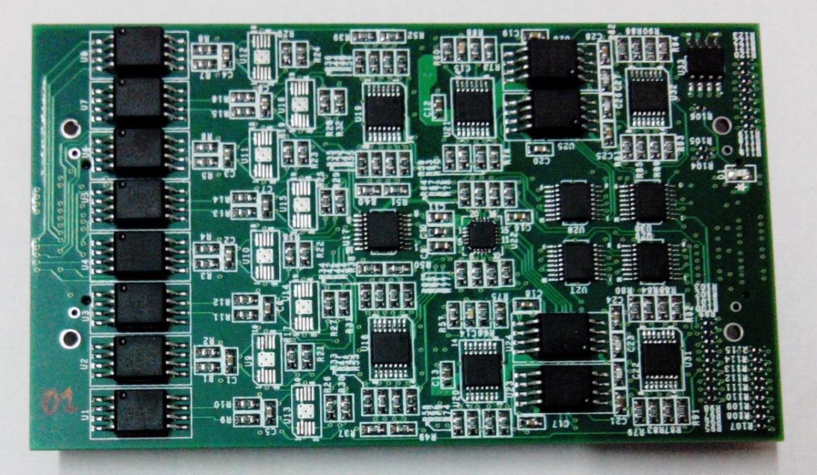
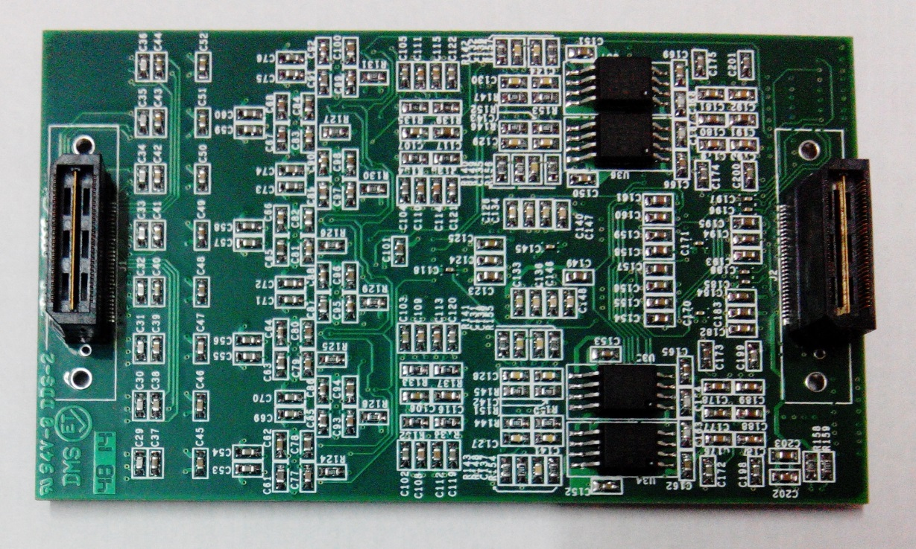
Eight channel Analog Input Output Board
Optically isolated input & output
0-10V, 10kHz BW for AI
Reverse polarity protection for AI
8 channel 500kSPS ADC
14 bit 8 channel DAC for trip limit
16 Bit 8 channel DAC for AO
0-5V, 10kHz BW for AO
Independent Isolated power supply for AI and AO
EEPROM for card identification and card specific data
100mm X 60mm
Top side view of Analog I/O Board
Bottom side view of Analog I/O Board

Slide 35
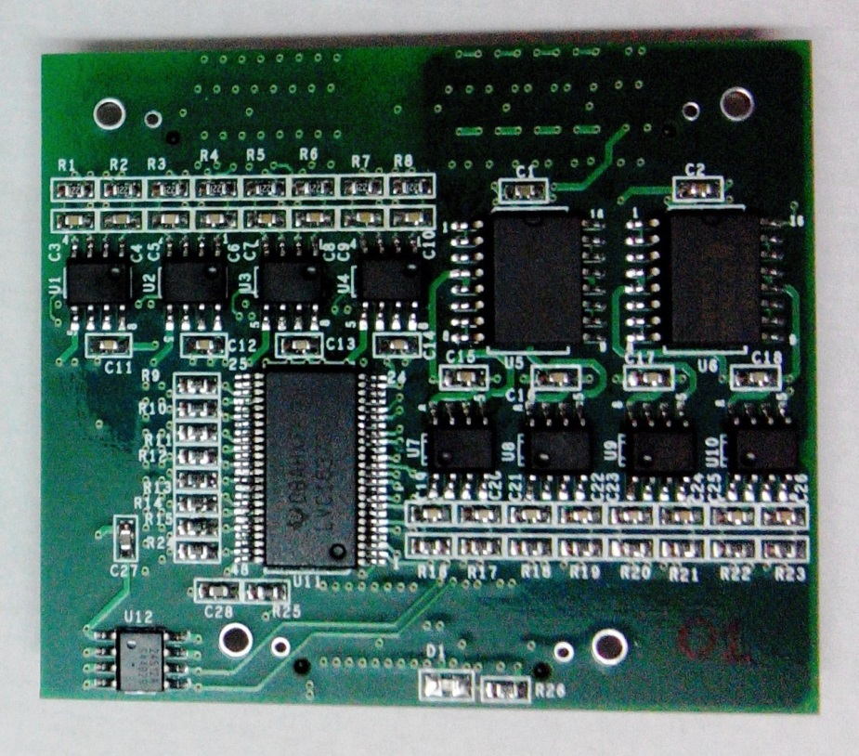
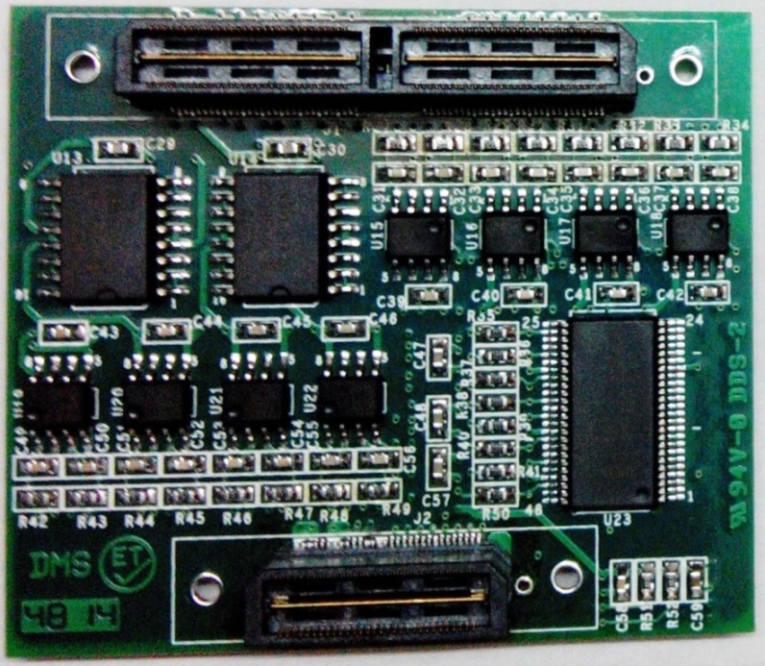
Sixteen channel Digital Input & Output Board
Optically isolated inputs & outputs
Contact / TTL, 50 Ω drive supported for DI
1 kV channel to channel isolation
Reverse polarity protection on DI lines
16 bit Latched output for DO
50 Ω drive for Digital Outputs
Independent Isolated supply for DO
EEPROM for card identification
60mm X 60mm
Top side view of Digital I/O Board
Bottom side view of Digital I/O Board

Slide 36
Inter-card Communication Bus

Slide 37
Current status of Mezzanine card based RFPI System
  Multi-trip, System Control Board, Rear Carrier Board, Rear Analog Board, Rear Digital Board –
    Fabricated and tested
  VME64x Carrier Board:
    Under Fabrication
    Expected by March 15, 2015
  PMT, FEP, Photo-diode Mezzanine Cards
    Layout in progress
    Expected by April 15, 2015
    VHDL codes and application software
      under development
    Documentation
      under preparation
    Prototype system with basic features ready by 15th May 2015
    System to be reviewed by experts from Fermilab

Slide 38
LLRF Projects at ED/BARC

Slide 39
RF Control Electronics at ED/BARC
Complete RF System for the BARC- TIFR Linac –
RF control for superconducting resonators, normal conducting resonators, RF reference distribution system
RF Control Electronics for the superconducting resonators of linacs at -
IUAC, New Delhi and ANU, Canberra, Australia
RF Control Electronics for 400 keV RFQ
Front-end RF modules under computer control via CAMAC Interface

Slide 40
BARC-TIFR Super-conducting Linac
- RF sub-systems
RF Control Electronics at ED/BARC
1) RF Electronics for Super Conducting Resonators
  a) Resonator Controller : Based on Self-excited-Loop architecture.
  b) RF Power Amplifiers : Solid-state, 150 MHz, 150W.
2) RF Electronics for Normal Conducting Resonators
  a) Dynamic Phase Reference Generation:
  Provides stable Phase References to all the RF systems of the linac.
  Counteracts the drift in time of flight through the Pelletron.
  Built around a phase detector resonator, which is excited by the beam.
  b) Resonator Controller:
  Based on Generator Driven Resonator architecture.

Slide 41

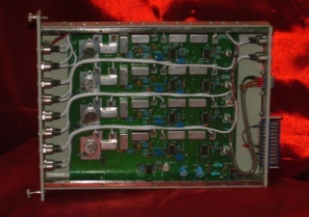
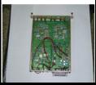
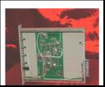
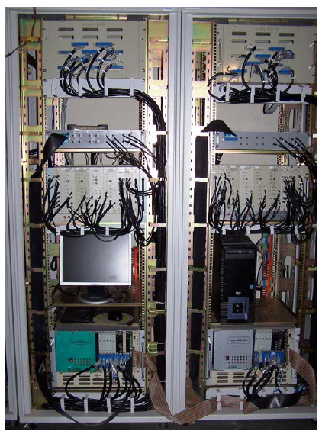
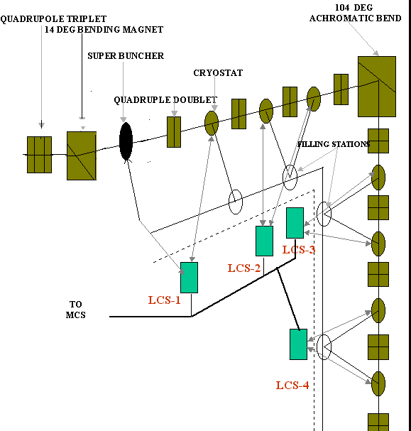
BARC-TIFR Super-conducting Linac
Some of the RF signal processing modules
Resonator Controller
Input Module
RF Multiplexer
Reference Splitter
Layout of Linac Hall
Instrumentation Racks at TIFR

Slide 42
LINAC Control System Software
Distributed Control System
Local Control Station (LCS) controls the Amplitude and Phase of 8 Resonator Cavities housed in two Cryostats.
Each LCS is a LINUX machine. It has its own DAQ and Interlock application.
JAVA applet for parameter monitoring and setting is hosted on individual web server of LCS node.
Easily scalable with increase in the number of Cryostats with (cavity).

Slide 43
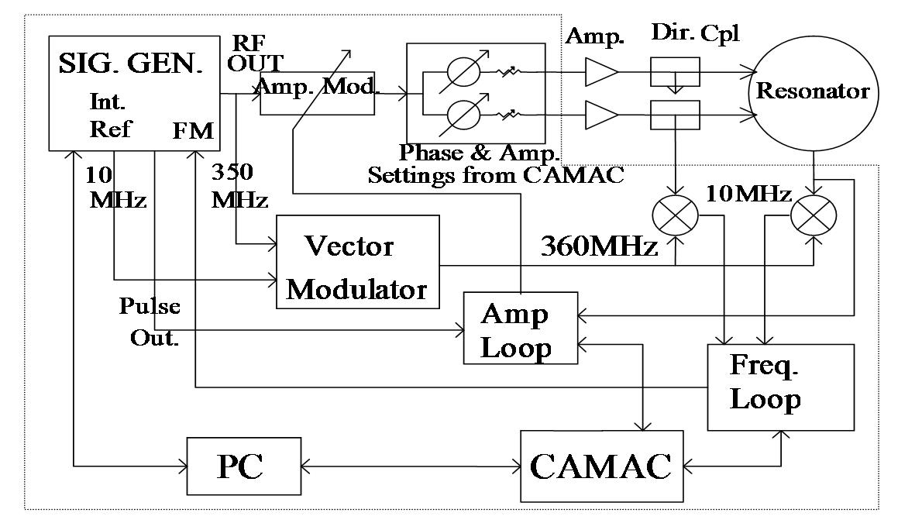
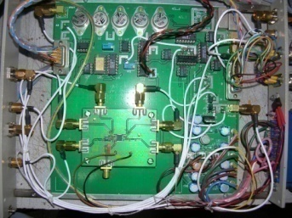
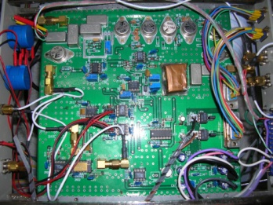
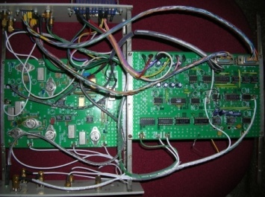

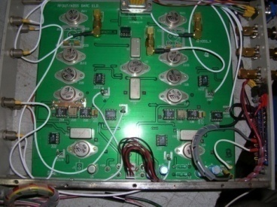
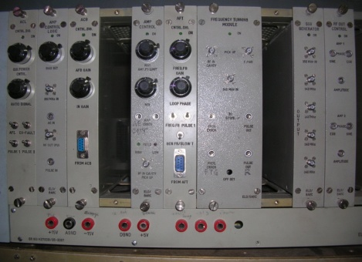
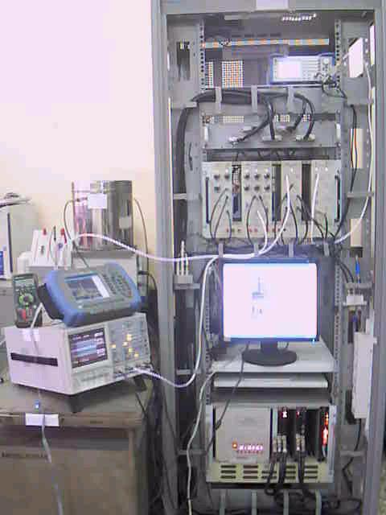
RF Control System for 400 keV, 350 MHz RFQ
For stabilization of amplitude, resonant frequency tracking
Amplitude Control Frequency Tracking Output

Slide 44
Digital SEL for SC RF cavities
SEL system implemented using 4 channel CPCI based Digital board.
  Full digital approach employing under-sampling of RF.
  Successfully tested at TIFR (150MHz) and IUAC (97 MHz) for RF field control
  Development of SEL to control two SCRF cavities in progress.

Slide 45
Digital SEL for SC RF cavities
Basic set-up of an SEL
Digital Limiter –
Innovation at BARC
Signal processing codes in an SEL

Slide 46
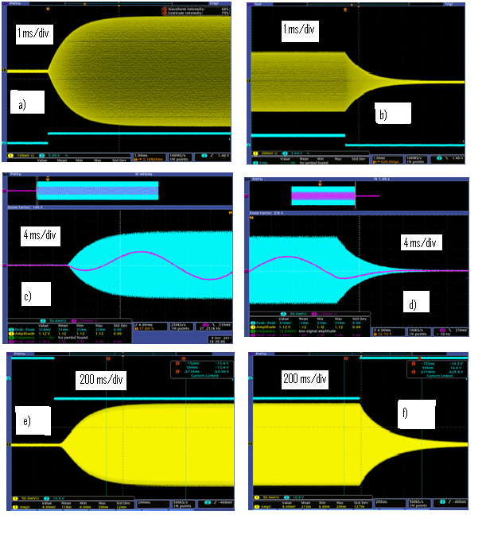
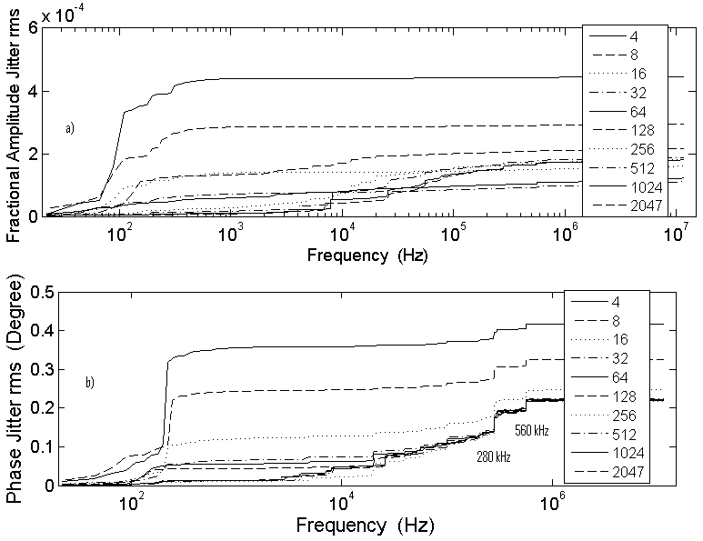
Digital SEL for SC RF cavities
Free Running SEL
under different operating scenario
SEL under Amplitude and Phase Lock
Work published in: Nuclear Instruments and Methods in Physics Research A 762 (2014) 70–76.

Slide 47
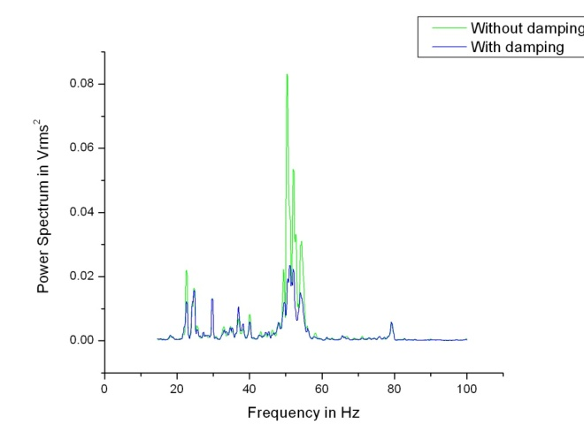
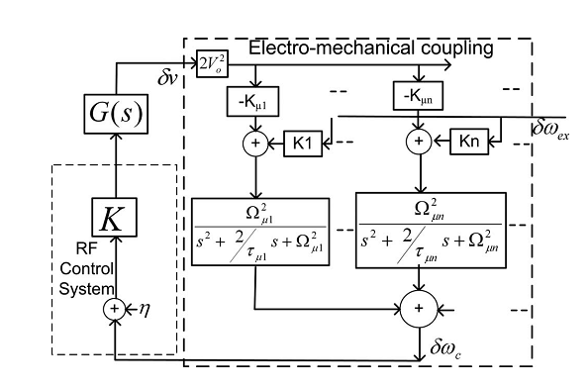
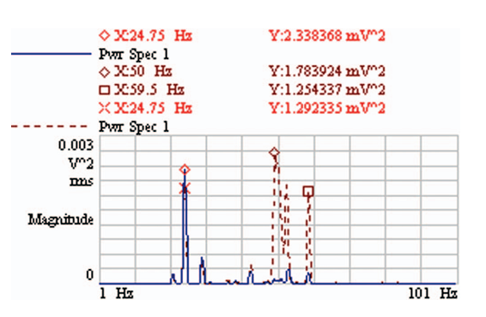
Electronic Damping of Microphonics in superconducting cavities
Use of electro-mechanical coupling existing in a resonator to generate forces
that act against those producing vibrations -
Resonance frequency variations fed back to produce field amplitude variations –
Significant reduction produced in some of the mechanical modes of the resonators of IUAC, New Delhi Linac
G(s) – two types investigated
1. Limited Derivative:
2. Positive Position Feedback:
Work published in:Review of Scientific Instruments, 85, 026107 (2014).

Slide 48
LLRF system for LEHIPA, BARC
LLRF system using 8 channel CPCI based Digital board
  Full digital approach employing under-sampling of RF.
  Auto-tracking implemented for cavity conditioning.
  CW and Pulsed mode of operation.

Slide 49
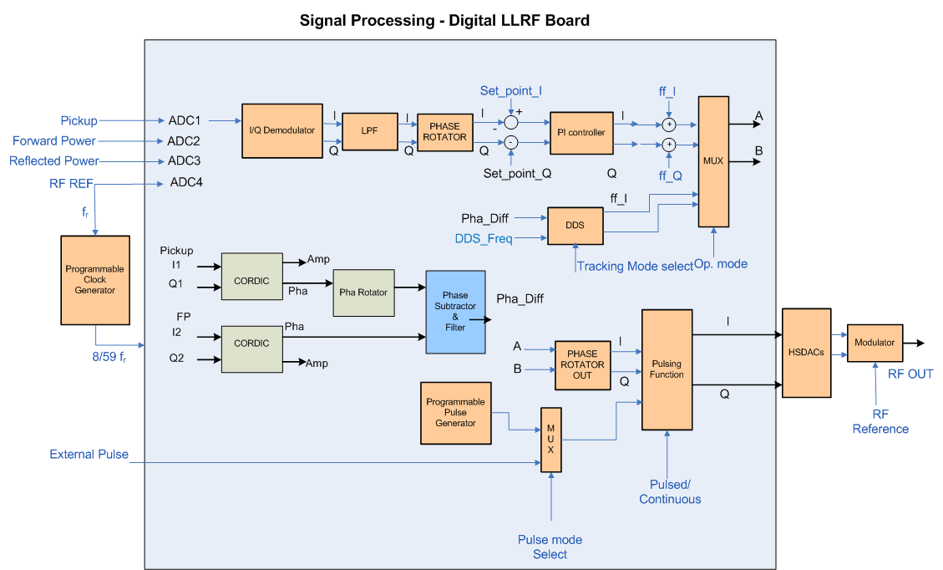
LLRF for LEHIPA, BARC

Slide 50
LLRF – Interactions with Fermilab

Slide 51
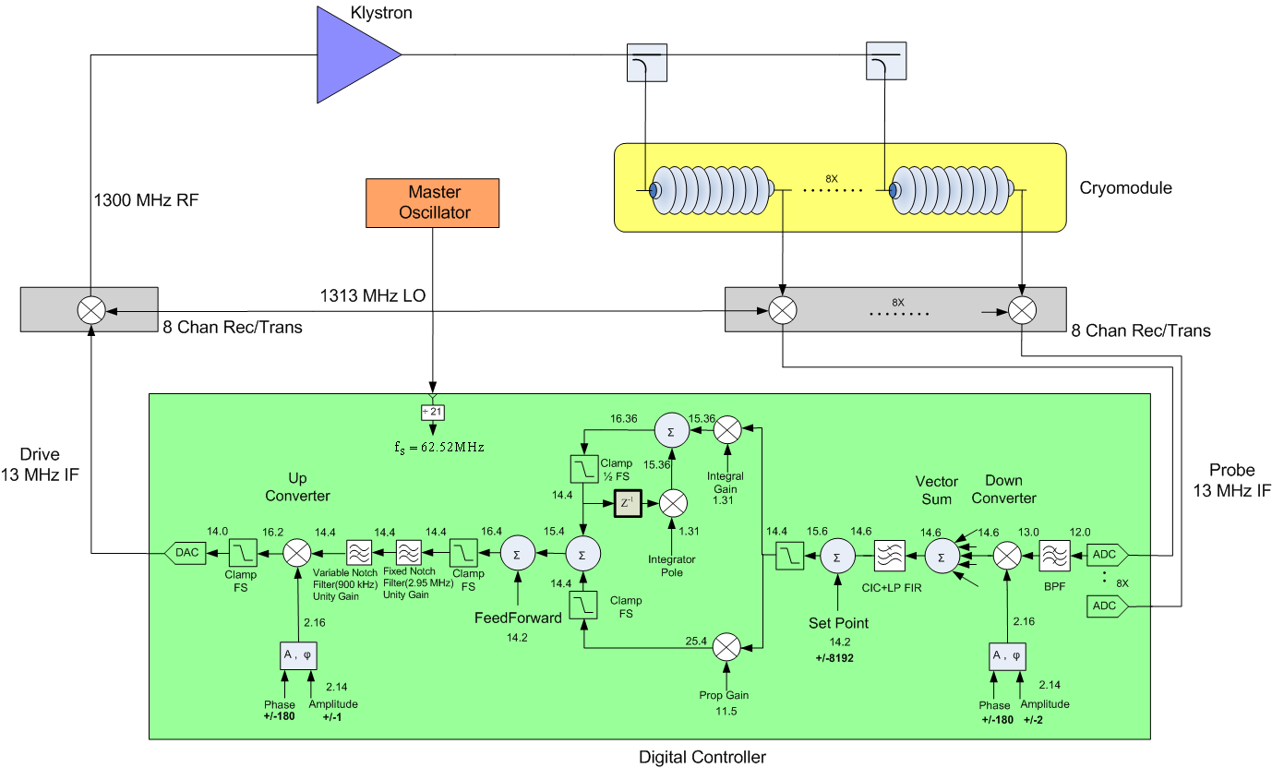
Low Level RF System(LLRF)
Sets up and stabilizes the RF Field in the cavities also performs the functions of testing, conditioning and tuning
The system typically consists of two type of boards: one analog and one digital
Control System Schematic
Source: LLRF11 P.Varghese#, B. Chase, B. Barnes, E. Cullerton, V. Tupikov

Slide 52
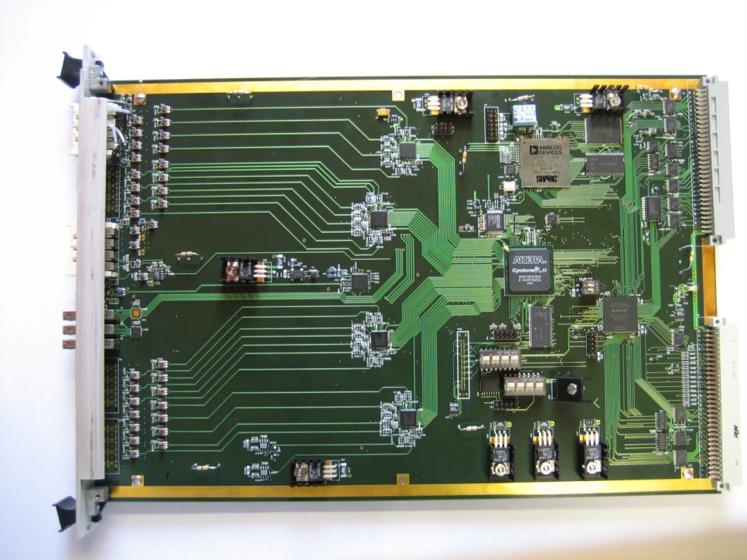
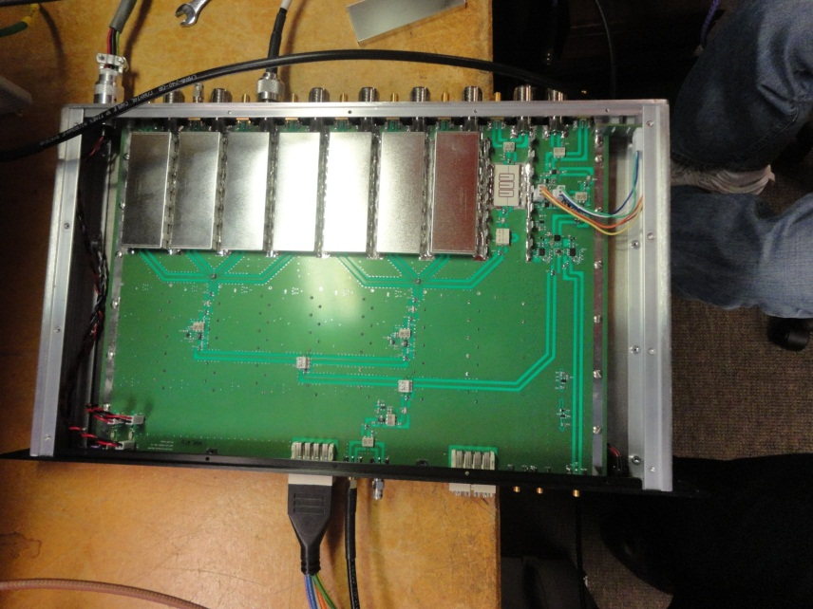
Boards of the LLRF system at Fermilab
Multi-cavity Field Control (MFC) Module
12-bit, 65 MS/S ADC
14-bit, 105 MS/S ADC
14- bit, 260 MS/S DAC
Cyclone II FPGA, 400 MHz
400 MHz, 32-bit floating point DSP
Memory,
Clock distribution,
High speed serial ports, etc.
Eight Channel Receiver/Transmitter
Eight Down-converter channels
LO-Distribution - one to eight
One Channel Up-converter

Slide 53
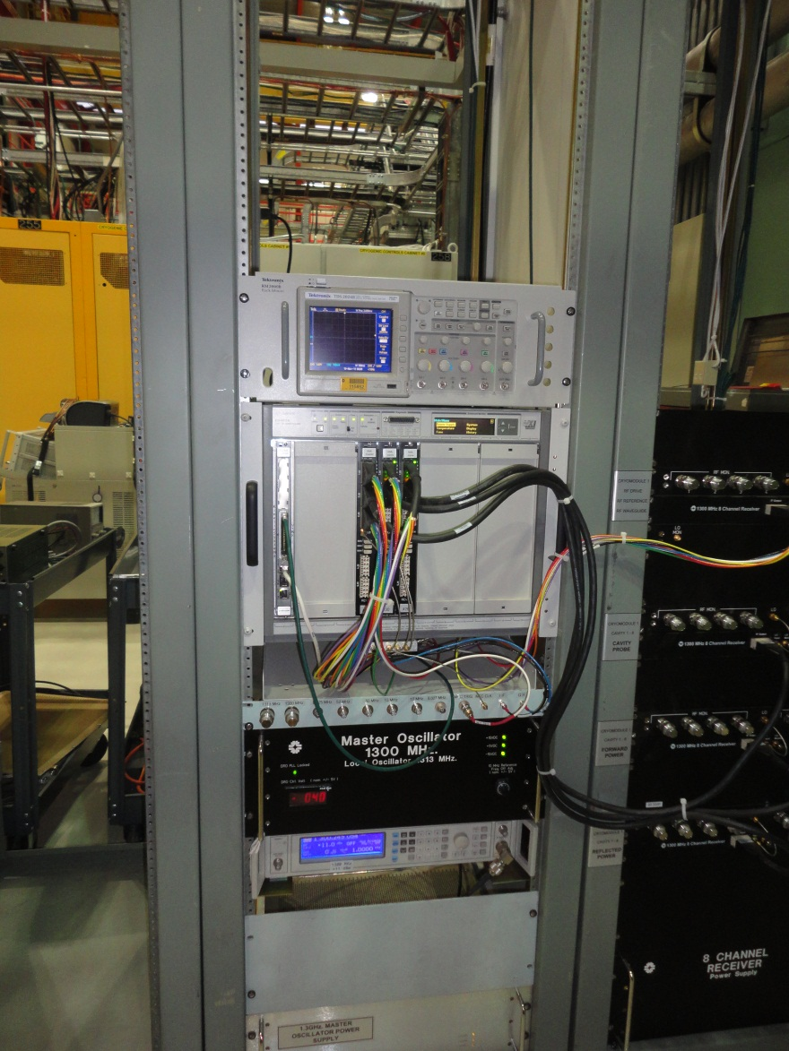
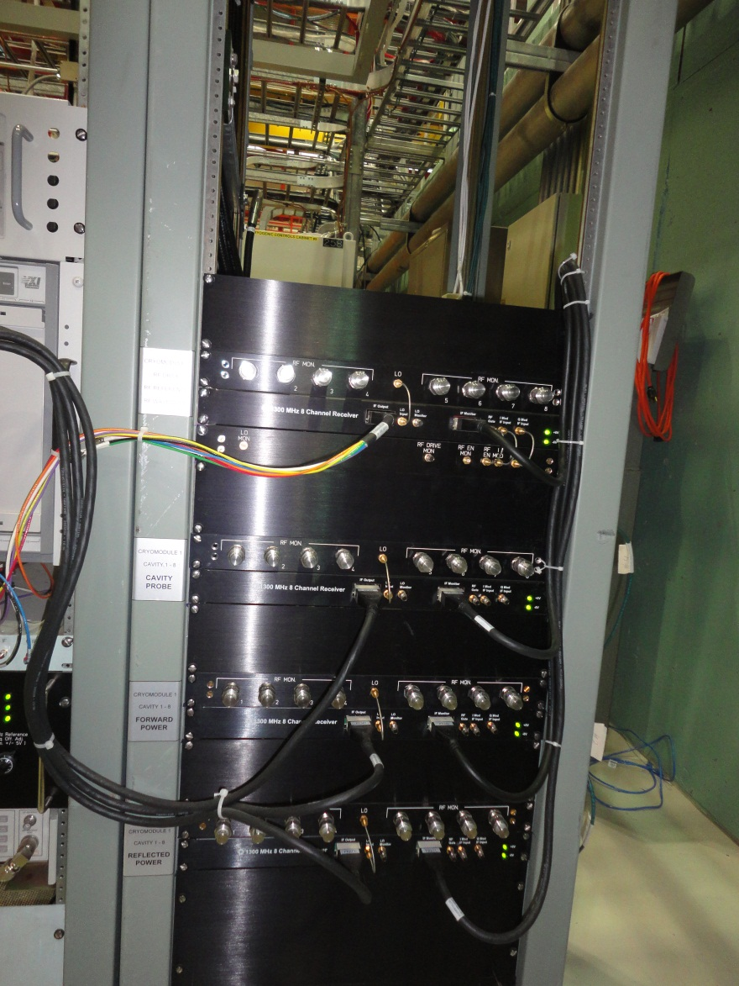
MFC and Receiver Modules in their respective chasis
at NML, Fermilab

Slide 54
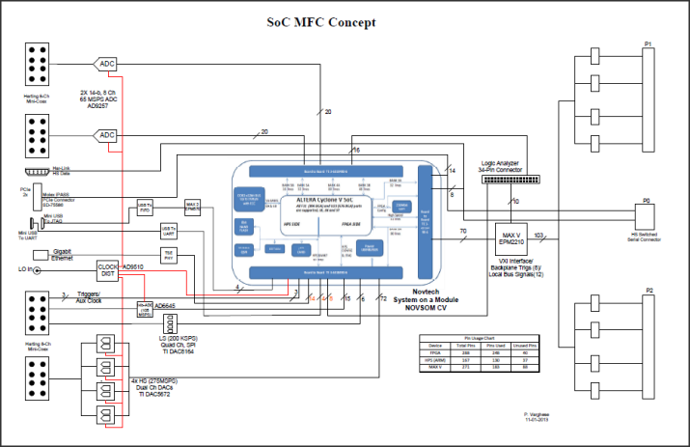
Low Level RF
The scheme of using System on Module (SoM) under study

Slide 55
LLRF – Action Plan
We look forward to receive detailed technical specifications from Fermilab
More frequent interactions between the design teams

Slide 56
BPM Projects at ED/BARC

Slide 57
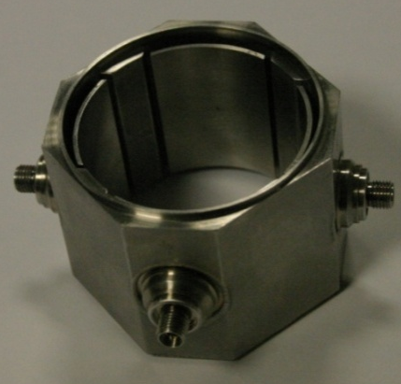
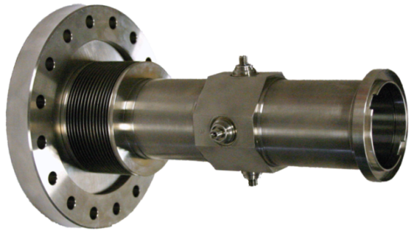
Beam Position Monitor (BPM) at ED/BARC
BPM Electronic System for SPIRAL2, GANIL
Sensor for SPIRAL2, GANIL
Designed and developed by IPN, Orsay, France
Non interceptive, Capacitive, 48 mm radius, 60 degree, 38 mm in the direction of beam

Slide 58
BPM- System Overview
Electronic System
Analog processing
Analog to Digital conversion
Digital Signal processing
To compute
-Amplitude
- Position
Phase
Calibration Processing
RF Reference
C
A
« PF » Input
B
D
STOP Acquisition
Interlock corresponding to ΔX and ΔY values
Interface Input data
Interface Output data

Slide 59
Beam Position Monitor (BPM) for SPIRAL2,
GANIL, France
Salient Features
Operating frequency | 88.0525 MHz and 176.1050 MHz, wide band for Bunch shape reconstruction
Measured parameters | Amplitude, Phase, Beam position
Input signal | -63dBm to -17dBm
Resolution | 50 µm, measurement speed 10 μs
Cable drift | To be compensated
Operating temperature | 15 – 35 degC
Range of measurement | ± 20mm
Operating modes | CW and Pulsed
Data acquisition modes | Normal, Interrupt and Post-Mortem

Slide 60
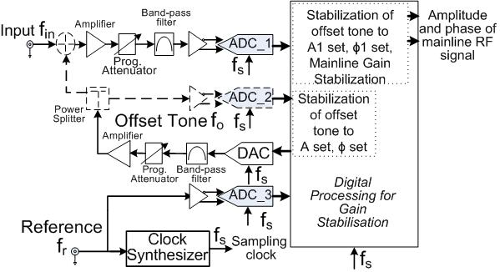

Beam Position Monitor (BPM) for SPIRAL2,
GANIL, France
Our Solution: Offset tone based gain stabilization
Inject a stabilized tone close enough in frequency at the input, and
Stabilize the gain of the analog front-end with respect to this calibration tone by applying suitable corrections in the digital domain.
Apply the same gain corrections to the input signal.

Slide 61
Beam Position Monitor (BPM) for SPIRAL2,
GANIL, France
Electronic Gain Stabilization: - signal measurement, position, phase
Cable Drift Compensation:
Inject stabilized offset tone towards the sensor, and
Stabilize the phase of the reflected signal.
Apply the corrections to the input signal.
Bunch Shape Reconstruction:
Sampling frequency: (256/345)*88.0525 MHz
Collect 256 consecutive samples
Arrange them in correct sequence
Obtain DFT
Correct DFT coefficients
Obtain Inverse DFT

Slide 62
Beam Position Monitor (BPM) for SPIRAL2
BPM- Electronic System block diagram

Slide 63




Beam Position Monitor (BPM) System
Analog Board
Digital Board
Digital Board in VME chasis (Front)
Two prototypes tested successfully at IPN, Orsay, France.
Final set of 24 modules to be delivered soon.
Analog Board in VME chasis (Rear)

Slide 64






Beam Position Monitor and Fast Faraday Cup Sensors
Beam Current
Output of BPM sensor
BPM Sensor
Fast Faraday Cup
S-parameter results of fabrication model of Faraday Cup

Slide 65



Wall Current Monitor and Test Jig
Toroid
Beam Current
Beam
Resistors
Output across the resistor
RF Signal Feed
Sensor
XY scanner
BPM sensor is stationary the wire is displaced with respect to sensor.
resolution of 10um in a span of ±50mm 5-phase stepper motor with more than 10,000 steps is used.

Slide 66
BPM – Action Plan
We look forward to receive detailed technical specifications from Fermilab
More frequent interactions between the design teams

Slide 67
Other Systems
Beam Loss Monitoring System:
Specifications not available from Fermilab
We are developing a system for LEHIPA based on radiation measurement.
Timing System:
Specifications not available from Fermilab
Integrated Control for CMTS:
Specifications not available from Fermilab
We have developed control systems for –
FOTIA, Superconducting Linac at TIFR and presently developing the control system for LEHIPA

Slide 68

LINAC TIFR C&I
Java Based RF control
Layout of Superconducting linac at TIFR

Slide 69
Control & Information S/W
1. EPICS based IOC for Spiral2 BPM
21 BPM control by 3 IOC. Each crate have MVME5500 VME controller with VxWorks.
Custom device support and BPM record support developed.
GUI developed using Control System Studio BOY.
2. LEHIPA Integrated Control System
QT based Operator Workstation. Subsystem framework running on QNX.
Custom Modbus protocol for Channel Access.

Slide 70
Thanks

Slide 71
Improving the reliability
The signal is compared against a reference voltage set by the DAC on the mezzanine card.
The signal is also compared against a reference voltage set by the POT on the carrier board.
The signal is also compared with a fixed low reference. The trip (DAC / POT) is valid only when the low side trip is also present.
The operating mode of RFPI (Local / Remote) determines which output is selected.
The signal is also compared against a fixed high limit which when crossed indicates a major fault.

Slide 72

Inter-Card Communication Bus
1.25mm pitch 34 pin FRC cable
System controller module
TRIP signals on each card

