Slide 1
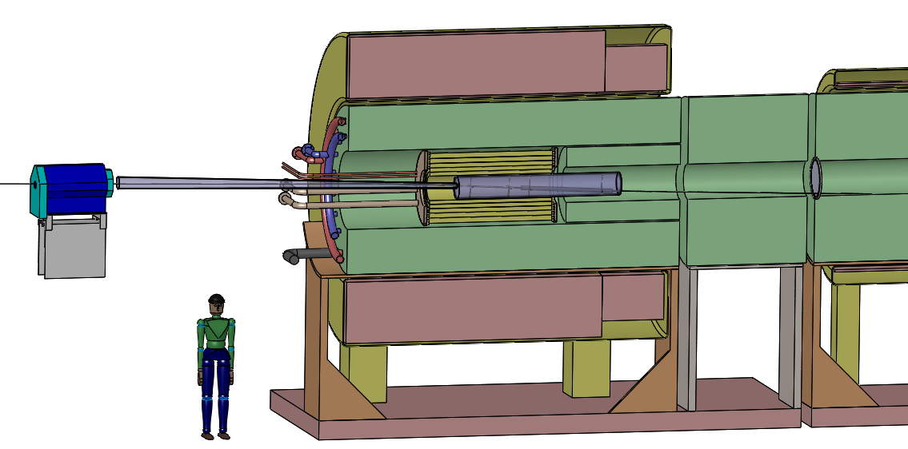
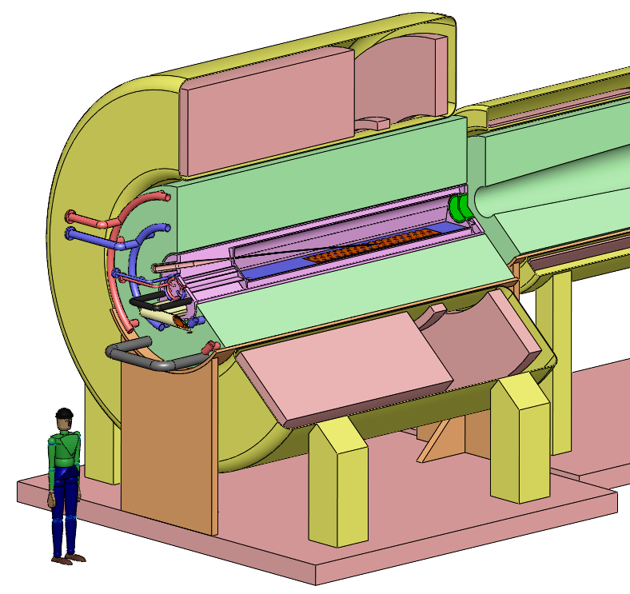
Finalizing the C- and Hg-Target Configurations for 6.75-GeV Proton Beams
Present studies are for a carbon target in a 20-T solenoid, with a fast taper over 5 m down to 2 T.
The proton beam has 6.75 GeV.
20to2T5m4PDL
The last Hg target configuration was that of Oct. 31, 2013, with a 15-T solenoid and a slightly different taper.
IDS120_15-1.5T7m3+4
Hg particle production studies were only performed for a 20-T solenoid, a slower taper, for 8 GeV, and with an older MARS version.

Slide 2
1. The C-Target Configuration
This configuration should be based on files from Bob Weggel, May 9, 2014
http://www.hep.princeton.edu/~mcdonald/mumu/target/weggel/20to2T5m120cm4pDL.docx
http://www.hep.princeton.edu/~mcdonald/mumu/target/weggel/20to2T5m120cm4pDL.xlsx
The field map for this should be
http://www.hep.princeton.edu/~mcdonald/mumu/target/weggel/205to2T5m120cm4pDL.txt
The central proton trajectory (6.75-GeV proton energy, in 20-T peak field) for this should be
http://www.hep.princeton.edu/~mcdonald/mumu/target/Souchlas/20to2T5mDL_xyzr.xlsx
The last version of this configuration (with 5-m taper) that I have from Van Graves is in
http://www.hep.princeton.edu/~mcdonald/mumu/target/graves/graves_140703.pptx
http://www.hep.princeton.edu/~mcdonald/mumu/target/graves/graves_140609.ppt
http://www.hep.princeton.edu/~mcdonald/mumu/target/graves/graves_140606.pptx
A bit of a loose end is how the central proton trajectory was generated. The file
http://www.hep.princeton.edu/~mcdonald/mumu/target/Souchlas/20to2T5mDL_xyzr.xlsx
seems to have been generated by Nicholas Souchlas on May 22, 1914.
Later that year, we came to realize the method used by Xiaoping at that time to generate the central proton trajectory was not quite right, and we devised a better scheme, written up in
http://www.hep.princeton.edu/~mcdonald/examples/track.pdf
I believe that this scheme is now used in Xiaoping's simulations, but I don't know if a new central proton trajectory, back to z = - 10 m, was ever generated using the new scheme.
This makes it likely that the central proton trajectory in Van's CAD layout is not quite right. If so, it would be good to update this.

Slide 3
2. Field Map for a 15-T Magnet Configuration
We now have a mandate to make a small effort to set up a mercury-target configuration for 6.75-GeV protons, that is a potential upgrade from the C-target scenario.
For this, we want to use the 20to2T5m120cm4pD superconducting magnets, but omit the 5-T copper insert (which is not very mechanically compatible with a mercury target + collection pool).
This configuration would have 15-T peak field, and would be called, perhaps, 15to2T5m120cm, following Bob Weggel’s nomenclature.
We need a field map for this variant, to be generated by Bob Weggel.

Slide 4
3. Optimize the 15-T, 6.75-GeV Hg Target
Once we have the field map for the 15-T case, 15to2T5m120cm, we need to optimize the Hg target and beam layout, and generate the central proton trajectory back t z = -10 m, for 6.75 GeV protons.
These are tasks for Xiaoping.
This optimization can be done with simplified geometry of the beampipe for the Hg target, perhaps even that recently used by Xiaoping and Scott for the 8-GeV Hg-target studies.

Slide 5
4. Finalize the 15-T, 6.75-GeV Hg-Target Station
Once the central proton trajectory is available for the 15-T, 6.75-GeV configuration, Van can produce the "final" Hg-target-station layout.
This needs to be a "possible" upgrade from the 20-T, 6.75-GeV C-target station.
The C-target station has "inner" modules for the 5-T copper coils, the C-target vessel, and a small inner-shield vessel. Presumably, these 3 "inner" modules would be removed, and replaced by a single Hg-target/shield(?) module.
It is not clear to me that Van ever developed a mercury-target scenario of quite this type.
Van's last review of Hg-target concepts seems to be on Oct 31, 2013:
http://www.hep.princeton.edu/~mcdonald/mumu/target/graves/graves_131031.ppt
It appears to have a "bell-shaped" mercury vessel inside a single, large "outer" shield module.
So, the proposed task for Van is to generate an alternate Hg-target scenario that is better matched to the C-target scenario as a first stage.
[Of, course, a possible solution is to remove the "outer" shield at z < 5 m, and replace the entire module for r < 1.2 m with a new shield + Hg target module that is more or less that given in the Oct 31, 2013 review.]

Slide 6
5. Generate Particle-Production Files for the Hg-Target Scenario
Once Van has established the "final" layout for the 15-T, 6.75-GeV Hg-target scenario, we should finalize the beampipe in Xiaoping's simulations, and generate the "final" particle production files for possible use in optimizing the Buncher and Phase Rotator for this scenario, etc.
If the project were to continue, we would need to make some evaluation of the effectiveness of the shielding for the revised Hg-target scenario. However, we likely won't carry the revised Hg-target scenario any farther than generating particle-production files for it.

