Slide 1
Front End – present status
David Neuffer
March 2015

Slide 2
Outline
Front End for Muon Collider/ Neutrino Factory
Baseline for MAP
8 GeV proton beam on Hg target
325 MHz
With Chicane/Absorber
Current status
New targetry
6.75 GeV on C target
New Mars generated beams
Mars ouput much different from previous version

Slide 3
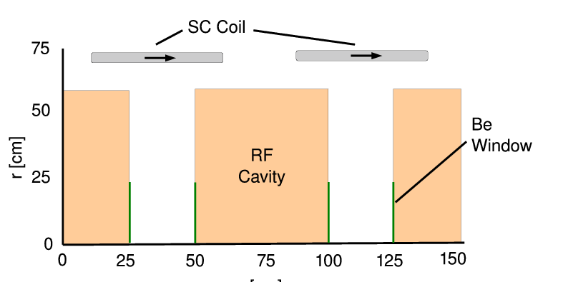
325MHz System “Collider”
Drift
20T→ 2T
Buncher
P_{o}=250MeV/c
P_{N}=154 MeV/c; N=10
V_{rf} : 0→ 15 MV/m
(2/3 occupied)
f_{RF} : 490→ 365MHz
Rotator
V_{rf} : 20MV/m
(2/3 occupied)
f_{RF} : 364→ 326MHz
N=12.045
P_{0,} P_{N}→245 MeV/c
Cooler
245 MeV/c
325 MHz
25 MV/m
2 1.5 cm LiH absorbers
/0.75m

Slide 4
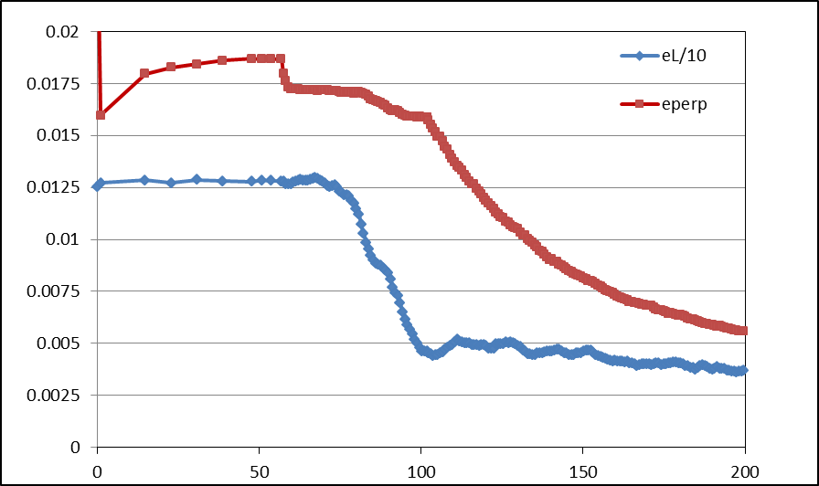
Simulation Results
Simulation obtains
~0.125 μ/p within acceptances
with ~60m Cooler
325 MHz – less power
shorter than baseline NF
But
uses higher gradient
higher frequency rf → smaller cavities
shorter than baseline NF
more bunches in bunch train
N :0.15<P<0.35 GeV/c
N: ε_{T}<0.03; A_{L}<0.2
N: ε_{T}<0.015; A_{L}<0.2
Useful
cooling

Slide 5
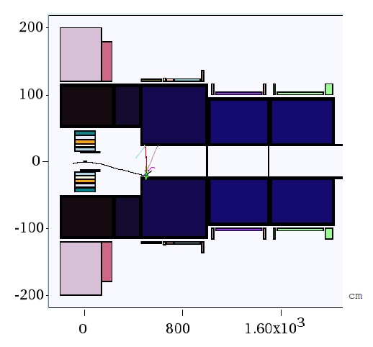
New Proton Driver parameters
6.75 GeV p, C target
20→2T short taper
~5m (previously 15)
X. Ding produced particles at z=2m using Mars
short initial beam
Redo ICOOL data sets to match initial beam
ref particles redefined
in for003.dat
and for001.dat

Slide 6
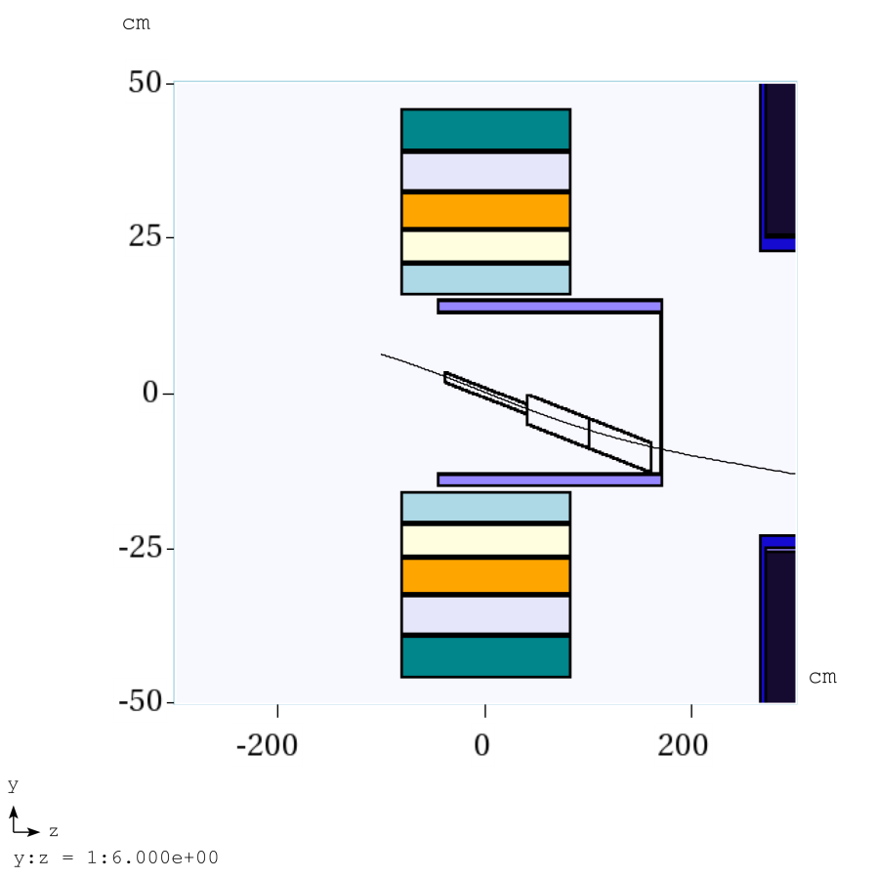
Use old FE with new initial beam
New beam based on Mars 15
different apertures than baseline scenarion
~half of initial beam lost in <6m
aperture cut off
Large amount of secondaries at larger apertures at start
Did not see in previous runs because of cut-offs near target
Lost at 23cm aperture used downstream

Slide 7
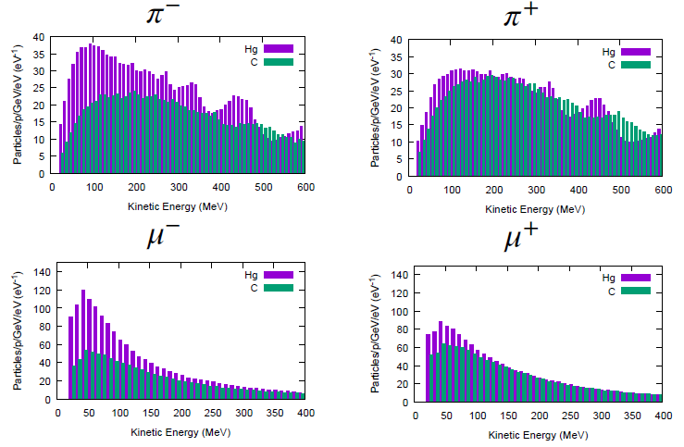
Following Scott’s review of front end
Use his initial distributions (obtained by X. Ding)
8 GeV protons on Hg targe
+ and minus
6.75 GeV protons on C target
Start beam from z =10m
must retranslate into ICOOL reference particles
Early losses on apertures have already occurred
23 cm apertures

Slide 8
ICOOL translation tips
start at “z=10m”
(particle time zero is at -1m)
reference particles
250 MeV/c ; 154 MeV/c μ⁺
165.75 MeV ; 81.1 MeV μ⁺
time set by 1m as 6,75 GeV proton + 10m as μ⁺
reference particles set in for003.dat, not for001.dat
01-Feb-2015 X. Ding C 10 m -
0.0 0.250 3.95709E-08 0.0 0.154 4.381345E-08 2
1 1 -3 0 4.354479e-008 1.000000e+000 0.03737 0.03656 0 7.861861e-004 2.558375e-002 2.189235e-001 0 0 0
3 1 -3 0 3.712592e-008 1.000000e+000 -0.03459 -0.11247 0 1.617131e-001 3.506310e-002 4.670452e-001 0 0 0
6 1 -3 0 3.748837e-008 1.000000e+000 0.00304 -0.04460 0 -1.827203e-002 -5.931789e-002 7.809555e-001 0 0 0
10 1 -3 0 3.738523e-008 1.000000e+000 0.07979 0.13944 0 -4.890422e-002 3.733585e-001 1.515145e+000 0 0 0
In ICOOL for001.dat
REFP
2 0 0 0 3
REF2
2 0 0 0

Slide 9
ICOOL features
ecalc9.for has an error
10.e09 should be 1.0e09
affects value of L in eV-s
After correction can use L to get ε⁺, ε⁻
L_{m}= 0.3L/2/0.10566
ε_{p}= (ε_{t}²+L_{m}²)^{1/2}
ε⁺ = ε_{p}+L_{m}; ε⁻ = ε_{p}-L_{m};

Slide 10
First simulation results
Simulation results
Hg target 8 GeV –end of cooling
~0.0756 μ⁺/p; ~0.0880 μ-/p;
C target 6.75 GeV p
~0.0613 μ⁺/p; ~0.0481 μ⁻/p;
0.0726 μ⁺/p; ~0.0570 μ⁻/p when multiplied by 8/6.75
Previous front ends had ~0.1 to ~0.125 μ/p

Slide 11
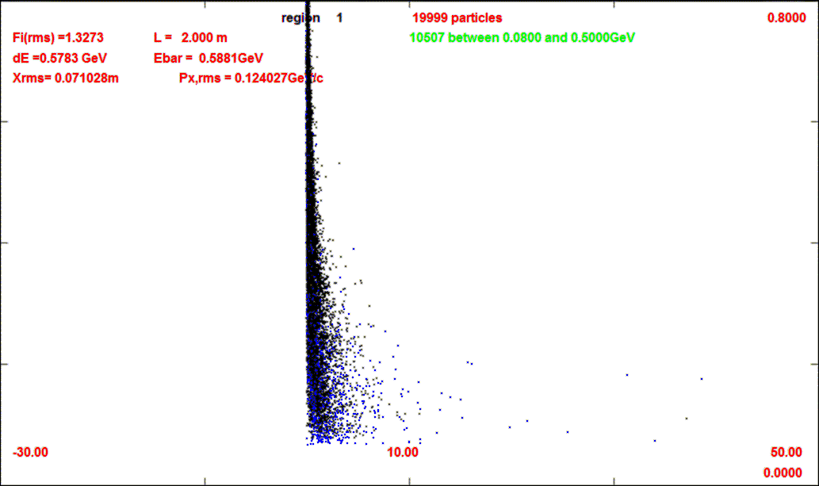
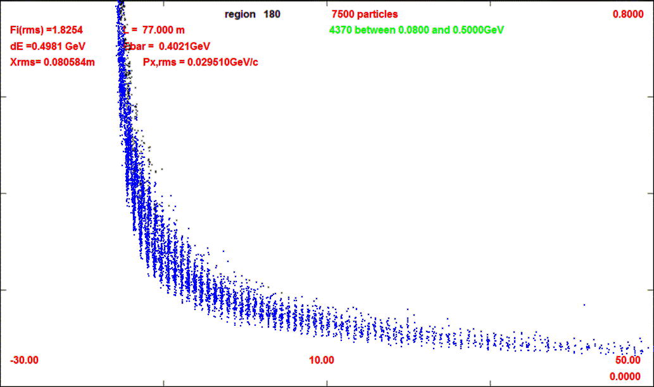
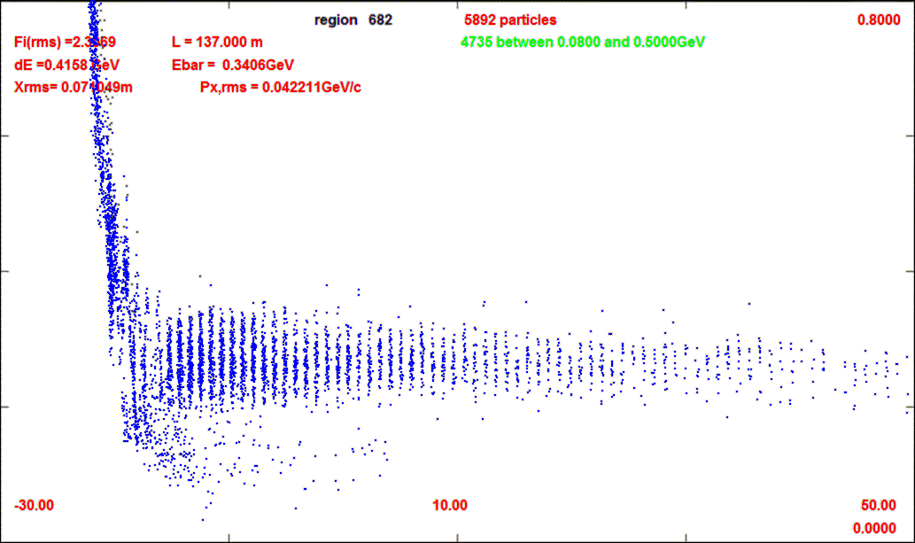
First simulations results
~60% of initial particles are lost in first 6m
previous front end lost ~20%
Beam starts out very large
previous much smaller in
front end simulations
μ/p reduced
→ ~0.061 μ⁺/p
~0.048 μ⁻/p
μ⁻ less than μ⁺ for C
Not fully reoptimized for new initial beam
z=2m
20000
z=8m
8386
z=77m
7500
z=137m
5892

Slide 12
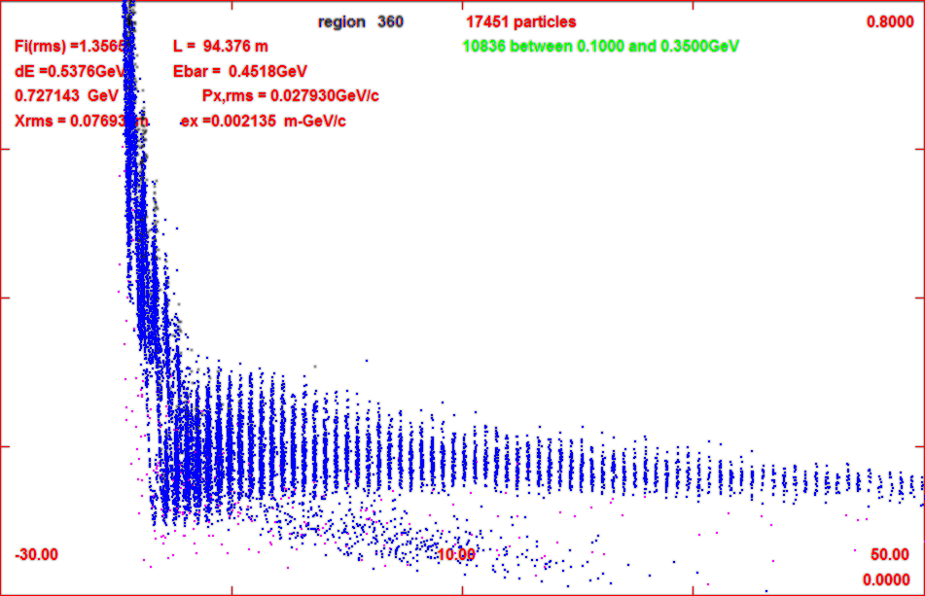
Progression of beam through system
z=11m
z=104m
z=135m

Slide 13
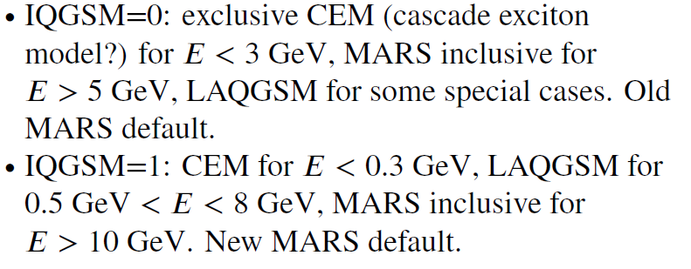
6.75 GeV p/ C target – 8GeV Hg
Simulations capture typically somewhat less than before
Big difference in MARS production model
Mars Inclusive → LAQGSM=1
Drop in production for ~8 GeV
Are previous MARS simulations that showed an advantage in production for ~8 GeV still true ?

Slide 14
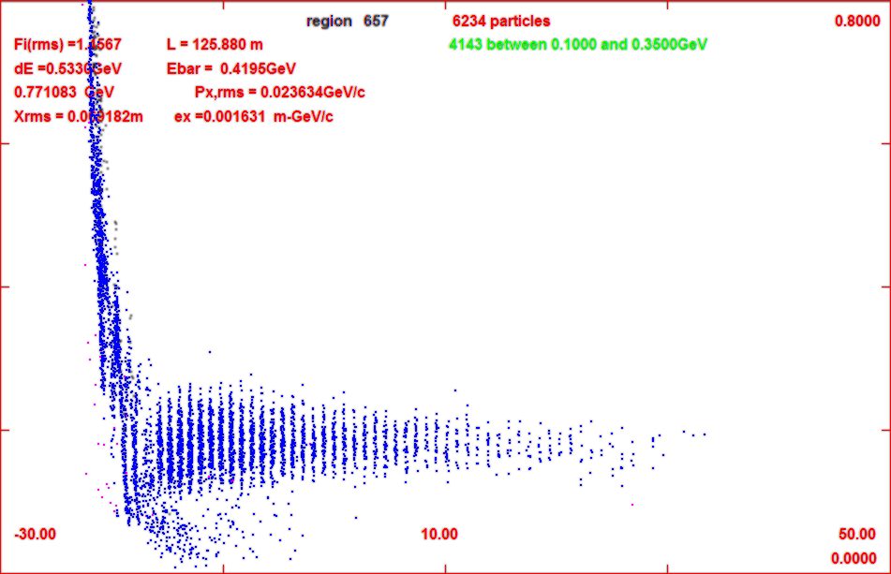
Add gas-filled rf in buncher/rotator
34 – 100 atm equivalent
1.14 MeV/m
34 atm
3.45 MeV/m
100atm
for 34 atm
add ~2MV/m to rf
First tries with ICOOL
GH in buncher 1 atm
no change in capture
Change to 34 atm by
DENS GH 34.0
Runs OK but
reduces capture by 20%
mostly from low-E muons
sorter bunch train
gas
z=71m
gas
z=135m
no gas

Slide 15
Other topics to explore
Replace vacuum rf with gas-filled rf
Also use gas in phase rotator
Do Buncher / phase rotation function as well ?
Replace initial 4-D Cooler with 6-D cooler
Has been initiated by Yuri
Would like a reference version to use as acceptance baseline
Integrate Buncher / Phase-rotation / Cooling
more compact system
adiabatic → snap rotation
Transform to general R&D
initial beam →???
lower B-field, lower energy
other uses (mu2e … LFV expts.

Slide 16
Any questions?

