Slide 1

Big Data & Data Science
“Bringing Particle Physics to the Enterprise” – A personal testimony
Ioannis Katsanos
VP, Data Scientist/Product Management
31-Oct-2013

Slide 2
What is the goal of this talk?
Introduce some elements of Market Research
Introduce the company I work for
Discuss the fields of Data Science and Big Data
Present my trip finding a career outside HEP and the lessons I learned in the process
Include thoughts and advices as they emerge from discussions with peers in industry and other researchers looking to make the jump
Note that each case is unique and your miles WILL vary
Disclaimer: The opinions expressed here are strictly personal
and may not necessarily reflect those of IRI .

Slide 3
Market Research & IRI

Slide 4
Market Research
Generally Market Research is the field that gathers information about targeted markets and analyze that information
Market Research helps analyze market needs, size, and competition
Is the cornerstone of business strategy with the goal to maintain or improve competitiveness against competing companies
One of the most challenging fields of Market Research is the Packaged Goods (CPG) of Fast-Moving Consumer Goods (FMCG)
  Products that are sold quickly, relatively often, and to a comparatively low cost
  They come in a package
  Typically consumable products like food, beverages, cleaning products, OTC medication, tobacco, etc
  High competitive field due to market saturation and low consumer switching goods
  An area that always has consumers
  Whole market is valued more than $2 trillion

Slide 5
Market Research – CPG
CPG Market Research is very challenging because of its size, and the consumers behavior
As an example there are 85000 stores in the US (mass merchandisers, grocery stores, bodegas/small neighborhood stores)
More than 2,000,000 products that fall into the CPG space and are moved weekly
About 6 years of data in out data warehouse
Tracking price reductions, and many types of promotions (causal factors) that can alter the market, even if momentarily
Consumer patterns are affected by various exogenous factors like weather, macroeconomic indicators, day of the month, fashion trends and fads, etc
Traditional methods focus on monitoring trends of econometric measures
Newer methods attempt modeling human behavior, helped by a glut of data including social networks, online footprint, smartphones, etc

Slide 6
IRI
IRI© is a market research company that focuses on the consumer packaged goods (CPG), retail, and health care industries
  Was formed as Information Resources, Inc. (IRI) in 1979
  Headquarters located in downtown Chicago
  International footprint:
    Offices throughout the US and in 7 countries in Europe
      UK, Germany, France, Netherlands, Spain, Italy, Greece
    An IT/Analytics center in Bangalore, India
    Since early September extended the footprint through acquisition to include:
      Australia, Canada, Hong Kong, New Zealand, South Africa, Sweden and the UK
Currently is a private company. The majority owner is the New Mountain Capital LLC; a private equity company
Continuous presence in the Top 10 of the Market Research Sector (Honomichl Report)

Slide 7
IRI
IRI© is a data, software, and consulting provider to more than 95% of the Fortune 500 in CPG and retail
  Provider of data to the financial community, consulting sector, marketing agencies
Biggest asset of the company (except for its employees) is point-of-sale (POS) and Panel data
  Collect transaction data from about 85000 retailers (US)
  Consumer Panel data from a sample of ~100K households through a collaboration with AC Nielsen©
  In continuous search for other sources of data, and analytics methods that can improve our product offerings
Offer software solutions that use the available data to provide insights to our clients
Analytics group provides customized solutions to clients
Consulting group works with our clients to answer very specialized questions

Slide 8
IRI – Dataflow diagram
Small company with a lot of data!
About 85K stores in the US; 2M actively maintained products; More than 6 years in our data warehouse

Slide 9
What is Product Management?
Per IRI Organizational Booklet:
  Product Management is responsible for the development, packaging, marketing of IRI products
Product Management:
  Owns existing datasets
  Identify and bring in new datasets
  Talks to clients
  Researches, designs, and produces new products
  Coordinates some activities between different groups in the company

Slide 10
IRI – Company Structure
Manufacturers
Retailers
Client Facing Teams
Analytics
Product Management
Technology - Operations

Slide 11
Big Data
Data Science

Slide 12
What is a Data Scientist?
Plenty descriptions out there
Generally accepted that such a role needs:
  Strong data analysis and modeling skills
    Ability to work with a disparate sources of messy data
  Strong computing skills leaning towards “hacking”
    Interest in open-source tools; Hadoop, Python, R, (oh! should not forget SQL, some C++)
  Building expertise in the area of interest
  A lot of curiosity!
Hacking Skills
Machine
Learning
Math & Statistics
Data
Science
Danger
Zone!
Traditional
Research
Field Expertise
*Inspired by Drew Conway’s
Venn Diagram

Slide 13
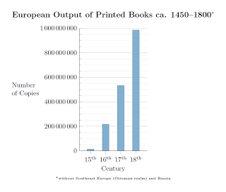
What is Big Data?
The term “Big Data” nowadays is everywhere (soon to be replaced by “Data”)
  A Google search gives more than 60M results (45M if you force the two word be next to each other)
From the dawn of civilization to 2003 ~5 Exabytes (2⁶⁰ bytes) had been created¹
  Including output from Aristotle, Descartes, Hume, Newton, Tolstoy, Gunsmoke
In 2012 alone 2.8 Zetabytes (2⁷⁰ bytes) were created². No stopping in sight…
Explosion of generating (digital) information
  Not entirely unprecedented – Invention of modern printing (Gutenberg ~1440AD)¹
¹ 15th Century Big Data
² Wired: Information Revolution
Notes:
Gunsmoke: ~600 TV episodes and ~500 radio shows

Slide 14

What is Big Data? – A Modern State
Library of Congress
Digital
~5K TB
One Year of All
Business Emails
~2M TB
NCDC
Weather Data
~6K TB
Uploads to Facebook
~0.2M TB
Contents of
every print issue
of Wired
~1.3 TB
LHC
~15K TB
Google Search Index
~0.1M TB
Tweets in 2012
~19 TB
Videos on
YouTube
Per Year
US Census
Bureau
~4K TB
Kaiser Digital
Health Records
~30K TB
NASDAQ DataBase
~3K TB
Wired: Information
Revolution

Slide 15
What is Big Data? – Great Opportunities
Data are being generated (and recorded) in
  Large volumes
  A lot of flavors
  Incredible speed
Great potential for Quantum Leaps in our knowledge and understanding of everything that can be measured
  Deeper look into behavior and shopping patterns
Big volumes and variety of sources allow us to make predictions
Speed of newly generated data allow us to:
  Monitor trends
  Give instant feedback
  Improve our predictions

Slide 16
What is Big Data? – Great Dangers
Not all Data are created equal
  Vast majority of them: Just Noise
Patterns emerge that are not real
  Random fluctuations can become prominent
  Easier to become victim of over-fitting
Big Data leads to Big Confidence
  “I believe that math is trumping science. What I mean by that is you don't really have to know why, you just have to know that if A and B happen, C will happen.”¹
Bottom-line: Big Data provide us with great opportunities, but at the same time increases our responsibility for critical thinking
  A process where we use the data to refine our thinking
  “Data-driven predictions can succeed — and they can fail. It is when we deny our role in the process that the odds of failure rise. Before we demand more of our data, we need to demand more of ourselves.”²
With great power comes great responsibility
Notes:
Bayesian vs Frequentist

Slide 17
What is Big Data? – Great Challenges
One theory suggests that the Big Data epoch started when Google proposed (implemented) the MapReduce algorithm
Handling of “large” amount of data due to computing, and statistical challenges. A few examples
  Computing: Doing in-memory operations limits the amount of data that can be handled; “in-disk” operations introduce a insurmountable overhead. Also currently available software techniques start breaking down; Huge “classical” databases
  Statistical: Noise accumulation; Fake correlations between response and unrelated covariance (“cross-talk”); Unrelated covariances be correlated with residual noise (incidental endogeneity)
Hadoop/MapReduce can solve some of the problems
  Also more generic programming languages like Python

Slide 18
Big Data/Data Science – Skills needed
Solid analytics skills
  How you approach a problem is more important than methods you know
    Methods needed are often “per case”
  But if you like to know “hot” methods:
    Principal Components Analysis, Clustering, Bayes, Random Forests, Neural Networks, …
Computing/Database Skills
  SQL, Python, R, …
  Solid understanding of databases and their limitations
  Distributed processing (Hadoop) of large data sets and its limitation
Communication skills
  Visualization tools, storytelling

Slide 19
Steps Towards
My Current Position

Slide 20
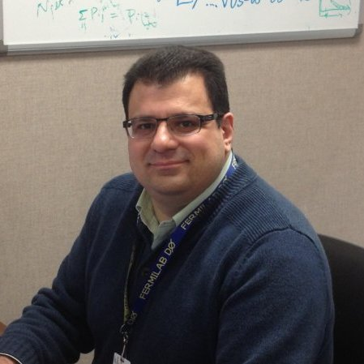
Who am I?
IDK
Education
  PhD in Physics, Columbia University – 2008
  MA – MPhil, Columbia University – 2002(5)
  BSc in Physics, Univ. of Athens – 2000
Experience
  Fermi National Accelerator Laboratory 2004 – 2013
    Initially for CU and later for UNL
  Nevis Laboratories/Columbia University 2000 – 2004
  CERN 1997 – 1998
  NCSR “Demokritos” 1995 – 1997
Bottom line: For a good part of almost 20 years, I have worked/studied particle physics ⇒ big (messy) data

Slide 21
Who am I? – Current Role
My role is a VP, Data Scientist:
  Identify and acquire various data
  Identify, in collaboration with the Client-facing teams, opportunities where we can develop new products
  Build models and data-analytics techniques that can be included in product offerings
  Evaluate new technologies and analytic methods
Day-to-day
  Spend a lot of time with data, acquiring, cleaning, and preparing for analyses (till the Data Steward position gets filled!)
  Spend a lot of time on arXiv for new statistics and CS papers
  Programming, analysis, build models
  Collaborate with other analysts
  Communicate with other PM members, Analytics leaders, Technology group, and Upper Management (C-level)

Slide 22
Step 1: Find a Career
In summer of 2011 I decided to leave physics, and academia
But I didn’t know what I could do (compatible with my interests)
During the “End of Tevatron” activities I met with various Tevatron alumni. One such discussion exposed me to the world of Data Mining and Business Intelligence
I started looking into the different options that were available
  … and into the data analytics methods and tools that are used in the business, and machine learning world
Discussed with some people in the lab about my plans and got very useful feedback
Talked to my advisor about my plans and got his support
Advice: Think about finding a career; not a job
Advice: Start EARLY!
Advice: Talk to people and be honest about your plans (wherever that is possible)!

Slide 23
Step 1: Find a Career - Available Options
I divided the available sectors into the following 4 sectors that were interesting to me AND were options in the Chicago area
Policy Analysis Sector
  An area where you can make a difference! BUT
  Not many opportunities available in Chicago
  Very guarded towards applicants with no policy analysis degrees
Market/Behavioral Analysis Sector
  Wealth of data
  Deals with real, physical products
  Some legacy analytics, but prime (and welcoming) for new analytics techniques; Make an impact quickly
Insurance Sector
Financial Sector – Risk management and modeling
Others: Computer gaming industry, HFT, one size fits all analytical efforts

Slide 24
Step 2: Build a Resume – Some Facts
Your resume will be read by some software → Include words that are mentioned in the ad (or the popular words used in the field)
The human reader (recruiter) will spend on average 6 SECONDS in your resume
The recruiter does not know physics
Awards, publications, talks, references, titles of theses/papers, names of PhD advisors are NOT evaluated
  Don’t WASTE valuable space!

Slide 25
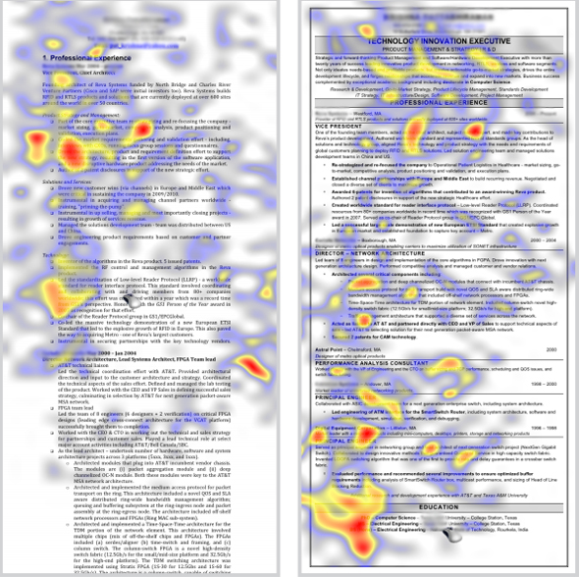

Slide 26
Step 2: Build a Resume
A resume has to be 1 – 2 pages long
  Contract researchers should aim for 2 pages
Compose your resume from the perspective of the reader
Use simple language to explain what you have done, BUT
  … be specific where possible
    Avoid eg. “Work with big data” or “Have worked with an enormous amount of data” etc. Instead use: “Extensive experience working with large datasets (in the order of 15PB)”
Advice: After you done, put aside your resume for a few days. Then read it from the perspective of a hiring manager: If you were hiring would you hire yourself based on that resume?
Two main type of resumes: Chronological, and Functional
  I prefer a combination of the two that is called “hybrid”
  Always include a summary of qualifications on the top if your resume
Make sure it matches your LinkedIn profile

Slide 27
Step 3: Networking – Informational Interviews
Networking is an important function at any stage of your career
Advice: Ask your colleagues, faculty, friends if they know someone in the area of your interest
If you find someone and they are willing to talk to you
  Have no expectations
  Do NOT sell yourself (unless you are explicitly told that they have an open position)
  Have an engaging discussion
I had 12 informational interviews (3 with upper management)
  2 had an immediate availability
An upper manager to a management & consulting company
  Provided many great options.
  He spoke highly of a company called “IRI”.
  Forwarded my resume to a friend of his in IRI
  Nothing came out of it BUT my resume ended up into the HR

Slide 28
Step 4: Applications
Job availabilities can be found through many sources
  Career pages of companies that interest you
  Dedicated search engines: Dice, Indeed.com, LinkedIn, etc.
  Job Fairs: Attend one in your school if possible. Many job fairs in tech conferences (TechWeek Chicago is a very good option)
  Networking
  Head-hunters
  …
If possible try to go through someone you know
If you apply by email/web-link ALWAYS include a cover letter
  Cover letter should explain why YOU are a good fit for that job
  Include words from the listing (but not verbatim!)
Job search queries may include data science, data mining, predictive modeling, statistics (a lot of noise), machine learning, etc.

Slide 29
Step 4: Applications – My Approach
I separate my job search in two periods: Limit setting , Signal observation
Limit setting period provided valuable lessons. Applications sent:
  Policy analyst fellowship in education (April 2012)
    Application through their website
    Did not go past the software scan
      Received rejection within a couple of days
  Marketing research company at Naperville (July 2012)
    Application through their website
    Did not go past the software scan
      Received rejection within a few hours

Slide 30
Step 4: Applications – Limit Setting (continued)
Insurance company in Chicago (September 2012)
  Through Networking
  2nd phone interview - Interview was a disaster!
    I went into too many details from the start
    Some of my explanations needed a physics background to understand
    My interviewer was difficult to understand over the phone
    Questions revolved around the type of statistics I had used in my studies
  Four days after the interview I received their decision to “move to another direction”. Just a formality

Slide 31
Step 4: Applications – Limit Setting (continued)
Facebook (October 2012)
  Combination of online application and networking
  2nd phone interview
    Interview went much better than the first one
    They interviewed me for a higher position than the one I applied for
    They seemed interested in inviting me for an in-person interview…
    Till I said that I am not sure if I have the qualifications for the higher position since it required 5 years in marketing (per their job ad)
    From the tone of the voice I realized that this was an unwise statement
    Still waiting for their decision…!
Advice: If a recruiter contacts you for a position different than the one you applied, do NOT question their judgment

Slide 32
Step 4: Applications – Limit Setting (continued)
Small startup in Chicago (December 2012)
  Applied over email
  Received their decision within a week (rejection)
  The only company where they offered their feedback
  Bottom-line was that my cover letter did not give them the impression that I had studied their company beyond the job posting, since I did not mention references from blog posts they had authored, common interests with people, etc. As a small startup they needed someone who was 100% behind their vision
    Side-note: I had done all the relevant research but I thought not to include that in my cover letter since I could discuss the common interests during the interview!
Advice: Tailor your cover letter according to the position and the company
  For a big corporation letter should be formal (“by the book”)
  For a start up you can (should) be more original

Slide 33
Step 4: Applications – Signal Finding
By February 2013 I decide that I was as prepared as I could be
Targeted the two biggest names in the field: AC Nielsen© and IRI©
IRI © was my primary target since it is a smaller company, more flexible, with a history in innovation (being the company that brought disruption in the field), and the position was by far more attractive
Both positions were about the CPG industry
IRI (mid-February 2013)
  Found position through LinkedIn
  Circumvented online application process and emailed directly the recruiter I had already been in touch
Advice: Networking always pays up even if not directly
Nielsen (end-February 2013)
  Found position through connection from Fermilab colleague
  Contact in the company was the hiring manager

Slide 34
Step 4: Applications – Signal Finding
IRI
More attractive position: VP, Data Scientist
First contact: Two hours after submitting the application by email.
  Arrange 1st phone interview with recruiter for two days later
A couple of hours after the 1st phone interview the 2nd is arranged for later that week
2nd phone interview is with hiring manager. A couple of hours after the call I am notified that I will be invited for an in-person interview
Interview scheduled for 1st week of March
Six calendar days after the interview I am notified that they will extend an offer
Offer letter is presented 2 weeks later
Minimal negotiations. Accepted the offer later that day
Nielsen
More technical position: Manager/Director of Analytics
First contact: Two days after introduction
  Almost an interview
Contacted by recruiter who is assigned my case. Have a phone interview with her. Guided to complete an online application and arrange to take online test
Two days after completing the online test I am notified that I will be invited for an in-person interview
Interview scheduled for 1st week of April
Day that IRI offer was presented the Nielsen hiring manager contacts me to touch base
Revealed that I have been talking to IRI. He admits that they cannot match the offer or grant me the conditions of the IRI position
Cancelled the in-person interview after officially accepting the IRI offer

Slide 35
Step 5: Interviews
Appearance:
  Find out company’s culture and match it by a tad more conservative
  If in doubt: wear a suit
  If cannot find credible information: wear a suit
  Do not forget that regardless of your role you may end up meeting clients, so appearance is important
Be professional and courteous to everybody
  When evaluating your application everybody’s opinion counts
Arrive on time (10 minutes earlier than your scheduled time)
Bring water!

Slide 36
Step 5: Interviews
Interview questions and conditions will vary
Everybody will ask
  Why leaving physics/academia
  Why chose the field where their company does business
  How what you have done translates to their area of business
  What is the salary range that you expect
    Try not to give a number (or a range) as long as possible
Need to convey expertise, maturity, good presentation skill to all levels
  Clients, upper management, other collaborators in the company will not have analytics background
Questions about data analysis and statistics, problem solving approach
Behavioral type questions (newest trend in interviews)

Slide 37
Step 6: Offer/Negotiations
Time between notifying that will extend an offer and presenting the offer is by far the most stressful!
That time can be a few days to a month, based on anecdotal information
Theoretically everything is for negotiation. Depends on the organization
  Note that for the first position after academia you do not have too much of leverage
  If you attempt to negotiate they are within their rights to engage in negotiations or recant their offer
Advice: Research the position, company, and area for salary ranges (payscale.com, glassdoor.com, strata, KDnuggets, etc…)
Advice: Find out if company tends to make high or low offers, and if they negotiate. BUT each case is unique
  Glassdoor.com is a good source of information
Advice: Remember that they are experienced and you are not!

Slide 38
Summary – Advice for Job Seekers
Big Data and Data Science is a very hot field with an expected shortage of talent
Not very clear for how long this shortage will persist
Most important: Search for a career, not a job
Start early! Talk to people you trust. You never know when a connection can be proven fruitful
Prepare! Look deeper in what you do on your day-to-day activities. Do not treat methods like black-boxes, but study what they do
Refresh your college statistics
Learn SQL (at a minimum). If you have time learn a statistical package. Python is the future, but R could be useful too…
Treat your job search as if it is your regular job
Do not forget that luck is a big factor (if not the most important)!

Slide 39
Summary – Advice for Advisors
How can senior members/advisors help?
Educate your students that more than 90% of the PhD particle physicists end-up outside academia
Find where your ex-students, and researchers have gone. Connect with them. Build a network that your current and future “underlings” can tap into
Collaborate with the career office in your school to help the people stationed off-campus. When it comes to accessing school resources, available to all other personnel, people at FNAL, CERN, etc., are on exile
  OR build one at FNAL (CERN, etc...,)
Keep up-to-date to the new developments in the job market. Help your students/researchers build the available skillset
  Allow (and encourage) your people to intern in the industry

Slide 40
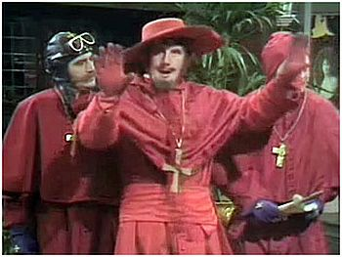
Questions?

Slide 41
Resources
Statistics/Machine Learning
  The Elements of Statistical Learning (Hastie et al.)
  Pattern Recognition and Machine Learning (Bishop)
  Statistical Methods in Experimental Physics (F. James)
Statistical Methods
  Principal Components Analysis
  Random Forests
  Bayes
  …

Slide 42
Resources
Software
  www.python.org
  http://www.r-project.org/
  www.stackoverflow.com
Big Data/Data Science
  http://blog.gopivotal.com/p-o-v/10-skills-of-effective-data-scientists
  www.hbr.org

Slide 43
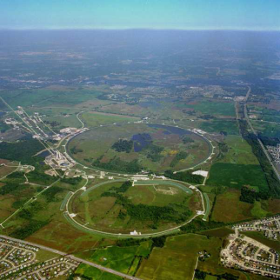
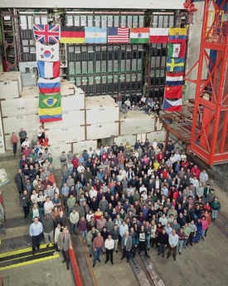
Particle Physics ⇒ Big Data?
Sources: A detector consists of about thousands of streams where data need to be combined
  A typical detector has more than 1M electronic channels
  Combine with timing information from accelerator and other sources

Slide 44
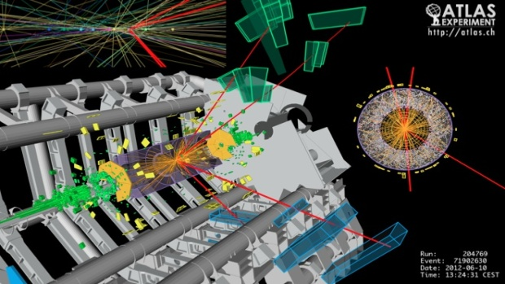
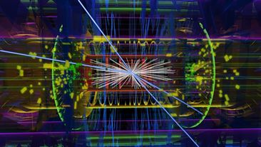
Who am I?
Size: Millions of events per minute
  Event is named the result of each collision
LHC outputs about 15K TB of data per year
Tevatron at FNAL would output about 2K TB of data per year
  Rates of incoming data at about 1.7MHz

Slide 45
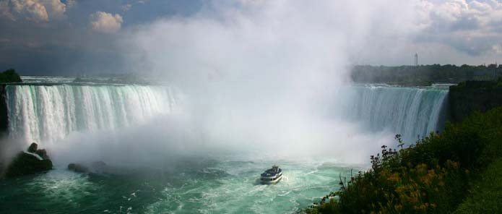
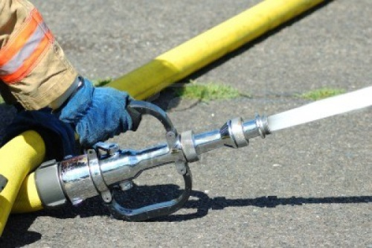

Who am I?
Speed: Choose in real-time the “interestingness” of each event
  Ability to record information is limited to about 200Hz; Remove about 99.99% of your data
  Need for a very robust online (real-time) monitoring, and triggering, system
Incoming Data
(1.7M gpm)
Recorded Data
100 gpm
Used in
Publications

