Slide 1
06 March 2015
1.05.03 MICE Magnetic Shielding
Holger Witte
Step IV Conceptual Design Studies: finished
Step IV Magnetic Shielding Detailed Engineering: finished
MICE Step IV Magnetic Shielding Fabricate Parts
MICE Final Step Conceptual Design ad Engineering
PRY Step IV
cam concept to avoid overstressing of L-seal bolts (now ok up to 5 times calculated load)
PRY legs arrived in UK, presently being installed
Steve Plate in UK to oversee this
Machining of PRY shielding plates ongoing as planned
Draw-wire sensors arrived, will be shipped to UK shortly
PRY Final Step
Required steel ordered
Transport of PRY to UK
Support installation
PRY Step IV: finish machining of PRY plates
Engineering/design of PRY Final Step

Slide 2
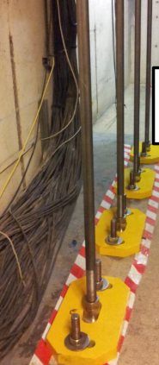
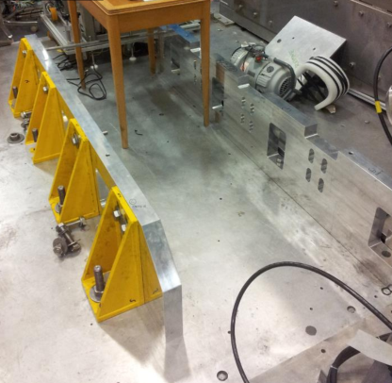
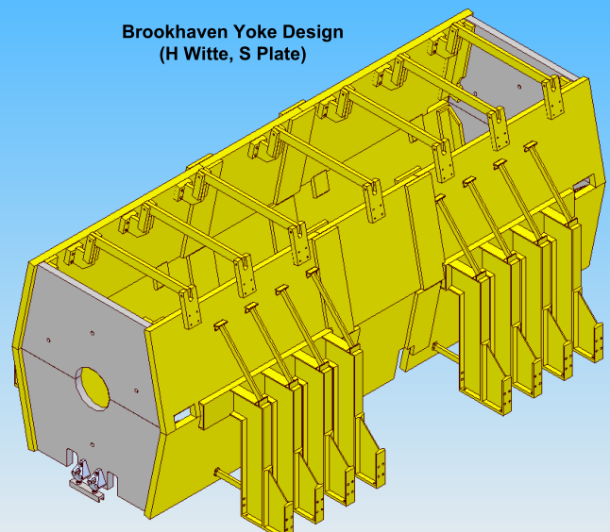
Step IV
PRY bases installed (UK)
One side of framework (south) in UK
Used for survey, shimming, … of north side before installed on south side
Time savings
MICE hall will be ready when PRY arrives
Schedule
March 20: South plates in UK
April 21: North framework + plates in UK
Framework

Slide 3
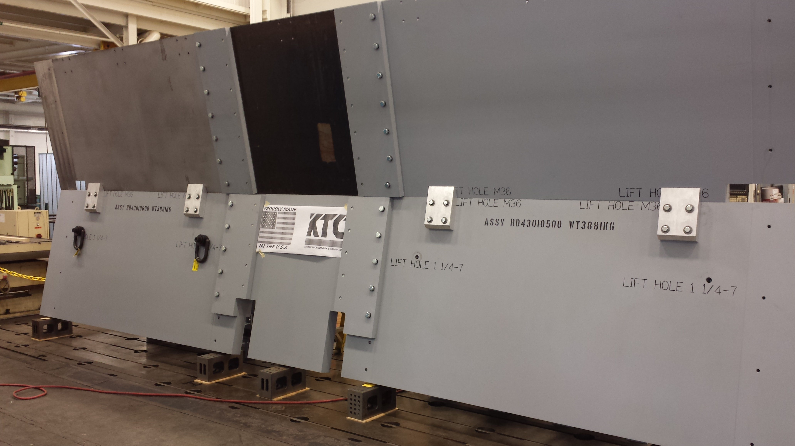
PRY South Wall
South wall at Keller (March 5th)
Trial assembly finished
Present status: dismantling
Crating + shipping to JFK

Slide 4
CAM Concept
L-Seal
Mitigates overstressing of L-Seal bolts
Stress analysis now ok up to 5 times calculated load on end plate of PRY

Slide 5
RF Penetration
Addition
for Step V’
Step IV PRY
R150

Slide 6
RF Penetration
5/10 Gauss Surface

