Slide 1
Migration to Drupal Status
Gunter Folger
CERN/PH/SFT
Geant4 collaboration workshop 2015

Slide 2
Content
Current Geant4 web sites
Migration of TagsDB web interface
What is Drupal
Creating new Geant4 web site in Drupal
Summary
Material on Drupal

Slide 3
Current Geant4 Websites
http://cern.ch/geant4 : master of web site
plain website based on shtml files in afs, using server side includes
Mirror at http://geant4.org
http://sftweb.cern.ch/geant4 : provides tagsDB web interface and Collaboration agreement tool
Linked from main page, but independent site
Both tools are custom made Drupal 6 modules, created by Przemyslaw Paprocki in 2010 in time with the migration from cvs to svn
Runs on Drupal 6 server provided by SFT.
Several wiki’s for individual working group pages
Linked from geant4 site, but are independent
Validation database portal at FNAL
See report by Hans Wenzel
Grid validation web page

Slide 4
Evolution of current sites
http://cern.ch/geant4 :
CERN had offered to create a Drupal site to replace the current plain files based web site
http://sftweb.cern.ch/geant4
TagsDB web interface and Collaboration agreement tools need to be migrated out of Drupal 6, either to Drupal 7, or to standard Apache web server.
Migrating to Drupal 7 or Apache are both non trivial, and both require code changes
CERN/IT security team is pushing to shut down this old web server under Drupal 6
Independent from migration of main Geant4 site
Other sites unchanged:
Several wiki’s for individual working group pages
If requested, these could be moved to the Geant4 site
Validation database portal at FNAL
Grid validation web page

Slide 5
Interface to TagsDB and collaboration agreement tool
Both tools are Drupal 6 custom made modules
This software needs to be migrated, choices are to
Move to Drupal 7: we need to adapt for changes in API between Druapl 6 and 7
Move to Apache: Software becomes independent tool, depending only on standard packages and usable on Apache server
Choosing where to migrate:
Stay with Drupal:
Migration may be simpler, but may repeat for Drupal 8…
Consequences for support given by IT for Geant4 Drupal web site
Move to Apache
Expect stable interface once the tool is migrated
In either case code of the tools would not be supported by IT

Slide 6
Migration of Drupal 6 modules
Used collaboration agreement module to evaluate possibility and effort to migrate to standalone tool, using functionality on Apache server.
Technologies used in module
javascript, jQuery, AJAX, JSON, php, ….
Lots of possibilities to learn
Started migration to independent tool
Running on standard Apache webserver provided by CERN/IT
No need to change javascript was needed
Need to migrate database access from Drupal API to standard PHP/PDO API.
Collaboration agreement tool already migrated
https://geant4-tools.web.cern.ch/geant4-tools/geant4ca/cgi-bin/geant4ca.php
TagsDB is far more code and complicate.
Migration is underway.
Several more weeks of work.

Slide 7
Custom geant4ca module
Database
(DBOndemand)
Consists of javascript, php, css, and drupal templates
Query DB on user
Store record
Browser
Window
Web server
php modules
- LDAP
- DB
- Email
- Ajax Callback
Shibboleth
Javascript
Get login, name
jQuery AJAX, JSON,
Query LDAP using php
Institute, email…
LDAP
email
Send confirmation
emails

Slide 8
New Geant4 Drupal 7 web site
Started to create Drupal web site http://new-geant4-dev.web.cern.ch
Stay close to design of current page
Only few pages created, only Applications is correct and complete
Addition of major part of pages waits for evaluation of import tool coded by a student
Created a trial mirror, check at http://cern.ch/gunter/mirror
Also gave tar file of mirror to Koichi for checking.

Slide 9
http://new-geant4-dev.web.cern.ch

Slide 10
What is Drupal
It is CERN’s choice for web management
Content Management System and Framework
Separate content from layout or look&feel
Extensible via modules
Popular open source (top 3: WordPress, Drupal or Joomla)
Root and PH/SFT are already in Drupal since ~5 years
It offers all must-have for a modern web site

Slide 11
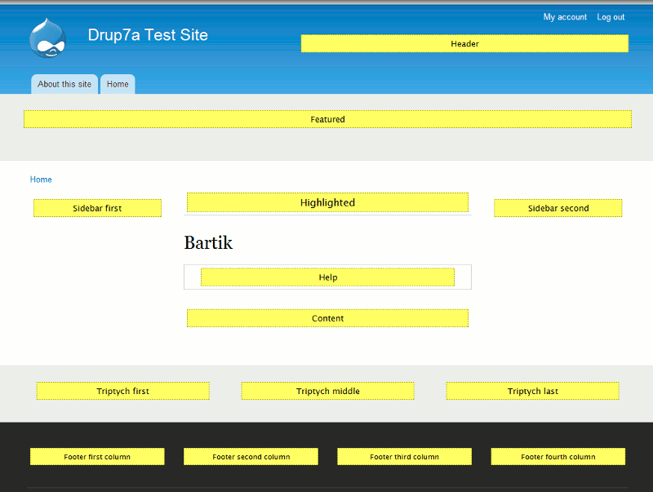
Drupal features
Powerful system to create web sites
Database driven, i.e. all content is in database, at CERN this is mysql.
Layout, or theme, is separate from content
Themes (can) adapt layout to phone, tab, or desktop
Pages consist of several areas with content in each area
Header, left/right side panel, footer,….
Here is the layout for Bartik theme
Users have different roles
Admin can do anything
Editor can create/edit content
Geant4 collaborators can edit all Geant4 content;
SB content reserved to SB members
simple user can read or comment, if comment is enabled
Wysiwyg editor

Slide 12
Importer tool
Created by the summer-student Leszek Ślażyński in 2011 for a test migration to Drupal 7
The site created had problems with protected pages
Effort and experience were lacking in Geant4 team
Importer tool parses a website
Importer allows to analyse site structure
Via standard tools, a graph of the site can be drawn
See www.graphviz.org, pictures shown are from ‘twopi’
Very useful to understand structure, including link
Importer handles import of parsed site to Drupal
Importer written in python
Using xmlrpclib module to communicate with Drupal web server
Several other modules used

Slide 13
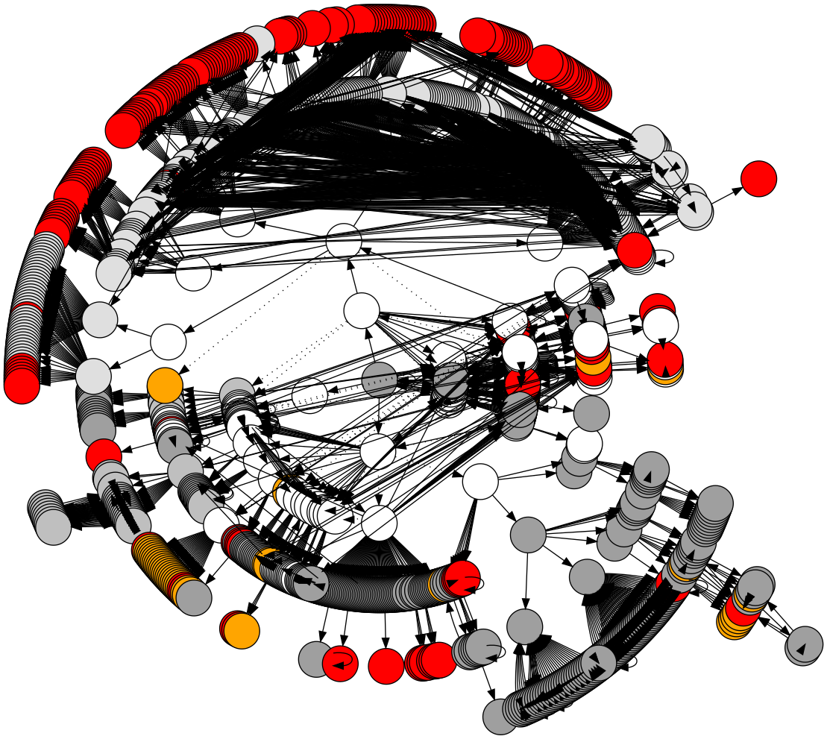
Structure of G4 website
http://cern.ch/gunter/g4-sitemap-full.svg
In browser you can see URL for each item
Geant4 home page is in center
Process model catalog
Steering board minutes
ESA workshop 1999
Red dots are missing links
Orange dots represent files not parsed

Slide 14
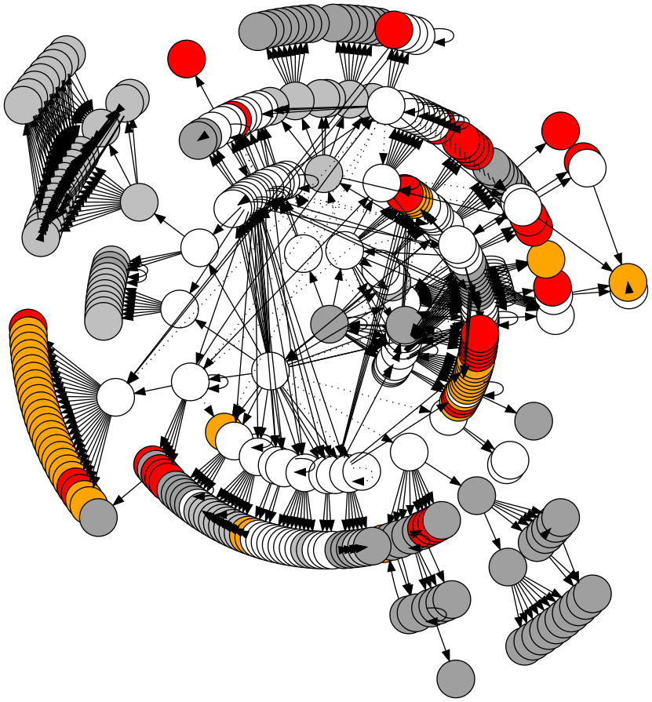
Structure of G4 website – 2
Skipping ESA workshop, process-model catalog and SB minutes
Geant4 home still in center
Working groups in grey
Workshops in green
OOAD analysis diagram in yellow

Slide 15
Importer tool - 2
Very useful to understand site structure
Graphs can be drawn in different style
Graphs shown are ‘onion’ style where radius corresponds to distance from home page in number of links to follow.
A full/partial import of pages not yet working
Documentation by student incomplete
Difficult to debug, due to lack of experience
Problems seem to be in setup of Drupal server
I expect to solve these problems within a few weeks.
Already had significant progress last few days, I went from near hopeless to optimistic
Backup scenario : Manual import of pages
Text of page is cut-and-paste, usually layout remains intact
Links need to be set manually

Slide 16
Items still to look into
Current site has pages which are compiled or generated from other sources
Importer can import these, but do we want this?
Most of these pages are in User Documentation pages
Docbook generated pages: Drupal hasmodules available, DocBook2Book, DocBookWiki, these need to be tried
Latex generated documentation: DruTeX module or single pdf file
Currently we only offer PDF file.
Doxygen: modules available (Drupal uses Doxygen itself!)
Generated physics list documentation
Listings of Geant4 members, working groups, …
Drupal should be good to handle this
Possible solutions for each these need to be evaluated, help by experts in documentation is welcome.

Slide 17
Summary
New Geant4 Drupal web site
Site exists, but still very limited content
Need to add more pages, expecting to get help by the Importer tool.
Start to look at solutions for generated pages
DocBook user documentation
Doxygen documentation, e.g. examples documentation
Parts of physics list documentation.
High density blobs, as shown in graph of website; i.e. process-model catalog, workshop pages, working group pages
Will carry into 2016
Can we identify content to exclude from this migration?
Collaboration agreement tool is ready to be put into production
Finish migration of TagsDB interface
Expect this to be a few weeks work, unless unforeseen difficulties arise
Beta for testing by end of October
Switch to production after release
Expect to finish end 2015

Slide 18
Basic introduction to edit/add pages
You need to log in to change or add pages
To edit, go to the page, and click on the edit just below the title of the page
To add a page, click add content, choose basic page.
Give a title, and body.
Choose the kind of text, plain asci, filtered or full html; usually we need full html
To add a link to another existing page, select the text to become the link, click on the link symbol, choose link type as URL, protocol to be
<other> for site internal link, address is something like content/…..,
http(s):// for link to external page, address is URL without the http(s)://
At the bottom of the page, you set options:
you may create an entry in a menu:
Select ‘Provide menu link’
choose parent menu where you want the entry
Create a new version, so we can revert
Under publishing information, select ‘published’
Then click SAVE, you may also save before you are fully done and continue later.
If you exit without save, all is lost. Going to another page without save also looses changes.

Slide 19
Material
Some URL’s I found useful
http://www.inmotionhosting.com/support/edu/drupal-7/working-with-content
Section 2, Basic pages
The Drupal Cookbook (for beginners) | Drupal.org
Most focussed on creating sites than on editing
A video showing how to add a basic page, https://www.youtube.com/watch?v=gQUsZk-lJbs

