Slide 1
Generic vs. Conventional Importance Biasing
Simple set-up
Results
Features of generic biasing
Next steps
Mu3e use of GB (bhabha cross-section) ☺

Slide 2
Setup
Muscle (10cm x 10cm x 10cm)
Tissue (10cm x 10cm x 10cm)
Bone (10cm x 10cm x 1.5cm)
Air gap (to sensor) 30cm-0.5 x sensor
CZT sensors (3mm thickeness)

Slide 3
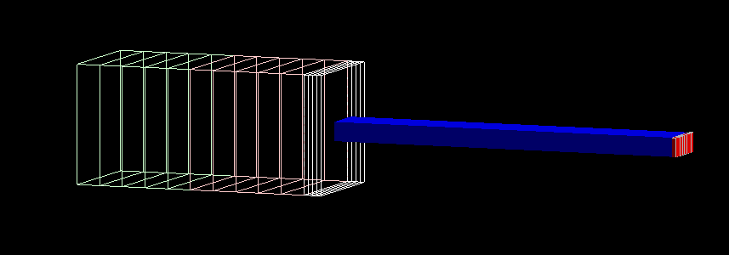
Setup with biasing sub-divison
Air column also introduced (otherwise killed on exit)

Slide 4
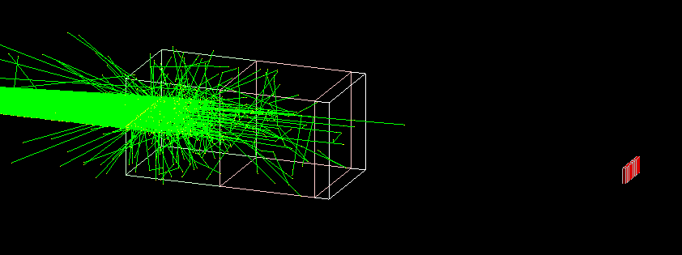
60keV x-ray fan beam
No biasing – strong attenuation

Slide 5
“Normal” importance biasing

Slide 6
Generic Biasing

Slide 7
Conventional Biasing 1 million events

Slide 8
Generic Biasing 10 million events

Slide 9
Normalised Flux - conventional

Slide 10
Normalised Flux - Generic Biasing Different numbers…

Slide 11
Features of Generic Biasing
Almost my “smart” biasing option (thanks Marc!)
Integer weights
Directionality
How to handle nested shells?
In general – how is direction handled – flat importance or always split?
How to get the flux into a displaced detector without splitting at the detector entrance?

