Slide 1
GeantV – status and plan
A. Gheata for the GeantV team

Slide 2
Outline
GeantV concept
Milestones
Concurrency & performance
Vector optimisations
Coprocessors
Geometry & physics
Conclusions

Slide 3
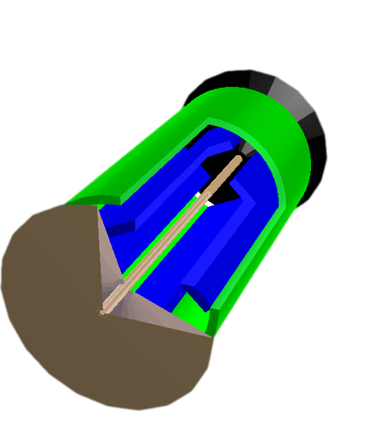
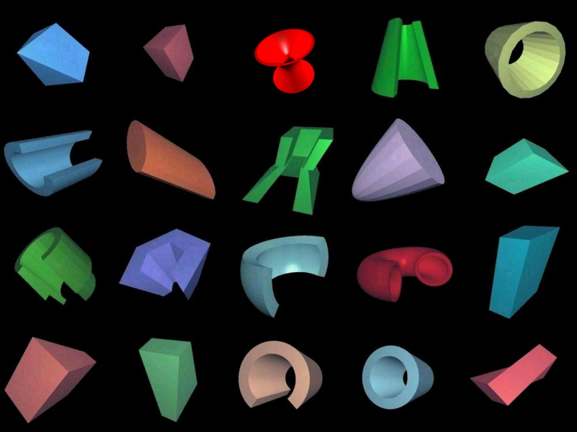
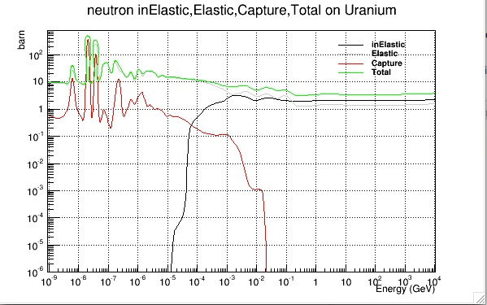
GeantV concept
Scheduler
Re-basketizer
Basket of tracks
Basket of tracks
Dispatching
MIMD
SIMD
Geometry navigator
Physics
Geometry algorithms
x-sections
Reactions

Slide 4
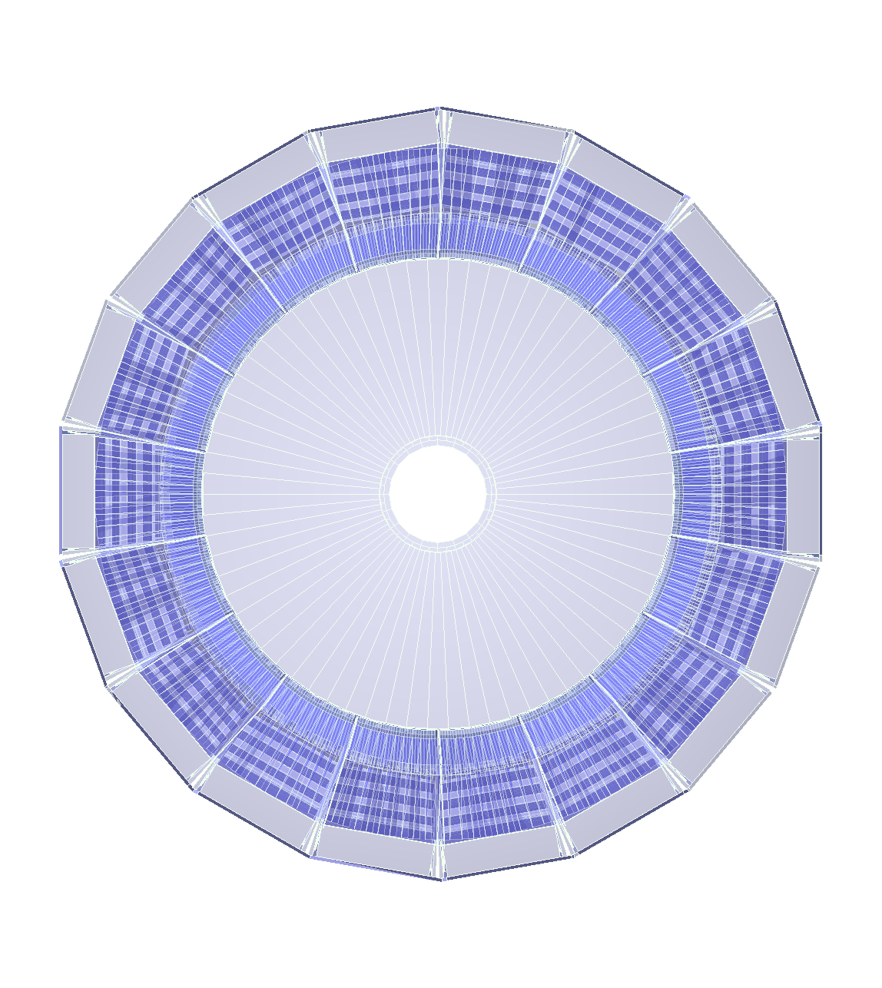
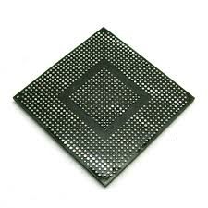
Geometry
Filters
(Fast)Physics
Filters
Stepper
Input queue
Vol₁
Vol₂
Vol₃
Vol_{n}
e⁺/e⁻
γ
Vector
stepper
Baskets
Step sampling
10⁵ baskets/sec
Filter neutrals
(Field) Propagator
Step limiter
reshuffle
Outputs
Coproc. broker
VecGeom
navigator
Physics sampler
Scheduler
Full geometry
Simplified geometry
Phys. Process
post-step
GeantV
Secondaries
TO SCHEDULER

Slide 5
Geometry
Filters
(Fast)Physics
Filters
Stepper
Input queue
Vol₁
Vol₂
Vol₃
Vol_{n}
e⁺/e⁻
γ
Vector
stepper
Baskets
Step sampling
10⁵ baskets/sec
Filter neutrals
(Field) Propagator
Step limiter
reshuffle
Outputs
Coproc. broker
VecGeom
navigator
Physics sampler
Scheduler
Full geometry
Simplified geometry
Phys. Process
post-step
GeantV
Secondaries
TO SCHEDULER

Slide 6
Project milestones (2015-2016)
CMS full simulation (Xeon): end Q4, 2015
Co-processor mode (GPU, Phi) functional – end Q4, 2015
GeantV simulation on Phi in native mode (KNL) – prototype by end Q2, 2016
Preformance optimisations by end Q4, 2016
Kernel offload doing part of processing + performance optimizations
Realistic scoring/ VecGeom geometry (vector mode)/ tab. physics
Performance goal vs. standard approach: 2x-3x
Geometry navigation optimizations + full support for missing features
E.g. divisions, solids
Support for other geometries than CMS: 2016
Showcase doing full CMS geometry raytracing on MIC: SC’15
New vector-aware physics models (continuous integration)
Finalizing interfaces, smooth transition from tab Xsec to vec. physics
By end 2016: New MSC, gammas, electrons

Slide 7
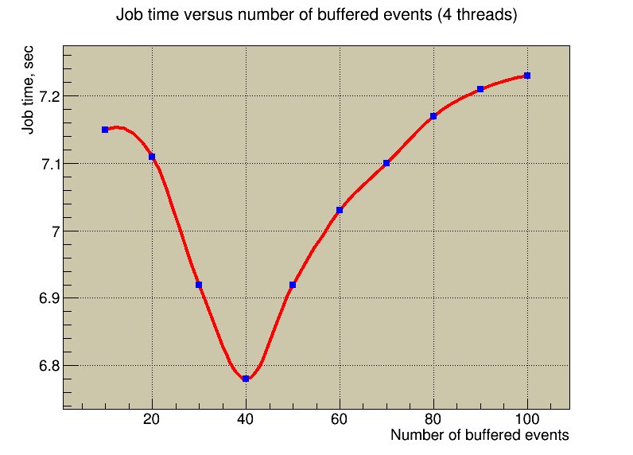
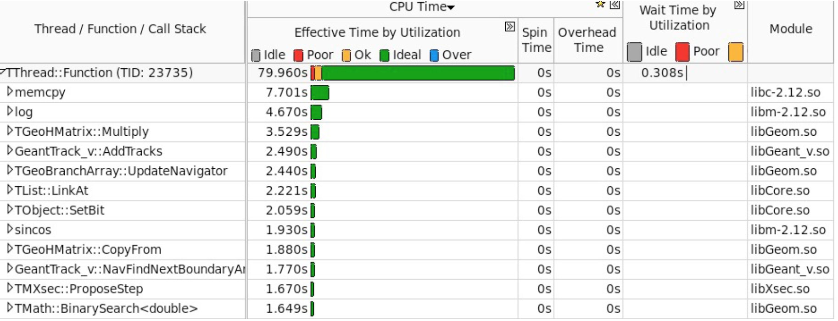
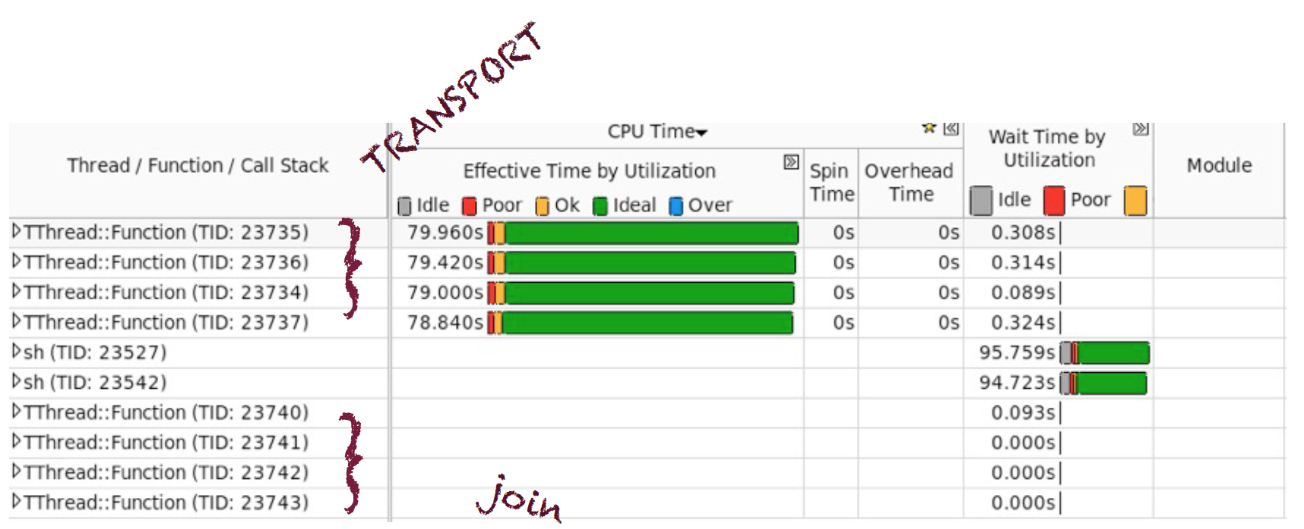
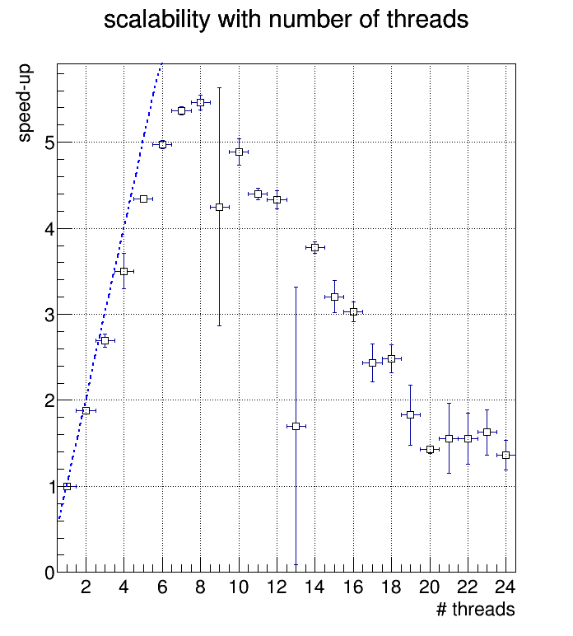
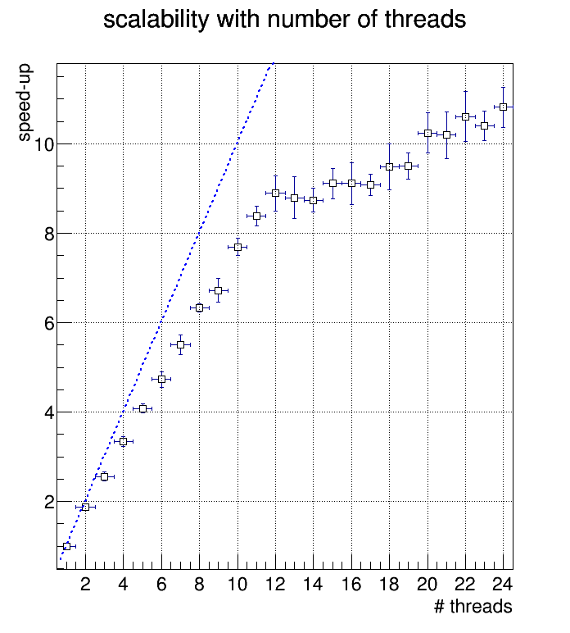
Fine grain parallelism is challenging
Optimising scheduler performance against several parameters
Several parameters to be tuned
Performance is monitored
Allows detecting and fixing bottlenecks
Amdahl still high due to rebasketizing operations
24-core dual socket E5-2695 v2 @ 2.40GHz (IVB).
2 NUMA nodes
CMS2015.root
Rebasketizing
Lock-free algorithm
(memory polling)
Algorithm using spinlocks
Notes:
All this to be done in a fine grain parallel environment-> monitor scalability
Removed a bottleneck due to unnecessary object allocation
Amdahl still high – we have clear ideas on how to improve this using atomics

Slide 8
Lock-free basketizing
I_{book0}
I_{book0} += threshold
I_{book}
replacement basket
current basket
threshold
I_{book}=I_{book0}
Fresh basket
Work queue
To transport…
N_{copied}=2
N_{copying}=2
N_{copied}>=threshold (Try dispatch)
N_{booked}>thres
copied
copying
“weak” replace
“strong” replace
booked
booking
10⁵/sec
T₁
T₂
T₃
T₄
T₅
…
T_{n}
threads
threads
Operations accounted by atomics
“copied”, “copying”, “booked”
Snapshot counters, check conditions, validate at the end that resource was not stolen (Ibook == Ibook0)
“Try/retry” policy for acquiring ownership on basket operations
“replace”, “replace & dispatch”
C++11’s compare_exchange to do basket stealing
First and subsequent not able to book slot in range – try to replace & book next basket
“weak” = try and succeed if lucky
First and subsequent who finished copying at/beyond last slot – try to replace and dispatch
“strong” = failing means someone else did it
Garbage collector can force replace and dispatch anytime
No dispatch before finishing pending copying operations to have “clean” baskets
basket = SOA of tracks

Slide 9
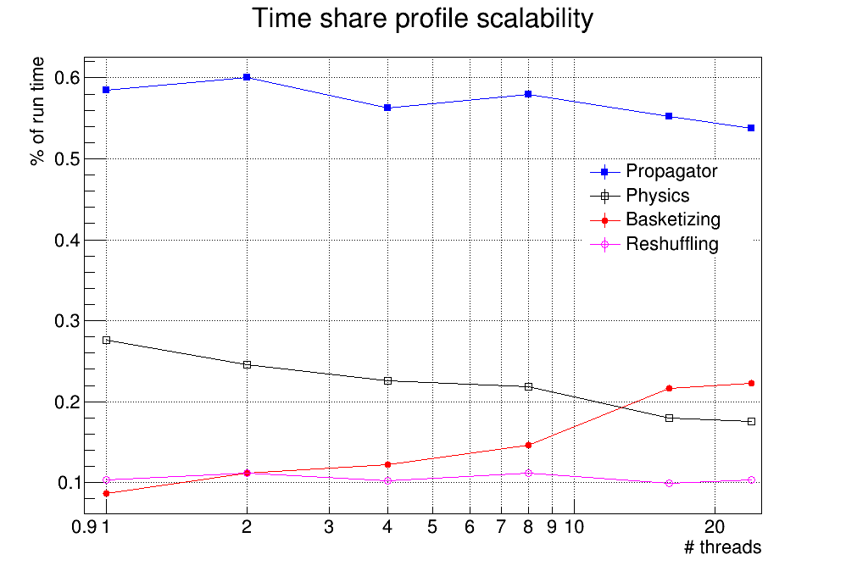
Contention sources
Geometry + propagator: main consumer, will balance with physics in future
Physics: low profile, will go up with physics models
Basketizer: main Amdahl source
Reshuffling (fill holes created in vector container): constant overhead

Slide 10
Vector policies
Track fluence not uniform for all geometry volumes
Most volumes have to cumulate long time to reach threshold
Many never entered by transport…
Basketizing is an overhead to compensate by vectorization/locality
Needing ability to transport in vector/scalar mode
Basketizing only a subset of volumes
Event tails are long – prioritize transport per event
Triggered by number of tracks in flight / maximum
Remaining tracks transported with priority in scalar mode in a MIXED basket
Depending on the cuts, most steps in some volumes are forced by physics
Tracks remaining in the same volume, keep the in the same basket

Slide 11
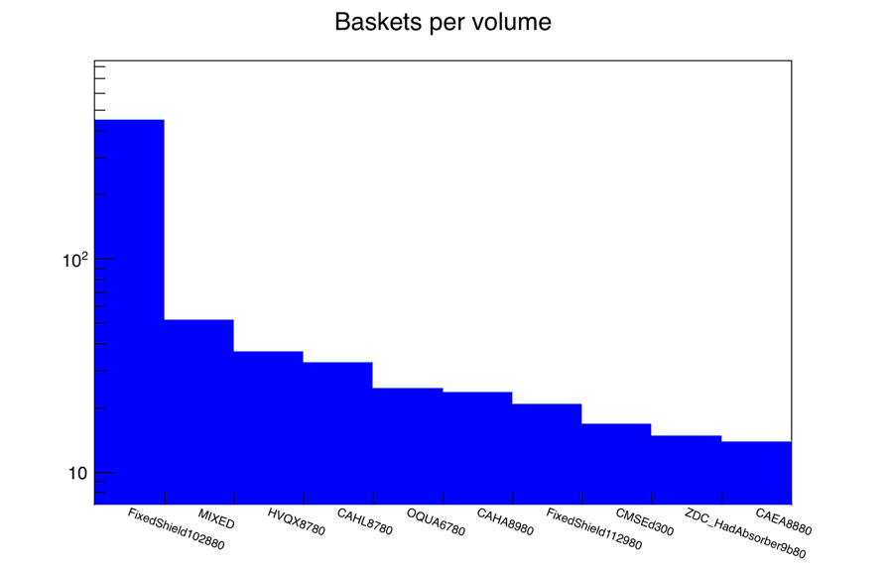
Learning dynamically which volumes are “important”
Learning converges fast
CMS simulation, sorting distribution of steps per volume, cutting out tail based on integral
Shielding (yes, cuts by region not yet available)
=== Learning phase of 4000000 steps completed ===
Activated 528/4156 volumes accounting for 90.0% of track steps

Slide 12
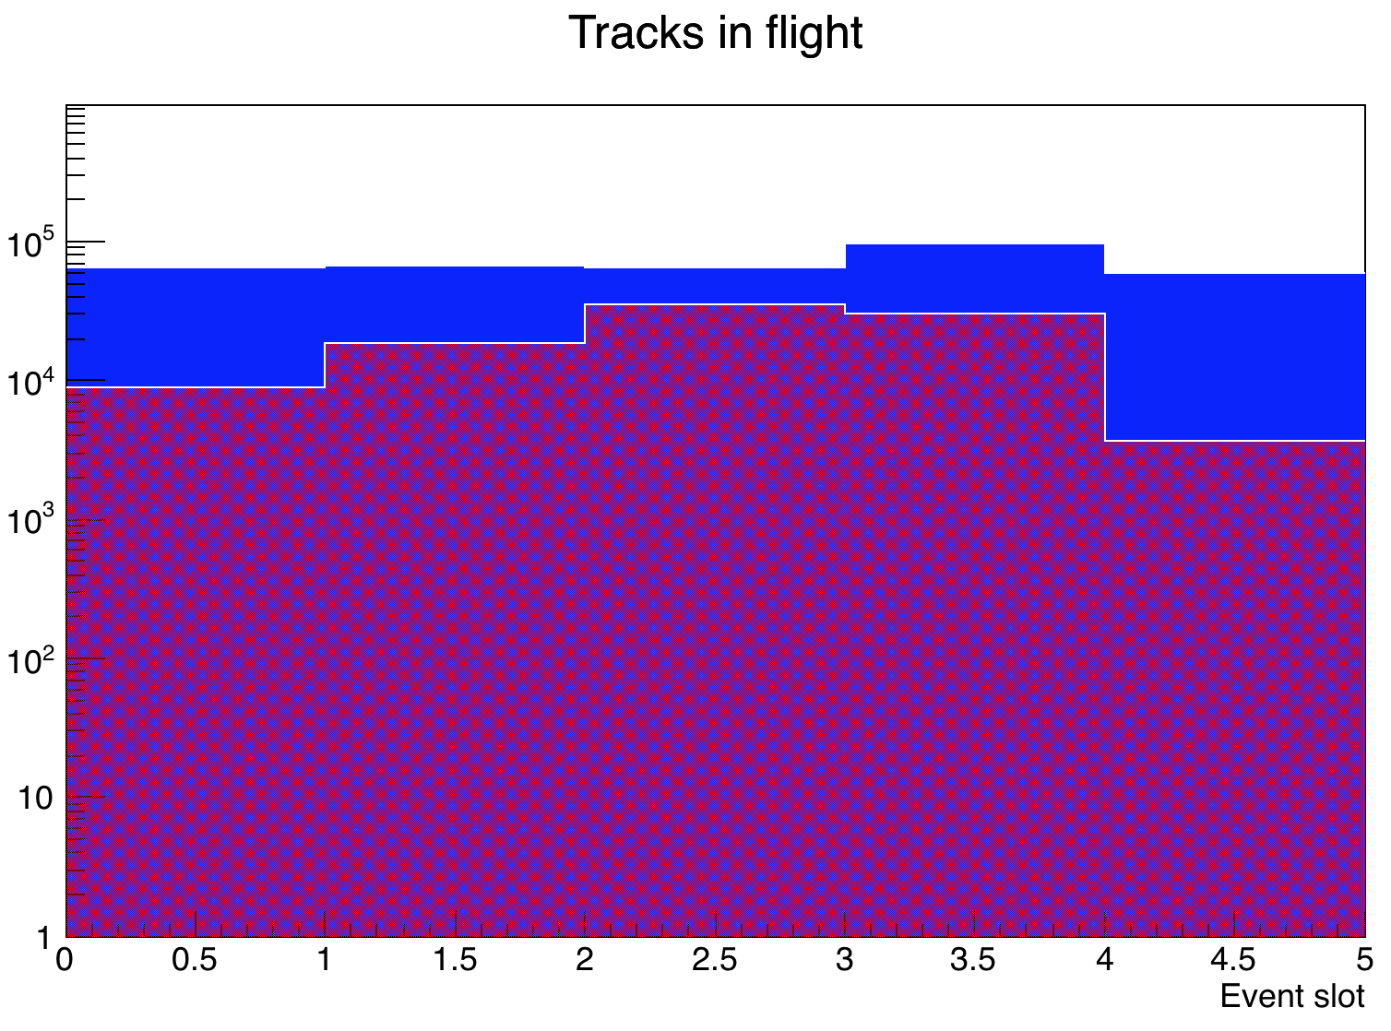
“Prioritizing” algorithm
Set priority threshold
“in flight”(magenta) / “max in flight” (blue) < 0.1 triggers priority transport
Tracks from prioritized events copied to thread local mixed baskets
Transported in scalar mode
### Event 1 prioritized at 10 % threshold
=== Garbage collect: 367 baskets
=== Garbage collect: 0 baskets
Event 0: 2308068 tracks transported, max in flight 46836

Slide 13
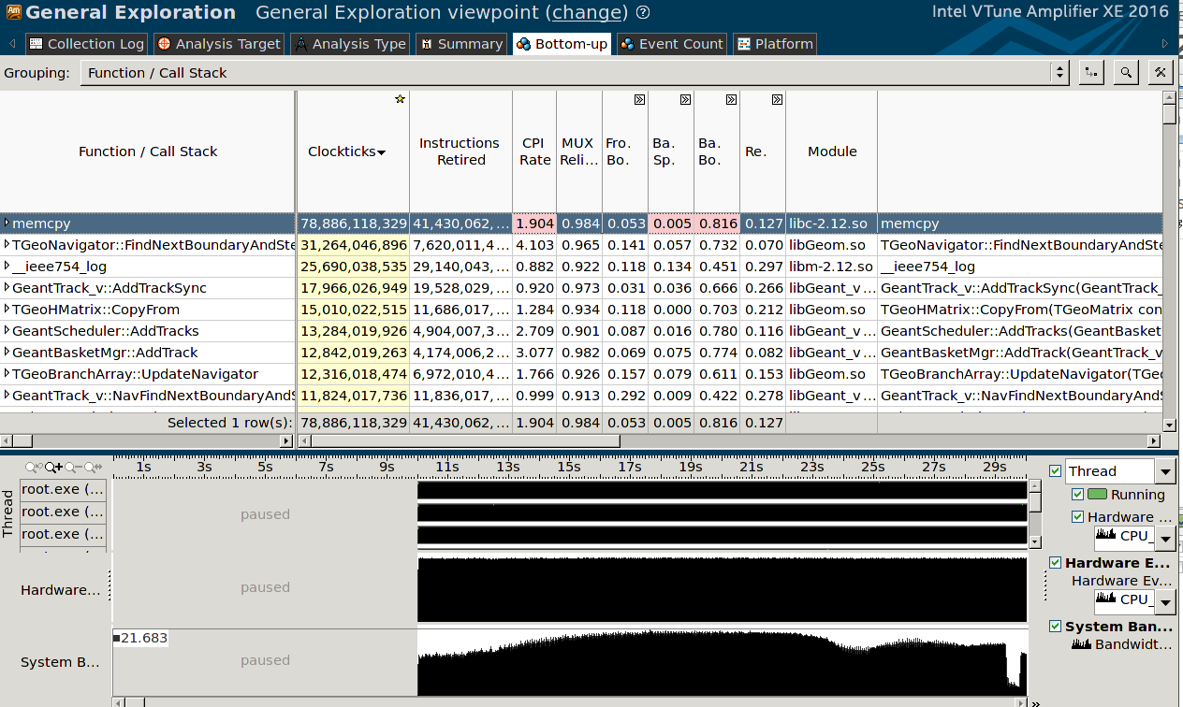
Data locality
Main data structures
Geometry ~ O(10 MB)
Physics Xsec ~ O(500 MB)
Baskets ~ O(1GB) or more
Data (baskets) flushed too fast from caches due to non-local access
Ongoing work
Pin threads to NUMA nodes, enforce basket allocation with numa_alloc_onnode()
NUMA allocator slow – need to allocate big chunks and re-use
Re-factorizing basket manager to favor filling from threads on the same NUMA node
Minimize exchanged across NUMA boundary to get cache coherency

Slide 14
I/O performance
Transport threads filling concurrently hit blocks
Single thread writing blocks to ROOT tree
Job time bound by the maximum throughput of a single thread writing to file
Transport finishes much faster
If no I/O limitation, throughput would be much higher
Need to parallelize the work up to disk serialization
Split API in “prepare buffer” and “write to device/socket”?
Disk throughput ~ 350 MB/s

Slide 15
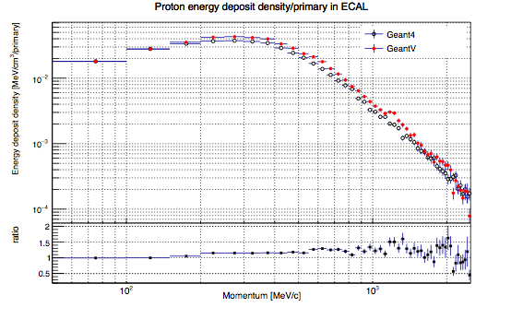
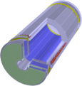
Large-scale exercise
Full CMS2015 geometry with 1MeV cuts
Comparison (tabulated physics, single thread)
GeantV scheduler w. TGeo/VecGeom geometry
Geant4 with equivalent G4 geometry
Make sure that transport behaves correctly and does the same job
Ongoing work to have realistic cuts/simulation
Already made some preliminary profiling
Much less instruction cache misses and better CPI
CMS Ecal

Slide 16
Coprocessor broker
Task: feed baskets to the coprocessor and copy back transported baskets
2 threads working part time to carry data back and forth
One thread assemblies special baskets
Generally larger, vector aware or not (PHI or GPU)
First implementation ready, debugging phase
Offloading full step computation on GPU
What can we offload on the Phi?
Geometry – Full CMS, can run basic ray-tracing task
Scheduling GeantV baskets requires removing some library dependencies
Coproc. broker

Slide 17
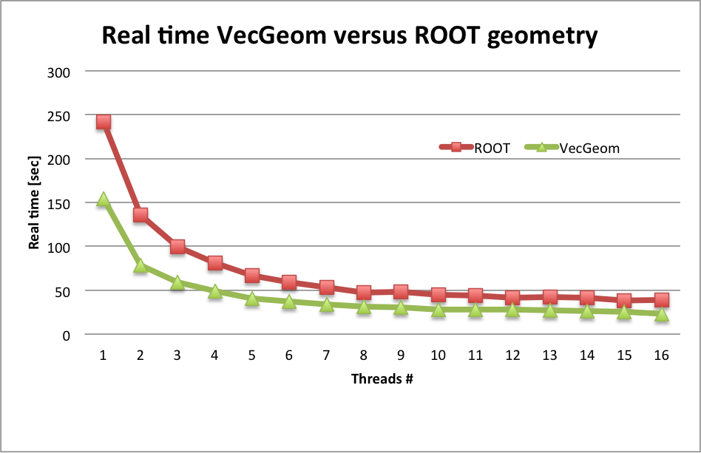
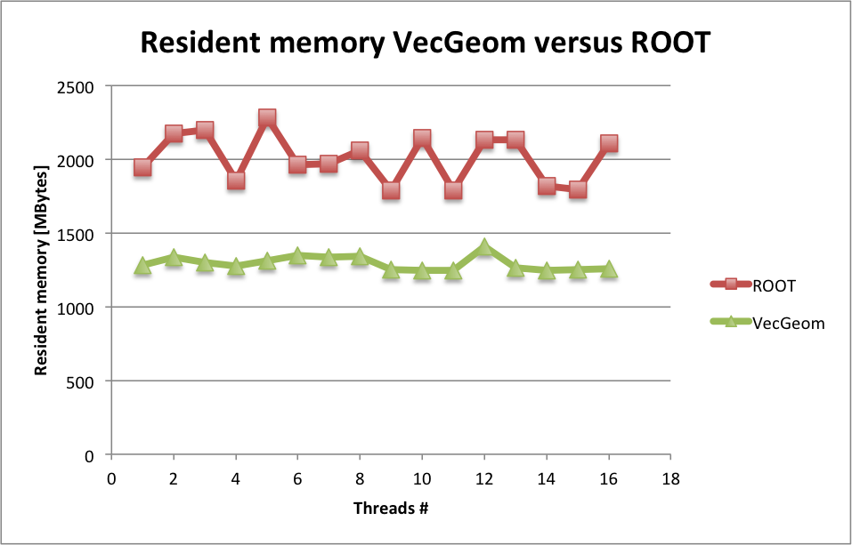
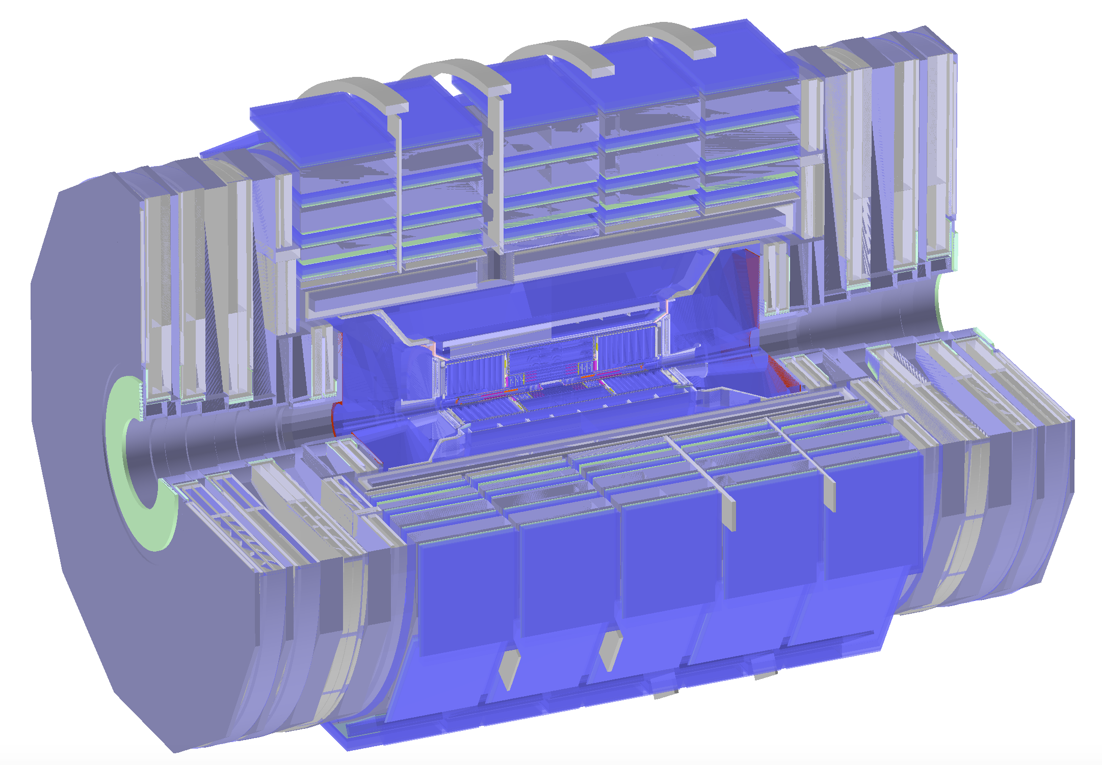
Geometry performance
real time for the simulation of 10 pp events at 7TeV using the new VecGom package instead of the existing ROOT geometry
More details on geometry performance in the talk of S. Wenzel

Slide 18
Physics: ongoing work
Several ongoing activities
Vectorized RNG
Vectorized field propagator
Interfaces & management
Physics models (Compton, gamma, e)
Redesign of TabXsec to adopt physics processes
Discussions/work on physics-related subjects planned for next week GeantV workshop

Slide 19
Conclusions
Very fruitful year with a lot of progress in several areas
Aproaching fast our major milestone
Running transport in a full LHC experiment in vector mode
Performance bottlenecks and opportunities better understood
A dense work plan for 2015-2016
New on the horizon: coprocessors and vector physics

