Slide 1
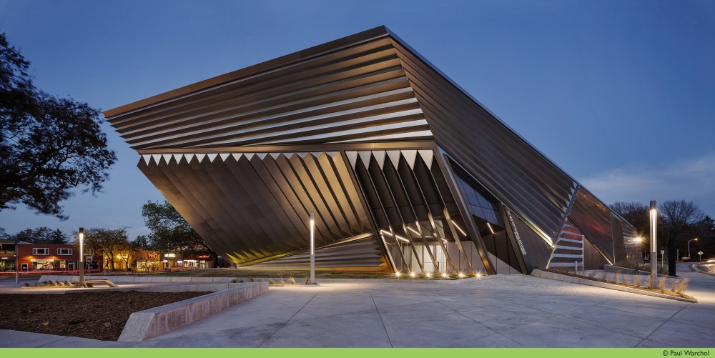
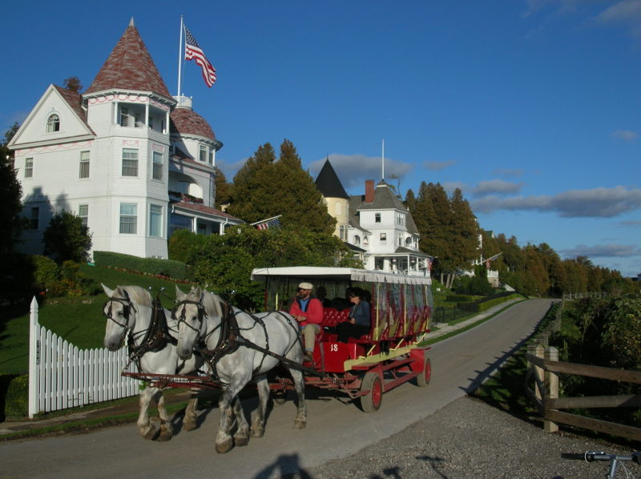
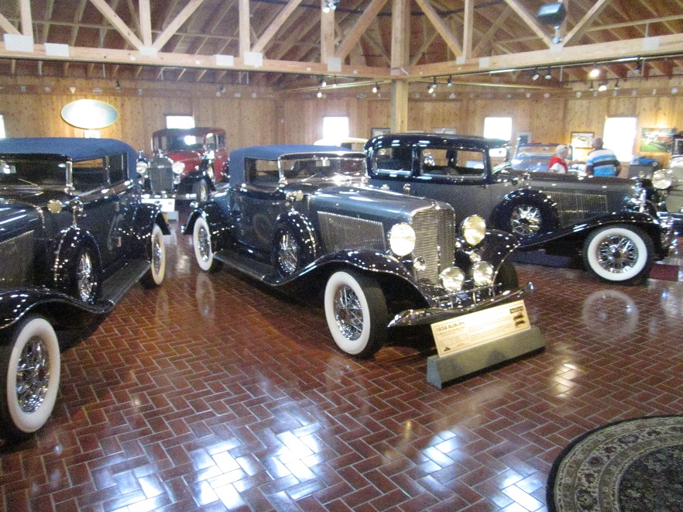
Welcome!
Welcome to Michigan
Welcome to MSU/FRIB
Welcome to the Spring 2015 EPICS collaboration meeting

Slide 2
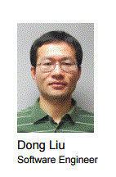
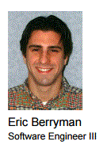
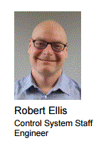
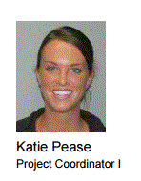
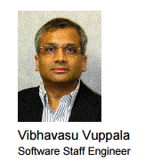
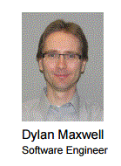
Local Committees and Support
LOC
PC
Support
If you have any questions or issues while you are here, please see me or one of these folk for help.

Slide 3
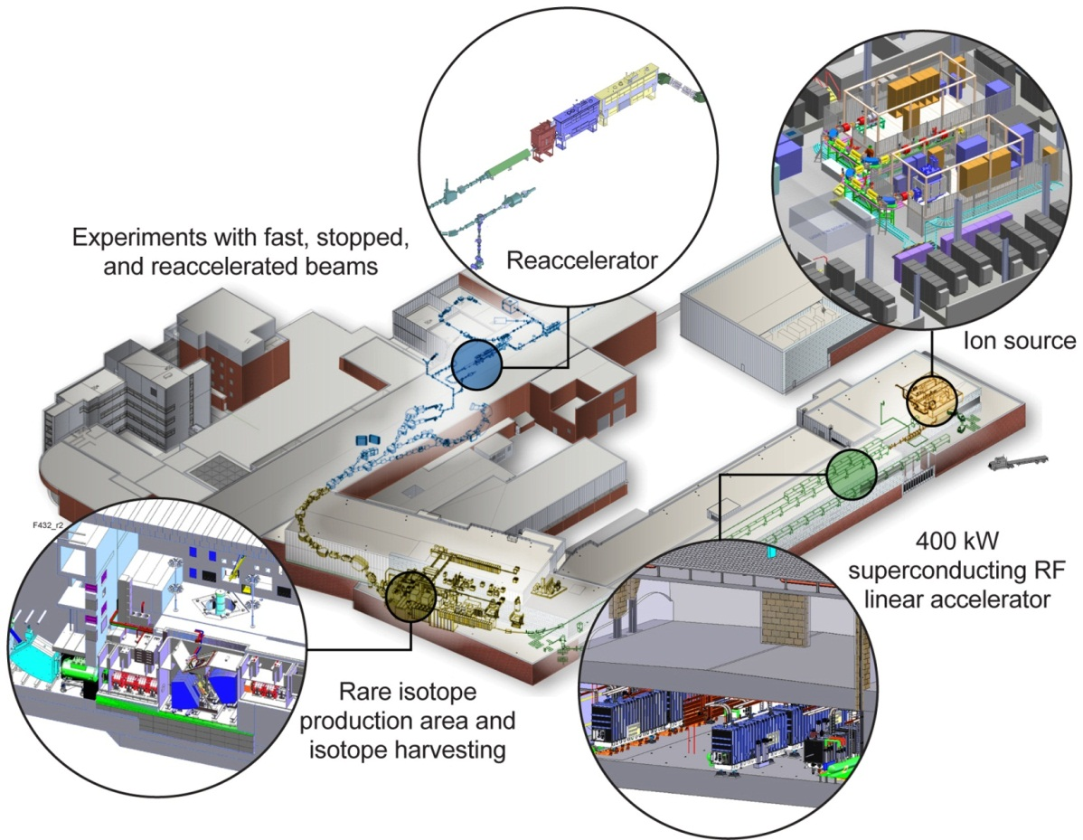
Facility for Rare Isotope Beams A Future DOE-SC National User Facility
Funded by DOE–SC Office of Nuclear Physics with contributions and cost share from Michigan State University
Serving over 1,400 users
Key feature is 400 kW beam power for all ions (e.g. 5x10¹³ ²³⁸U/s)
Separation of isotopes in-flight provides
Fast development time for any isotope
All elements and short half-lives
Fast, stopped, and reaccelerated beams

Slide 4
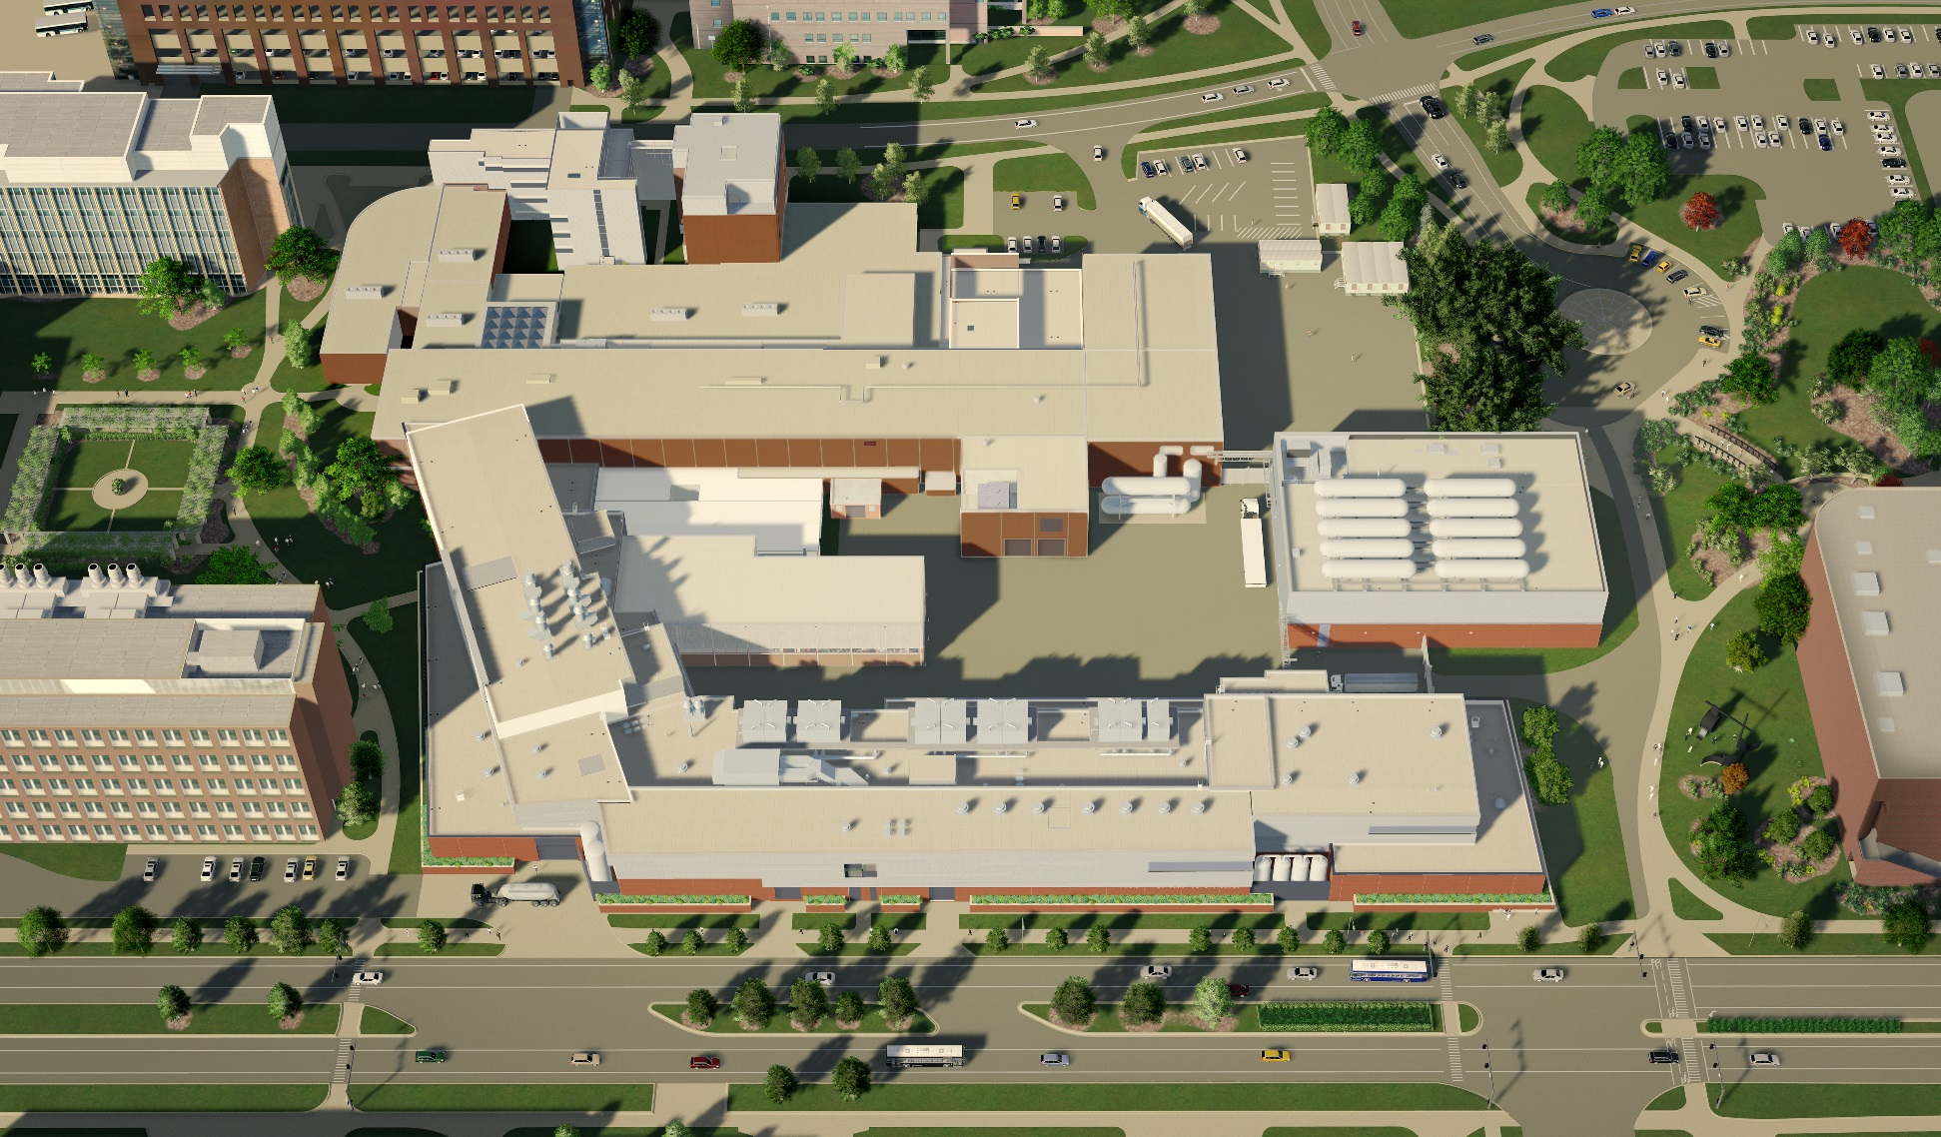
What FRIB will look like in 2 years
NSCL experimental area to be enhanced for FRIB

Slide 5
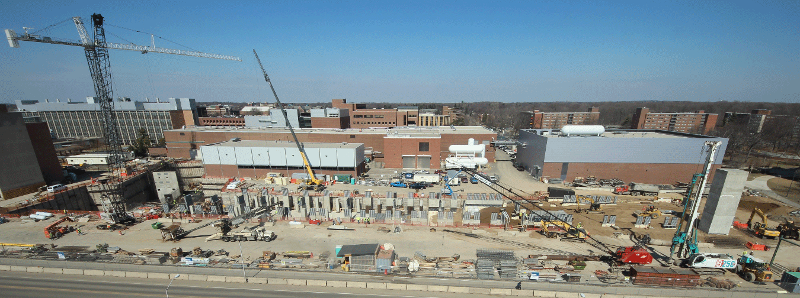
What FRIB looks like today
LINAC tunnel construction complete
RF coax installed
Emphasizing ion-source building in support of commissioning in 2016
20 March 2015

Slide 6
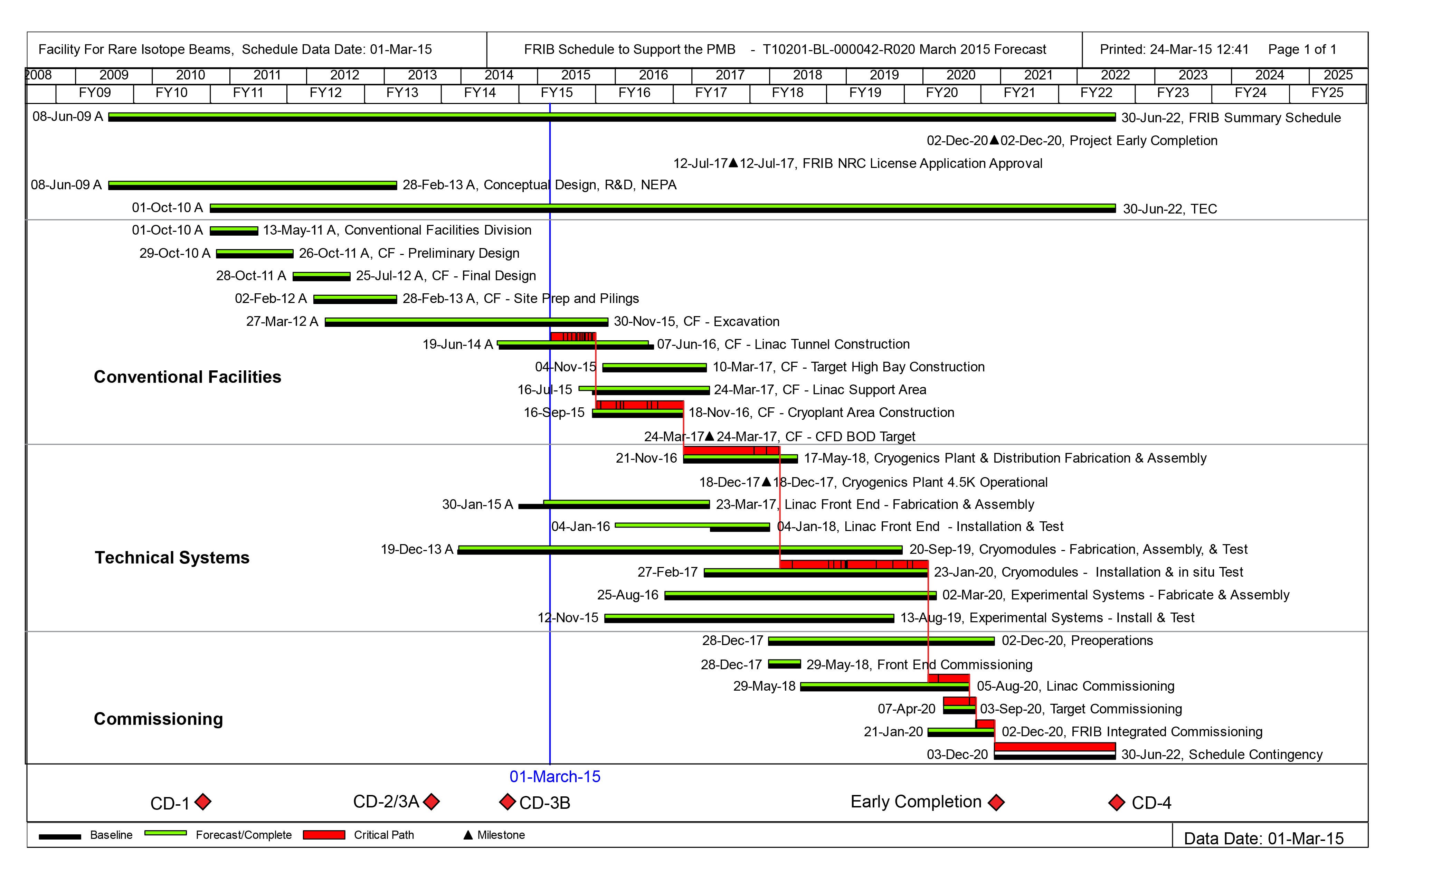
FRIB Schedule as of Today
CD-1
CD-2
CD-3b
CD-4
FRIB cryoplant operational 2017
Ion source commissioning 2016
Cryomodule installation/test 2017
Early completion goal 2020

Slide 7
EPICS History at NSCL[1]
NSCL has been an EPICS facility for nearly 20 years
Initially to support the “coupled cyclotron project” starting in 1997
With support and assistance from the newly christened CEBAF
First participation in an EPICS Collaboration meeting in May 1998
9 people registered for both May 1998 and May 2105 meetings
Transitioned from VME/Fermi-style controls, with serial-attached intelligent controllers
Shut down operations for 18 months, restarted with all new control software
Retaining hardware infrastructure
Transitioned from serial to network-attached intelligent controllers
Transitioned (nearly entirely) from VME to LINUX

Slide 8
EPICS History at NSCL[2]
Operator consoles run Windows
Interfaced with “knob panels” for cyclotron tuning
NSCL has an eclectic mix of controls UIs, reflecting its research nature
Homemade, often pre-dating EPICS use at NSCL
Panelmate – similar to EDM
QtParam - dynamic spreadsheet
Tcl/tk, LabVIEW, etc.
MEDM initially, then EDM
Often associated with Window-based “high level” IOCs
NSCL-specific e-log (hourlog)
Captures facility status information, status of experiments, sources of unscheduled downtime

Slide 9
NSCL Timeline from Inception to FRIB
EPICS introduced to NSCL
FRIB controls components defined: Continuing the use of EPICS
Introducing CS-Studio, DISCS
Introducing distributed timing, fast protection
Spring 2015

Slide 10
FRIB Benefits From Collaborations, Community
EPICS – of course
Archive Appliance
CS-Studio
Operator screens
Alarm system – BEAST
Application framework
DISCS
Configuration database and related applications
V4
Physics application/server framework

Slide 11
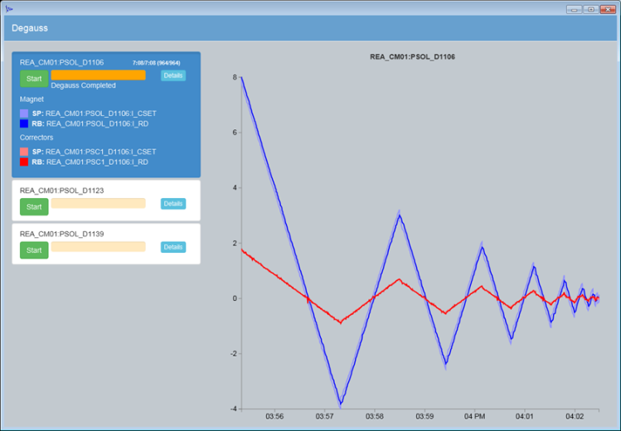
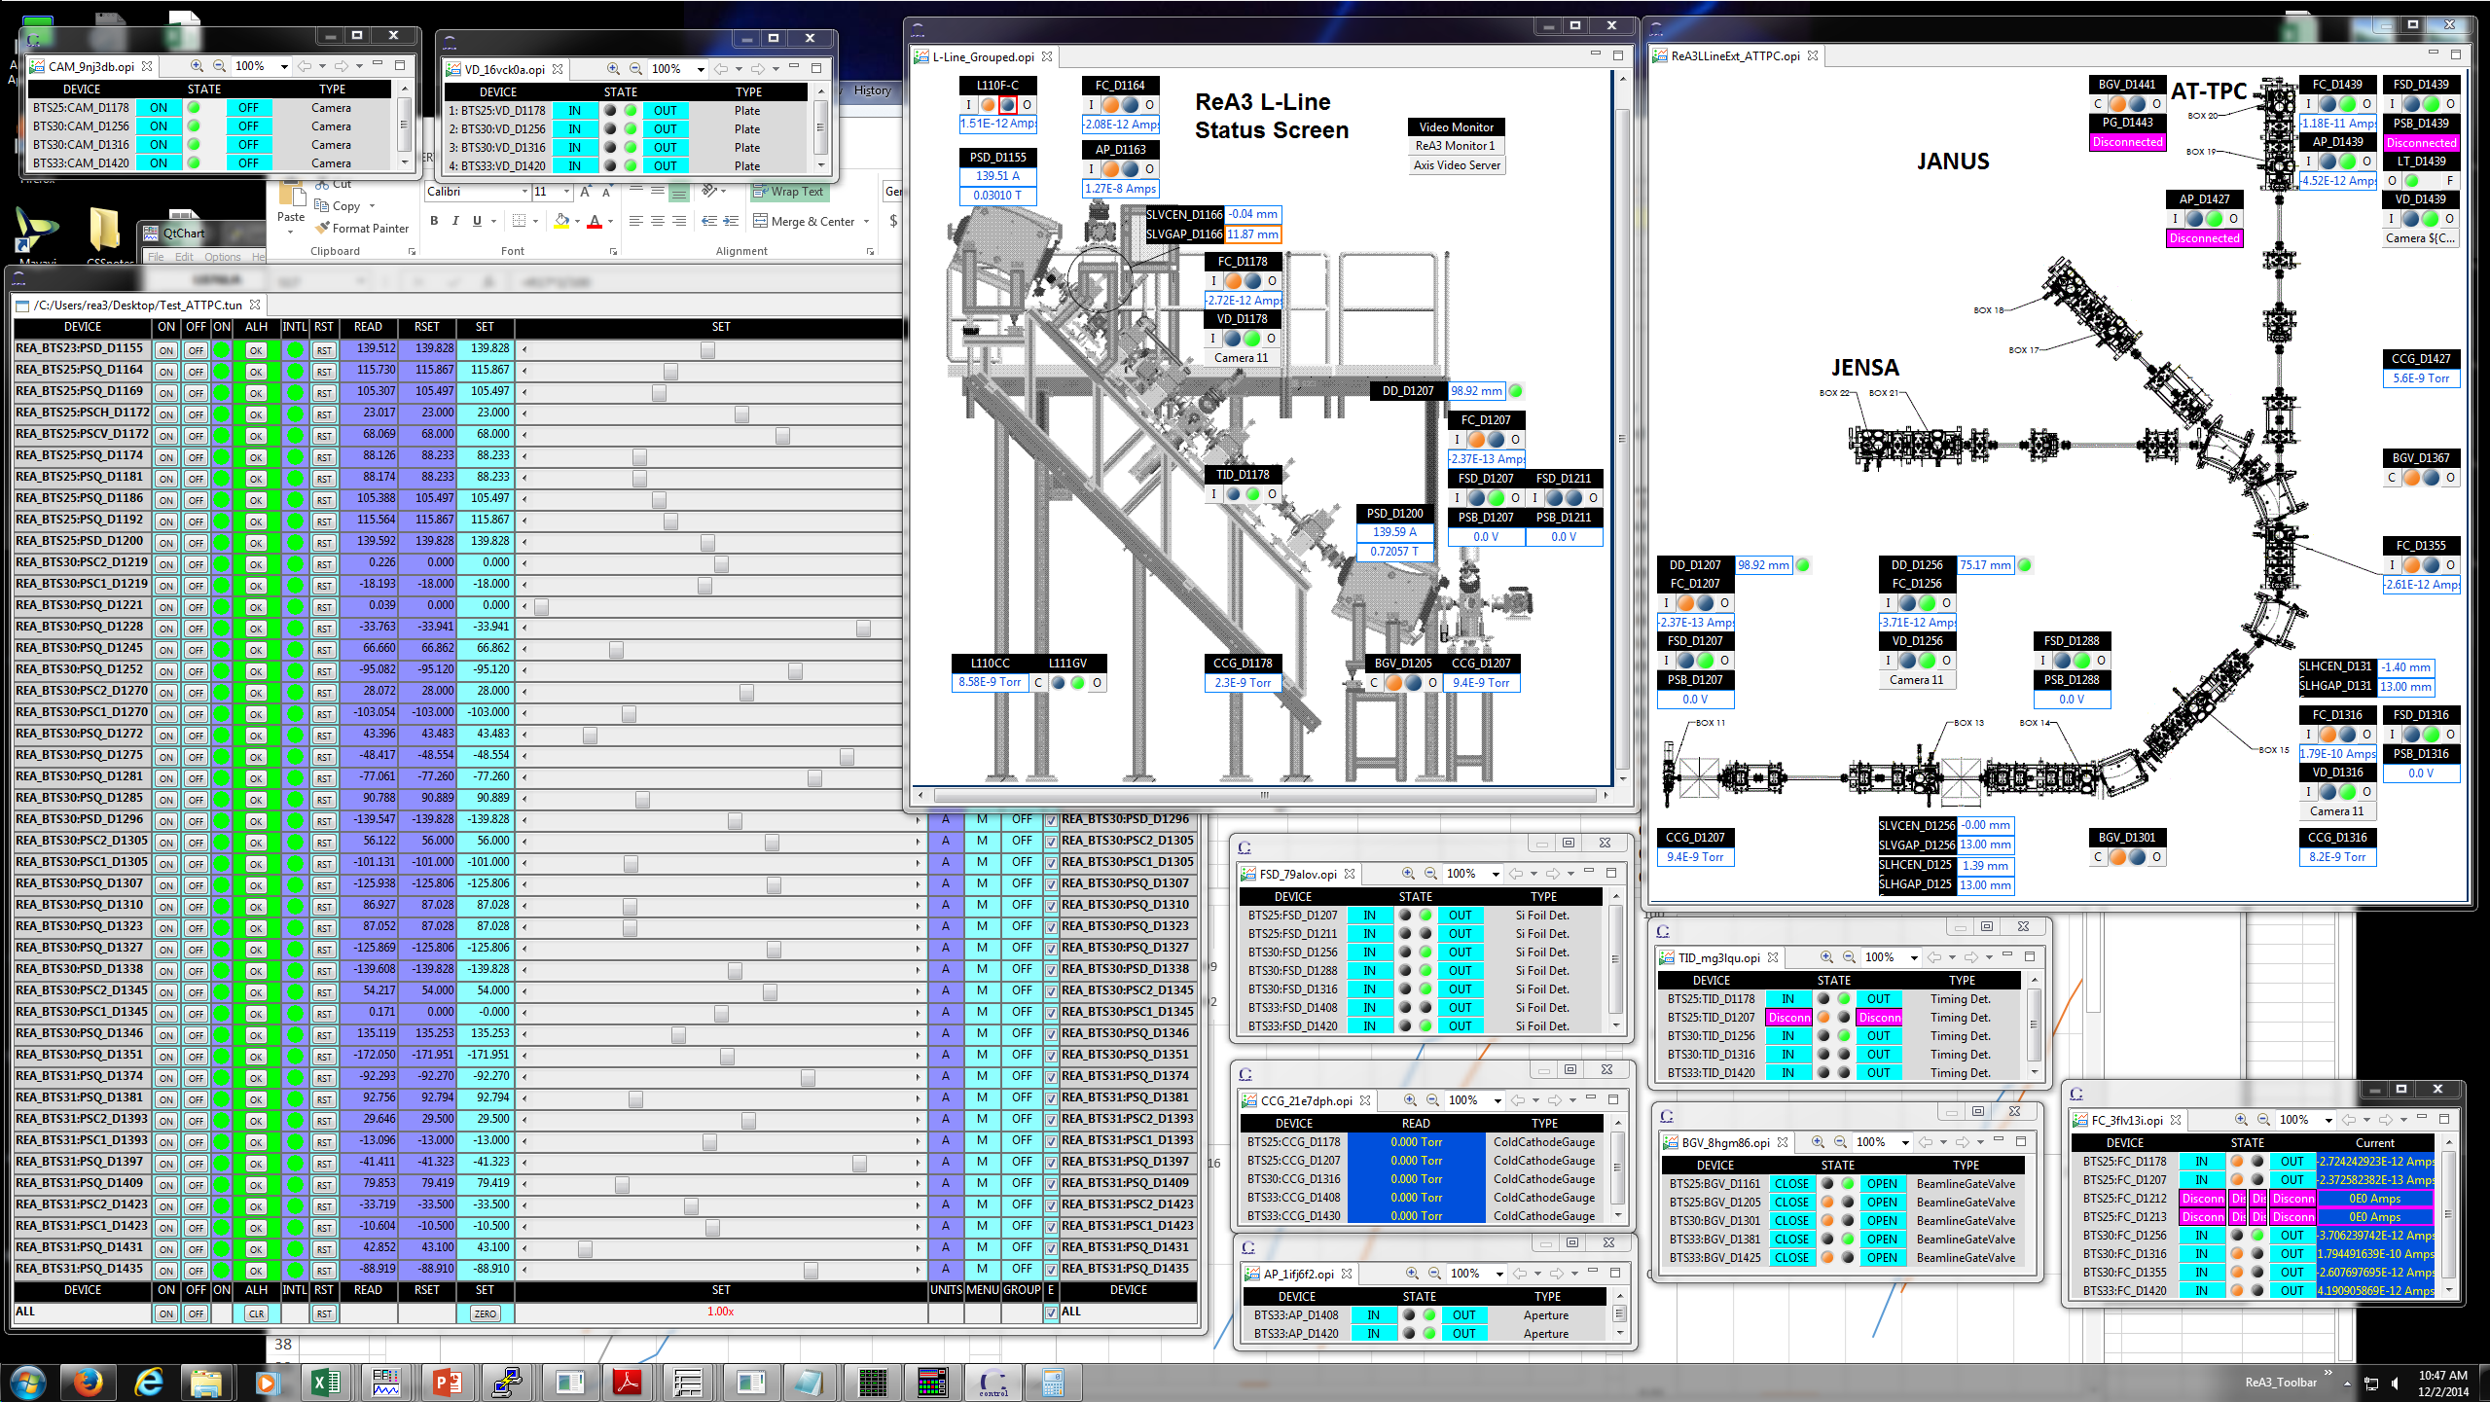
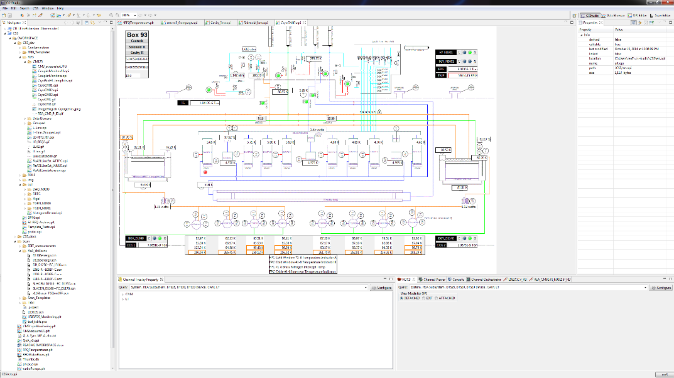
CS-Studio Framework For Control Screens/Applications

Slide 12
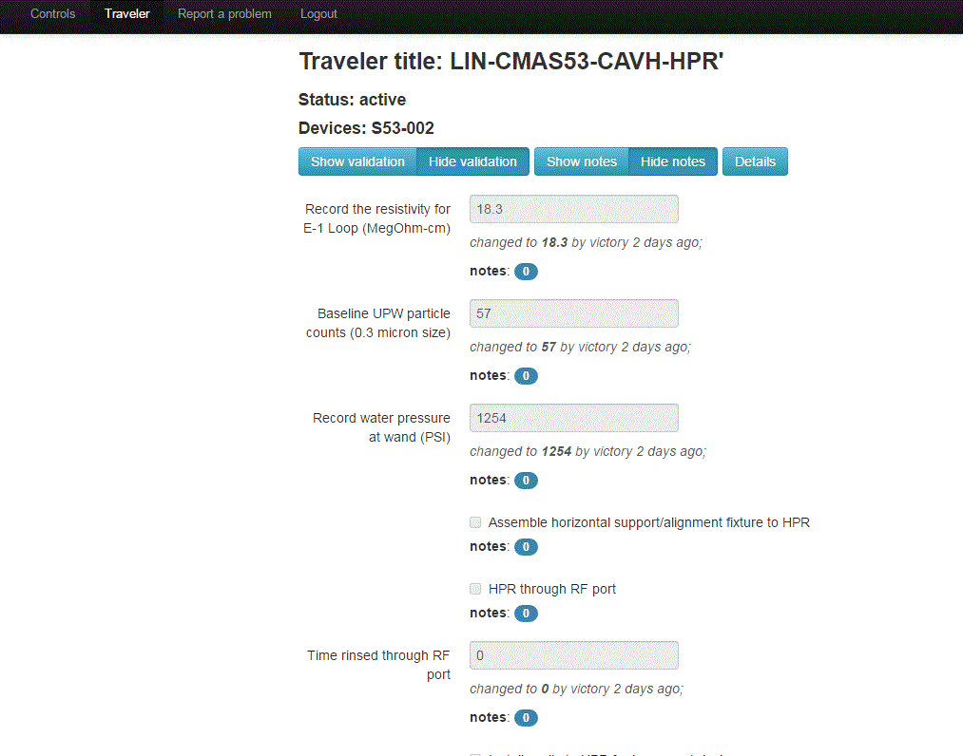
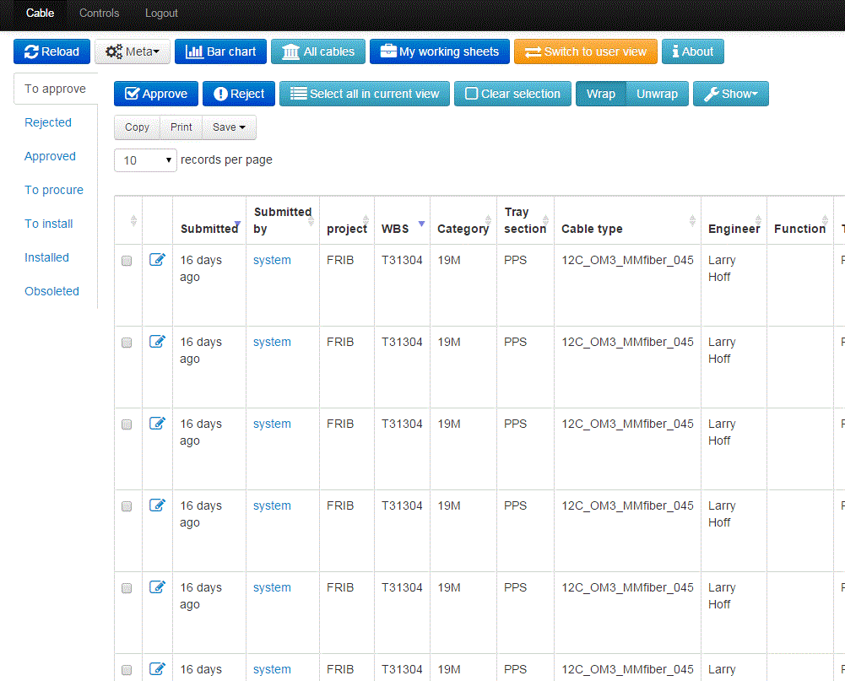
DISCS Components Support Configuration
E-traveler system
Cable Database

Slide 13
FRIB Low-Level Controls
Hardware interfacing/interlocking
Extensive use of PLCs to interface with equipment
MRF timing
Not required for CW NSCL beam
FRIB beam macrostructure created by LEBT chopper
Machine Protection System
Fast protection not required for NSCL
High-power ion beam requires fast (down to 35 usec) shutoff
Based on FRIB uTCA-capable general-purpose FPGA board
Personnel Protection System
Based on safety-rated PLCs

Slide 14
FRIB Presentations
Tuesday 2:45 - Getting Timestamps right – Martin Konrad
Wednesday 11:35 - Rare Isotope Beam Transport at 30 kV – Mathias Steiner
Wednesday 11:55- ElasticSearch as a EPICS Directory Service – Evan Daykin
Wednesday 4:30 - Traveler and cable web applications at FRIB – Dong Liu
Thursday 9:30 - Moving towards Continuous Delivery – Martin Konrad
Thursday 9:45 - CS-Studio Collaboration Status – Eric Berryman
Wednesday 3:15 – the infoServ system - John Priller

Slide 15
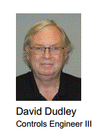
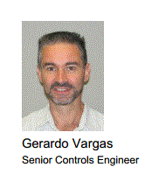
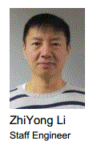
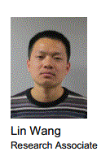
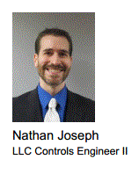
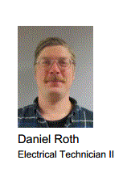
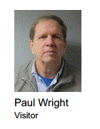
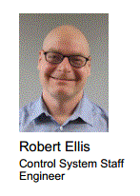
Thank You For Your Attention
These folks have joined since last year:
See me about joining the team!

