Slide 1
LCLS-II Status
Debbie Rogind
SLAC National Accelerator Laboratory
Slides Courtesy of
Hamid Shoaee (Controls Manager)
John Galayda (Project Manager)

Slide 2
Outline
  SLAC Linac Landscape
  High Level Requirements
  Project Scope
  Controls Scope
  SLAC & Partner Lab Resources
  Controls Design Strategies
  High Level Schedule
  Summary

Slide 3
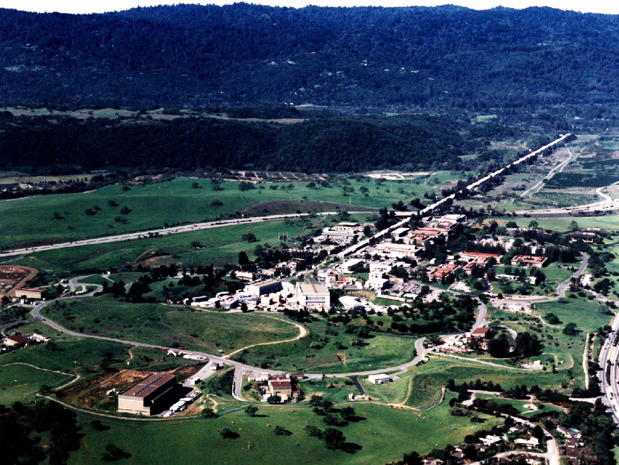
LCLS
Linac Coherent Light Source
S20 Injector
at 2-km point
Existing 1/3 Linac (1 km)
e⁻ Transfer Line
X-ray Transport Line (200 m)
Undulator (130 m)
Near Experiment Hall (underground)
Far Experiment
Hall (underground)
Notes:
Increased brightness & contrast +20%

Slide 4
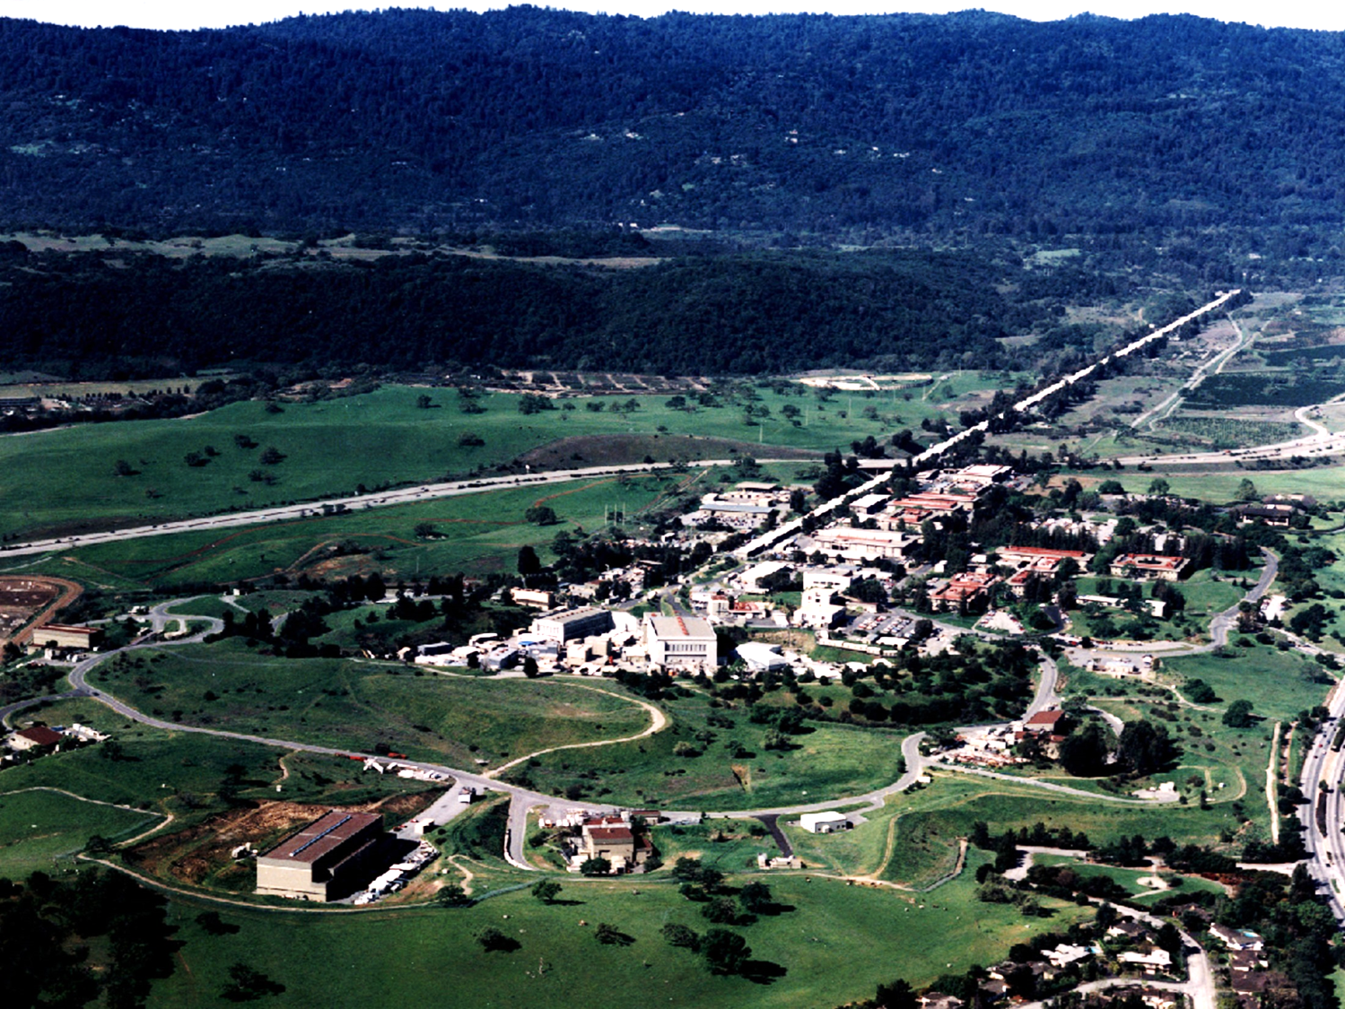
New Injector at
Beginning of linac
LCLS-II
New 4 GeV
Superconducting Linac
Extend existing transfer Line,
Bypassing LCLS Linac
New Hard x-ray Undulator,
fed by either SC or Copper linac
Use Existing X-ray Transport Line
New Soft x-ray undulator fed by
SC linac
Use Existing Near Experiment
Hall and instruments
Use Existing Far Experiment
Hall and Instruments
Notes:
Increased brightness & contrast +20%
Decrease data acq time by providing high rep rate over broad energy range
CW superconducting linac with bunch rep rates <= 1MHz
Beam power of several hundreds kilowatts

Slide 5
LCLS-II Layout in SLAC Linac Tunnel
See PRD: LCLSII-2.4-PR-0041
(only approximately to scale)
A-line
LCLS-II SC Linac
proposed FACET-II
LCLS-I
SXU
L1
L2
L3
extension line
bypass line
spreader
μ-wall
HXU
Sector-0
Sector-10
Sector-20
Sector-30
B-line
s (m)
New SCRF
Linac (4 GeV)
Proposed FACET-II
and Bypass Line
Existing LCLS-I
Linac (15 GeV)
Undulators
(SXU & HXU)
Courtesy of Paul Emma

Slide 6
LCLS-II Beam Distribution
See PRD: LCLSII-2.5-PR-0134
(plan view - not to scale)
0.93 m
LTUS
SXU
LH
BC1
BC2
LCLS-I
Linac
0.65 m
L1
L2-Linac
L3-Linac
D2
Sec. 21-30
2.50 m
BC3
D10
kicker
LTUH
HXU
μ-wall
1st Dog
Leg
Bypass
Line
Beam
Spreader
LTU
Transport
New SCRF
Linac (4 GeV)
undulators
“glowing” sections indicate these are not in the vertical plane of either linac
Courtesy of Paul Emma

Slide 7
High Level Requirements
Extend the successful EPICS Controls for LCLS to LCLS-II
Preserve all the single-pulse control and read-back features of a single-pass accelerator but do so for the CW LCLS-II with a repetition rate up to 1 MHz
Maintain compatibility with the present 120 Hz LCLS
Some systems have substantial new requirements due to higher beam power and high rep rate
  SC LLRF system, data acq electronics for the BPM and other beam diagnostics, timing system, new beam based feedback
  Faster beam abort mechanisms for MPS, BCS
  New radiation containment system

Slide 8
Scope - Controls
  Controls scope includes…
    Control & monitoring of beam line components
    Data acquisition and analysis for diagnostic systems
    Timing, synchronization and event systems
    Network and Controls computing infrastructure
    Low Level RF and Feedback systems
    Machine and personnel safety systems
    Cryo Interfaces (Cryoplant, Cyro Distribution, Cryo Module)
    X-ray Transport and Experiment Systems controls
    Controls infrastructure, including racks & cables
Notes:
High Level Requirements…
Extend the successful EPICS Controls for LCLS to LCLS-II
Preserve all the single-pulse control and read-back features of a single-pass accelerator
But do so for the CW LCLS-II with a repetition rate up to 1 MHz
Maintain compatibility with the present 120 Hz LCLS
A few systems have substantially new requirements due to higher beam power and repetition rate

Slide 9
Controls Subsystems Design Maturity
Systems with High Design Maturity, (60%) Ready for Final Design
Network Architecture
Controls Computing Infrastructure
Drive Laser Control
Vacuum Controls
Magnet power supply
Personnel Protection
Beam Containment
General Motion Control
Undulator Control
Self-Seeding
Systems with substantial new requirements at Conceptual Design Maturity, with PDR in October 2015
  Timing & Synchronization
  SC Low Level RF
  Diagnostic Systems
  (BPM, charge monitor, etc.)
  Machine Protection
  Some Beam Containment System Electronics
  Cryo Module, Cryo dist, Cryoplant I/F Controls

Slide 10
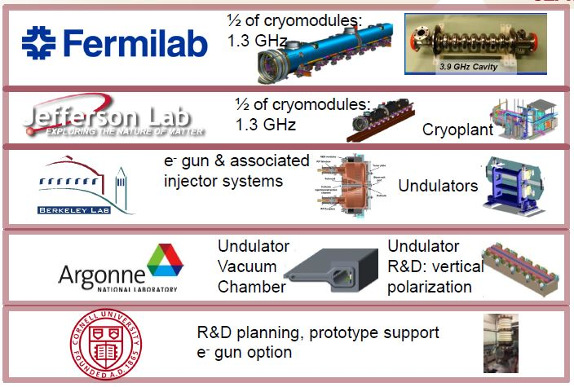




Project Collaboration
50% of cryomodules: 1.3 GHz
Cryomodules: 3.9 GHz
Cryomodule engineering/design
Helium distribution, including valve boxes
Processing for high Q (FNAL-invented gas doping)
50% of cryomodules: 1.3 GHz
Cryoplant selection/design/installation/commissioning
Processing for high Q
LLRF Controls
Undulators
e⁻ gun & associated injector systems
LLRF Controls
Accelerator physics support
Undulator Vacuum Chamber
Also supports FNAL w/ SCRF cleaning facility
Undulator R&D: vertical polarization
R&D planning, accelerator physics & prototype support
processing for high-Q
e⁻ gun option
LLRF Control
LLRF Control
LLRF Controls
LLRF Control
Notes:
5 - JLab is doing installation and commissioning of cryoplant.

Slide 11
SLAC LCLS-II Controls and Safety Systems Leads
H. Shoaee
M. Boyes
Safety Systems
Tao
BCS
Turner
PPS
Diagnostics
Global
Systems
Granieri
Network
Weaver
Timing
Zhou
Computing
DiSalvo
Racks/Cables
Herbst
MPS
Young
BPM
Bong
Wire Scanner
Beamline I&C
Alverson
Vacuum
Saraf
Facilities
Piccoli
Beam Profile
Sapozhnikov
Bunch Current
Alverson
Laser Control
Luchini
Power Supply
Sapozhnikov
Bunch Length
D’Ewart
Undulator Motion
Cryo System
Fairley
Cryo Control
Babel
LLRF
Turner
ODH

Slide 12
Controls Design Strategies
  Extend the successful EPICS Controls for LCLS-I to LCLS-II
  Lab-wide
  Accelerator & photon experiment controls to be as common as possible
  LCLS-I and LCLS-II controls to be as common as possible
  Goal: Reduce maintenance, training, documentation, support costs lab-wide
Notes:
New EVR SW to support EVR sharing amongst multiple EPICS IOCs
Migrate RTEMS low latency stack to linuxRT

Slide 13
Controls Design Strategies
  Develop Common Electronics Platform
    Development kicked off for LCLS-I electronics upgrades (LLRF, BPM, BCM, BLEN)
      Platform proof of concept for LCLS-II
      General purpose ADC + FPGA FW electronics
    LCLS-II leverages Platform for 1MHz Systems
      (LLRF, BPM, BCM, BLEN, MPS, Timing, Beam based feedback)
      FPGA with hundreds of thousands of cells capable of doing LLRF or feedback algorithms including calibrations and diagnostics
      Memory to buffer several million consecutive readings
      Computer interface for setup/read-back
Notes:
In addition to the EPICS V4, I would emphasize the new and challenging features of LCLS-II which are MHz operation, Superconducting controls including the cryo system and the new LLRF and the requirement for fast beam shut off for safety systems including MPS and BCS.

Slide 14
Controls Design Strategies (cont.)
  Usage of Industrial PCs versus VME / LinuxRT versus RTEMS wherever possible (Mitch D’Ewart)
  Controls and Operations Software
    Most of LCLS-I software will be shared with LCLS-II for dual use, but clearly identified for each machine
    LCLS-I applications and infrastructure have already been leveraged for usage in other facilities; slight modifications were made for the applications to be machine agnosticI
    Tools that manage SW deployment to multiple facilities
    (Murali Shankar)
Notes:
Cost and HW availability make industrial PCs runing linux attractive.
Currently used in upgrades for cameras, beamline data, MPS, Fast Feedback,
New EVR SW to support EVR sharing amongst multiple EPICS IOCs
Migrate RTEMS low latency stack to linuxRT

Slide 15
Controls Design Strategies (cont.)
  EPICS
    New V4 Middleware
      Directory service, name service, model service, archiver service, SCORE API planned FY15-16
      More services likely to come in support of physics HLAs.
      Replaces CORBA based middleware technology
    Archiver Appliance enhancements (Murali Shankar)
      LCLS-II expected to be the largest EPICS installation with ~8-10M PVs
      DBE_PROPERTIES / PVAccess
      Changes to the V3 gateway for DBE_PROPErTIES and variable sized arrays
      New archive viewer
    HMI Upgrade
      LCLS is evaluating display manager alternatives based on QT technology

Slide 16
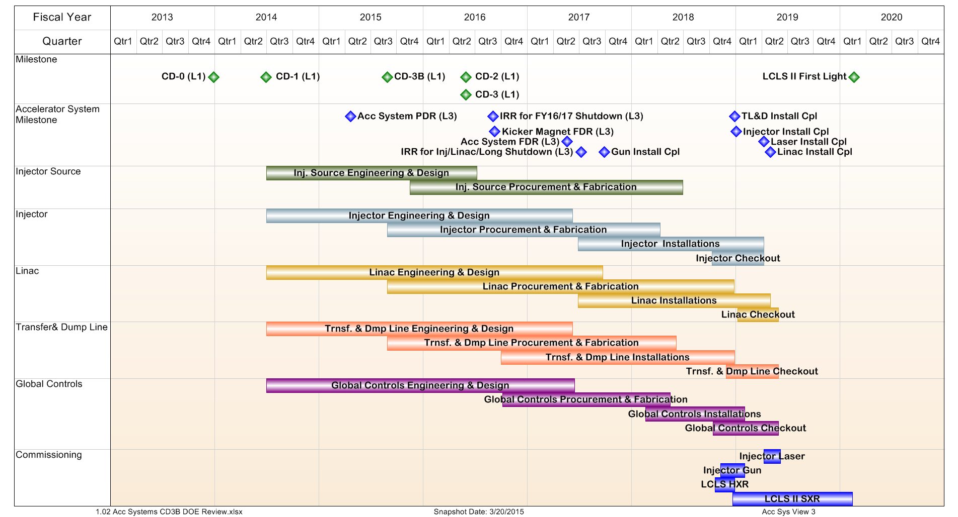
Accelerator Systems Schedule
LCLS Downtime
(cryomodule delivery)
Critical Path:
CM Delivery during FY18 downtime
LCLS Downtime
Linac critical path
Transfer & Dump Line critical path
Notes:
Project critical path and near critical paths being refined
#1 – Cavities CM Assembly Eq. Remove & Install V&C
Managing multiple vendors and hardware supply-chain are critical to staying to schedule
#2 – FY18 Shutdown Und, BD, etc. Eq. Remove & Install V&C
#3 – 4.5K Cold Box Cryoplant Assembly Commissioning
FACET has requested two additional months of runtime
Delays LCLS-II access to S0-10 from Apr16 to Jun16. Evaluating LCLS-II equipment removal schedule to determine impact
LCLS-II FY18 shutdown disrupts LCLS SXR program for 2 years, HXR program for 14 months.
Evaluating options to optimize LCLS-II and LCLS research program

Slide 17
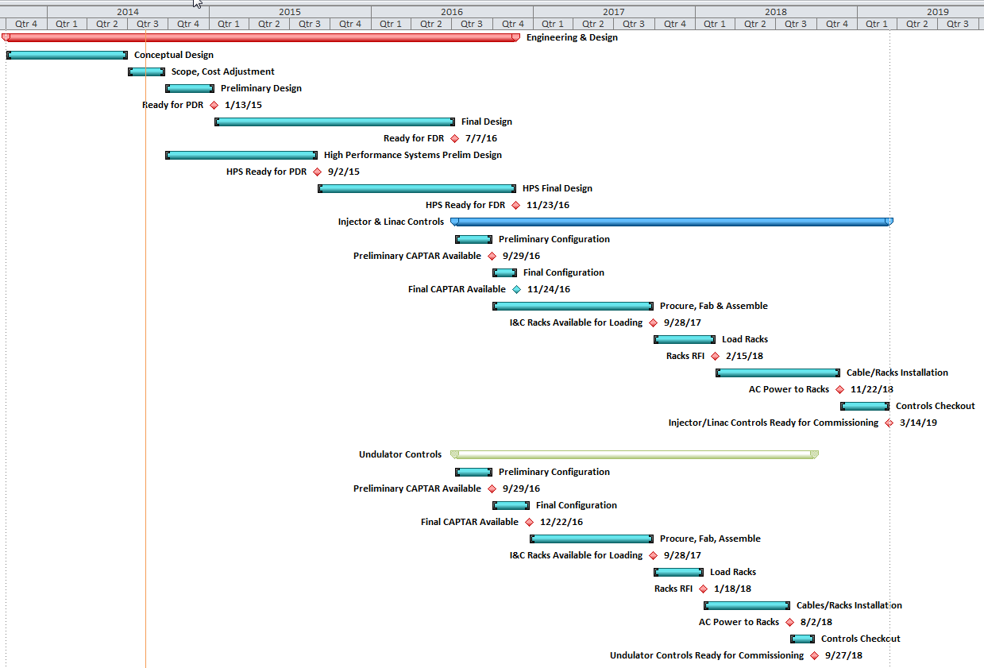
Controls System High Level Schedule
Final Designs complete: 10/16
Linac Controls Ready for
Commissioning: 3/19
Undulator Controls Ready
for Commissioning: 9/18

Slide 18
Summary
The requirements for LCLS-II controls are well understood
Detailed CD-2 cost estimates & schedules have been developed
LCLS-I designs support a large fraction of the systems with CD-2 (60%) level of design maturity
Preliminary design reviews have been held for all mature controls subsystems – ready for final design
For systems with substantially new requirements, there are conceptual designs – none appear to be show-stoppers
A common platform architecture is underway for high performance systems
Teams at SLAC and partner labs have been identified with the capability and capacity to develop the required systems
Controls will be at CD-2/3 design maturity (60%) by Oct 2015

Slide 19
Thank-you
  More talks to come in addition to Murali’s ...
  Undulator radiation monitoring system (Garth Brown)
  Magnet PS Upgrade (Kristi Luchini)
  MPS BSA Upgrade (Gasper Jansa, Cosylab)
  Time source callback & attribute plugin for areaDetector
  (Garth Brown for Kukhee Kim)
  ..

Slide 20
Detailed Subsystem Slides - Backup

Slide 21
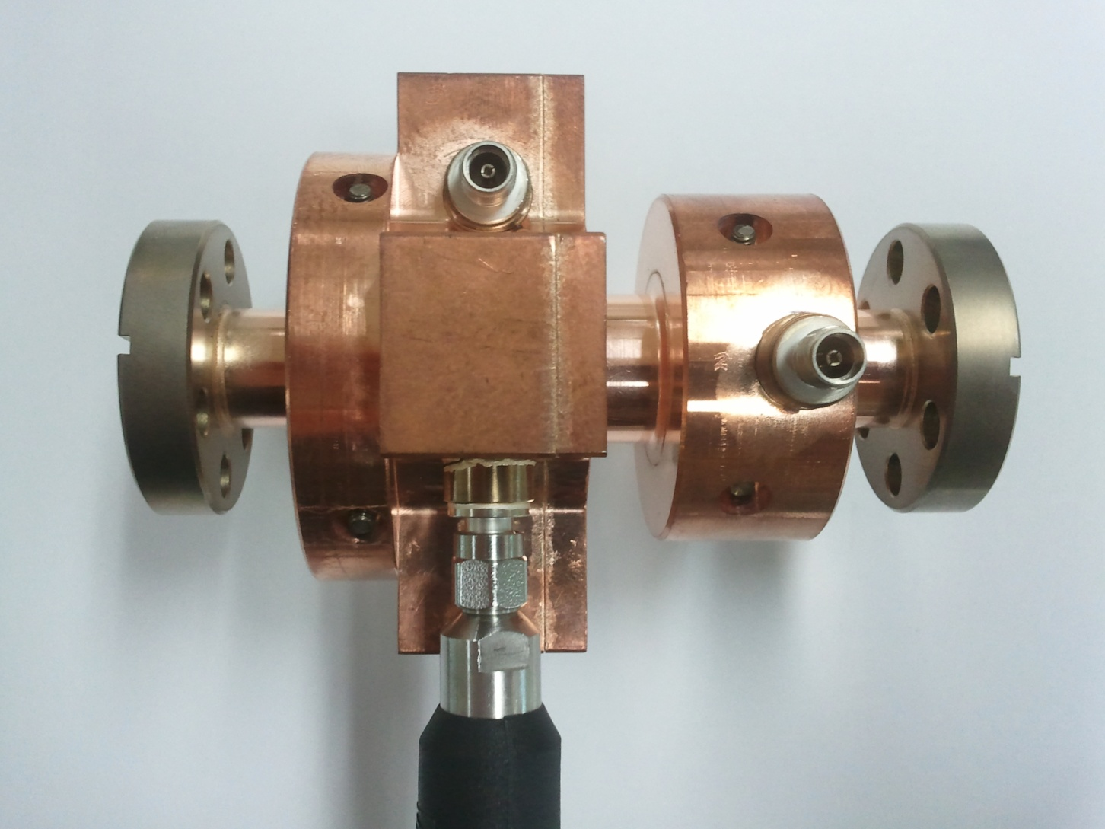
Beam Diagnostic Systems
  High Beam Rate Diagnostics
    Beam position, charge, energy and bunch length measurements
      must be integrated into fast feedbacks
    All diagnostic data tagged with beam pulse ID’s
    Allows pulse stealing to dedicated low rate
    diagnostic lines
    Allows fast “flying wire” scans of the main beam
    with minimal interference with experiments
  Low charge operation (10pC)
    Cavity BPMs in critical locations
    Millimeter-wave diodes along with
    pyro sensors for Bunch Length Measurement
  High average power
    High average power in relative bunch length
    monitors requires a new design
    Halo monitors
PAL X-Band Cavity BPM Prototype
Courtesy Henrik Loos
Bergoz Turbo-ICT

Slide 22
Cryogenic Control Systems
Cryogenic Plant
Delivered as a unit including all local controls with Allen-Bradley PLCs and Local Touch-panel user interface
SLAC provides:
    EPICs soft IOC(s) that interface the PLC controls to the SLAC Master Control Center (MCC)
    A Cryogenic plant HMI that is integrated into the MCC HMI
    SLAC & JLAB will be collaborate in the plant control systems checkout
    A Server near the Cryoplant will continue to operate if MCC goes down
Cryogenic Distribution System
The Cryogenic Distribution interfaces to SLAC Controls at all instrument signals and control points of the distribution system designed by Fermi Lab. The interface is at the primary device connector.

Slide 23
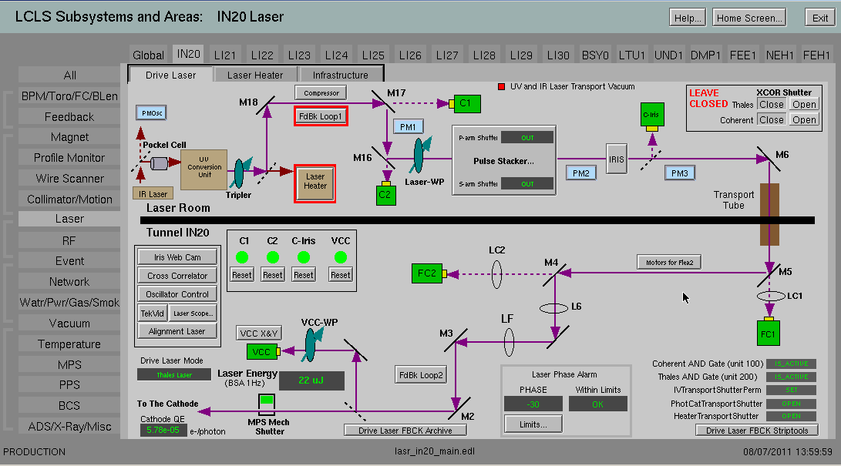
Drive Laser & Laser Heater Controls –
Based on LCLS-I Design

Slide 24
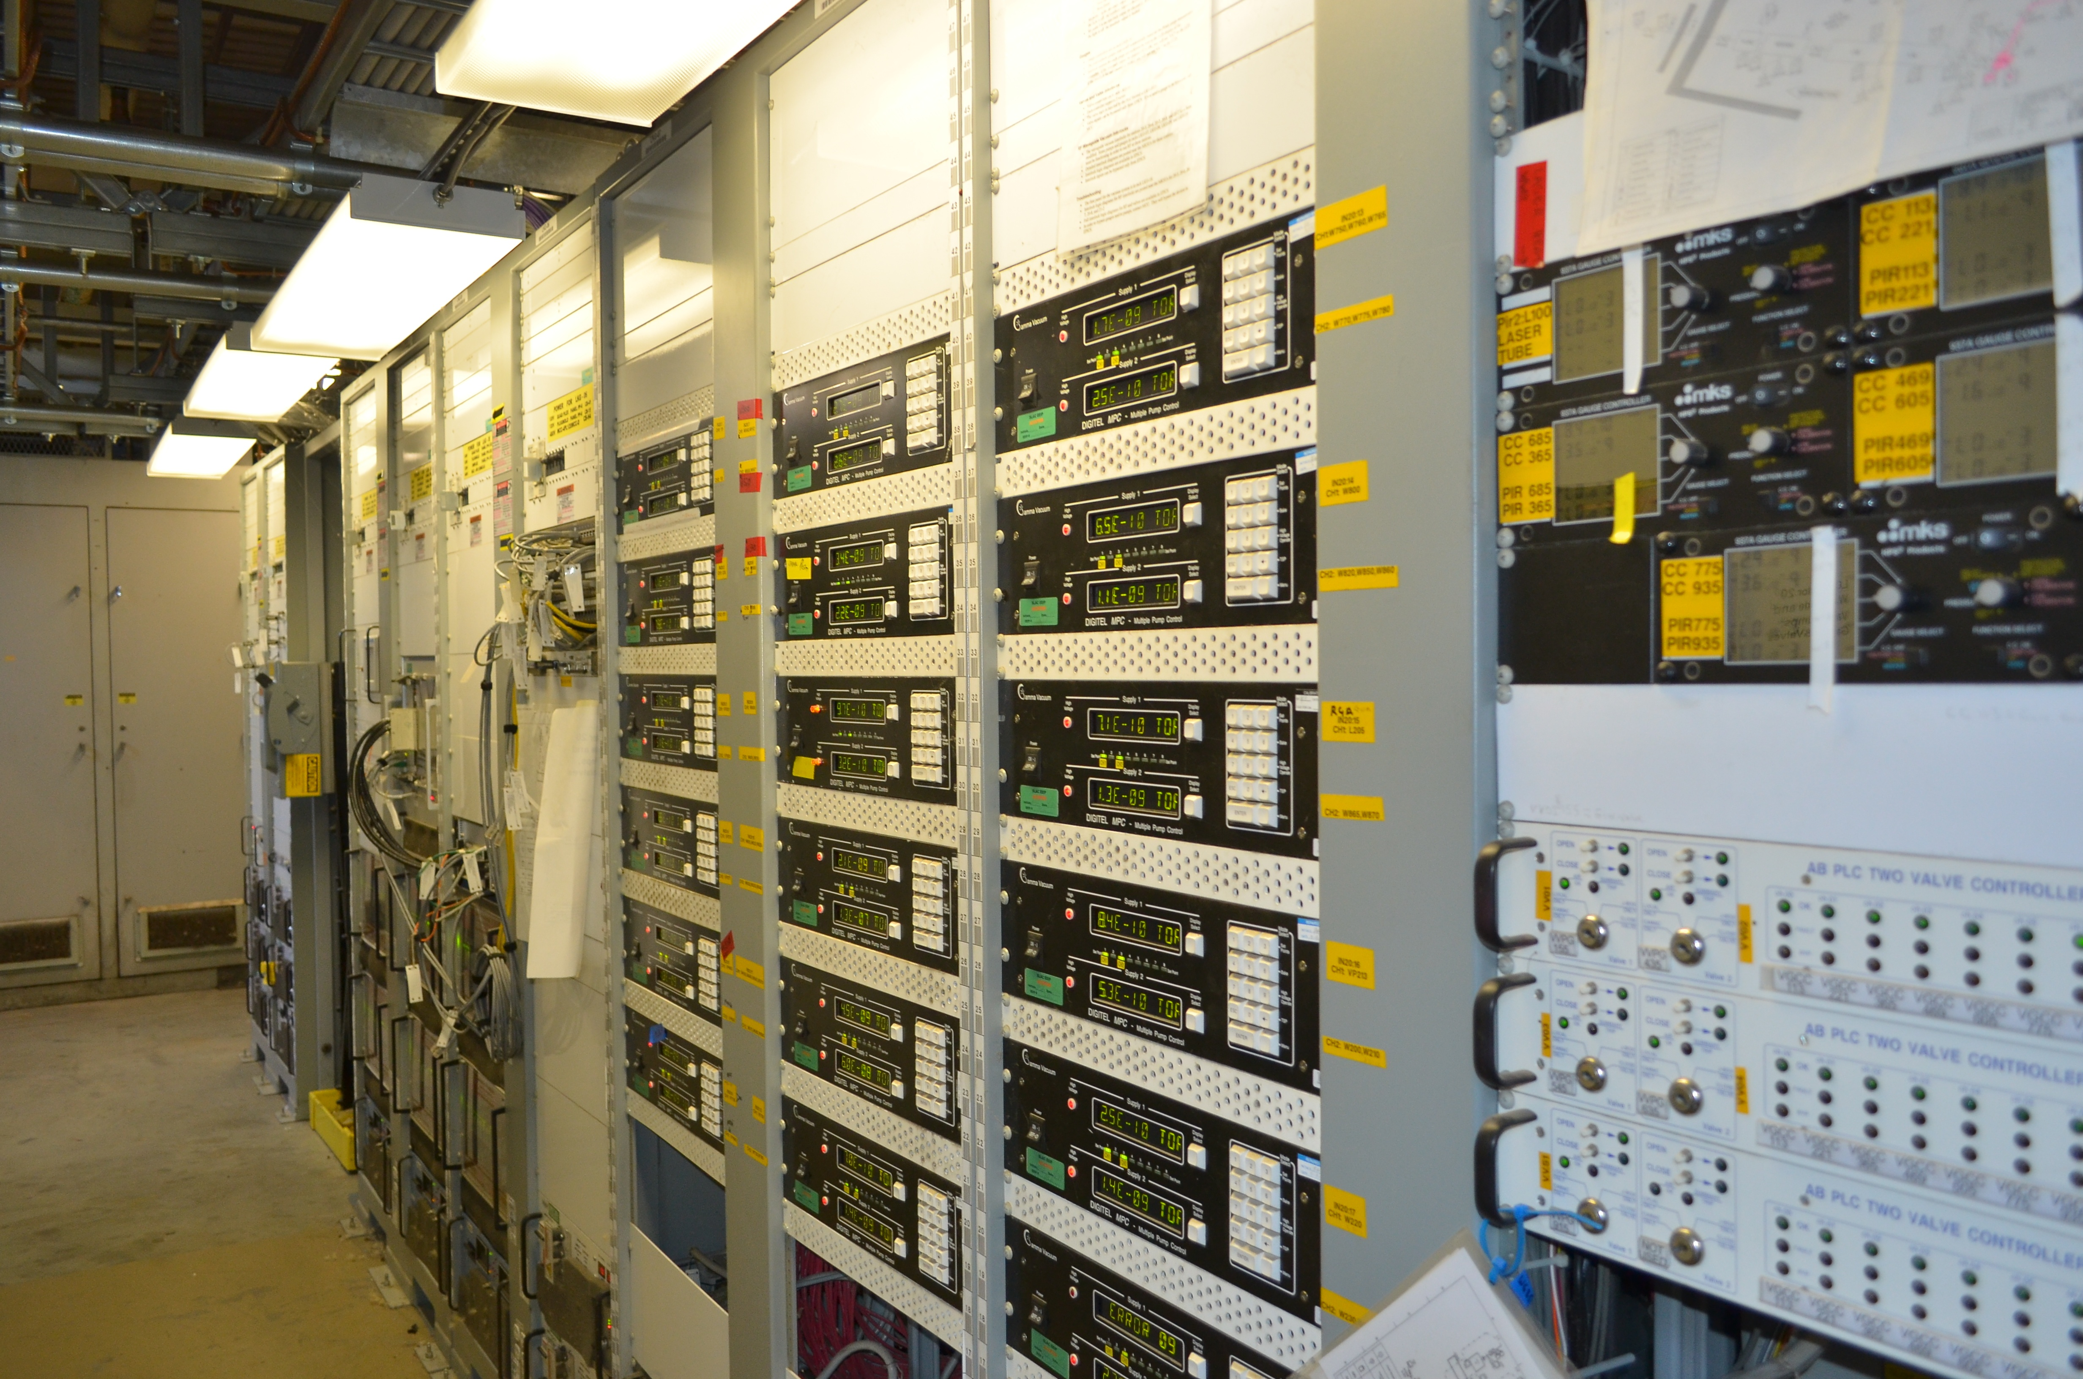
Vacuum controls will use the same proven design as LCLS-I
Existing HXU Vacuum hardware will be repurposed for LCLS-II HXU

Slide 25
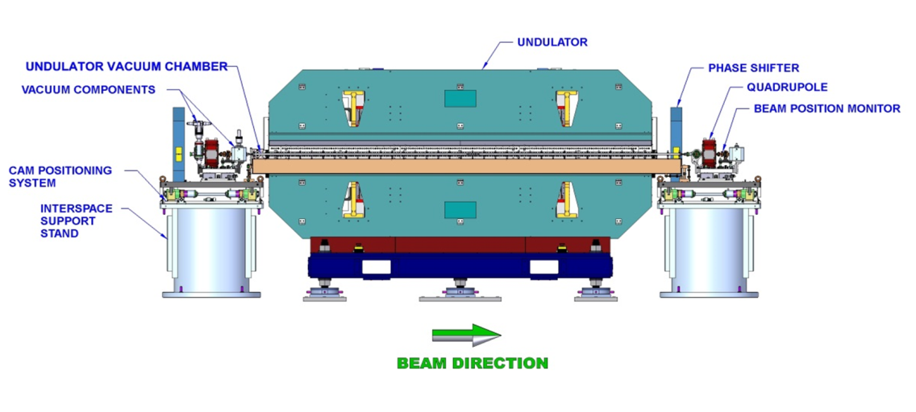
Undulator Motion - Variable Gap Undulator Motion Control System
  Undulator gap control using 4 motors, position encoders & limit switches
  Interspace control using 5 cam system, 5 contact points at four corners
  Controls for each undulator and interspace will be integrated into a single system that interfaces to an EPICS IOC
  Prototype assembly is complete
  A temperature monitoring system is also integrated into each control chassis, with sensors on the undulator and interspace

Slide 26
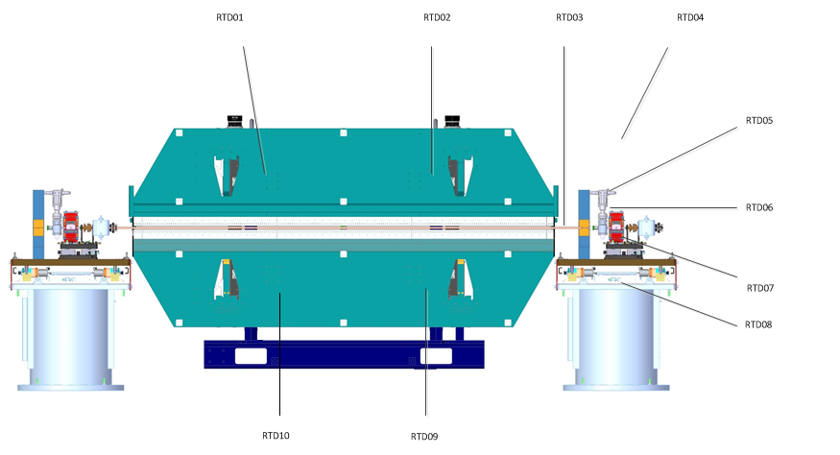
Undulator Temperature Monitoring
High Resolution RTDs
  <0.1 C Accuracy
  <0.05 C Resolution
  7 Channels
    2 Upper Jaw
    2 Lower Jaw
    1 Phase Shifter
    1 Vacuum Chamber
    1 Air
Lower Resolution RTDs
  <0.5 C Accuracy
  <0.1 C Resolution
  3 Channels
    1 Quad
    1 Pedestal (top)
    1 Undulator Frame
Beckhoff KL3222
  4 Wire RTD
  2 Channels
  0.01 C Resolution
  0.1 C Accuracy @ 40 C
Beckhoff BK9000 TCP/IP Bus Coupler

Slide 27
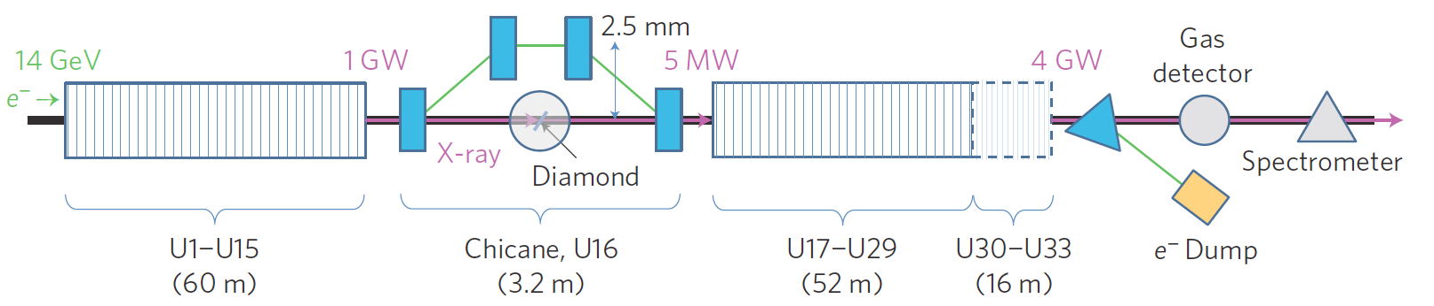
Hard & Soft X-ray Self-Seeding Control
  LCLS-I system will be re-installed.
  Controls will be based on successful LCLS-I design
  Further development is required for high rep-rate operation.
  LCLS-I SXRSS components can be re-purposed.
HXRSS

Slide 28
Safety Systems Overview: PPS, BCS, MPS, EPS

Slide 29
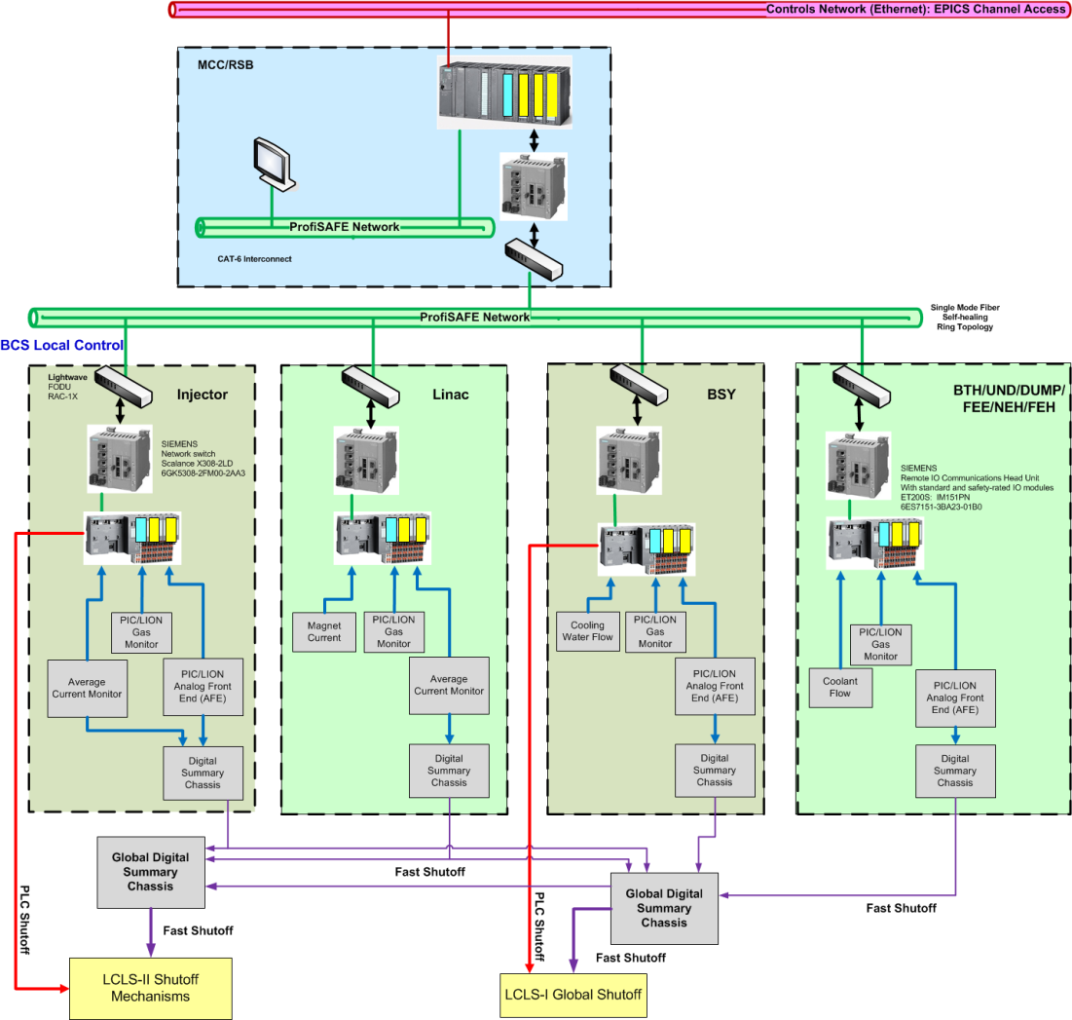
BCS System Architecture
Siemens S7 PLC will be used as the backbone for control and data acquisition
Same PLC that PPS has been used for years with proven field record
Same distributed architecture as PPS, remote I/O drops are used to handle distributed devices scattered over a long distance
SIL-rated hardware will enhance the system safety performance
PLC will add intelligence into system decision process
Unify the data exchange with EPICS, eliminating the need for CAMAC, VME etc.
Fast shut-off path is critical to meet the response time requirement
Courtesy F. Tao

Slide 30
Machine Protection System – Scope and Requirements
  Protect LCLS-II machine components from beam based damage by shutting off beam or reducing beam rate.
        Respond within 2.78 msec for slow type faults
        Respond within 100 usec for fast type faults
        MPS does not handle equipment protection. Ex. Magnet and Water INTLK , Vacuum INTLK , Motion INTLK
LCLS-I: Requirement is within 8.3ms, but it actually responds within 2.78ms
  System must support multiply sources (new LCLS-II Injector and current LCLS-I Injector)
    HXR beamline must support both LCLS-I and LCLS-II sources.
    LCLS-I and LCLS-II must be able to run at the same time.
        LCLS-I delivering to HXR and LCLS-II delivering to SXR (Interleaved operation not supported)
  Simultaneous Beam Destination each with varying allowed rates
        MPS must monitor a Beam Spreader that switches beam between two undulator beam lines and pulsed magnet kickers that pulse steal into diagnostic beam lines
        LCLS-II MPS must be capable of independently rate-limiting the beam in either of its two undulator beam lines.
Protect LCLS-II beamline components from beam based damage by reducing beam rate or shutting off the beam.
        Beamline walls
        Undulators
        Insertable devices (vacuum valve, profile monitor, etc.)
Rate limit for both HXR and SXR beam destination. (targeted shutoff)
Communicate with the Timing Master.
Communicate with and monitor mitigation devices.

Slide 31
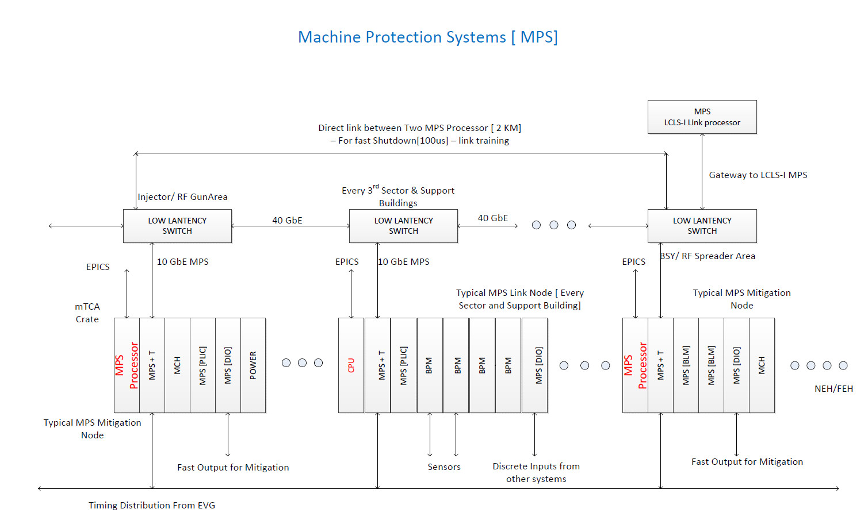
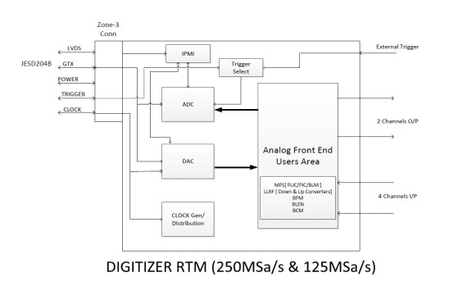
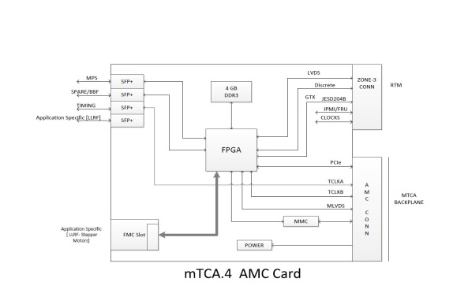
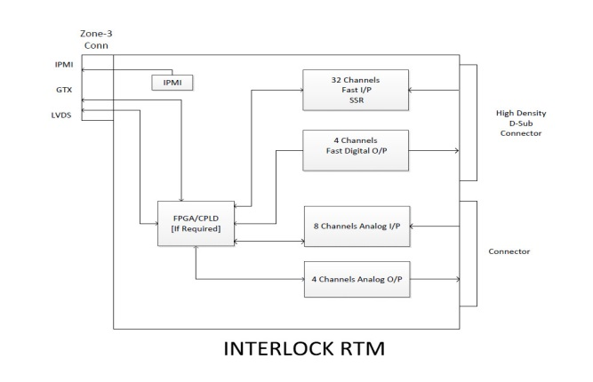
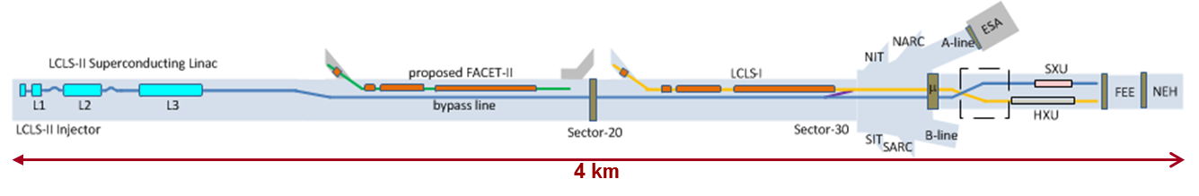
Conceptual MPS Architecture Block Diagram

Slide 32
ODH Monitoring (Part of Cryogenic Safety System)
For the complete cryogenic system design and overview of the hazards, see Marc Ross’ talk: Oxygen Deficiency Hazard; Cryogens in the SLAC Infrastructure – Hazard Analysis.
Preliminary Hazard Simulations have shown there are a number of credible incidents that will cause an oxygen deficiency hazard in the LCLS-II SC LINAC.
The conceptual design for the active engineering controls include
a ventilation system (facilities scope) and
oxygen monitoring and alarm system, “ODM controls” (ICD controls scope).
Scope of ODM Controls by ICD

Slide 33
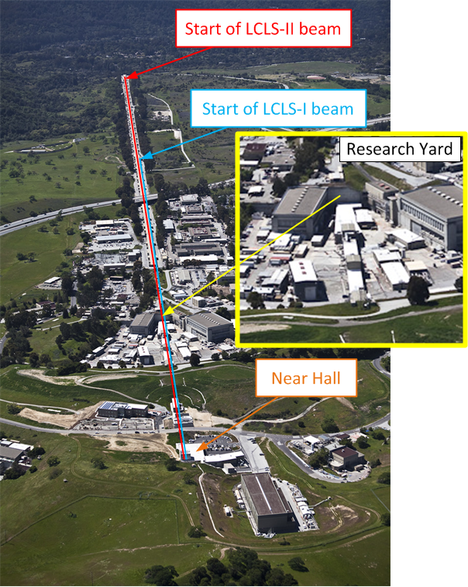
LCLS-II ODM Scope Overview
New Oxygen Deficiency Monitoring for
  Klystron Gallery (support building above the tunnel)
  Superconducting LINAC
  Cryogenic Plant (near LI04)
The oxygen replacing gases are
  Nitrogen: Cryogenic Plant
  Helium: Cryogenic Plant, Klystron Gallery, and Superconducting LINAC Tunnel
Controls will deliver Oxygen monitoring system for:
  The Cryogenic Plant
  The LINAC tunnel & klystron gallery
33

Slide 34
Injector Baseline Layout
Collimator
  CW (up to 1 MHz), 0.4 µm emittance @100pC
  Major injector components:
    NC 185.7 MHz (1300/7) RF gun
    Cs₂Te cathode; UV/IR lasers for cathode/laser heater
    NC 1.3-GHz buncher; two solenoids
    SC 1.3-GHz 8-cavity CM (energy up to 100 MeV)
    Laser heater system (1030 nm IR)
    Off-axis diagnostic line (100 Hz pulse stealing)
See PRDs:
LCLSII-2.3-PR-0166
LCLSII-2.3-PR-0167
LCLSII-2.3-PR-0165
LCLSII-2.4-PR-0068
LCLSII-2.2-PR-0086

Slide 35
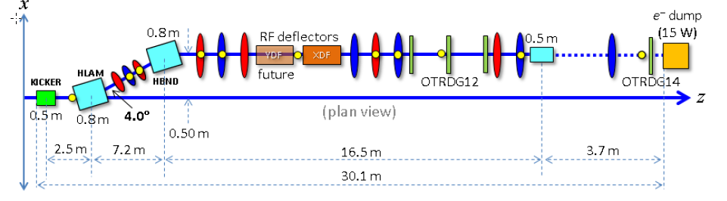
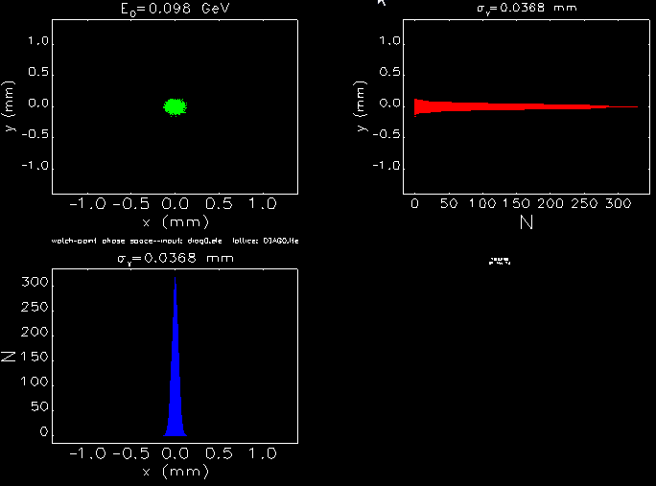
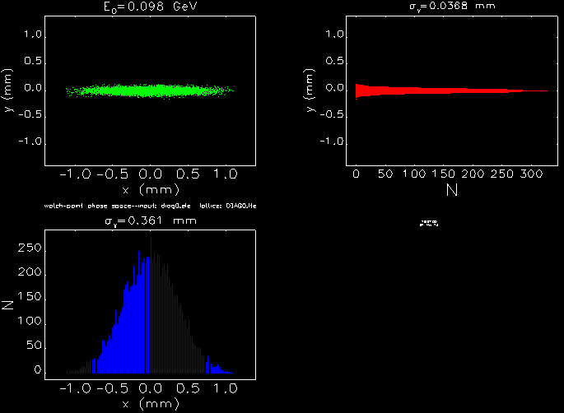
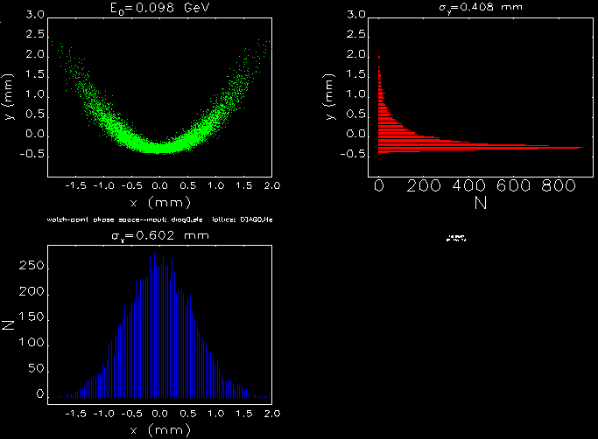
‘Pulse-Stealing’, Off-axis Diagnostic Beamline
See PRD LCLSII-2.4-PR-0068
Follows laser heater: ≤ 120 MeV, ≤ 120 Hz, ≤ 15 W
Measure at max. 120 Hz:
Emittance (projected & slice)
Energy Spread (proj. & slice)
Bunch length (absolute)
Simulations of time-resolved measurements (Elegant)
OTRDG12
(TCAVX OFF)
OTRDG12
(TCAVX ON)
OTRDG14
(TCAVX ON)

Slide 36
LCLS-II Controls Integration
May 5, 2015

Slide 37
Agenda
LCLS-II Path to CD-2/3
Preparing for the DOE CD-2/3 – December 2015
    Design Documents
    Conceptual design reviews in May-July
    Preliminary design reviews Oct-Dec 2015
Controls Baseline Changes
    Add-back List
    APEX Controls
Bypass and SXU cable plant specification status
Q&A

Slide 38
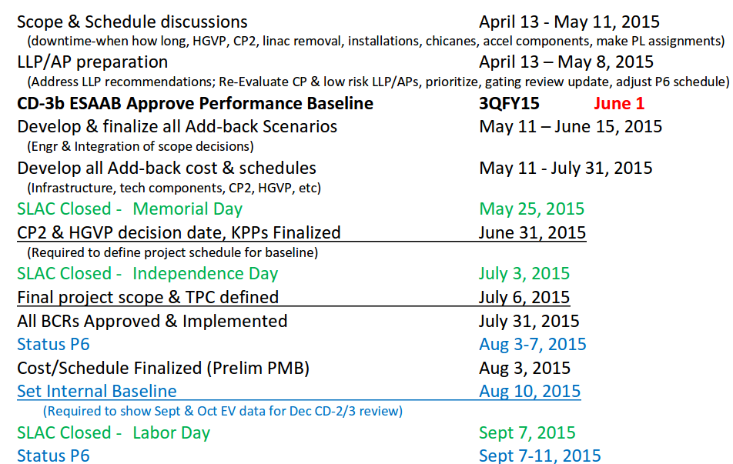
LCLS-II Path to CD-2/3

Slide 39
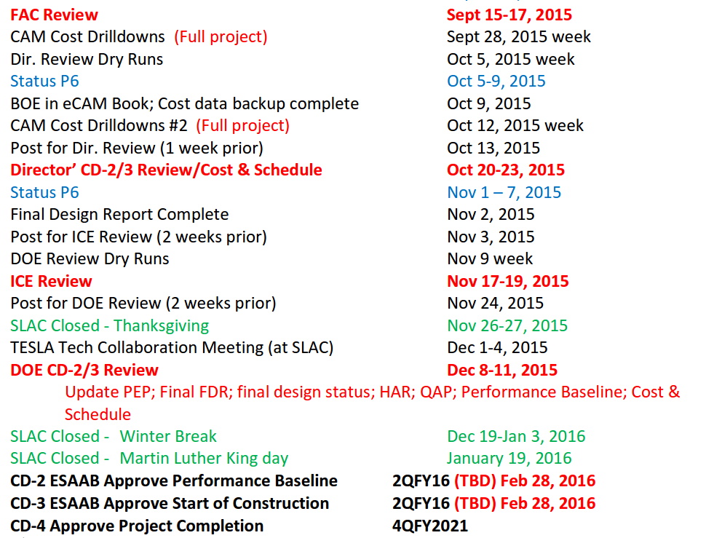
LCLS-II Path to CD-2/3

Slide 40
Eight-month Look ahead –
Review and Design Activities
Systems with High Design Maturity
    Preliminary Design Review – January 20-21, 2015
    Final Design Review – July, 2016
    A little over one year to finalize all the designs
    Now reviewing the plans for the next 8 months
Systems Currently at Conceptual Design Level
(LLRF, BPM, BCM, BLEN, MPS, Timing, BCS, Cryo Controls)
    Complete all necessary documents: FRS, ESD, etc.
    CDR – May/July 2015
    Design Documents: FRS, ESD before Preliminary Design
    PDR – October/December 2015
    FDR –November 2016

Slide 41
LCLS-II Beam-based Feedback Requirements
  Charge Feedback (<30Hz)
  Transverse feedbacks for steering at linac accelerator sections (<30Hz)
  Faster steering before undulator sections (100 kHz)
  Beam-rate Longitudinal feedback for stability (1 MHz)

Slide 42
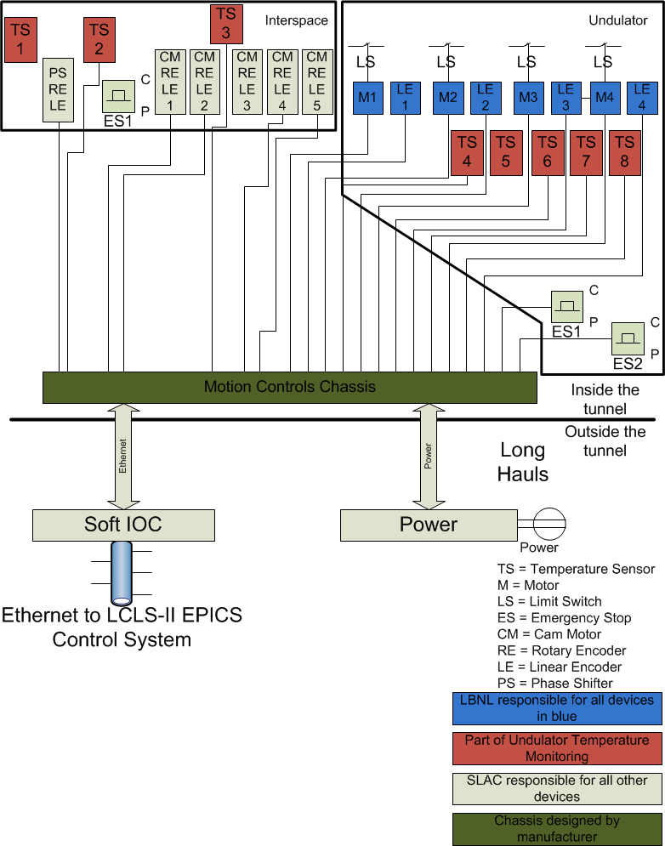
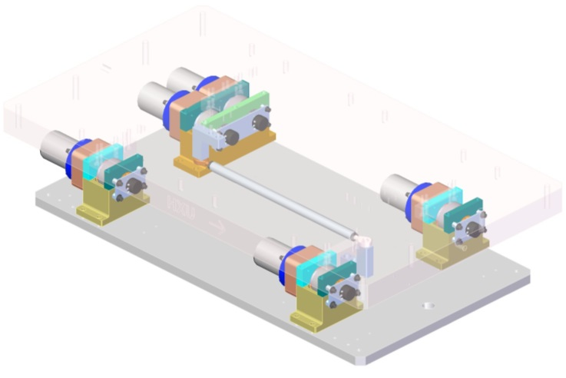
Variable Gap Undulator Motion Control System
  Undulator gap control using 4 motors, position encoders & limit switches
  Interspace control using 5 cam system, 5 contact points at four corners
  Controls for each undulator and interspace will be integrated into a single system that interfaces to an EPICS IOC
  Prototype assembly is complete
  A temperature monitoring system is also integrated into each control chassis, with sensors on the undulator and interspace

Slide 43
Two Categories of External Projects
Category I Projects are essential for achieving CD-4
    MPS Design Upgrade
    BCS Design Upgrade
    Linac PPS
    BSY PPS Upgrade
    Linac BPMs
    Phase Reference System
    Linac Network Upgrade
    LCLS-I Controls Computing Infrastructure Upgrade

Slide 44
Phase II External Projects
Category II Projects are needed to achieve the performance goals of LCLS-II
These may be implemented later in the construction lifecycle, or shortly after CD-4
    Fast Feedback Upgrade
    MCC Network Backbone Upgrade
    LCLS-I Applications Software Upgrade for LCLS-II
    LCLS-I Network Upgrade to Accommodate LCLS-II Needs
    LCLS-I Controls Computing Facility Upgrade to Support the additional LCLS-II load

Slide 45
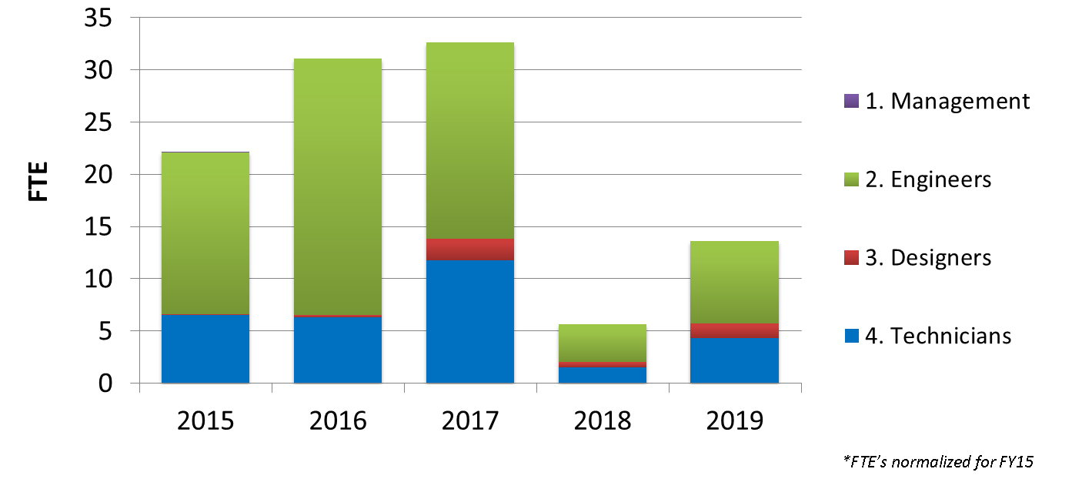
Resource Usage by Fiscal Year
Notes/Comments

Slide 46
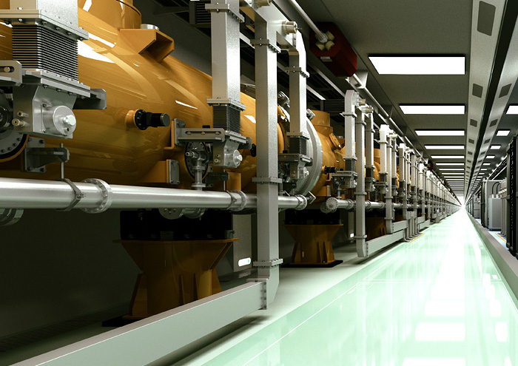
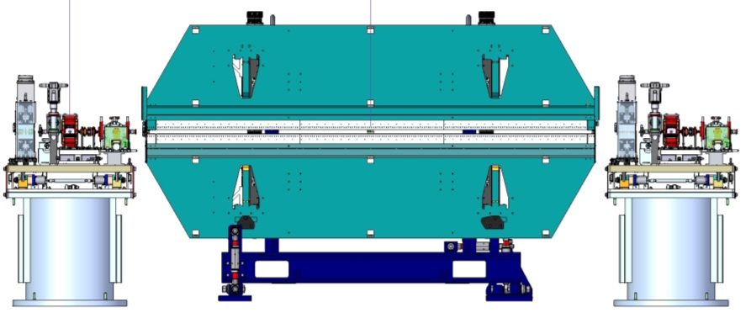
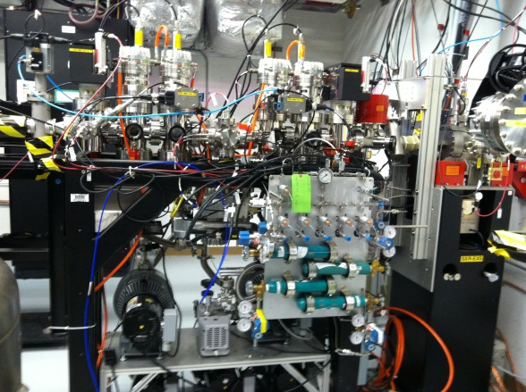
Controls Scope –
Injector, Linac, Undulators, Dump, Experiment Systems
Injector – in collaboration with LBNL
SC Linac – in collaboration with JLab and FNAL
Undulator System
X-ray Transport & Experiment Systems

Slide 47
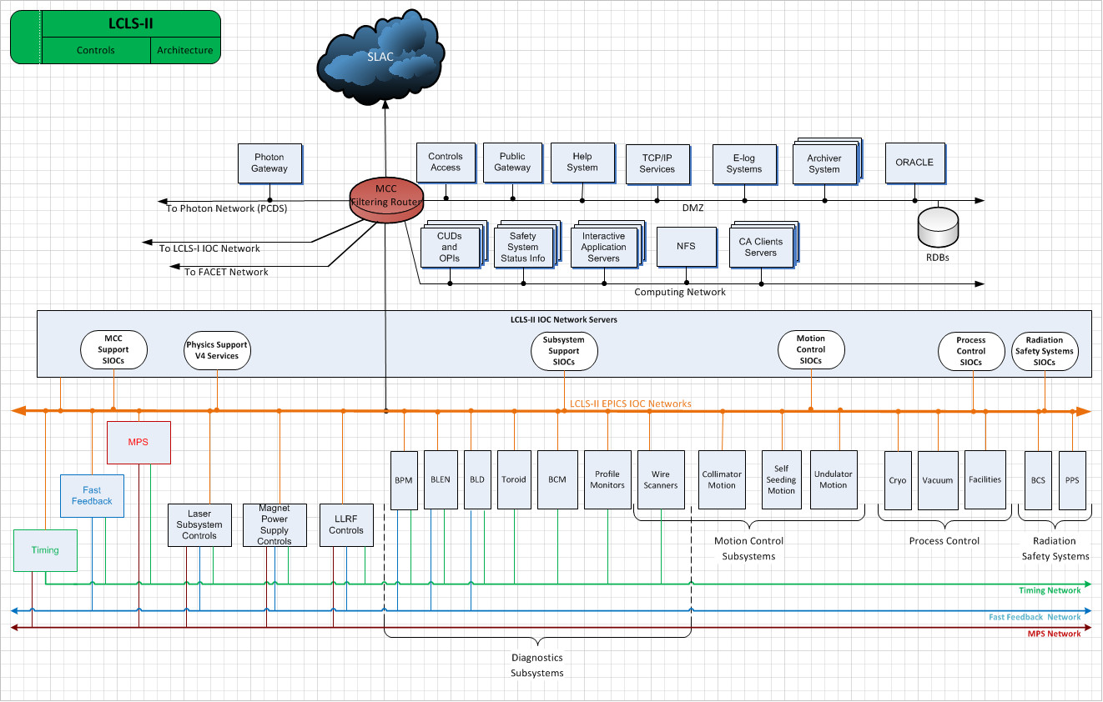
Top Level Controls Architecture

Slide 48
“Warm” LCLS-II Project began ~FY11…
Was to occupy middle 1/3 of linac
Injector vault built at S10 at the 1km point
Essentially a klone of LCLS with the exception of new variable gap unds developed at LBNL; controls at SLAC
Controls for injector were fabricated and installed in racks awaiting controls software and chekout, until…

Slide 49
A New LCLS-II Project Redesigned in Response to BESAC (FY 14)
Accelerator | Superconducting linac: 4 GeV
2 Variable Gap Undulator lines in existing LCLS-I Tunnel | New variable gap; soft x-ray (north) New variable gap; hard x-ray (south), replaces existing fixed-gap und.
Instruments | Re-purpose existing instruments (instrument and detector upgrades needed to fully exploit new configuration)
Total Project Cost (Rev 9/2014) | $965M
Notes:
The undulators, when fed by the superconducting linac, enable a new class of experiments making full use of the high repetition rate and lower intensity pulses, such as high resolution and multi-dimensional X-ray spectroscopy.
New hard X-ray undulator when fed with electrons from the existing linac provides pulses with high energy, high intensity and very short duration.
The new plan incorporates all the capabilities called for in the BESAC subcommittee report and help the U.S. maintain its world leadership in light sources and LCLS to continue to set the standard for cutting-edge scientific discovery.
To meet BESAC's recommendations, we have proposed constructing a 4 GeV superconducting linear accelerator in the first third of our existing linac tunnel. Rather than building a new undulator tunnel as was called for in the original design for LCLS-II, we now propose placing two variable-gap undulators in the existing undulator tunnel: a new soft X-ray undulator and a hard X-ray undulator that would replace the existing LCLS undulator. The existing LCLS instruments would be upgraded to take advantage of the new configuration. The undulators, when fed by the superconducting linac, would enable a new class of experiments making full use of the high repetition rate and lower intensity pulses, such as high resolution and multi-dimensional X-ray spectroscopy. It will still be possible to feed the new hard X-ray undulator with electrons from the existing linac to provide pulses with high energy, high intensity and very short duration. The new plan would allow us to incorporate all the capabilities called for in the BESAC subcommittee report and help the U.S. maintain its world leadership in light sources and LCLS to continue to set the standard for cutting-edge scientific discovery.
If the proposal is approved and funded, we will need the help of a number of partners to help make it a reality as soon as possible. We have begun discussions with other national laboratories that have expertise in areas such as superconducting radio frequency, high repetition rate injectors and undulators to explore how we may work together.
We have worked closely with the Office of Science on this proposal but as I said, there is a ways to go before any decisions are made with regard to whether we move forward with these modifications. We need to remain mindful that we continue to live in a very constrained funding environment. Until and unless our response to BESAC’s recommendations moves beyond the proposal stage, it is too early to discuss timing or schedules for this modified plan. However, we strongly agree that the opportunities for exciting science laid out in the BESAC report with such an instrument are unprecedented.
As the report said, such a revolutionary new X-ray facility "will enable world-leading experiments in chemistry, physics, biology, and materials science – experiments that will expand the science frontiers and advance energy science resulting in broad economic and societal benefits." It’s incumbent on us to work with the DOE and with our partners.

