Slide 1
CS-Studio Collaboration Status
Eric Berryman Controls Engineer

Slide 2
Overview
Collaboration Statistics
Feedback from Issues
4.1.x Issues
Comments Activity
Issues Activity
Milestone Activity
Milestones Status
4.1.x (testing->stable)
4.2.x (unstable->testing)

Slide 3
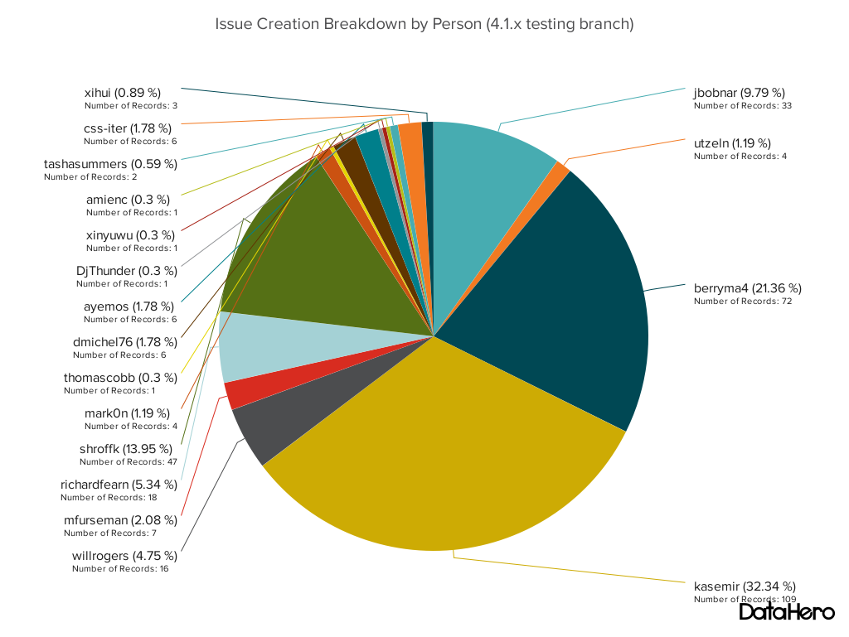
Feedback from Issues

Slide 4
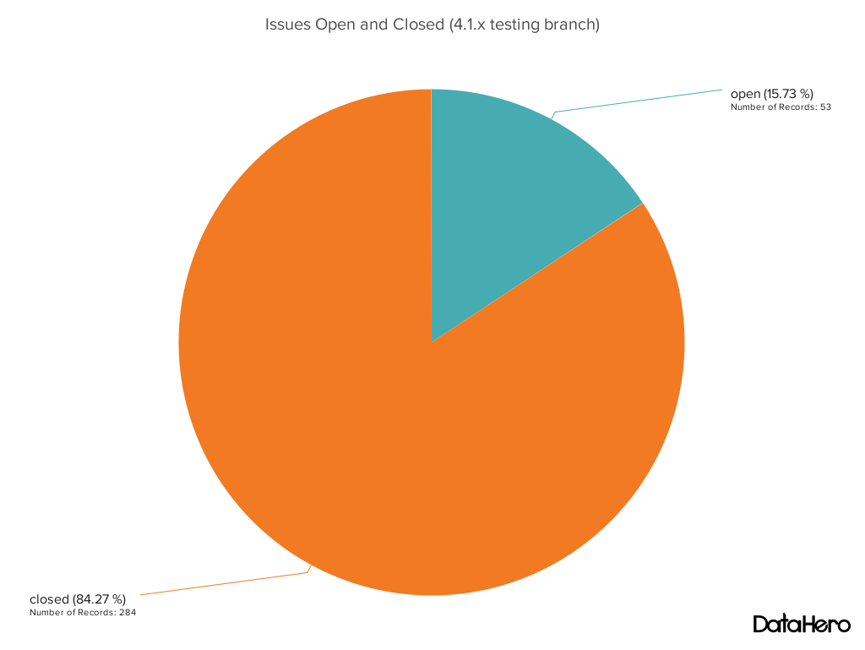
4.1.x Issues

Slide 5
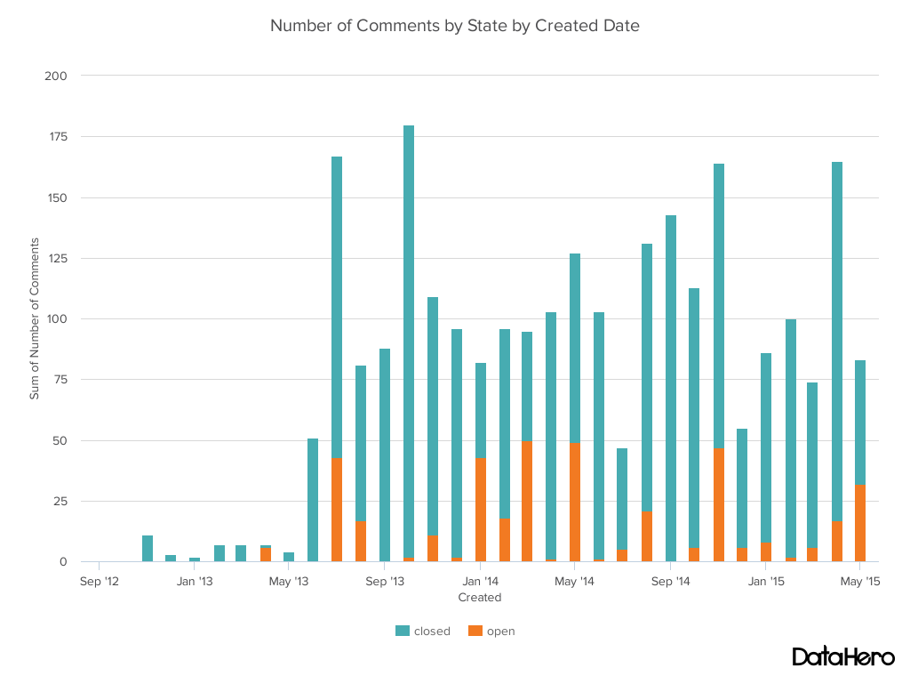
Comments Activity

Slide 6
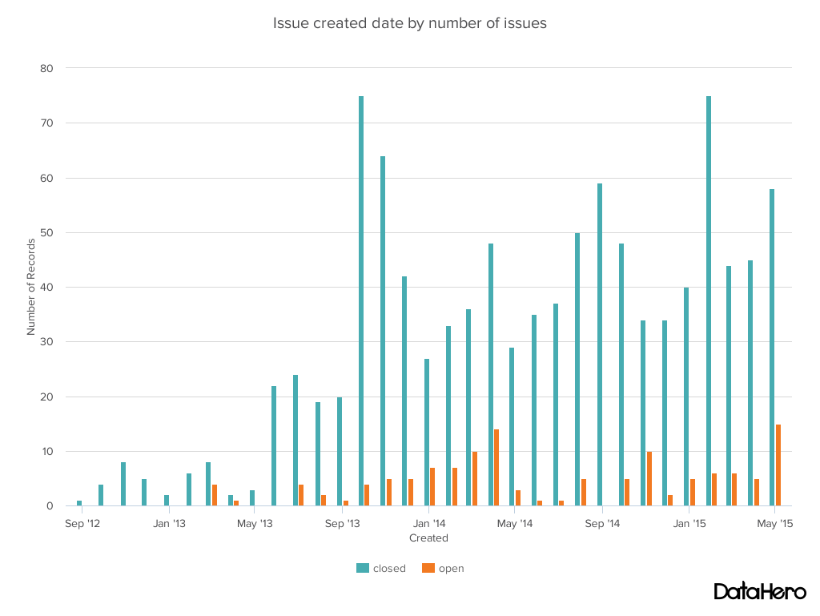
Issues Activity

Slide 7
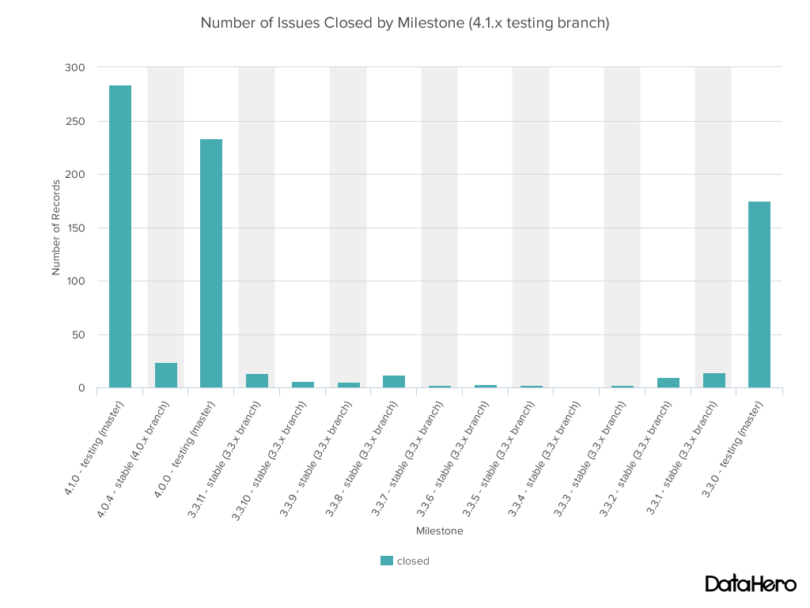
Milestone Activity

Slide 8
Closing 4.1.x (testing to stable)
4.1.x due date end of this month
Repository clean up (enable/speed up unit test)
Data Browser rewrite (replacing xygraph)
Logging UI (using javafx)
Checkstyle (enforce code formatting)
Common Product (general product for download)

Slide 9
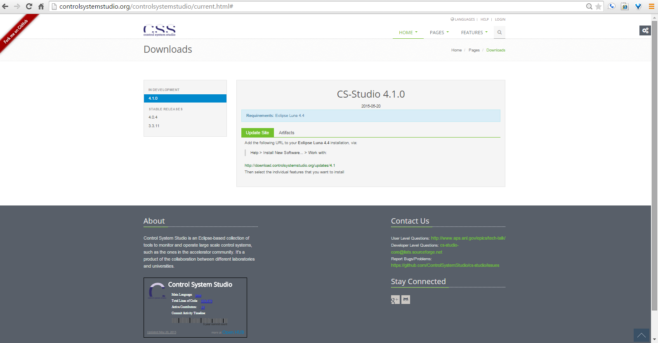
Common Product

Slide 10
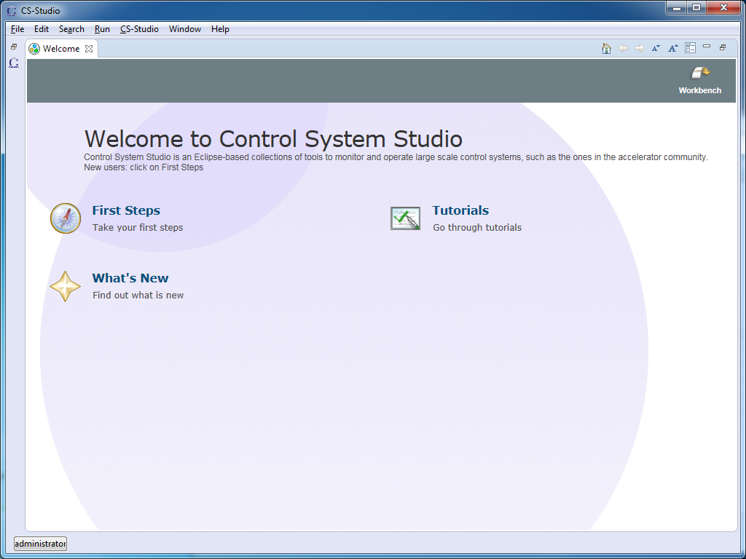
Common Product

Slide 11
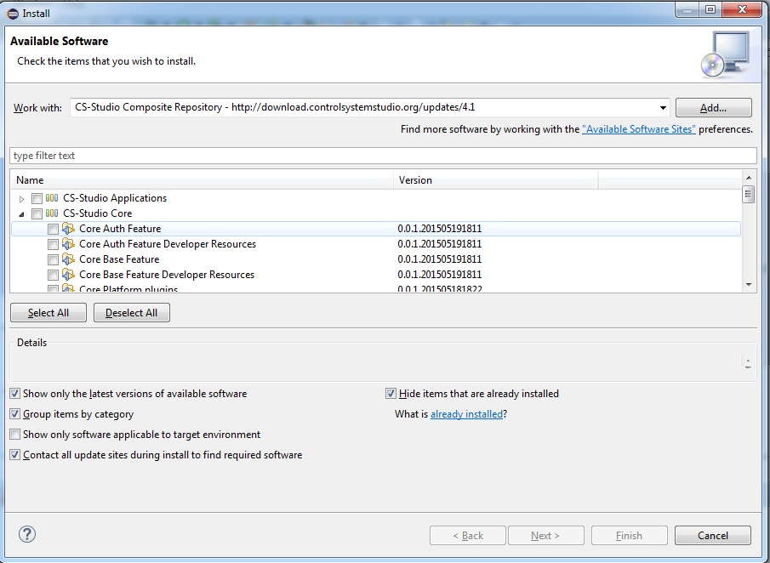
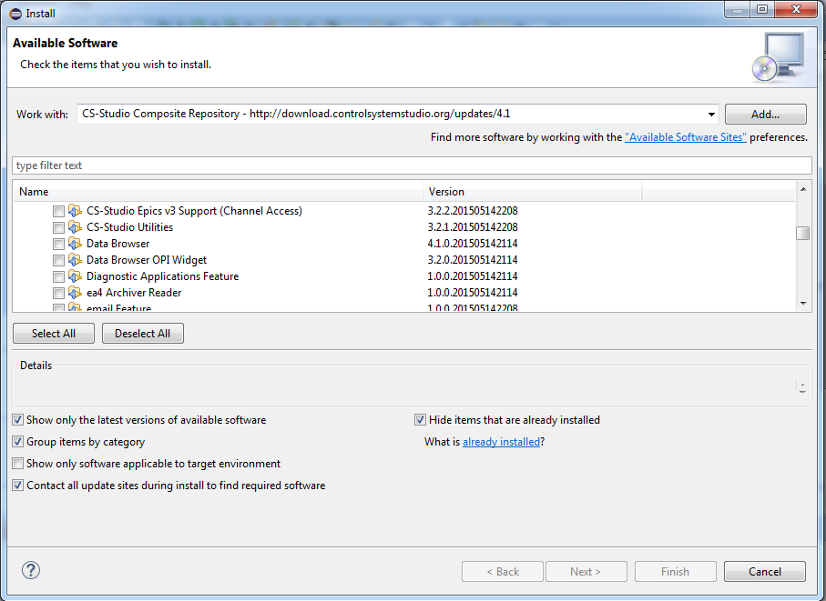
Common Product

Slide 12
Common Product
All Products built from binaries
Can make lab specific products with two files
.product file listing features
pom.xml file with <packaging>eclipse-repository</packaging>
Can include lab specific configuration feature as “rootfiles”
Adding root = {directory_name} to an Ecilpse feature build.properties file allows adding files respective to the cs-studio root directory
Rootfile feature allows versioning of configuration files
All configuration files have been pull out of jars, into configuration directory

Slide 13
4.2.x (testing)
4.2.x due date latest October
Will close 4.2.x as soon as BOY Perspectives Project is done (Issue #544)
Allows users to save and load BOY screens and their locations as perspectives.
Allows users to run a BOY screen in an independent window (much like EDM)

Slide 14
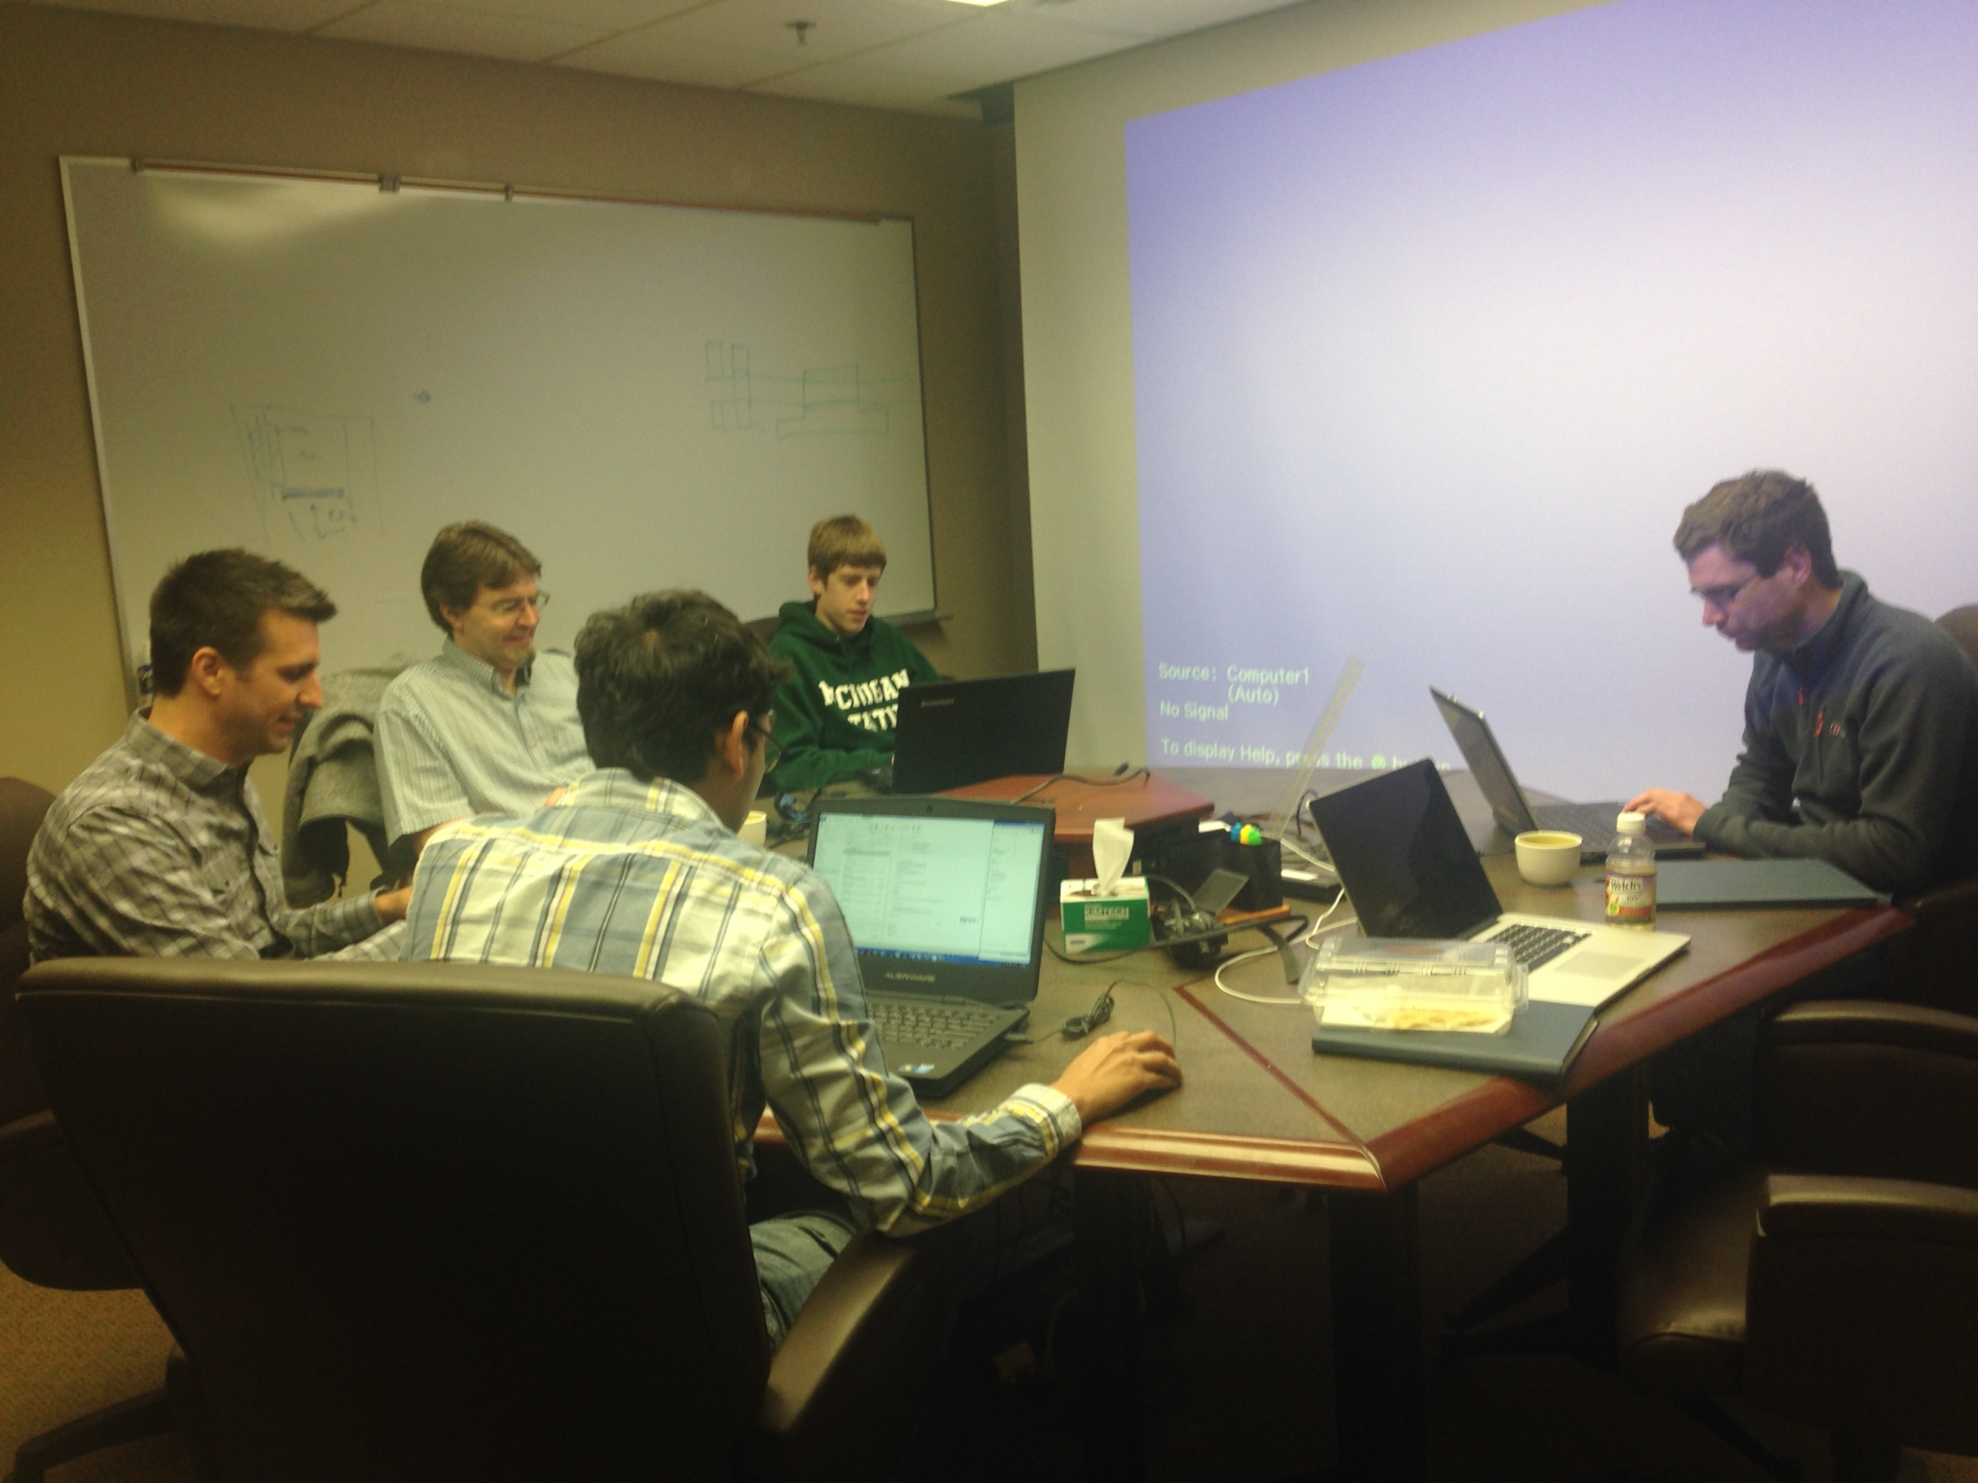
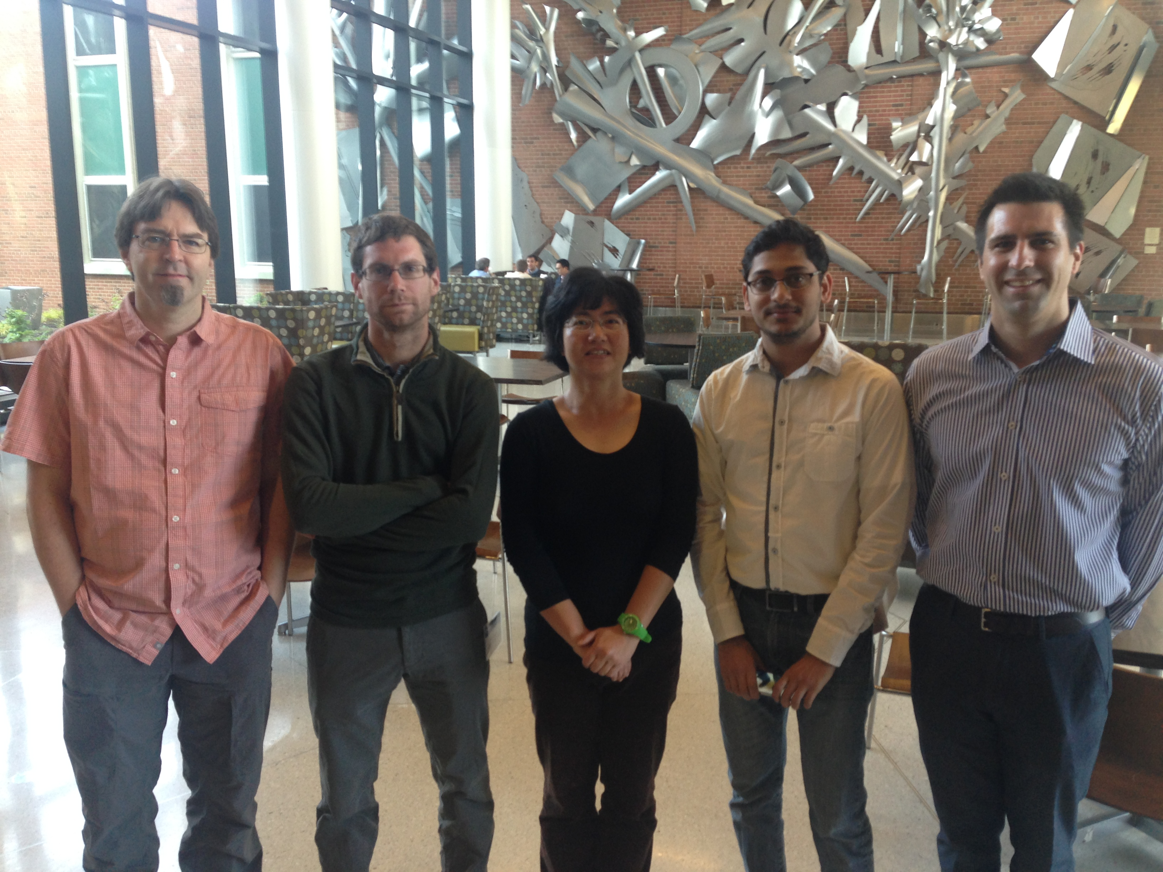
Code a thon (Build a thon)

Slide 15
Code a thon
CS-Studio development environment (Issue #818) Goal: All agree and understand the build process so that we’re able to build from sources and get the same results, everything or module-by-module.
IDE build, command line build
defining target platform (Issue #1155)
Configure Cloudbees (Issue #818) Goal: CIoudbees builds everything, everybody can use the results (plugins, complete products) or, if desired, reproduce in local Jenkins setup.
Create common jobs on cloudbees jenkins (using Jenkins Job Builder).
Re-enable the unit tests for the various cs-studio modules.
Makes the jenkins jobs accessible (github repo of Jenkins Job Builder scripts)
Modularize applications into features (Issue #462 -> #818) Goal: Speed up build. Allow products to use older versions of selected features.
Add Checkstyle (Issue #1055)
Goal: Enforce code style, Jenkins and IDE

Slide 16
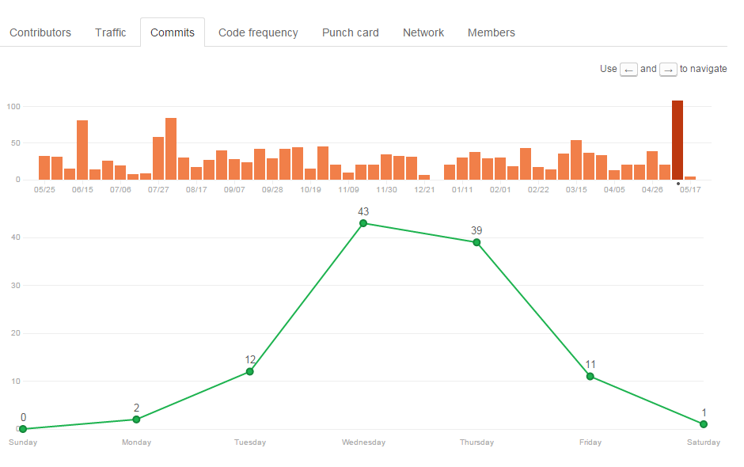
Code a thon

Slide 17
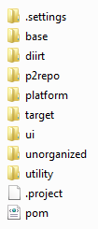
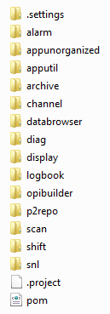
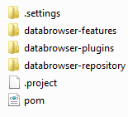
Reorganization
Core
Applications

Slide 18
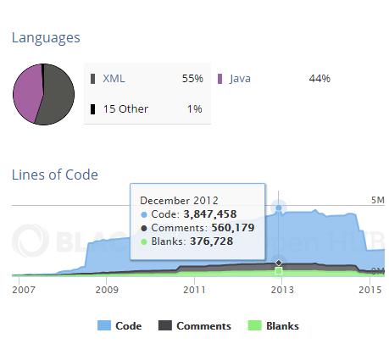
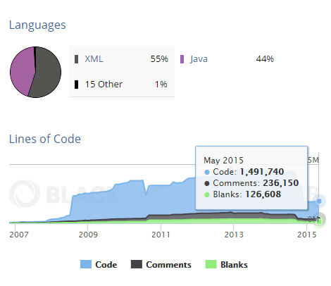
Reorganization
2,355,718 lines of code removed

Slide 19
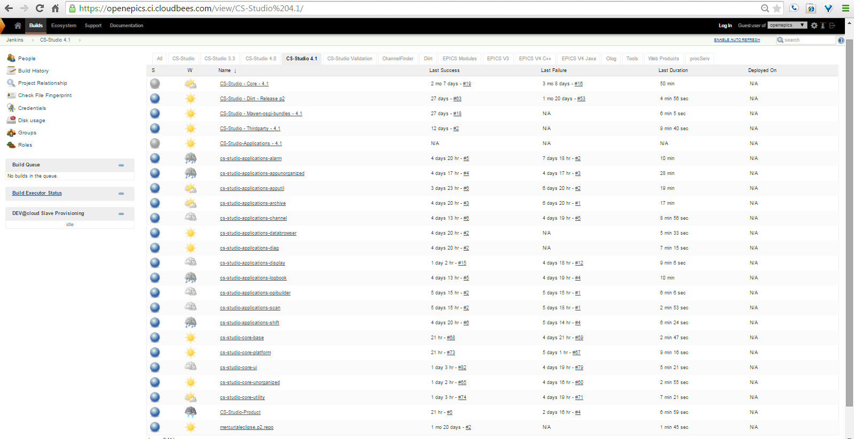
Reorganization

Slide 20
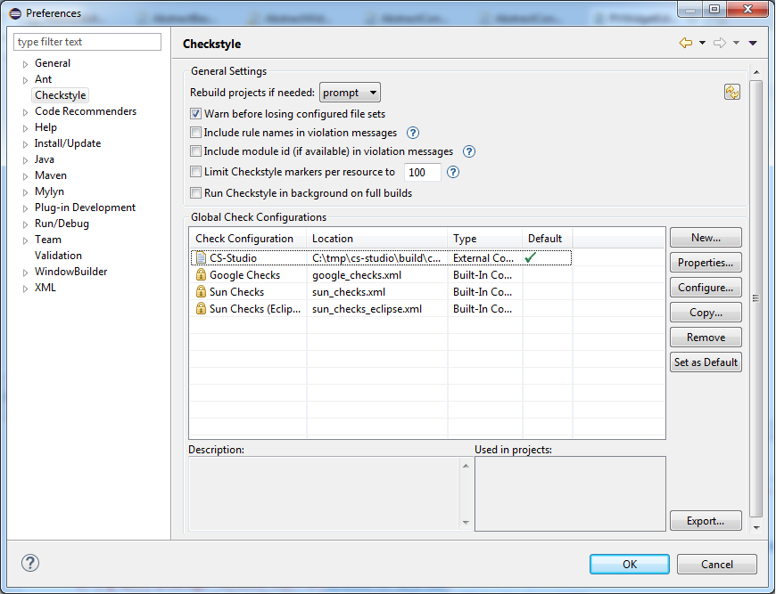
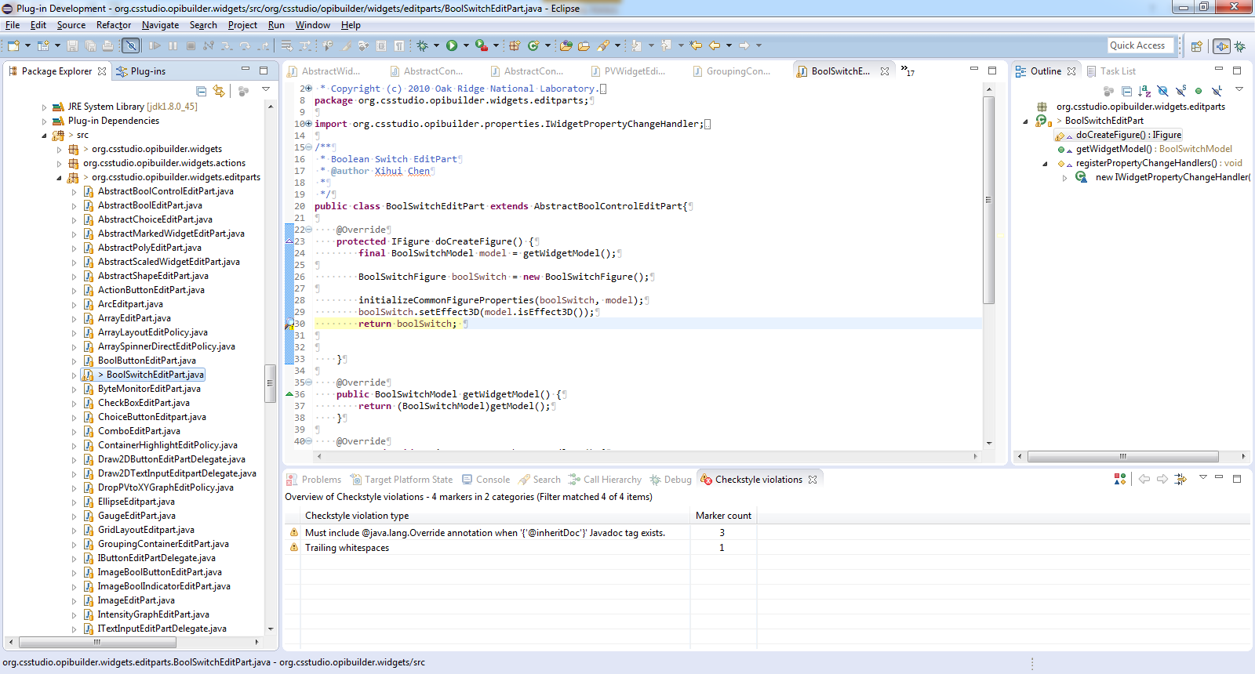
Checkstyle

Slide 21
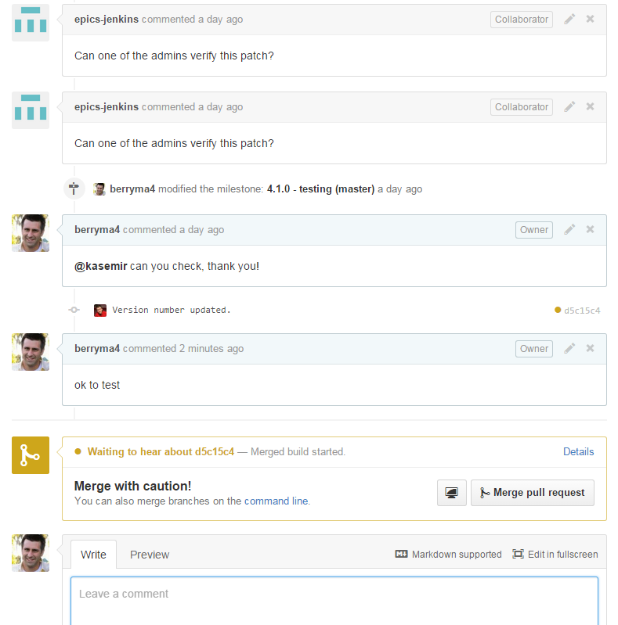
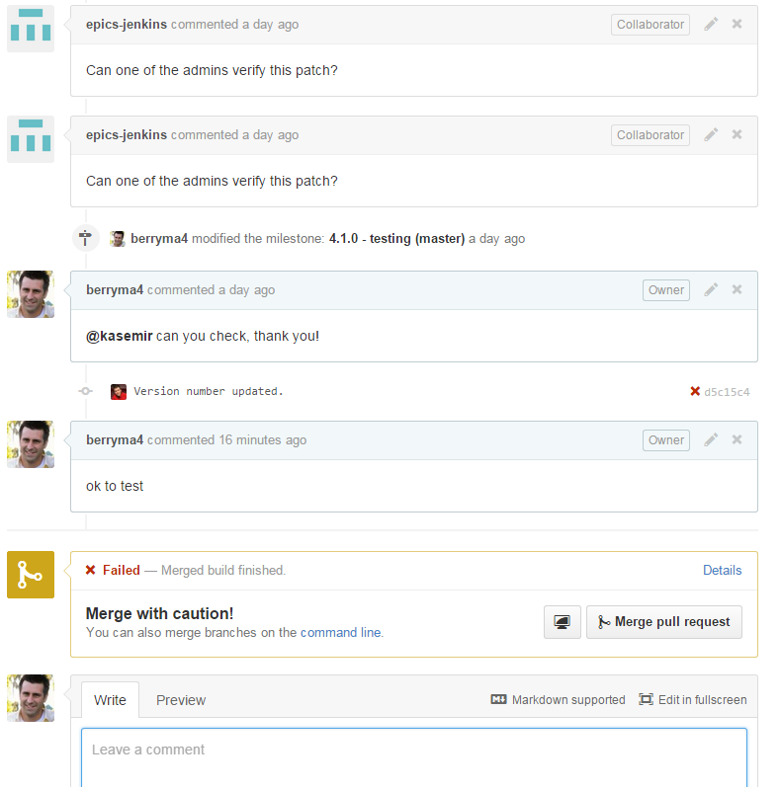
Checkstyle

Slide 22
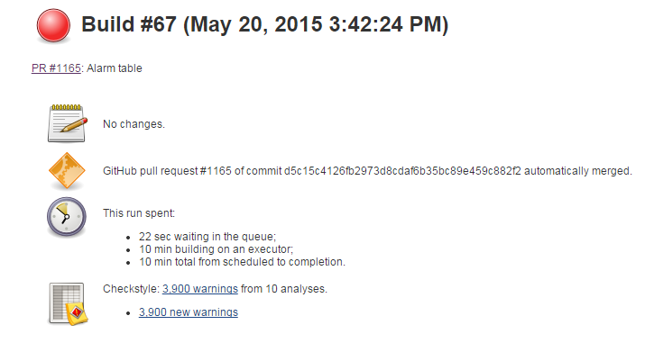
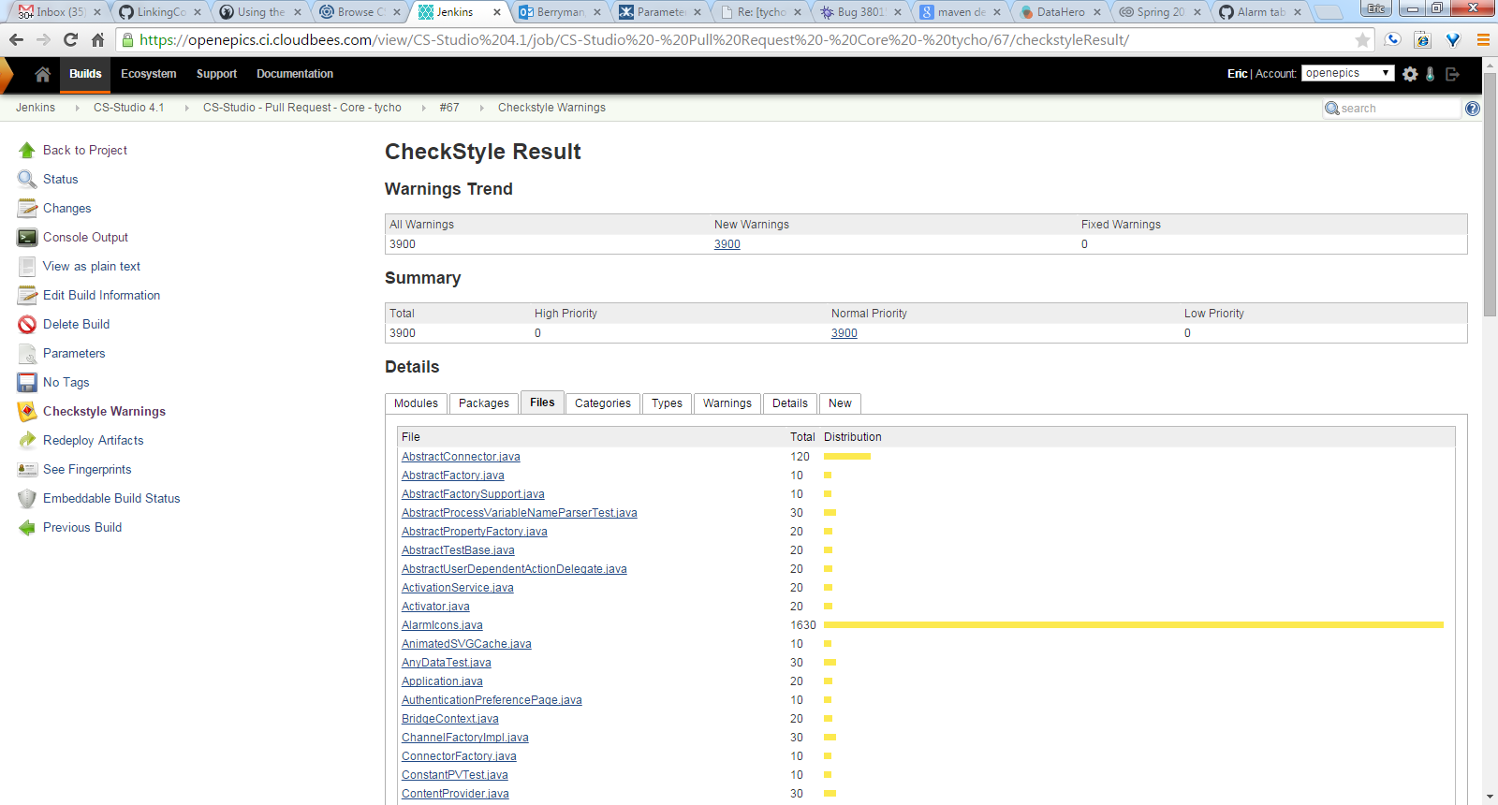
Checkstyle

Slide 23
How to Contribute
Fork us Github
Pick an issue/feature or make one
Create a branch in your fork with the fix or feature
Make a Pull Request with the issue number in the title
Attend meetings, know the release schedule, subscribe to mailing list

Slide 24
Development Process
Github
Pull Request (must reference issue ticket)
Jenkins
Amazon S3
Product Build
Feature Owner Reviews
Commits as Needed

Slide 25
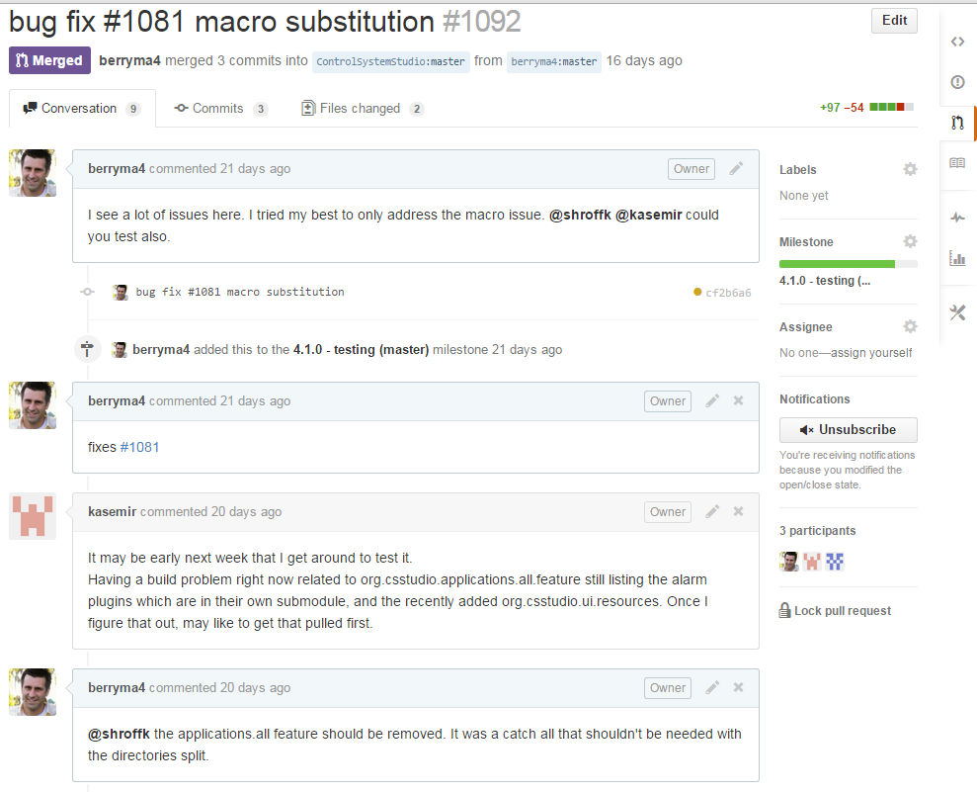
Development Process

Slide 26
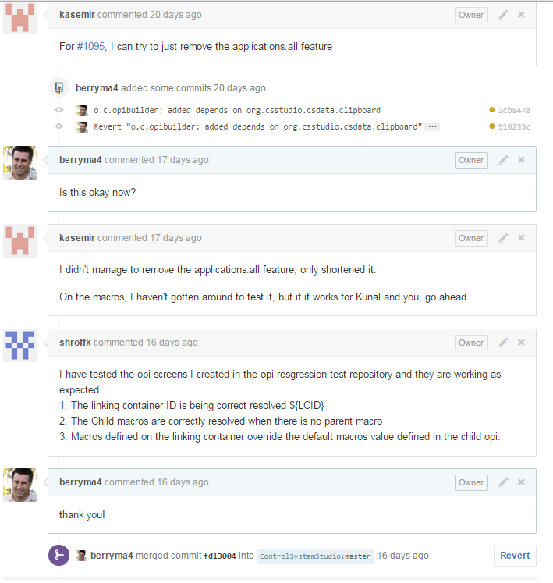
Development Process

Slide 27
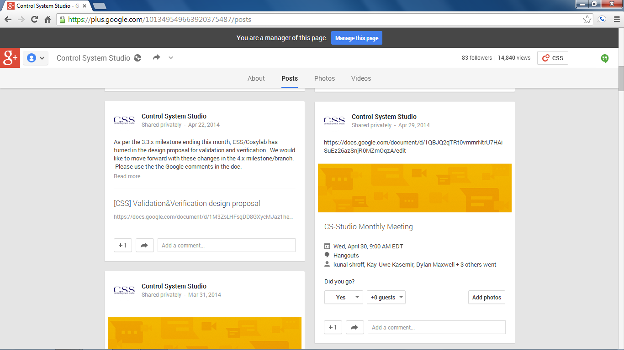
Attend Meetings
We use Google Hangouts to share our progress and discuss issues
Follow us on Google Plus
https://plus.google.com/101349549663920375487/posts
Meetings are posted (viewable after being added to group)
First Wednesday of the month (9am EST)
Project group meet once a week when actively developing

