Slide 1
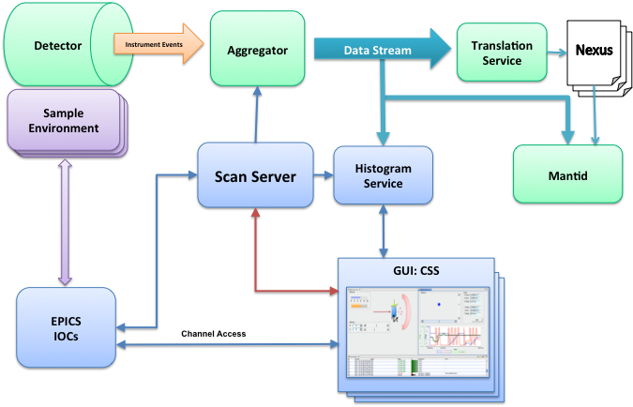
Scan System Update
Kay Kasemir,
May 2015

Slide 2
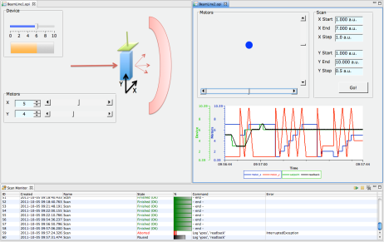
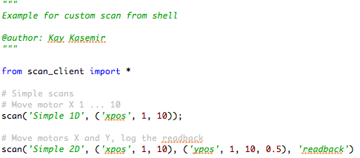
Scan Server
Sample Environment Equipment
Sample Environment Equipments
Sample Environment Equipments
GUI: CSS
Script
Scan Server
REST
EPICS IOCs
Channel Access

Slide 3
What it is and isn’t*
Is
Automation via Channel Access
Scan = Batch of commands
Queue multiple scans
Basic value logging
Submit, monitor, pause, resume, abort
Isn’t
Synchronization of actions beyond Channel Access
Data Acquisition (log every event, catalog, keep forever)
* .. depends on your definition of “is”

Slide 4
Set, Loop Commands
Set “some_pv” = 3.14
Loop “some_pv” = 1..10, step 0.5
Optionally
Await completion (put-callback)
Check read-back to match written value (same or other pv)
.. With numeric tolerance
Timeout

Slide 5
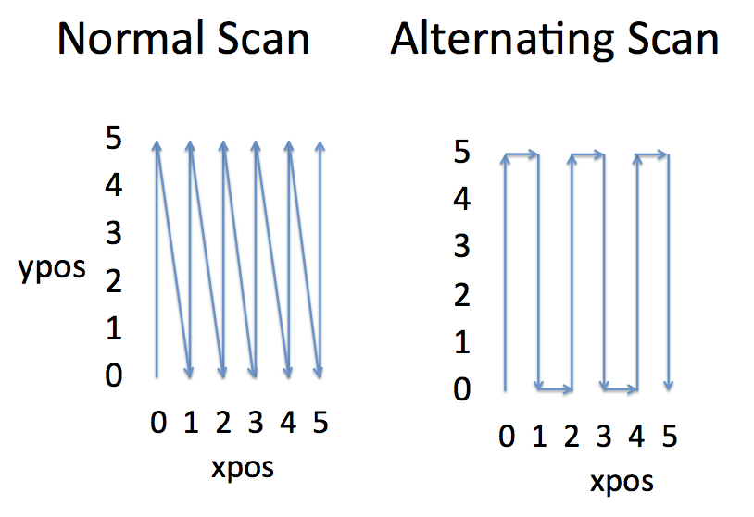
Direction of (Nested) Loops
Loop(‘x’, 0, 5, 1) → 0, 1, 2, 3, 4, 5
Loop(‘y’, 5, 0, -1) → 5, 4, 3, 2, 1, 0
Loop(‘x’, 0, 5, 1, Loop(‘y’, 0, 5, -1)) →Alternate direction on ‘mismatch’

Slide 6
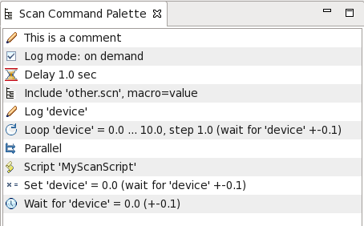
Other Commands
Wait for “pv1” > 100
Wait for “pv2” to increment by 200
Get-callback for initial value, then monitors
Log “pv1”, “pv2”, “pv2”
Get-callback for current value, to RDB
Invoke ‘MyScript’
Jython-based custom commands

Slide 7
Like Sequencer?
Yes: Read/write Channel Access
No compilation
Monitor & control progress of scan
Basic data log
Schedule multiple scans
No arbitrary C code
No ‘if-then-else’ command

Slide 8
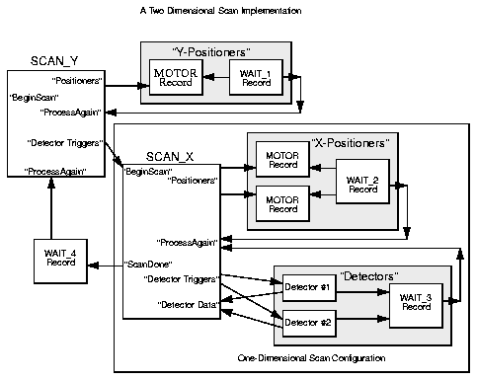
Like Scan Record?
Loop y=1..10: Loop x=1..5: Set “det_trigger”=1 with completion, Log “x.RBV”, “y.RBV”, “det_counts”
Monitor, pause, resume, abort. Save, edit, resubmit scans vs. save/restore scan records.
Add 3rd loop without rebooting IOC to add 3rd scan record
Queue multiple scans
Logs to RDB w/ REST readout. No MDA/XDR/Nexus.

Slide 9
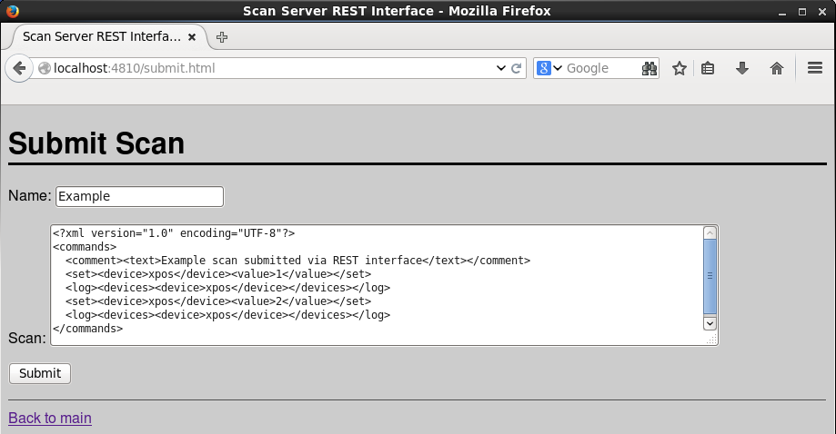
REST Interface

Slide 10
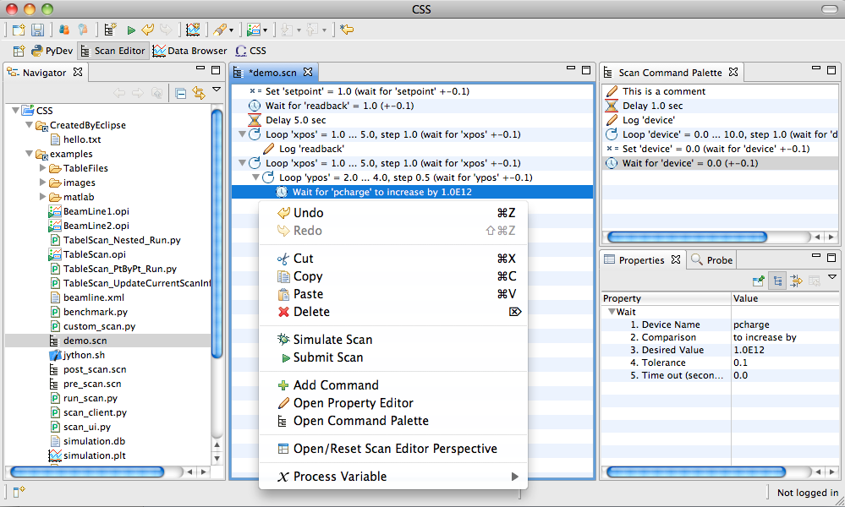
Scan Editor
Add commands
Open, save
Set parameters

Slide 11
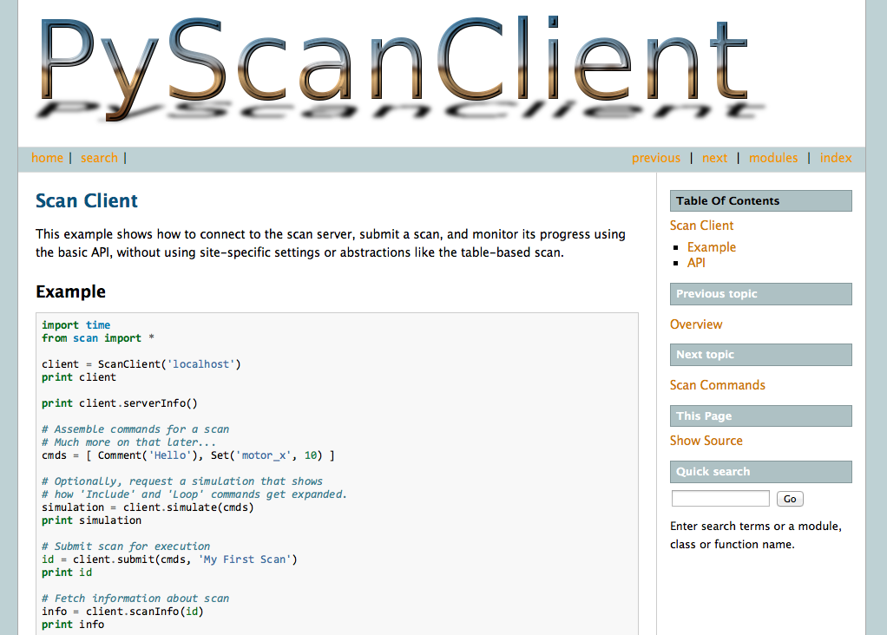
Python API

Slide 12
Site-Specific Settings
class BeamlineScanSettings(ScanSettings): def __init__(self): self.defineDeviceClass("chopper:.*", completion=True) self.defineDeviceClass("motor.*", completion=True, readback=True)
def getReadbackName(self, device_name): if "motor" in device_name: return device_name + ".RBV“ return device_name
“Set(‘x’, 42)” → Set(‘x’, 42’) “Set(‘motor_x’, 42)” → Set(‘motor_x’, 42, completion=True, readback=‘motor_x.RBV)

Slide 13
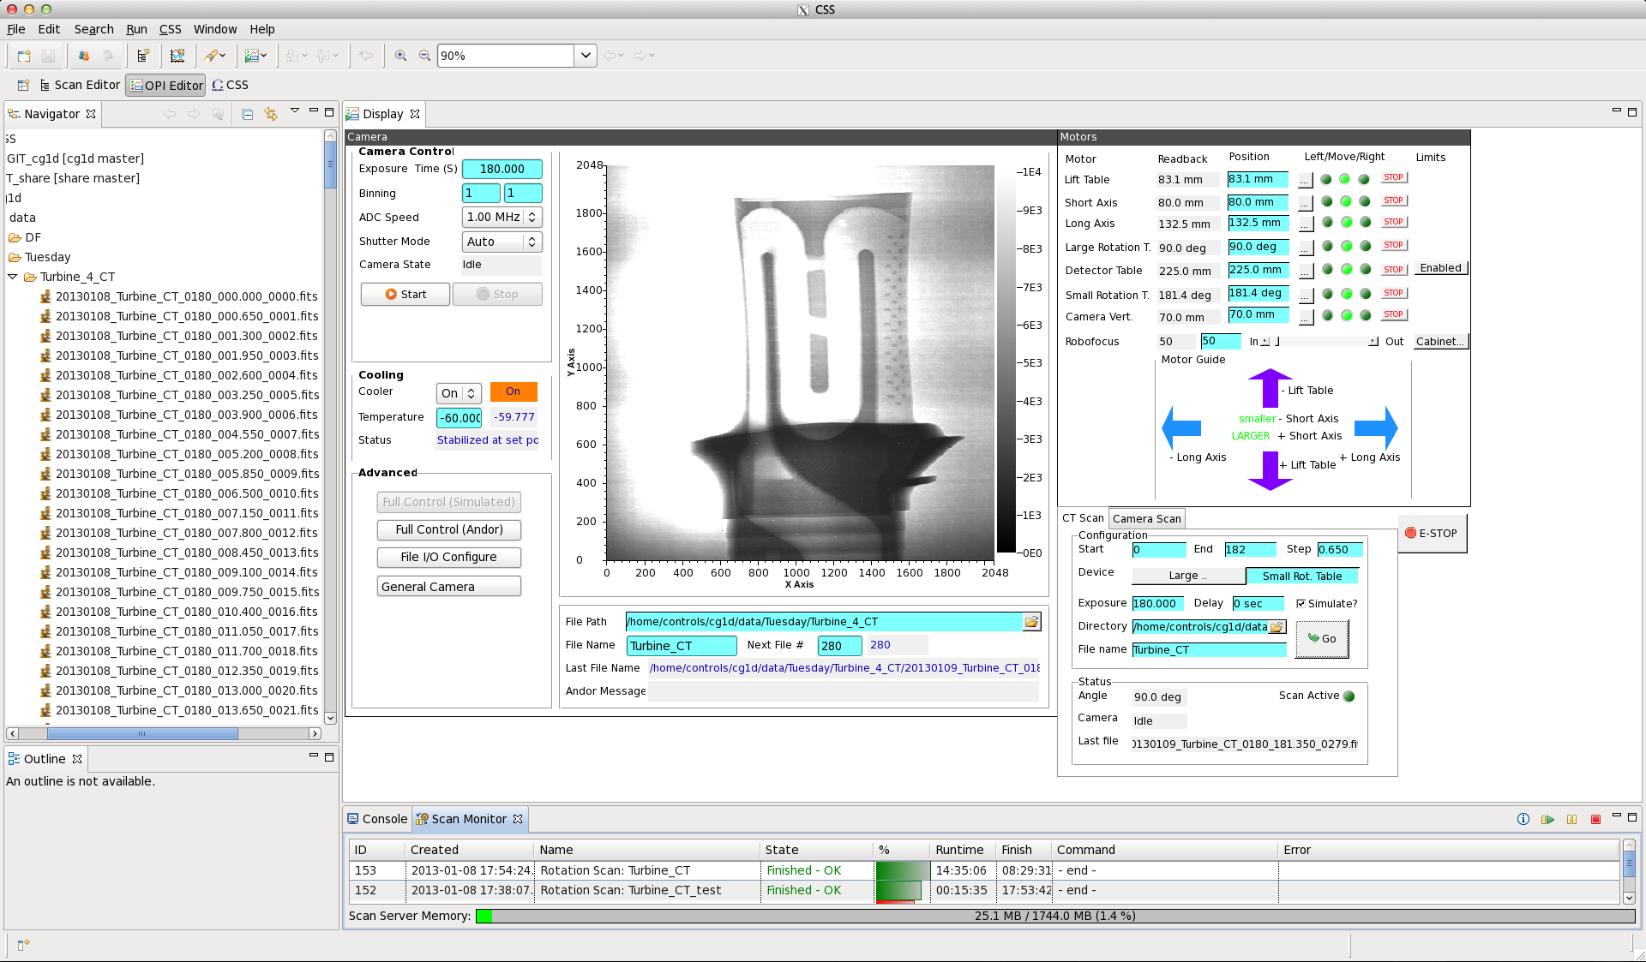
GUI for Routine Beam Line Task

Slide 14
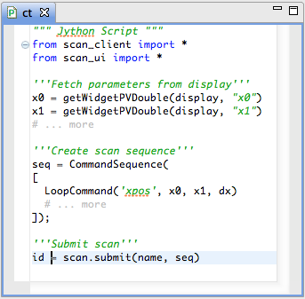
Under the hood
Scan Server

Slide 15
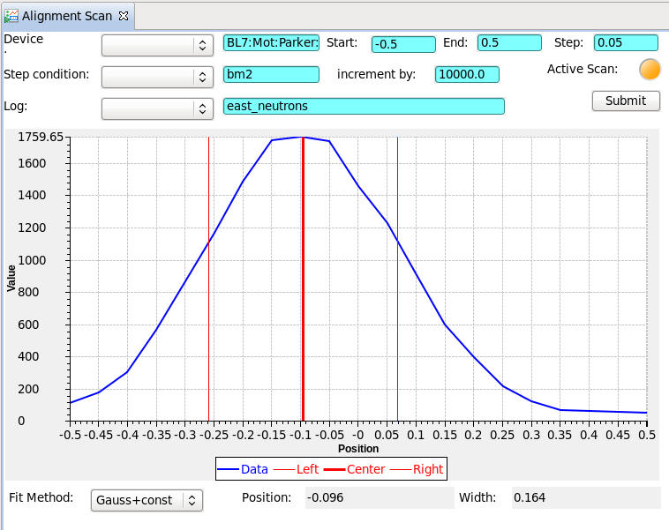
Alignment Scan

Slide 16
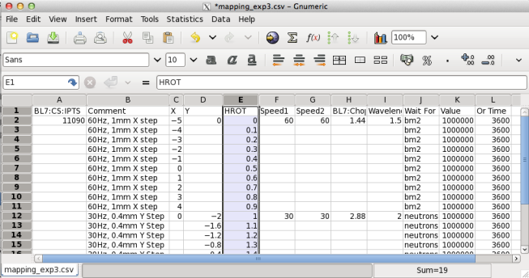
Table Scan
Load/save *.csv, *.xls

Slide 17
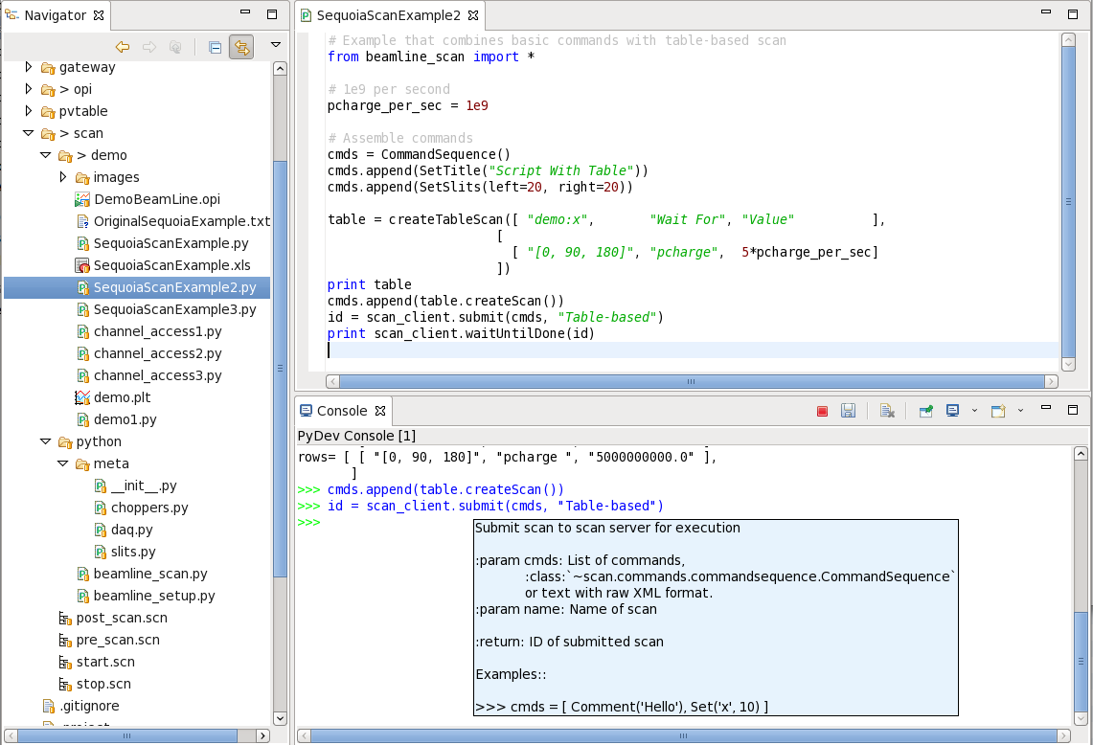
Scripted Scan

Slide 18
Parallel Command

Slide 19
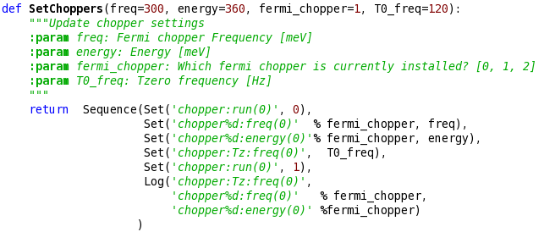
Sequence Command

Slide 20
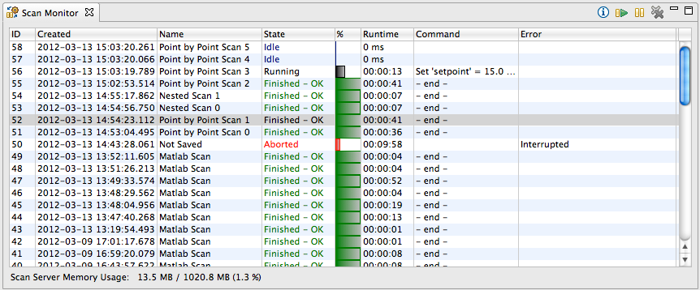
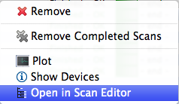
Scan Monitor

Slide 21
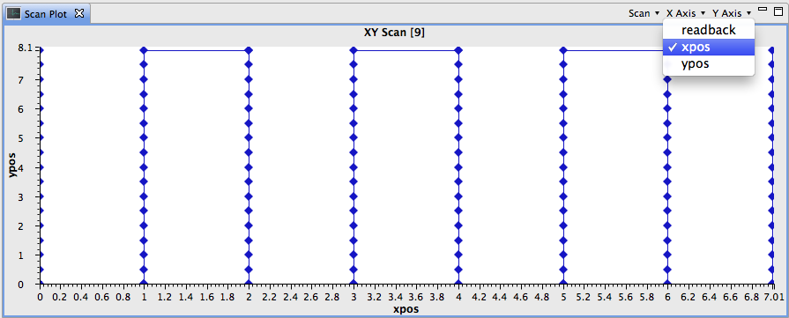
Scan Plot
Plot variables logged by scan
Get data from Running or Finished scans

Slide 22
Summary
Scan System helps automate SNS since 2013
Scan Server: REST instead of JNI
Python API: Pure Python instead of Jython
→Thanks to Qui Yongxiang, Guobao Shen, Dylan Maxwell
New Parallel & Sequence commands
Biggest Issue:
Can’t use numpy (Fortran) inside Script command (Jython)

