Slide 1
nED Overview
EPICS-based data acquisition and detectors control software
Greg Guyotte
Spallation Neutron Source
May 2015

Slide 2
Introduction to nED
neutron Event Distributor
  Basic Functions:
    Interface to custom hardware for detectors (OCC, DSP, FEM, ROC, etc.)
      Includes data acquisition, configuration, diagnostics, calibration
    Device support for heterogeneous detector systems:
      LPSD: Linear Position Sensing Device (He3 tubes)
      Scintillator
      Anger camera detector
      2D detectors

Slide 3
Introduction to nED
Designed to replace legacy ‘dcomserver’ software currently deployed at SNS beamlines
Why replace?
“All repairs tend to destroy the structure, to increase the entropy and disorder of the system. {…} more and more (effort) is spent on fixing flaws introduced by earlier fixes. Sooner or later the fixing ceases to gain any ground. {…} the system has worn out as a base for progress.”
Frederick P. Brooks, Jr. – The Mythical Man-Month

Slide 4
Introduction to nED
Or, put more simply:
“Things are always at their best in the beginning.”
Blaise Pascal

Slide 5
nED Capabilities / Requirements
Must handle 10 million “events” per second
  80MB/sec required by some beamlines
Run on Linux PC (RHEL 6, moving to RHEL 7)
Minimum hardware requirements
  Multi-core Linux PC, 4GB+ memory
    Typ. 12 cores, 128 GB memory as deployed

Slide 6
Architecture / Design
Design draws heavily from areaDetector
  Functionality is modularized into “plugins”
  Design goal: each plugin remains small and simple
    One data source and many destinations
  Similar to “Chain of Responsibility” design pattern
    Promotes loose coupling between plugin objects
      Receiver and sender unaware of each other and the overall structure
    Flexibility in assigning responsibilities to plugin objects
      Interconnection of plugins is defined in the IOC startup file (st.cmd)
      Allows nED config to be modified without changing source code!

Slide 7
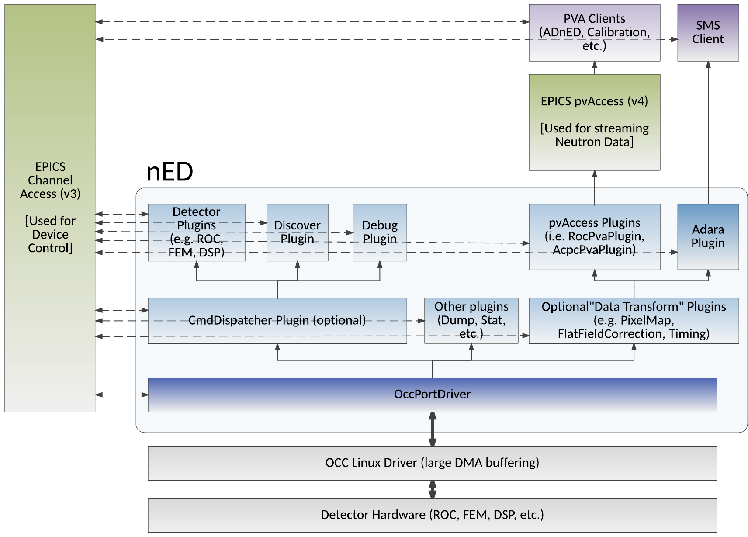
Architecture / Design

Slide 8
Notes on Performance
Goal: Minimize processing of neutron data
    Get the data to the network as fast as possible (‘zero copy’)
    Use large DMA buffer (256MB+) in Linux driver
Performance bounded by packet processing in the nED plugin layer
    Each plugin takes a reference to the DMA memory
      Once all plugins process the data, memory can be returned to DMA
    Tradeoff between expensive data transforms at the nED layer vs. higher level software
      nED throughput vs. client complexity

Slide 9
Use of EPICS v3 in nED
Plugins are all base classed from asynPortDriver and epicsThreadRunable
  Plugins can be configured to run in separate threads
Each plugin defines a record instance definition (loaded in st.cmd via dbLoadRecords)
  All detector device command and control accomplished via EPICS PV’s
  Supports the easy creation of control GUI’s using Control System Studio (CSS)
Leverage EPICS base features
  Build environment, signaling, timers, DB, etc.

Slide 10
Use of EPICS v4 in nED
Neutron data is processed through plugins that export data through EPICS v4 pvAccess
  Early example of successfully deployed EPICS v4
  EPICS v4 proving stable with good performance
PVA Client programs can then be written to monitor pvAccess channels and act on data
  CalibrationClient (uses pvaPy)
  ADnED (uses pvAccessCpp)
  Future: detector diagnostics

Slide 11
Active Deployments
VISION (chemical spectrometer) beamline at SNS
  Control and data acquisition from ~25 detector hardware units (ROC, FEM, DSP)
  Steady operation at ~40MB/sec, with headroom
  Only 2 hours downtime in current cycle, due to issue in detector firmware
USANS (ultra-small-angle neutron scattering instrument)
  Small number of detectors

Slide 12
Future Deployments
3 more beamlines by end of summer
  CORELLI
  HYSPEC
  SEQUOIA
1-2 beamlines in 2015/2016 winter outage
Eventually all SNS beamlines

