Slide 1
EPICS Integration of Raspberry Pi Monitoring System for simple applications and user trainings
Son, ChangWook
IBS, S.Korea
May 18. 2015 Michigan, USA
2
0
1/13
1
5

Slide 2
Contents
Brief introduction of raspberry pi
How to use and integrate into EPICS
Environment monitoring system
EPICS Training kit
5. Summary & Plan
2
0
2/13
1
5

Slide 3
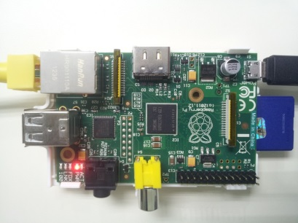
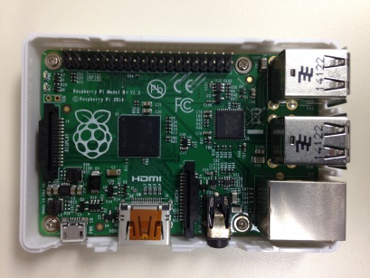
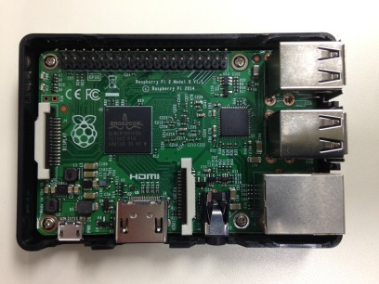
Raspberry Pi
 | Model B | Model B+ | Pi2
SoC | Broadcom BCM2835 | Broadcom BCM2835 | Broadcom BCM2836
CPU | 700 MHz ARM1176JZF-S Single Core |  | 900 Mhz ARM Cortex-A7 Quad Core
SDRAM | 512MB | 512MB | 1GB
External Memory | SD | Micro SD | Micro SD
Interface | GPIO, UART, I²C, SPI, I²S +3.3V, +5V
Power | 5V 700 mA (3.5 W) | 5V 600 mA (3.0 W) | 5V 800 mA (4.0 W)
OS | Raspbian, Google Chrome OS, Windows 10 (Pi2)
Library | wiringPi, BCM2835, pigpio, Python, Ruby, Perl, Java
Cost | $35 | $35 | $35
2
0
3/13
1
5

Slide 4
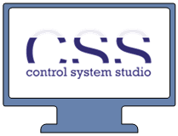
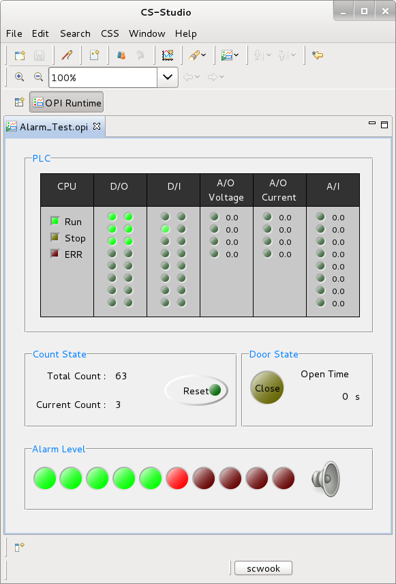
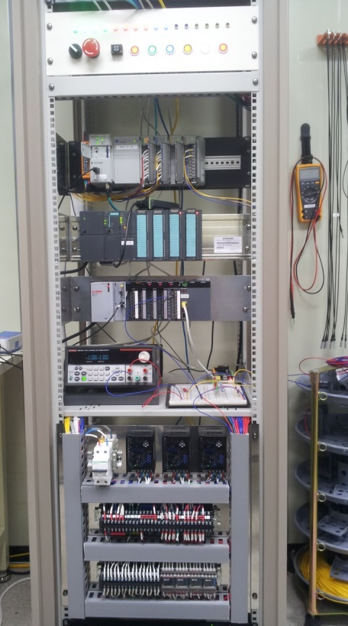
How to use
IOC
(Raspberry Pi)
Ethernet
PLC Test System
RPi
OPI
Controller (PLC)
Sensors
2
0
4/13
1
5

Slide 5
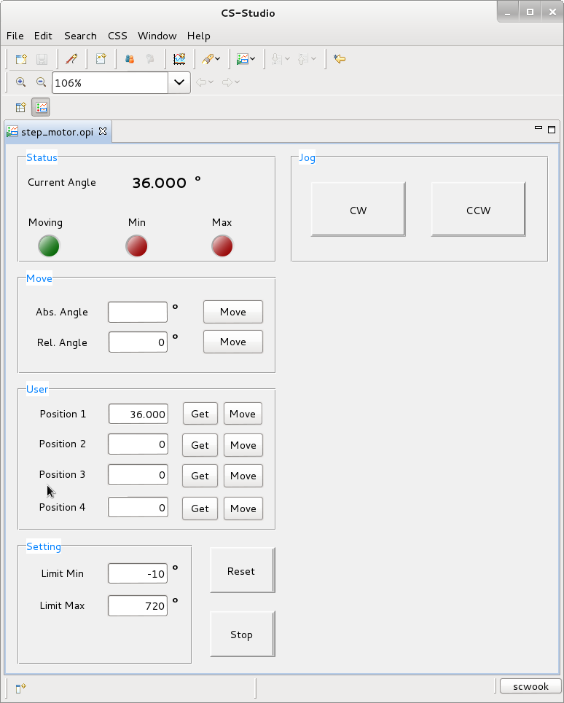
How to use
Ethernet
Step Motor Test
OPI
IOC
(Raspberry Pi)
Driver
Motor
2
0
5/13
1
5

Slide 6
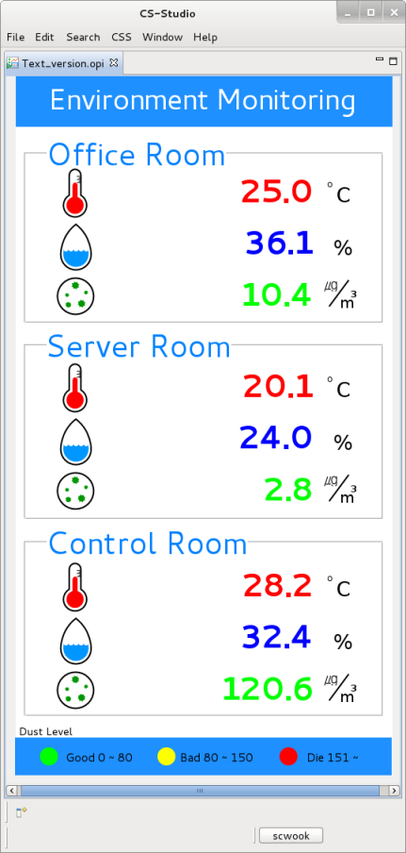
How to use
Ethernet
IOC
(Raspberry Pi)
Raspberry Pi
T&H
Sensor
Camera
Sensors
Dust
Sensor
2
0
6/13
1
5

Slide 7
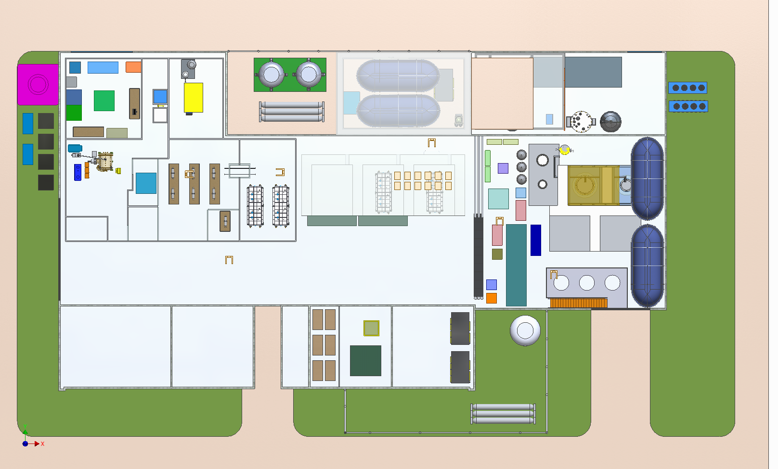
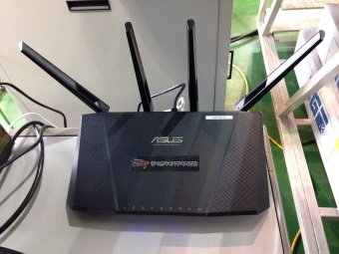
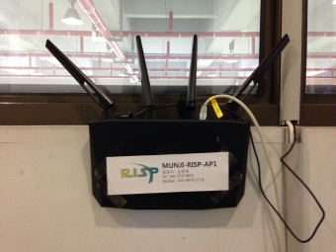
Environment Monitoring System
- In order to Monitoring of Temperature and Dust
- Three Raspberry pi is installed in SRF Test Facility
- Two routers have configured for network
Pi1
ECRIS
Pi2
Pi0
RFQ
Wireless
Bridge
2
0
7/13
1
5

Slide 8
Environment Monitoring System
- Channel data is archived -> archiver appliance
- Retrieve & Save to text data -> Python script
- Convert to graph -> jQuery
Web Browser
IOC
(Pi0)
Server(Debian wheezy 64bit)
jQuery
Archiver
Appliance
Data
Python script
IOC
(Pi1)
Web Server
IOC
(Pi2)
2
0
8/13
1
5

Slide 9
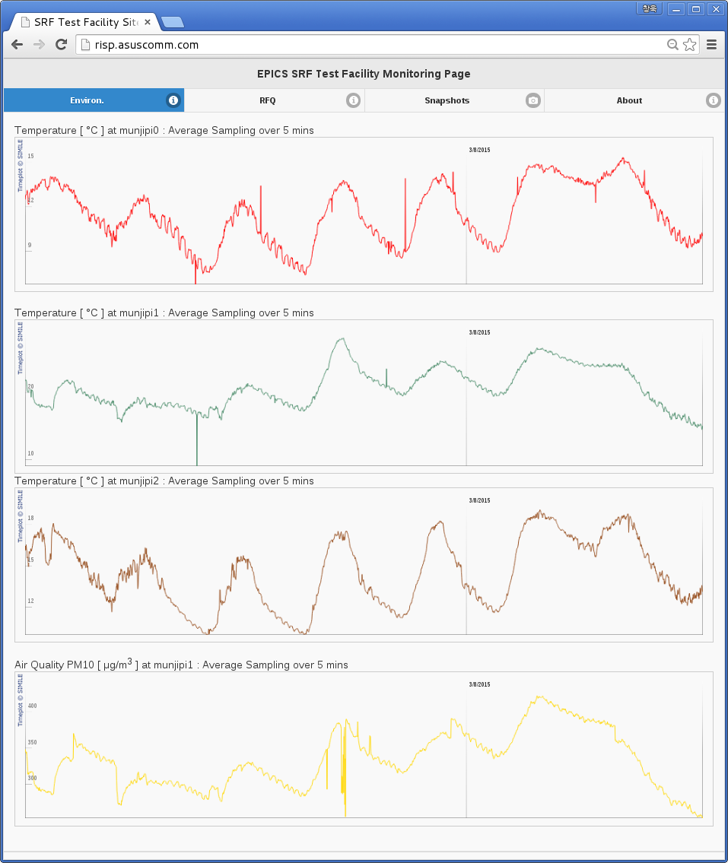
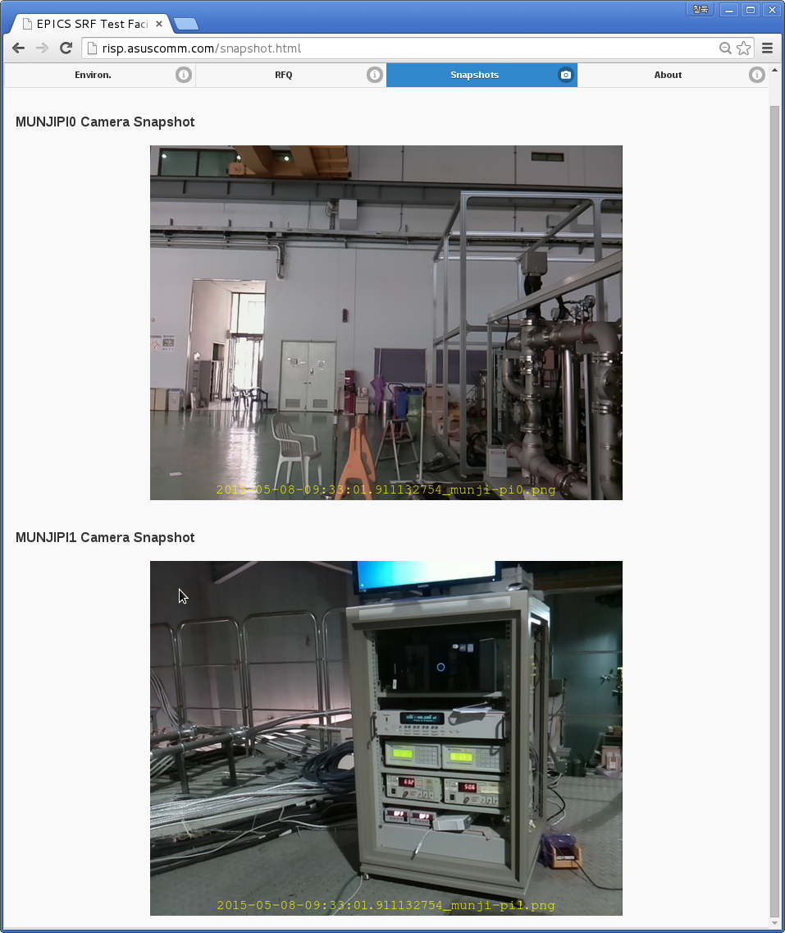
Web Interface
Pi0 Camera
Pi0 Tem.
Pi1 Tem.
Pi2 Tem.
Pi1 Camera
Pi1 Dust
7 Days
5 min. interval snapshot
2
0
9/13
1
5

Slide 10
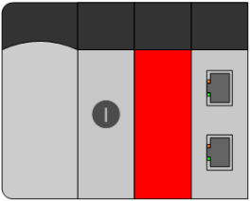
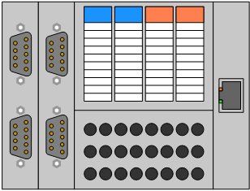
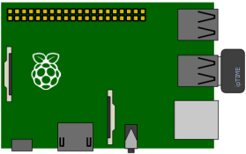
EPICS Training Kit
Propose
- For education and EPICS starter user
- For easy approach
High Cost & Complicated
Low Cost & Simple
2
0
10/13
1
5

Slide 11
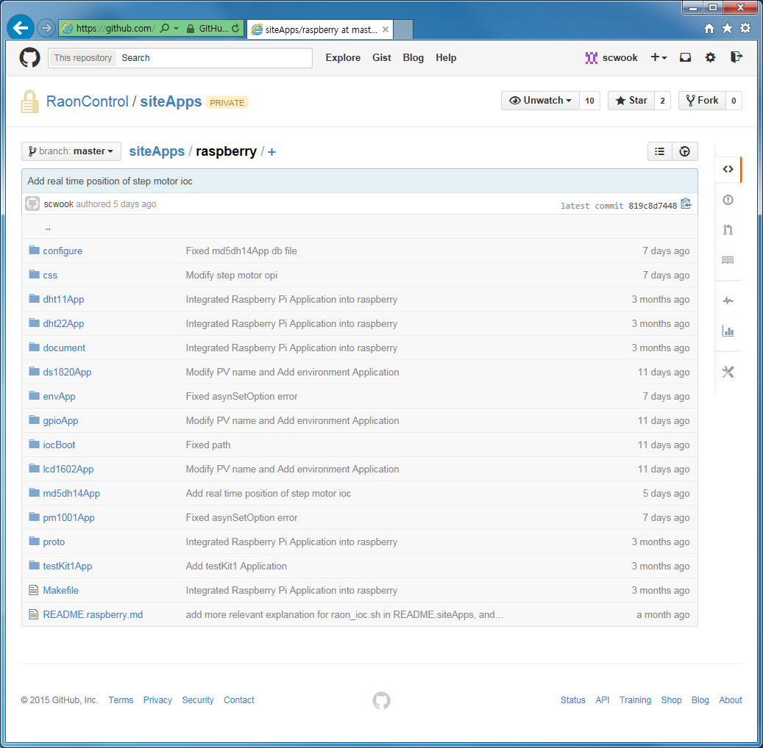
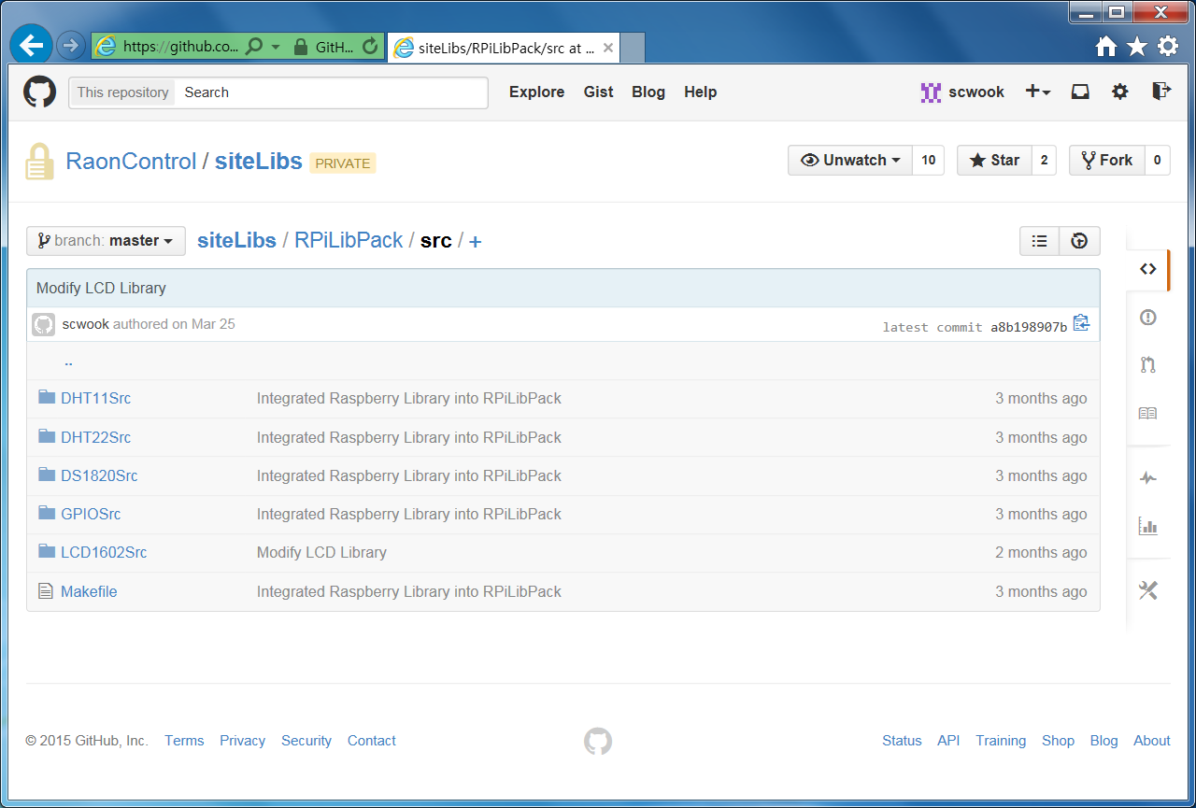
EPICS Training Kit
Support Library & Applications
https://github.com/RaonControl -> Private
Will be open to the public
Applications
Support Library
2
0
11/13
1
5

Slide 12
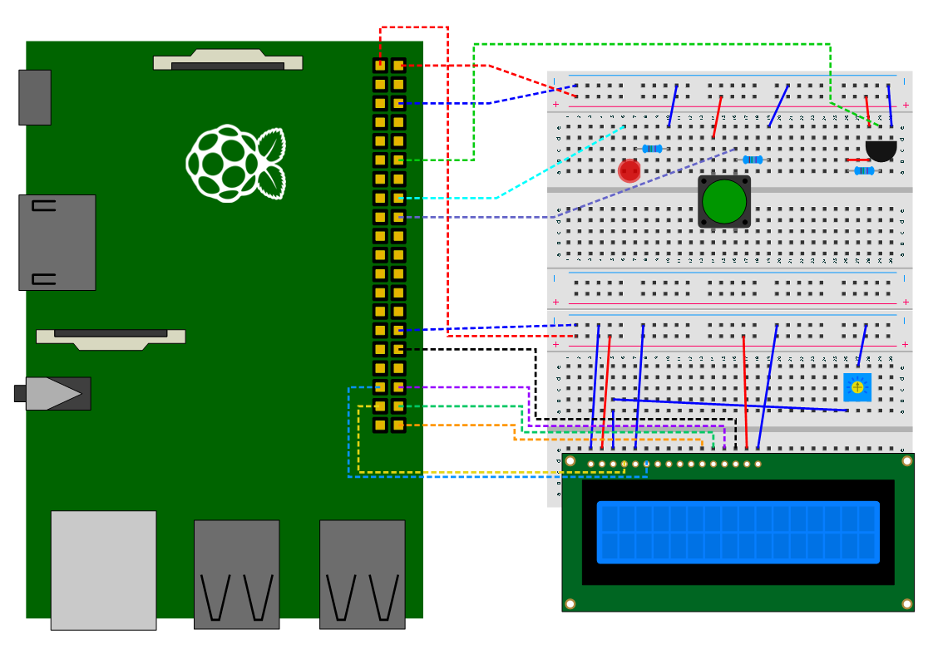
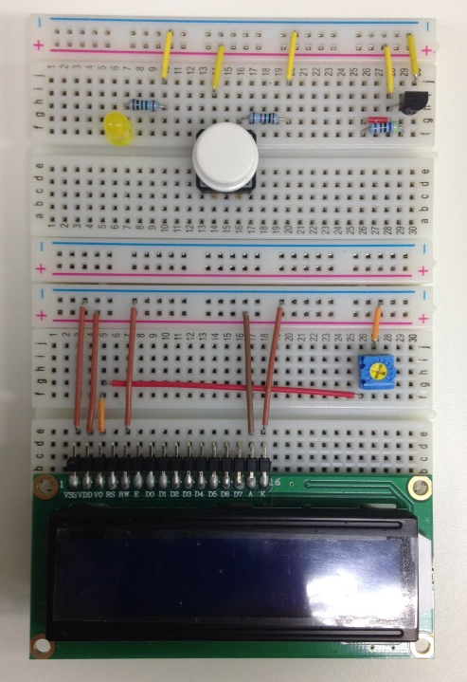
EPICS Training Kit
Temperature
Sensor
LED
Button
Character LCD
2
0
12/13
1
5

Slide 13
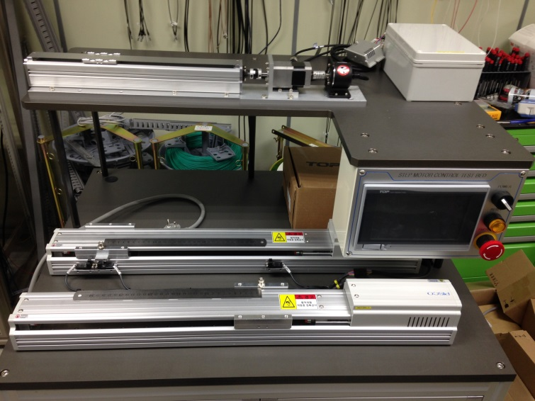
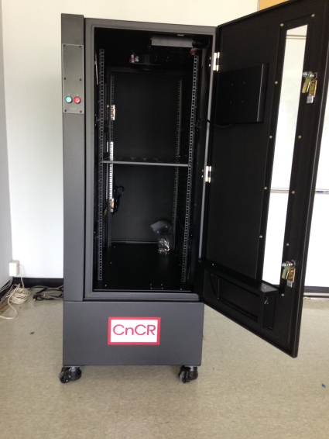
Summary & Plan
Summary
Various Raspberry pi application test is done
Environment Monitoring System is working
Plan
Reliability Test for Step Motor with test bed system
Temperature distribution test of Cooling Rack
Make a all-in-one case with 3D printer
2
0
13/13
1
5

