Slide 1
Hour Log: System for Facility Status
Vasu Vuppala, FRIB/NSCL
May 20, 2015

Slide 2
What does it do?
Manages Facility Status
  Experiment, Source, Vault, Breakdowns, Beams
  Shift Information
Integrates with External Systems
  Approved Experiments
  Trouble Reports
  Training System
  Olog Service
Provides API
  DataU Displays
  Hallway Displays
DISCS Operation Domain

Slide 3
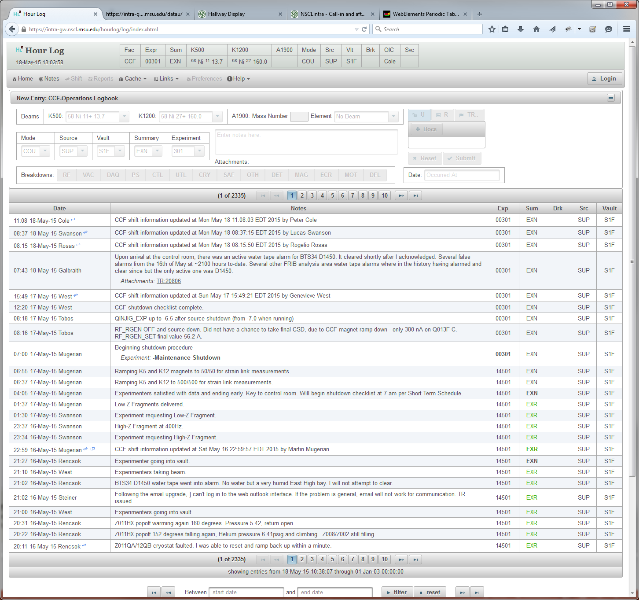
Notes, Status, Shift

Slide 4
Dashboard

Slide 5
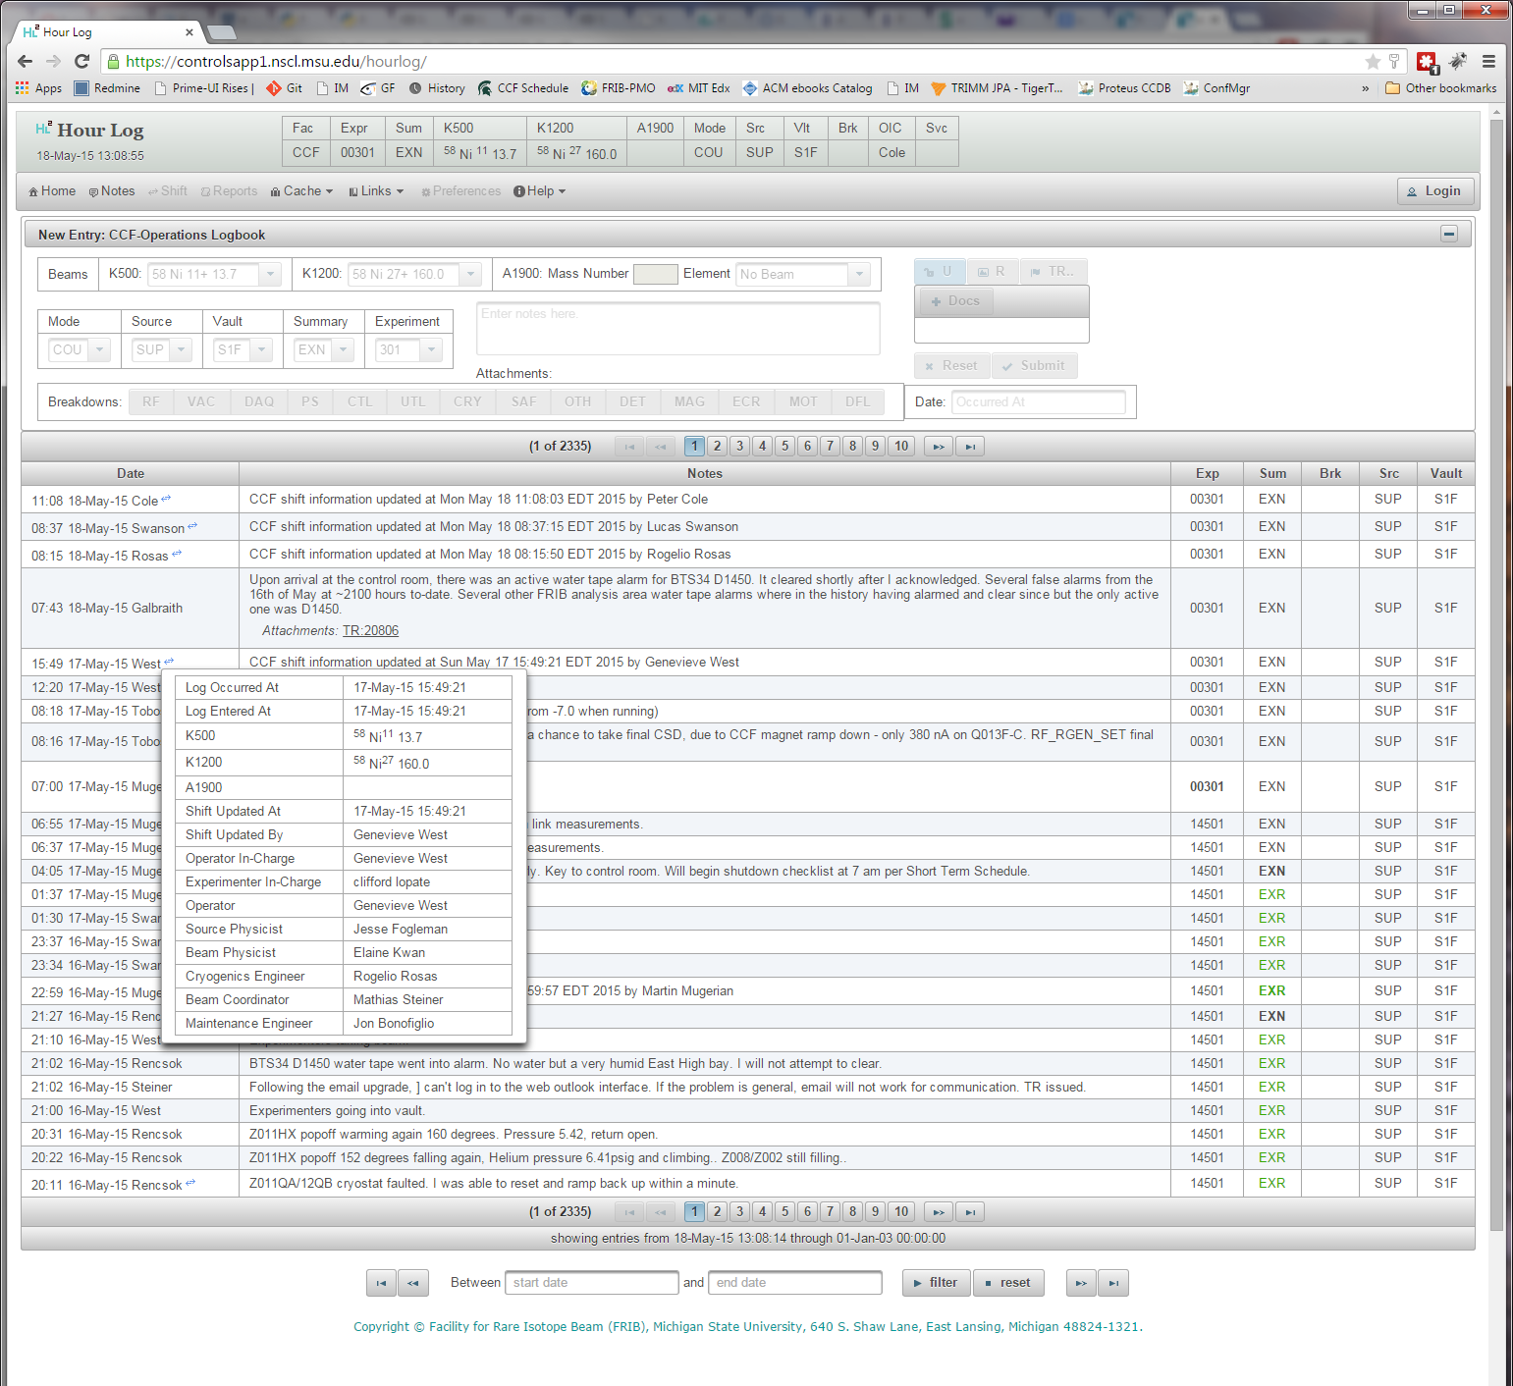
Shift Information

Slide 6
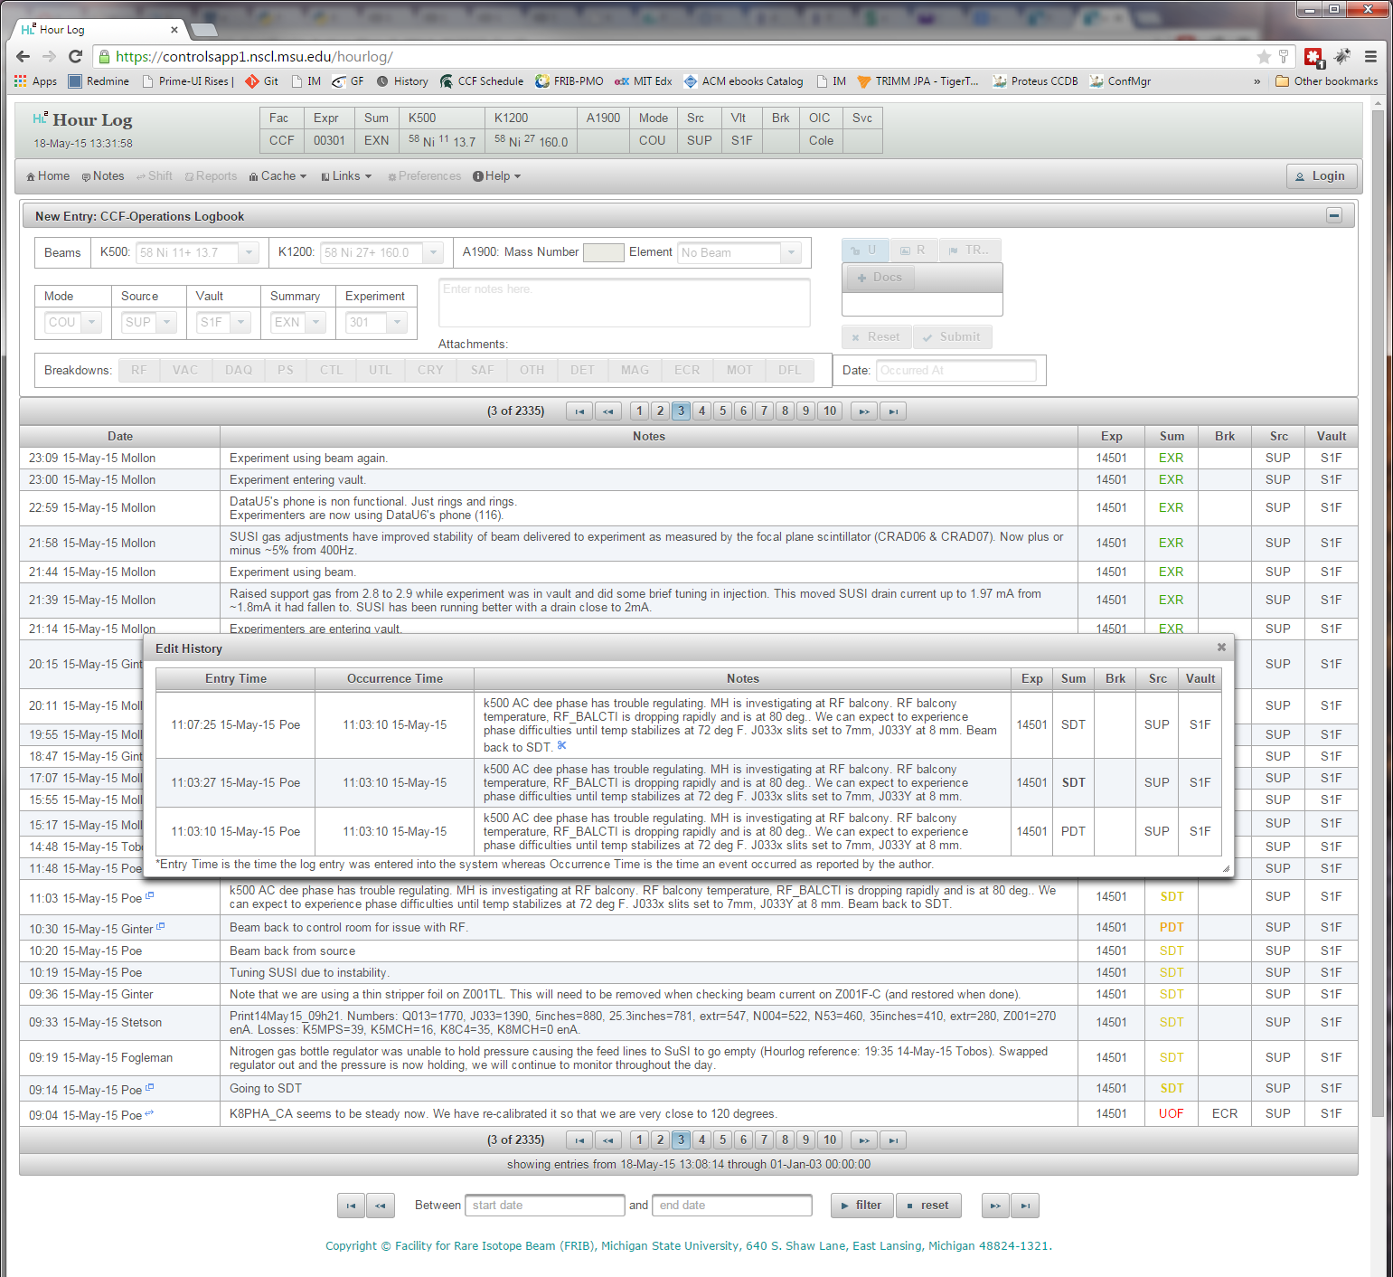
Notes History

Slide 7
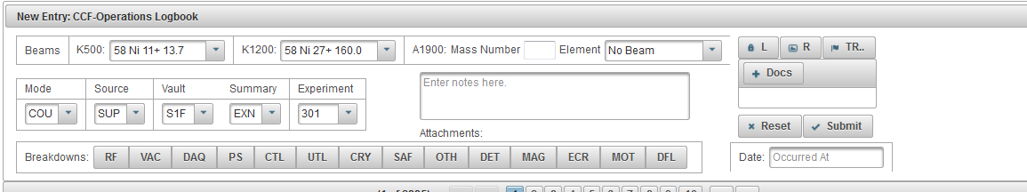
New Status

Slide 8
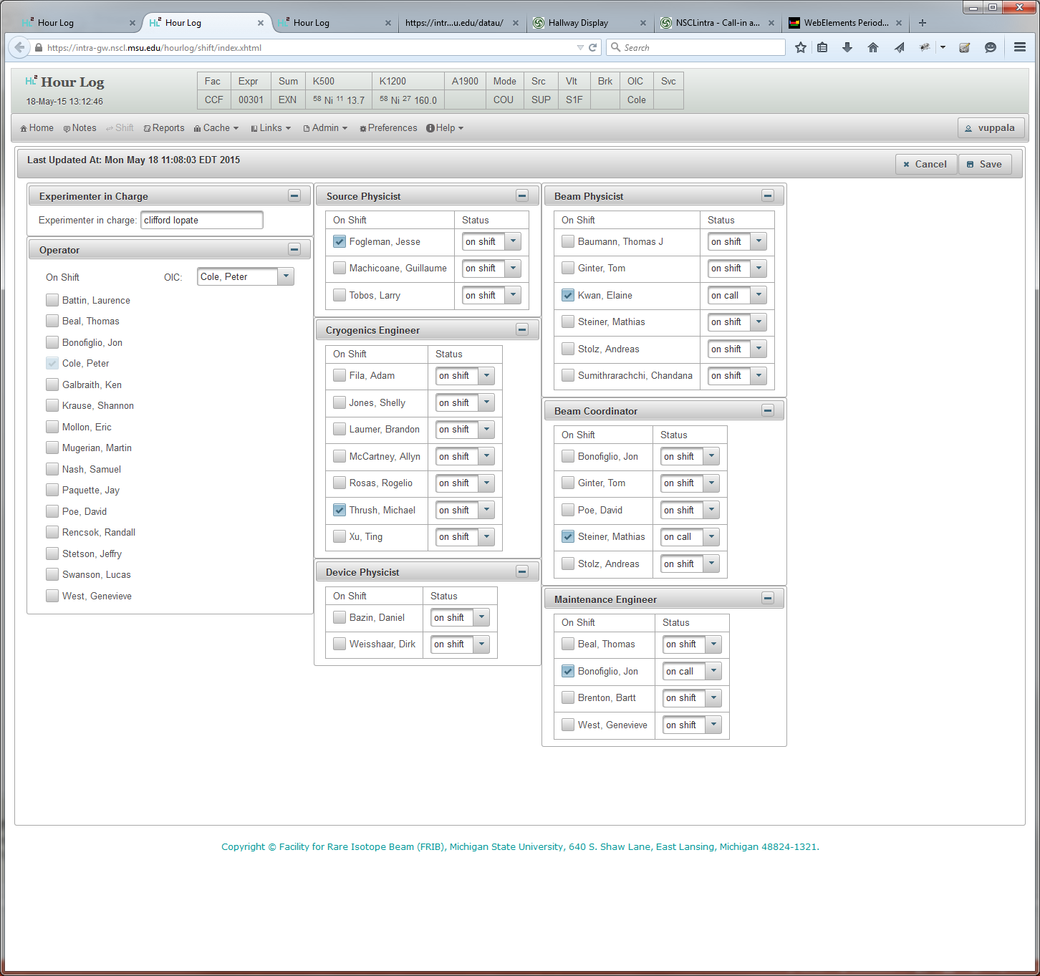
Shift Change

Slide 9
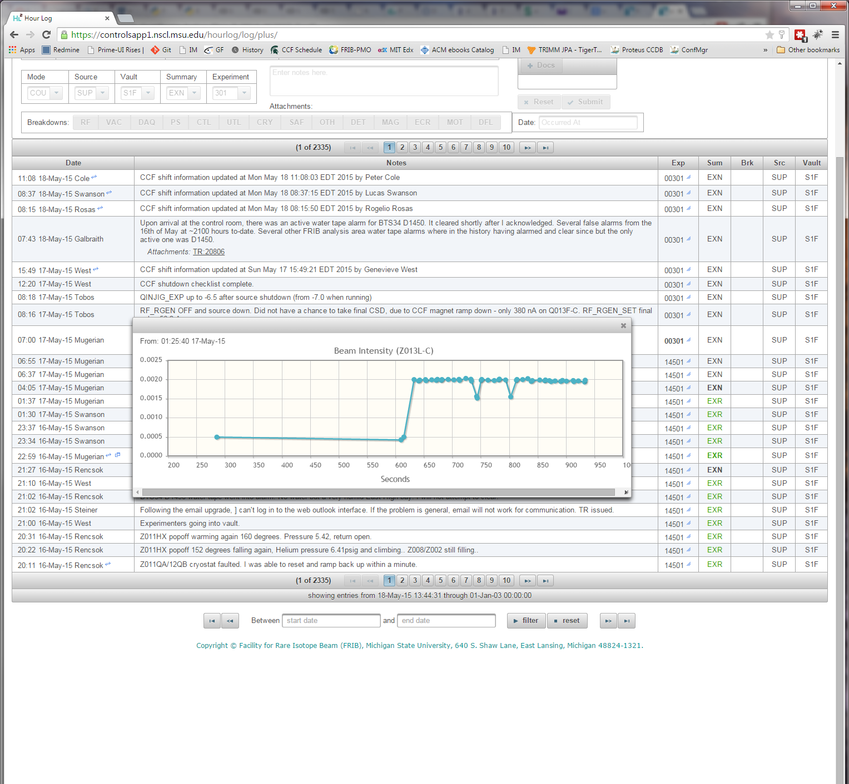
Archived State

Slide 10
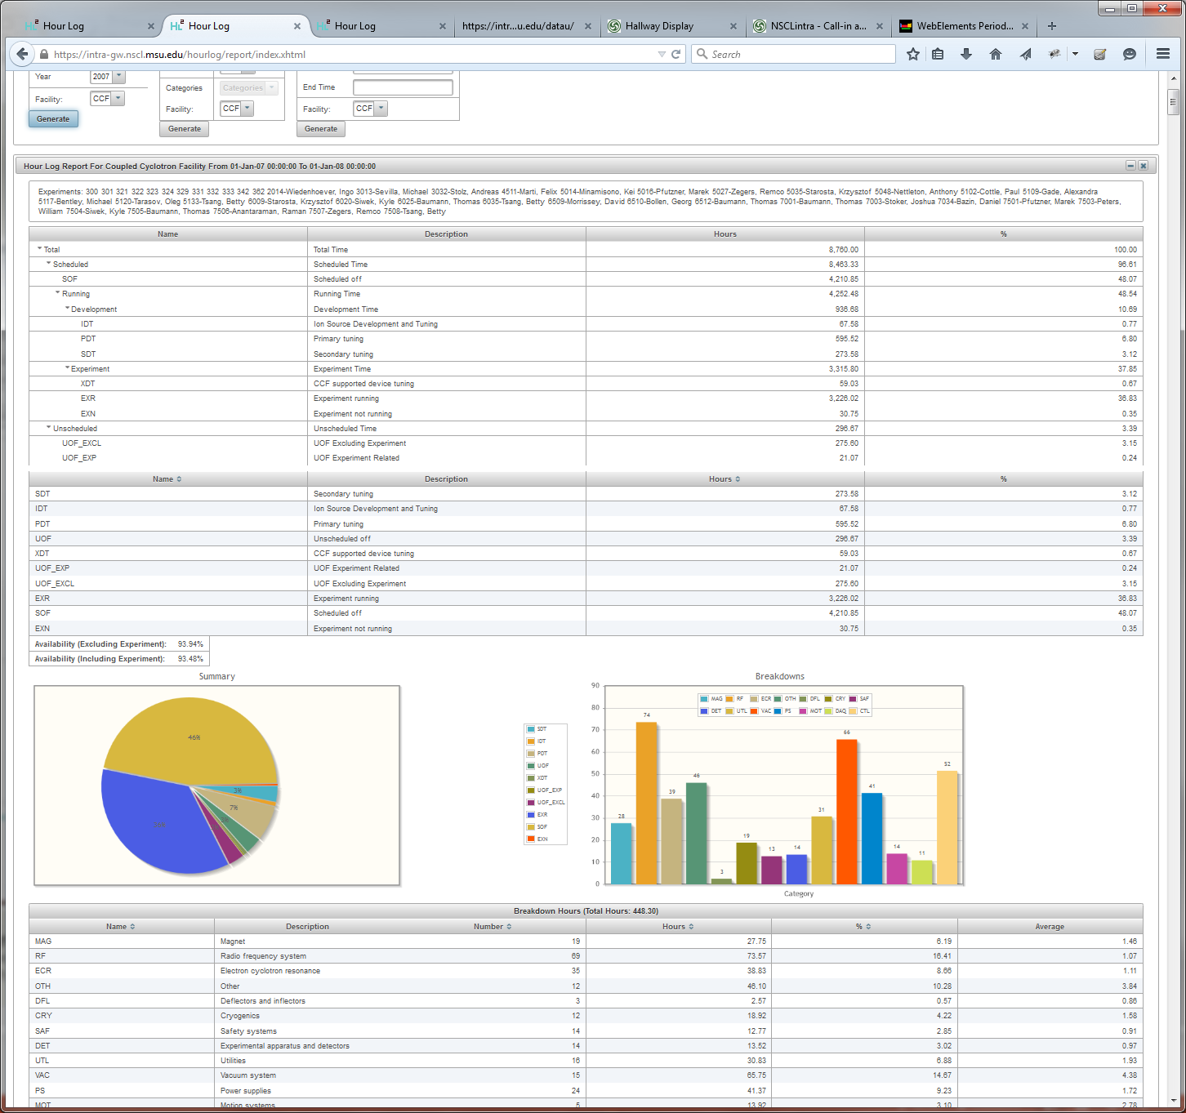
Status Report

Slide 11
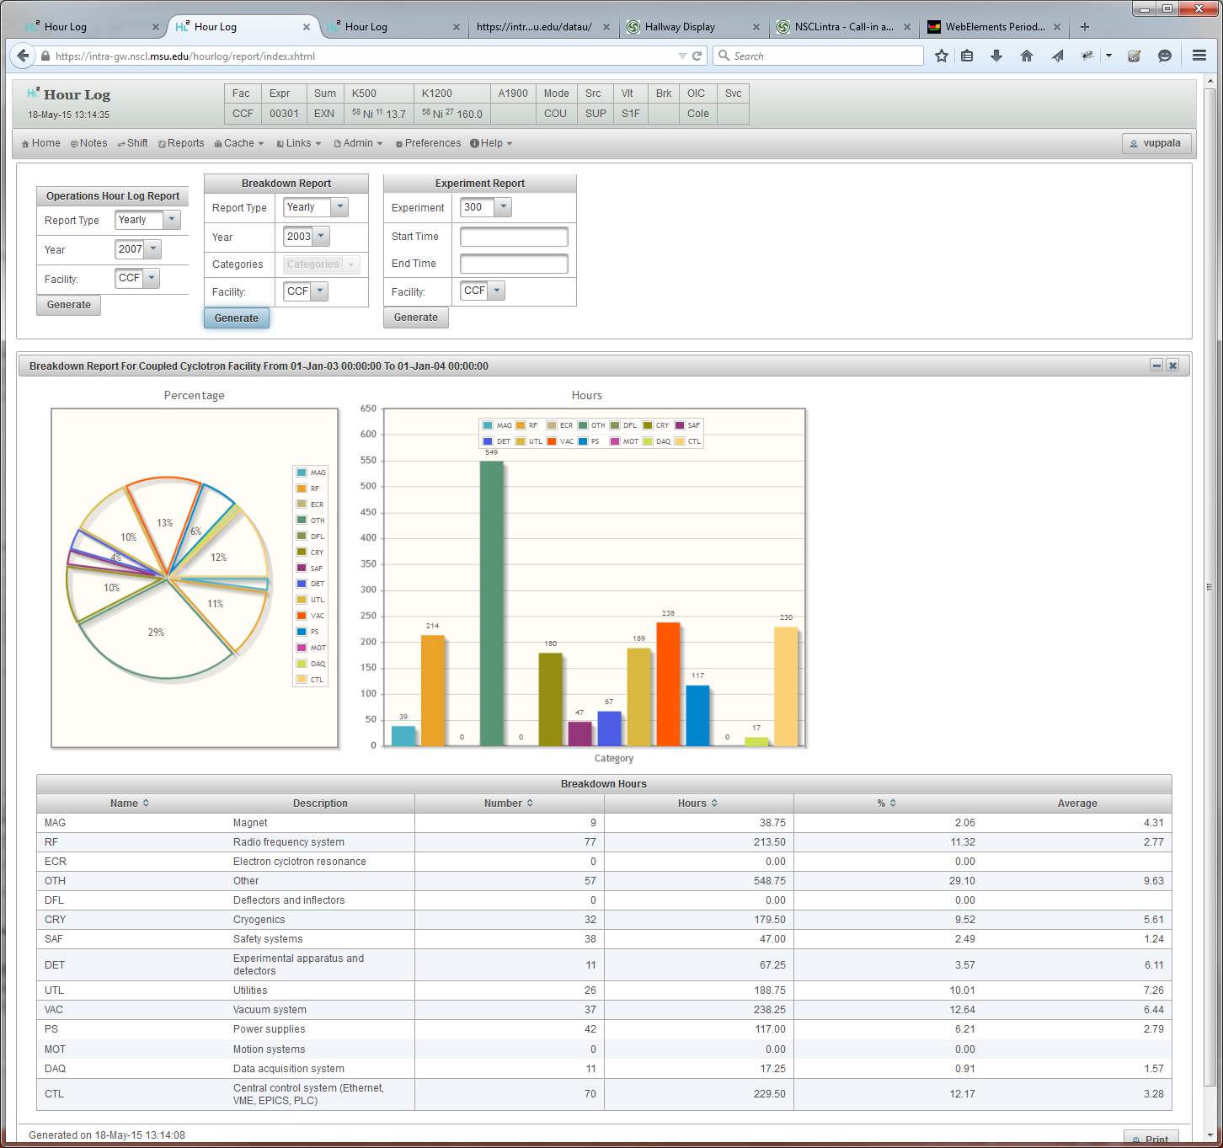
Breakdown Report

Slide 12
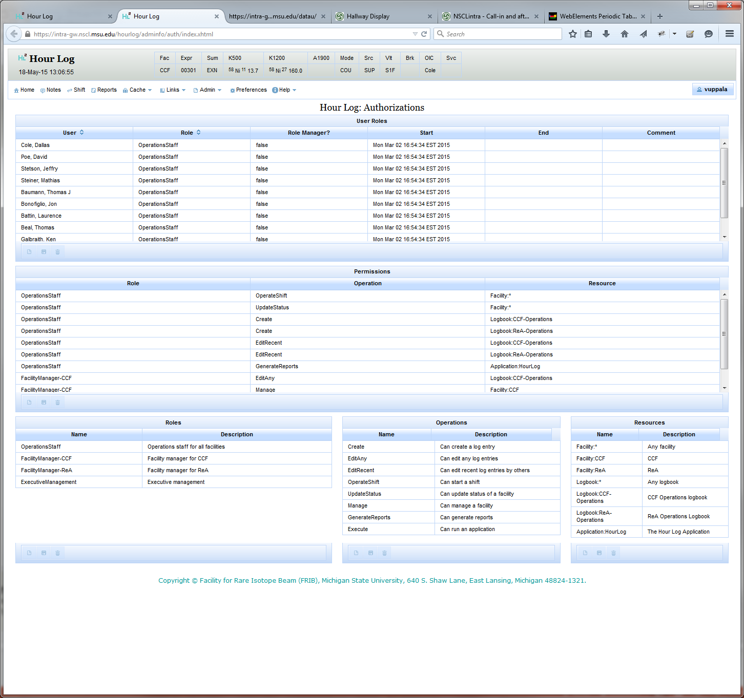
Security

Slide 13
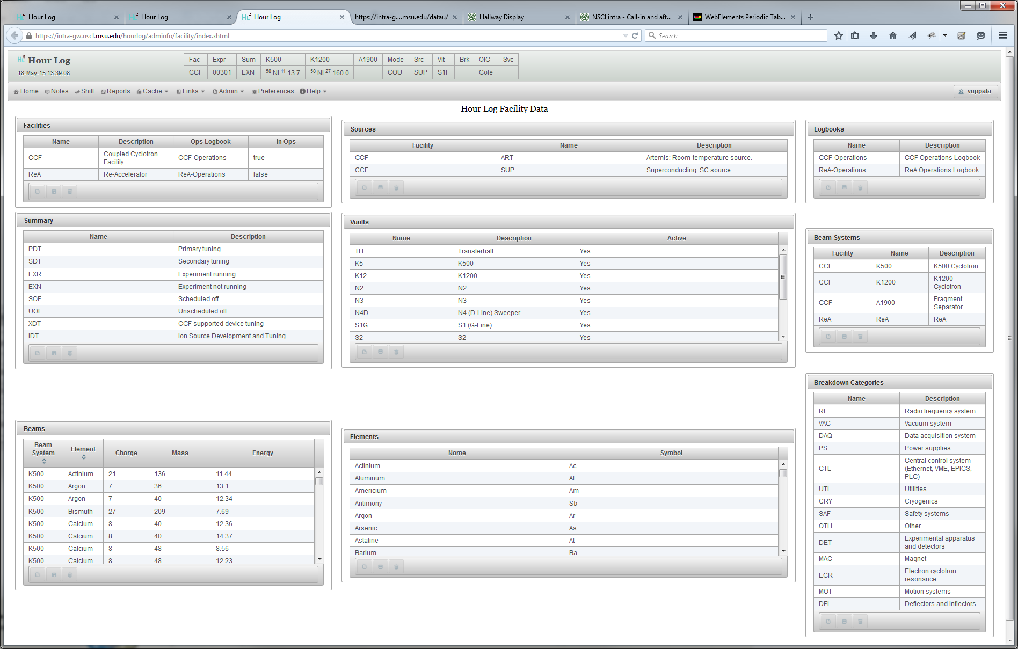
Facility Information

Slide 14
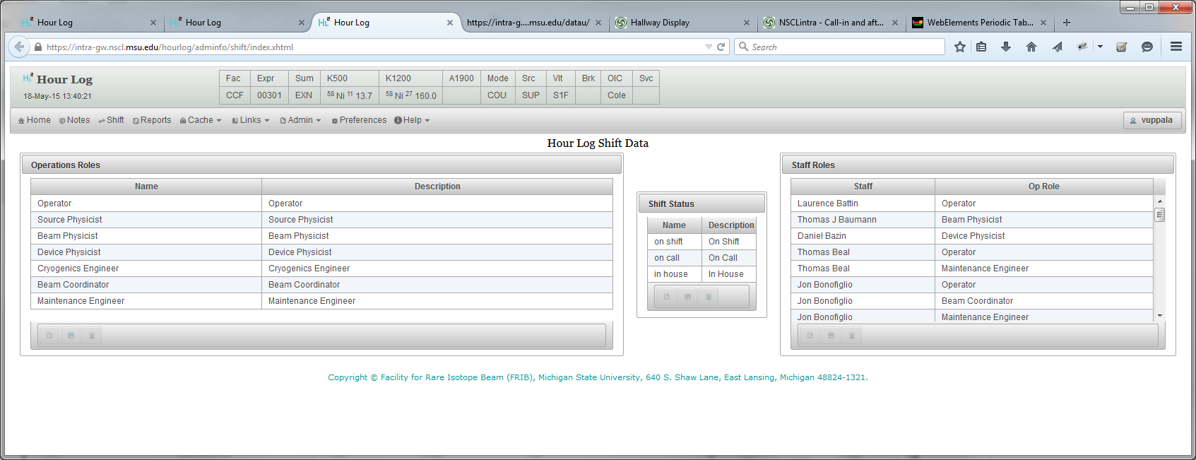
Staff Information

Slide 15
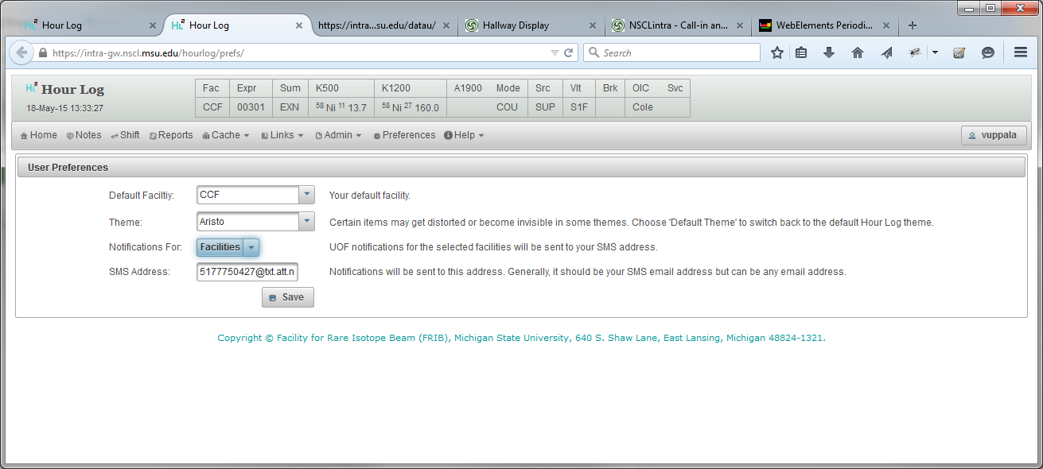
Notifications

Slide 16
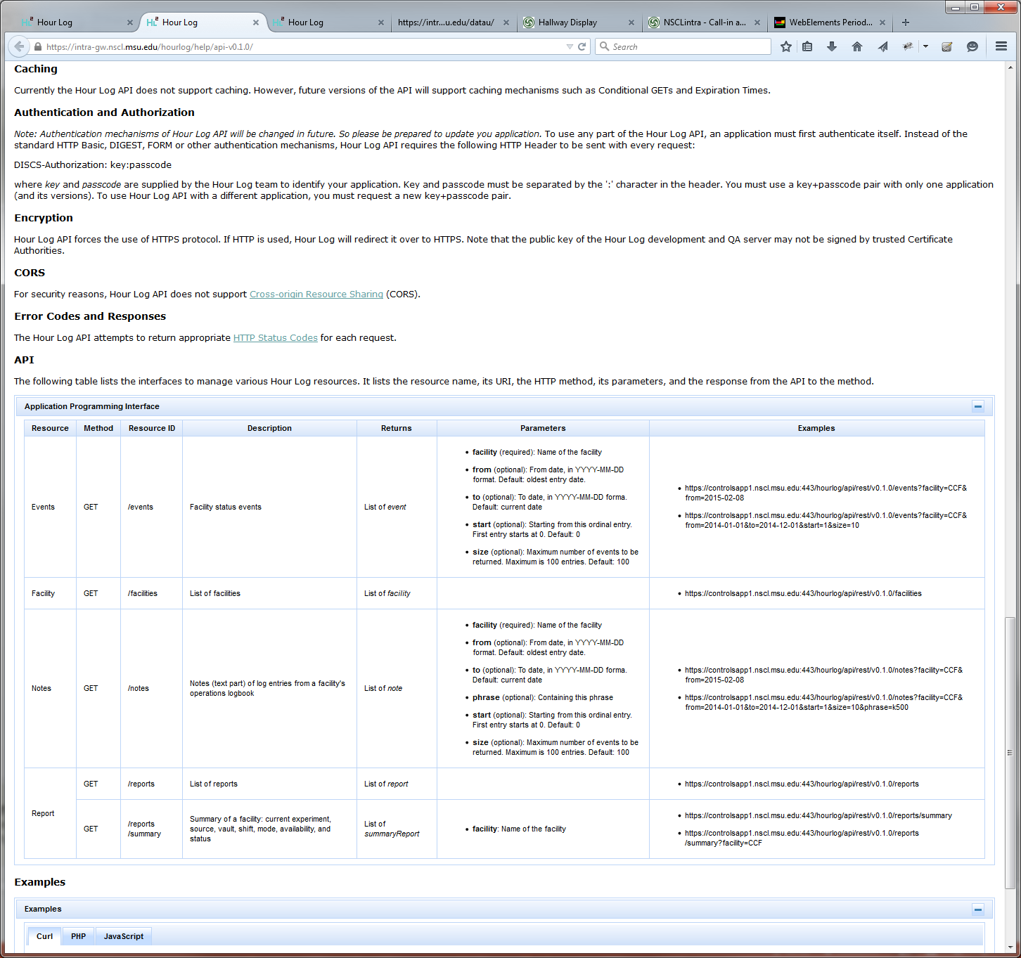
API

Slide 17
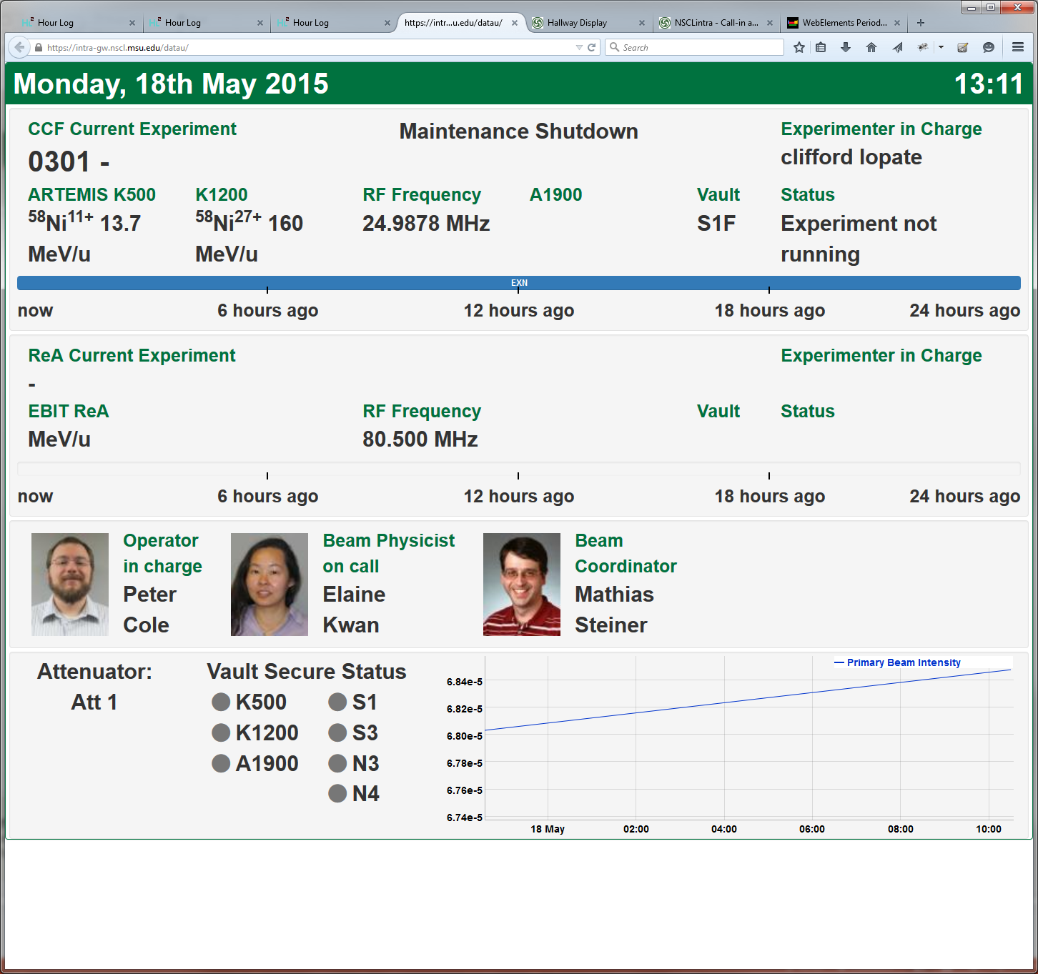
DataU Display

Slide 18
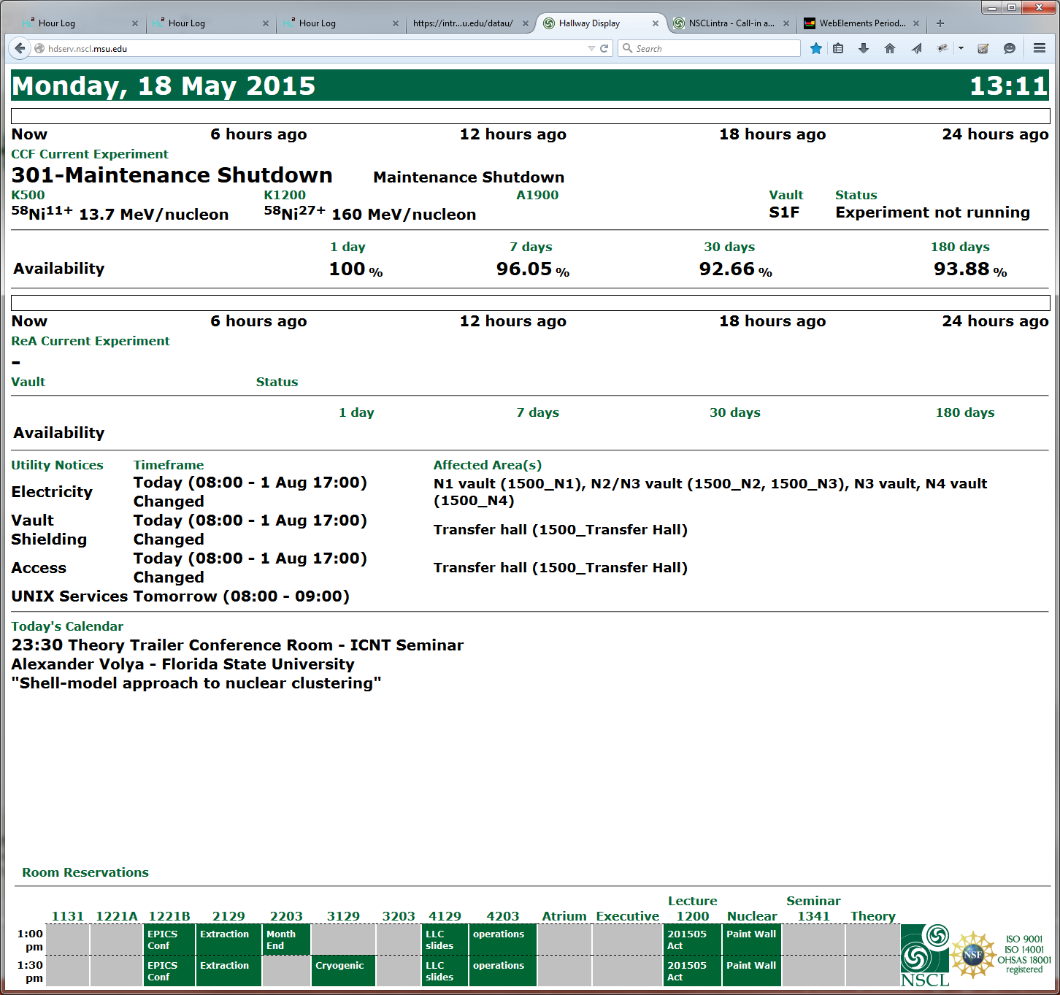
Hallway Display

Slide 19
Architecture
Trouble Reports
Approved Experiments
Training
Archiver Appliance
Hour Log
Facility Status
Olog
DataU Display
Hallway Display
Call-In List
….

Slide 20
The Problem: Status Snapshot
UOF
Down
Down
Snapshot
Up
17040
Up
EXR
Time
Up
SOF
S1
00301
Up
Down
90803
S2
Down
Down
EXR
RF
VAC
CTL
Experiment
Summary
Source

Slide 21
Current Status
In Production at NSCL Since March 2015
Integration of ReA (Re-Accelerator Facility)
New version to be released end of this month

