Slide 1
NSLS-II Data Management Framework
Arman Arkilic
Brookhaven National Lab
EPICS 2015 Collaboration Meeting-FRIB

Slide 2
Overview
History
Tools Utilized
Architecture
Current Implementation
Performance
Future

Slide 3
History
As of Summer 2014, there was no way to manage experimental data for most beamlines
When benchmarked the existing analysis code, the bottleneck was file I/O
In order to tackle the issue, molded existing SQL databases into complex systems for managing experimental data
Hit a wall due to choice of technology: Flexibility in SQL comes at a performance cost and complicated code maintanance
Decided to explore new “big data” technologies

Slide 4
History
The big data technologies suffered from scalability issues(Not enough data in the short term)
For most beamlines, a lot of small, scattered data that is not technically big data
Data is unstructured, semi-structured, and structured…
Attempted to tackle unstructured and image data first

Slide 5
Tools Utilized
MongoDB: Because it is really flexible, fast, and has decent Python support for prototyping and initial data analysis goals
Python— Open source and in-house expertise
EPICS Infrastructure
Various open-source Python libraries

Slide 6
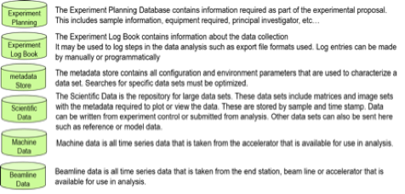
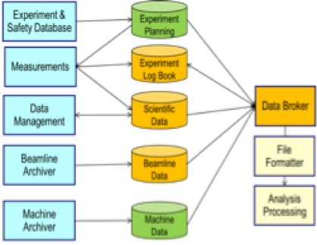
Architecture

Slide 7
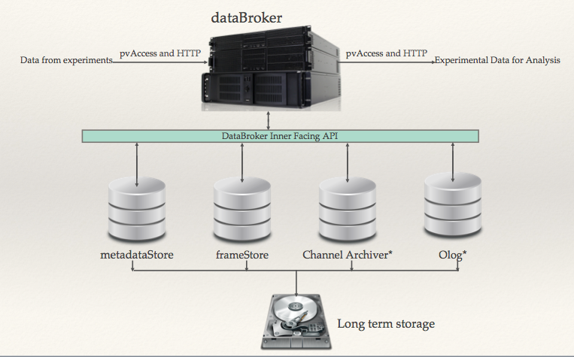
Architecture

Slide 8
Current State of Implementation
metadatastore v1.0 — Python library
mdservicehttp v0.1 — HTTP1 service based on Python library with Cherrypy backend (nginx work in progress in case of performance bottleneck)
pyOlog v1.1 — RESTful interface (Kunal Shroff and Eric Berryman)
ChannelArchiver— Archiver Appliance API(Murali Shankar, Michael Davidsaver) not yet added to the framework because scientists don’t know what to do with archived data yet…
filestore v1.0— Python library
databroker— Python library

Slide 9
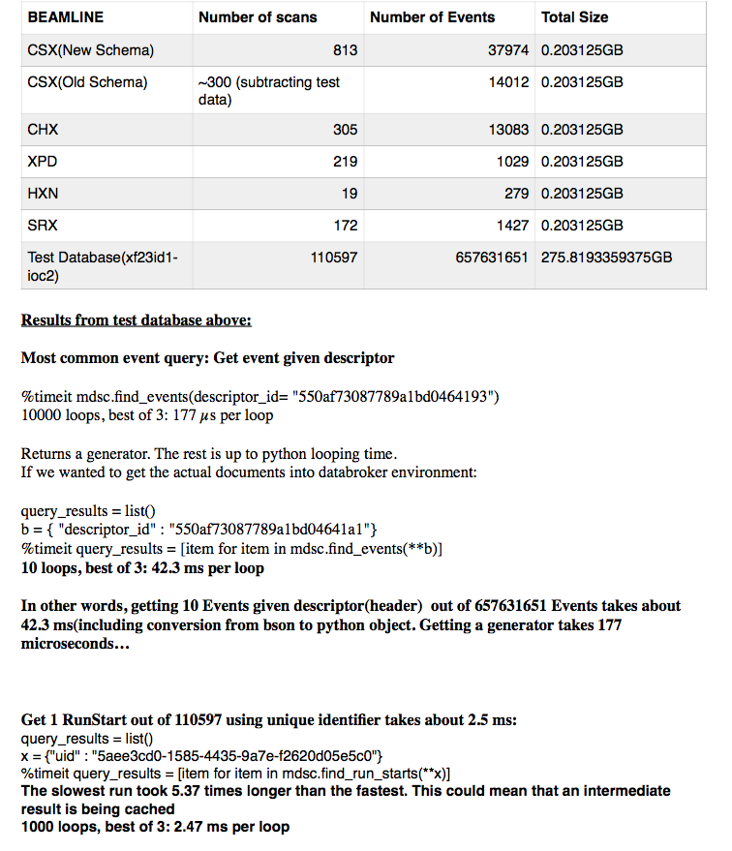
Performance
metadatastore scales to half a billion entries in a single node(our test) and outperforms the prior data management system by 6 orders of magnitude

Slide 10
Future
Libraries are fine but we need services!
EPICS v4
More performance analysis as more users become involved
Provide support for more languages down the road
Possible changes to architecture…

