Slide 1
Ophyd: Software for Data Collection, Management, and Analysis
Daron Chabot, Arman Arkilic
EPICS Collaboration Meeting
May 2015

Slide 2
Outline
Main Ideas & Design Principles
Architecture Components
Data Collection, Storage, & Retrieval
Focus here will be Data Collection oriented
Current Status & ToDo List

Slide 3
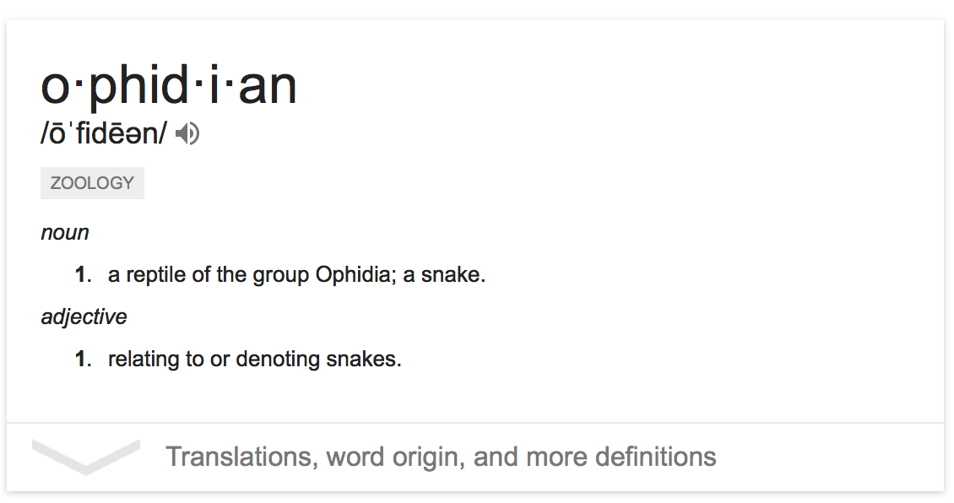
What the H#&% is Ophyd?
“A python framework for data collection, management, and analysis”
Originally, “ophyd” was a reference to only the data collection component
For better or worse, it seems to have become an umbrella term, encompassing all components…
Notes:
We all know that it is frowned upon by pythonistas to have a project whose name does not contain a “p” and a “y”.

Slide 4
Principles & Concepts
Holistic Approach
Problem space includes data acquisition, storage, retrieval, and analysis
The solution space must cover all of these
Framework Based
Permits flexibility and customization
Content Based data access
Not file based
Above all, support improvisation & exploration

Slide 5
Architectural Components
Notes:
Explain data flow, from collection, to DataPortal, to FileStore and MetadataStore, and back out to the clients.

Slide 6
Data Flow
Data dicts produced by Ophyd are consumed by clients: MetadataStore and FileStore
Other consumers include Olog, console formatters (stdout), analysis & plotting code, etc
Interactive/programmatic access to stored data are via queries to the DataPortal (DataBroker)
Notes:
Mention the varieties of queries that DataBroker can handle (scan_id, time, owner, etc)

Slide 7
Ophyd Internals: Archeology
It is useful to dissect one of the most successful applications of this kind – Spec
What components are essential for alternative applications to adopt?
Everything below, except the device driver libraries
(thanks, EPICS!)
Equally important, what components can be dropped, added, or improved upon?
Replace the esoteric domain-specific language with a modern general-purpose language (python)
Incorporate a more “end-to-end” approach to data collection

Slide 8
Ophyd Internals - Current
Device Model – a small class hierarchy for abstracting hardware control
Sequencer (RunEngine) – a state-machine that executes scanning algorithms
Session Management – integrates aspects of Ophyd into the IPython environment
User API – user function library for motion, hardware queries, scan configuration, etc
Diffractometer Support – Supports reciprocal space operations. Not fully implemented.
Clients interact with Ophyd via the command-line in IPython or through an available CA server (pcaspy), or they may also register their interest in receiving scan-data

Slide 9
Device Model
Device Model hierarchy based on a Signal class
A process variable in the traditional sense: an observable parameter that may have separate channels for setpoint and indicator
Signals and SignalGroups form a composite pattern for constructing complex devices
Positioners, Scalers, Detectors, etc
PseudoPositioner class available
Eg: a beamline “energy” Positioner comprised of monochromator and undulator motions
Can be exposed via CAS (pcaspy) for integration
Positioners and Detectors participate in scans
Notes:
Pseudomotors: Traditionally awkward to achieve in EPICS, simply bc it almost requires the construction of special motor types. Sub-class of signal group and positioner to be able to take a group of things, apply an eqn to it and have those separate things and back. Inverse and forward transform.
Channel Access service hooks via pcaspy, enabling us to export our pseudomotors via CA so that they become CSS.
Last bullet, those two objects are really the two things scan knows about.

Slide 10
The RunEngine
The RunEngine sequences through iterative step-scans:
move Positioners, wait, trigger Detectors, wait, read, save, repeat
Satisfies the conventional ascan/dscan of Spec
Refactoring underway to support additional event handling
State Changes – “write 1 to X every Pause event”
Periodic – “read X every N seconds”
Asynchronous – “read X every CA Monitor from Y”
Scaler – “read X every N^{th} occurrence of Y”
Notes:
In this context, a “Run” is a generalization of a “Scan”.
In tern, a “Scan” is simply an iterative data collection algorithm.
Different kind of triggers to run data…
Currently, start stop run
Insert callbacks on state changes
Configure periodic scans
Asynchronous(CA monitors)
A scan can have multiple event handling methods

Slide 11
Status
Deployed on all 6 NSLS-II Project beamlines
Used for commissioning and early science experiments (Jan-May 2015)
Efforts have been well received so far…
Much development in progress now
Integration of libhkl - reciprocal space
RunEngine refactoring
Expand range of supported scanning techniques
User session environment – IPython kernel use
Device model enhancements
Notes:
Pseudopositioner stuff comes in handy. Now we can make hkl motors and move them around in python. Do the analytical calculations
Transform each pixel into hkl coordinates
Kernel instead of session so becomes a server rhater than individual sessions

Slide 12
Acknowledgements
The crew that design/build/fix:
A. Arkilic, D. Allen, T. Caswell, D. Chabot, E. Dill, K. Lauer, S. Wilkins
For more info:
http://nsls-ii.github.io (docs)
https://github.com/NSLS-II (src)

Slide 13
Scan in Progress

Slide 14
Point Scans (“ct”)

Slide 15
Replay Plot Utility

Slide 16
Olog

Slide 17
Scan Logging

