Slide 1
Front End – present status
David Neuffer
April 2015

Slide 2
Outline
Front End for Muon Collider/ Neutrino Factory
Baseline for MAP
8 GeV proton beam on Hg target
325 MHz
With Chicane/Absorber
Current status
New targetry
6.75 GeV on C target
New Mars generated beams
Mars ouput much different from previous version
Buncher rotator with H2 gas
rematches OK except for loss at beginning of buncher
can cool and rotatoe simultaneously

Slide 3
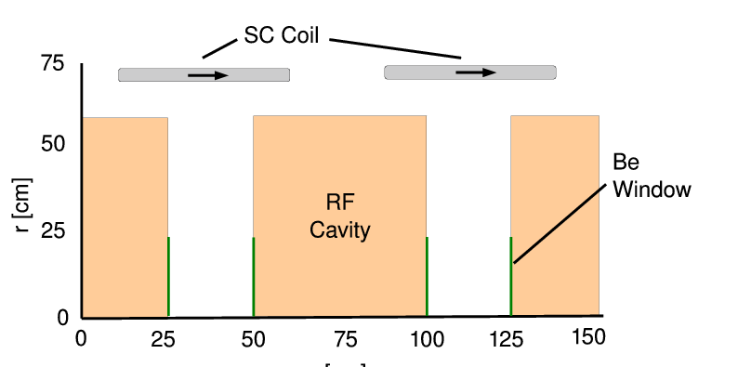
325MHz System “Collider”
Drift
20T→ 2T
Buncher
P_{o}=250MeV/c
P_{N}=154 MeV/c; N=10
V_{rf} : 0→ 15 MV/m
(2/3 occupied)
f_{RF} : 490→ 365MHz
Rotator
V_{rf} : 20MV/m
(2/3 occupied)
f_{RF} : 364→ 326MHz
N=12.045
P_{0,} P_{N}→245 MeV/c
Cooler
245 MeV/c
325 MHz
25 MV/m
2 1.5 cm LiH absorbers
/0.75m

Slide 4
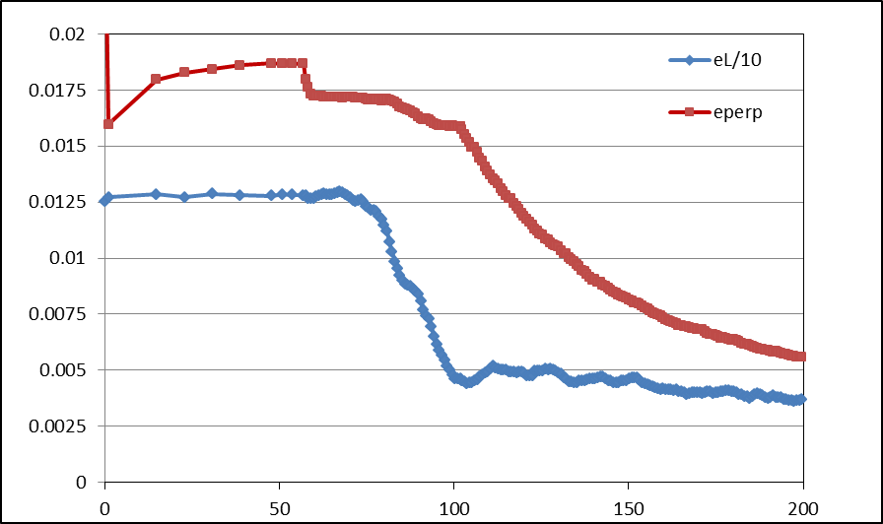
Simulation Results
Simulation obtains
~0.125 μ/p within acceptances
with ~60m Cooler
325 MHz – less power
shorter than baseline NF
But
uses higher gradient
higher frequency rf → smaller cavities
shorter than baseline NF
more bunches in bunch train
N :0.15<P<0.35 GeV/c
N: ε_{T}<0.03; A_{L}<0.2
N: ε_{T}<0.015; A_{L}<0.2
Useful
cooling

Slide 5
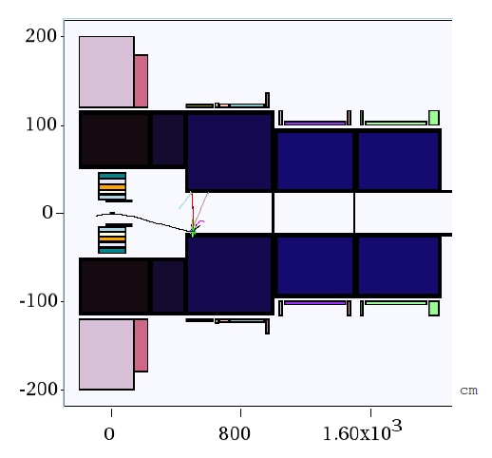
New Proton Driver parameters
6.75 GeV p, C target
20→2T short taper
~5m (previously 15)
X. Ding produced particles at z=2m using Mars
short initial beam
Redo ICOOL data sets to match initial beam
ref particles redefined
in for003.dat
and for001.dat

Slide 6
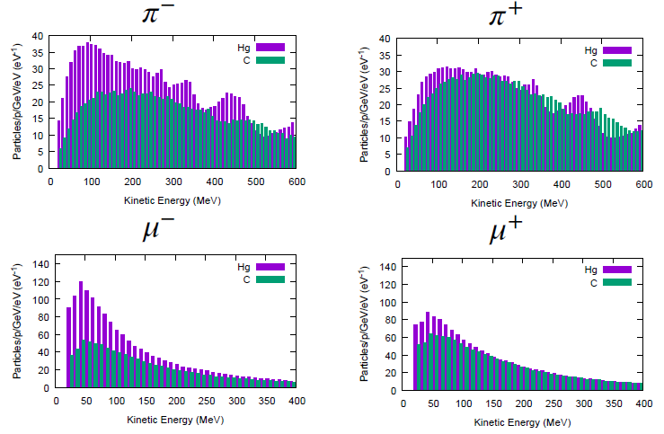
Following Scott’s review of front end
Use his initial distributions (obtained by X. Ding)
8 GeV protons on Hg targe
+ and minus
6.75 GeV protons on C target
Start beam from z =10m
must retranslate into ICOOL reference particles
Early losses on apertures have already occurred
23 cm apertures

Slide 7
ICOOL translation tips
start at “z=10m”
(particle time zero is at -1m)
reference particles
250 MeV/c ; 154 MeV/c μ⁺
165.75 MeV ; 81.1 MeV μ⁺
time set by 1m as 6,75 GeV proton + 10m as μ⁺
reference particles set in for003.dat, not for001.dat
01-Feb-2015 X. Ding C 10 m -
0.0 0.250 3.95709E-08 0.0 0.154 4.381345E-08 2
1 1 -3 0 4.354479e-008 1.000000e+000 0.03737 0.03656 0 7.861861e-004 2.558375e-002 2.189235e-001 0 0 0
3 1 -3 0 3.712592e-008 1.000000e+000 -0.03459 -0.11247 0 1.617131e-001 3.506310e-002 4.670452e-001 0 0 0
6 1 -3 0 3.748837e-008 1.000000e+000 0.00304 -0.04460 0 -1.827203e-002 -5.931789e-002 7.809555e-001 0 0 0
10 1 -3 0 3.738523e-008 1.000000e+000 0.07979 0.13944 0 -4.890422e-002 3.733585e-001 1.515145e+000 0 0 0
In ICOOL for001.dat
REFP
2 0 0 0 3
REF2
2 0 0 0

Slide 8
First simulation results
Simulation results
Hg target 8 GeV –end of cooling
~0.0756 μ⁺/p; ~0.0880 μ-/p;
C target 6.75 GeV p
~0.0613 μ⁺/p; ~0.0481 μ⁻/p;
0.0726 μ⁺/p; ~0.0570 μ⁻/p when multiplied by 8/6.75
Previous front ends had ~0.1 to ~0.125 μ/p

Slide 9
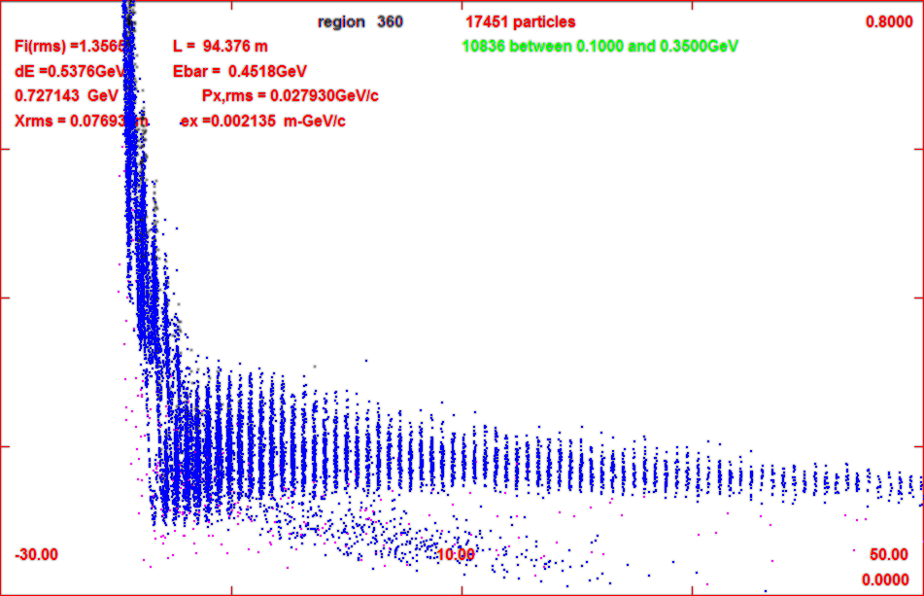
Progression of beam through system
z=11m
z=104m
z=135m

Slide 10
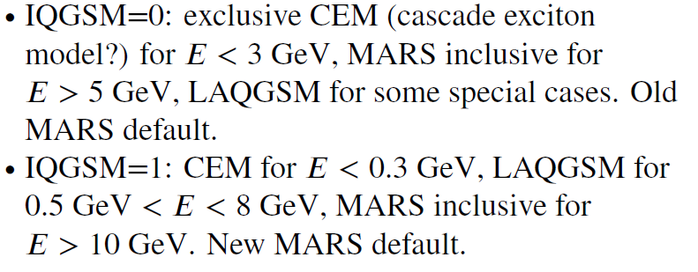
6.75 GeV p/ C target – 8GeV Hg
Simulations capture typically somewhat less than before
Big difference in MARS production model
Mars Inclusive → LAQGSM=1
Drop in production for ~8 GeV
Are previous MARS simulations that showed an advantage in production for ~8 GeV still true ?

Slide 11
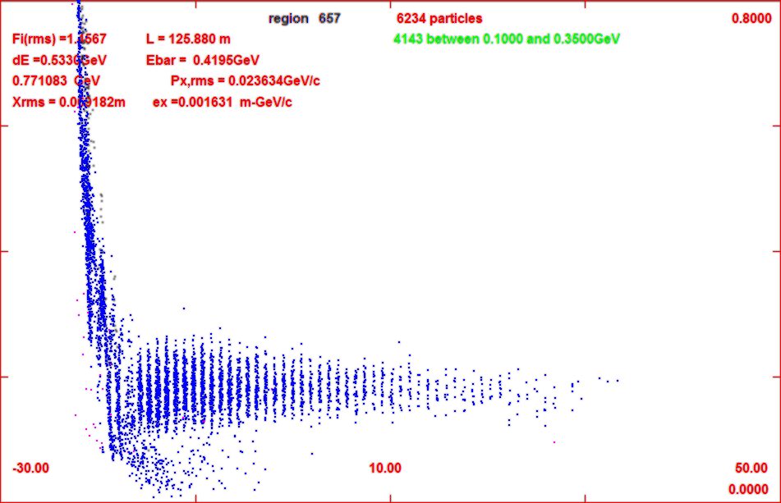
Add gas-filled rf in buncher/rotator
34 – 100 atm equivalent
1.14 MeV/m
34 atm
3.45 MeV/m
100atm
for 34 atm
add ~2MV/m to rf
First tries with ICOOL
GH in buncher 1 atm
no change in capture
Change to 34 atm by
DENS GH 34.0
Runs OK but
reduces capture by 20%
mostly from low-E muons
shorter bunch train
gas
z=71m
gas
z=135m
no gas

Slide 12
Updated gas-filled front end
added gas in rotator
34 atm
dE/dx
Increased rf a bit
Buncher 15z → 2+20(z/24) MV/m
Rotator 20 → 25
ref particles decelerate to 230Mev/c
Cooler 25→28 MV/m
Results are not so bad
8GeV Hg + → 0.0718 μ/p
8GeV Hg - → 0.0773 μ/p
6.75 geV C + → 0.0539 μ⁺/p
6.75 geV C -→ 0.0430μ⁻/p
~10% worse than baseline
Tweak of reference particle to fit ICOOL features
REFP
2 0.250 0. 1.7 4
REF2
2 0.154 0. 7.1
use phase model 4
tracks reference particles energy loss in drft/absorber but not in rf
fixed energy gain.loss in rf
ref particle acceleration fitted to

Slide 13
FrontEnd variations
Reduce buncher gas to 17atm
~ 10% better
back to ~ baseline
~0.062 μ⁺/p
change decelerating rotator back to constant energy rotator
C → ~0.063 μ⁺/p
about the same
no real advantage/disadvantage in deceleration
Note initial beam is “cooled”, but only in one dimension
B=2T – no field flip
Angular momentum increases
z | ε_{t} | ℓ=L/2 | ε₊ | ε₋
59 | 0.0184 | 0.0054 | 0.0246 | 0.0138
78 | 0,0173 | 0.0059 | 0.0243 | 0.0124
102 | 0.0151 | 0.0074 | 0.0242 | 0.0095

Slide 14
Effect of new initial distributions
Redo with old initial beams
2010 Hg 8GeV p
0.114μ⁺/p
2014 Hg 8GeV p
0.112μ⁺/p
Compare with current BEAM
Hg 8GeV p
0.072 μ⁺/p
Major difference is newer MARS model

Slide 15
Beam difference notes
Most of loss in intrinsic performance is from gas in buncher
Beam enters completely unbunched
Initial rf is weak; and slowly increases
After some initial loss, SIMILAR TO GAS-FREE BASELINE

Slide 16
Increase rotator to 100atm
Buncher at 17atm
LESS INITIAL LOSS
Increase Buncer gradient to 28 MV/m
to compensate energy loss
Fairly good performance
~0.063μ/p (C 6.75)
More cooling in Rotator
1-D cooling (2T solenoid)
one mode highly damped
Significant initiation of cooling
(integrating rotator/cooler)
z | ε_{t} | ℓ=L/2 | ε₊ | ε₋
77 | 0.0176 | 0.0061 | 0.0248 | 0.0124
89 | 0,0144 | 0.0077 | 0.0241 | 0.0087
102 | 0.0128 | 0.0088 | 0.0242 | 0.0066

Slide 17
Next steps

