Slide 1
Introduction to IOTA and Injectors
Alexander Valishev
Fermilab
28 April 2015

Slide 2
IOTA/ASTA Schematic

Slide 3
Existing Infrastructure
IOTA/ASTA capitalizes on the investments made by OHEP for highly successful ILC/SRF R&D Program.
Construction of ASTA (formerly NML) began in 2006 as part of the ILC/SRF R&D Program and later American Recovery and Reinvestment Act (ARRA). The facility was motivated by the goal of building, testing and operating a complete ILC RF unit.
Multi-million (>$90M) investment resulted in the successful commissioning of 1.3 GHz SRF cryomodule (CM2).
  Beam through low-energy photo injector
  Facility nears completion
The addition of IOTA expands scope to host high-intensity accelerator research.

Slide 4
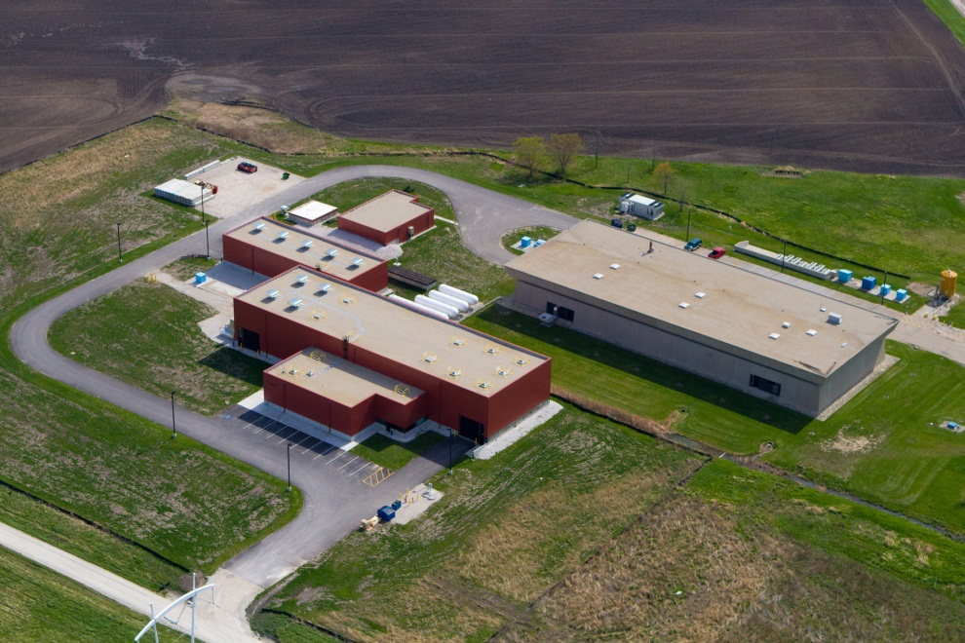
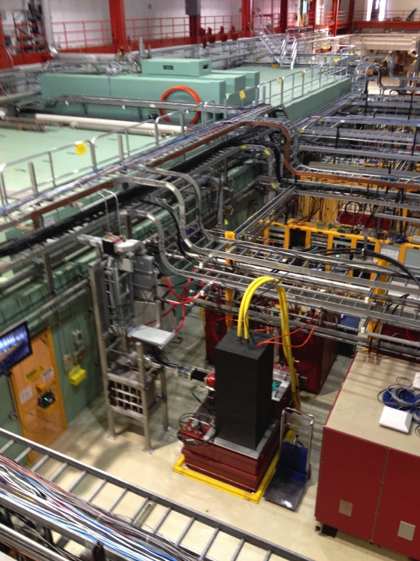
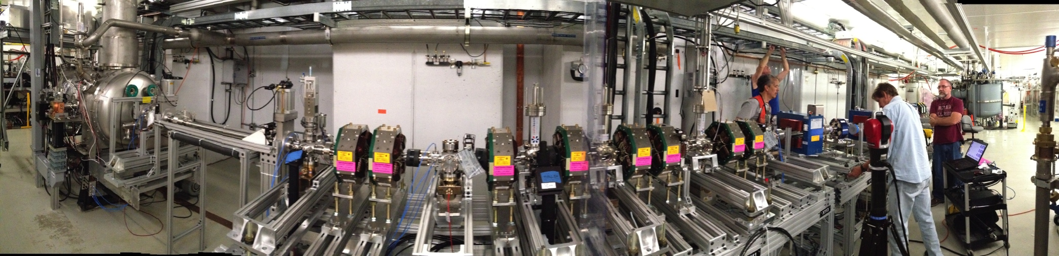
ASTA Facility

Slide 5
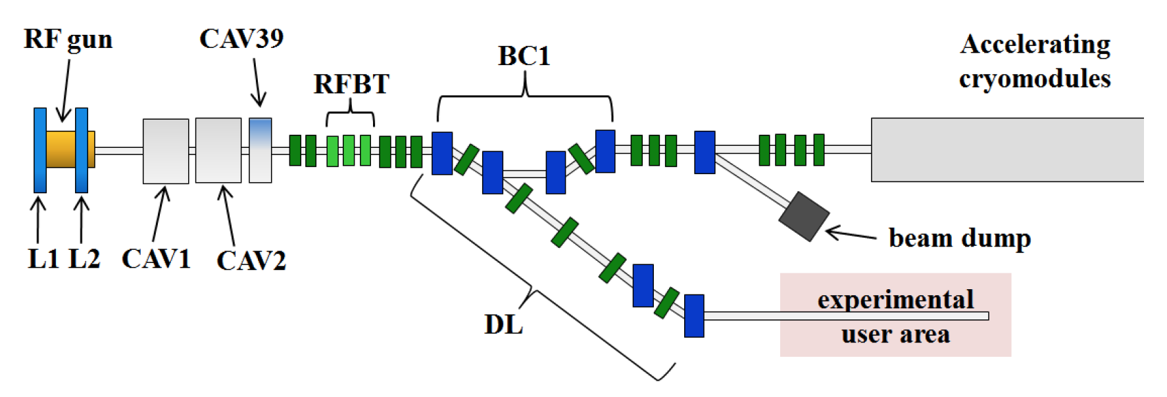
ASTA e⁻ Injector
Parameter | ILC nominal | Range
Bunch charge | 3.2 nC | 10pC to > 20 nC
Bunch spacing | 333 ns | <10 ns to 10 s
Bunch train | 1 ms | 1 bunch to 1 ms
Train rep. rate | 5 Hz | 0.1 Hz to 5 Hz
Transverse emit. | 25 mm-mrad | 1 to 100 mm-mrad
r.m.s. bunch length | 1 ps | 10fs to 10ps
Beam energy | 300 MeV | 50-300 MeV

Slide 6
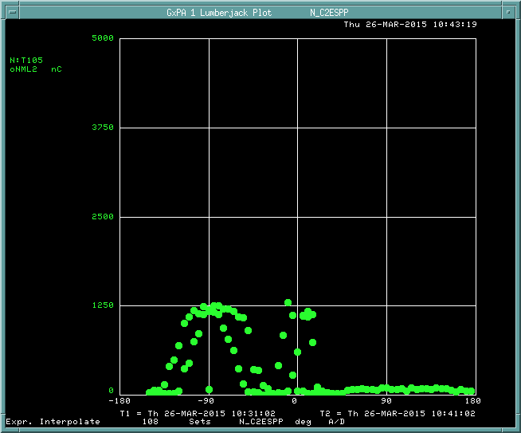

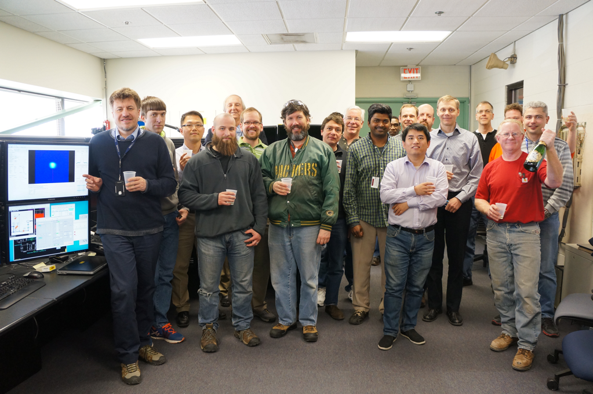
First Electrons Through Photoinjector!
Sign-offs Wednesday, 25 March
Electrons beyond the gun - Wednesday, 25 March
Beam after CC2, towards end of line – Thursday, 26 March
Electrons seen at low energy beam absorber ( ~20 MeV) – Friday morning, 27 March
Initial CC2 Phase Scan
OTR Screen after 22.5° bend

Slide 7
Integrable Optics Test Accelerator
Unique features:
  Can operate with either electrons or protons (up to 150 MeV/c momentum)
  Large aperture
  Significant flexibility of the lattice
  Precise control of the optics quality and stability
  Set up for very high intensity operation (with protons)
Based on conventional technology (magnets, RF)
Cost-effective solution
  Balance between low energy (low cost) and discovery potential

Slide 8
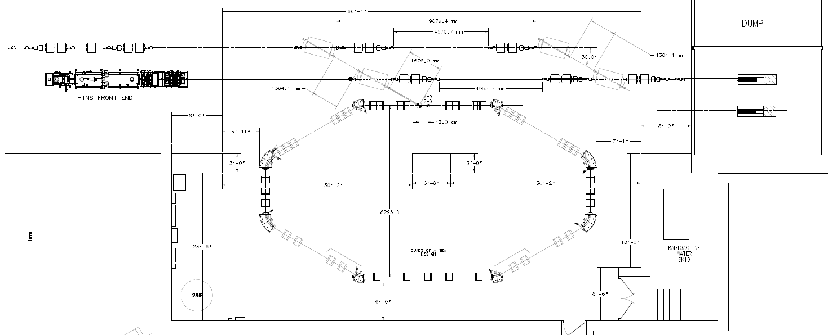
IOTA Ring
e- beam line
p beam line
2.5 MeV RFQ

Slide 9
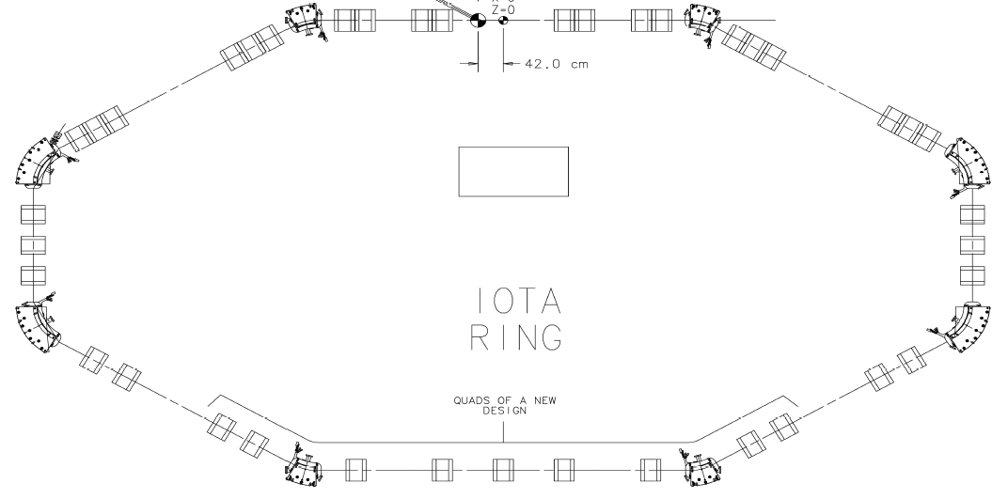
IOTA Layout
NL2
NL1
RF
EL
OSC

Slide 10
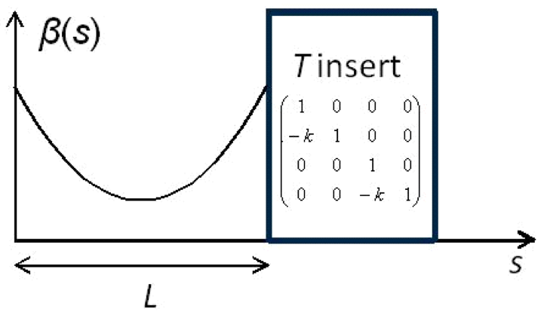
Machine Design Principles – 1
Start with a round axially-symmetric linear lattice (FOFO) with the element of periodicity consisting of
  Drift sufficient length
  Axially-symmetric
  focusing block “T-insert”
  with phase advance n×π
Add special nonlinear potential V(x,y,s) in the drift such that
can be also

Slide 11
Machine Design Principles – 2
To maximize the attainable tune shift / spread, design for at least 2 elements of periodicity
Allow for a second approach to integrability – the Electron Lens
Reserve 5 m drift for Optical Stochastic Cooling chicane
Decouple transverse and longitudinal degrees of freedom as much as possible
  Zero dispersion in nonlinear elements
  Maximize momentum compaction
Limit the beta-beating to allow large amplitudes of oscillation for studies with pencil beam

Slide 12
Machine Design Principles – 3
Fit in the experimental hall
Minimize number of power circuits to reduce cost
Minimuze the number of magnets
Instrumentation/correction to achieve high precision
Good vacuum to ensure sufficient beam circulation time

Slide 13
IOTA Optics Options
1 Nonlinear Insert
2 Nonlinear Inserts
Electron Lens
2D McMillan
Optical Stochastic Cooling

Slide 14
IOTA Option 1 – 2NL
1.8m
T-Insert
NL2
NL1
T-Insert
RF

Slide 15
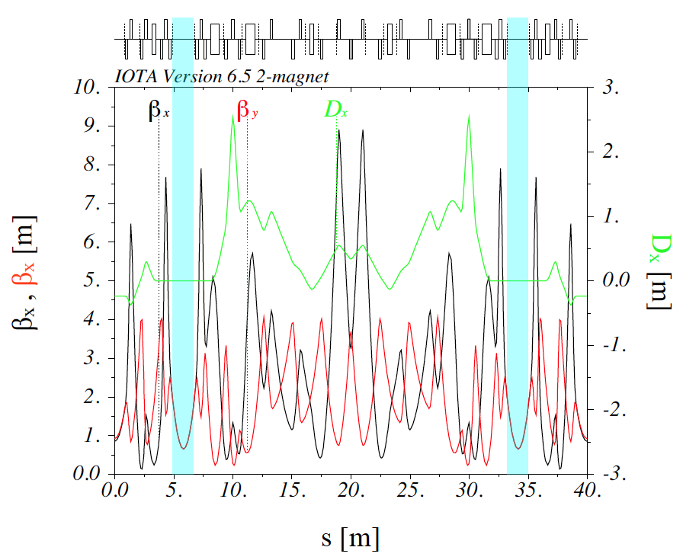
IOTA Option 1 – 2NL

Slide 16
IOTA Parameters
Nominal kinetic energy | e⁻: 150 MeV, p+: 2.5 MeV
Nominal intensity | e⁻: 1×10⁹, p+: 1×10¹¹
Circumference | 40 m
Bending dipole field | 0.7 T
Beam pipe aperture | 50 mm dia.
Maximum b-function (x,y) | 12, 5 m
Momentum compaction | 0.02 ÷ 0.1
Betatron tune (integer) | 3 ÷ 5
Natural chromaticity | -5 ÷ -10
Transverse emittance r.m.s. | e⁻: 0.04 μm, p+: 2μm
SR damping time | 0.6s (5×10⁶ turns)
RF V,f,q | e⁻: 1 kV, 30 MHz, 4
Synchrotron tune | e⁻: 0.002 ÷ 0.005
Bunch length, momentum spread | e⁻: 12 cm, 1.4×10⁻⁴

Slide 17
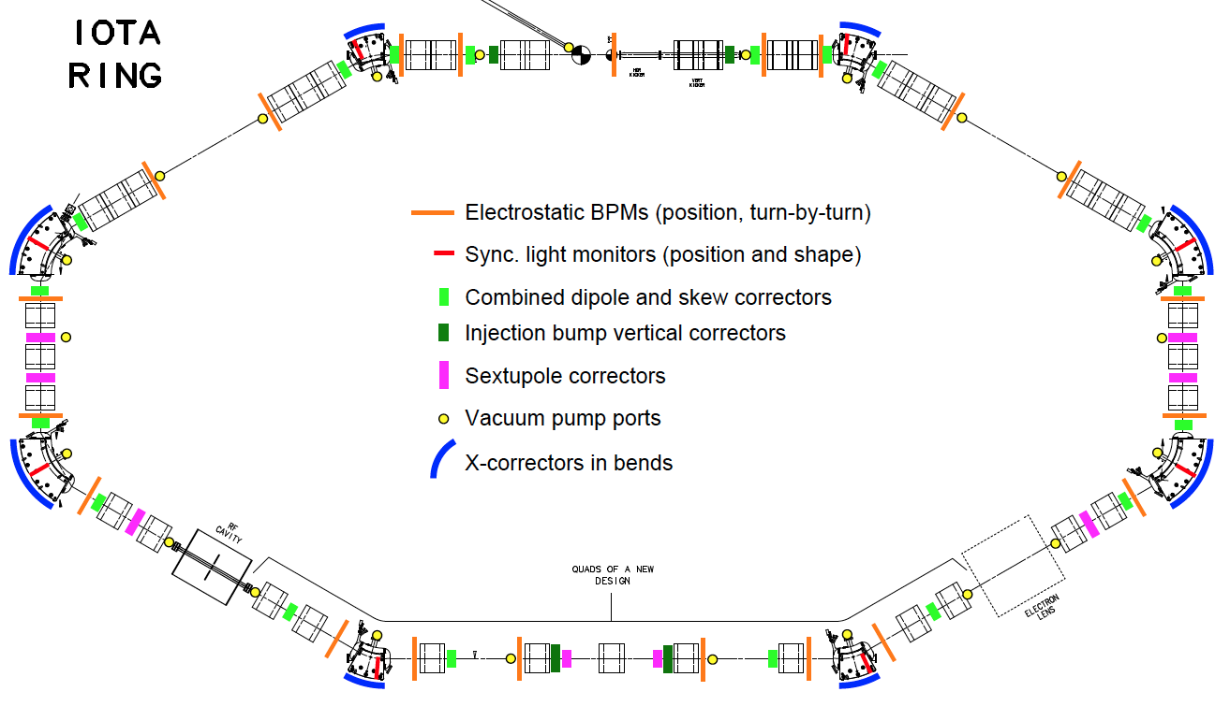
IOTA Layout

Slide 18
IOTA Elements – 1
8 sector bending magnets (4 30-degree, 4 60-degree)
39 quadrupole magnets in 26 circuits
25 H dipole correctors, 21 V
20 skew-quadrupole correctors
8 sextupole magnets
20 button-type BPMs
8 Synchrotron Light ports (CCD cameras, PMTs)
Current monitor

Slide 19
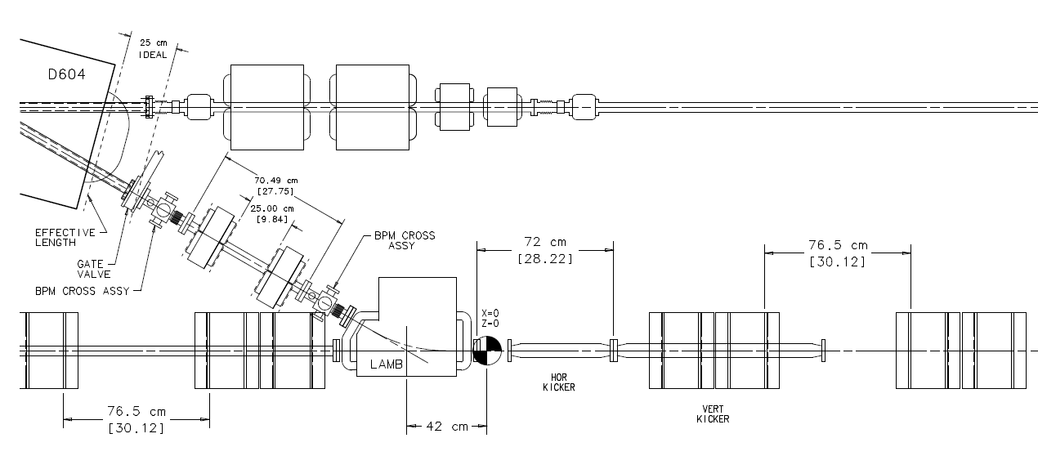
IOTA Elements – 2
Dual-frequency RF cavity (30 MHz, 2 MHz)
Single-turn injection
  Lambertson magnet
  H and V stripline kicker (also for painting the aperture)
S.Antipov

Slide 20
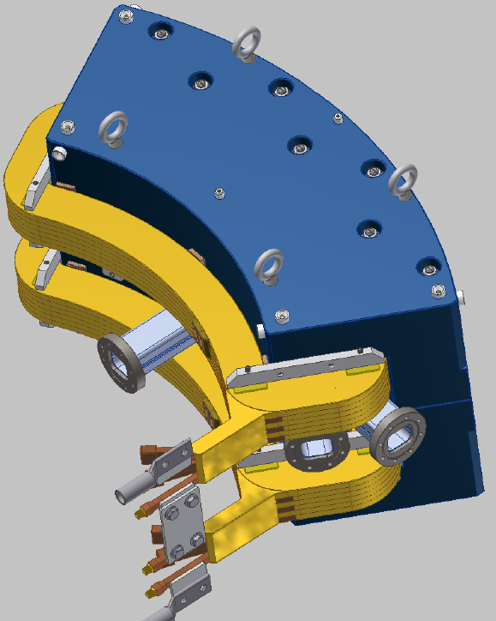
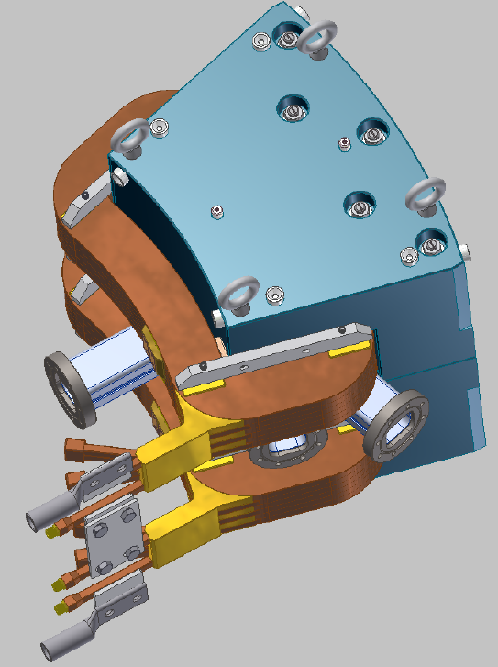
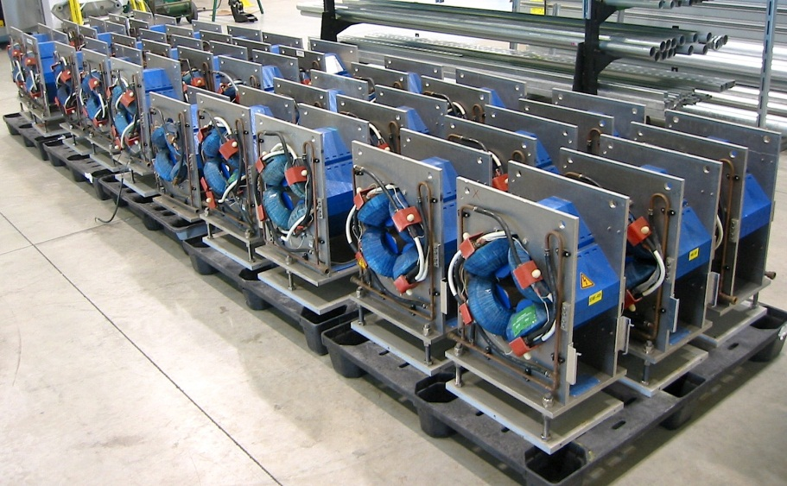
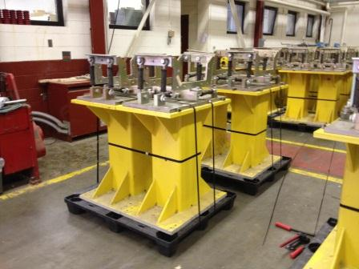
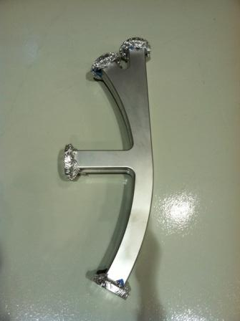
Ring Elements in Hand
32 quads from JINR (Dubna) being measured
Dipole magnets (ordered)
Magnet support stands
from MIT (received)
Also:
BPM bodies and electronics
Vacuum system
Dipole power supply
Quad supplies
Corrector power supplies
Vacuum chambers
for dipoles (received)
Notes:
Dubna quadrupoles – in-kind

Slide 21
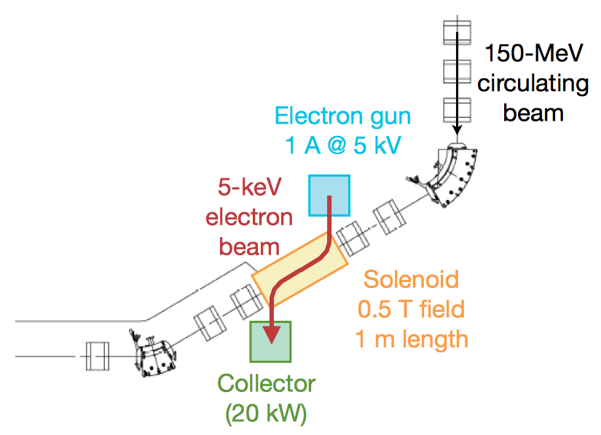
IOTA Electron Lens
Capitalize on the Tevatron experience and recent LARP work
Re-use Tevatron EL components
G.Stancari

Slide 22
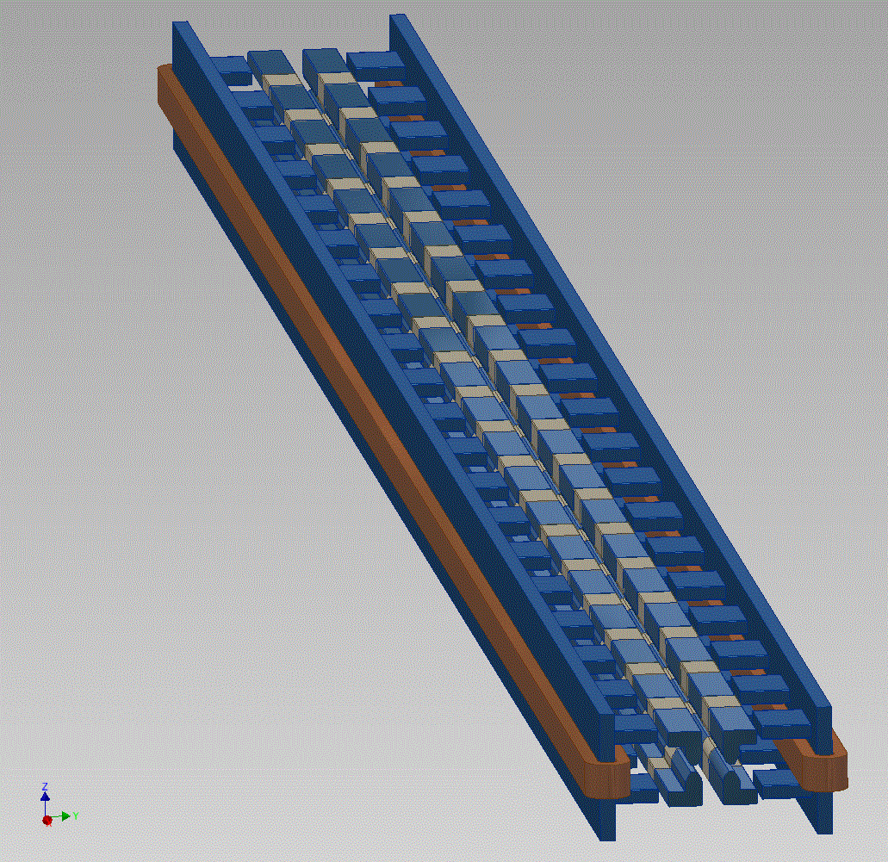
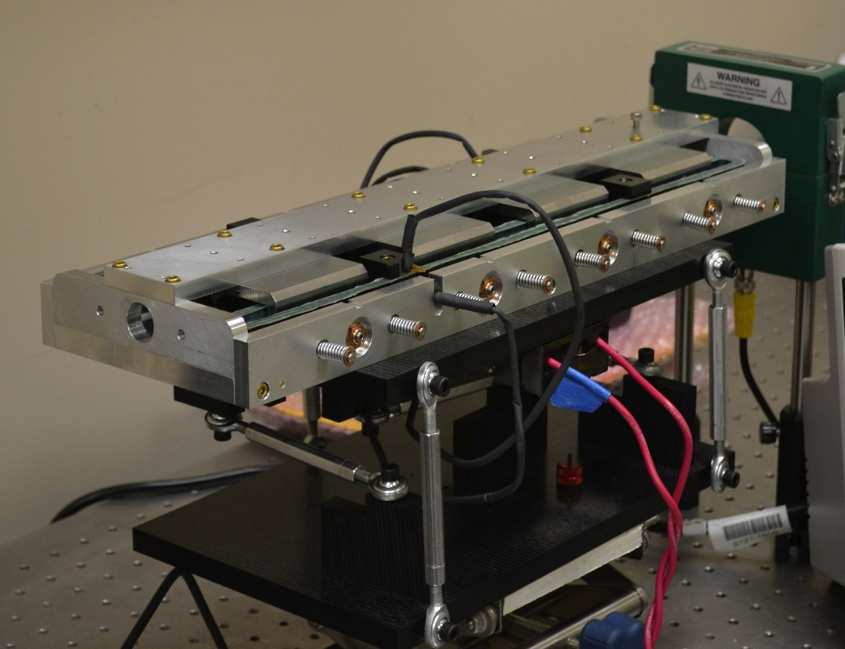
Nonlinear Magnet
Joint effort with RadiaBeam Technologies (Phase I and II SBIR)
FNAL Concept: 2-m long
nonlinear magnet
RadiaBeam short prototype. The full 2-m magnet will be designed, fabricated and delivered to IOTA in Phase II

Slide 23
IOTA Staging – Phase I
Phase I will concentrate on the academic aspect of single-particle motion stability using e- beams
  Achieve large nonlinear tune shift/spread without degradation of dynamic aperture by “painting” the accelerator aperture with a “pencil” beam
  Suppress strong lattice resonances = cross the integer resonance by part of the beam without intensity loss
  Investigate stability of nonlinear systems to perturbations, develop practical designs of nonlinear magnets
  The measure of success will be the achievement of high nonlinear tune shift = 0.25
Notes:
color pencil beam

Slide 24
IOTA Staging – Phase I
The magnet quality, optics stability, instrumentation system and optics measurement techniques must be of highest standards in order to meet the requirements for integrable optics
  1% or better measurement and control of β-function, and 0.001 or better control of betatron phase
This is why Phase I needs pencil e⁻ beams as such optics parameters are not immediately reachable in a small ring operating with protons

Slide 25
IOTA Staging – Phase II
After the IOTA commissioning with e-, we will move the existing 2.5 MeV proton/H- RFQ into the ASTA hall to inject protons into the IOTA ring.
  ΔQ_{SC} =0.5 for one-turn injection, multi-turn injection possible
  Allows tests of Integrable Optics with protons and realistic space charge beam dynamics studies
Beam energy | 2.5 MeV
Beam momentum | 70 MeV/c
Relativistic beta | 0.073
RF structure | 325 MHz
Average beam current | <8 mA
Transverse emit. | 0.4 mm-mrad
Momentum spread | 3.7×10⁻³
Pulse rate | 0.2-1 Hz
Max. protons per turn | 8.8×10¹⁰
Notes:
multi-tun injection possible

Slide 26
Plan of Activities and Status
Phase 1: FY15-17
Construction of main elements of the ASTA/IOTA facility:
  electron injector based on existing ASTA electron linac
    Low energy injector operational. HE beamline construction in FY15. Connect CM2 and send beam down HE beamline in FY16
  IOTA ring
    Most components procured. Begin assembly in FY16
  proton injector based on existing HINS proton source
    Resurrecting the ion source in FY15, RFQ in FY16
  special equipment for AARD experiments.
Commissioning of the IOTA ring with electron beam – FY17
Study of single-particle dynamics in integrable optics with electron beams.

Slide 27
Plan of Activities – Outlook
Phase 2: FY18-20
Commission IOTA operation with proton beams.
Carry out space-charge compensation experiments with nonlinear optics and electron lenses.
Phase 3: FY21 and beyond
Study the application of space-charge compensation techiques to next generation high intensity machines.
Expand the program beyond these high priority goals to allow Fermilab scientists and a broader accelerator HEP community to utilize unique proton and electron beam capabilities of the ASTA/IOTA facility

Slide 28
Acknowledgments
A.Burov, K.Carlson, A.Didenko, N.Eddy, V.Kashikhin, V.Lebedev, J.Leibfritz, M.McGee, S.Nagaitsev, L.Nobrega, A.Romanov, G.Romanov, A.Valishev, S.Wesseln, D.Wolff (FNAL)
D.Shatilov (BINP)
G. Kafka (IIT)
S. Danilov (ORNL),
S. Antipov (U of Chicago)
J. Cary (Tech-X)
D. Bruhwiler, S. Webb (RadiaSoft)
F.O’Shea, A.Murokh (RadiaBeam)
R.Kishek, K.Ruisard (UMD)
JINR, Dubna

