Slide 1

MICE Step IV Run Plan
MAP Meeting
FNAL, 21 May 2015
Paul Soler
University of Glasgow

Slide 2
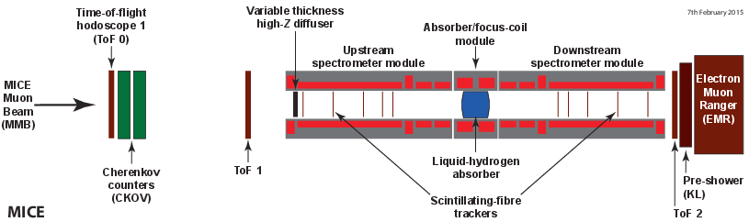
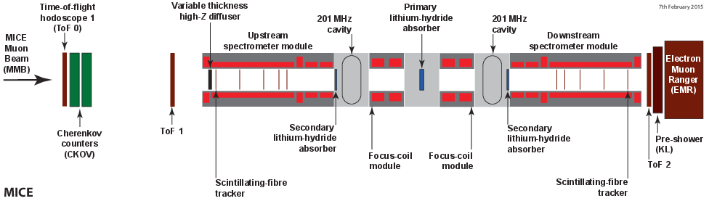
Muon Ionization Cooling Experiment
MICE will demonstrate ionization cooling in steps
  Step IV: demonstration of reduction of normalised emittance
  Final cooling demonstration step will demonstrate ionization cooling with reacceleration by RF cavities
MAP Meeting, FNAL, 21 May 2015

Slide 3
MICE Step IV
MICE Step IV goals:
  Step IV does not have RF restoration of energy
  First measurement of reduction of normalised transverse emittance in two absorbers: LiH and liquid H₂
  Measurement of absorber material properties
  Validation of optics for demonstration of ionization cooling
MAP Meeting, FNAL, 21 May 2015

Slide 4
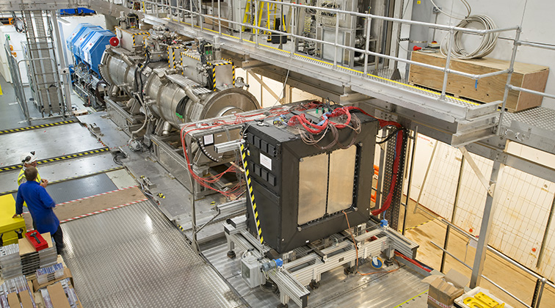
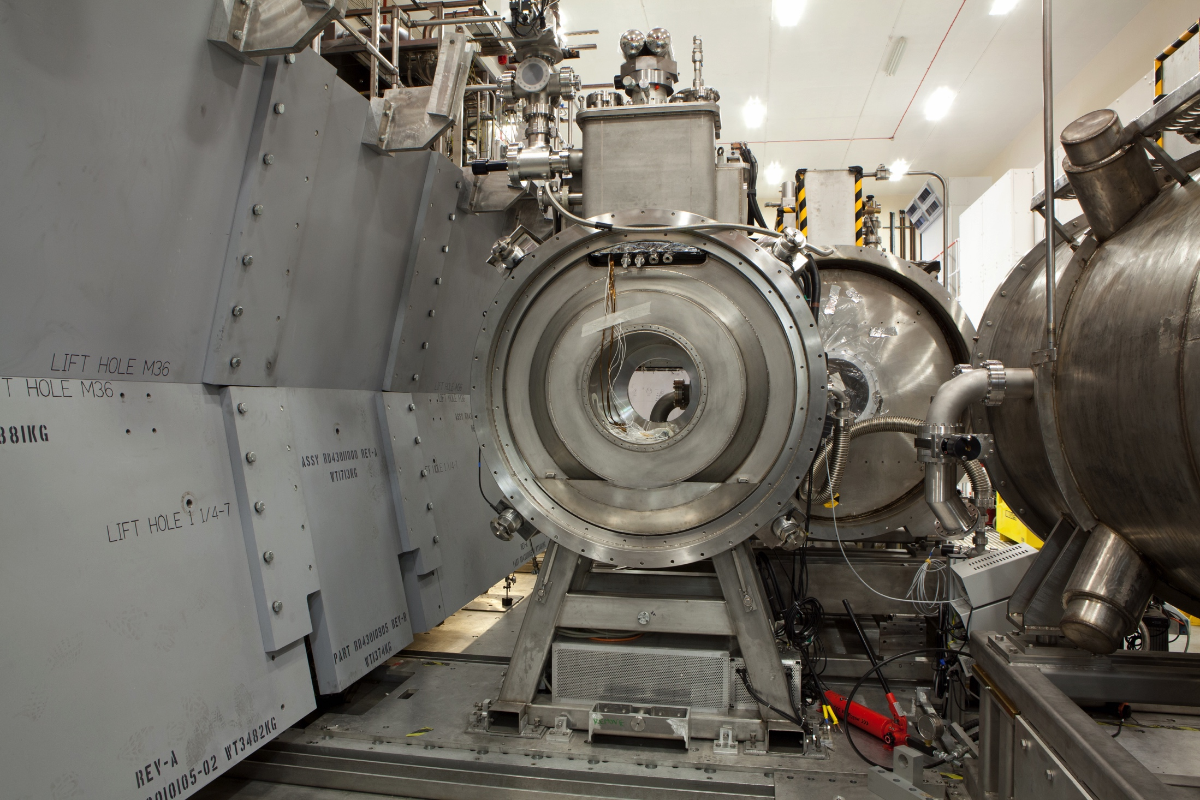
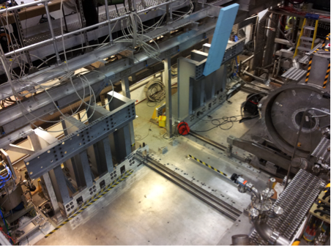
Step IV Construction
Construction of Step IV:
  Beam line installed and working
  Two spectrometers and the focus coil module installed
  Partial Return Yoke: south side installed, north side being installed this week
MAP Meeting, FNAL, 21 May 2015

Slide 5
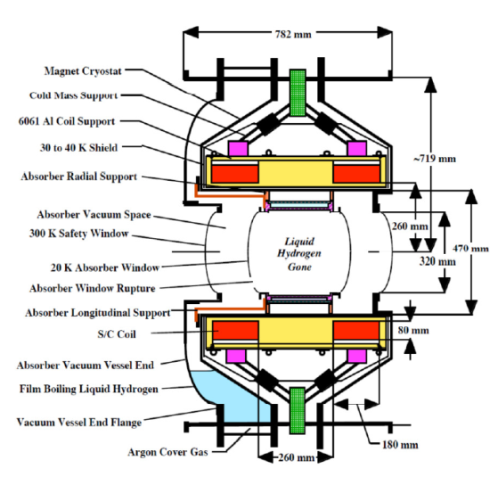
Step IV Absorbers
Two absorbers in step IV:
  Liquid hydrogen
  Lithium hydride (LiH)
Liquid hydrogen review
  Held January 2015
  Approval, subject to design changes due to absorber window failure mode
    Boil off of LH2 in vacuum
    Change diameter of relief line to cope with increased pressure (5-8 bar)
    Burst test of thin window (25%): 7.66 bar
    Installed window should burst at ~8.5 bar
    Install a relief line to give safety factor of 2 in pressure rise (< 4.25 bar)
Original plan: start data taking with LH2
New plan: start with LiH to accommodate changes to LH2 design
MAP Meeting, FNAL, 21 May 2015

Slide 6
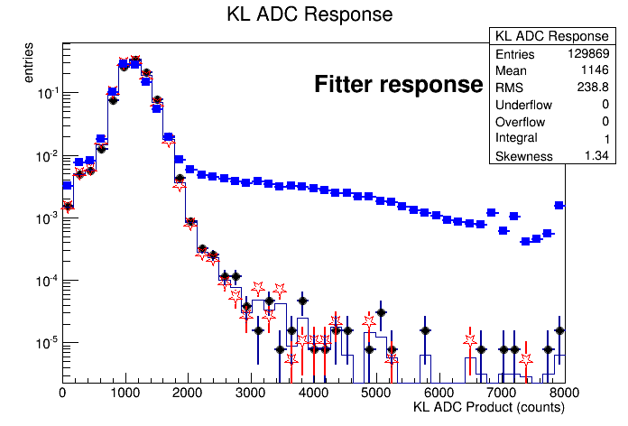
Step I Analyses
Demonstration of beam and detectors :
  Pion contamination paper: upper limit on pion contamination of beam based on KL distributions
  EMR paper: muon-electron separation based on EMR
MICE OsC, RAL, 13 May 2015

Slide 7
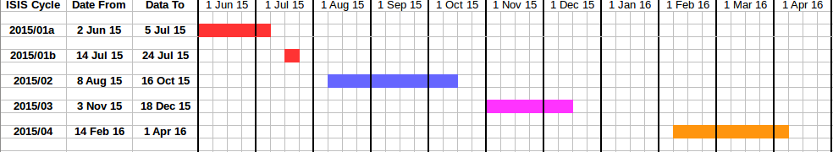
MICE Running Schedule
Operational plan for Step IV
  All Step IV MICE Operations Managers (MOM) appointed
  ISIS schedule for Step IV:
  March-June 2015: installation and running simultaneously (weekend running)
  June-July 2015: cooling channel commissioning
  August 2015-April 2016: Step IV running
  Likely to have another period running between April-June 2016 but ISIS schedule not available yet
MAP Meeting, FNAL, 21 May 2015

Slide 8
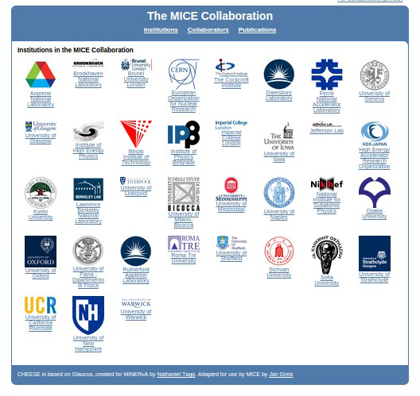
Shift Allocation Tool
Shift allocations
  Shift allocation system rolled out (CHEESE): https://cheese.mice.rl.ac.uk/public
  79 people eligible for shifts (including new collaborators from Belgrade and China)
  Will run 24/7 from July: blocks of 5 shifts, each shifter to do 3 blocks
  MOMs do not do shifts
  Training on Fridays for now
  Wednesdays will be maintenance day when running 24/7, so can offer training on Wednesdays
  Shifters take two shadow shifts before allocated shift blocks
MAP Meeting, FNAL, 21 May 2015

Slide 9
Step IV Physics Goals
Physics analysis goals for Step IV:
  Description of MICE Step IV
  First observation normalised transverse emittance reduction
  Diagnostics: detector alignment, resolutions, efficiencies, particle ID
  Magnetics: magnet mapping and analysis, magnet alignment, beam quality, optical emittance growth, transfer map, study of non-linear effects, validation cooling channel optics
  Absorber properties: energy loss, multiple scattering, angular momentum, beam depolarization
  Final paper on beam cooling channel: final long paper with all physics of normalised transverse emittance reduction
MAP Meeting, FNAL, 21 May 2015

Slide 10
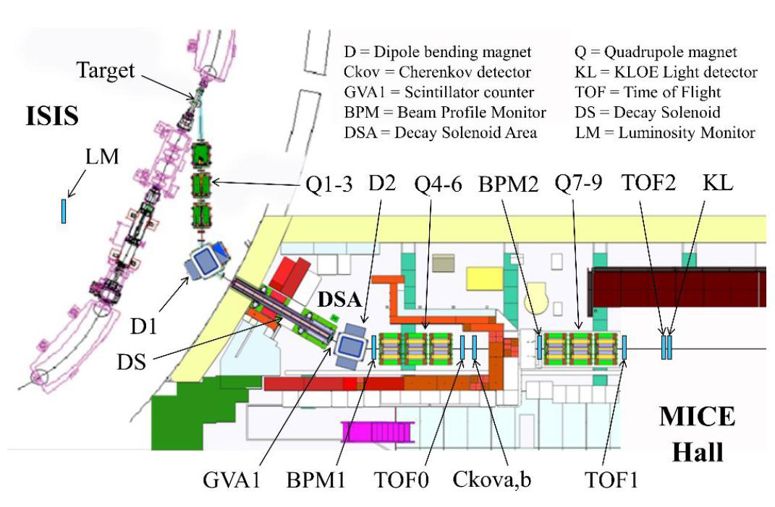
Beam Pre-commissioning
Pre-commissioning plans: period 2015-01 (May-June)
  Commission beam settings: magnet scans
  Commission particle ID detectors
MAP Meeting, FNAL, 21 May 2015

Slide 11

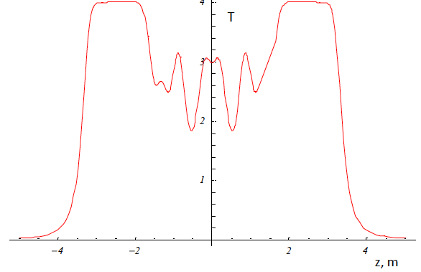
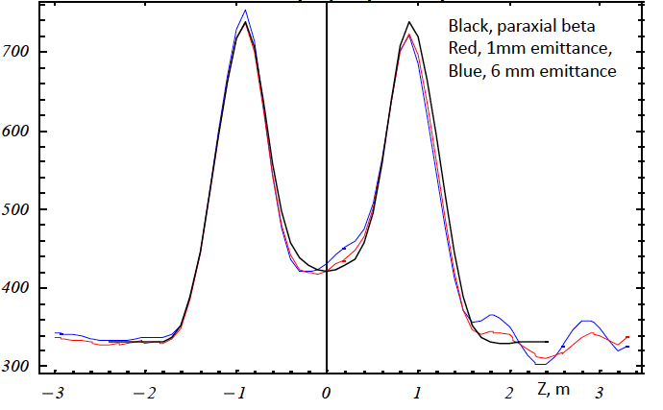
Beam Line Commissioning
Commissioning plans: period 2015-01 (May-June)
  Muon beam matching to the MICE Channel
  Requires beta, alpha and emittance reconstruction at all five upstream tracker planes to test behaviour of the beam
  Magnet Commissioning: assess beam optics
  Measure transfer matrix through the channel
MAP Meeting, FNAL, 21 May 2015

Slide 12
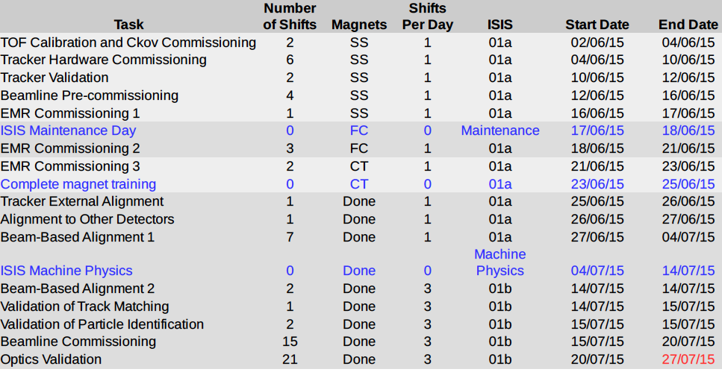
Beam Line Commissioning
Beam commissioning plans during 2015-10
  Train magnets during day, one data-taking shift at night
MAP Meeting, FNAL, 21 May 2015

Slide 13
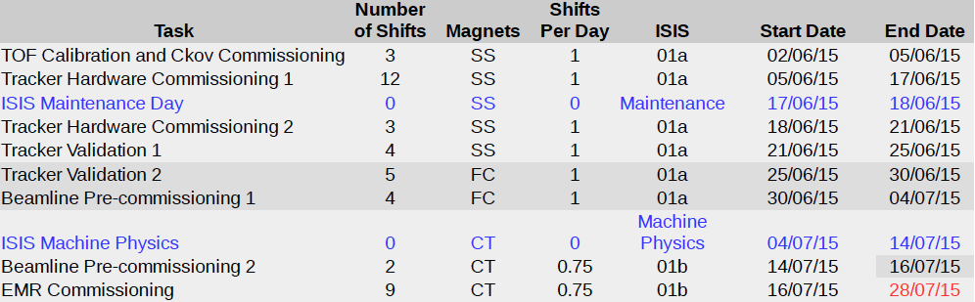
Beam Line Commissioning
Pessimistic run plan
  Depends on magnet training and number of quenches when three solenoid magnets trained jointly
MAP Meeting, FNAL, 21 May 2015

Slide 14
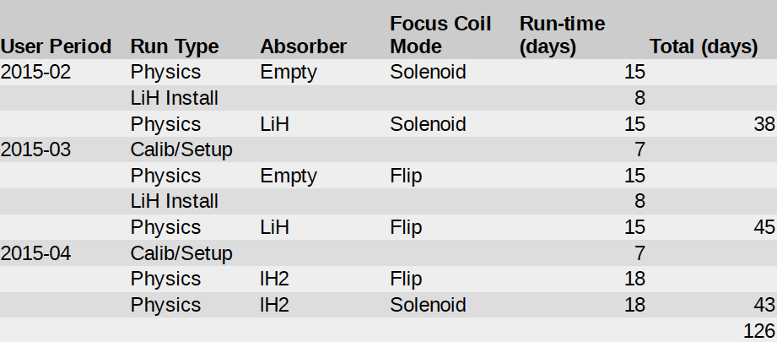
Operations and Analysis
Data taking plan:
  Start data taking with Empty and LiH absorber
  Each measurement has a “proponent” with configurations, Monte Carlo, physics analysis, etc.
MAP Meeting, FNAL, 21 May 2015

Slide 15
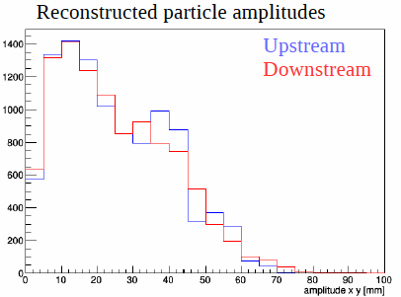
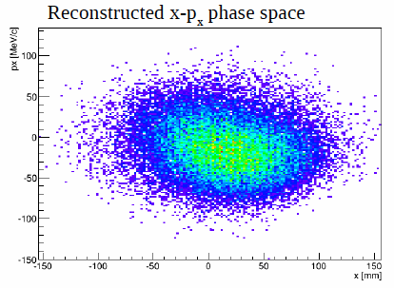
Step IV Cooling Analysis
Blind analysis of a MC data set (MC data challenge)
  Realistic beam configuration
  Reconstruction of all detectors
  Reweighting technique to simulate matched beams
MAP Meeting, FNAL, 21 May 2015

Slide 16
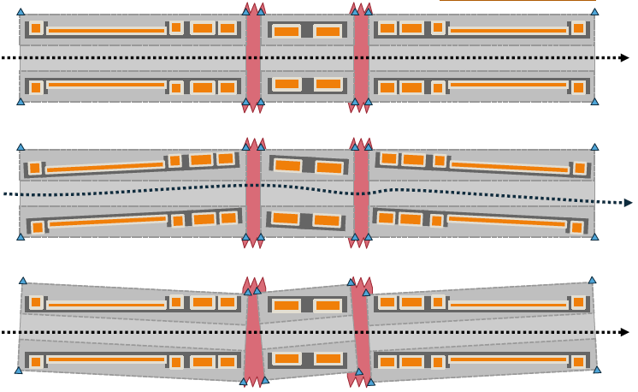
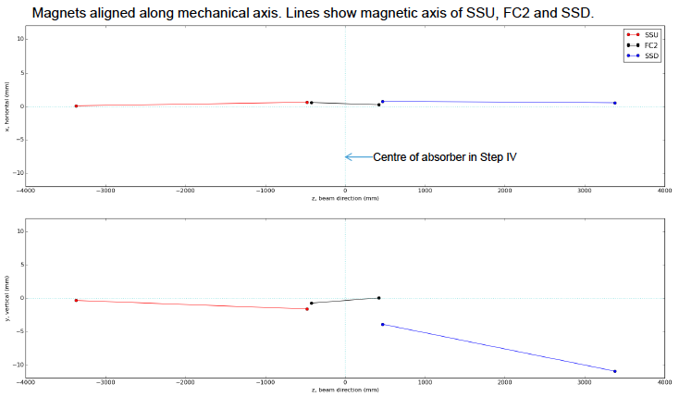
Step IV Magnetic Field Analysis
Magnetic alignment (preliminary) using three methods:
  Perform fit of magnetic field map with respect to geometric axes from survey information
  Minimise |B| to find axis
  B_{T} should also point to axis
MAP Meeting, FNAL, 21 May 2015

Slide 17
Start of Step IV Operations Event
STFC and RAL want to mark start of MICE Step IV with an open event at RAL on 25 June 2015
  Mini-conference for scientists followed by a public lecture
  Tentative Schedule (all times BST=GMT+1):
    13:30-17:00: Extended seminar on the physics and technology of cold muon beams
    17:30-18:30: Public Lecture by a distinguished scientist
    18:30-19:00: Reception
    19:00: Adjourn
MAP Meeting, FNAL, 21 May 2015

Slide 18
Conclusions
MICE is proceeding towards Step IV and detector commissioning has already commenced
Run plan includes:
  Pre-commissioning of muon beam
  Commissioning of detectors (including tracker)
  Commissioning of magnets and cooling channel
  Full data taking to commence in August 2015
  New baseline is to start with LiH (but could change to liquid hydrogen if new relief line ready in time)
  Software and systems in good shape and operational plan ready for running 24/7 from July 2015
MAP Meeting, FNAL, 21 May 2015

