Slide 1
Experiment in a bottle (magnetic): MICE PRY

Slide 2
Overview
Introduction and Concept
CAM concept (Forces on PRY)
Status of Manufacturing
Effect of PRY on MICE Beam
MICE PRY V’

Slide 3
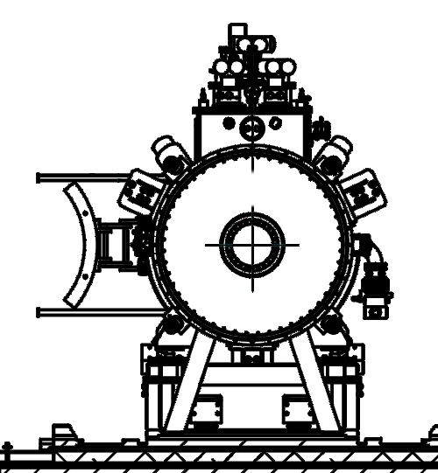
Partial Return Yoke
MICE hall: solenoids cause large stray field
Aim of PRY:
Reduce stray field in hall to tolerable level
Shielding plates
  wall thickness 10 cm
  weight: 55t
Performance
  Reduces stray field outside of shield to 5-10 Gauss
H Witte. Step IV & VI: Local Flux Return. MICE CM 34, October 2012.
(Note: not to scale)

Slide 4
Principle

Slide 5
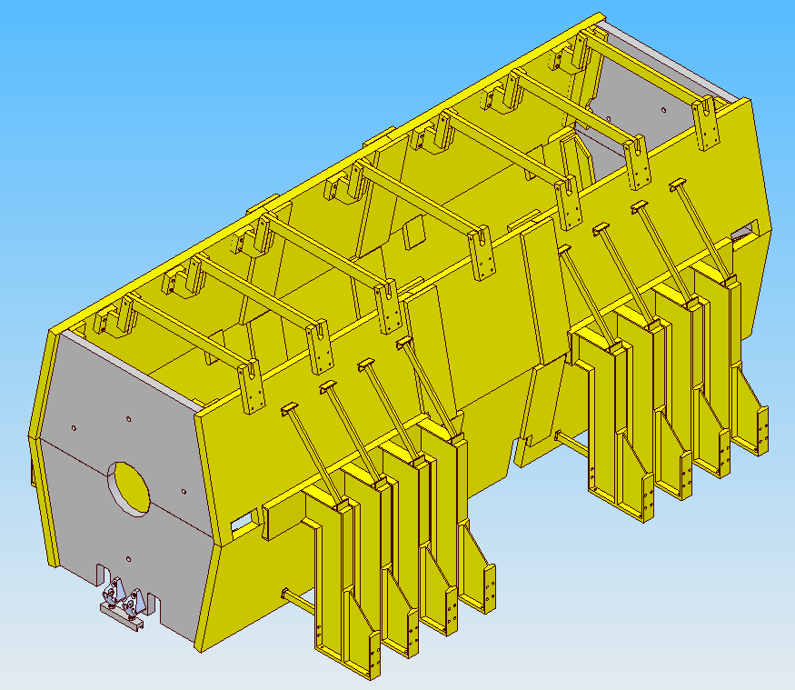
PRY Step IV
7.6m
2.8m
Courtesy of J. Tarrant / S. Plate

Slide 6
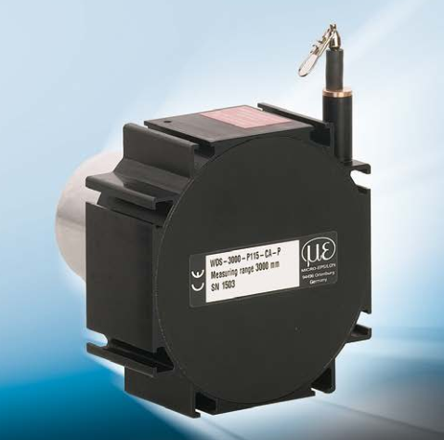
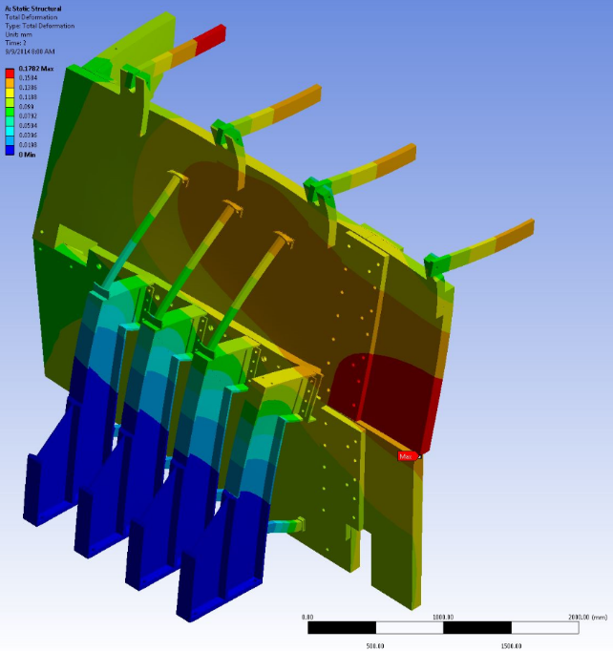
Force Scenarios
Nominal cases
  200/240 MeV
  flip/solenoid mode
  Deflection 0.18 mm
Worst case analysis
  Increased forces by factor 5
  Still very safe
Monitoring: draw-wire sensor
WDS-3000-P115-CA-P

Slide 7
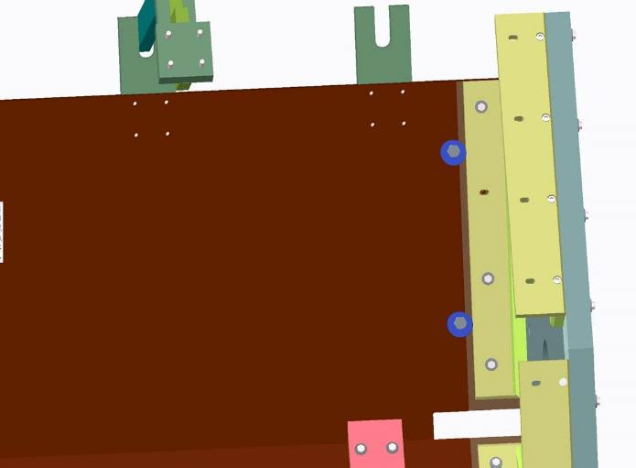
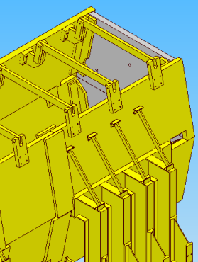
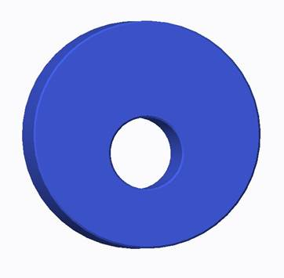
CAM Concept
L-Seal
Mitigates overstressing of L-Seal bolts
Stress analysis now ok up to 5 times calculated load on end plate of PRY

Slide 8
Status of Manufacturing

Slide 9
Schedule
April 1st: PRY South Side complete
April 30th: PRY North Side arrived at
Liverpool port
May 12th: PRY North Side at RAL
May 15th: PRY North legs installed and
aligned
May 20th: Installation of north side plates

Slide 10
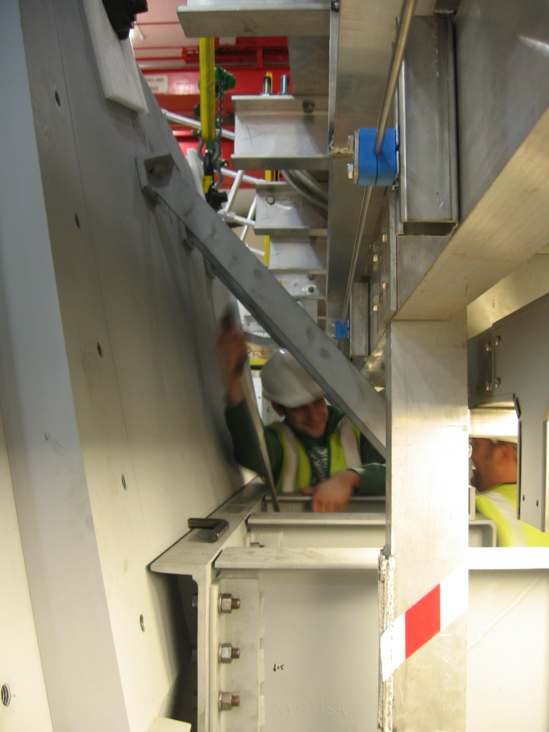
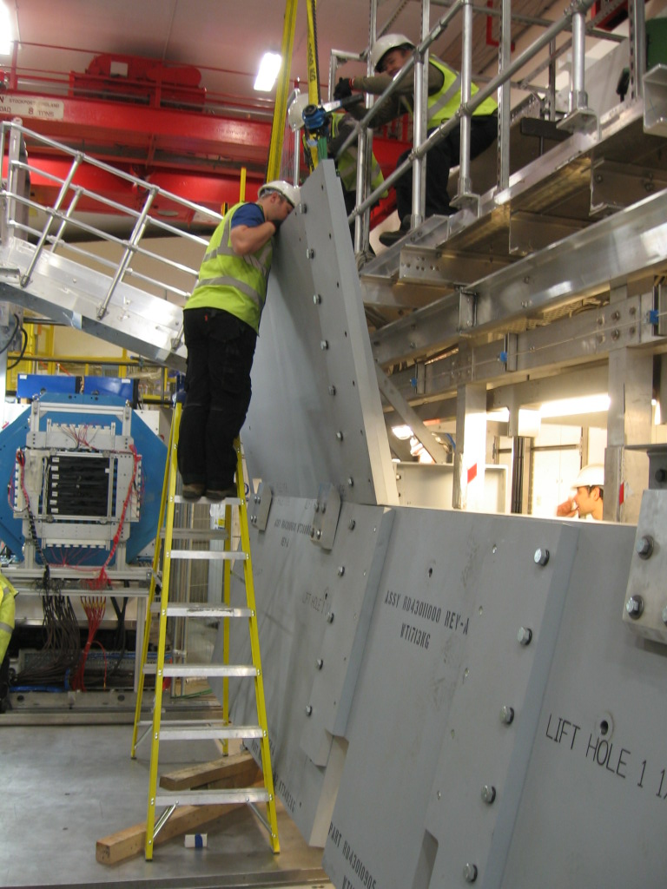
PRY South Side
April 1st 2015

Slide 11
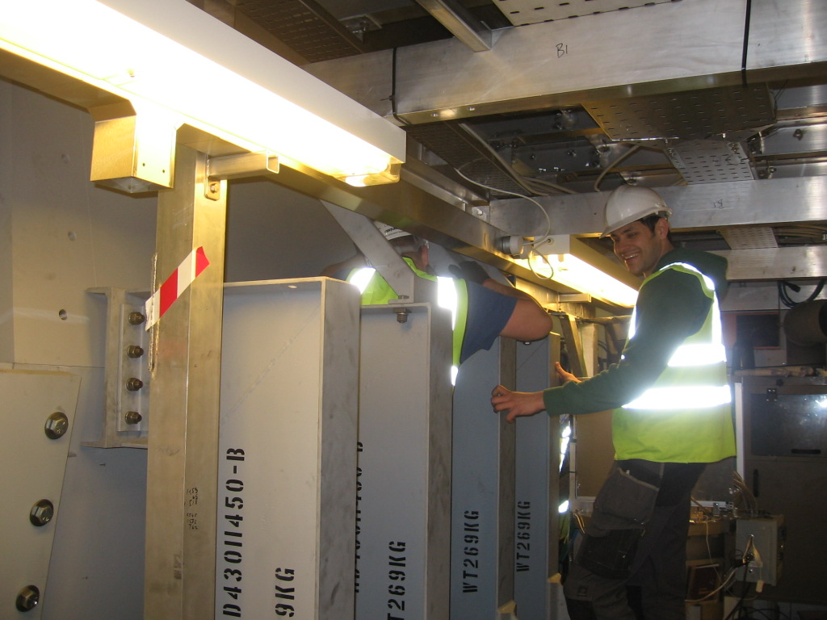
PRY South Side
April 1st 2015

Slide 12
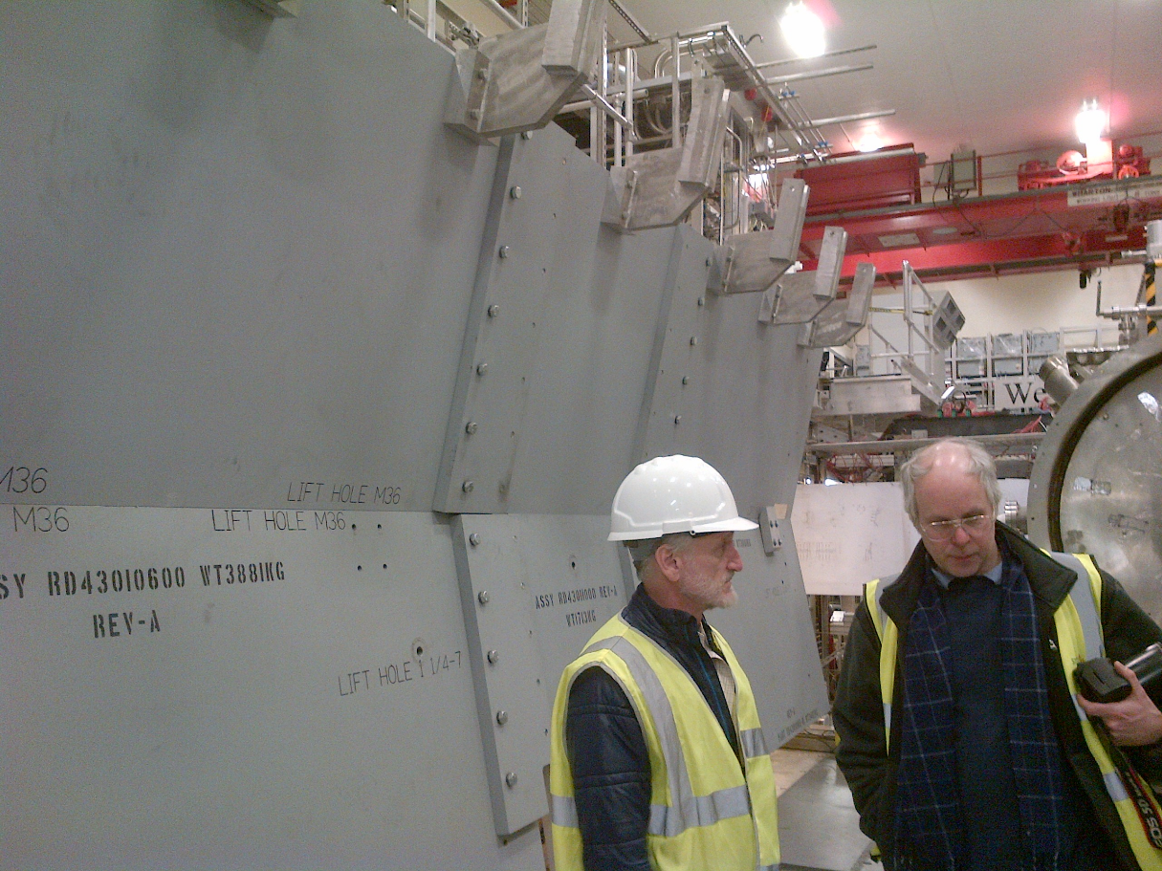
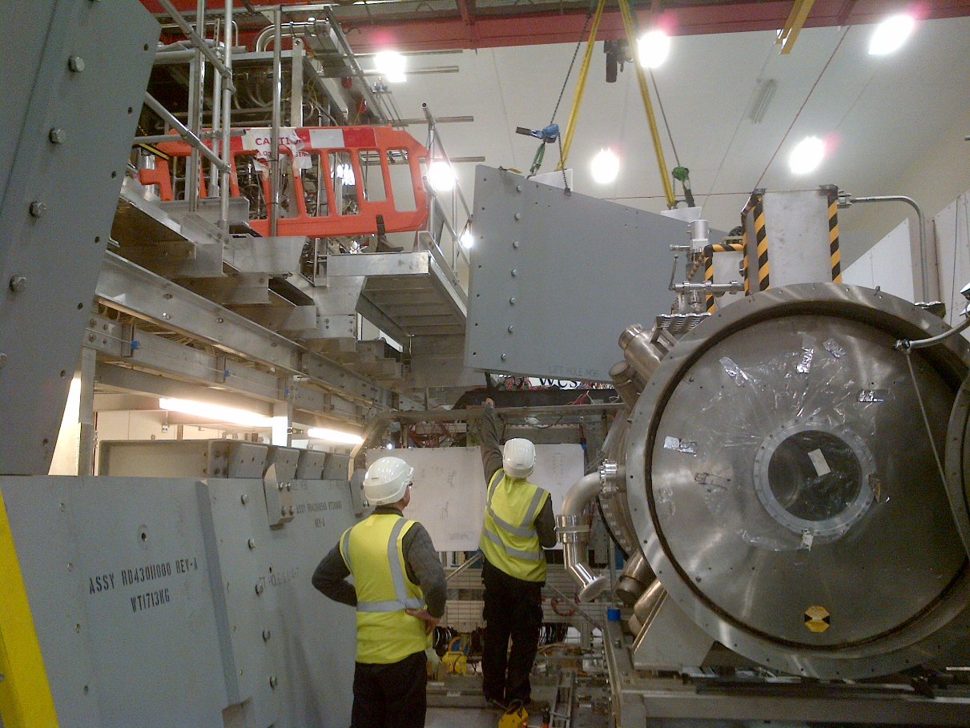
PRY South Side
April 2nd 2015

Slide 13
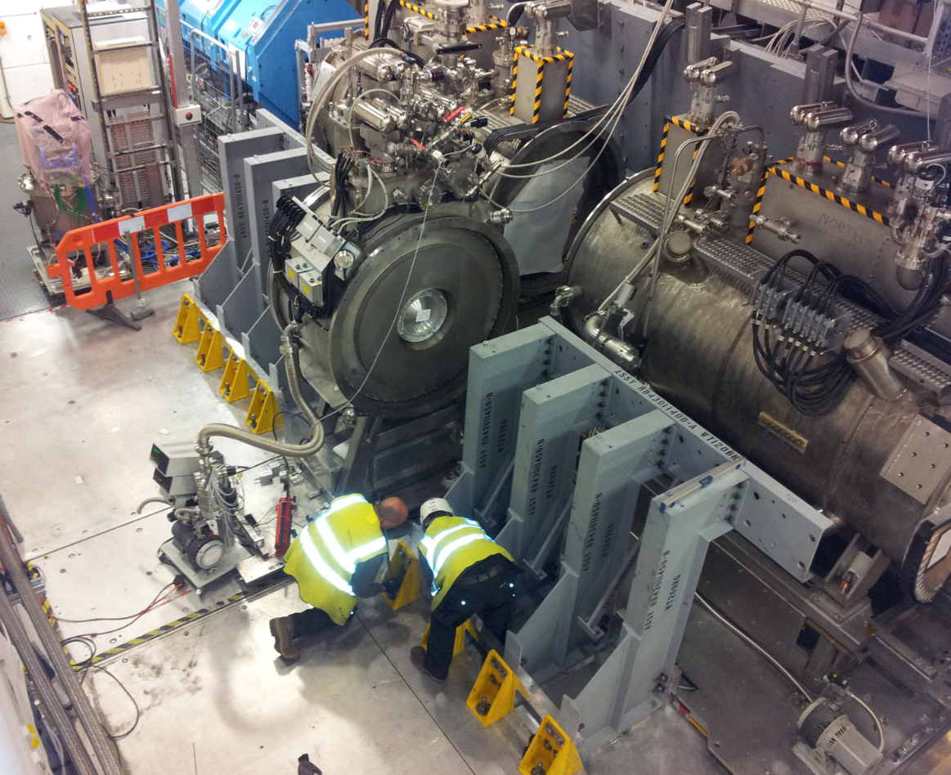
PRY North Side
PRY South Side
Support structure
aligned to within 1 mm
May 15th 2015

Slide 14
Effect of PRY on MICE Beam

Slide 15
Correction MICE Coil Currents
Solenoids run more efficiently with iron yoke
  i.e. at nominal current longitudinal field is too large
  Small effect (≈ %)
  Can be corrected by tweaking coil currents, but this is a lengthy process if done manually
New approach: perturbation theory
  Magnetization in PRY does not change
  Treat error field as perturbation
  Find set of coil currents which corrects these errors

Slide 16
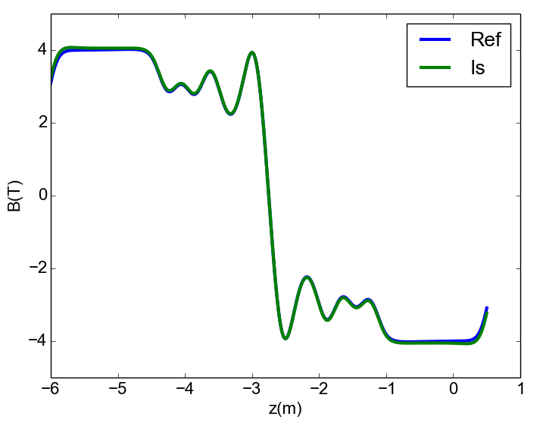
240 MeV Flip

Slide 17
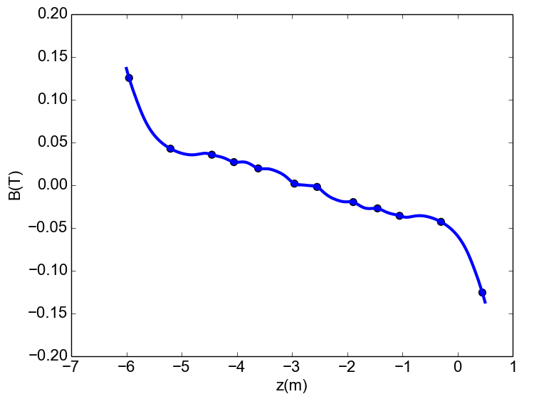
240 MeV Flip – Field Error

Slide 18
Methodology
E2
SS
E1
M2
M1
FC
B_{z1}
B_{z2}
B_{z3}
B_{z4}
B_{z5}
B_{z6}
Linear equation system
Solve for x (=I)
A · x = b

Slide 19
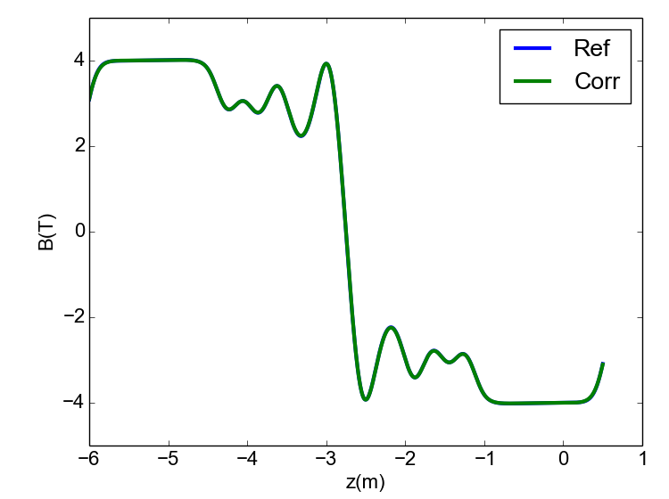
240 MeV Flip - Corrected

Slide 20
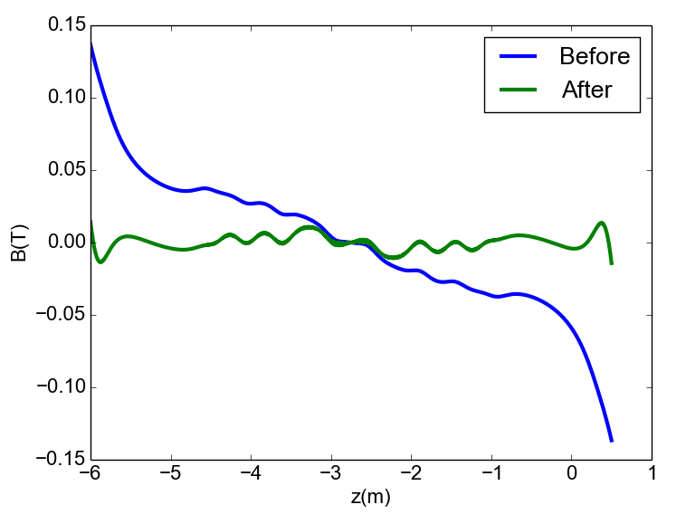
240 MeV Flip – Error Field

Slide 21
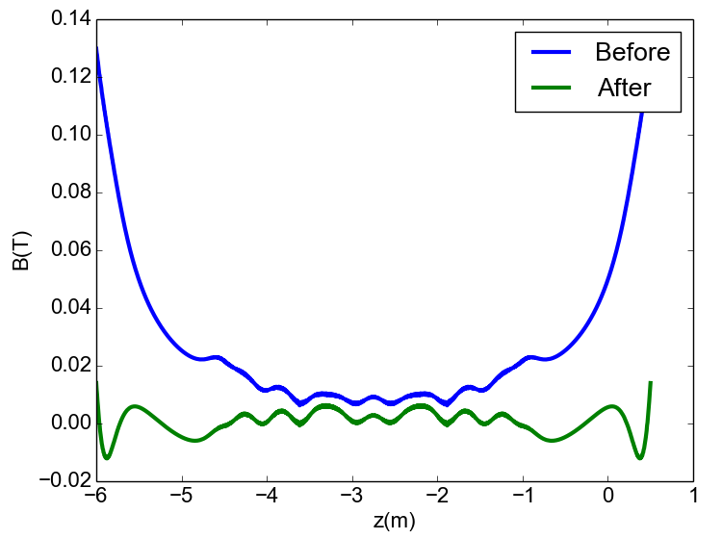
240 MeV Sol – Error Field

Slide 22
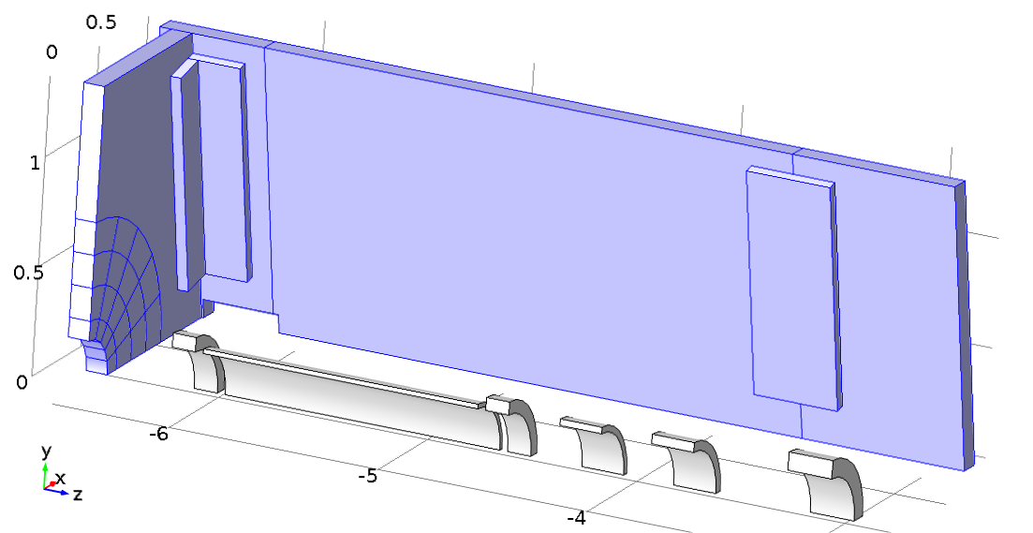
Uncorrectable Error
Partial iron return yoke: causes asymmetry of field
Evaluate by looking at field harmonics

Slide 23
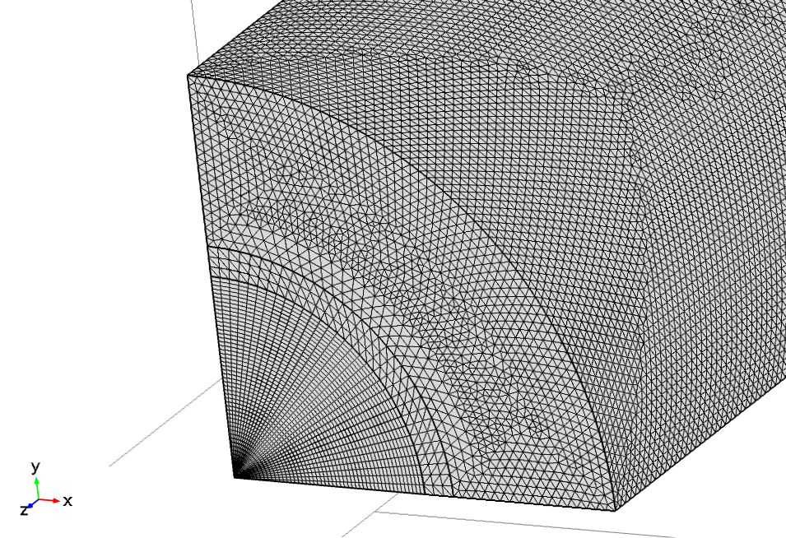
Central Mesh
Small effect, good accuracy required – need very fine mesh
Tetrahedral mesh
Surface mesh extruded
Quad mesh
(3D: hexahedral mesh)

Slide 24
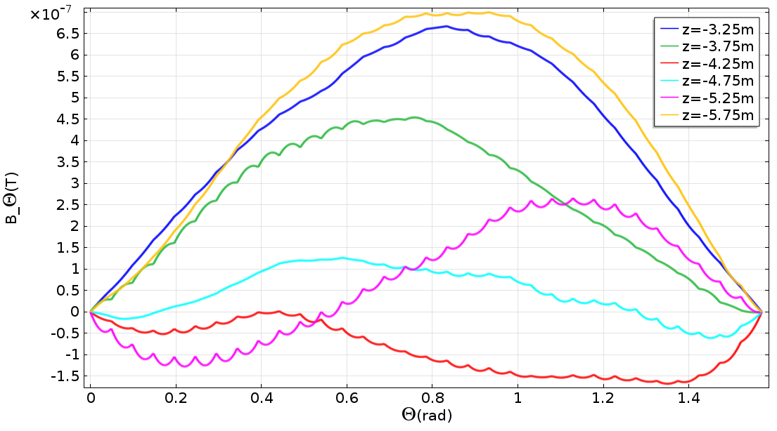
Azimuthal Field – No Iron
Mesh good enough? Test with case we know the answer for!

Slide 25
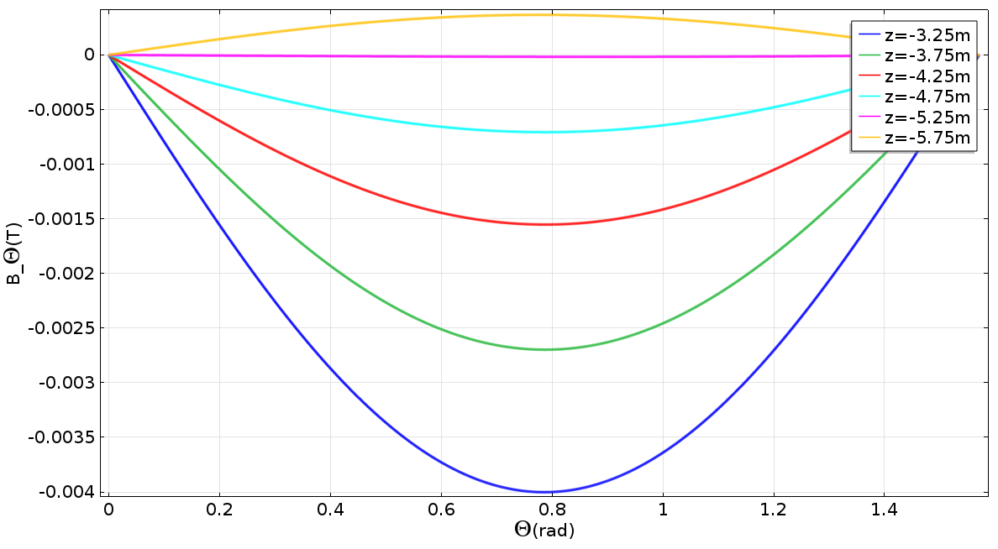
Step IV, 240 MeV Flip
R=0.15m

Slide 26
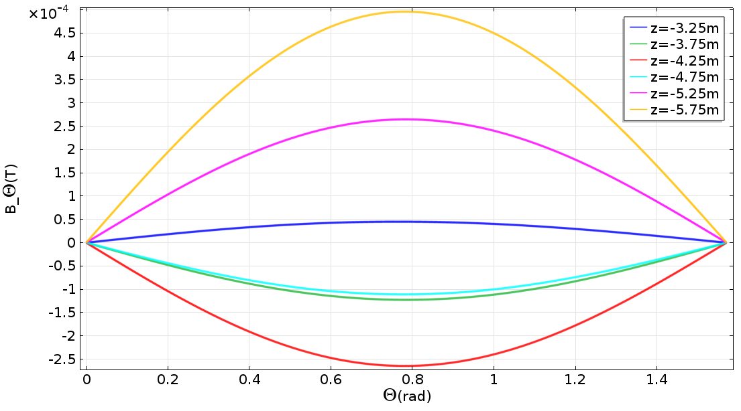
Step IV, 240 MeV Solenoid
R=0.15m

Slide 27
Harmonics 240 MeV Flip
 | A | B
1 | -5.00E-20 | -1.30E-19
2 | 1.77E-06 | 4.00E-03
3 | 5.11E-20 | 5.98E-19
4 | 6.23E-19 | -1.78E-18
5 | -3.85E-20 | 4.32E-19
6 | -1.29E-06 | -2.85E-07
7 | 1.01E-19 | 3.96E-19
8 | -5.34E-19 | 6.30E-19
9 | -5.11E-20 | 5.26E-19
10 | -4.77E-07 | 2.44E-09
11 | -1.26E-20 | -1.66E-19
 | A | B
1 | 1.00E-19 | -2.19E-19
2 | 4.25E-06 | 2.70E-03
3 | -1.19E-19 | 4.43E-19
4 | 5.86E-19 | -8.93E-19
5 | 2.92E-19 | 4.02E-19
6 | -3.10E-06 | -1.80E-07
7 | -3.64E-19 | 7.93E-20
8 | -3.18E-19 | 2.02E-19
9 | 2.64E-19 | 2.98E-19
10 | -1.14E-06 | 5.95E-09
11 | -1.73E-19 | -4.09E-20
 | A | B
1 | 7.48E-20 | -1.01E-19
2 | 2.51E-06 | 1.55E-03
3 | -9.58E-20 | 2.40E-19
4 | 3.07E-19 | -6.09E-19
5 | 2.02E-19 | 2.10E-19
6 | -1.84E-06 | -4.50E-08
7 | -1.71E-19 | 3.06E-20
8 | -3.08E-19 | 1.74E-19
9 | 9.58E-20 | 1.31E-19
10 | -6.76E-07 | 9.77E-09
11 | -1.06E-19 | -2.95E-20
 | A | B
1 | 6.65E-20 | -9.05E-20
2 | 1.25E-06 | 7.07E-04
3 | -5.38E-20 | 1.17E-19
4 | 1.45E-19 | -3.08E-19
5 | 6.43E-20 | 1.40E-19
6 | -9.15E-07 | -8.40E-09
7 | -1.02E-19 | -2.82E-20
8 | -8.09E-20 | 9.49E-20
9 | 3.57E-20 | 6.23E-20
10 | -3.32E-07 | 7.27E-09
11 | -1.05E-20 | 2.32E-20
Z=-3.25m
Z=-3.75m
Z=-4.25m
Z=-4.75m
A: real harmonics
B: skew harmonics
R=0.15m

Slide 28
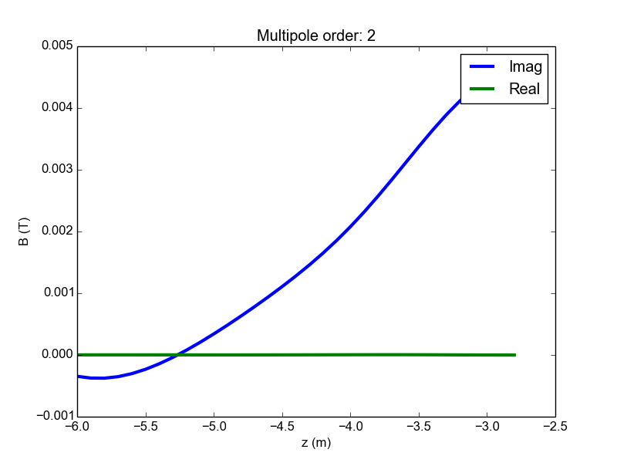
Harmonics 240 MeV Flip
R=0.15m

Slide 29
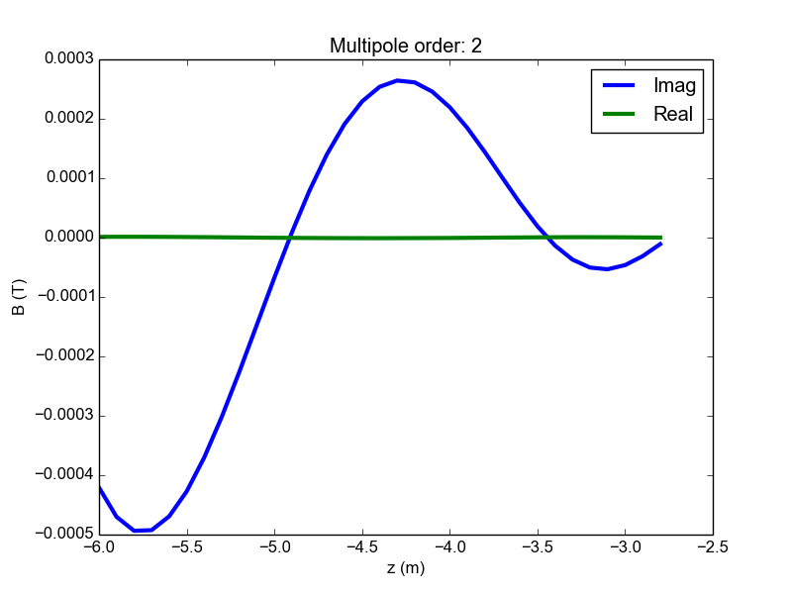
Harmonics 240 MeV Solenoid
Communicated to Analysis Group
R=0.15m

Slide 30
MICE Step V’

Slide 31
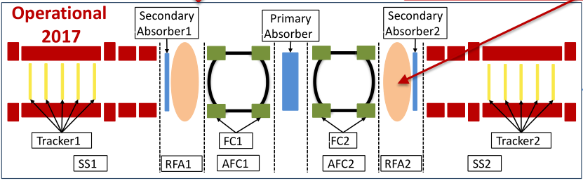
MICE Step V’
Two versions
  Reference design (J. Pasternak, V. Blackmore, …)
  Alternative design (Chris Rogers)
Described in MICE Note 450

Slide 32
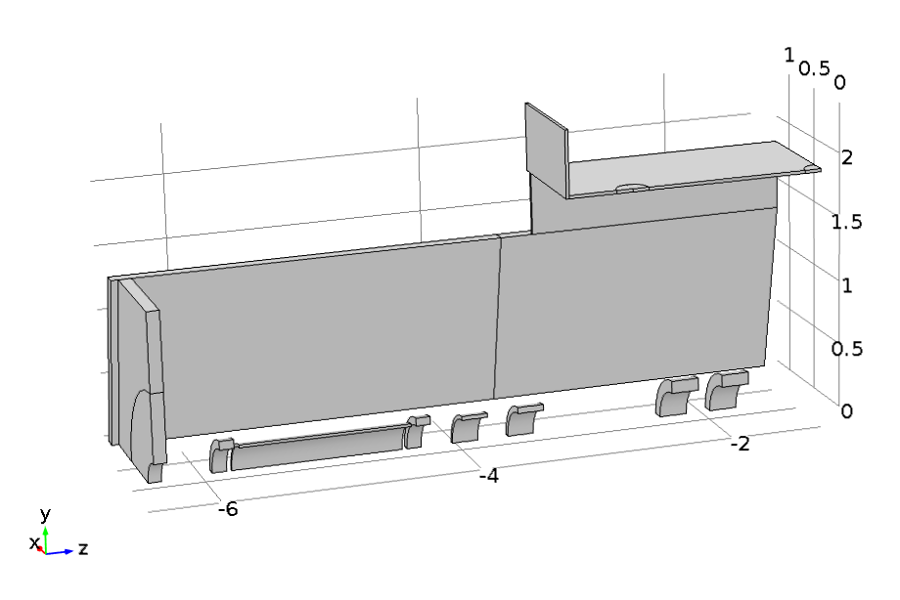
PRY MICE Final Step
Doghouse may be required to shield vacuum pumps
Existing PRY
2.25m
New PRY Section

Slide 33
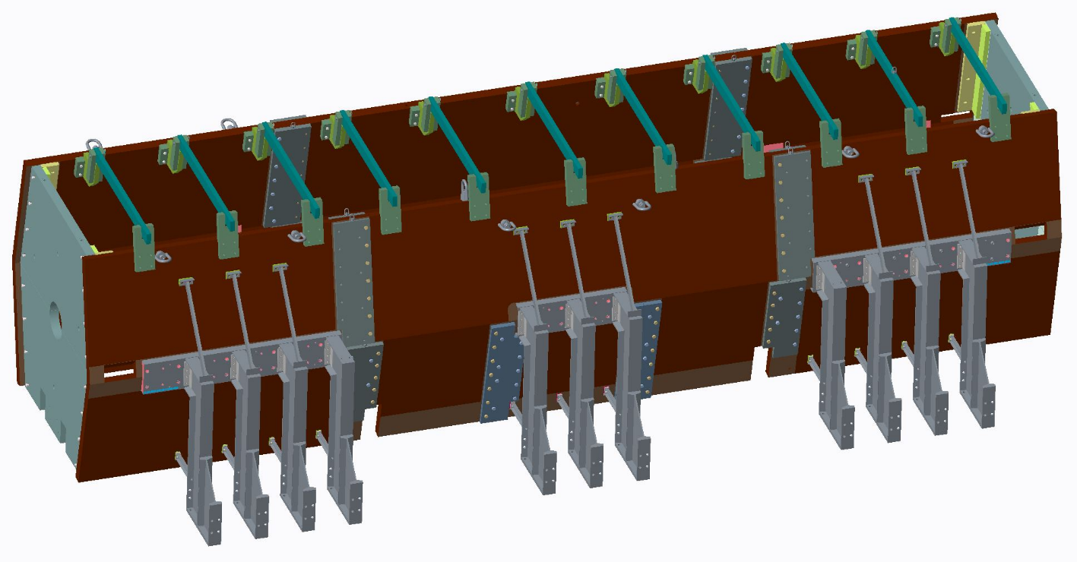
Engineering
New center section
120 kN
3 kN
1.2 kN
Aim: drawings complete by beginning of June

Slide 34
Summary
Manufacturing PRY Step IV
  South side complete and installed
  North side: at RAL
  Installation ongoing
Effect of PRY on beam
  Procedure for correction of solenoid currents
  Effect of non-correctable error on beam quantified
PRY MCE Step V’
  Engineering ongoing, expected to be finished June 1st

Slide 35
Additional Slides

Slide 36
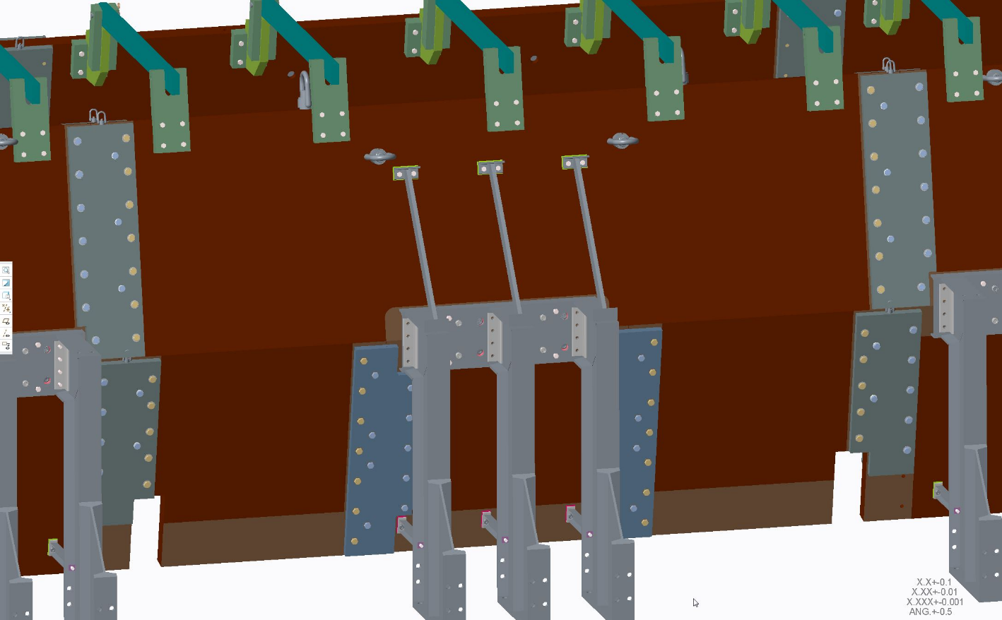
Engineering

Slide 37
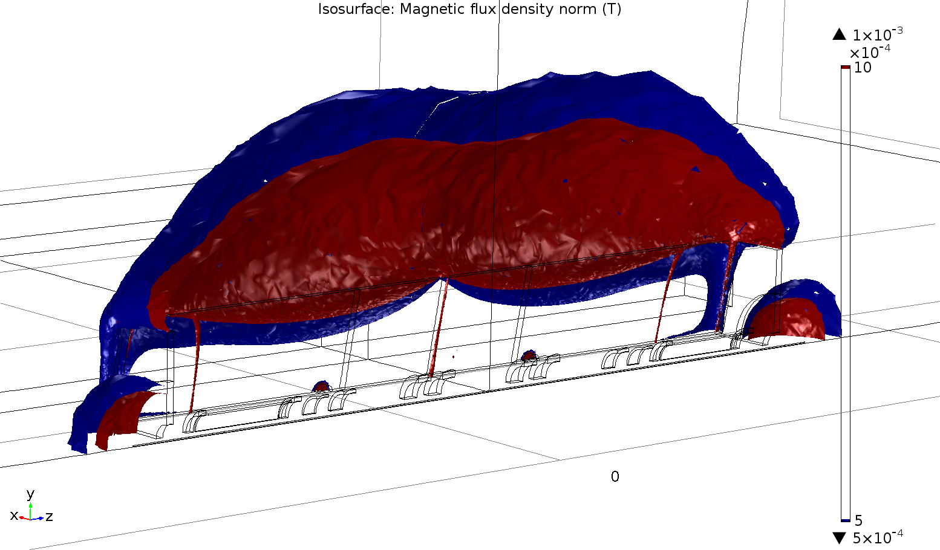
Ref Lattice - 5/10 Gauss No Doghouse

Slide 38
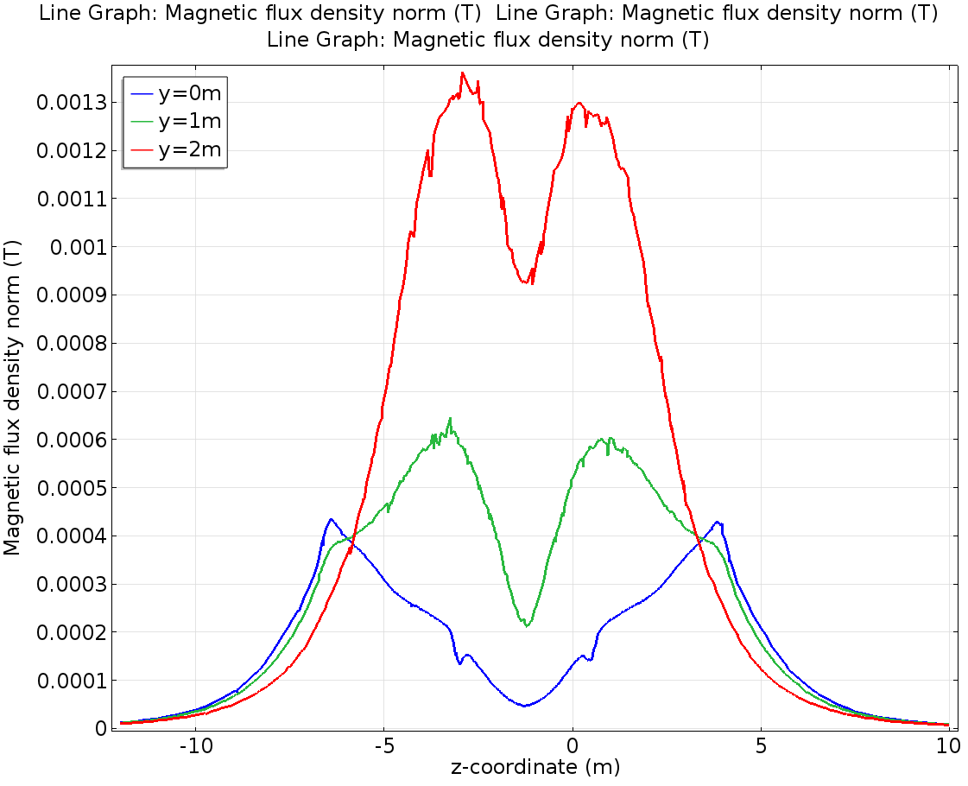
Reference Lattice

