Slide 1
MICE
…and the next generation of muon beams for particle physics

Slide 2


Fundamental
  Particles &
  forces
Understanding:
  Symmetries
  Conservation laws
  Dynamics
And yet …
The Standard Model
u
c
t
g
up
charm
top
gluon
Quarks
s
γ
d
b
down
strange
bottom
photon
Force Carriers
ν_{e}
ν
ν
ν_{e}
ν
ν
W
μ
τ
μ
τ
Leptons
e-neutrino
μ-neutrino
τ-neutrino
τ
W boson
e
μ-neutrino
τ-neutrino
e-neutrino
μ
Z
electron
muon
tau
Z boson
Generations of matter
I
II
III
Higgs
Boson
Higgs
Boson
Discovered completing the picture …

Slide 3
… our understanding remains incomplete
Hypothesis:
  The Standard Model is sufficient
Test through study of Higgs at LHC, ILC, FCC, MC … :
  Requires exquisite precision; √s ➔ 1 TeV

Slide 4
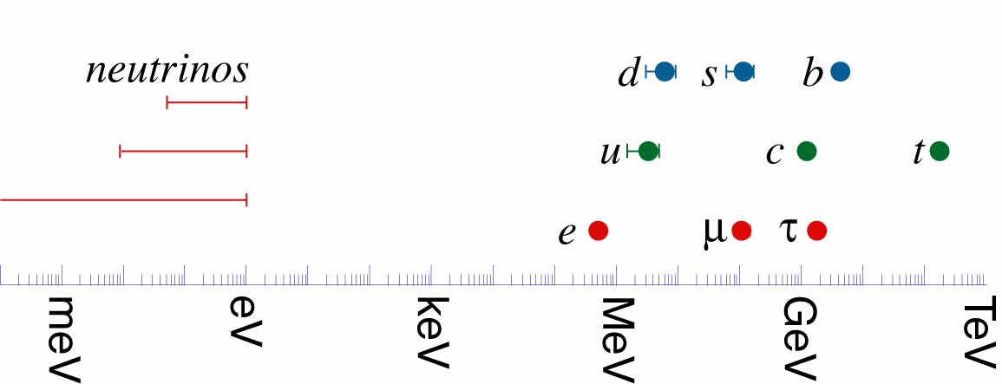
… our understanding remains incomplete

Slide 5
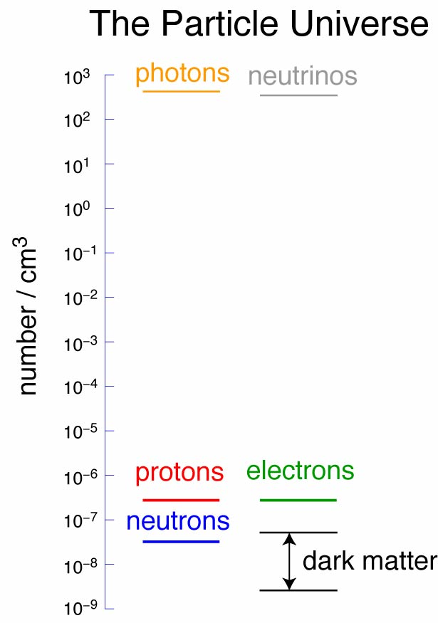
… our understanding remains incomplete

Slide 6
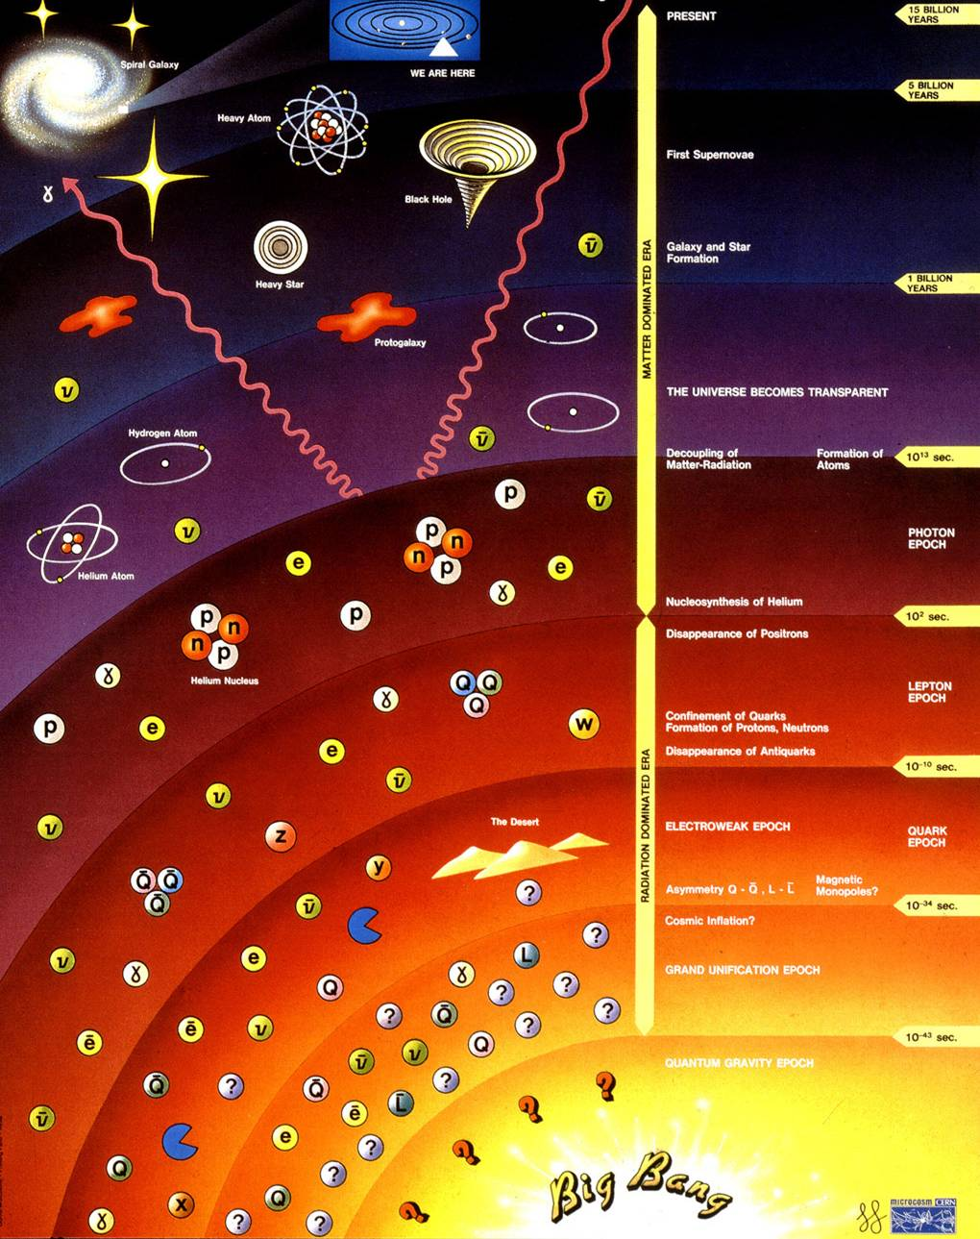
Dark matter
Galaxy/star
formation
Removal of
anti-matter
Inflation
Improved understanding
will have impact
beyond particle physics

Slide 7
Muon beams have the potential to
Serve neutrino physics with intense beams that have:
  Precisely known flavour content;
  Precisely known energy spectrum
Provide multi-TeV lepton-anti-lepton collisions:
  With extremely small energy spread;
  Most cost-effective means to achieve E_{CM} > 1. TeV

Slide 8
Contents
Muon beams for particle physics
Ionization cooling
Muon Ionization Cooling Experiment (MICE)
Historical interlude
Vision for a cold, bright future for muon beams
Conclusions

Slide 9
Muon beams for particle physics
MICE and the next generation of muon beams for particle physics

Slide 10
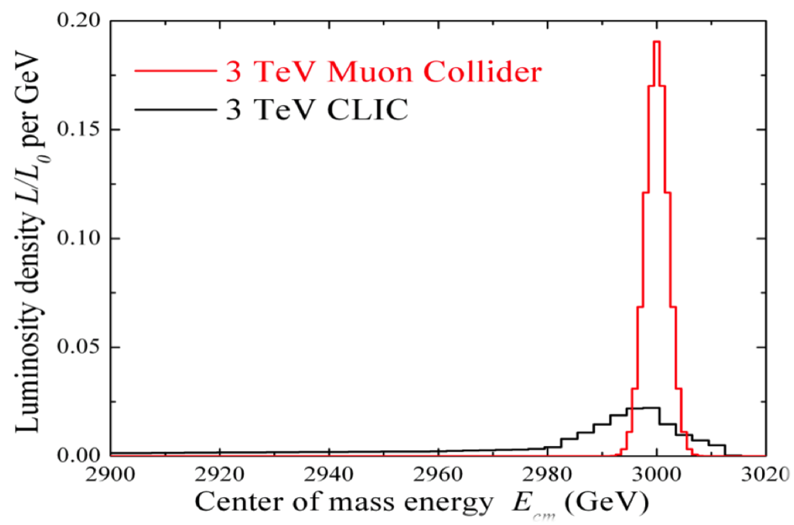
Muon beams; basis of advantages
Muon mass:
  m_{μ} = 106 MeV/c² ≈ 200 * m_{e}
Consequences:
  Negligible synchrotron radiation during acceleration:
    Rate ∝ m⁻⁴ ⇒ reduction of factor 5 × 10⁻¹⁰ over e
  Strong coupling to Higgs:
    Production rate ∝ m² ⇒ enhancement 5 × 10⁴ over e⁺e⁻

Slide 11
Muon Collider:
Optimum route to multi-TeV lepton-anti-lepton collisions:
  Muon mass; 200 times that of the electron mitigates:
    Synchrotron radiation;
    Beamsstrahlung
  Muon rigidity allows efficient acceleration
    Results in cost-efficient acceleration to very high energy
Luminosity critical:
  Muon-beam cooling essential
MAP/MASS

Slide 12
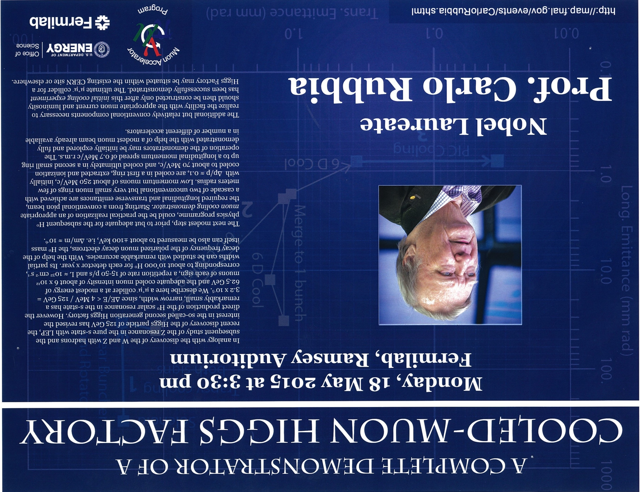

Slide 13
Muon beams; basis of advantages
Muon decay described precisely by SM
Charge to mass ratio favourable:
  Readily tune neutrino-beam energy

Slide 14
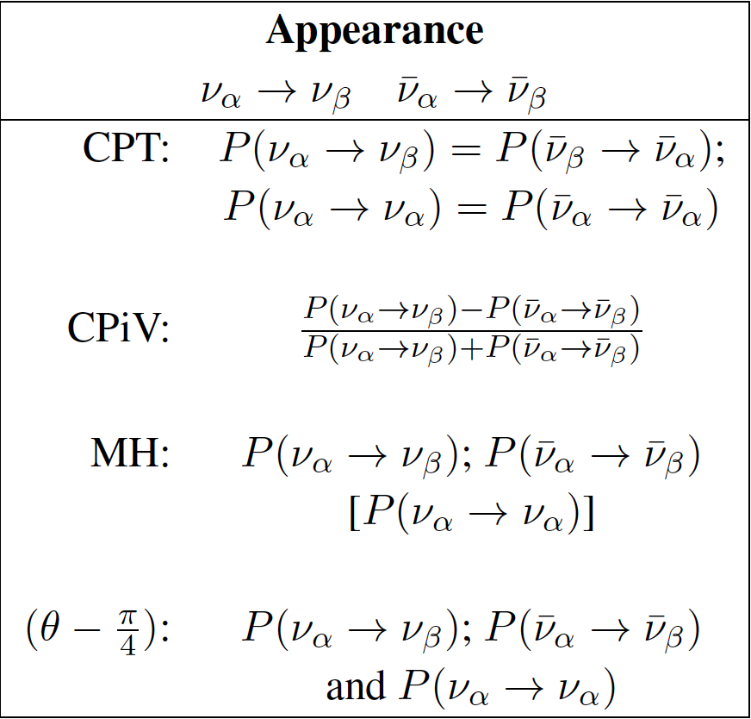
Neutrino Factory
Optimise discovery potential for CP and MH:
  Requirements:
    Large ν_{e} (ν_{e}) flux
    Detailed study of
    sub-leading effects
Unique:
  Large, high-energy
  ν_{e} (ν_{e}) flux
    Muon-beam cooling
    huge advantage
  Optimise event rate
  at fixed L/E
    Optimise MH sensitivity
    Optimise CP sensitivity

Slide 15
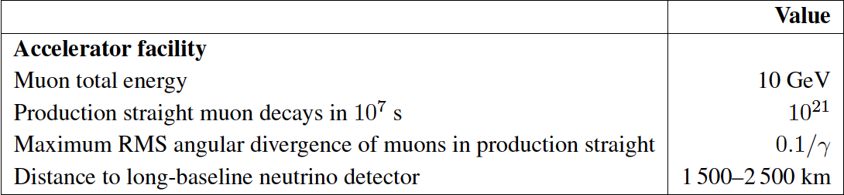
Neutrino Factory:
arXiv:1112.2853
Two approaches:
  Optimise L and E to match magnetised Fe/scintillator
    IDS-NF approach:
      1.4% signal
      20% background

Slide 16
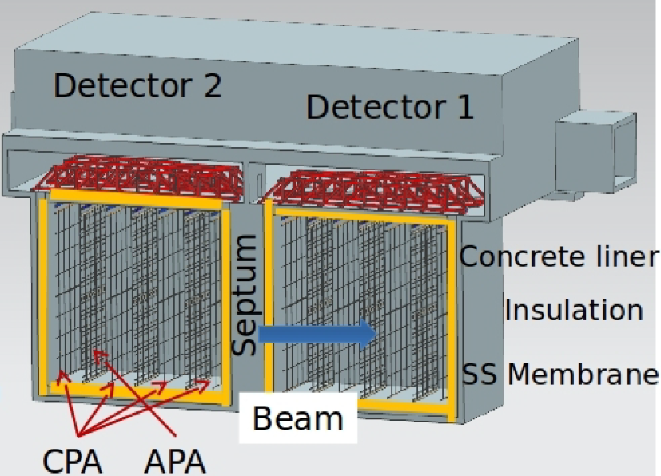
Neutrino Factory
arXiv:1112.2853; 1308.0494v1
Two approaches:
  Optimise L and E to match detector threshold
    IDS-NF approach:
  Exploit LAr detector sited 1300 km from FNAL
    MAP/MASS approach:
MAP/MASS

Slide 17
Neutrino Factory
Bayes, Coloma, Huber
IDS-NF
NuMAX

Slide 18
Neutrino Factory & Muon Collider concept

Slide 19
Accelerator challenges
High-power, pulsed proton driver:
  Development of high-power, pulsed proton source underway at proton labs
Pion-production target:
  MERIT experiment
    Proved principle of mercury jet target
Muon front end:
  Chicane (new) to remove secondary hadrons:
  MuCool programme at FNAL:
    Study of effect of magnetic field on high-gradient, warm, copper cavities;
  MICE experiment at RAL:
    Proof of principle of ionization-cooling technique
Rapid acceleration:
  EMMA experiment at DL:
    Proved principal of non-scaling FFAG technique

Slide 20
Ionization cooling
MICE and the next generation of muon beams for particle physics

Slide 21
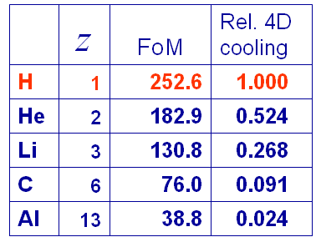
Competition between:
  dE/dx [cooling]
  MCS [heating]
Optimum:
  Low Z, large X₀
  Tight focus

Slide 22
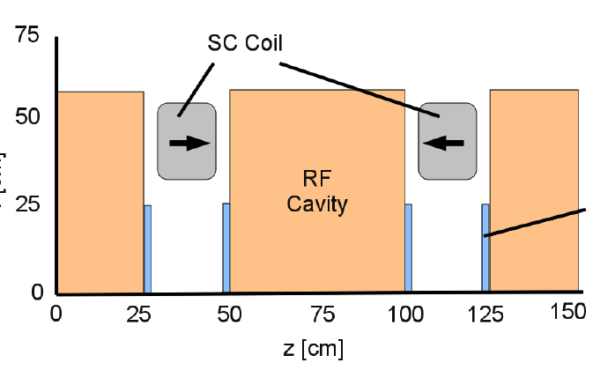
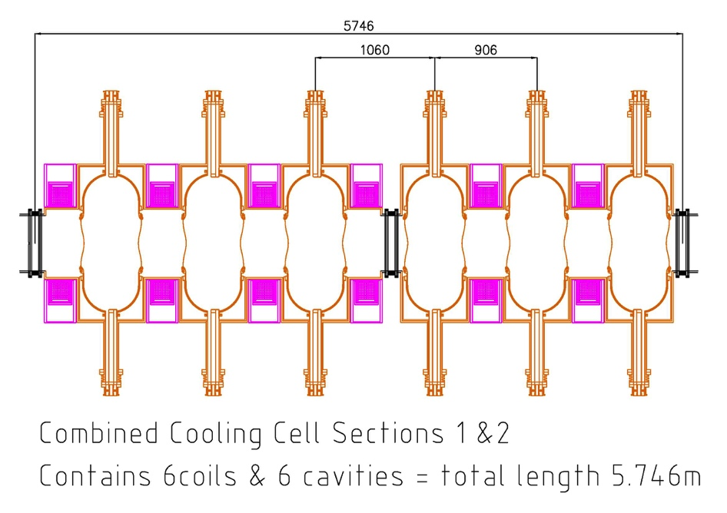
Neutrino Factory
Requirement is to maximise rate:
  Transverse (4D) cooling sufficient
IDS-NF/Accel

Slide 23
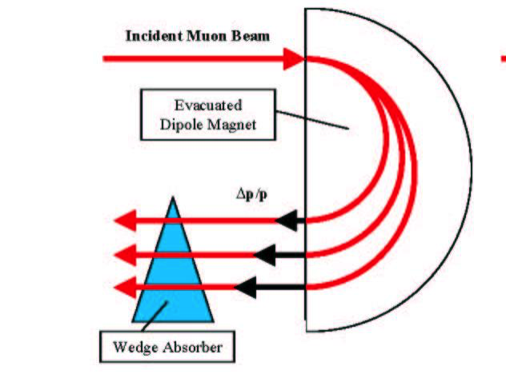
Muon Collider
Requirement is
tiny emittance
  6D cooling essential
MAP

Slide 24
Muon Collider: cooling system
MAP

Slide 25
Muon Ionization cooling Experiment
… MICE
MICE and the next generation of muon beams for particle physics

Slide 26
MICE:
MICE approved to:
  Design, build, commission and operate a realistic section of cooling channel
  Measure its performance in a variety of modes of operation and beam conditions
    Results will allow Neutrino Factory [and Muon Collider] complex to be optimised
Requirements:
  Normalised transverse emittance: 0.1%
    Requires selection of 99.9% pure muon sample
ISIS
RAL
MICE

Slide 27
Cooling demonstration; performance:

Slide 28
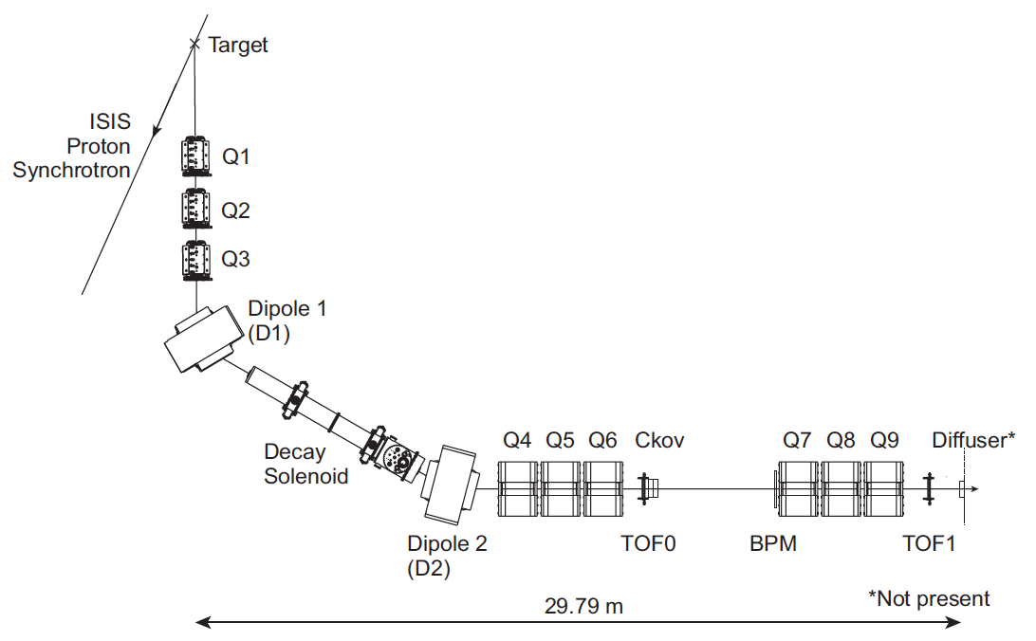
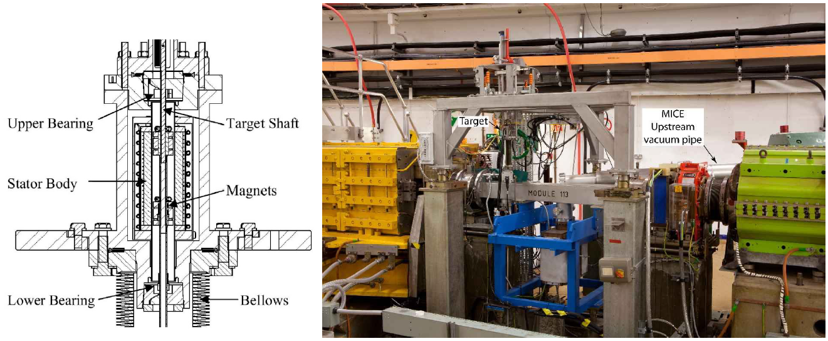
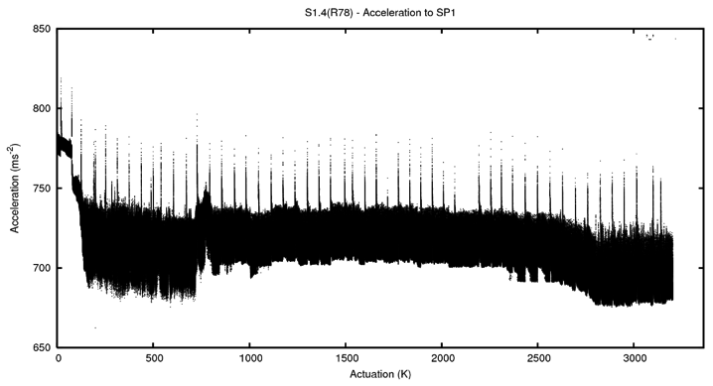
MICE Muon Beam

Slide 29
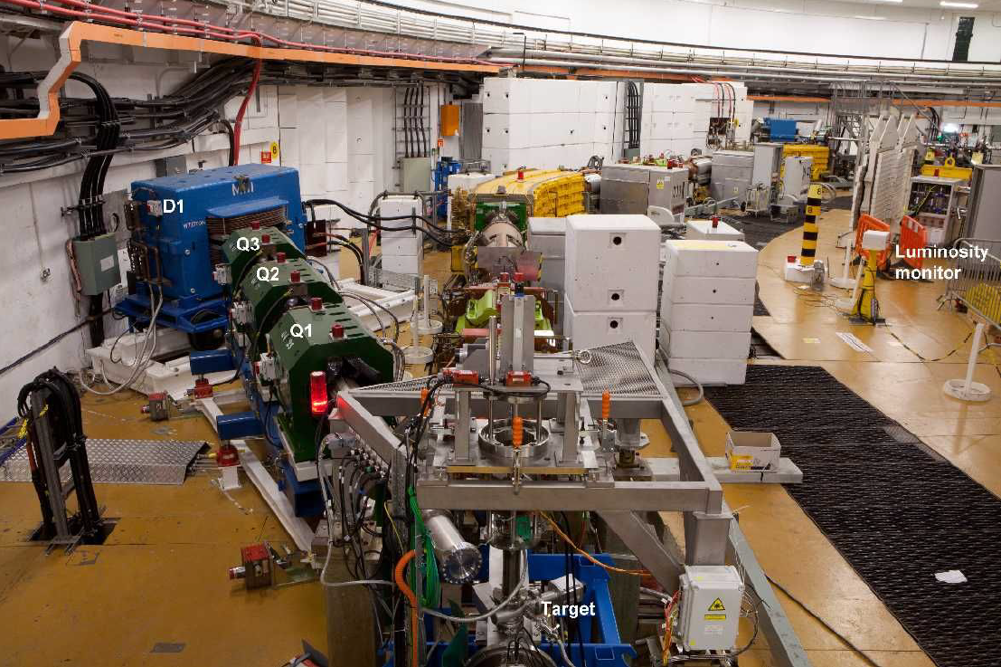
MICE Muon Beam

Slide 30
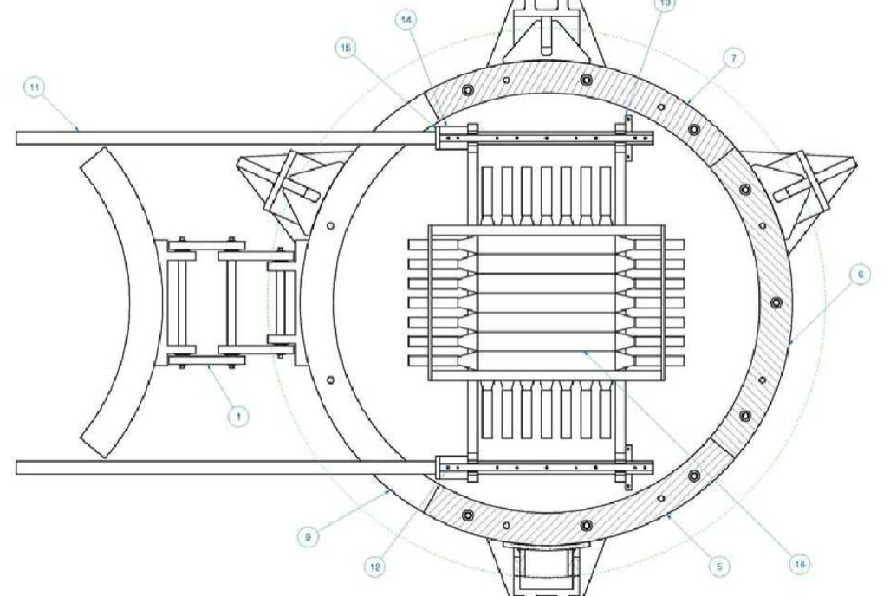
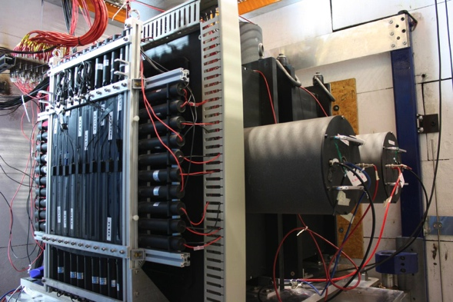
Beam-line instrumentation

Slide 31
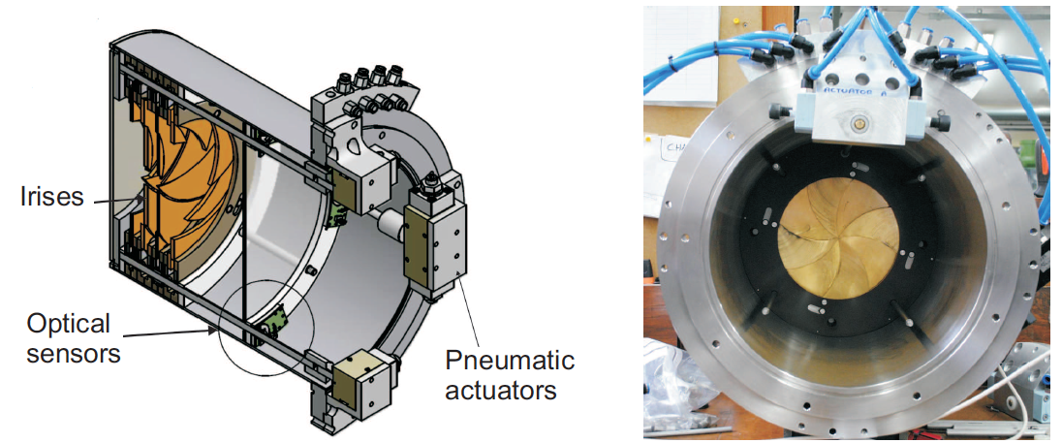
MICE Muon Beam

Slide 32
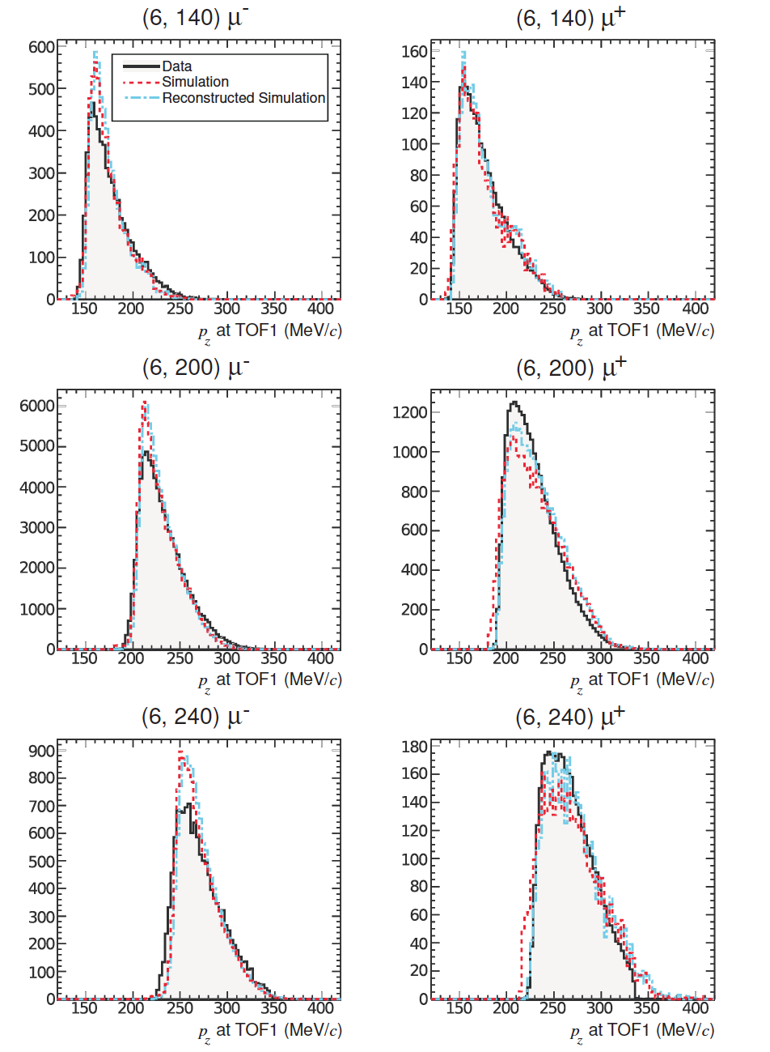
Characterisation of the MICE Muon Beam
Iterate to determine trace-space parameters:
  Initial estimate of p_{z} from TOF
  (x₀,y₀), (x₁,y₁) and M_{x,y}(p_{z}) used to determine trace-space parameters
  Updated estimate of p_{z} from trace space parameters
Corrections applied for energy loss in air and material

Slide 33
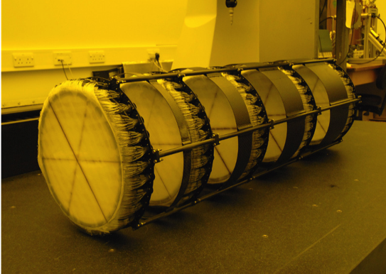
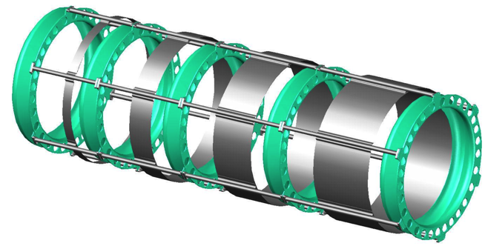
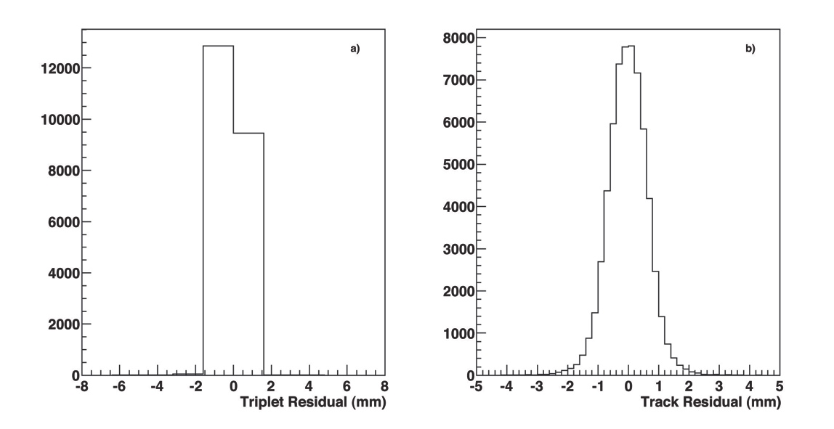
MICE trackers
350 μm scintillating-fibre tracker:
  10 p.e./mip demonstrated with cosmics
  470 μm intrinsic resolution per plane
MC: delivers per-cent level emittance measurement

Slide 34
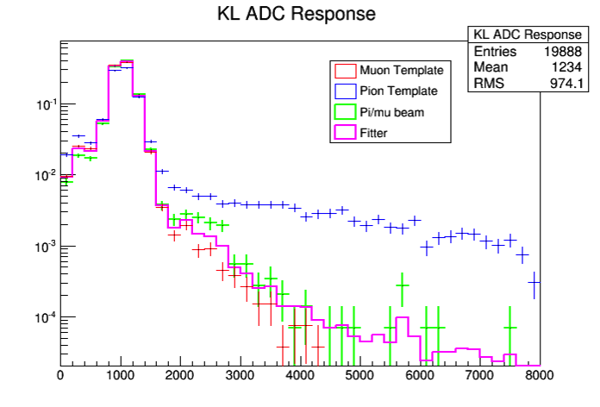
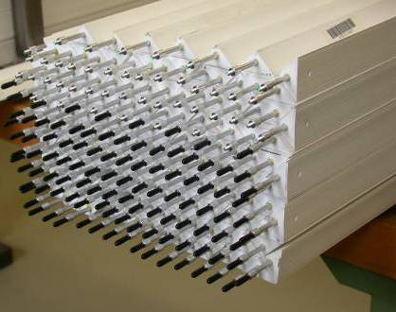
Calorimetry

Slide 35
Single cavity modules
14.5 MV/m achieved in magnetic field
  MICE requirement
  10.3 MV/m

Slide 36
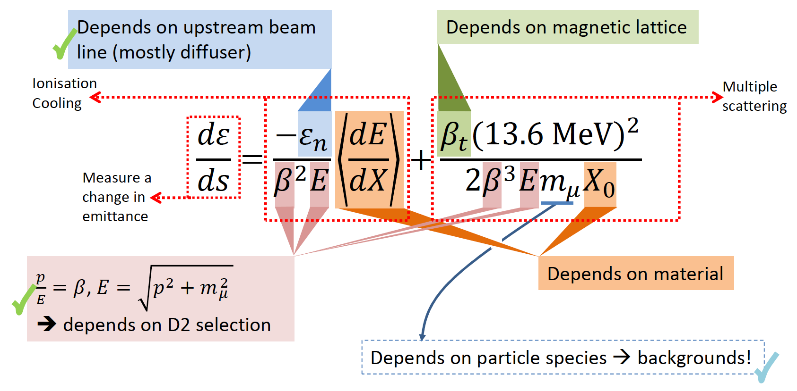
Study of factors that affect cooling:
Emittance:
  MICE Muon Beam optics and diffuser settings
Material:
  Absorber change (LH2; LiH);
p, E and β:
  Vary beam momentum, optics
Data taking: summer 2015 to summer 2016
Commission has started (in parallel to completion of the build)

Slide 37
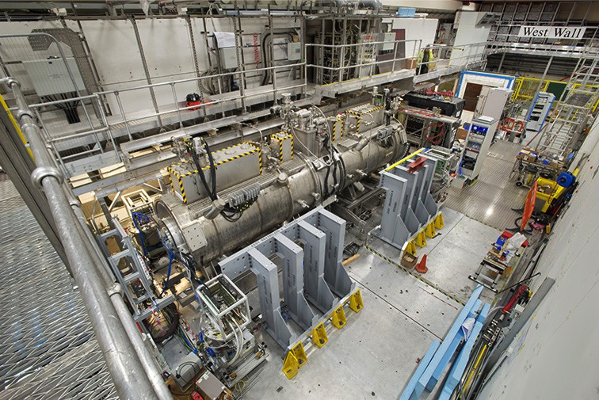
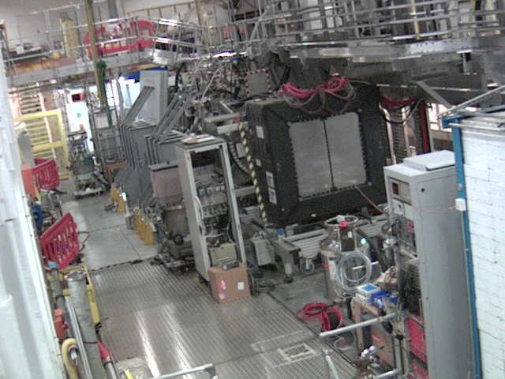
MICE Step IV

Slide 38
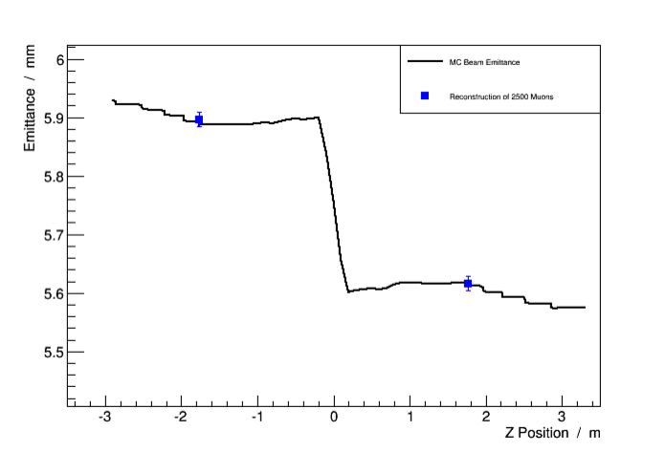
“Step IV”; 2015/16

Slide 39
Historical interlude
MICE and the next generation of muon beams for particle physics

Slide 40
Neutrino & the Standard Model
1950
1960
1970
1980
1990
2000
2010
2020
2030
The
dark
age!

Slide 41
Discovery of muon neutrino: ν_{μ}
Brookhaven; Alternating Gradient Synchrotron
Beryllium
target
Protons
Neutrinos
Neutrino
detector
Lederman,
Schwarz,
Steinberger
Steinberger,
Ledermann,
Swartz

Slide 42
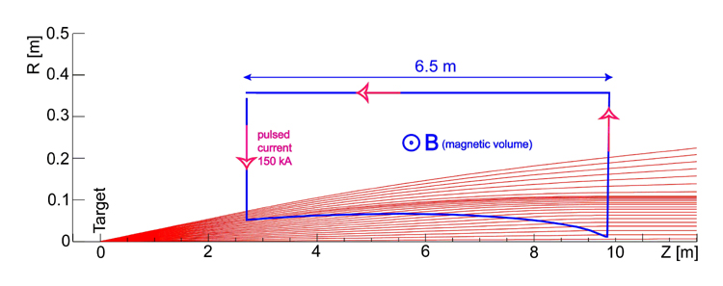
Innovation, the first neutrino beam:
Increase neutrino flux by order of magnitude:
  Focus π/K produced in proton-target interaction:
    Ideally point to parallel;
      Requires toroidal magnetic field
Requires:
  Extracted, pulsed proton beam

Slide 43
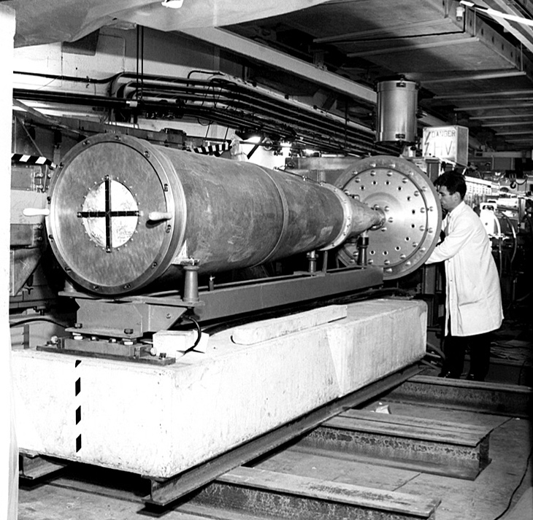
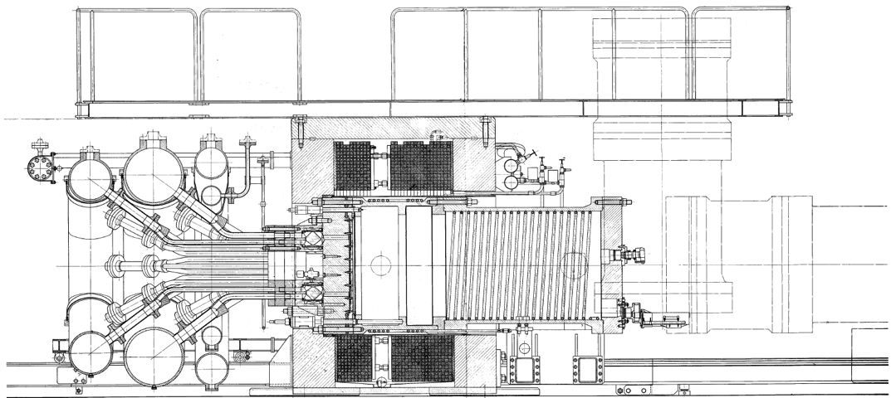
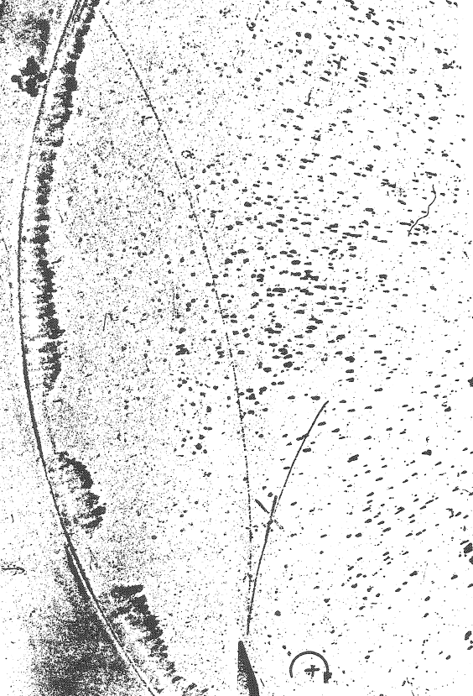
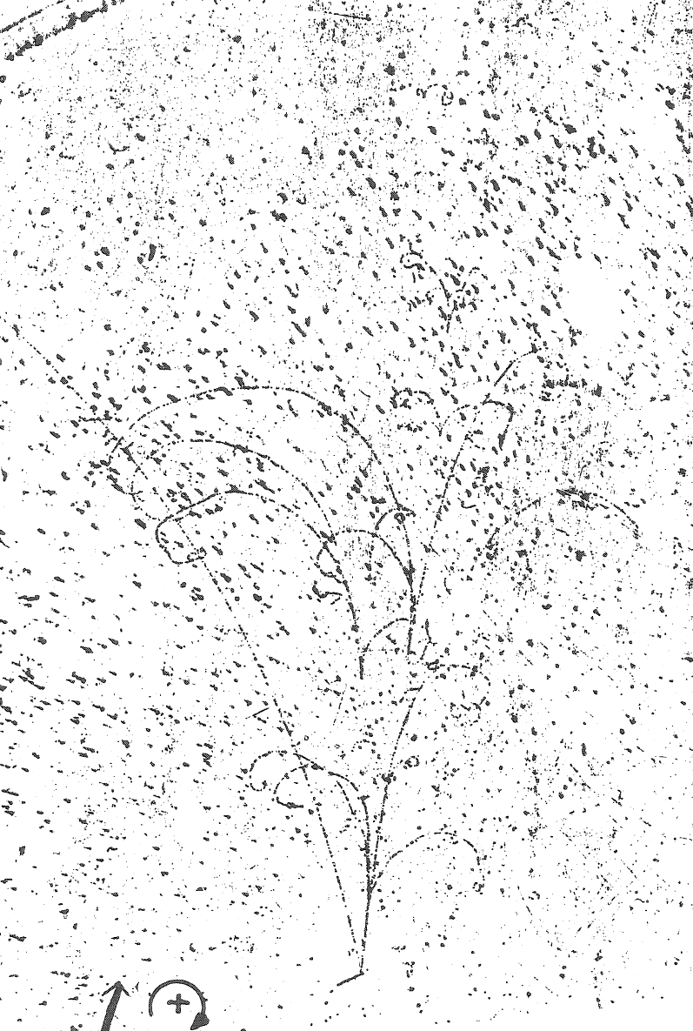
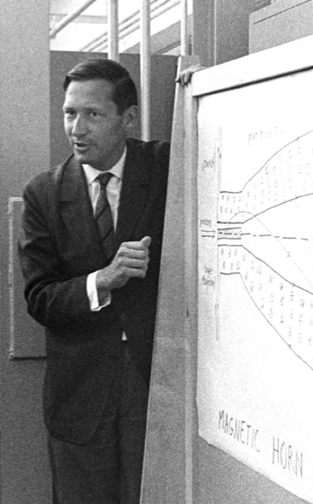
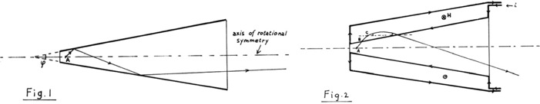
Innovation, the first magnetic horn:
Simon van der Meer
CERN, 1961
Confirmation:
muon-/electron-neutrino universality
Further innovation:
  The bubble chamber

Slide 44
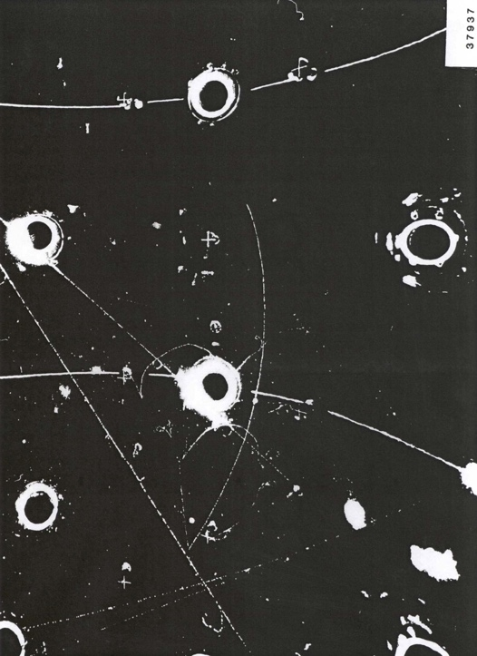
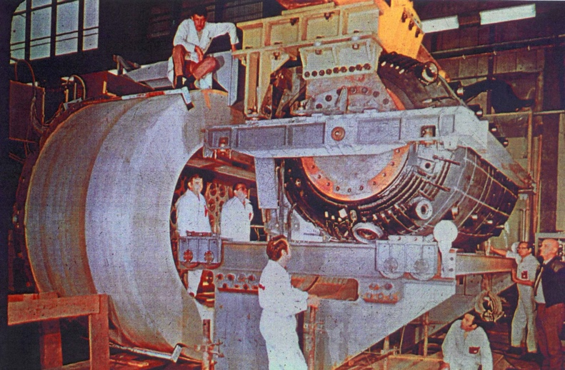
Discovery of neutral currents:
Development …
of beam and detector:
  Improved horn:
    Parabolic; with neck and downstream toroids
  Improved detector:
    Gargamelle
1971

Slide 45
Neutrino & the Standard Model
CERN
Horn and bubble chamber
First neutrino beam
IHEP
SKAT, JINR
CERN
Gargamelle, Aachen/Padova, CDHS,
CHARM, BEBC, CCFR, NOMAD, CHORUS
BNL
first neutrino
“beam”
BNL/FNAL
CITF, HPWF, 7’ BC, 15’ BC, E605,
E613, E734, E776, NuTEV
CERN
Horn #2 & Gargamelle
1950
1960
1970
1980
1990
2000
2010
2020
2030
ν_{μ}
discovery
Development of
E/w SM, QPM, QCD
ν_{e}/ν_{μ}
universality
Neutral
Current
discovery
The
dark
age!
The middle ages

Slide 46
Neutrino oscillations
SK collaboration: PRL 81(8) 1998
Super-Kamiokande

Slide 48
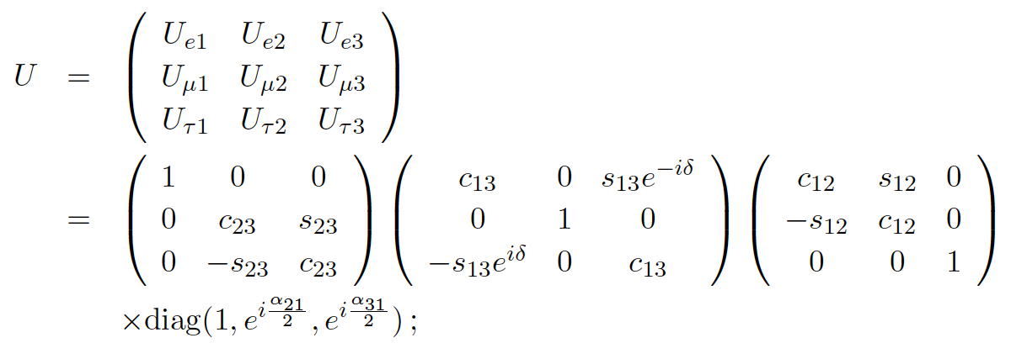
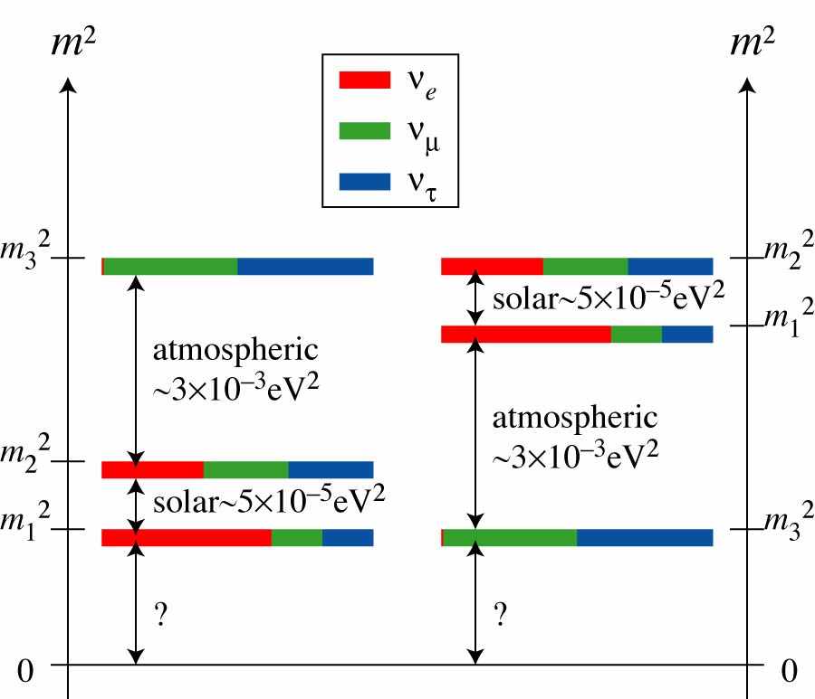
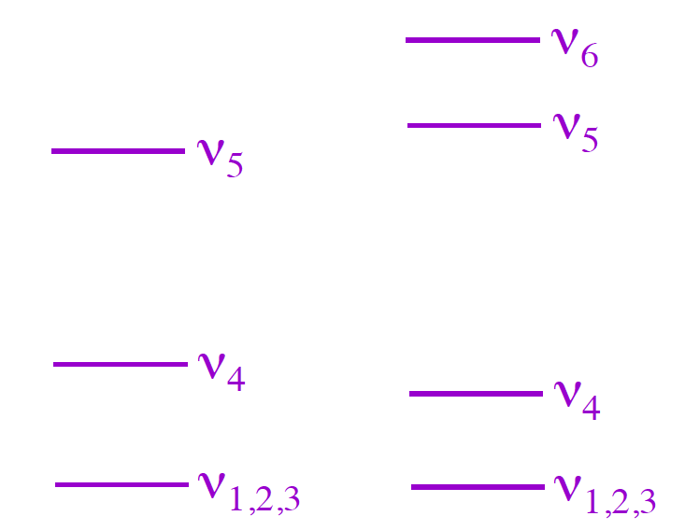
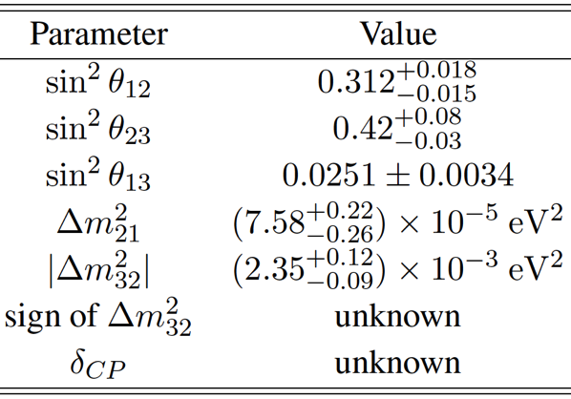
Steriles

Slide 49
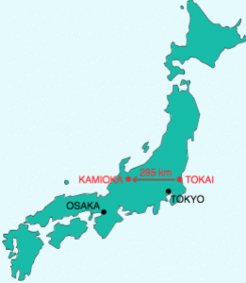
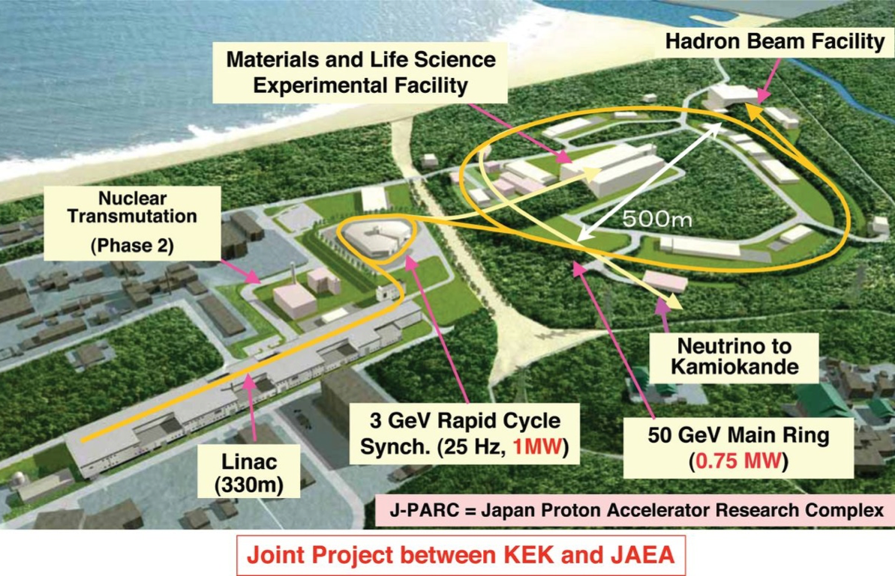
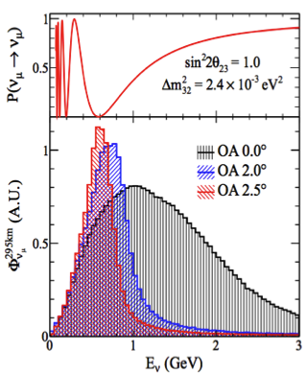
T2K: electron-neutrino appearance:
Bordoni, Neutrino’14

Slide 50
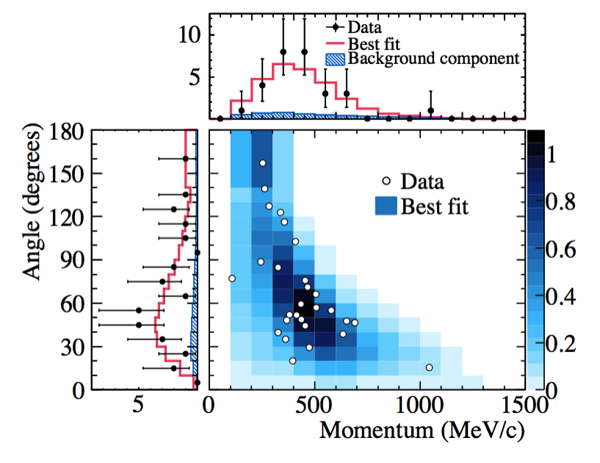
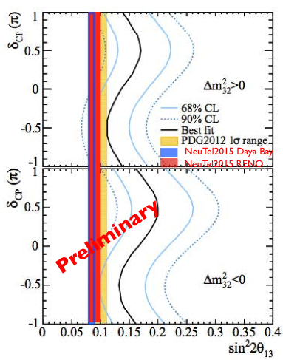
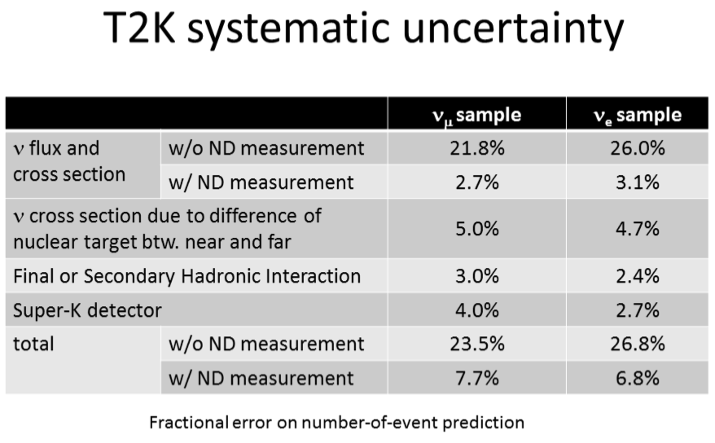
T2K: electron-neutrino appearance:
Bordoni, Neutrino’14
T2K collaboration, PRL 112.061803 2014

Slide 51
Standard Neutrino Model:
Fogli et al; 10.1103/PhysRevD.89.093018
Schwetz et al; 10.1007/JHEP11(2014)052
Notes:
The Double Chooz collaboration, by measuring the "disappearance" of electron antineutrinos, presents hints for oscillation also involving the third angle with the following value: sin^2(2theta_13) = 0.085 +/- 0.051. The probability given by preliminary results that there is no oscillation is only 7.9%.

Slide 52
Standard model and LBL oscillations
CERN
Horn and bubble chamber
First neutrino beam
IHEP
SKAT, JINR
CERN
Gargamelle, Aachen/Padova, CDHS,
CHARM, BEBC, CCFR, NOMAD, CHORUS
FNAL
MINOS, MINOS+, NOvA
CERN
OPERA, ICARUS
BNL
first neutrino
“beam”
BNL/FNAL
CITF, HPWF, 7’ BC, 15’ BC, E605,
E613, E734, E776, NuTEV
KEK/J-PARC
K2K, T2K
CERN
Horn #2 & Gargamelle
1950
1960
1970
1980
1990
2000
2010
2020
2030
ν_{μ}
discovery
Development of
E/w SM, QPM, QCD
Development of
Standard Neutrino
Model
ν_{e}/ν_{μ}
universality
Neutral
Current
discovery
The
dark
age!
The middle ages
The enlightenment

Slide 53
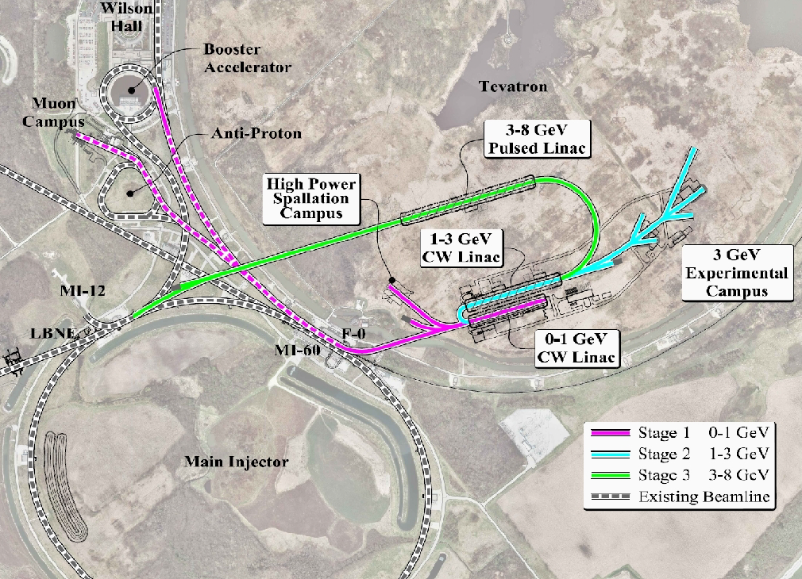
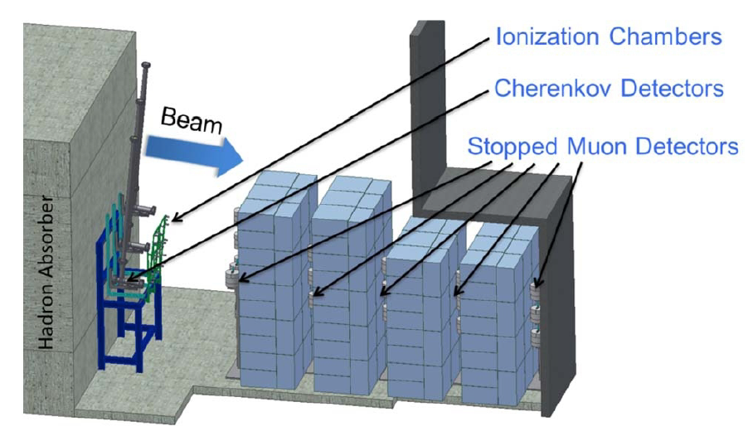

LBNF/DUNE:
1110.6249, 1307.7335
Near detector options:
  HiResMnu
  Lar TPC

Slide 54

Long-Baseline Neutrino Experiment:
Source:
  FNAL MI: 700 kW
  Project X: 2.3 MW [upgrade]
Detector: LAr TPC
  Fiducial mass: 10 kTonne
    Upgrade to 34 kTonne
  Site: SURF
    On axis; upgrade u/g 4850 ft
    Baseline 1300 km
~1.2 GeV
arXiv:1307.7335

Slide 55

Long-Baseline Neutrino Experiment:
Systematic uncertainties:
  Signal: 1%
  Background: 5%
arXiv:1307.7335

Slide 56
Standard model and LBL oscillations
CERN
Horn and bubble chamber
First neutrino beam
IHEP
SKAT, JINR
CERN
Gargamelle, Aachen/Padova, CDHS,
CHARM, BEBC, CCFR, NOMAD, CHORUS
FNAL
MINOS, MINOS+, NOvA
Global neutrino
progamme
Hyper-K
LBNF/DUNE
CERN Neutrino Platform
CERN
OPERA, ICARUS
BNL
first neutrino
“beam”
BNL/FNAL
CITF, HPWF, 7’ BC, 15’ BC, E605,
E613, E734, E776, NuTEV
KEK/J-PARC
K2K, T2K
CERN
Horn #2 & Gargamelle
1950
1960
1970
1980
1990
2000
2010
2020
2030
ν_{μ}
discovery
Development of
E/w SM, QPM, QCD
Development of
Standard Neutrino
Model
ν_{e}/ν_{μ}
universality
Neutral
Current
discovery
Discovery of
CP-invariance violation?
The
dark
age!
The
age of
reason
The
enlightenment
The middle ages

Slide 57
Innovation in detectors
M. Nessi; CERN Neutrino Platform

Slide 58
Neutrino beams
S.E. Kopp; Phys. Rep. 439 (2007) 101

Slide 59
Effect of systematics:
Performance rapidly degrades if systematic error is not controlled at the several % level
  Cross section error makes a critical contribution

Slide 60
Vision for a cold, bright future for muon beams
MICE and the next generation of muon beams for particle physics

Slide 61

Potential
Posit #1:
  %-level measurement of ν_{e}N cross sections will be required
arXiv:1307.7335
1307.1243; Coloma, Huber

Slide 62

nuSTORM and cross section measurement:
LOI to FNAL PAC: 1206.0294;
EoI to CERN: CERN-SPSC-2013-015, SPSC-EOI-009,1305.1419;
Proposal to FNAL PAC, May 2013
nuSTORM event rate is large:
  Statistical precision high:
    Can measure double-differential cross sections
Events per 100 Tonne
Events per 100 Tonne

Slide 63

CCQE cross section measurement:
Systematic uncertainties for CCQE measurement at nuSTORM:
  Six-fold improvement in systematic uncertainty compared with “state of the art”
  Electron-neutrino cross section measurement unique

Slide 64



nuSTORM serving the CERN Neutrino Platform
under study; M. Nessi et al

Slide 65
Potential
Posit #1:
  %-level measurement of ν_{e}N cross sections will be required
Posit #2:
  Neutrino Factory capability likely required

Slide 66
nuSTORM
Instrumentation
Large aperture
magnets
Target and
capture

Slide 67
Potential
Posit #1:
  %-level measurement of ν_{e}N cross sections will be required
Posit #2:
  Neutrino Factory capability likely required
Posit #3:
  Capability to deliver
  multi-TeV l⁺l⁻ collisions
  likely required

Slide 68
6D cooling demonstration
nuSTORM

Slide 69
Vision

Slide 70
Conclusions
MICE and the next generation of muon beams for particle physics

Slide 71
Muon accelerators and MICE
Muon accelerators have the potential to:
  Serve the next generation long- and short-baseline programmes by:
    Making precise measurements of electron- and muon-neutrino nucleus cross sections
  Revolutionise the study of neutrino oscillations:
    And make searches for sterile neutrinos of exquisite sensitivity
  Provide a route to multi-TeV lepton-antilepton collisions;
Development of the capability to deliver the Neutrino Factory is required:
  To study CP-invariance violation in detail if it is discovered; or
  To continue the search of it is not; and
  To deliver precision sufficient to elucidate the underlying physics
MICE will unlock the exploitation of muon accelerators by providing the essential demonstration of ionization cooling:
  Starting now:
    Investigation of the effect of material, emittance, momentum on the cooling effect
  Starting 2017:
    Demonstration of ionization cooling;
    Systematic study of factors that affect cooling performance
Basis for executing the vision!

