Slide 1
Field Emission in the 201 MHz Cavity
2015 MAP Collaboration Meeting
V. Tollestrup & K. Yonahara
FNAL

Slide 2
Measurements of Field Emission During Training of the 201 MHz Cavity
The 201 MHz model MICE cavity has been trained with both copper and Be end plates. Measurements of electron field emission have been made under both conditions while the cavity was trained to the required MICE gradient. For the Be case, studies were made both with and without axial magnet field.
This report covers the non-magnet field case. The future analysis will cover all cases and these present results are preliminary.
The low frequency of the cavity and its geometrical configuration allows measurements to be made that would be very hard for cavities in the GHz range.
These measurements were made possible by the hard work of the MTA crew.

Slide 3
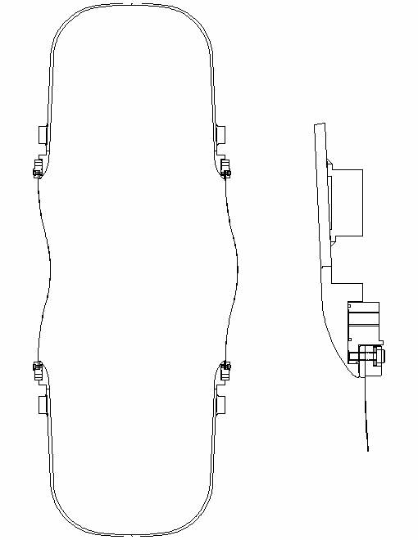
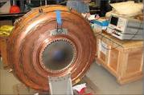
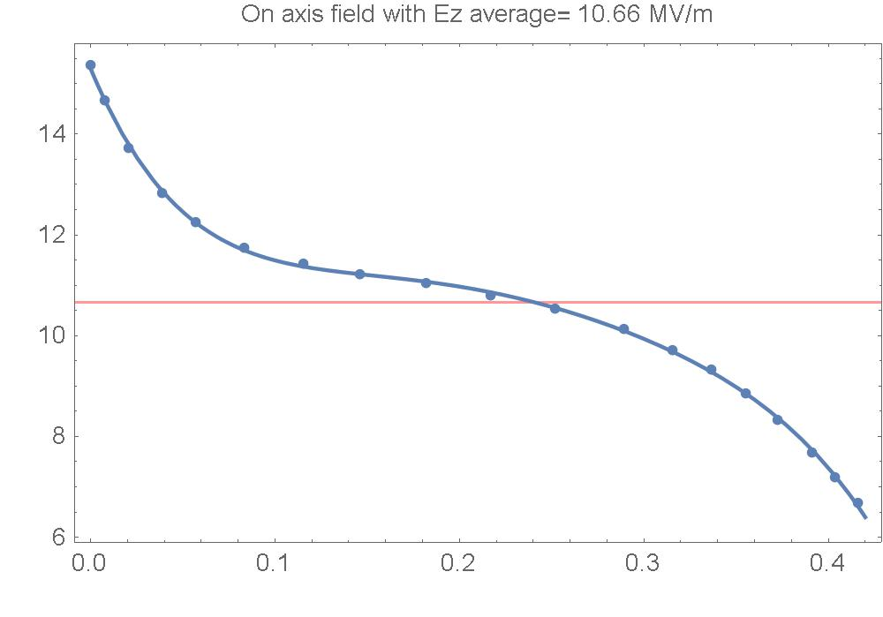
Two Configurations – Two Materials
FE this side only
No FE
Copper
Ez on axis
Ez uniform
On axsis
10.6 MV/m
Field Emission: both sides active
Tianhuan Luo <tluo@lbl.gov>

Slide 4
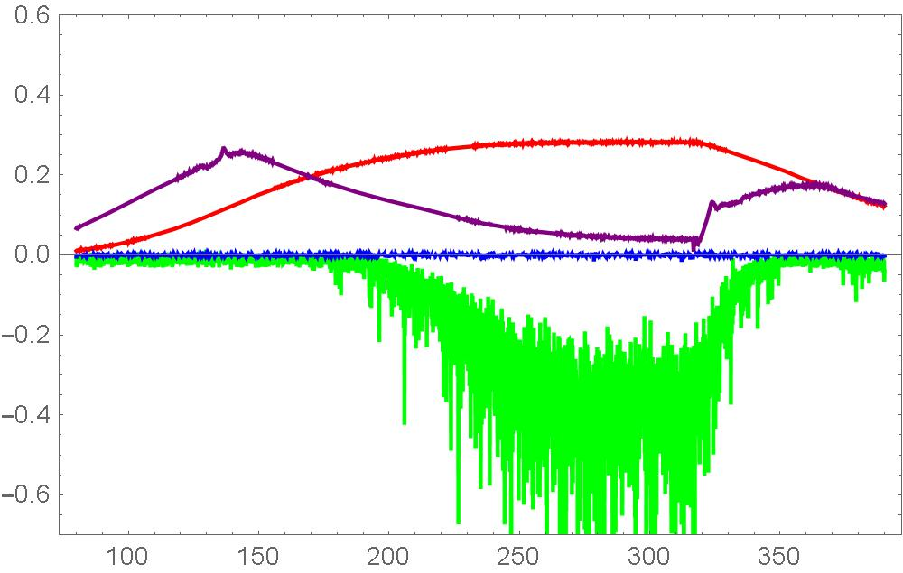
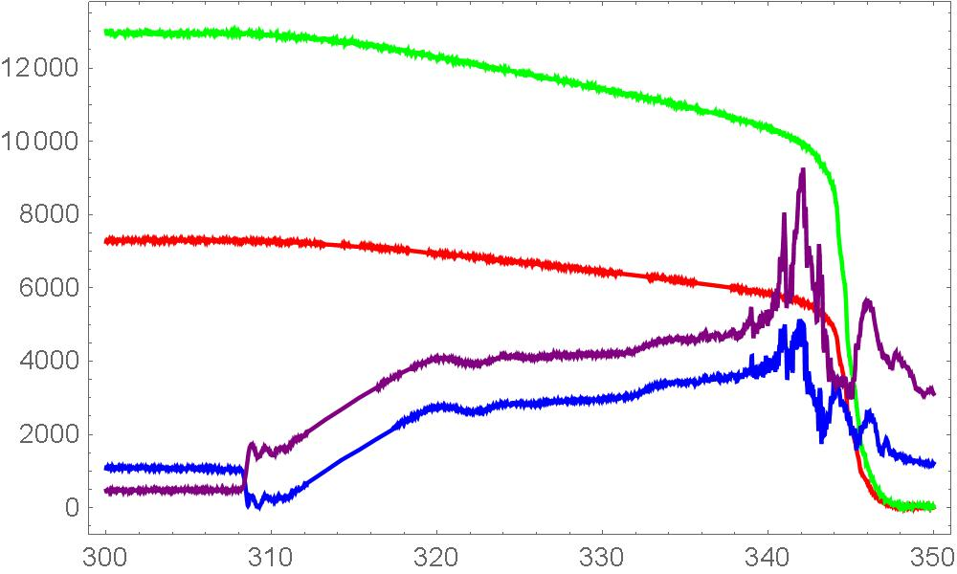
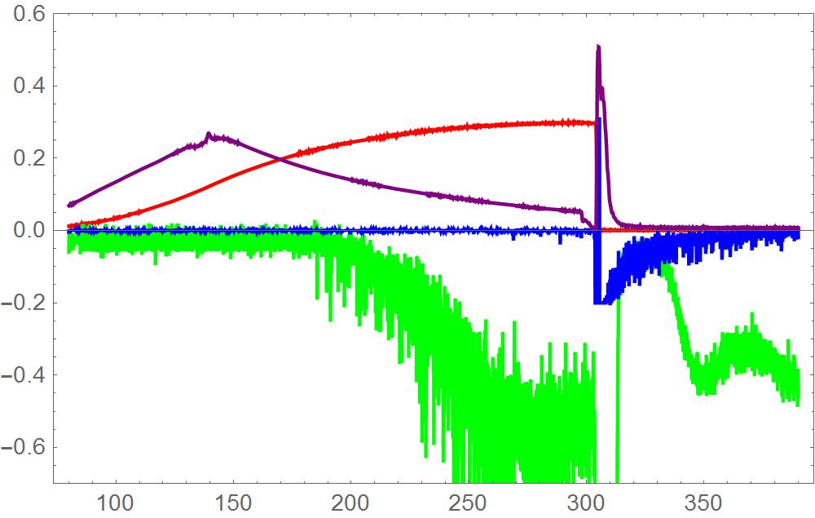
Field emission with Cu end plates
3 Types of F cycles studied
Top left. Normal cycle. No breakdown.
Top Right. Breakdown during down ramp.
Left. Breakdown during RF on time.
Color code: Red is proportional cavity gradient
Green Scintillation counter
PMT looking at light in cavity

Slide 5
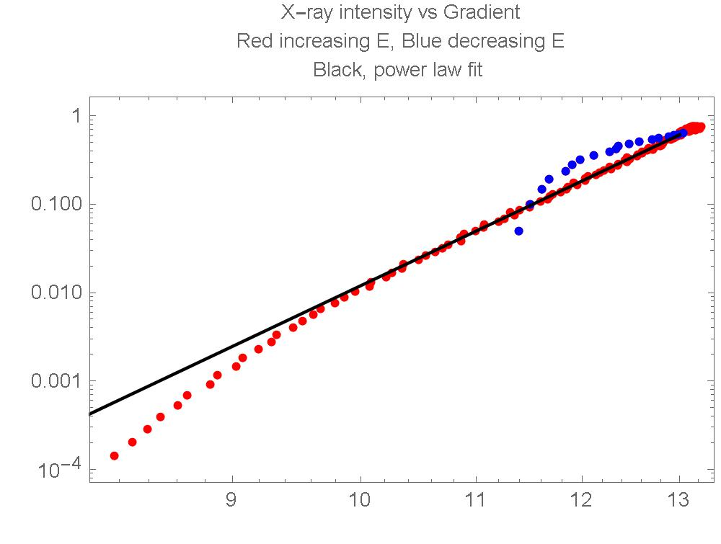
X-Ray emission vs time and energy
Vertical is averaged Scint response.
Red > gradient
Blue <gradient
Black Fitted c x^15
Ez MV/m
The Plot on the left shows Cavity Voltage Red; Reflected power Purple Scintillator counter response Green.
The right shows xray intensity -> vertical vs RF peak gradient-> Horzontal
Red is increasing RF, Blue is decreasing RF. The black is a fit of the form:
y = c x¹⁵
c is a function of run number and the exponent = 15 is fixed for all the runs.

Slide 6
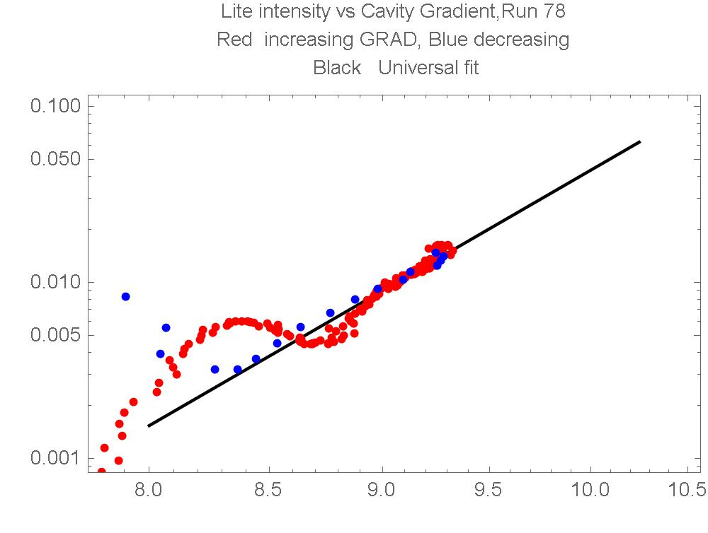
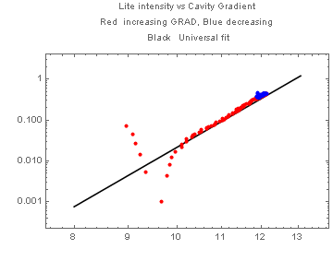
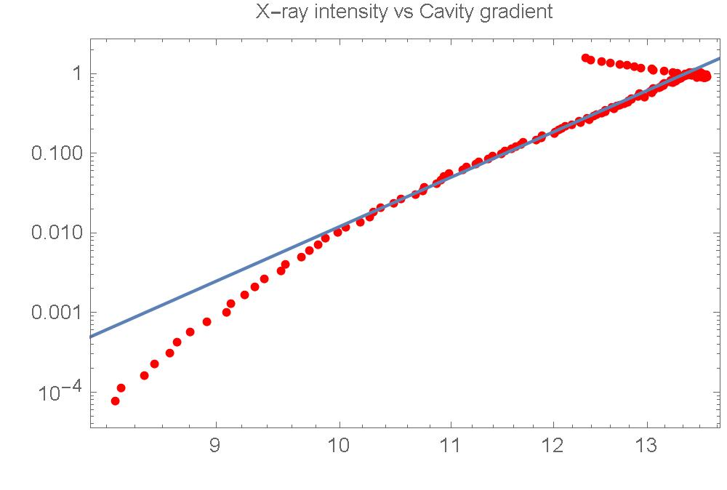
X-RAY EMISSION CHANGE DURING TRAINING
Copper case
NO BREAKDOWN
NO BREAKDOWN
← Run 77
Oct 6 2014
C=8
Run 110→
Nov 14 2014
C=0.4

Slide 7
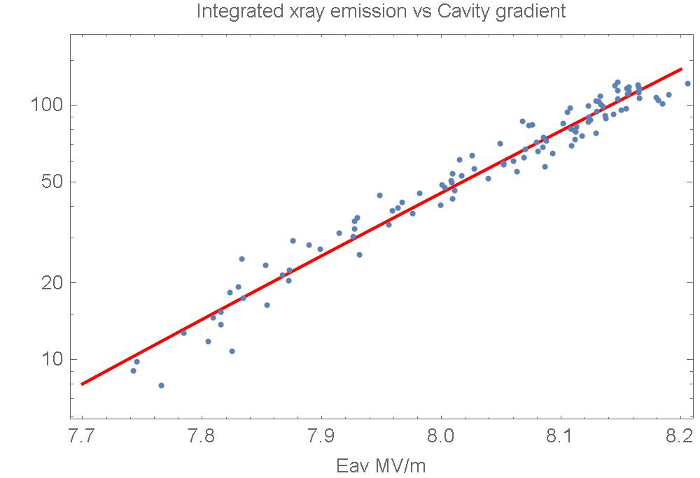
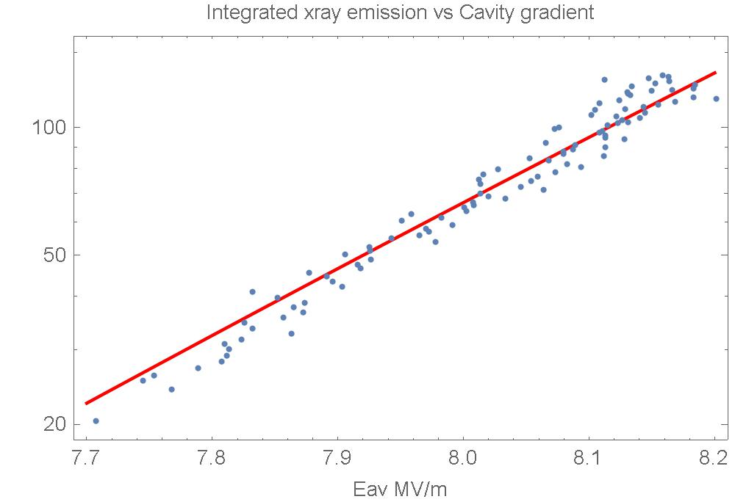
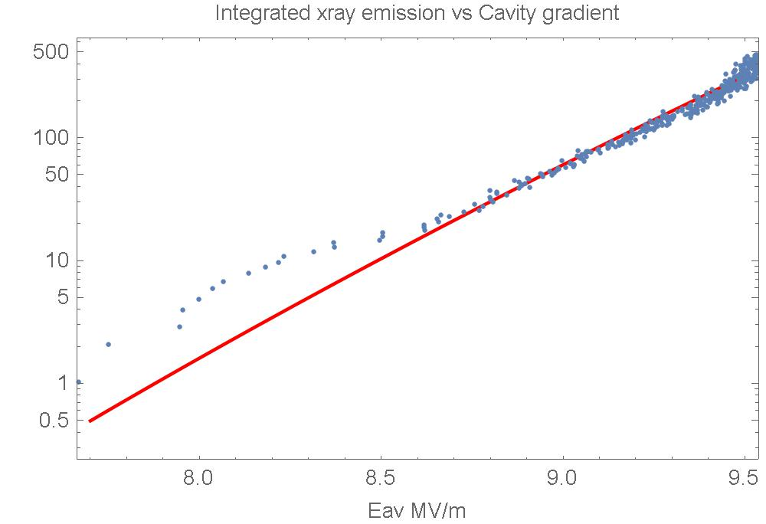
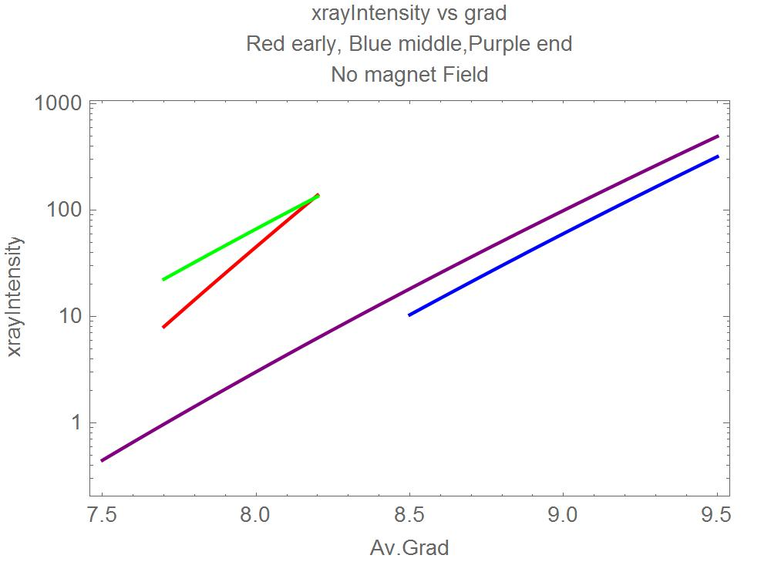
FIRST RUN WITH Be ENDS….. NO FIELD
Early
Middle
Late
Compare

Slide 8
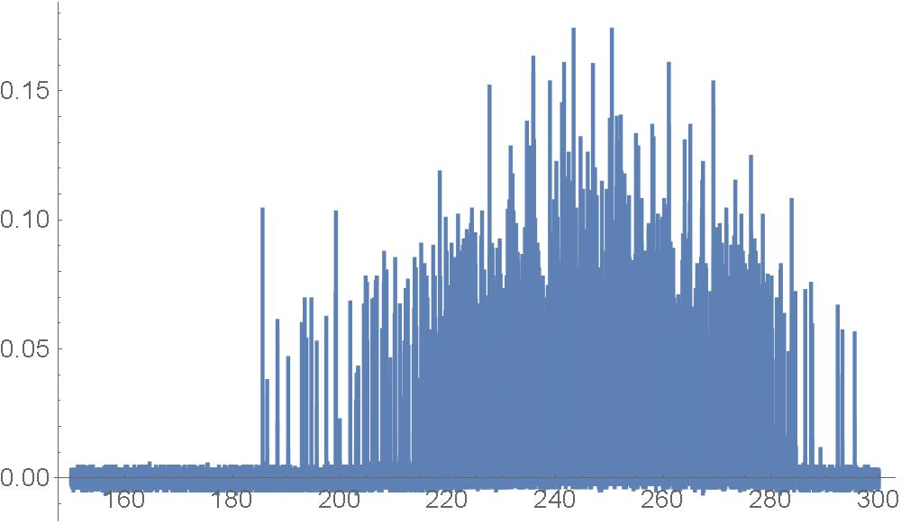
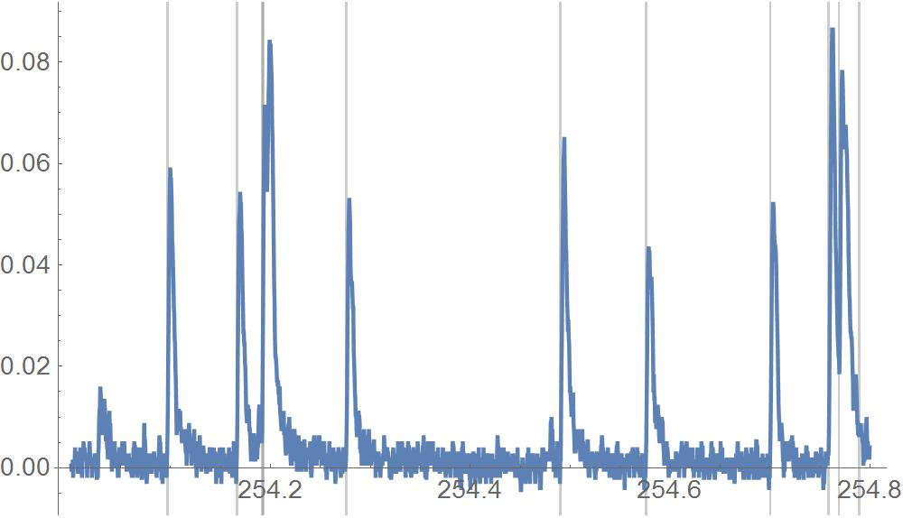
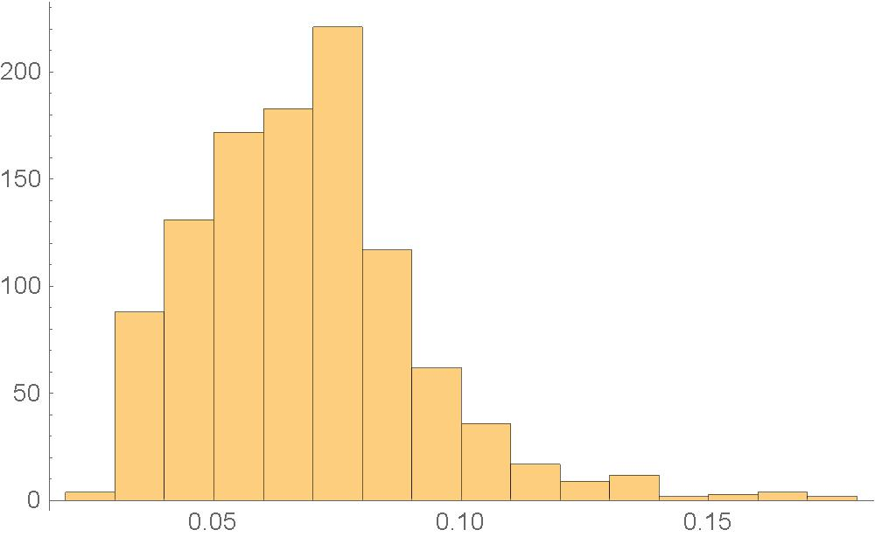
Mystery of missing emitters
Katsuya raised the question: If an emitter emits on one RF cycle, why doesn’t it do so on the next?
Three possibilities:
Our efficiency is low so we just don’t see it.
Time resolution isn’t good enough.
Emitter disappears.

Slide 9
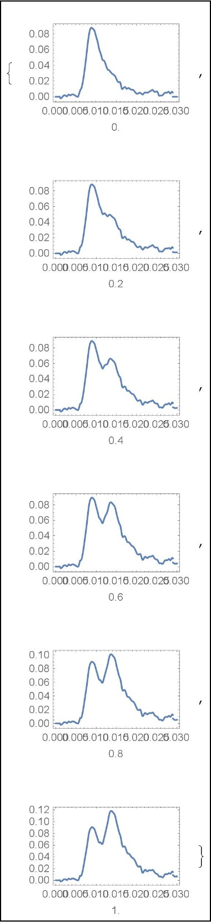
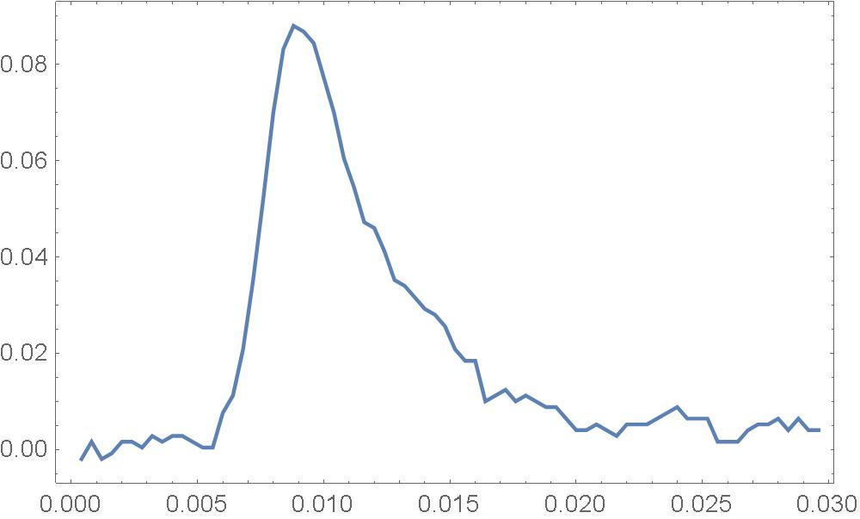
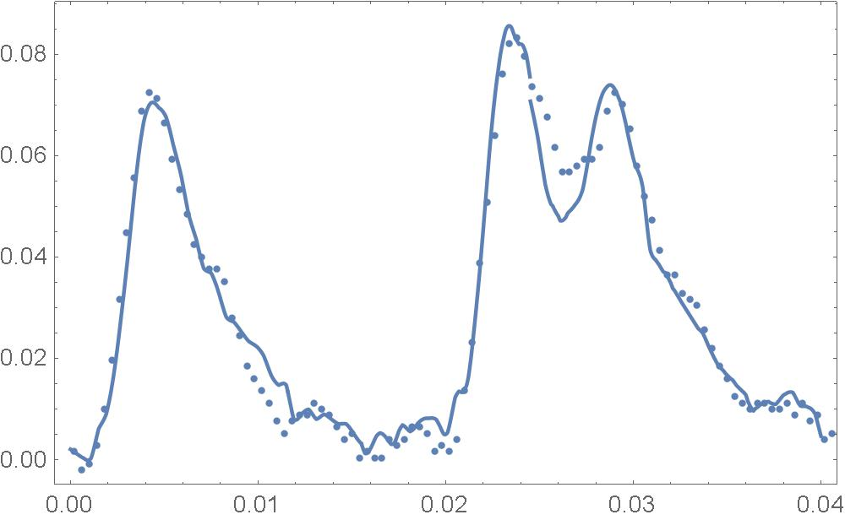
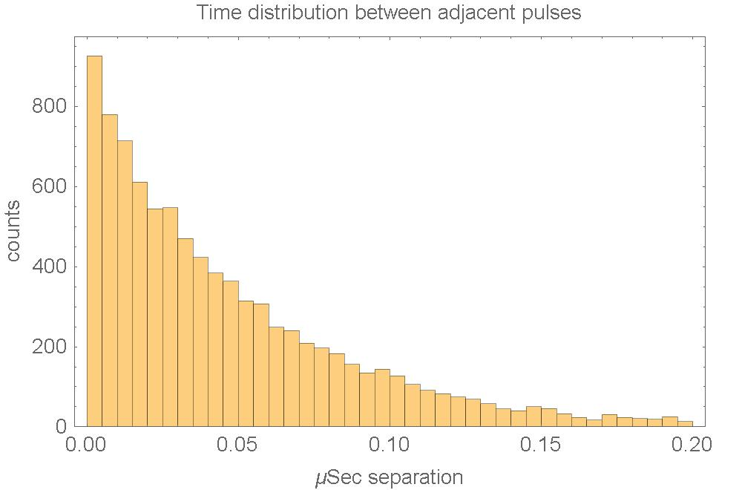
More details
Can we see it?
Top left: Pick a pulse a “Standard”
Try fitting: delta t multiples 5 ns
Amplitude variable. Fits ok.
Make sample: 5 ns, 0->100% amplitude.
Make Poisson Distribution. Look for deviation in the 5 ns bin. None.

Slide 10
SO MAYBE THE EMITTER DISAPPEARS
Or our efficiency is low
PHYSICAL REVIEW SPECIAL TOPICS - ACCELERATORS AND BEAMS 8, 072001 (2005)
Very early work in Lab G.
Nice paper. 805 Mhz pill box cavity.
10 min interval. Center pix during breakdown.
3 out of 4 emitters remain in later pulses.
So maybe our efficiency is low.
Needs a coincidence experiment
!.

Slide 11
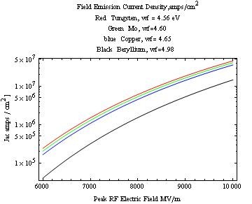
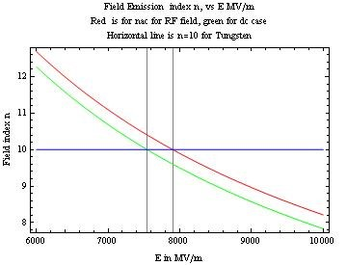
FIELD EMISSION PHYSICS
Over small range J = C Ez^{n} . So if one knows n, then J is known. If the current from an emitter is measured,then one knows the area of an emitter.
I = area J

Slide 12
Bremstrahlung
At right: k dn/dk is the number spectrum of gamma rays of energy k for various electron energies: ‘.05, .5, 5 50 500 MeV. Thin target spectrum. For accurate results, one needs to integrate over the electron energy as it stops and there are large corrections for low z.
Efficiency: For scale
1 ma for 0.5 ns 4 MV from an emitter with 10% efficiency will produce 10 e 8 100 kv hv.

Slide 13
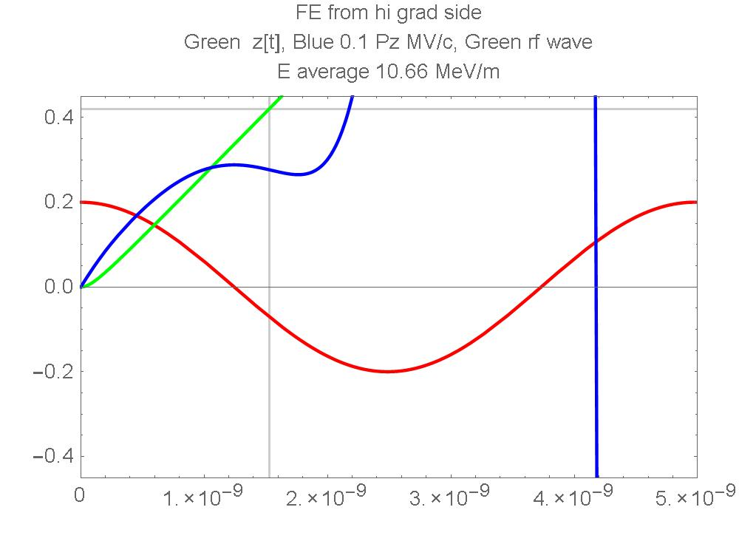
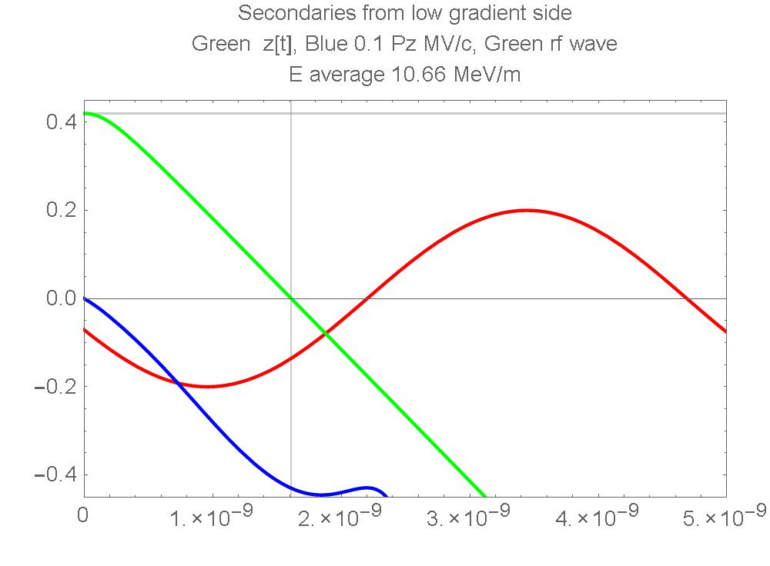
Electron motion in the cavity
Farady cup
Sc1
Sc2
Ez left side = 15.5 MV/m
Ez right side = 6.5 MV / m
Blue arrow FE 2.7 MeV
Red Arrow Secondary emission 4.4 MeV
Forward and back trajectories only same on the z axis.

Slide 14
SUMMARY
COPPER: EMISSION DECREASES DURING TRAINING BUT SPECTRUM SEEMS TO REMAIN THE SAME.
Be: FE DECREASES DURING TRAINING. SPECTRUM ALSO CHANGES.
Be No Bz: DO FIELD EMITTERS DISAPPEAR DURING SINGLE RF CYCLE.
NEED COINCIDENCE EXPERIMENTS TO FIND ANSWER.
Be WITH Bz: LOTS OF DATA THAT NEEDS STUDY!
THE CAVITY IS AN IDEAL EXPERIMENTAL BENCH. THE FREQUENCE IS LOW ENOUGH AND THE TRANSIT TIMES LONG ENOUGH SO ONE CANE MAKE ACCURATE MEASUREMENTS THAT WOULD BE VERY DIFFICULT AT HIGHER FREQUENCIES.

