Slide 1
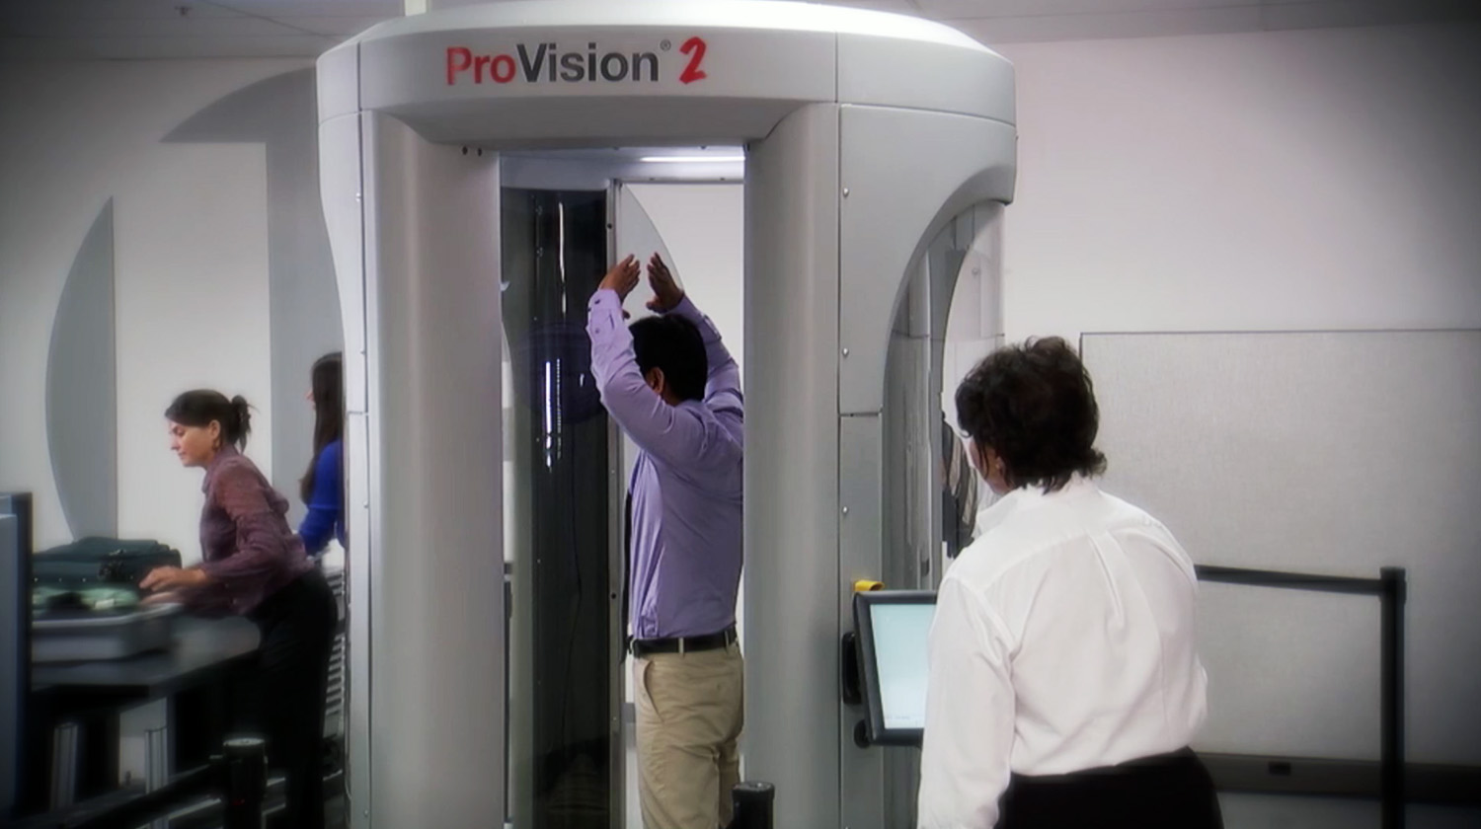
Technology Transfer Working Group
Technology Maturation: A key element of improving technology transfer and commercialization
Bruce Harrer (PNNL), Poorinima Upadhya (BNL), Roger Werne (LLNL)

Slide 2
Definitions
In simple terms, technology maturation is the technical de-risking of a technology in a specific application.
Many Laboratory developed technologies and capabilities are simply too immature for industry to fully embrace.
Laboratory Technology
Maturation

Slide 3
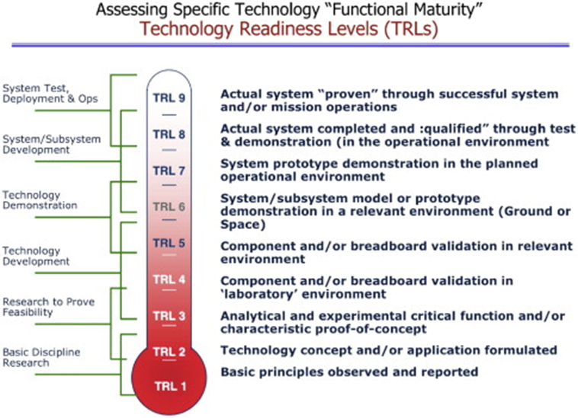
Examples of Technology Maturation
Common in Government programs where new products or services are needed but not otherwise available
DOD, NASA, DOE NNSA and selected Energy Programs (e.g. EERE)

Slide 4
The Problem
No generalized source of support for Laboratory technology maturation exists other than royalty income
The largest funders of Laboratory research (Office of Science and NNSA) typically stop research efforts at TRL 2 or 3 and provide no funds for moving further
Many of the opportunities for technology transfer and commercialization involve “spin off” technology where there is no source of program funding
Opportunities to work with industry often require a fairly short response time

Slide 5
Potential Solutions
Allow for the Laboratories to use a small amount of overhead funds to support technology maturation projects*
Could potentially be fit within the 0.5% that Stevenson-Wydler mandates be spent on technology transfer activities
Set aside a nominal (<1) percent of total DOE R&D funding for a centrally administered technology maturation
Require each DOE program to set aside a small proportion of their funds for technology maturation efforts appropriate to their mission
*Thought by the subcommittee to be the most realistic alternative at this time.

Slide 6
Conclusions
Regardless of funding source, program elements would include:
Industry input/cost share
Clearly defined evaluation criteria
Competitive proposal review
Well defined metrics
Additional support for technology maturation will enhance technology transfer and commercialization
Resources exist within the DOE Complex to provide such support; it comes down to priorities

