Slide 1
Make an IMPACT: Improved Metrics and the DOE FY14 Data Call
Overview and Context Setting- Bill/Steve
Lab Partnerships- Lessons from 2014 Data Calls- Charlie
Review of TTWG/NIST Metrics- Ingrid
Future Metrics- Bill
Discussion led by: Bill Farris, Steve McMaster, Charlie Russomanno and Ingrid Milton

Slide 2
Technology Transitions includes Technology Transfer
DOE is committed to strengthening its technology transfer capabilities and recognizes that technology transfer is just one component of its overall mission to promote scientific and technological innovation that advances the economic, energy, and national security interests of the United States.
Technology Transitions
Management, coordination, data collection, analysis, evaluation and policy development
Early-stage research
Technology Transfer
Commercialization
Deployment
High impact commercialization activities

Slide 3
FY15 Major Statutory Deliverables Tentative Calendar
FY15 Q2 | FY15 Q3 | FY15 Q4 | FY16 Q1
FY16 and FY17 Technology Commercialization Fund - Planning & Development
FY16 Technology Commercialization Fund -Implementation
NIST Federal Lab Tech Transfer Summary Data
DOE Technology Transfer/Partnering Annual Report 2014
Technology Transfer Execution Plan
Activities where Data is used by DOE/OTT

Slide 4
TTWG Metrics Information Meeting- May 15, 2015
Objective- begin to gather input, starting with small group of thought leaders
Discuss data, metrics, and analysis important to measuring the success of technology transfer across the national labs
Attendees
DOE Representatives | National Lab Representatives
Jetta Wong, Director, U.S. DOE, Office of Technology Transitions (OTT) | Connie Cleary, Brookhaven National Laboratory
 | David Koegel, U.S. DOE Office of Science
Steven McMaster, Deputy Director, U.S. DOE, OTT | David R. Pesiri, Los Alamos National Laboratory
Charles Russomanno, U.S. DOE | Duncan McBranch, Los Alamos National Laboratory
Rob Bectel, US DOE, OTT | Gregory S. Morin, Argonne National Laboratory
Ingrid Milton, U.S. DOE, OTT | Lee Finewood, NNSA
Facilitation | Michael J. Paulus, Oak Ridge National Laboratory
Joan Pellegrino, Energetics Incorporated | Suresh Sunderrajan, Argonne National Laboratory
Jonny Rogers, Energetics Incorporated | William Farris, National Renewable Energy Laboratory
Outcomes
Obtained guidance on how to improve data collection
Proposed approach for process automation/developing a pilot
Discussed key metrics/agreed upon a process to refine the key metrics
Collected insight on the metrics and analyses that can be used to measure tech transfer success across the labs

Slide 5
Earlier Samples using FY14 Data (5/15/15)
Note: Updated samples to be shared by Charlie Russomanno today

Slide 6
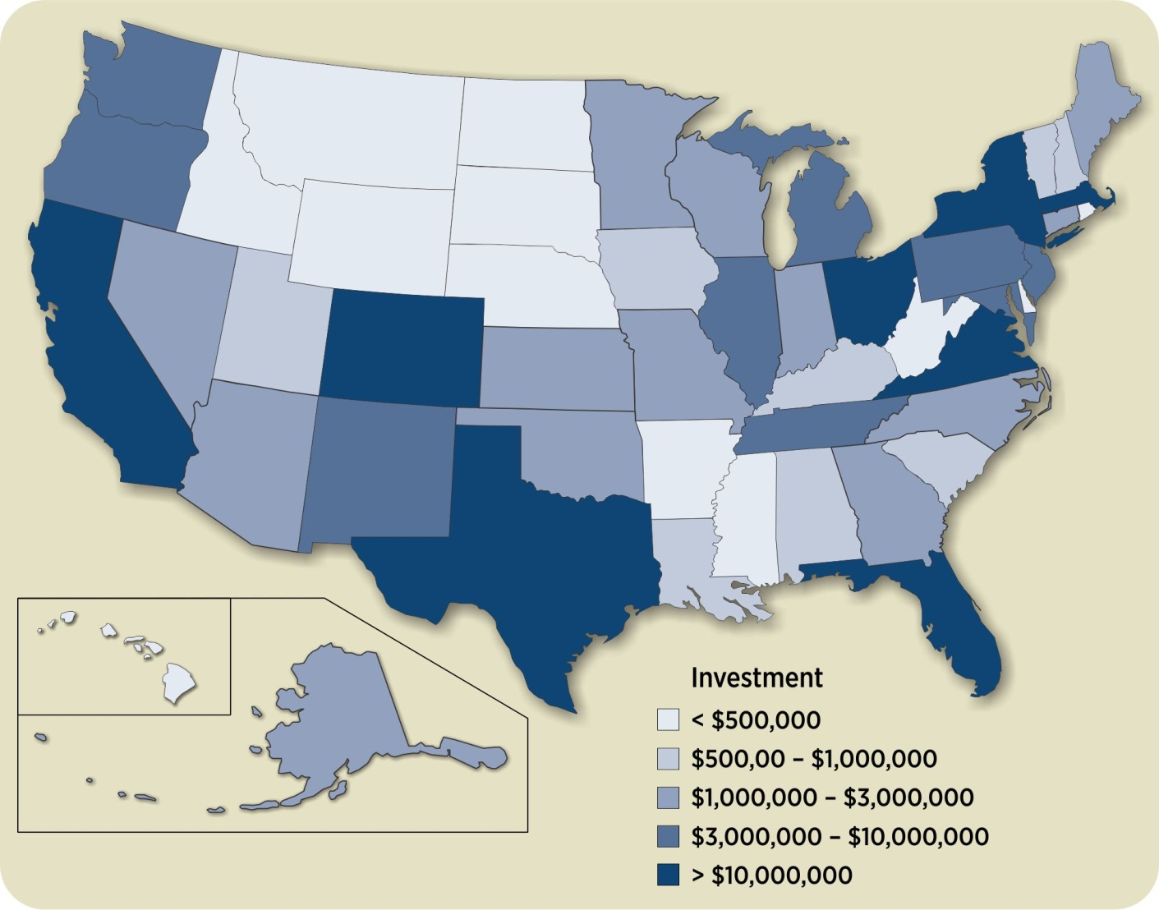
Sample#1
Total Projects and FY 14 Partner Funds by State
79
8
8
2
42
19
4
2504 Total Projects ($339 M)
2034 WFO ($245 M)
402 CRADA ($65 M)
67 ACT ($29 M)
Investment $ are for FY14 partner funds in only
QC on data will update to break down by DOE funds, partner funds, etc.
23
21
10
6
88
100
8
53
2
15
46
10
13
76
25
85
501
73
5
88
6
26
15
55
37
26
13
1
20
26
34
2
13
158
4
39
4
7
Note: Investment $ are for FY14 partner funds in only. 7.7% of projects were foreign accounting for 16.5% of funds. 4.9% of projects had no zip listed accounting for 6.4% of funds. < 1% of projects not categorized accounting for <1% of funds.

Slide 7
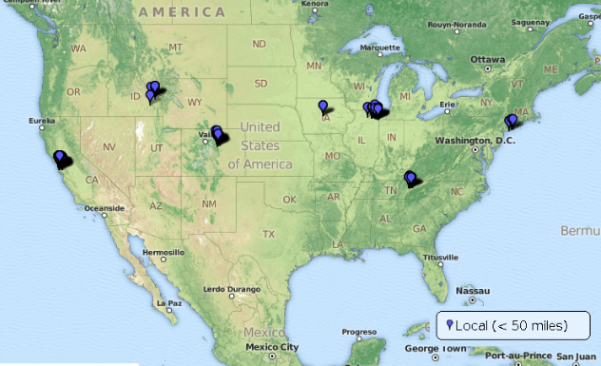
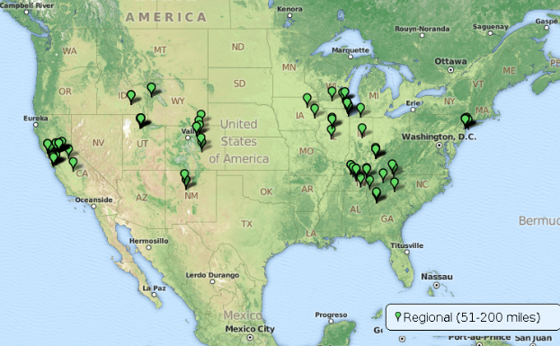
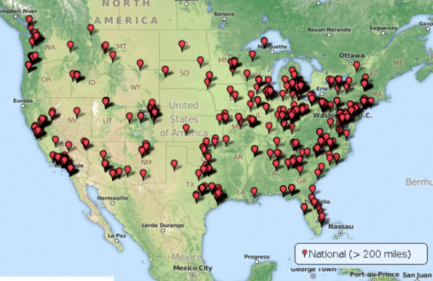
Sample #2
Comparison of Local, Regional and National Partnerships in the Continental U.S.
Note: Investment $ are for FY14 partner funds in only. 7.7% of projects were foreign accounting for 16.5% of funds. 4.9% of projects had no zip listed accounting for 6.4% of funds. < 1% of projects not categorized accounting for <1% of funds.
Local <50 miles
Regional 50-200 miles
National >200 miles
237 projects (9.5%);
$30.0 M (8.8% of funds)
185 projects (7.4%);
$22.5 M (6.6% of funds)
1746 projects (69.7%);
$207.7M (61.2% of funds)
Funding and number of projects by contract type
199
159
1396
305
4
34
5
21
44

Slide 8
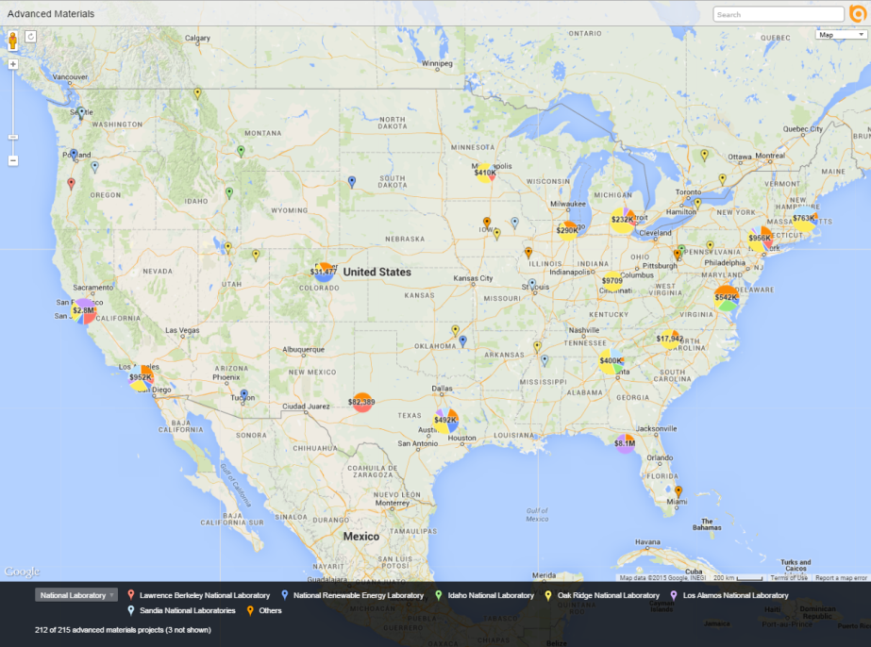
Sample #3
What Parts of the Country are Specialized in Advanced Materials?
Top 10 U.S. Metropolitan Areas for Advanced Materials
Interactive map that lets you drill down on advanced materials:
https://batchgeo.com/map/fad0938a0b896aa1d87d77af84fb88c3

