Slide 1
DOE Labs and Innovation:
EERE Lab Impact Initiative Progress and Direction
Joyce Yang, PhD
Director, Lab Impact Initiative
June 15, 2015

Slide 2
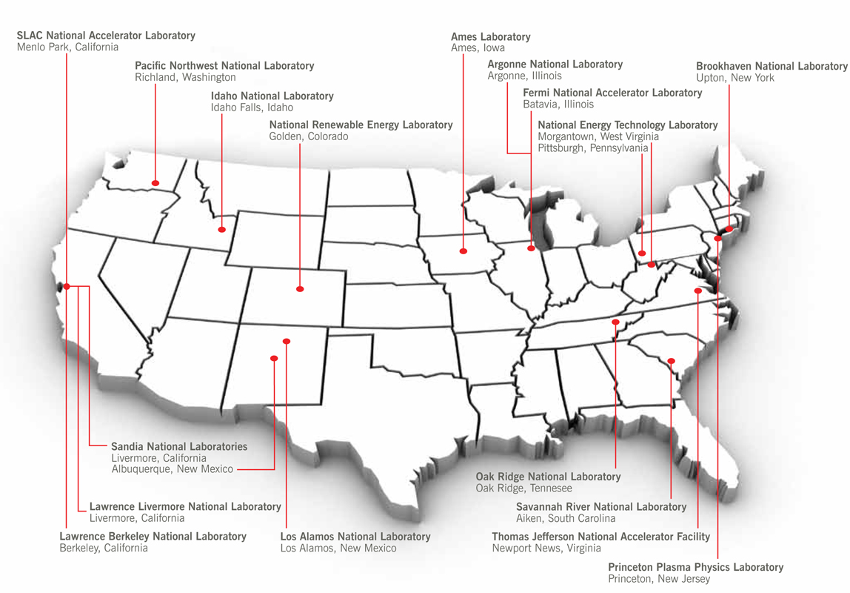
DOE Labs: A Reservoir of Talent for Science and Technology
17 National Laboratories
10 Office of Science
3 NNSA
1 Nuclear Energy
1 Fossil Energy
1 Energy Efficiency and Renewable Energy
1 Environmental Management
~ 66,000 Total Employees
Over 50 Nobel laureates affiliated with DOE National Laboratories
Graphic taken from “A Decade of Discovery” DOE. 2008

Slide 3
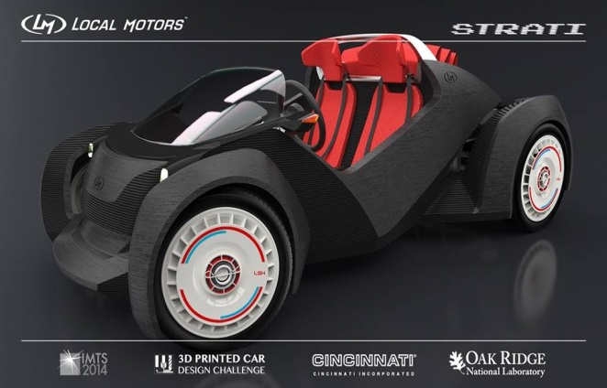
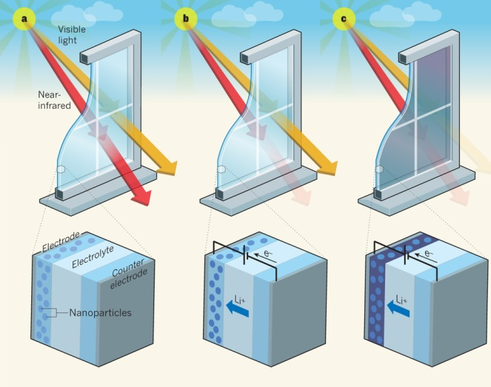
Recent High-Impact Lab Successes
Lawrence Livermore National Laboratory and GE are partnering through the HPC for Energy incubator program to develop next-gen fuel injectors that will make aircraft engines more powerful and energy efficient.
Local Motors produced the world’s first 3D-printed car using a process made available through Oak Ridge National Laboratory’s Manufacturing Demonstration Facility.
Lawrence Berkeley National Laboratory is working with Heliotrope Technologies to roll out Universal Smart Window (USW) Coating that lowers energy by blocking heat-producing, near-infrared solar radiation without blocking visible light.
Notes:
-Work such as laser diagnostics and combustion modeling at the Combustion Research Facility have had a big impact on the vehicles industry, resulting in an astounding 53:1 return on investment.
- Lawrence Livermore National Laboratory’s cryogenic pressurized hydrogen storage is a leading concept for safe, low cost, compact, and light weight vehicular hydrogen storage systems for long-range (300+ miles) zero emissions transportation using hydrogen.

Slide 4
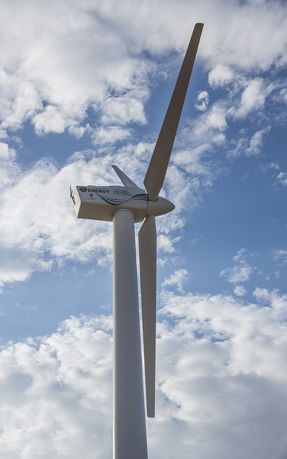
EERE Lab Impact Initiative
Mission: significantly increase the industrial impact of DOE national labs on the U.S. clean energy sector!
Increase and enhance lab-private sector relationships
Increase and streamline access to national lab capabilities
Demonstrate the value of lab-developed science and technology
Notes:
Increasing the Industry Impact & Importance of EERE National Lab Work and Capabilities
DOUBLE THE INTENSITY OF SUCCESSFUL LAB-INDUSTRY ENGAGEMENT WITHIN THE NEXT 3 YEARS
Affirming EERE’s Long-Term, Special, Committed Relationship with the National Laboratories
Establishing a High-Impact, Well-Defined, Uniformly Applied Model for the EERE-National Laboratory Relationship – “EERE-National Lab Constitution”
Crafting Communicating Our Impact/Success Stories and Increasing the EERE-National Lab Brand/Reputation in Clean Energy Impact
EERE – National Laboratory Relationship
$600-900 million in annual funding to the labs over the last 5 years
Labs are SPECIAL PARTNERS with EERE and I am moving back towards the FFRDC model.

Slide 5
PART I: UNLEASHING INNOVATIONS WITHIN LABS

Slide 6
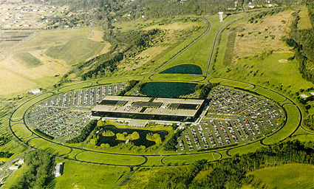
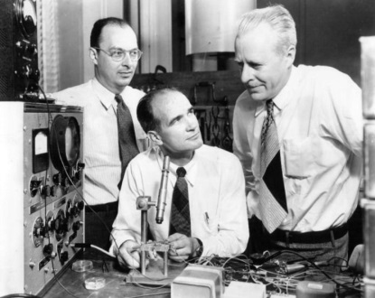
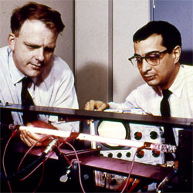
True Innovation: Bell Labs Ingredients
Taken from J. Gertner, NYTimes Article “True Innovation” (Feb 12, 2012)
Invest in Research
Critical Mass of Talent
Purposely mixed scientists, engineers, and technologists on projects
Proximity of Discovery and Commercialization
Organize work divisions and architecture to assist in transfer of ideas and product developments
Trust and Freedom
Provide autonomy to researchers
Allow time for innovation
Promote sharing of knowledge
Transistor- 1940’s
Gas Laser- 1960’s
Charge Coupled Device- 1960’s
Computers
Digital Media
Digital Cameras
> $200 billion in annual sales (~ 0.1% US GDP)

Slide 7
EERE- Lab Guiding Principles Framework
The document establishes: “core principles, operating principles, and implementation strategies that define and communicate how EERE will uniformly and effectively engage with DOE’s National Laboratories.”
Engaged with multiple levels of lab leadership (LPC reps, ALDs), GC, Science, S-4, Tech Transitions, and EERE Directors
4 Core Principles
World-Class Science and Technology
Long-term Commitment and Stewardship
Mutual Respect and Accountability
Industry and Market Impact

Slide 8
Principles and Innovation Ingredients (Side-By-Side)
4 Core Principles
World-Class Science and Technology
Long-term Commitment and Stewardship
Mutual Respect and Accountability
Industry and Market Impact
Invest in Research
Critical Mass of Talent
Purposely mixed scientists, engineers, and technologists on projects
Proximity of Discovery and Commercialization
Organize work divisions and architecture to assist in transfer of ideas/technology for product developments
Trust and Freedom
Provide autonomy to researchers
Allow time for innovation
Promote sharing of knowledge

Slide 9
EERE’s Lab Principles: Change Management
Over the last two years, EERE has substantially redesigned our approach to developing annual operating plans with the national laboratories and to align with Principles:
FY14 Standard AOP Template
Project Count: 1424
Milestone Count: 7,500 milestones
FY15 AOP Policies
FY15 AOP Analysis
F14 AOP Analysis
Average project size: $580,000
Fewer, larger projects
Multi-year projects
Fewer, smarter milestones
Merit review prior to funding
Project Count: ~1000 (50% decrease)
Average project size: $1 million (two-fold increase)
Milestone Count: < 2,000 (75% decrease)
EERE developed its first standard template for AOPs
On-time completion of AOP process
AOPs increased transparency and communication between EERE and the labs it funds
% Go/No-Gos: 27% (five-fold increase)
% Go/No-Gos: 5%
FY16 AOP
Policies
Capability & Facilities Matrices
Merit review +33%
Discretionary Funds
Multi-Lab Consortia
Larger/Multi-year projects
Increased Industry Partnerships
Piloting Innovative Approaches

Slide 10
Technology-to-Market (T2M) Plans in AOP
1% percent of Technology Office total direct EERE Lab AOP funding (across all Labs) will be directed towards new activities included within the T2M Activity Plans.
Tech Office Budget
Lab Funding (FOA)
Intent/Purpose: Develop a deliberate technology transfer approach to realize the commercial impact of the EERE/lab R&D portfolio
Lab Funding (Direct)
99% R&D
1% T2M
FY15 New Activities = Funded at $6.9M
T2M Plan Components
Strategy- the overall approach to technology transfer that the lab will apply to the research portfolio
Topic Areas - major research areas in the AOP portfolio that may warrant specialized T2M approaches
Activities - individual activities funded by EERE (or lab overhead) that complement the R&D projects

Slide 11
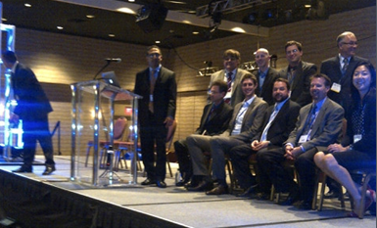
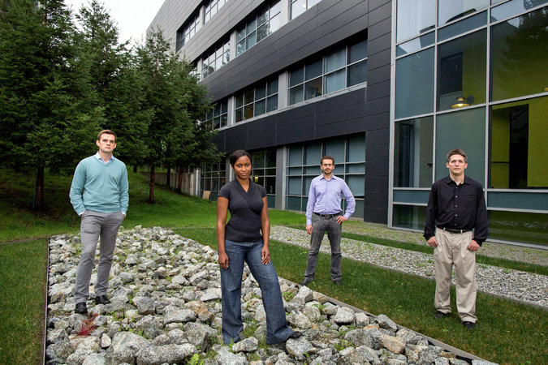
Examples of FY15 T2M Activities
AMO Cyclotron Road (Berkeley Lab)
First-of-Kind Incubator at LBNL
Featured in NY Times (Feb., 2015)
Nurture young scientists and entrepreneurs to develop technologies
Lab provides mentorship and access
FCTO Expo (Los Angeles, Nov 2014)
Special T2M Event
Lab, DOE, Industry Collaboration Corner
Demystified working with labs
Assessed perception of lab
Discussed T2M opportunities with labs

Slide 12
Industry Engagement: Inform/Test Market Hypotheses
How big is the market? Competitors? What are regulatory challenges?
Is this the right “problem”? If I solve it, who cares (who is the customer)?
How good is my solution for the given application? Will it scale? Can it be manufactured?
Potential
T2M Activity
Industry Inform R&D Plan
Lab and Industry
R&D Collaboration
Lab Tech Transfer
Assistance
Early stage R&D
Late stage R&D

Slide 13
PART II: LABS BEING THE CATALYSTS FOR THE
U.S. ENERGY INNOVATION SYSTEM

Slide 14
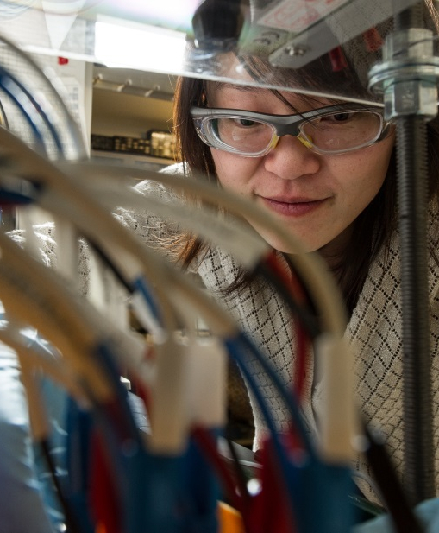
Reinvigorating the U.S. Energy Innovation System
Talent
Investment
Innovation Infrastructure
Platforms for Clean Energy Innovation Ecosystems

Slide 15
Lab-Corps: Unleashing Talent
Talent
Lab-Corps Vision: Empower leading National Lab researchers to successfully transition their discoveries into high-impact technologies in the marketplace.
CRADA
Lab Sites
License
Teams
Teams
Customer &
Value
Discovery
Commercialization Training
Node
Teams
Startup
Lab Sites
Other Partners
No-Go / Further RD&D
FY14 Funding = $2.3M
Sponsor: Office of Strategic Programs.
Tech-to-Market

Slide 16
Lab-Corps: A National Network to Unleash Lab Impact
PNNL
INL
Fermi
ANL
BNL
LBNL
NREL
LLNL / SNL-CA
Node
LANL
Site
SNL
Partner

Slide 17
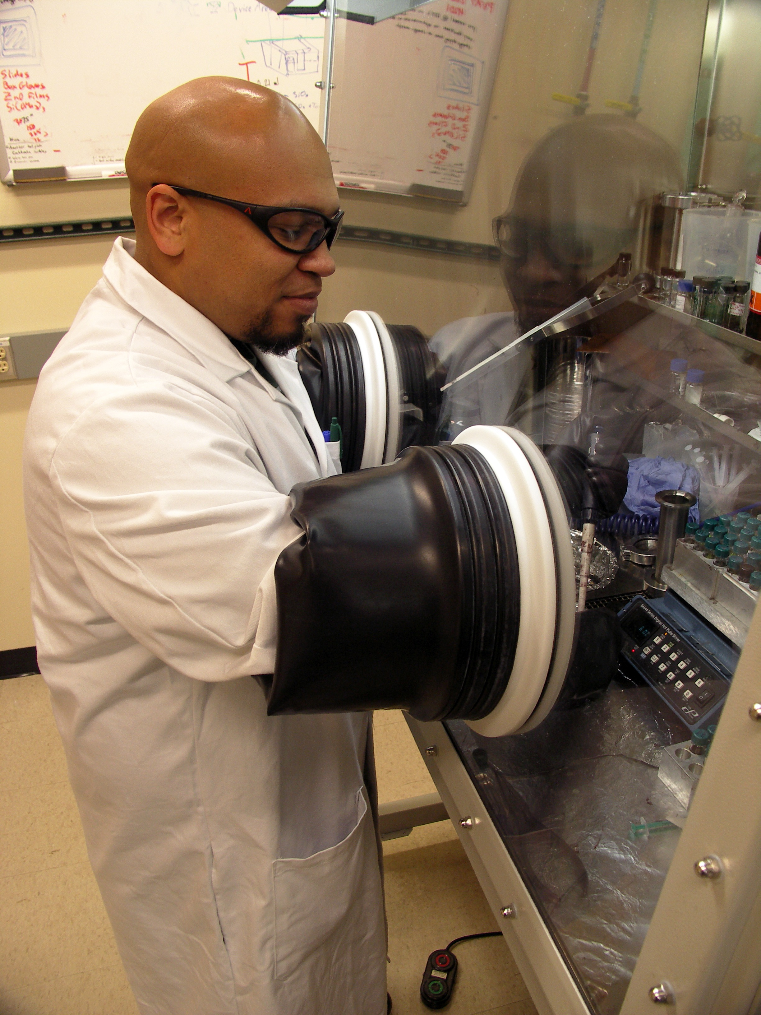
Technologist-in-Residence Pilot: Unleashing Infrastructure
Infrastructure
GOAL: Catalyze strong lab-industry relationships to stimulate high-impact lab-industry research agreements
Senior Technologist,
National Laboratory
Senior Technologist,
Industry
“Embedded” researcher exchanges for ~2 years to identify strategic industry technology challenges that can be solved by leveraging National Lab resources
FY15 Funding = $2.3M
Sponsor: CEMI through Advanced
Manufacturing Office

Slide 18
Technologist-in-Residence Pilot Details
Pair Formation
Pairs will consist of a Lab Technologists and Industry Technologists
Pairs will apply to the pilot together
Industry technologists can represent single companies or multiple companies through any sort of consortium or other organization
Laboratories will lead the pair formulation process, DOE will not be involved in matching companies with laboratories
DOE will provide a centralized location to post and communicate pair formulation activities carried out by laboratories

Slide 19
Small Business Vouchers (SBV): Unleashing Infrastructure
Infrastructure
GOAL: Provide clean energy small businesses with easy and affordable access to laboratory capabilities to solve critical technology challenges
Labs
Conduct Outreach
Labs Issue Voucher Competition
High Impact Small Businesses Chosen
Voucher Credit Spent at Labs
IT
Major Components:
Lab Call
IT Platform
Outreach
Lab Infrastructure
Voucher Work
Standard IP terms
Third Party Evaluation
FY15 Funding = $20M
Sponsors: EERE Tech Offices

Slide 20
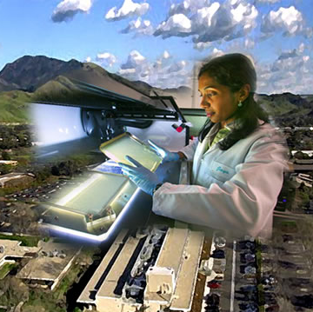
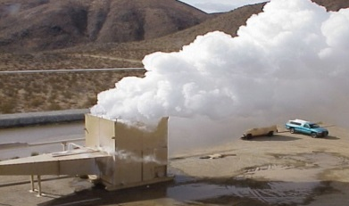
SBV Assistance and Funding Gaps
$ (loss)
Technology Creation
Product and Process Development
Commercialization
Net Capital Requirements
Nanotechnology for Li Battery
(with LBNL)
Basic
R&D
Applied
R&D
Integration / Scale Up
Plant
Construction
Even
Assistance GAP
Design/Test Prototypes
Generate Product Samples
Validate Technology
Information for Regulations
Operations and
Sales
Cobalt Bioprocess Scale UP
(with NREL)
Technology
Gap
$ (revenue)
Time (in Years)*
GTO LEAMS III Separator (with Sandia)
Existing Tech Assistance Program ($10-$40K)
Funding GAP
Joint Applications to FOAs (> $1M)
*Adapted from the NRC Report “An Assessment of SBIR”, 2008
Small Business Voucher ($50-$300K)
Notes:
Jonathan Labs help you develop new catalysts
Lidija measurement work
Pat battery testing at INL

Slide 21
Recent Senate Energy and Natural Resources Testimony
On June 9th, 2015
The large body of research conducted in the National Labs not only has advanced specific energy technologies… but also tend to find applications in industry in non-energy fields. Unfortunately, in my view relatively little of this potential is being realized by American industry as it seeks to compete in the global marketplace. Among the many reasons for this, one is that industry, especially small firms, has little idea what research is being conducted at the national laboratories.
Norman Augustine- Former CEO Of Lockheed-Martin, Former Acting Secretary of the Army, current member the Secretary’s Lab Commission and Current Board Member of the Bipartisan Policy Center
A second reason is that well-intended rules and oversight mechanisms make it difficult for the laboratories to work closely with industry and also discourage the best means of technology transfer, the movement of people between government and industry.
The Committee today is considering a number of bills that address different aspects of this challenge. What unites them all is a strong, bipartisan agreement on the importance of public-private partnerships in energy technology innovation, primarily through the National Laboratories. Facilitating these partnerships among universities, industry, and the Labs will more readily translate publicly funded research into commercial offerings, maximizing the return on federal investments.

Slide 22
Together we can build a new model for American Clean Energy Innovation & Commercialization
Technology
Entrepreneurs
Incubators/
Intermediaries
National Labs/
Innovation
Infrastructure
Foundations/ Philanthropy
VCPE Investors
Gov’t Investments
Corporates
For more information: energy.gov/eere

