Slide 1
Office of Science-Led Pilots and Initiatives: Accelerator Stewardship Test Facility Pilot Program
TTWG FY2015 Summer Meeting
June 17, 2015, Washington DC
Eric R. Colby†
Office of High Energy Physics
Office of Science
U. S. Department of Energy
†DOE Program Contact: Eric.Colby@Science.DOE.GOV, (301)-903-5475
Image courtesy of Oak Ridge National Laboratory

Slide 2
The Office of Science leads numerous collaborative R&D initiatives aimed at joint technology development and transfer
High Performance Computing
Bioenergy Research Centers
Energy Innovation Hubs
Energy Frontier Research Centers
SBIR/STTR Program
Isotopes Program
Accelerator Stewardship
Stewardship Solicitations
Operation of BNL ATF as a SC User Facility
Accelerator Stewardship Test Facility Pilot Program

Slide 3
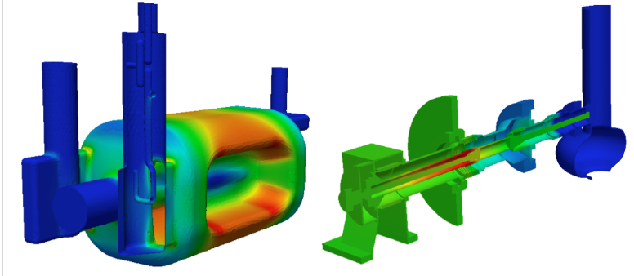
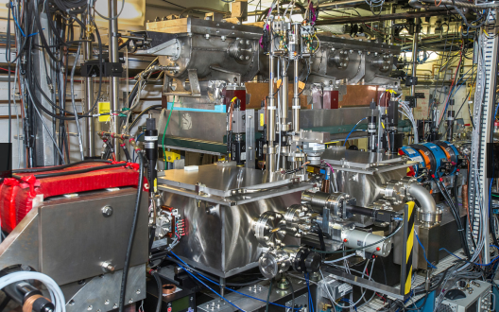
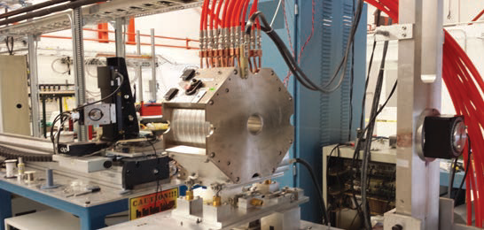
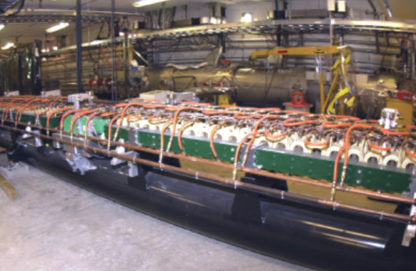
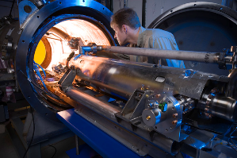
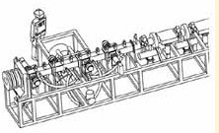
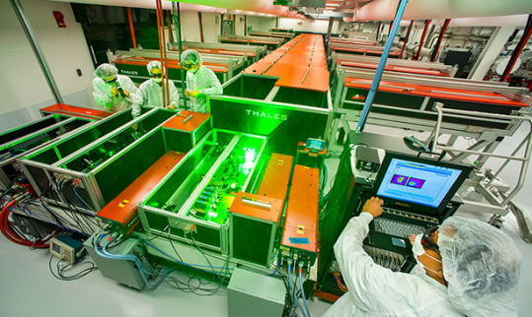
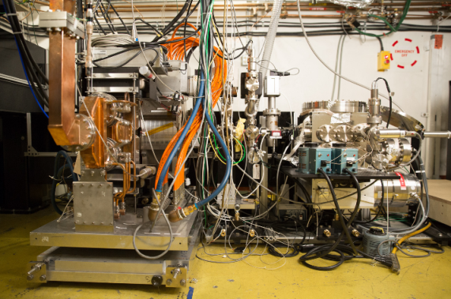
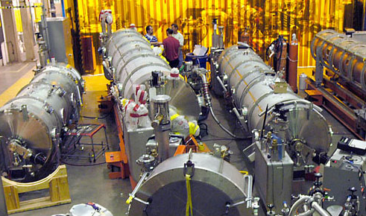
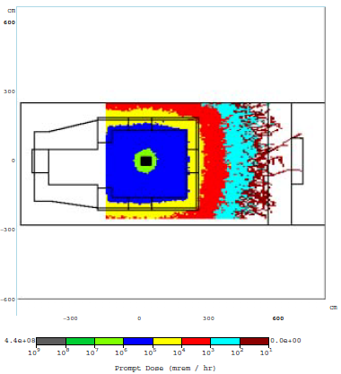
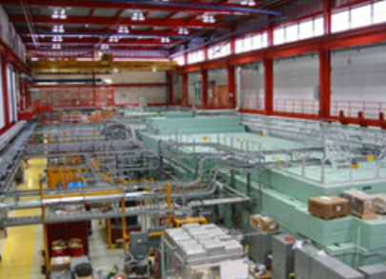
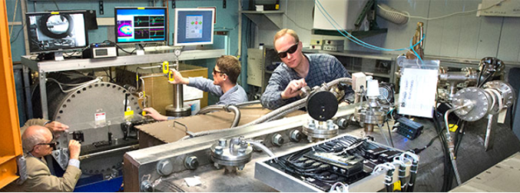
The Office of Science builds and maintains unique accelerator test infrastructure to support its basic science R&D mission
These are just a few of the more than 50 specialized accelerator R&D capabilities across the DOE SC complex…

Slide 4
DOE SC accelerator facilities and capabilities span the full cycle from design to prototype testing and beyond
Design
Beam physics and high-performance computing expertise
High accuracy modeling of complex accelerator systems
Design and engineering of accelerator components
Complete concept-to-prototype design capability
Fabrication & Subcomponent Testing
Superconducting cable/strand and cavity preparation and testing facilities
Processing and testing infrastructure for cable and RF cavities
Magnet test facilities
Power supplies, cryogenic test stands, high precision field mapping
Microwave and laser test facilities
Microwave and laser source & measurement capability covering a very wide spectrum
Fabrication and materials characterization facilities
Beam Testing Facilities
Provide electrons, neutrons, protons, light and heavy ions, x-rays, gamma rays, …
And more!

Slide 5
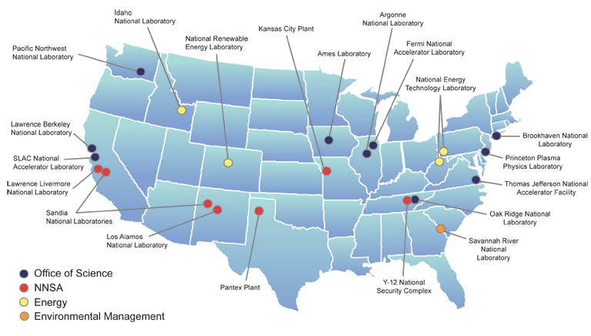
This is how DOE National Laboratories see themselves…
Slide courtesy of Eric Isaacs

Slide 6
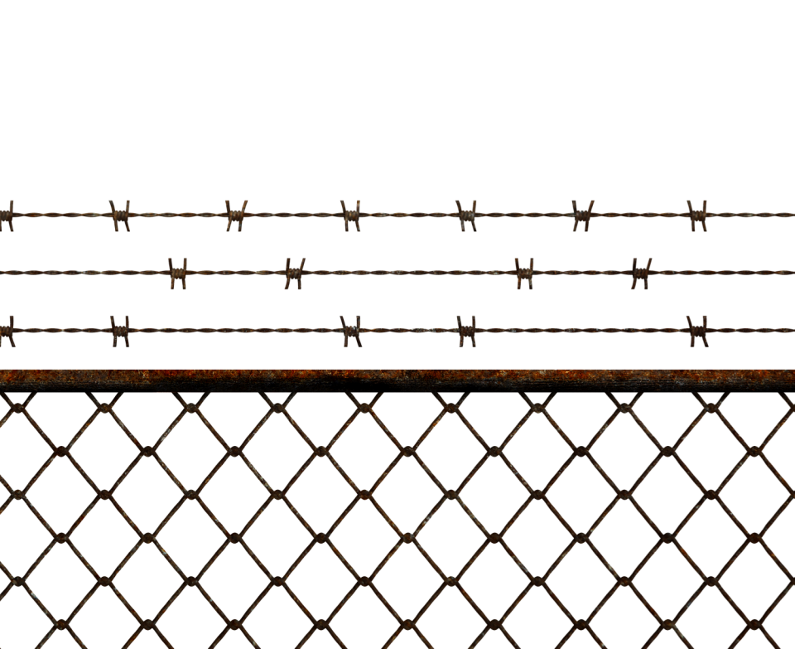
…and this is how industry has viewed us.
Slide courtesy of Eric Isaacs
Notes:
In talking with industry, we hear a number of reasons they find it difficult to work with DOE:
Lack of access
Difficult to get information about what facilities and expertise are available
IP protection
Time to contract
Advance payment
Liability, indemnity
But barriers created by IP and limited access are only part of the story. If we can solve their problems, they’ll find ways to overcome these barriers. The real issue is to reach out to industry and let them know that we’ve changed and we’re ready to serve as real partners and build strong new relationships.

Slide 7
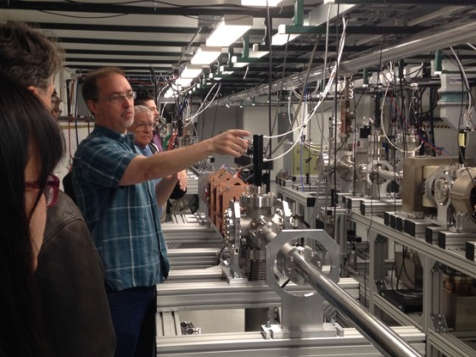
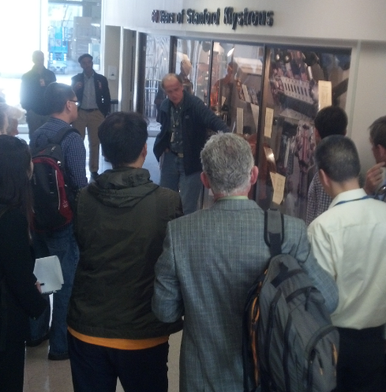
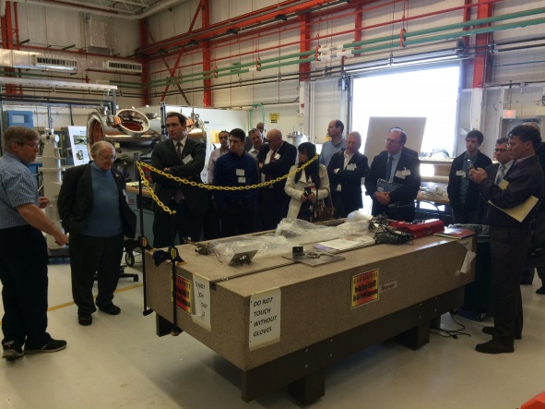
The DOE Office of Science Accelerator Stewardship Test Facility Pilot Program
Is a one-year Pilot to:
Broaden public awareness of accelerator R&D capabilities at the DOE National Laboratories
Survey the potential demand for accelerator R&D capabilities
Seed fund a few collaborative R&D efforts
Test the process and logistics involved in engaging Stewardship users

Slide 8
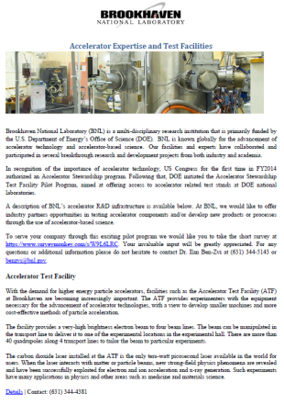
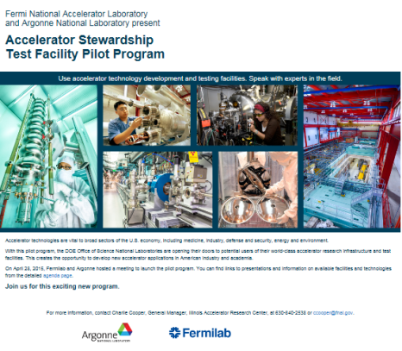
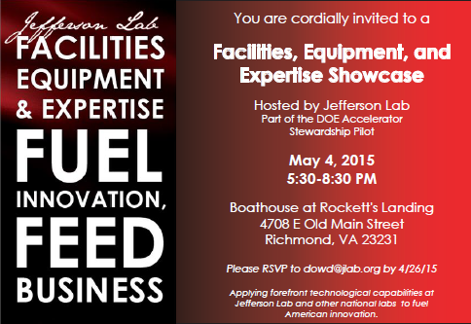
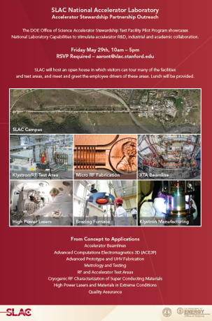
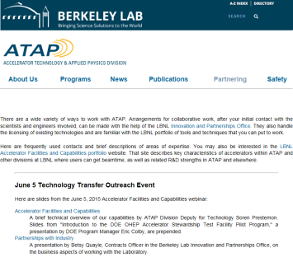
Pilot Program Process and Timeline
April-June Labs conducted public outreach events
BNL – Survey; industry group meetings
ANL & FNAL – Open house on 4/28/15
JLAB – Networking meeting on 5/4/15
SLAC – Open house 5/29/15
LBNL – Webinar on 6/5/15
June 15, 2015 Seed funding proposals due
Now Proposals are under peer review
Aug/Sept Seed funding awarded
Spring 2016 Evaluate results of pilot program
formulate follow-on program

Slide 9
Pilot Program seed funding will be awarded selectively to test the stewardship use of accelerator R&D infrastructure
Criteria:
High value-added collaborative accelerator R&D opportunities that:
Mutually benefit the lab and the Stewardship partner
Capitalize on existing lab accelerator test facilities and expertise
DOE policy guidelines on Strategic Partnerships
“The proposed work—
(1) is consistent with or complementary to missions of DOE/NNSA and the facility to which the work is to be assigned,
(2) will not adversely impact programs assigned to the facility,
(3) will not place the facility in direct competition with the domestic private sector, and
(4) will not create a detrimental future burden on DOE/NNSA resources.”
-- DOE O 481.1C, section 4(c)

Slide 10
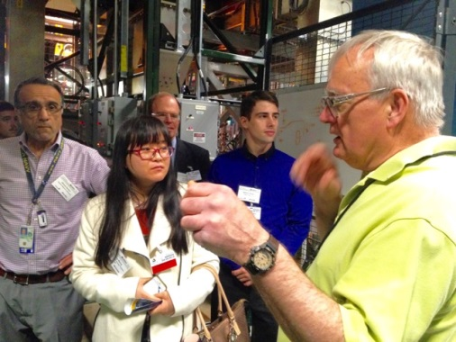
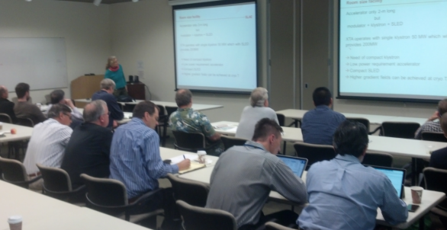
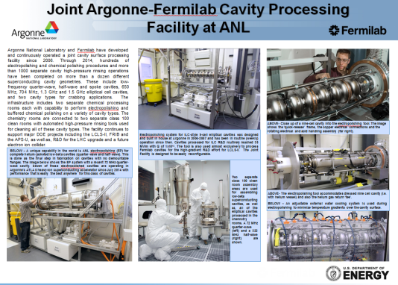
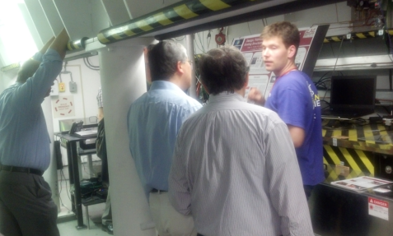
National Laboratory Public Outreach Events
Goals of the public outreach events:
Broaden public awareness about the lab’s accelerator test facilities and accelerator expertise
Open Houses, Webinars, Meetings, Updated Webpages
Meet potential Stewardship partners, and discuss their needs:
One-on-one Meetings, Discussions, Surveys
What facilities and expertise are needed?
What time and effort is needed?
What supporting engineering is needed?
How will results be published and/or protected?
Feedback about the Outreach process or lab/industrial collaborative process?

Slide 11
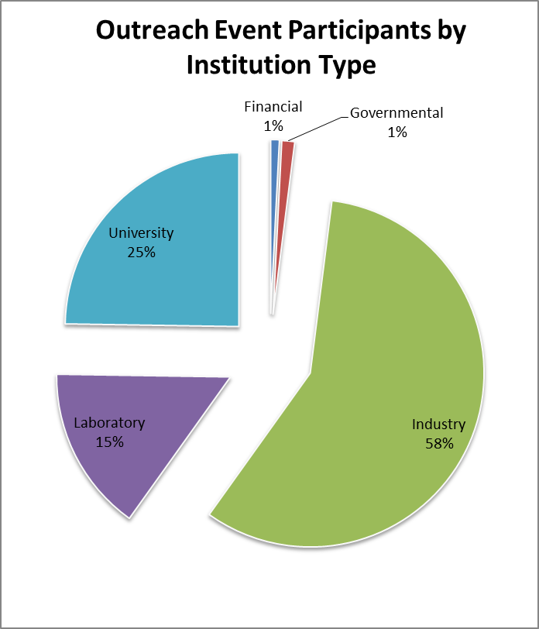
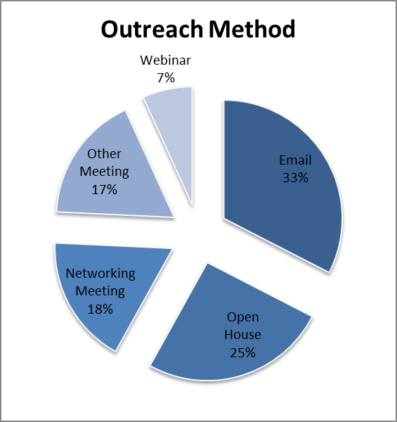
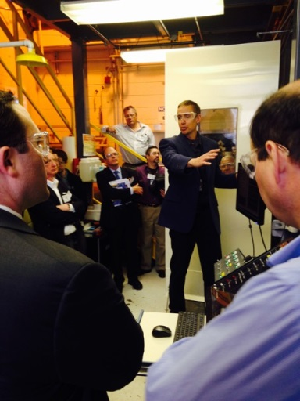
National Laboratory Public Outreach Events
Outreach outcome:
More than 450 participants contacted through public outreach events organized by 6 DOE-SC Labs
Diversity of outreach methods
Many “first-time” contacts
Proposals submitted for seed funding
Next steps:
Seed-funding proposals under peer-review now
Plan awards in August/September
Analyze outcomes in Spring ‘16
Formulate follow-on program

Slide 12
Feedback from the Public Outreach Events
“Simply an impressive day. The capabilities – scientific, technological and as an engine for innovation are quite astonishing.”
“Great capabilities, but Lab labor and overhead rates are very high.”
“Facilities are amazing, I was green with envy”
“Full cost recovery for work at Labs is not appropriate. Therefore how can the work be competitive?”
“…can you do an open house every year?”
“WFO is not acceptable! Other agreements are not clear how they work.”
“We are very pleased to see the changes that are happening at our labs!”
“Most wanted a mechanism for very quick turnaround on $10-20k projects.”
“[participants showed] probably as much interest in lab capabilities beyond [accelerator] stewardship as within stewardship”

Slide 13
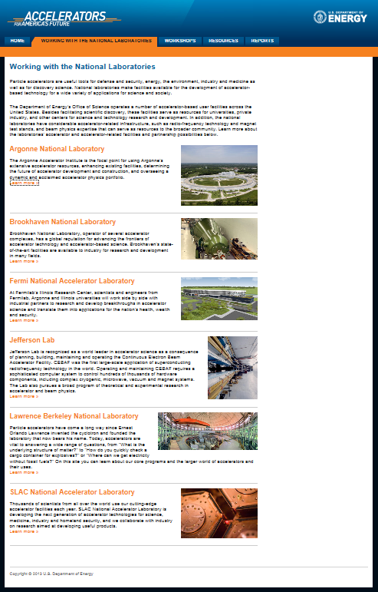
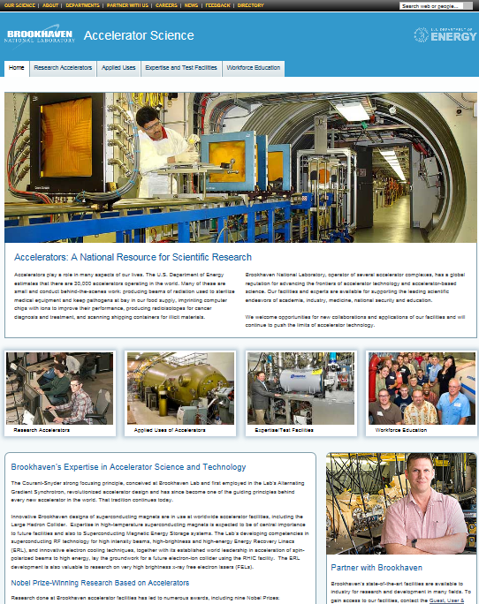
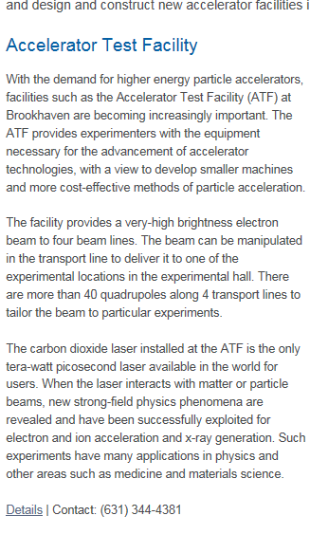
“One-Stop Shopping” for finding Accelerator R&D Capabilities at the DOE Office of Science National Laboratories http://www.acceleratorsamerica.org

Slide 14
Closing Comments
The Accelerator Stewardship Test Facility Pilot Program is a new mechanism to make national lab accelerator R&D capabilities and technologies more accessible
Recent public outreach events reached over 450 participants
Showed that there is considerable interest in the national lab infrastructure
This interest is broader than the accelerator R&D infrastructure
Showed that national lab staff are very interested in engaging with others
Labs enthusiastically embraced the opportunity to show how they can help
Using the national lab accelerator capabilities for mutually beneficial R&D will strengthen the overall R&D ecosystem
There is unique accelerator technology and capability at the labs that can be used and developed for other applications

Slide 15
Thank you!
Questions?
†DOE Program Contact: Eric.Colby@Science.DOE.GOV, (301)-903-5475
Image courtesy of Oak Ridge National Laboratory

