Slide 1
DOE Office of Economic Impact & Diversity Lab-to-Market Pilot
Tech Transfer Working Group Summer Meeting
J. Chris Ford, Ph.D.
Technical Advisor to the ED Director
Office of Economic Impact & Diversity
June 17, 2015

Slide 2
Agenda
Overview of Office of Economic Impact and Diversity (ED)
  Highlight of Minority Education
ED Programmatic Priorities for 2015-2016
Lab-to-Market Initiative
  ED-MBDA MOU
  Mission of Lab-to-Market
  Relevant Tech Transfer Policy
  DOE-ED/DOC-MBDA Approach to Lab-to-Market
  Program differentiation
  DOE-DOC Innovation Ecosystem Needs
ED/Lab-to-Market Pilot
Summary

Slide 3
Our Work: Office of Economic Impact and Diversity
Dot Harris, Director
Office of Economic Impact and Diversity
energy.gov/diversity
Notes:
Agenda- 10 min overview of DOE’s work and challenges, and the ways that states participate in them.

Slide 4
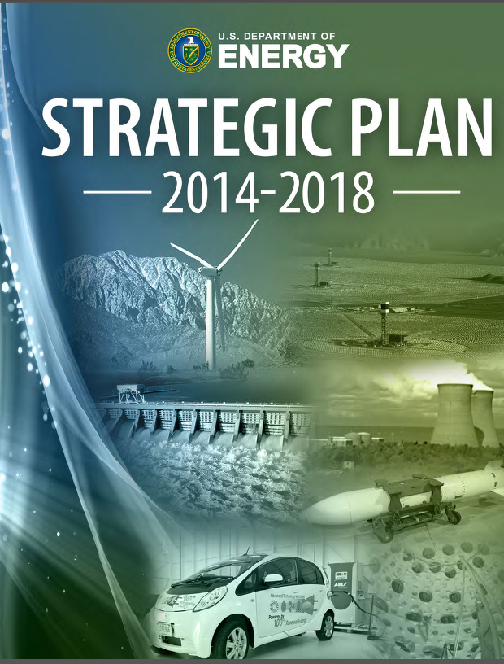
What We Do
The Office of Economic Impact and Diversity (ED) identifies and implements ways of ensuring that all communities are afforded opportunities to participate fully in the Department of Energy's programs, funding, and activities. We lead the Department in partnering with students and programs at Minority Serving Institutions and other diverse stakeholders and individuals.

Slide 5
Our Structure
Office of the Director (ED1)
Office of Minority Education and Community Development (ED2)
Office of Minority Business and Economic Development (ED3)
Office of Civil Rights (ED4)
Office of Diversity and Inclusion (ED5)

Slide 6
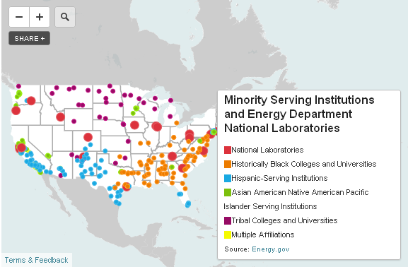
Minority Education Engagement and Support
We provide management and technical assistance to Minority Serving Institutions (Historically Black Colleges & Universities, Tribal Colleges & Universities, Asian American and Pacific Islander Institutions, and Hispanic-Serving Institutions).
For more: http://energy.gov/diversity/working-us/minority-serving-institutions

Slide 7
Office of Economic Impact and Diversity
PROGRAMMATIC PRIORITIES FOR 2015-2016
1. Institutionalize the Nationally Recognized Minorities in Energy Initiative (MIE)
  Establish sustainable investments in Minority Serving Institutions through DOE-wide collaborative efforts
  Develop a regional energy economic development roadmap that leverages federal agencies and other stakeholders
  Conduct a series of events across the country, raising awareness and engaging diverse communities (e.g. STEM/energy literacy, climate change mitigation, resilience, and energy workforce)
  Establish enduring public-private partnerships
2. Advance Diversity, Inclusion and Equal Opportunity Across the DOE Complex
  Re-establish the DOE Headquarters Equal Employment Opportunity Office
  Develop and lead implementation of an effective Diversity & Inclusion action plan
  Support DOE laboratory and field site Diversity & Inclusion efforts
3. Support Transfer of Technologies to Minority Businesses
  Develop a Minority Serving Institution research and technical capabilities database and communication network
  Support DOE laboratory collaborations with Minority Serving Institutions and minority businesses
  Leverage joint initiatives with the Department of Commerce Minority Business Development Agency
4. Develop and Publish a Nationally Recognized Women In Energy STEM Education Series
  Develop Women @ Energy, a publication featuring diverse female STEM professionals working for the Department and its National Laboratories
  Develop a web portal (with PA) to serve as a home for the Women @ Energy Series and a supplement to the publication.
  Develop education resources and lesson plans for teachers and parents that integrate W @ E material with the Energy Literacy framework

Slide 8
DOE Labs and DOC-MBDA Centers
The DOE Office of Economic Impact and Diversity, through an MOU with the Minority Business Development Agency (MBDA) of DOC, has engaged MBDA’s network of business centers to identify qualified MBEs and provide technical assistance for the Lab-to-Market Initiative.
Notes:
MBDA = Minority Business Development Center

Slide 9
ED-MBDA: Lab-to-Market Initiative
Economic Impact:
Technology commercialization creates jobs and grows the economy.
Stimulates development of minority businesses.
Leverage large businesses resources, brand, and distribution channels.
Websites:
TechTransfer.Energy.gov
Diversity.Energy.gov
MBDA.gov
NIST.gov/MEP
Innovation
Ecosystem
Businesses
LBs, MBEs
DOE National Labs
Commercially Viable Product or Service
Workforce Development and Diversity
Economic Impact
DOE-DOC
Federal Resources, State and Local Agencies
MSIs
Mission: To catalyze regional innovation ecosystems that stimulate job creation and business growth opportunities for minority business enterprises (MBEs) and minority serving institutions (MSIs) by leveraging the federal resources of the Department of Energy and its National Labs and the Department of Commerce.
Notes:
MBE= minority business enterprise
MSI = minority serving institutions
LB = Large business

Slide 10
Relevant Tech Transfer Policy
(DEAR) 970.5226-1, “Diversity Plan” clause, the Management and Operating (M&O) contractor must have a “total package” Diversity Plan: Economic development including technology transfer, and the following pertinent mandates:
  The Diversity plan is to encourage and foster relationships with minority serving institutions (MSIs) and develop strategic partnerships with professional and scientific organizations to promote careers in STEM and increase participation in subcontracting opportunities, research and development partnerships, and mentor-protégé’ relationships.
Tech Transfer Policies
  Stevenson-Wydler Technology Innovation Act of 1980 -- Purpose: “stimulating improved utilization of federally funded technology developments … by state and local governments and the private sector.”
  Federal Technology Transfer Act 1986 -- Technology transfer is a responsibility for all federal lab scientists and technology transfer activities are to be considered in employee performance evaluations.
  Executive Order 12591, 1987 -- All agencies are required to “assist in the transfer of technology to the marketplace”
Energy Policy Act 2005 -- “The Secretary shall establish an Energy Technology Commercialization Fund, using 0.9 percent of the amount made available to the Department for applied energy research, development, demonstration, and commercial application for each fiscal year, to be used to provide matching funds with private partners to promote promising energy technologies for commercial purposes.” (Section 1001)
Presidential Memorandum 2011 -- Accelerating Technology Transfer and Commercialization of Federal Research in Support of High-Growth Businesses.
  Each executive department and agency that conducts R&D commits to improve the results from its technology transfer and commercialization activities. The aim is to increase the successful outcomes of these activities significantly over the next 5 years, while simultaneously achieving excellence in our basic and mission focused research activities.
  Establish Goals and Measure Progress. Establishing performance goals, metrics, and evaluation methods, as well as implementing and tracking progress relative to those goals, is critical to improving the returns from Federal R&D investments.
  Streamline the Federal Government's Technology Transfer and Commercialization Process. Streamlining licensing procedures, improving public availability of federally owned inventions from across the Federal Government, and improving the executive branch's Small Business Innovation Research (SBIR) and Small Business Technology Transfer (SBTT) programs based on best practices will accelerate technology transfer from Federal laboratories and other facilities and spur entrepreneurship.
  Facilitate Commercialization through Local and Regional Partnerships. Agencies must take steps to enhance successful technology innovation networks by fostering increased Federal laboratory engagement with external partners, including universities, industry consortia, economic development entities, and State and local governments.
Notes:
Regulation (DEAR) 970.5226-1, “Diversity Plan” clause, the Management and Operating (M&O) contractor must have a “total package” Diversity Plan

Slide 11
ED/MBDA Approach to Lab-to-Market
Aligning Policy and the U.S. Innovation Ecosystem
Robust Program Design with Focus on the U.S. Innovation Ecosystem
White House Policy
Presidential MOU
Lab-to-Market
Cabinet Agencies: Policy and Budget
DOE
DOC
DOE: ED, S4/OTT,NNSA
DOC: MBDA,NIST, EDA
U.S. Innovation Ecosystem
Program and Staff Offices: Develop Programs and Execute
ED/MBDA’s strategy for Lab-to-Market has focused on the building a bridge to the U.S. innovation ecosystem.
  With a robust approach, the strategy allows for changes at the White House and DOC & DOE senior leadership.
  Ensures long term sustainable program growth.

Slide 12
Differentiation from other DOE & DOC Programs
Measured Inclusion of Minorities: MSIs and MBEs.
Emphasis on Ecosystem and Regional Tech Transfer & Commercialization Infrastructure.
Leveraging of Public and Private resources for both execution, advisement, and funding.
Comprehensive approach that includes ecosystem, funding, and STEM workforce.

Slide 13
DOE-DOC Innovation Ecosystem Needs Defined
The initiative will address the following key innovation ecosystem needs:
  Talent Development & Entrepreneurship (Pilot)
  Leveraging of Information Technology Tools (Pilot)
    Technical Database of MSIs and DOE Lab Resources
    Virtual Innovation Ecosystem
    Crowd-Sourcing of Innovation Supply Chain
  Ecosystem Coordination (Future)
  Funds for Technology Maturation (Future)

Slide 14
ED-MBDA: Lab-to-Market Pilot
Pilot Features
Technology Focus
14 MEISPP Summer Interns at LLNL (6) and Argonne (8)
Key Goal/metric: Commercialization Packages (5-7)
Coordination with Programs via Minorities in Energy (MIE).
Supports MIE Goal Areas 1 & 2: STEM Workforce and Energy Economic Development.
Launch: Argonne- June 1, 2015, LLNL-June 22, 2015
In 2016, expand to 40 students and up to 5 DOE Labs.
Medical
Cyber Security & Smart Grid
Energy Efficiency and Storage
Environmental

Slide 15
Power Moves Oakland, CA:
August 10-12, 2015
Demo of ED Lab-to-Market Pilot
  Pitch Competition
3 day event celebrating minority entrepreneurship
  https://vimeo.com/candlelightfilms/review/125660544/5fabf8cb33
Opportunity to showcase DOE technology

Slide 16
Summary
Partnering with DOE Labs is critical to the MIE initiative.
U.S. Government role is to foster innovation ecosystems to catalyze economic growth.
Federal policy and convening authority is critical to seeding communities of innovation ecosystems & scaling innovation.
A public private partnership model that uses both market “pull” and market “push” tactics for tech transfer is needed.
MSIs & MBEs can play vital roles in the innovation ecosystem and process of scaling innovation with DOE Labs.
Notes:
MBE= minority business enterprise
MSI = minority serving institutions
LB = Large business

Slide 17
Thank You
DOE Websites:
TechTransfer.Energy.gov
Diversity.Energy.gov
DOC Websites:
Mbda.gov
NIST.gov/mep
J. Chris Ford, Ph.D.
Technical Advisor to the Director
Office of Economic Impact & Diversity
US Department of Energy
Chris.Ford@hq.doe.gov

Slide 18
Back Up Slides

Slide 19

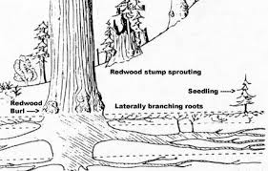
Culture and Innovation Ecosystems
Culture is the engine that drives an innovation ecosystem.
A Redwood forest is highly sophisticated ecosystem. Each tree is a part of a community that shares resources which causes the entire ecosystem achieve unparalleled heights that could not be achieved alone.

Slide 20
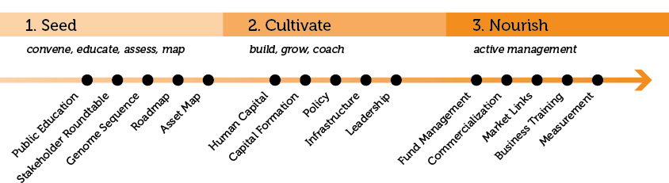

Innovation Ecosystem
Rainforest model of Innovation Ecosystem Development
Seed a culture of innovation at Federal agencies and labs, minority businesses, minority serving institutions, large businesses, investment community, and stakeholder groups and agencies.
Cultivate communities that catalyze regional economic development.
Nourish regional economic development with capital, technology commercialization, market verticals, and entrepreneurship training.

Slide 21
Economic Impact of Tech Transfer
 | TechLink Study of DoD | IBRC Study of Navy
Time Period | 2000-2009 | 2005-2009
Types of Tech Transfer Agreements Considered | 44% R&D contracts 36% licenses 20% CRADAs | 25% licenses 75% CRADAs
Economic Impact per Tech Transfer Agreement | $2.24MM 13 jobs created or retained | $5.4MM 26 jobs created or retained
Average Job Compensation (for jobs attributable to direct sales) | $73,279 | $79,300
Swearingen and Slaper, Economic Impact of DoD Technology Transfer, June 2012

Slide 22
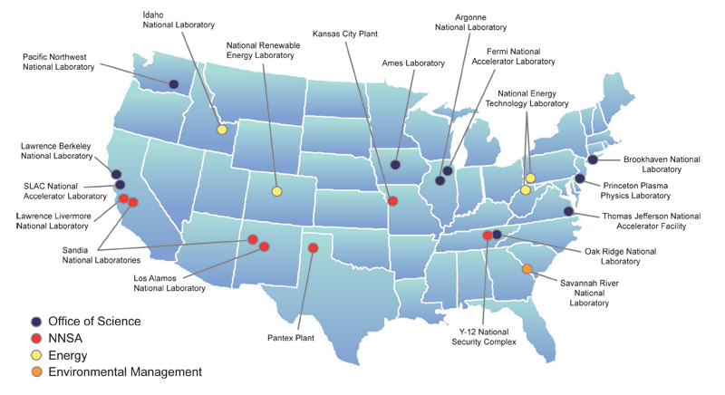
DOE Labs

Slide 23
MBDA Centers

Slide 24
Ecosystem Indicators
Ecosystem Indicator | Guiding Questions | Metrics
Policy | Are the State, Local, and Lab policies supportive of technology transfer and commercialization, economic development, and entrepreneurship? | Number of policies that incentivizes tech transfer/commercialization, economic development, and entrepreneurship
Ideas | How well is Intellectual Property (IP) (DOE or others) being translated to the entrepreneurs, universities, and investors? What’s the economic impact of the IP? | DOE IP Utilization, MSI IP Utilization, Jobs Created, Revenue Generated (MBE and non MBE)
People | Does the ecosystem have the needed competent players such as Innovators, Integrators, Entrepreneurs, Leaders, and Role Models? Is the ecosystem developing the requisite talent to spur economic growth? How are minorities, MBEs, and MSIs being utilized? | Minority Business Utilization and created, Minority Serving Institution Utilization, Number of Entrepreneurs trained (Minority, non Minority)
Community | Has the region developed a collaborative environment with local universities, businesses, city and state officials, and investors? | The number of events and public private partnerships with academic, public, and private leaders focused on innovation, entrepreneurship, or economic development
Capital | Are gap funds and technology maturation dollars available and active for ecosystem? Is there continuum of capital available for entrepreneurs? In what capacity? How much capital is utilized by MBE and MSI participation? | Amount of technology maturation funds invested by source for DOE Lab IP and non DOE IP. Leverage of federal dollars (additional matching private funds). Capital utilized by MBEs and MSIs

Slide 25
Technology Readiness Level
Phase | Technology Readiness Level | Description
Prototype Development | TRL 1 | Basic Research is translated to Applied Research
 | TRL 2 | Invention begins - Once basic principles are observed, practical applications can be invented. Applications are speculative and there may be no proof or detailed analysis to support the assumptions. Examples are limited to analytic studies.
 | TRL 3 | Active R&D is initiated - Active research and development is initiated. This includes analytical studies and laboratory studies to physically validate analytical predictions of separate elements of the technology. Examples include components that are not yet integrated or representative.
 | TRL 4 | Basic technological components are integrated - Basic technological components are integrated to establish that the pieces will work together.
Prototype Testing | TRL 5 | Fidelity of breadboard technology improves significantly - The basic technological components are integrated with reasonably realistic supporting elements so it can be tested in a simulated environment. Examples include “high fidelity” laboratory integration of components.
 | TRL 6 | Model/prototype is tested in relevant environment - Representative model or prototype system, which is well beyond that of TRL 5, is tested in a relevant environment. Represents a major step up in a technology’s demonstrated readiness. Examples include testing a prototype in a high-fidelity laboratory environment or in simulated operational environment.
Product Development | TRL 7 | Prototype near or at planned operational system - Represents a major step up from TRL 6, requiring demonstration of an actual system prototype in an operational environment.
 | TRL 8 | Technology is proven to work - Actual technology completed and qualified through test and demonstration.
 | TRL 9 | Actual application of technology is in its final form - Technology proven through successful operations.

Slide 26
Manufacturing Readiness Level
Phase | Manufacturing Readiness Level | Description
Prototype Development | MRL 1 | Basic Research is translated to Applied Research
 | MRL 2 | Application and validity of concept validated or demonstrated.
 | MRL 3 | Experimental proof of concept completed
 | MRL 4 | Production validated in lab environment
Pre-Production | MRL 5 | Basic capability demonstrated
 | MRL 6 | Process optimized for production rate on production equipment
Product Development | MRL 7 | Capability and rate confirmed.
 | MRL 8 | Full production process qualified for full range of parts .
 | MRL 9 | Full production process qualified for full range of parts and full metrics achieved.

