Slide 1
Make an IMPACT Spring Meeting June 17, 2015
TTWG Board:
Cherri Schmidt (Chair)
Connie Cleary (Vice Chair)
Jeremy Benton (Sec)
Steve McMaster (Past Chair)

Slide 2
Our Theme: Make an IMPACT
Innovative Models and Practices for Accelerating the Commercialization of Technology (IMPACT)
New Leadership
New Organizations
New Program Initiatives
New Administrative Options
New Relationships

Slide 3
Agenda
09:00 - 09:10 Welcome & Meeting Call to Order Baltimore 1-2 Ballrooms, Gaylord National Hotel
09:10 - 09:50 Make an IMPACT Keynote Event: Strengthening the partnership between DOE and its laboratories and facilities for more effective transition of technology from laboratory to marketplace
Dr. Franklin Orr, Under Secretary for Science & Energy
Steve Ashby, Laboratory Director PNNL & NLDC Member
09:50 - 10:10 Make an IMPACT: The New Office of Technology Transitions
Jetta Wong, Acting Director OTT
10:10 - 10:30 Networking Break
10:30 - 11:30 Make an IMPACT: Cross-Cutting Program Initiatives Jetta Wong (Moderator)
EERE-Led Pilots & Initiatives (Lab-Corps, SB Vouchers) Joyce Yang
SC-Led Pilots & Initiatives (Accelerator Stewardship Pilot Program) Eric Colby
Technology Transfer at NNSA Kevin Greenaugh
11:30 - 12:10 Make an IMPACT: Cross-Cutting Administrative Initiatives Steve McMaster (moderator)
MEISPP/Lab-to-Market Entrepreneurship Initiative Chris Ford
International CRADA Development John Lucas
SPP Community of Practice and SPP Order (Status Update) Cherri Schmidt
12:10 - 13:30 Lunch (on your own)

Slide 4
Agenda
13:30- 15:00 Make an IMPACT: Committee Reports & Recommendations
Connie Cleary (BNL) FY2015 TTWG Vice Chair (Moderator)
Technology Maturation Poornima Upadhya (BNL) and Bruce Harrer (PNNL)
Entrepreneurial Leave Program Peter Atherton (SNL)
Improving SPP/CRADA/ACT Diane Hart (ANL)
Quadrennial Technology Review (QTR) Mike Paulus (ORNL) and Charlie Russomanno (DOE/OTT)
15:00 - 15:20 Networking Break
15:20 - 16:30 Make an IMPACT: Improved Metrics and the DOE Data Call
Jetta Wong, Charlie Russomanno, Bill Farris, Ingrid Milton
16:30 - 17:00 TTWG Business Matters and Adjournment- Charter, Mailing List, Elections, FY16 Meeting Venues
Jeremy Benton, Cherri Schmidt

Slide 5
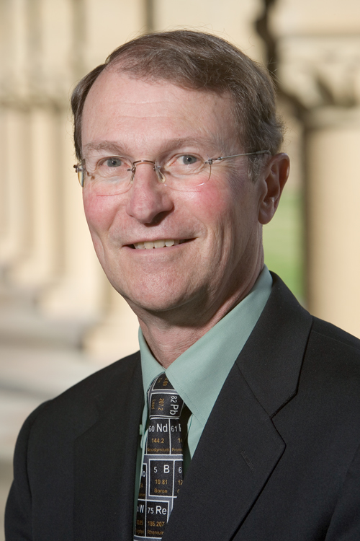
Introductions
Dr. Franklin (Lynn) M. Orr was sworn in as Under Secretary for Science and Energy on December 17, 2014.
As the Under Secretary, Dr. Orr is the principal advisor to the Secretary and Deputy Secretary on clean energy technologies and science and energy research initiatives. Dr. Orr is the inaugural Under Secretary for the office, which was created by Secretary of Energy Ernest Moniz to closely integrate DOE’s basic science, applied research, technology development, and deployment efforts. As Under Secretary, he oversees DOE’s offices of Electricity Delivery and Energy Reliability, Energy Efficiency and Renewable Energy, Fossil Energy, Indian Energy Policy and Programs, Nuclear Energy, and Science. In total, these programs steward the majority of DOE’s National Laboratories (13 of 17).
Prior to joining the Department of Energy, Dr. Orr was the Keleen and Carlton Beal Professor Emeritus in the Department of Energy Resources Engineering at Stanford University. He joined Stanford in 1985. He served as the founding director of the Precourt Institute for Energy at Stanford University from 2009 to 2013. He was the founding director of the Stanford Global Climate and Energy Project from 2002 to 2008, and he served as Dean of the School of Earth Sciences at Stanford from 1994 to 2002. He was head of the miscible flooding section at the New Mexico Petroleum Recovery Research Center, New Mexico Institute of Mining and Technology from 1978 to 1985, a research engineer at the Shell Development Company Bellaire Research Center from 1976 to 1978, and assistant to the director, Office of Federal Activities, U.S. Environmental Protection Agency from 1970 to 1972. He holds a Ph.D. from the University of Minnesota and a B.S. from Stanford University, both in Chemical Engineering.
Dr. Orr is also a member of the National Academy of Engineering. He served as a member of the Board of Directors of the Monterey Bay Aquarium Research Institute from 1987 to 2014, and was a member of the Board of Trustees of the David and Lucile Packard Foundation from 1999 to 2008, for which he has also chaired the Science Advisory Panel for the Packard Fellowships in Science and Engineering from 1988 to 2014. He served as a member of the 2008/09 National Research Council Committee on America’s Energy Future.
Lynn Orr

Slide 6
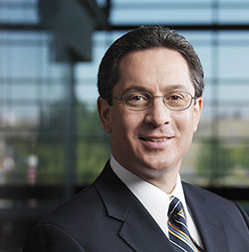
Introductions
Dr. Steven Ashby has served as Director of the Pacific Northwest National Laboratory (PNNL) since April 2015.
Under his leadership, PNNL's staff are advancing the frontiers of science and addressing complex challenges in energy, the environment, and national security. In particular, the Laboratory is providing national leadership in climate science, the power grid, nuclear nonproliferation, and environmental remediation.
Dr. Ashby previously served as PNNL's Deputy Director for Science and Technology, and was responsible for integrating PNNL's science and technology capabilities to meet national needs. Toward that goal, he led institutional strategic planning activities, stewarded an $80M discretionary research portfolio, and promoted Laboratory-wide efforts to elevate PNNL's standing in the broader scientific community. He also oversaw the Laboratory's technology commercialization, government relations, and research integrity functions. He served as a member of DOE's Laboratory Operations Board and was past chair of the DOE National Laboratory Chief Research Officers Working Group, which advises the National Laboratory Director's Council on scientific and programmatic issues.
Before joining PNNL in 2008, Dr. Ashby spent nearly 21 years at Lawrence Livermore National Laboratory (LLNL), ultimately serving as Deputy Principal Associate Director for Science and Technology. Dr. Ashby was the founding director of LLNL's Center for Applied Scientific Computing, which was established in 1996 and has since matured into one of the world's premier scientific computing research organizations.
Dr. Ashby is widely recognized as a leader in computational science and has worked to advance it as a discipline throughout his career. He holds a B.S. in Mathematics/Computer Science from the University of Santa Clara. He earned his M.S. and Ph.D. in Computer Science from the University of Illinois at Urbana-Champaign.
In 2013, Dr. Ashby was elected a Fellow of the American Association for the Advancement of Science in the mathematics section for "exceptional technical contributions and scientific leadership in applied mathematics and computational science, particularly the development of novel numerical methods and robust software for parallel computers, as well as for exemplary service to the field of computational science and engineering." He also was elected to the Washington State Academy of Sciences in 2013.
Steve Ashby

Slide 7
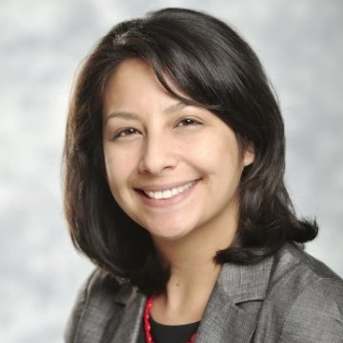
Introductions
Jetta Wong became the Acting Director of the Office of Technology Transitions for DOE in 2014.
Jetta joined the Department in July of 2012 as a Special Advisor in the Office of Energy Efficiency and Renewable Energy where she worked on a number of special projects and led the office’s National Laboratory Impact Initiative.
Before joining the Department of Energy Jetta worked for the United States House of Representatives’ Committee on Science, Space, and Technology. She worked on a wide range of energy and environment policy issues related to civilian research, development and demonstration programs at the Department of Energy and the Environmental Protection Agency.
Before working for Congress, Jetta worked for the Clean Energy Program of the Union of Concerned Scientists (UCS) where she brought stakeholders together from southern states in support of clean energy policy.
Prior to her work at UCS she served as the Senior Policy Associate on Sustainable Biomass for the Environmental and Energy Study Institute (EESI). There she testified twice for Congress on bioenergy and worked to develop policies that promote cutting edge sustainable renewable energy technologies.
Jetta’s career in energy started in Uzbekistan where she was a natural resources consultant on an anaerobic digestion development project.
Jetta holds a MPS in Legislative Affairs from George Washington University and B.S. in Natural Resources and the Environment from the University of Michigan.
Jetta Wong

Slide 8
Make an IMPACT Keynote Event: Leadership Perspectives
A conversation about strengthening the partnership between DOE and its laboratories and facilities for more effective transition of technology from the lab to the marketplace.
Steve Ashby Lynn Orr

Slide 9
Make an IMPACT: The New Office of Technology Transitions
Jetta Wong, Acting Director OTT

Slide 10
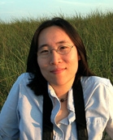
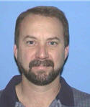
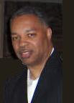
Make an IMPACT: Cross-Cutting Program Initiatives
Jetta Wong (Moderator)
EERE-Led Pilots & Initiatives, Lab Corps Pilot, Small Business Voucher Pilot: Joyce Yang
SC-Led Pilots & Initiatives, Accelerator Stewardship Pilot Programs: Eric Colby, Office of High Energy Physics, Office of Science
Technology Transfer at NNSA : Kevin Greenaugh, Assistant Deputy Administrator for Strategic Partnership Programs, NNSA (presented by Lee Finewood)
Jetta Wong Joyce Yang Eric Colby Kevin Greenaugh

Slide 11
Internet Connection
TechConnect World
TechConnect
Innovate

Slide 12
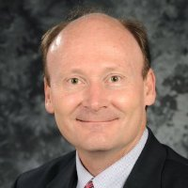
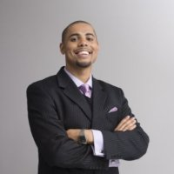
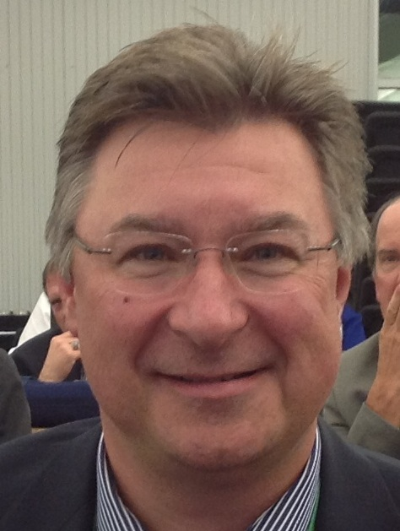
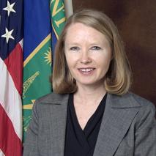
Make an IMPACT: Cross-Cutting Administrative Initiatives
Steve McMaster (moderator)
MEISPP/Lab-to-Market Entrepreneurship Initiative: Chris Ford, Technical Advisor to ED Director
International CRADA Development: John Lucas, Assistant General Counsel for TT and IP
SPP Community of Practice and SPP Order: Ingrid Kolb (presented by Cherri Schmidt)
Steve McMaster Chris Ford John Lucas Ingrid Kolb

Slide 13
Make an IMPACT: Committee Reports & Recommendations
Connie Cleary (BNL) FY2015 TTWG Vice Chair (moderator)
Technology Maturation
Poornima Upadhya (BNL) and Bruce Harrer (PNNL)
Entrepreneurial Leave Program
Peter Atherton (SNL)
Improving SPP/CRADA/ACT
Diane Hart (ANL)
Quadrennial Technology Review (QTR)
Mike Paulus (ORNL) and Charlie Russomanno (DOE/OTT)

Slide 14
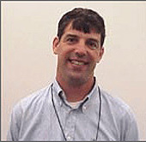
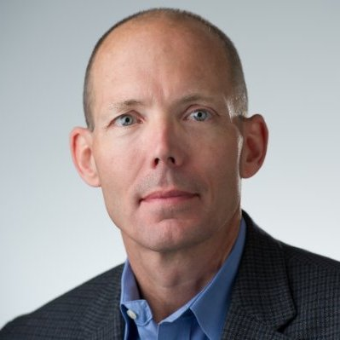
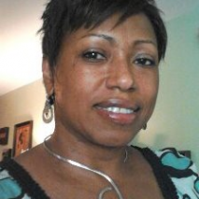
Make an IMPACT: Improved Metrics and the DOE Data Call
Jetta Wong Charlie Russomanno Bill Farris Ingrid Milton

Slide 15
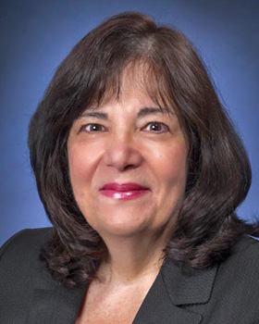
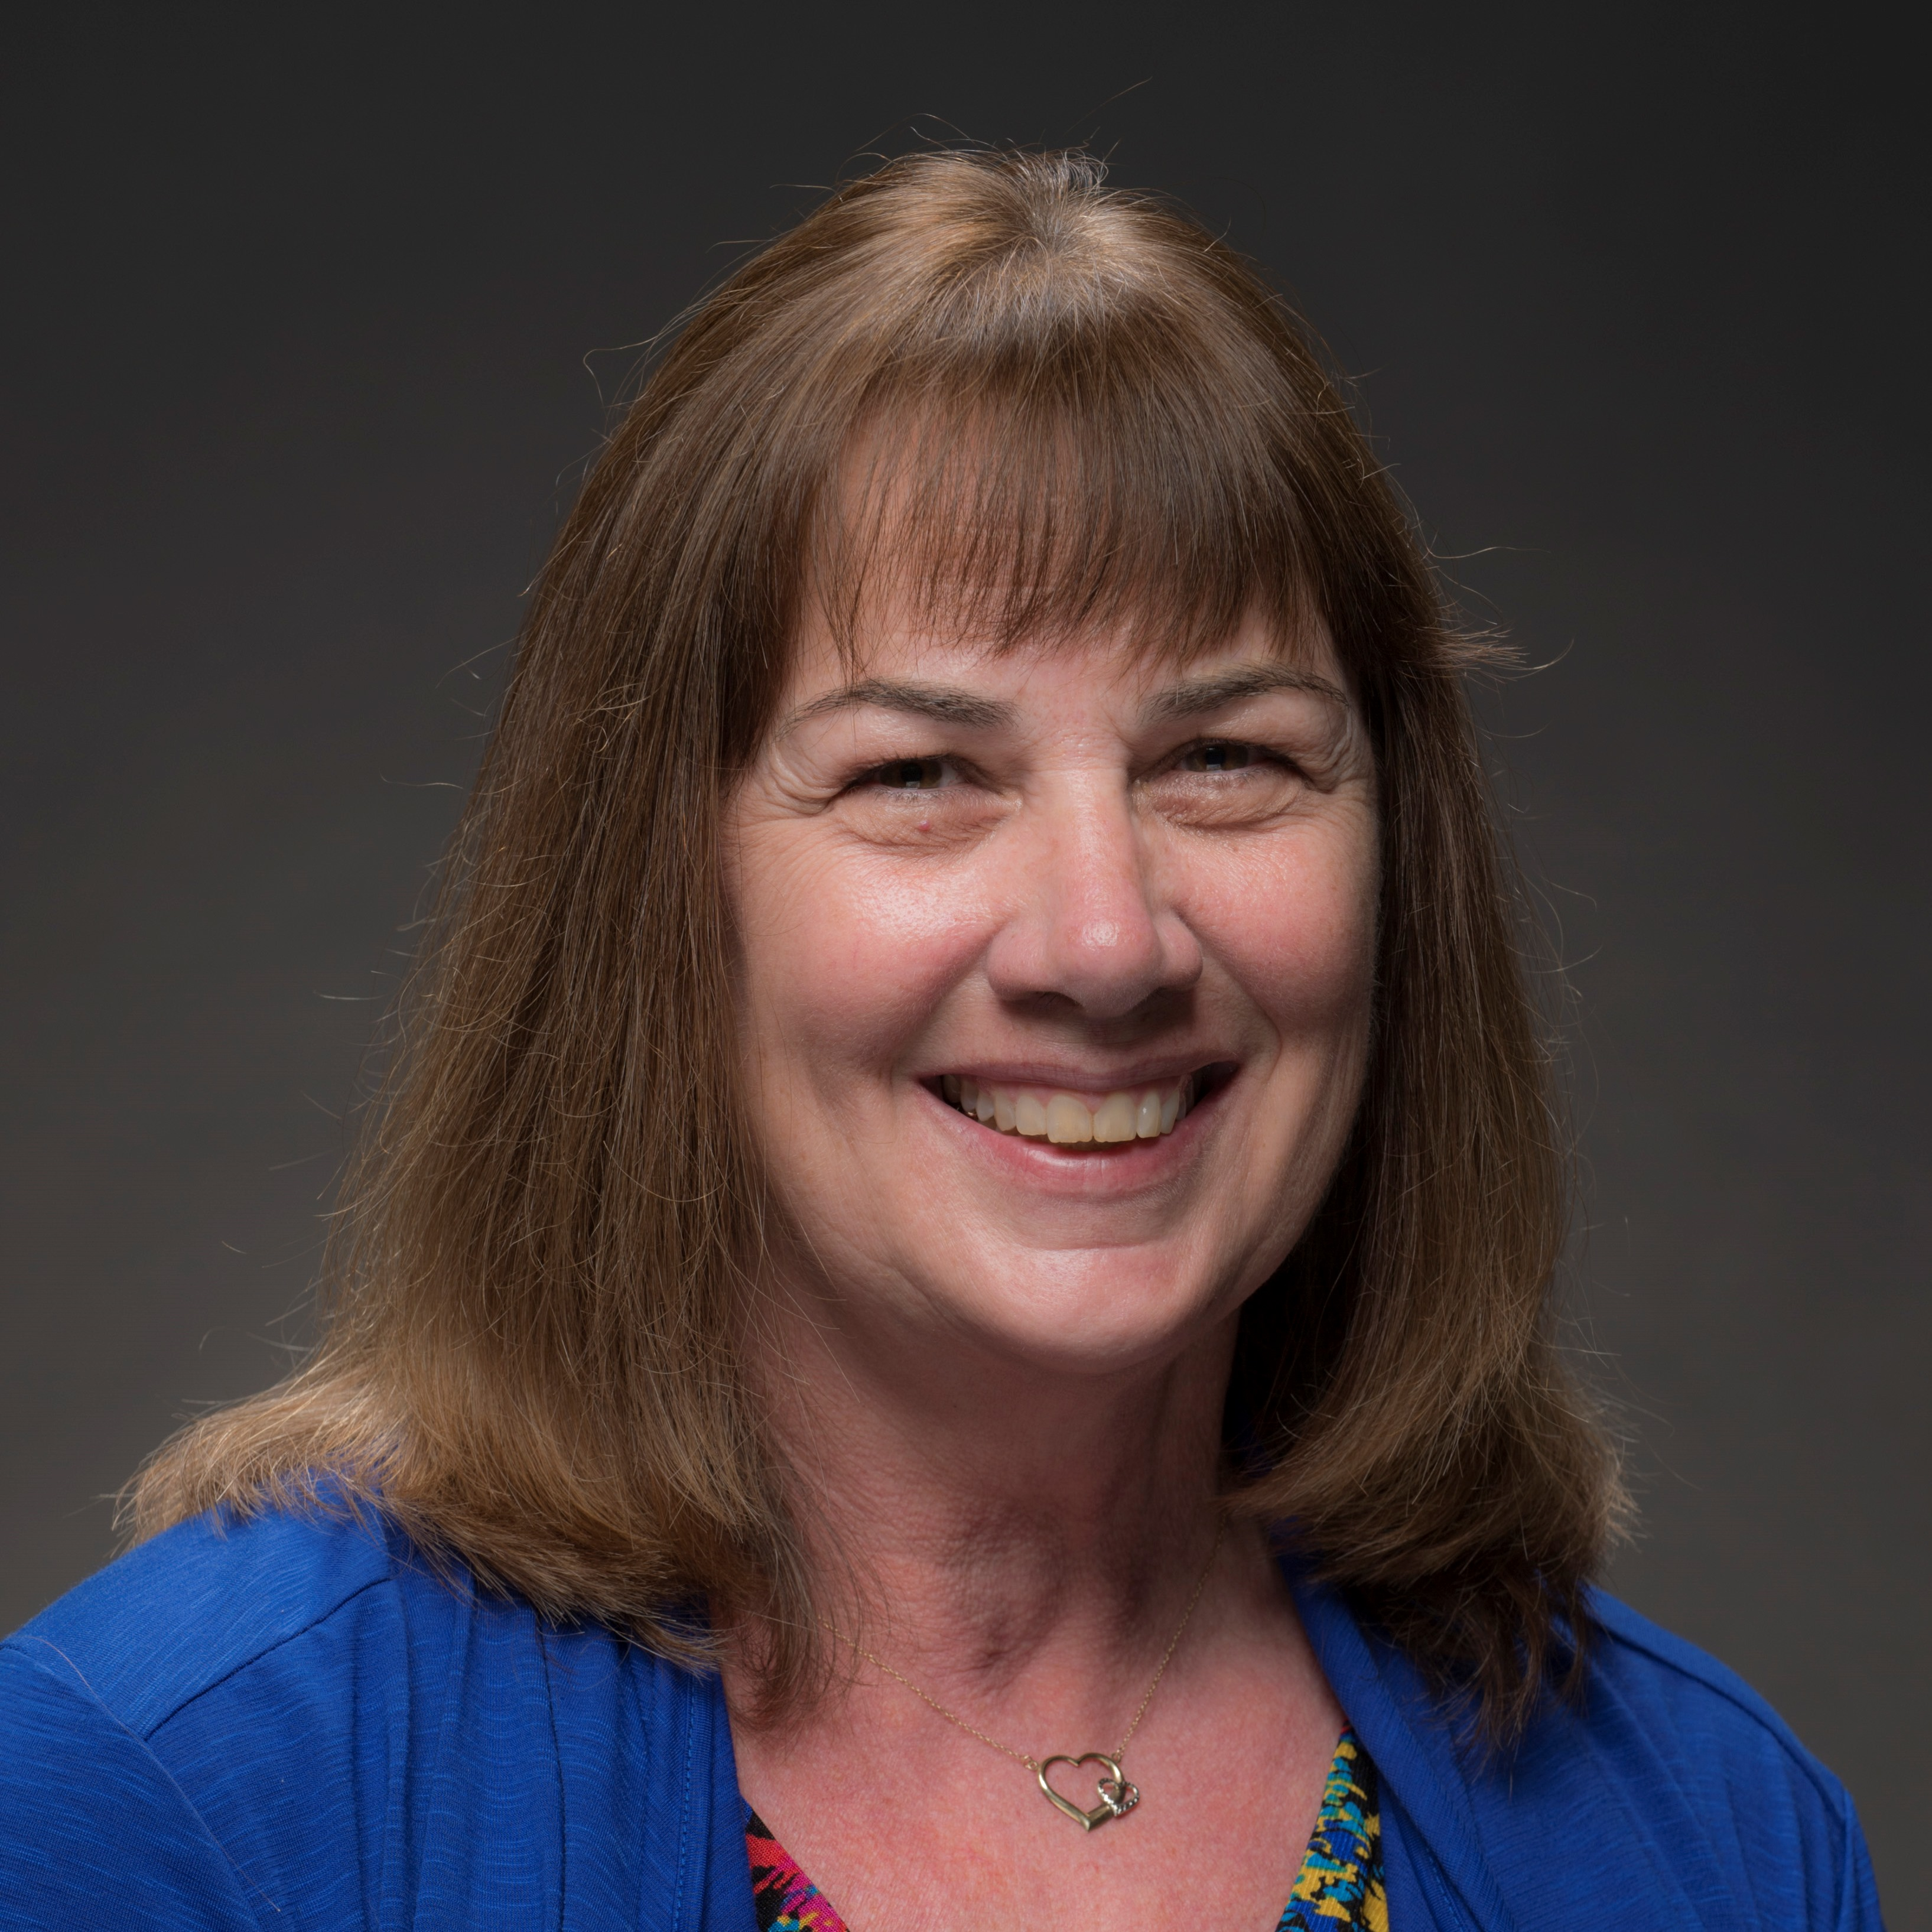
TTWG Business Matters and Adjournment
Charter, Mailing List, Elections, FY16 Meeting Venues
Thanks to all for your participation
Update TTWG membership/mailing list (if you haven’t already)
‘Save the Date’ – November 9, 10 BNL
Safe travels
Cherri Schmidt Jeremy Benton Connie Cleary

