Slide 1
Heaters for the QXF magnets:
designs and testing and QC
M. Marchevsky (LBNL)

Slide 2
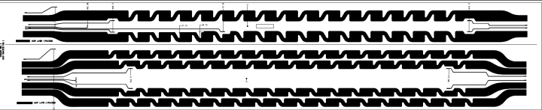
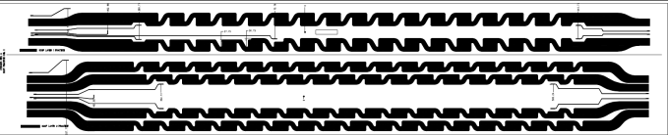



Heater plan for the short QXF one year ago
CAD
Trace
  Coil 1: LARP
  IL :“SS only”
  OL: “SS only
  Coil 1: CERN
  IL :“SS only”
  OL: “SS only”
  Coils 2-3: LARP
  IL: “Cu plating” option 1
  OL: “SS only”
  Coils 2-3: CERN:
  IL: “Cu plating” IL, option 2
  OL: “Cu plating” OL option 1 or 2
v
v
v
v
v
x
v
x
In progress
x
v
x
x
x
x
x

Slide 3

OL heater options
”SS only”- Option 1
”Cu” - Option 2
Cu
SS
Cu
120 mm
40 mm
 |  | short
Magnet length | (m) | 1
Heater width | (mm) | 24
Heater thickness | (mm) | 0.025
Station length | (mm) | 12 (straight part)
Station distance | (mm) | 60.7
SS resistivity | (Wm) | 5.0E-07
Number of stations | (dimless) | 16 (IMT) 17 (OMT)
Total resistance | (W) | 1.32 (IMT) 1.4 (OMT)
Voltage | (V) | 100
Current | (A) | 75 (IMT) 71.4 (OMT)
Power | (W/cm²) | 103 (IMT) 93 (OMT)

Slide 4
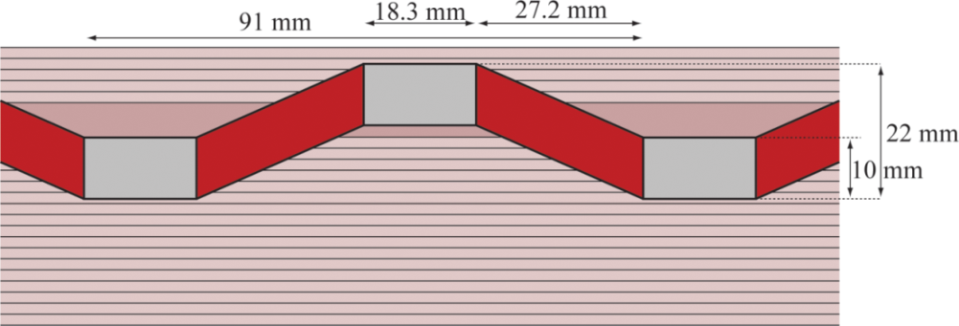
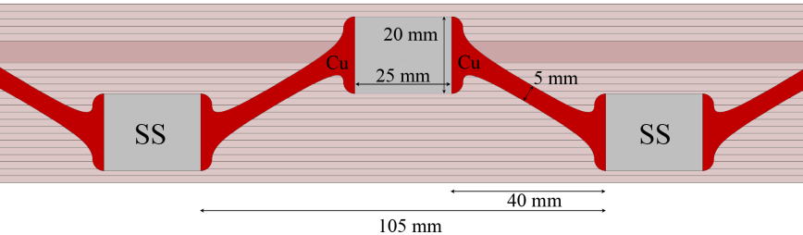
IL heater options
”Cu” - Option 1
”Cu” - Option 2

Slide 5
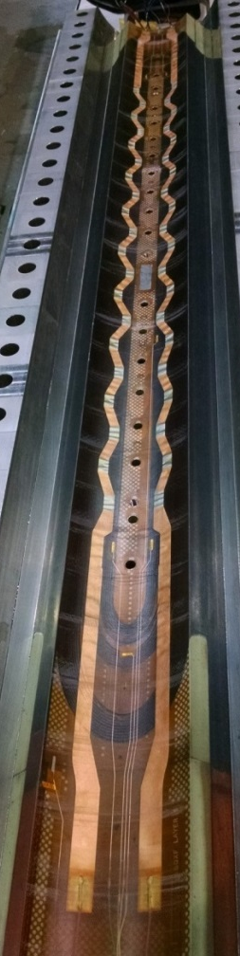
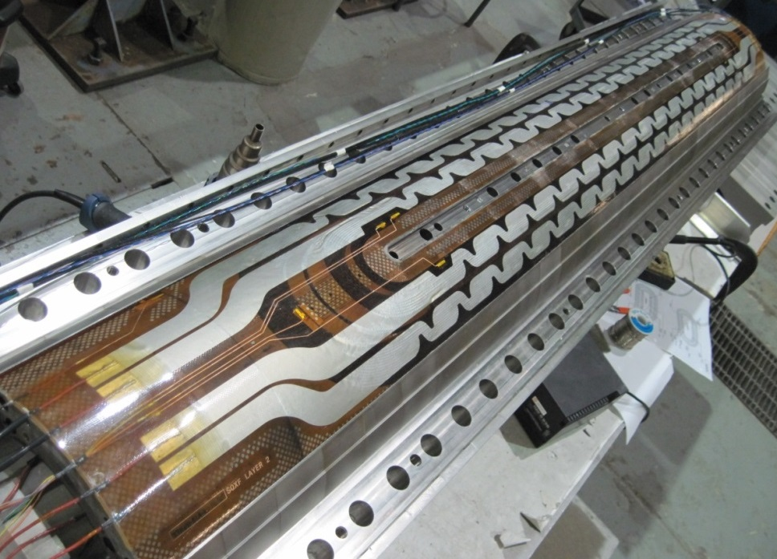
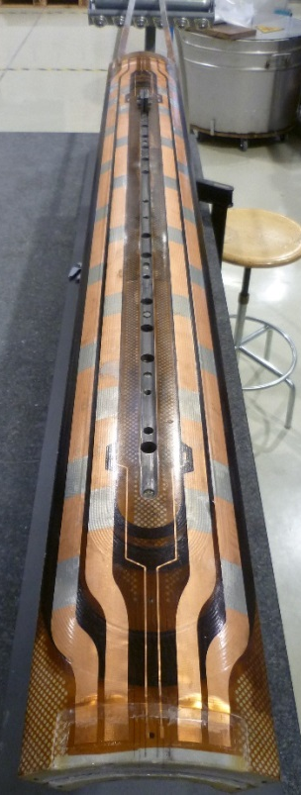
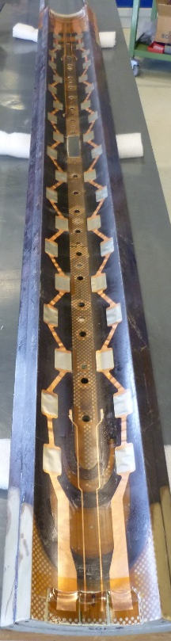
Current short QXF coils
LARP
CERN
SQXF03 (mirror); SQXF06 - spare
SQXF04 or 05 & SQXF05 - first magnet
Coil 103 & Coil 104
(first magnet)
Two different designs for the inner layer and two different designs for the outer layer

Slide 6
Heater choice for the long QXF
OL:
G.A: “We need the copper cladding for the long coils. And in a few months from now the CERN style OL heaters will be the only one demonstrated with copper cladding. If they perform as expected or "good enough" we have no need to develop and test other solutions.”
“Of course, if we find any issue with these traces, we will come back to other design options.”
IL:
No decision yet.
- What is “good enough” in term of numbers?
- How and when are we going to select the IL heater design?

Slide 7
Typical scope of the heater tests
Heater performance
Quench delays as function of heater power density
Quench delays as function of magnet current
MIITS studies with varying heater power / firing delays / in combination with CLIQ
(In the past LQ/HQ tests these were mainly driven by T. Salmi’s effort for validating the CoHDA code )
Heater reliability
Bubbles / delamination
Hipot issues
Cracks / burnouts
Which of these heater tests are relevant for qualifying them for the machine?

Slide 8
Minimal list of heater tests for the short QXF
Validating protection:
Firing heaters at “nominal magnet” current using standard HFU settings of the LHC (450 V?) and accessing quench delays and MIITS
Repeating tests for 80%, 50%, 30% of the “nominal” current
Repeating above tests in combination with CLIQ (tbd)
Accessing reliability and degradation:
Multiple firing of a single heater:
performance comparison between the beginning and the end of the firing sequence
visual / IR imaging / resistivity assessment before and after the test for detecting bubbles / cracks / delamination
(may be done even without having current in the magnet!)

Slide 9
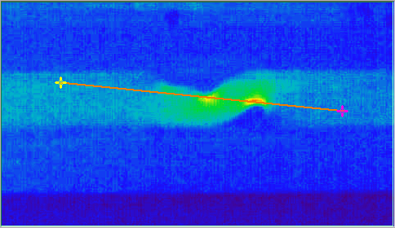
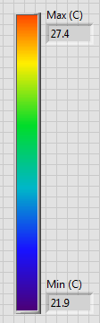
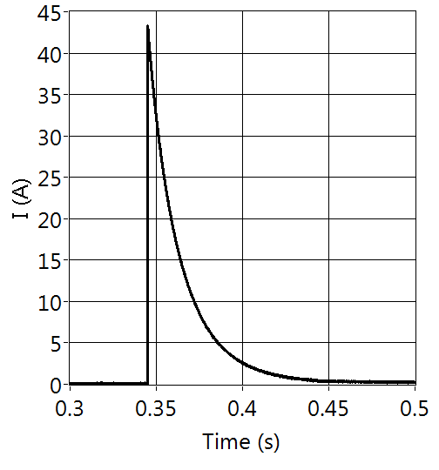
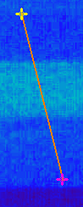
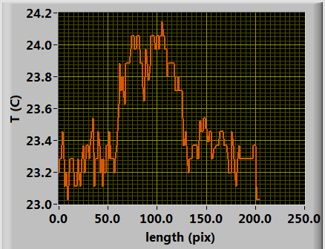
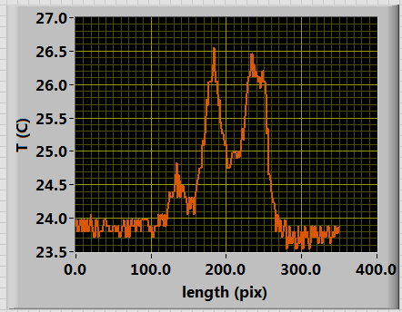
IR heater imaging results
A
27.4
B
B
T (C)
A
21.9
A-A
B-B
Hot spots at the concave-curved portion of the heating station

Slide 10
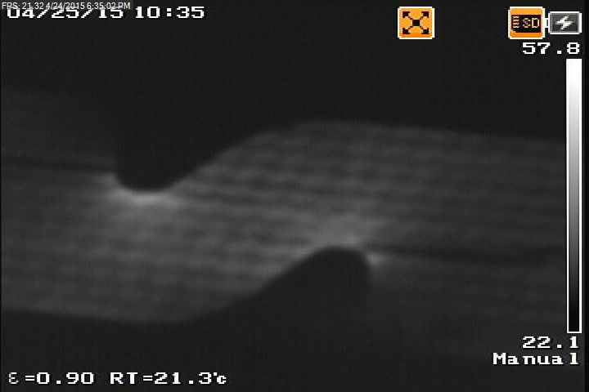
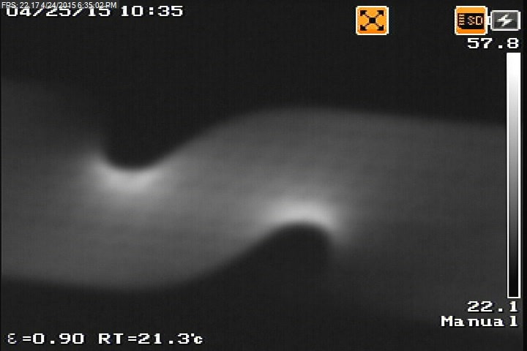

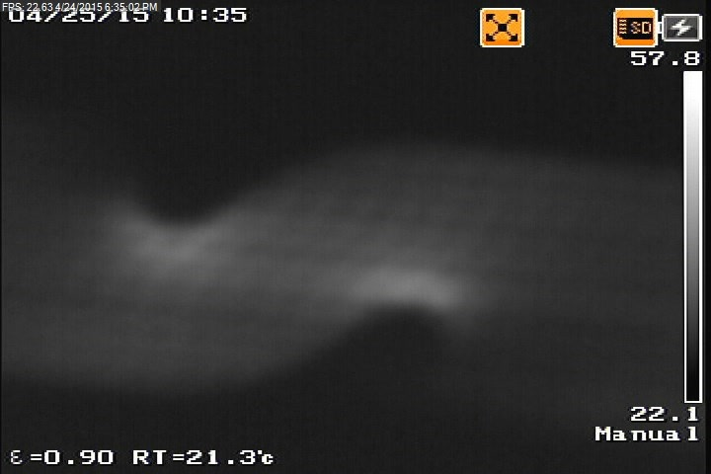
Time-resolved heat diffusion
(300 V pulse)
+9 ms
+18 ms
+18 ms
+36 ms

Slide 11
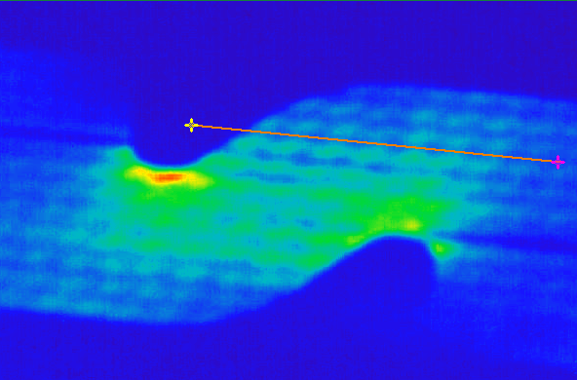
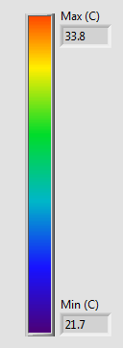
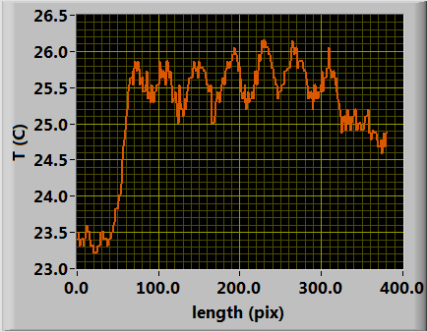
Time-resolved IR “tomography” of heat diffusion
33.8
T (C)
21.7
Image was taken ∼9 ms after the current pulse has been applied. Fine details of thermal diffusivity profile are seen revealing the underlying cable and its edge profile.
For copper: D= 1.16 x 10⁻⁴ m²/s (293 K),
hence at τ = 9 ms we are probing depths of ∼ 1 mm
For Kapton insulation: D= 1.8 x 10⁻⁷(293 K)
hence at τ = 9 ms we are probing depths of ∼ 40 micron
Heat diffusion time and dimensional scale are related as: τ=a²/D
An effective tool for testing uniformity of the insulation layer under the trace!

Slide 12
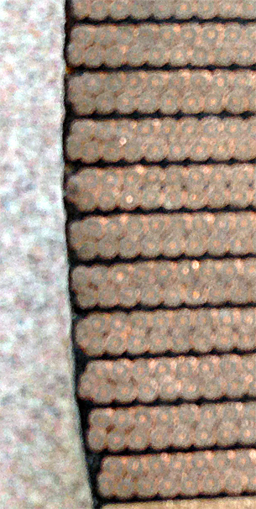
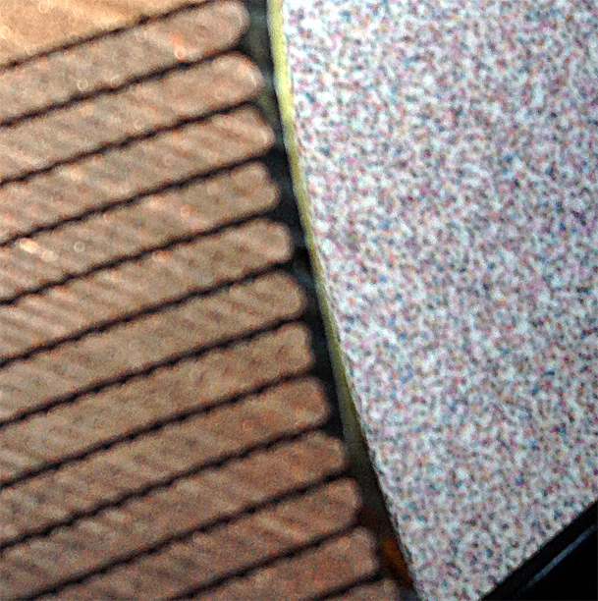
Epoxy thickness variations under the heater trace
OL
IL
Can be readily probed with a non-destructive IR imaging technique

Slide 13
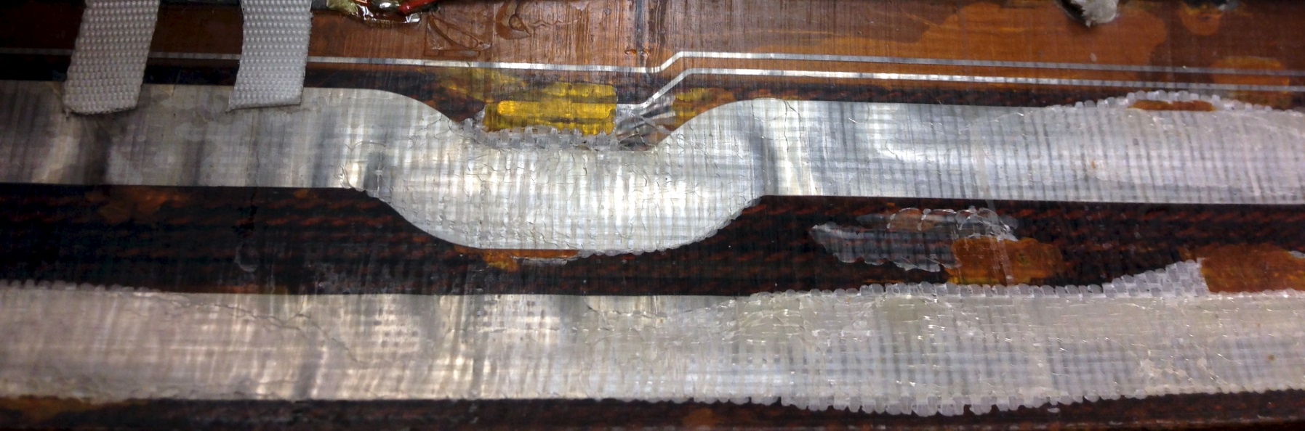
Bubbles in the HQ heater (HQ02 Coil 16)
“bubble”

Slide 14
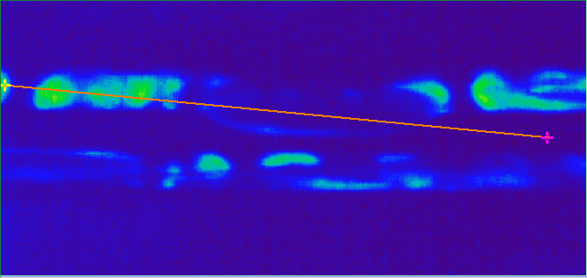
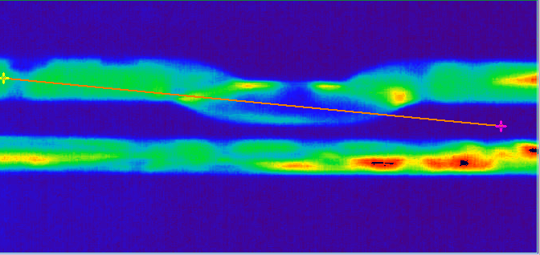
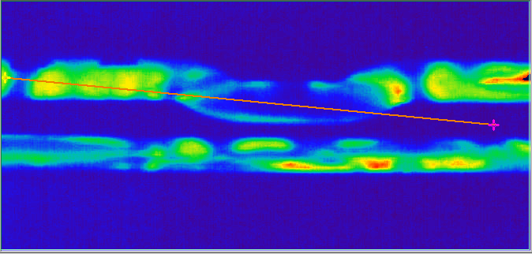
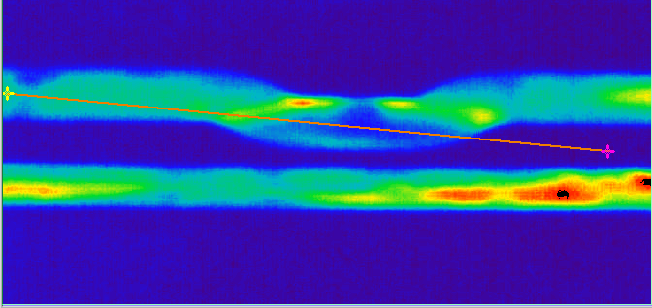
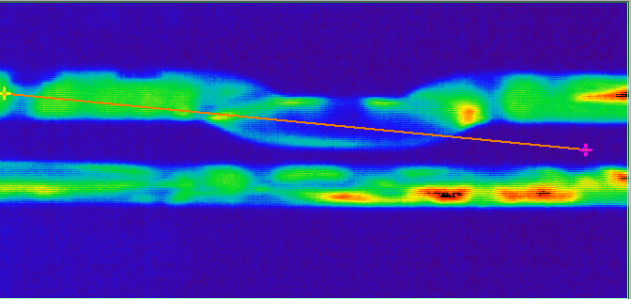
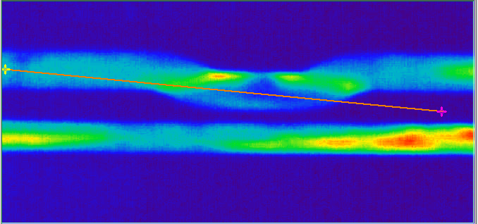
Bubbles in the HQ heater (HQ02 Coil 16)
∼ 126 ms time interval; 350 V pulse
T (C)
0 ms
+18 ms
30.1
+18 ms
+36 ms
21.7
+ 18 ms
+36 ms

