Slide 1


MQXFS1
Quench Protection Test Plan
Overview
G. Sabbi
LARP-HILumi Collaboration Meeting 24

Slide 2
Goals, Agenda and Outline
Goal for today is to present some initial ideas and get feedback to help more detailed test planning
Presentations:
  Overview - GianLuca
  Heaters configuration and characterization – Maxim
  CLIQ tests – Emmanuele
  (initial input from Vittorio, Tiina et al. is included)
Outline:
  Studies to be included in the plan
  Needs for programmatic guidance
  Preliminary schedule of studies in each area
  Test plan optimization, HQ experience

Slide 3
Quench Protection Studies
Detection times, thresholds, redundancy (during training phase)
Natural propagation (along turn, turn to turn, layer to layer)
  Also during training phase, impacts selection of heater and extraction delays. Important to verify expectations/models
Heater performance (delays to first start, propagation from layer to layer, quench integral)
  Schedule of tests (current, power) – reference form previous tests, e.g. mirror, HQ
  Different heaters designs (mixed in same magnet): strategy for comparison, decision points
CLIQ performance (foreseen to be available from first model)
CLIQ + heaters: comparisons, optimization, application
Inductance measurements
Protection limits

Slide 4
Programmatic Guidance
Input needed regarding goals at each step (i.e. model test) in order to establish key parameters and boundary conditions
  Limits for various studies: voltages, temperature/MIITs
  Priorities for allocation of testing time
Drivers:
What feedback is needed at which time
  Links between testing and design/fabrication decisions
Balance with more progressive/conservative approach
  Need to reuse coils for future magnets
Overall test time/budget (a strong constraint in the past)

Slide 5

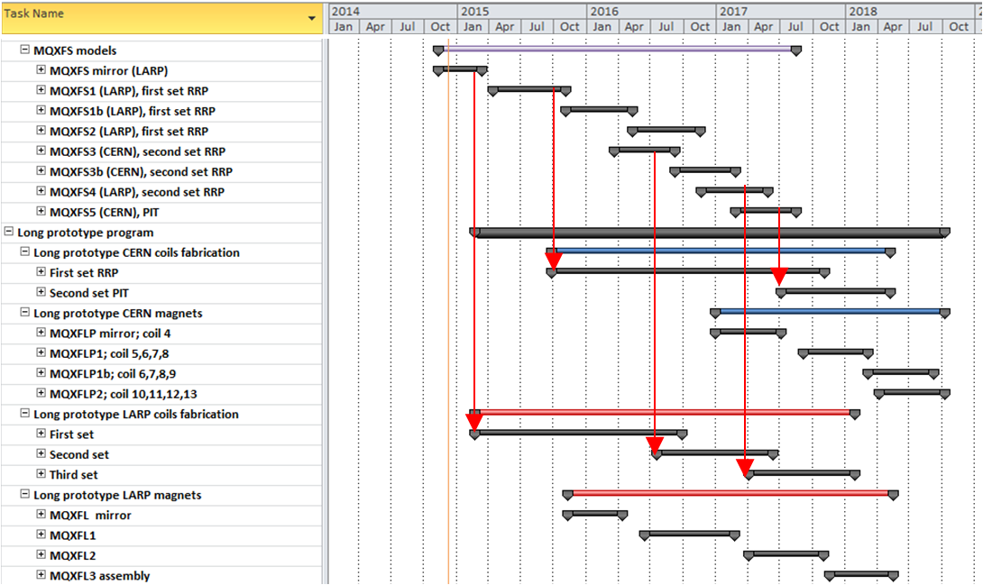
MQXF Model Plan

Slide 6
Protection studies during training
Only opportunity (hopefully) to get data from spontaneous quenches at various current levels
  Propagation, quench integral in various conditions
Choice of parameters: minimum MIITs (large dump, minimum delays) vs. propagation studies (larger delays) or accelerator relevant conditions (smaller dump)
Use of CLIQ as a standard protection tool during training and other phases of the test
  Gain operational experience
  Decrease MIITs: possibly reduce risk, improve performance
    And/or, more flexibility in selecting delays
  But, tends to generate longer recovery times (more energy absorbed in the magnet)
  Some implications on test schedule (see HQ example)

Slide 7
Heater delays
(From MQXFSM1 Test Plan)
Set 60 mOhm dump configuration (confirm)
Check the lowest required power density quenching the magnet at different currents I_{mag} = 0.2 I_{nom}, 0.5I_{nom}, 0.8 I_{nom} and I_{nom}. All heaters are fired, gradually increase the HFU voltage. (I_{nom} =? why stop at I_{nom}?)
PH delay as a function of the magnet current. Compare performance of the IL and OL heaters (…for different types of heaters)
PH delay as a function of the peak power density at I_{mag}=0.6 I_{nom}, 0.8 I_{nom} and I_{nom}
PH delay as a function of the HFU decay time constant at I_{mag}=0.6 I_{nom}, 0.8 I_{nom} and I_{nom}
Reproducibility check for the IL and OL heater delay at different magnet current

Slide 8
Heaters: QI and Propagation
(From MQXFSM1 Test Plan)
Set 2.5 mOhm dump configuration
Quench integral (QI) and quench propagation (from the OL to the IL) study with dump delay of 1000 ms (“no dump” configuration)
Start with a manual trip at low currents (Iq/ISSL=0.3) without the dump resistor
Gradually increase the magnet current. Stop testing if the QI is 2 MIITs higher than in the spontaneous training quenches with a standard protection settings. (how to select MIITs limits?)
Repeat selected points with 5 mΩ dump resistor (specify points)
Fast extraction study

Slide 9
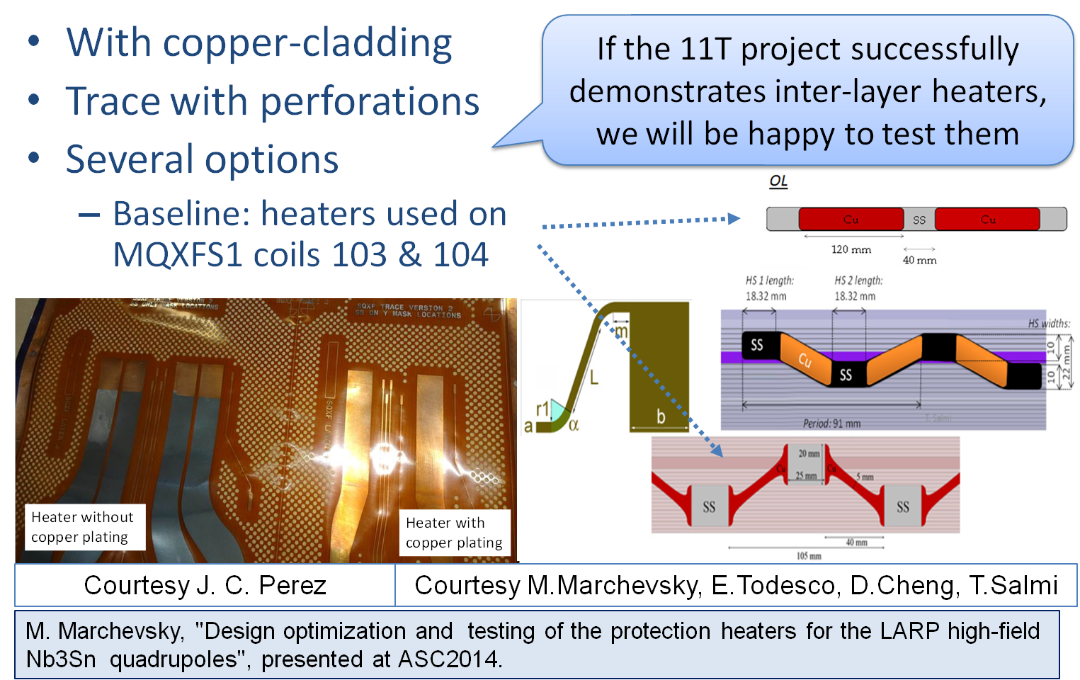
Heater Design Options
Information for test planning
Comparison criteria
Model magnet configuration
Timeline for selection

Slide 10
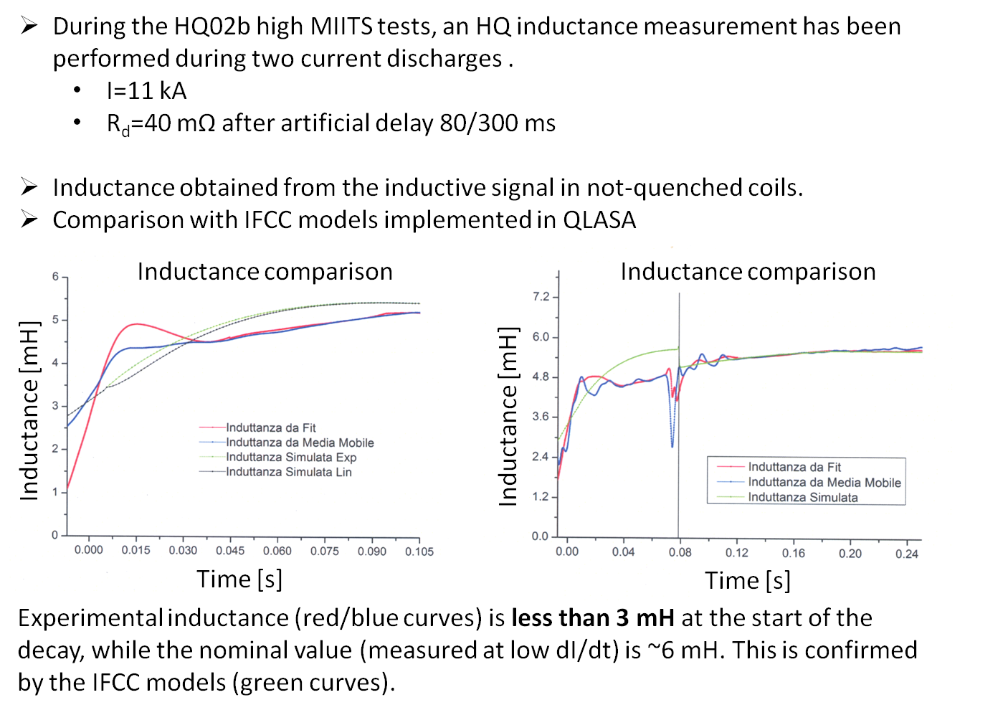
Inductance Measurement Proposal (1/2)
V. Marinozzi

Slide 11
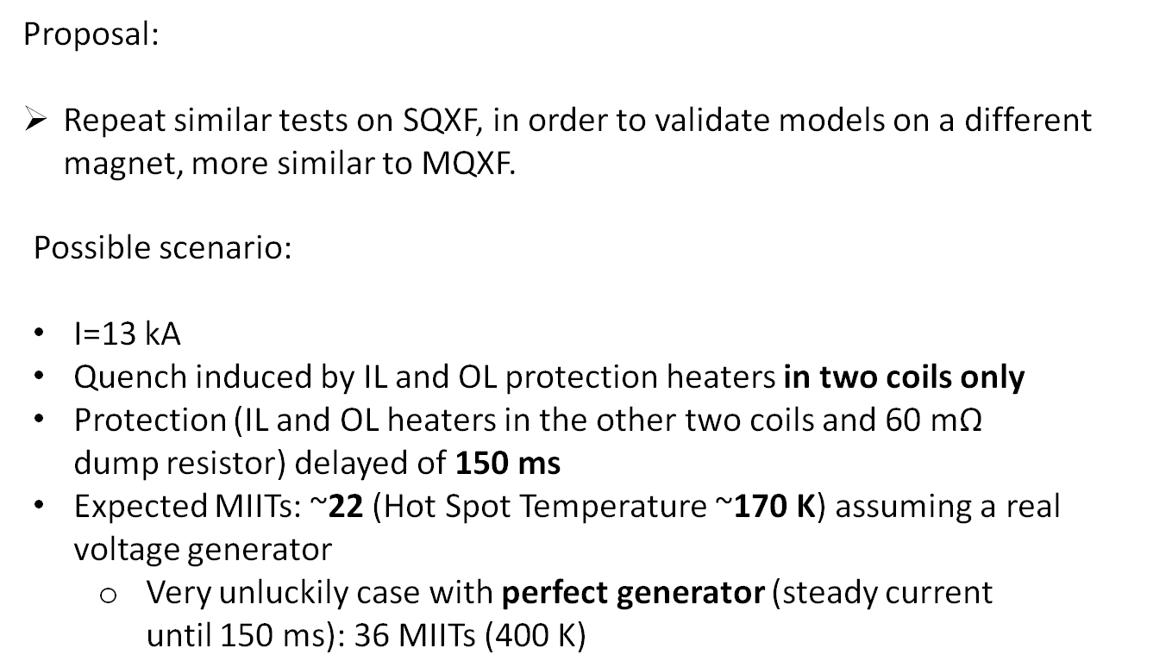
Inductance Measurement Proposal (2/2)
V. Marinozzi

Slide 12
Protection Limits
General questions on strategy: define MIITs limits at each step
  May get useful information even with a conservative MIITs limit
  Depending on conditions, only one coil is at risk
  Spot heater was successfully tested in HQ, with critical role
  HQ showed very fast natural decay
  Also helps to characterize other protection systems
Ultimate protection limit study requires stringent conditions to work well, for example to reach high fraction SSL, and repeated quenches in same conditions (coil, location)
  However, may do some preparation work, in particular how to reach high MIITs

Slide 13
HQ02b Protection Test Plan (part 1)

Slide 14
HQ02b Protection Test Plan (part 2)

Slide 15
Additional Slides

Slide 16
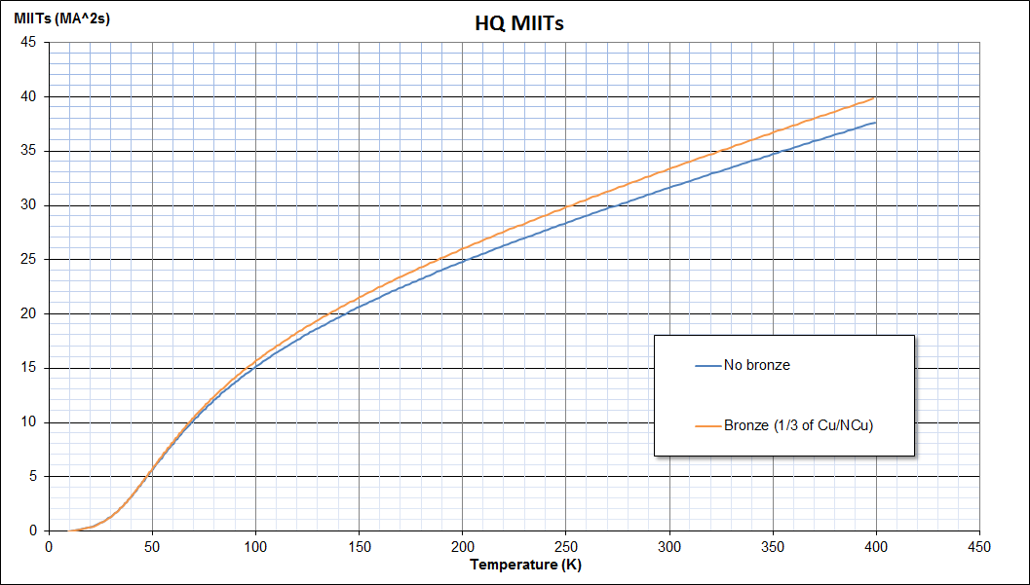
QI vs. Temperature
V. Marinozzi

Slide 17
Title
txt

