Slide 1
Second generation coils: technical details
Susana Izquierdo Bermudez
Joint HiLumi LHC-LARP Annual Meeting/24th LARP Collaboration Meeting
12th May, 2015

Slide 2
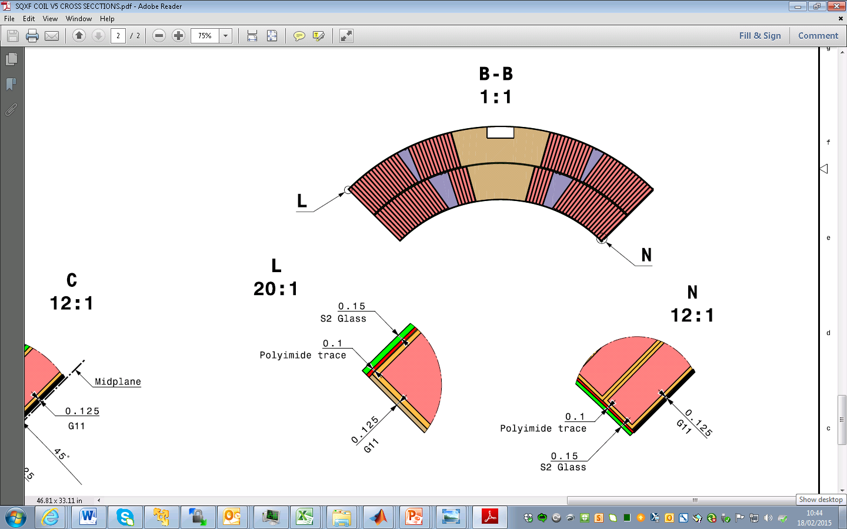
Coil insulation
Outer radius:
150 µm S2 Glass →
2 x 150 = 300* µm S2 Glass
Inter layer:
500 µm S2 Glass
→ 650* µm S2 Glass
*310µm
*660 µm
S2 thickness |  | Without binder |  | With binder
µm | Nominal | Meas. 1 MPa | Meas. 5 MPa | Meas. 1 MPa | Meas. 5 MPa
66 TEX 933 | 250 | 185 | 173
33 TEX 493 | 175 | 128 | 119
Wedge | 125 | 123 | 114
Cable 66 TEX 933 | 145 |  | 139 |  | 155

Slide 3
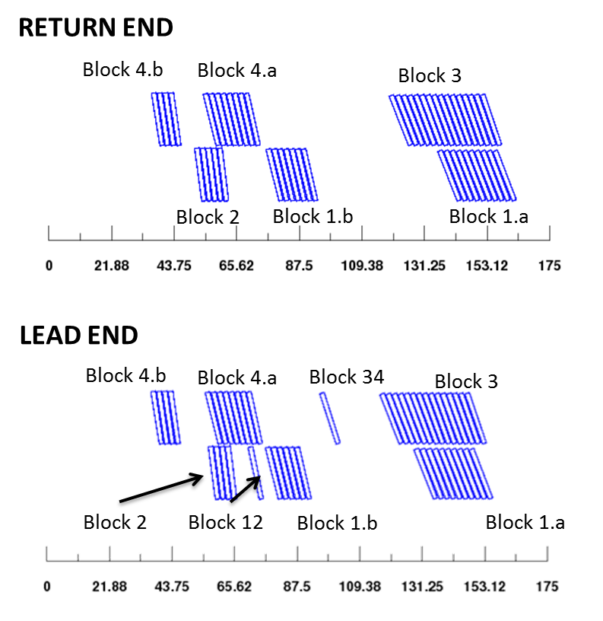
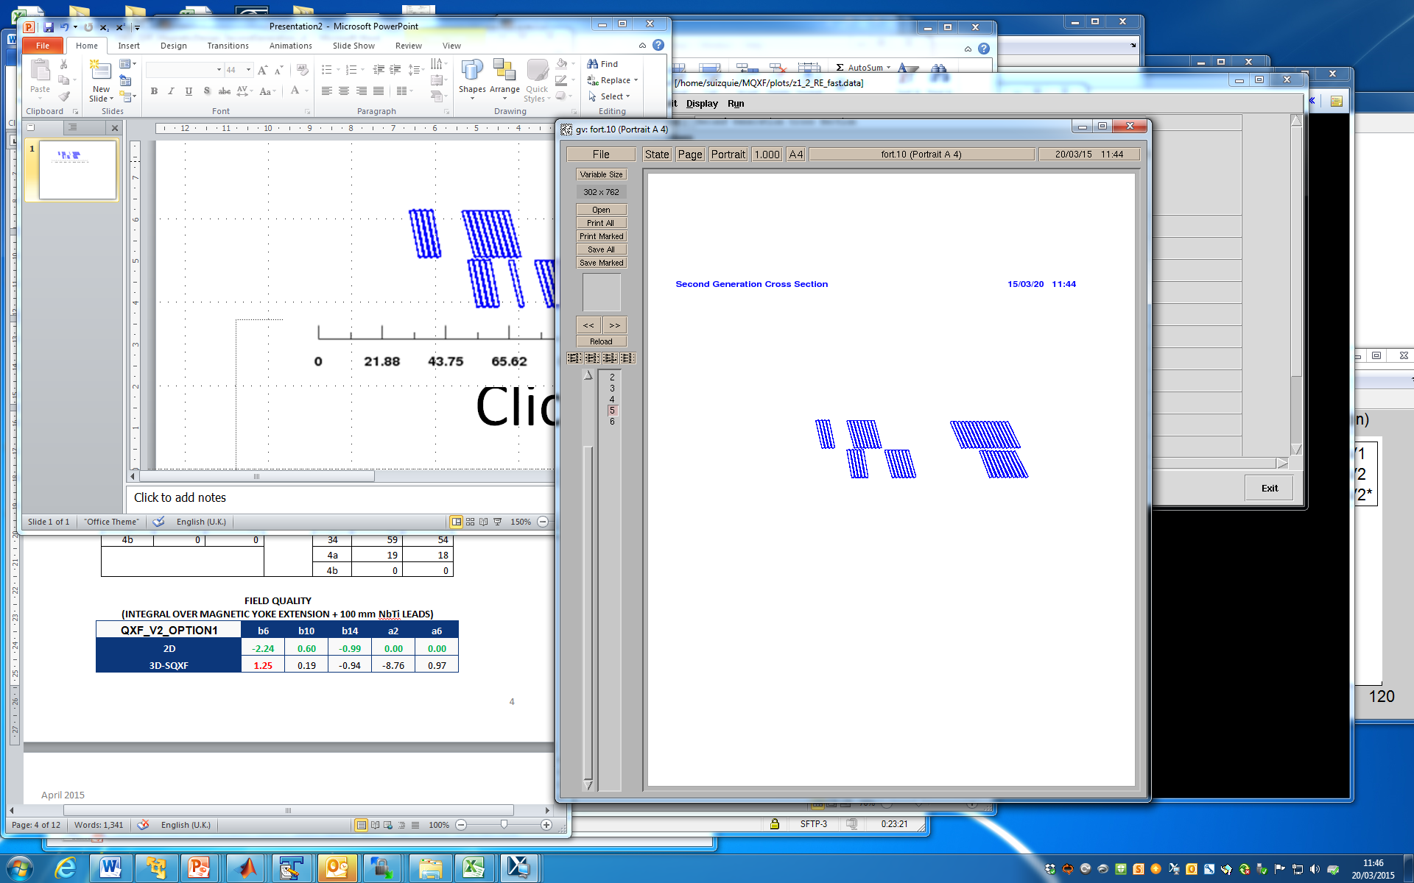
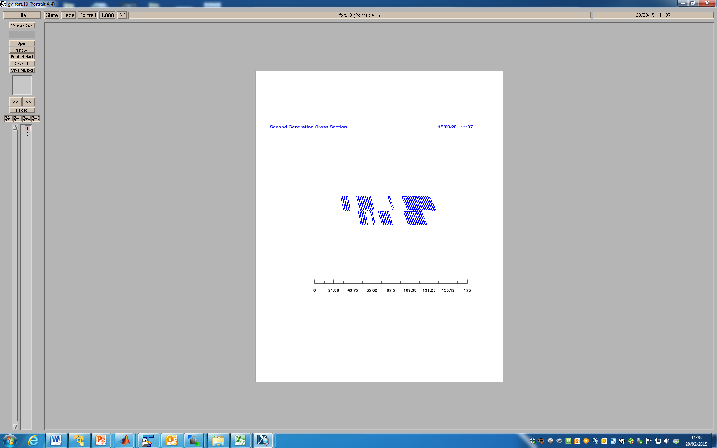
Coil dimensions
First generation coils
1066 mm
1104 mm
Second generation coils
Δ = -5
Δ = -9
Δ = -10
1081 mm
Δ = 5 mm
1119 mm
Δ = 10 mm
Δ = -10 mm

Slide 4
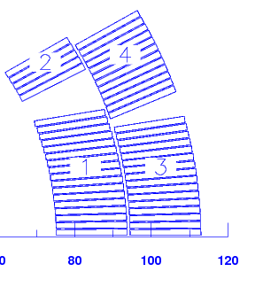
Coil shimming
Flexibility to add/remove ~ 100 µm shim with no impact on coil compaction
How to do it?
Mid-plane:
  1st Generation: 0.125 mm G11 in the mid-plane
  2nd Generation: 2x0.125 mm G11 in the mid-plane?
Pole: modify insulation layout around the pole
  1st Generation: 2 x 0.175 mm.
  2nd Generation: 4 x 0.125 mm

Slide 5
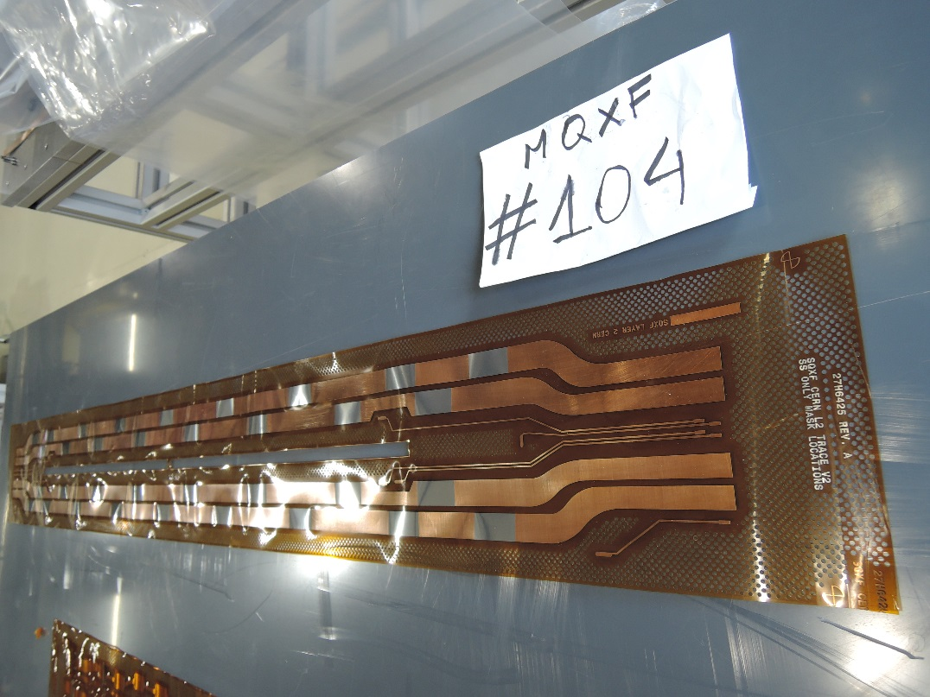
Update of Traces
During the installation of the traces on the coils from 001 to 104, some little issues were found, so it has been decided to make some modifications on the traces (update from version V2 to version V3).

Slide 6
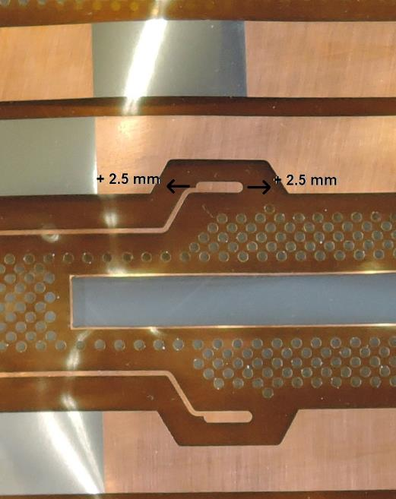
Update of Traces
List of modifications on the traces:
All the pads for the soldering of the vtaps have been elongated of 5 mm (i.e. 2.5 mm on each side), to better accomodate the position of the vtaps coming from the coil.

Slide 7
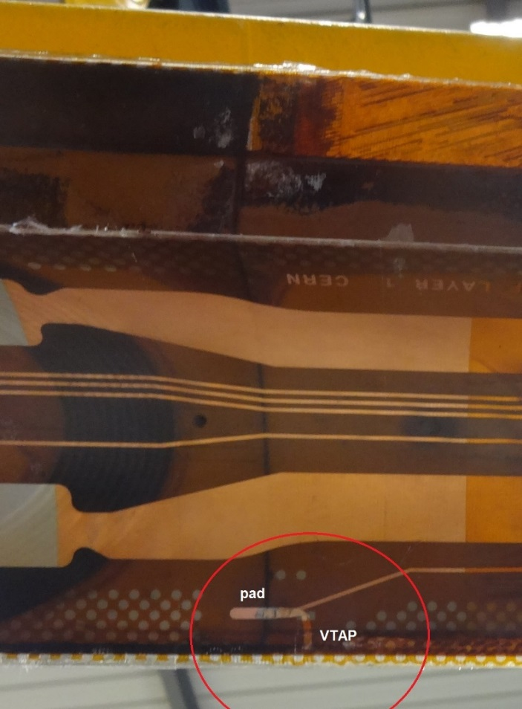
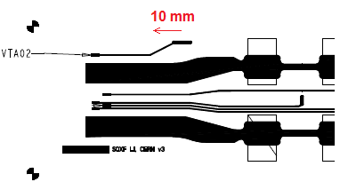
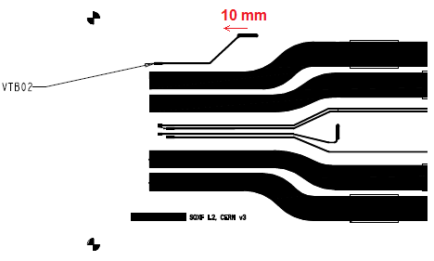
Update of Traces
The pads for soldering the vtaps coming from the splice area have been displaced of 10 mm towards LE.
Before, they didn’t match with the position of the vtaps.

Slide 8
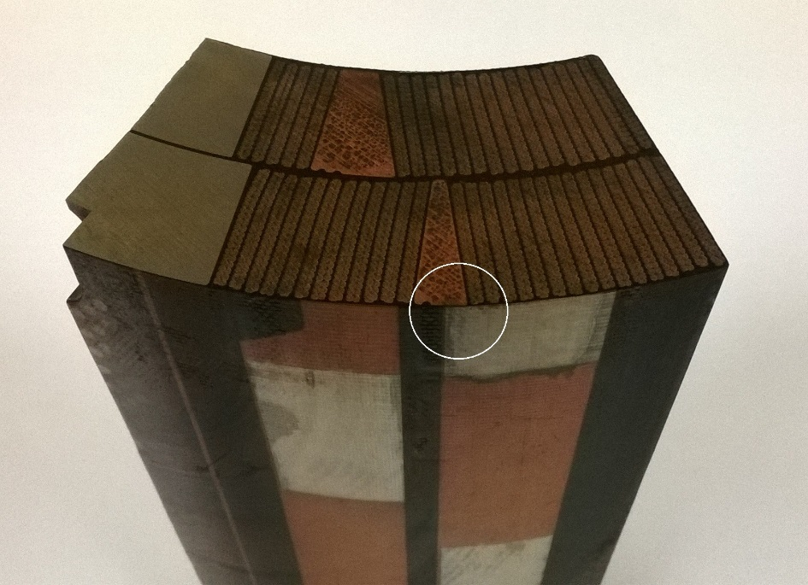
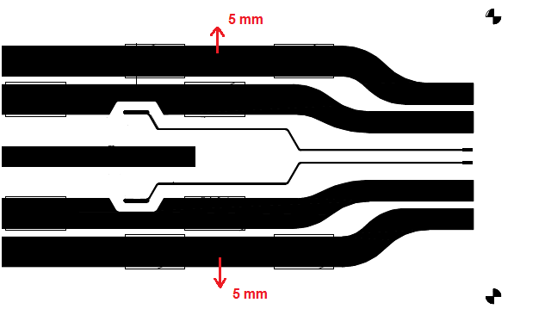
Update of Traces
The quench heaters of low field area of outer layer have been displaced 5 mm towards the midplanes.
Before, they were partially on the copper wedge.

Slide 9
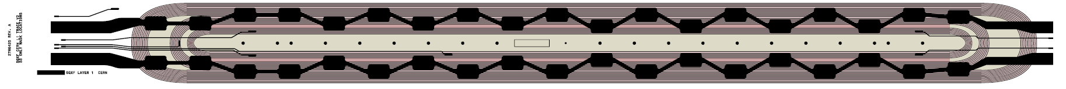
IL trace, questions

Slide 10
Additional slides

Slide 11
10 stack measurements
Scope
The aim of the 10 stack measurements is to verify the thickness of the insulation of the cable.
The insulation thickness shall not be higher than 150 μm.
The operation is done as soon as we receive the insulated cable from the company that perform the insulation, before starting winding.

Slide 12
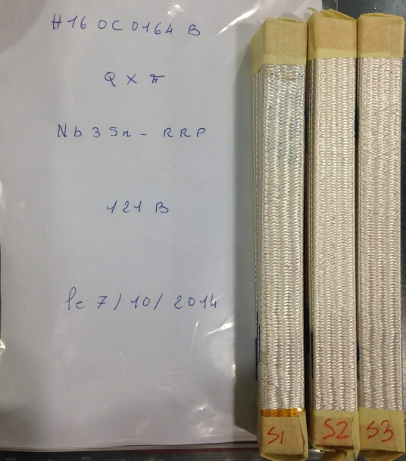
10 stack measurements
Measurement criteria
10 pieces of cable are piled up, with such orientation to have a rectangular shape (Keystone angles).
N°3 stacks are prepared for the cable of each coil.

Slide 13
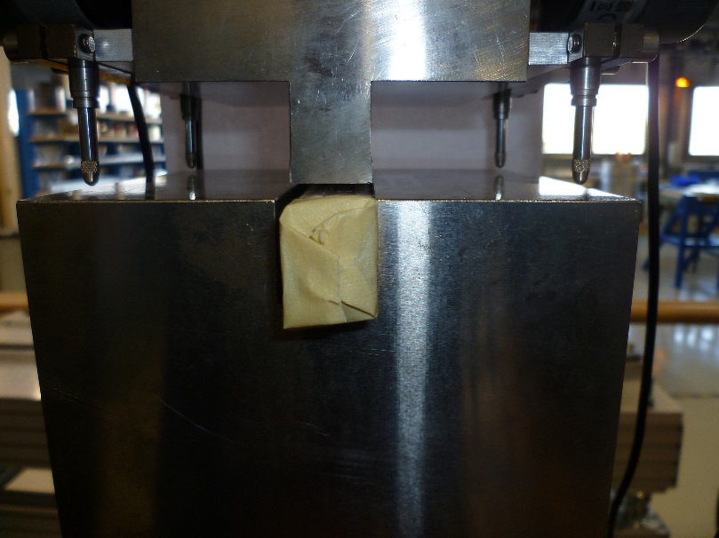
10 stack measurements
Each stack of insulated cables is then placed inside a press, and subjected to 3 cycles of pressure up to 5 MPa, measuring its deformation by displacement sensors.

Slide 14
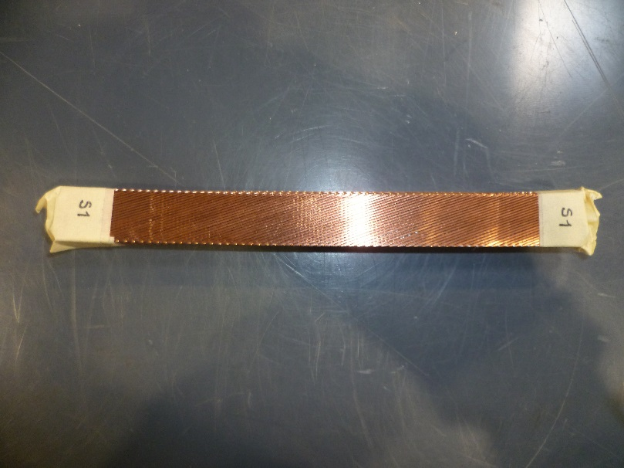
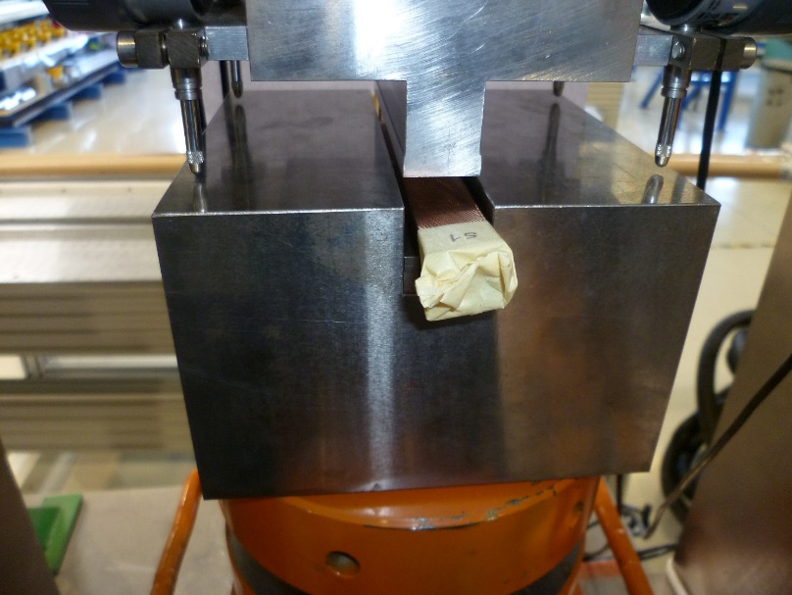
10 stack measurements
Then the insulation is removed and the same meaurement is repeated on the stacks of bare cables.

Slide 15
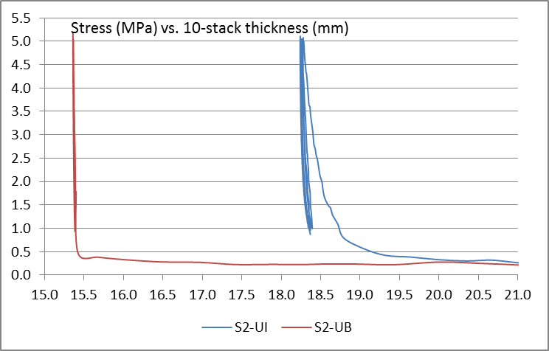
10 stack measurements
Comparing the two measurements, it is possible to evaluate the thickness of the insulation.

Slide 16
10 stack measurements
Summary of the insulation thickness for cables of coils 102, 103, 104
Coil 102
Coil 103
Coil 104
S1, S2, S2: sample (stack) n° 1, 2, 3
UI: unreacted insulated sample
UB: unreacted bare sample

Slide 17
10 stacks of S2 Glass layers
Some measurements of 10 stacks have been performed on the layers of S2 glass that we use as insulation layers on the coils.
S2 933, with nominal thickness 0.250 mm.
This is used as interlayer.
This fiberglass has also been used in coils 103 and 104 as insulation between the turns and the end spacers, i.e. it has been placed all around the perimeter of the end spacers.
S2 33 TEX 493, with nominal thickness 0.175 mm.
This fiberglass is placed around the pole as insulation with respect to the first turn.
S2 glass sleeve, with nominal thickness 0.125 mm.
This fiberglass is used for the insulation of the copper wedges.

Slide 18
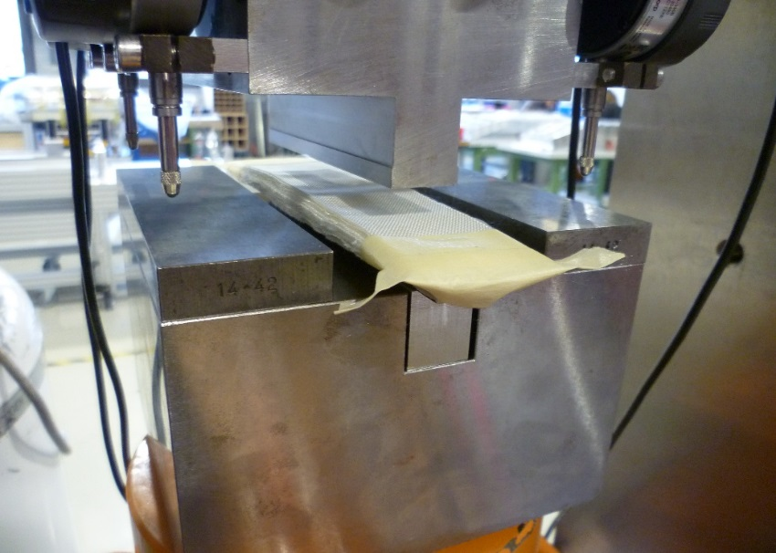
10 stacks of S2 Glass layers
The goal is the measurement of the insulation thickness when it is compressed at a pressure of 5 MPa, considered the upper boundary of the pressure seen by the coil during the fabrication process.
The thickness of the insulation has been measured in a way similar to the one that is commonly used for the 10 stack measurements of the cables.
N° 3 cycle of pressure up to 5 MPa have been performed on the samples.

Slide 19
10 stacks of S2 Glass layers
Summary of the results
Thickness of the insulation at 5 MPa
Type of S2 glass | Nominal thickness [μm] | Measured thickness @ 5 MPa [μm]
S2 933 | 250 | 173
S2 33 TEX 493 | 175 | 119
S2 glass sleeve | 125 | 114

Slide 20
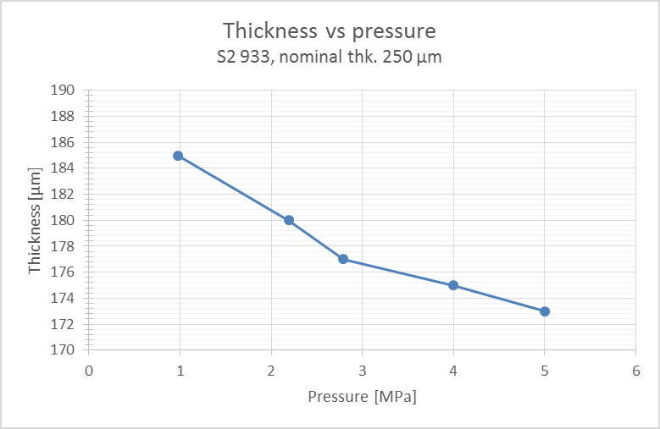
10 stacks of S2 Glass layers
Summary of the results
Variation of the thickness with respect to the pressure, S2 933, nominal thk. 250 µm.
Pressure [MPa] | Thickness [µm]
0,97 | 185
2,19 | 180
2,79 | 177
4,00 | 175
5,00 | 173

Slide 21
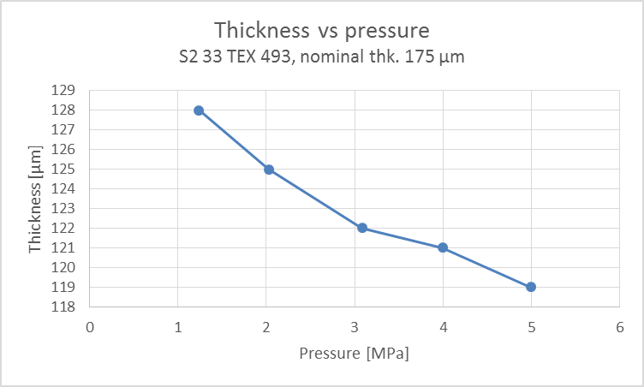
10 stacks of S2 Glass layers
Summary of the results
Variation of the thickness with respect to the pressure, S2 33 TEX 493, nominal thk. 175 µm.
Pressure [MPa] | Thickness [µm]
1,24 | 128
2,03 | 125
3,08 | 122
3,99 | 121
5,00 | 119

Slide 22
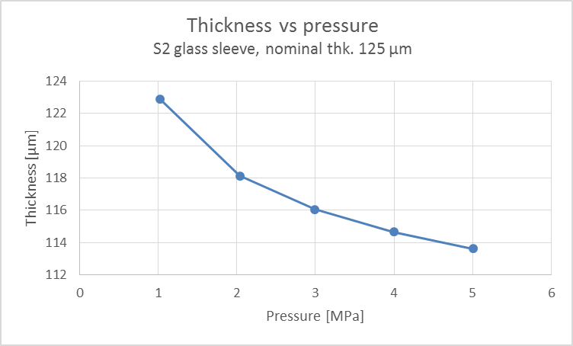
10 stacks of S2 Glass layers
Summary of the results
Variation of the thickness with respect to the pressure, S2 sleeve, nominal thk. 125 µm
Pressure [MPa] | Thickness [µm]
1,02 | 123
2,04 | 118
2,99 | 116
4,00 | 115
5,00 | 114

Slide 23
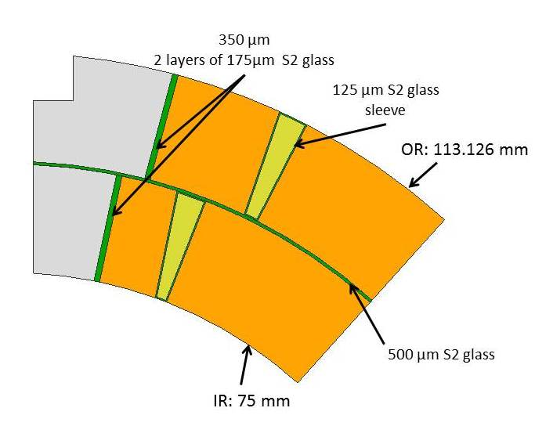
Insulation layers
Wedge:
  S2 ??TEX-??? Sleeve 0.125 mm thickness
Coil Inter-Layer:
  2 x S2 66TEX-933
  (250 mm width, 0.250 mm thickness)
Splice box Inter-Layer:
  3? x S2 33TEX–493 (is it supposed to be better for impregnation if it is not reacted?)
  (250 mm width, 0.250 mm thickness)
Pole:
  2 x S2 33TEX–493 → 66TEX-933?
  (19 mm width, 0.175 mm thickness)
  4 or 5 x S2 33TEX–493 → 66TEX-933?
  (19 mm width, 0.100 mm thickness)
  4 x S2 33TEX–493 → 66TEX-933?
  (19 mm width, 0.125 mm thickness)
Interface spacers-conductor:
  1 x S2 33TEX–493 → 66TEX-933?
  (19→25 mm width, 0.175 mm thickness)
Additional orders
Can we change?
To be cross-checked
933 → Thermally stable inorganic sizing
493 → Sizing compatible with epoxies or polyesters (slightly darker after reaction)

