Slide 1


MQXFS Coil L03 and L05
Conductor Test Report
Arup. K. Ghosh
MQXFS1 Magnet Readiness Review
FNAL
May 14, 2015

Slide 2
Outline
Introduction
Extracted Strand Tests
Summary

Slide 3

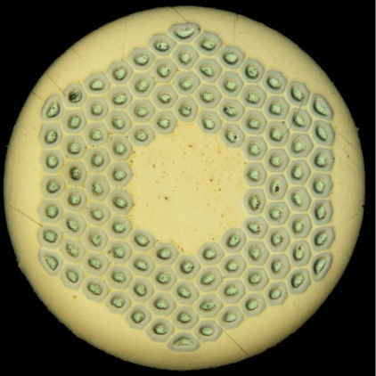
Introduction
MQXFS-L03 and L05 are made from 1st Gen. cable using the RRP 108/127 Ti-Ternary strand with Nb/Sn=3.6
Reaction temperature used 640 C/48 h
Ic (15 T) = 400 A
Ic (12 T) = 751 A
Cu/Non-Cu = 1.14

Slide 4
Extracted Strand as witness to Coil reaction
Coil L03: cable ID: P33OL1053AA. Cable fabricated using:
  Billet 14896 (34 strands), 14752 (4 strands) and 14984 (2 strands)
  7 extracted and 1 round (14896) wires were measured
Coil L05: cable ID: P33OL1057AD. Cable fabricated using:
  Billet 14983 (19 strands), 14752 (15 strands) and 15519 (5 strands)
  6 extracted strands and 2 round (14983 and 15519)wires were measured
  15519 has a lower Ic and Kramer field than other billets with a 640 C/48 h reaction.

Slide 5
I_{c} – H for 14983 and 15519
I_{c} of 15519 is 8 % lower at 15 T and 5% lower at 12 T

Slide 6
Ic of Extracted Strands
MQXFS-L03
MQXFS-L05

Slide 7
RRR of Extracted Strands
MQXFS-L03
MQXFS-L05

Slide 8
SSL for MQXFS-L03

Slide 9
SSL for MQXFS-L05

Slide 10
Short Sample Limit at 4.5 K and at 1.9 K

Slide 11
Summary
Extracted strand tests show that the critical current and the RRR for the cable in both coils are acceptable for use in the magnet.
The short sample limit of the two coils is fairly similar; 20.12 kA and 19.73 kA at 4.5 K.

Slide 12
End of Presentation

