Slide 1
SQXF Coil Metrology Report
Michela Semeraro, Eugenio Cavanna, Paolo Ferracin, Juan Carlos Perez
Joint HiLumi LHC-LARP Annual Meeting/24th LARP Collaboration Meeting
12th May, 2015

Slide 2
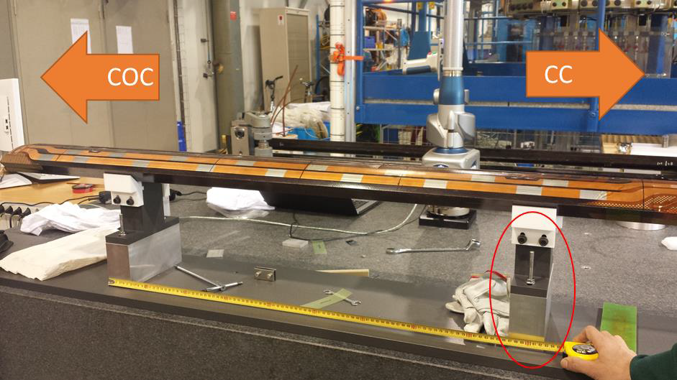
Set up
Equipment: FARO Edge Arm 2,7 m
Software for data post-processing: Polyworks 2014
Coil supported in two points

Slide 3
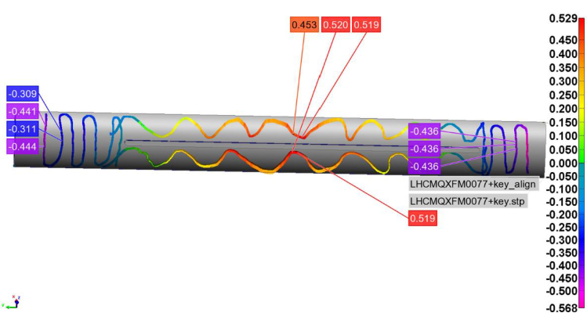
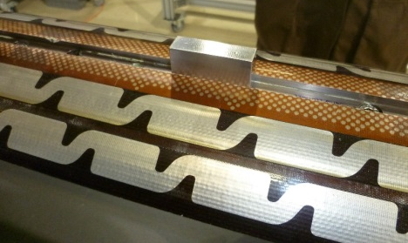
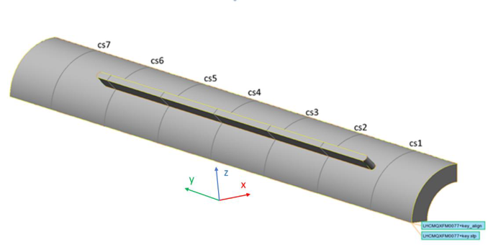
Method
1) Scan of the Outer Diameter
2) Determine the radius and the axis of the cylinder which best fit OD measured data. The axis of the best fit cylinder coincides with the coil axis of the CAD model.
3) The angular alignment is given a key inserted in the pole central groove
4) Scan of the coil cross-section (mid-planes + OD) at 7 locations along the length (5 in the straight section and 2 over the end saddles)
Work in progress!!

Slide 4
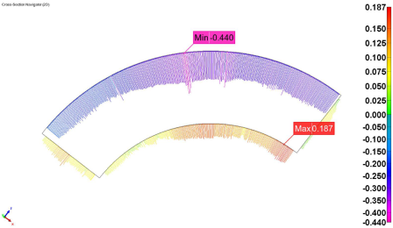
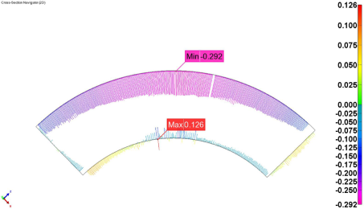
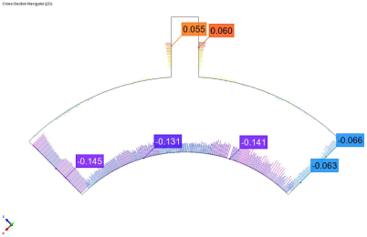
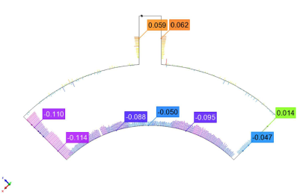
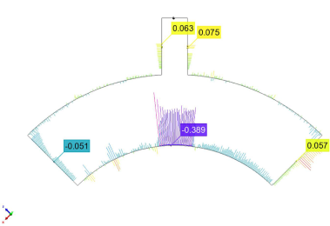
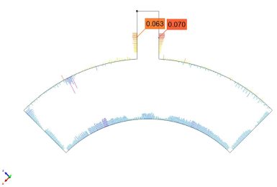
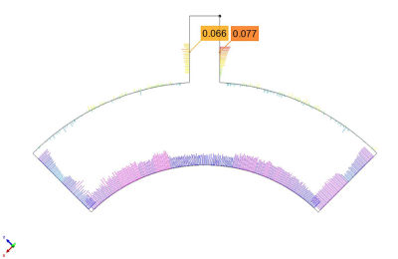
Typical Faro Arm Measurements
2 measurements in the ends region
(azimuthal alignment not possible)
5 measurements in the straight section

Slide 5
Coil Sagitta
Coil Sagitta = Deviation from the axis of the cylinder which best fit OD measured data
The coil is shaped like a banana after impregnation (2 x 0.6 mm).
Coil 103 is significantly better. Remarks
Coil 101 data is not very representative (first measured coil)
Coils 101 and 103 where impregnated in “tool#2”, coils 102 and 104 in “tool#1”
Target

Slide 6
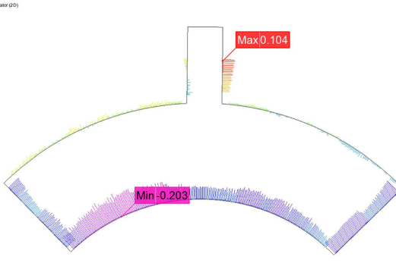
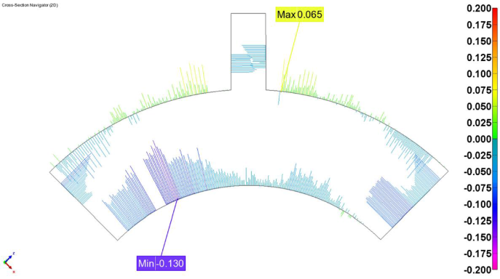
Average radial size
Average radial size = inner radius deviation for a coil aligned in the OD
< 0 means coil smaller than nominal
The coil is radially ~ 0.1 mm smaller than nominal
Coil ends are smaller than the straight section
Target
Average deviation from nominal radial thickness
Remark: some times the data is very clear, but in other cases it is rather difficult to find the average deviations!

Slide 7
Average Azimuthal Size
Average azimuthal side = Right mid-plan deviation + Left mid-plan deviation
< 0 means coil smaller than nominal
Coil is under-sized but it is not very reproducible, in particular for coil 102.
Coil to coil reproducibility 150-300 µm
Section to section reproducibility significantly better in coil 104 (~100µm). For coils 102 and 103 section to section reproducibility ~300µm.
Target
Left mid-plan deviation
Right mid-plan deviation

Slide 8
Coil left-right asymmetry
Coil asymmetry = Right mid-plan deviation – Left mid-plan deviation
In average, Left-Right asymmetry ~ 50 µm
Left-Right asymmetry within a coil can vary up to ~ 150 µm.
Section to section reproducibility is better for coil 104.
Target
Left mid-plan deviation
Right mid-plan deviation

Slide 9
Summary
The coil is shaped like a banana after impregnation (coil Sagitta 0.6 -1.2 mm).
Coils are radially 0.1 mm smaller than nominal in average. Coil ends are smaller than the straight section.
Coil to coil azimuthal size difference is up to 0.3 mm, and vary a lot along the coil longitudinal axis.
Left-Right asymmetry within a coil is about 0.1 mm
Coils are similar in terms of radial azimuthal size but the behavior is quite erratic for the average azimuthal size and the left-right asymmetry.
Coil 104 is significantly better than the previous coils in terms of azimuthal size and asymmetry, so there is some hope that we are getting better in terms of production and measuring method ☺

Slide 10
Additional Slides

Slide 11
Coil 101 – Mid Planes deviation
Was not possible to take measurement on Cross-Section 4 because of the position configuration faro arm-coil.

Slide 12
Coil 101 – Average Azimuthal Size

Slide 13
Coil 101 – Coil Size Asymmetry

Slide 14
Coil 101 – Outer vs Inner diameter

Slide 15
Coil 102 – Mid Planes deviation

Slide 16
Coil 102 – Average Azimuthal Size

Slide 17
Coil 102 – Coil Size Asymmetry

Slide 18
Coil 102 – Outer vs Inner diameter

Slide 19
Coil 103 – Mid Planes deviation

Slide 20
Coil 103 – Average Azimuthal Size

Slide 21
Coil 103 – Coil Size Asymmetry

Slide 22
Coil 103 – Outer vs Inner diameter

