Slide 1
MQXFS1 Assembly plan
H. Felice – D. Cheng – X. Wang

Slide 2
Schedule
Cool-down
Disassembly
Coil ready 6/12/2015
Assembly
2.5 months
Warm MM
QA, shipping prep and shipping
MQXFS1 at FNAL

Slide 3
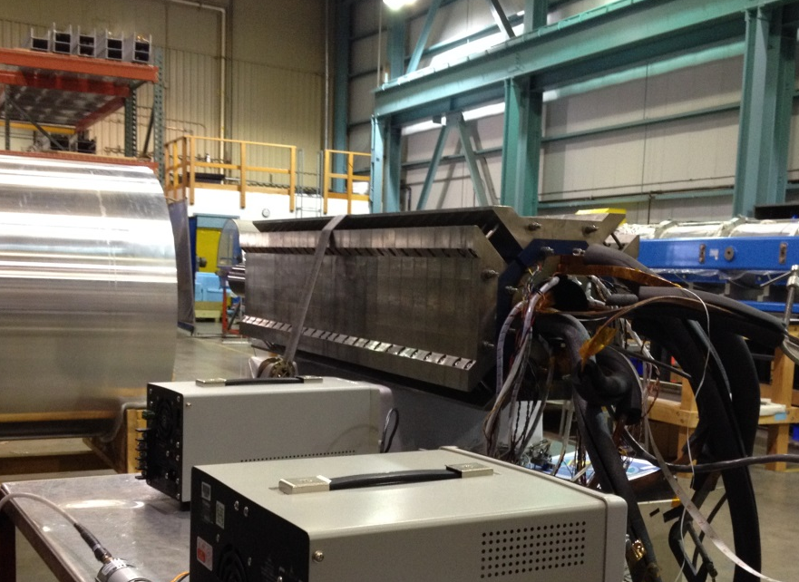
Warm magnetic measurements
Powerful QA tool
Large aperture to measure high-order errors
Track and possible to reduce the geometric errors during assembly
Measurement plans and schedules for MQXFS01
Coil pack assembly, 3 days (including system setup)
In the structure before loading, 0.5 days
After loading, 0.5 days
Measurements of HQ
Measurement probe and support will be ready in early June

Slide 4
Splice box

Slide 5
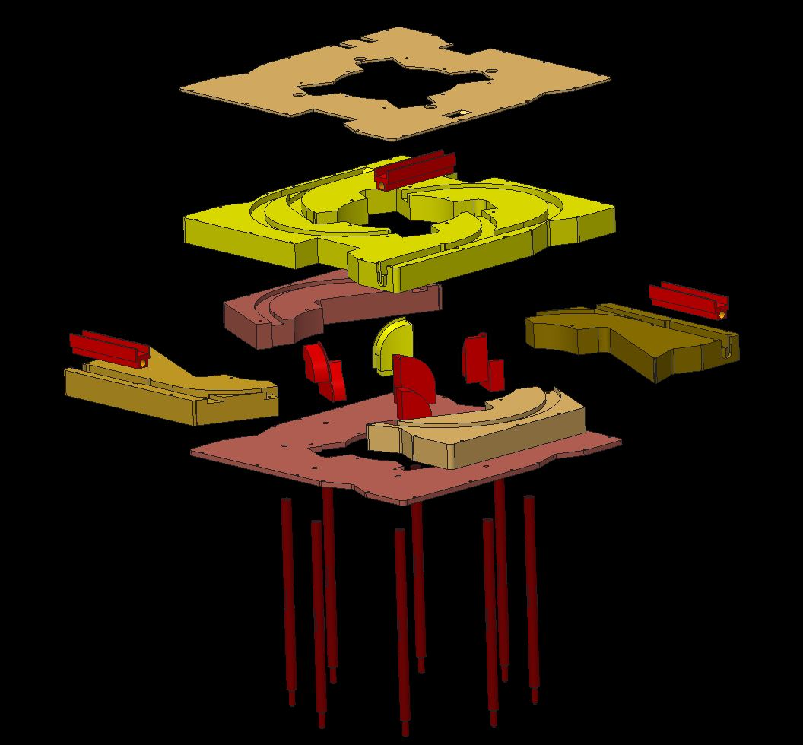
HQ style design

Slide 6
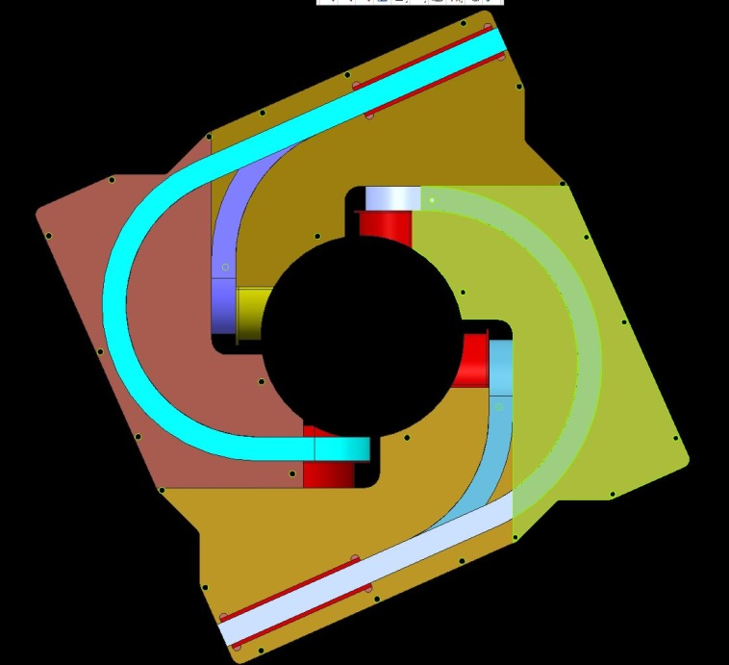
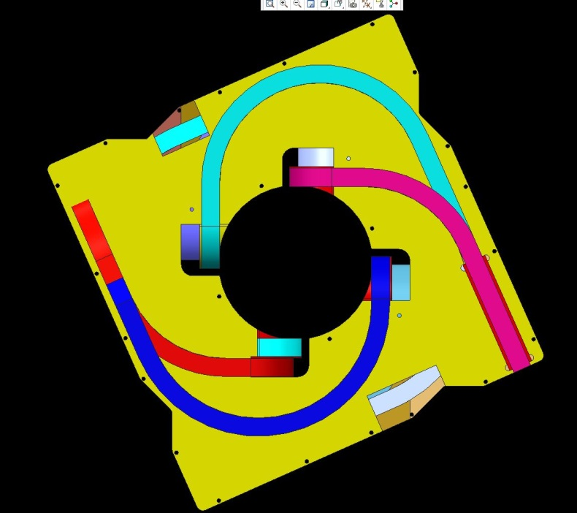

Slide 7
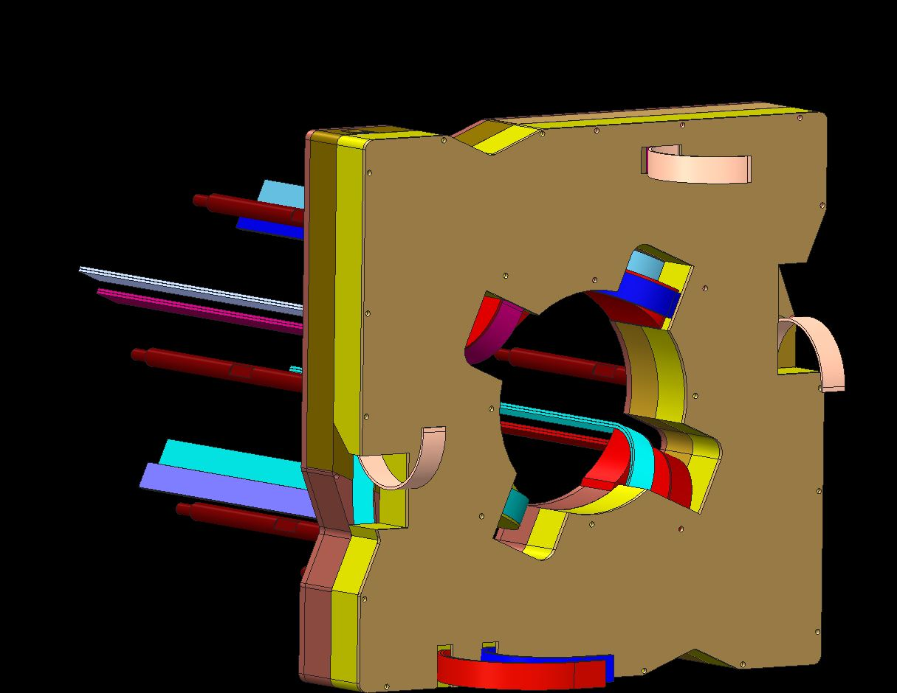
74.7 mm thick

Slide 8
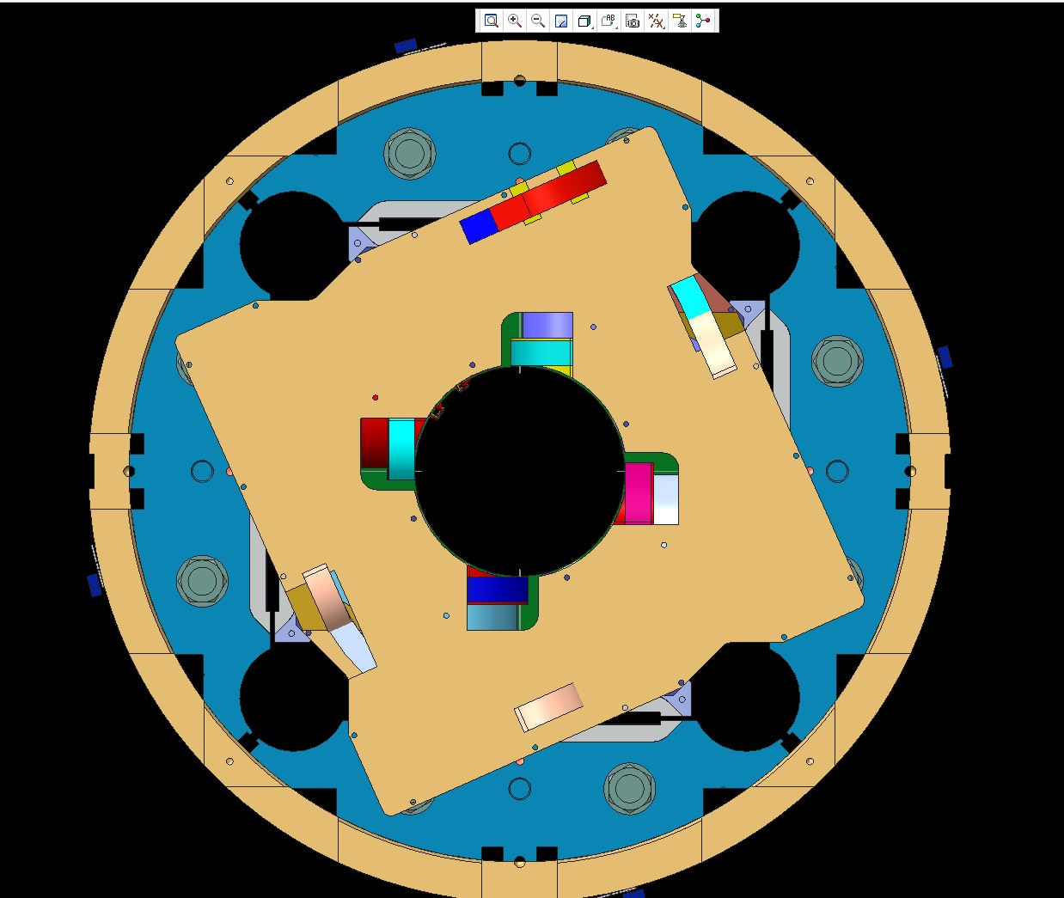

Slide 9
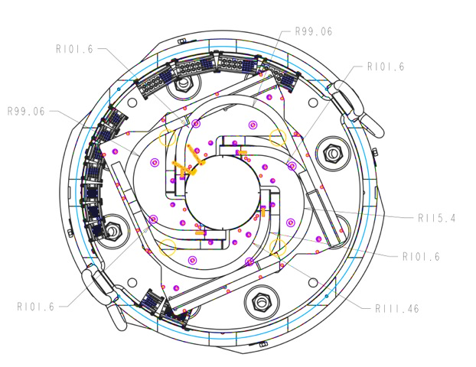
R99.06
R101.06
R101.06
R99.06
R115.04
R101.06
R101.06
R111.46

Slide 10
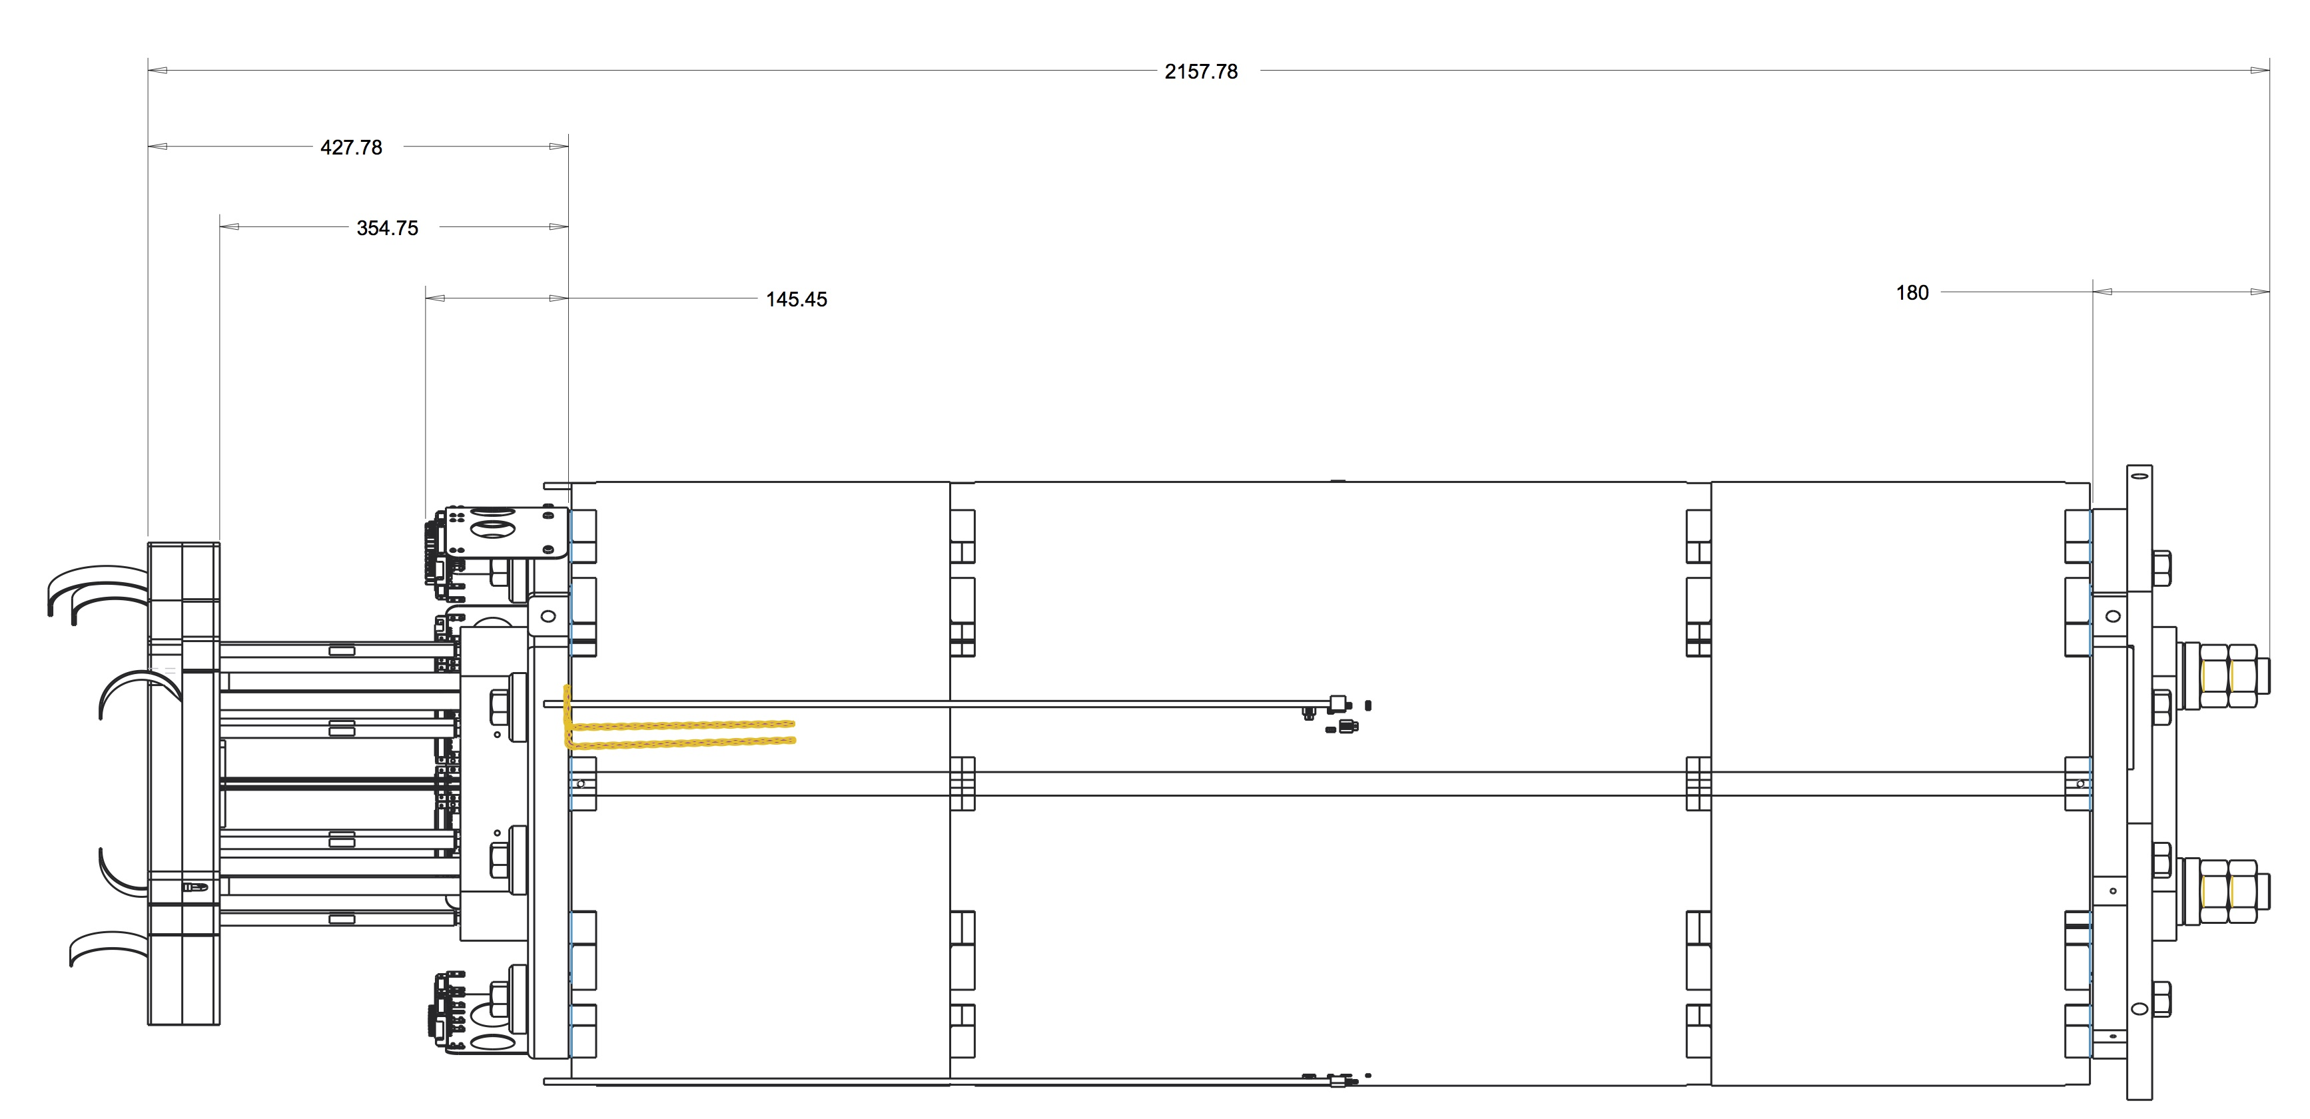
Compatibility between CERN and LARP coils
2158 mm
428 mm
355 mm*
145 mm
180 mm
* Extended lead length due to CERN coils being produced with 375 mm long copper stabilizers instead of 2nd NbTi cable

Slide 11
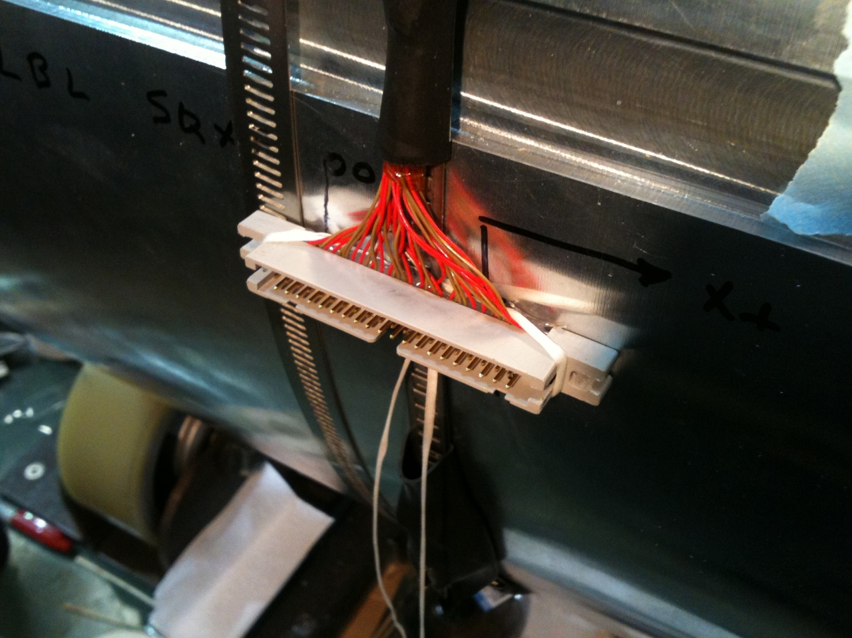
MQXFS Assembly Diameter requirements
647 mm
Guide Plate*
614 mm Dia. shell
Connector can be oriented to line up with one of the 647 mm diameter lobes
CERN-style shell SG connector on OD of shell, approximately ~15 mm proud in one location

Slide 12
MQXFS Assembly Support Interface
Typical ¾-10 tapped 4-hole pattern support interface
HQ-style support ring and connector skirts

Slide 13
MQXFS Wire Routing
All IL wires will pass thru wire guides underneath the axial endplates

Slide 14
Long prototype

Slide 15
Pin/no pin between shell and yoke
Yoke position is the reference
=> accurate positioning of the shell not required
No pinning
Uneven number of long shell segment to bridge the master

Slide 16
Preload

Slide 17
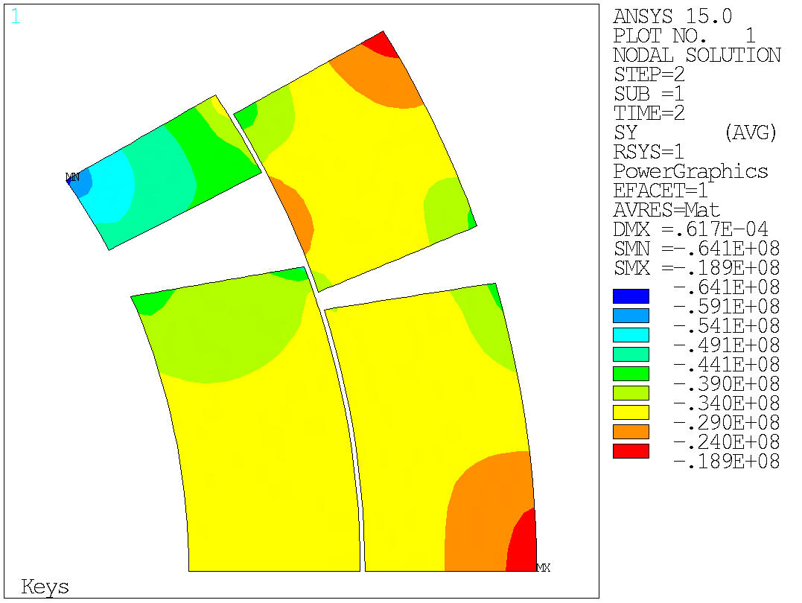
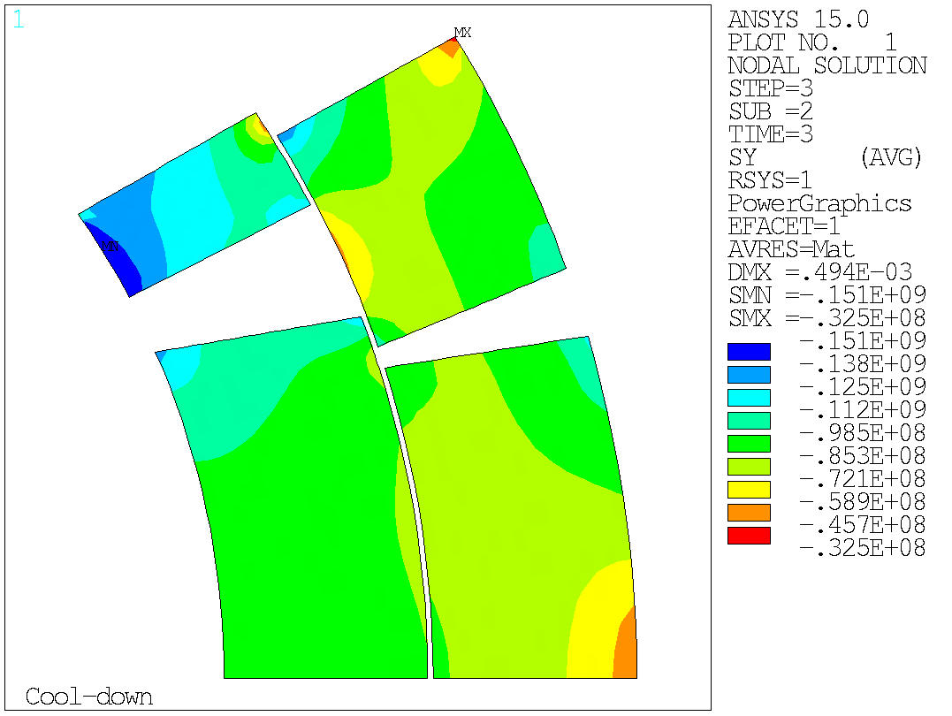
Baseline case Azimuthal Stress distribution in coil
Shimming
4.2 K

Slide 18
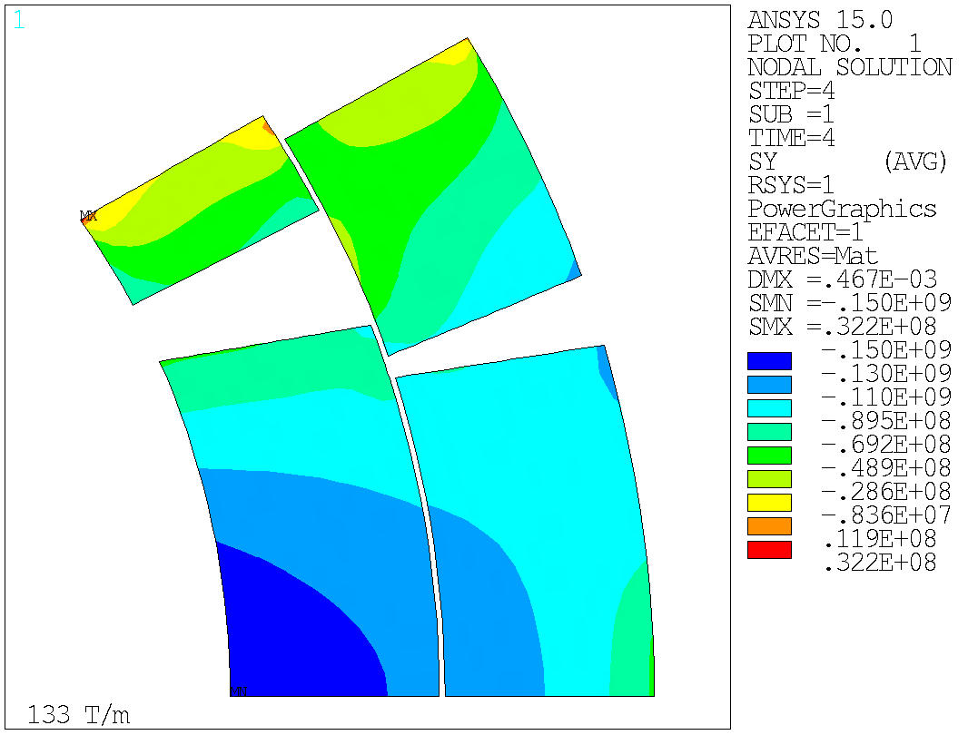
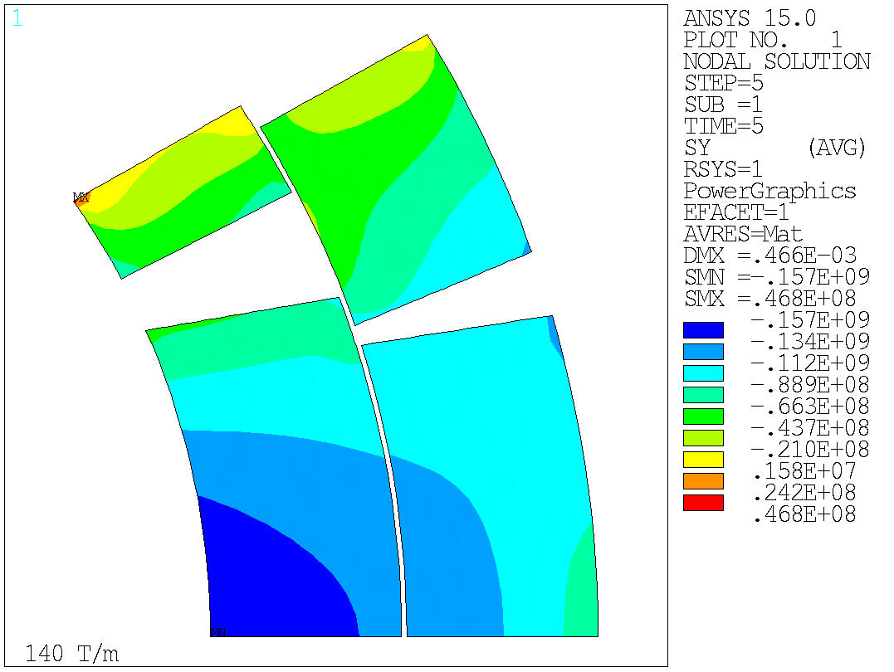
Baseline case Azimuthal Stress distribution in coil
133 T/m
140 T/m

Slide 19
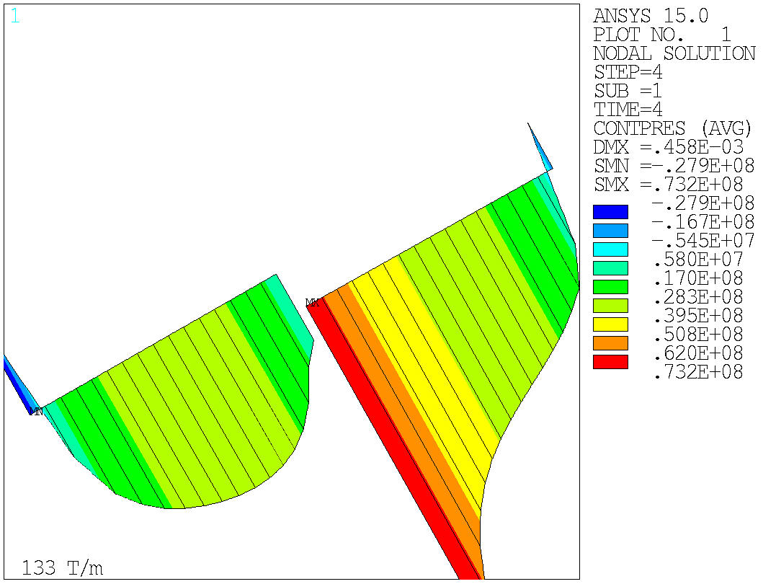
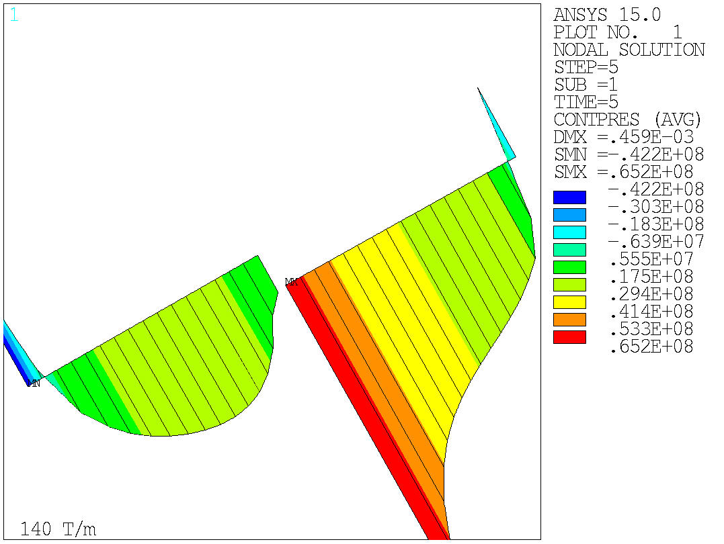
Baseline case Contact pressure coil to pole
133 T/m
140 T/m

Slide 20
Summary
Operating Gradient target: 133 T/m
550 microns interference
Stress distribution < HQ stress distribution
Compression of the pole turn provided beyond 140 T/m

Slide 21
Back up

Slide 22
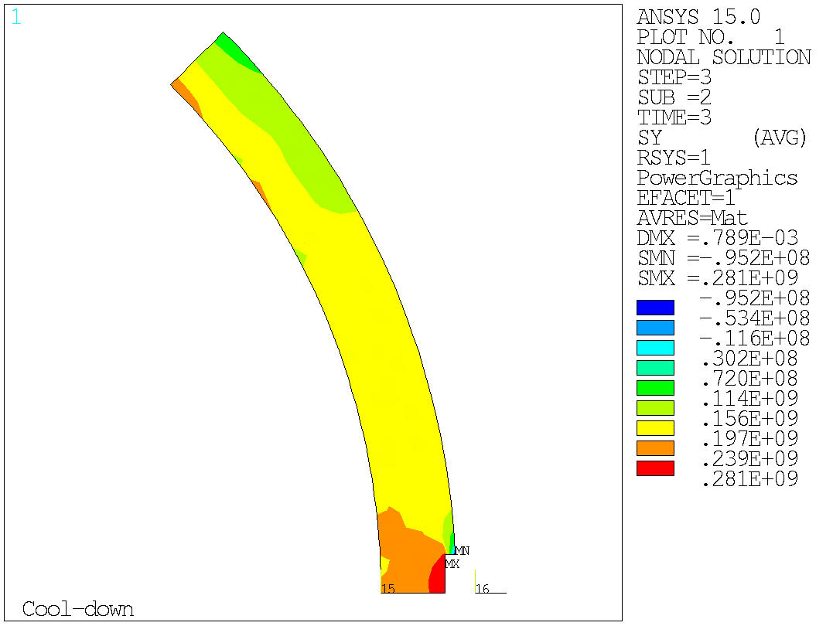
Baseline case azimuthal stress in shell
4.2 K
133 T/m

