Slide 1
ACCEPTANCE TESTS
M. Bajko
LARP HL LHC collaboration meeting
May 2015

Slide 2
Overview of COLD tests
MODELS:
vertical position @ CERN and USA
PROTOTYPES
vertical position:
4 m magnets USA
horizontal position:
2 x 4 m cold mass in USA
1 x 8 m cold mass @ CERN
SERIES
horizontal position:
8 m cryostated cold masses @ CERN

Slide 3
MODELS Overview of COLD tests
In operation
In construction
Scheduled x June 2016
@FNAL
@CERN
VERTICAL TEST
@ 1.9 K
I max = I ss (22 kA)
High Voltage
Magnetic Measurements
CLIC and PH

Slide 4
Q1 and Q3 PROTOTYPES Overview of COLD tests
@BNL
@FNAL
@CERN
I max = 90% I ss
20 kA ?
I max = 90% Iss
20 kA
I max = 108 % Inominal
18 kA

Slide 5
Q2a and Q2b PROTOTYPES Overview of COLD tests
@CERN
@CERN
?
I max = 90% I ss
20 kA
I max = 108 % Inominal
18 kA
Without end covers, adequate horizontal test cryostat need to be designed. SHOULD be COSIDERED It is the only way to test the magnet before cryostating

Slide 6
Q1 and Q3 SERIES Overview of COLD tests
@BNL
@FNAL
OR
@CERN
I max ≥ 108 % Inominal
18 kA
I max = 108 % Inominal
18 kA
I max = 108 % Inominal
18 kA
I max = 108 % Inominal
18 kA

Slide 7
Q2a and Q2b SERIES
Overview of COLD tests
@CERN
@CERN
?
I max ≥ 108 % Inominal
18 kA
I max = 108 % Inominal
18 kA
I max = 108 % Inominal
18 kA
Without end covers, adequate horizontal test cryostat need to be designed. SHOULD be COSIDERED. It is the only way to test the magnet before cryostating

Slide 8
LIST of ACCEPTANCE tests
ELECTRICAL
Continuity and instrumentation
High Voltage
Joint resistance
PERFORMANCE
Training
Memory
Protection
MECHANICAL
Pressure test
Leak test at cold
MAGNETIC
Field, axes and harmonics
GEOMETRIC
Axe, position of interface of extremities

Slide 9
ELECTRICAL TEST
ELECTRICAL
Continuity and instrumentation
High Voltage
Joint resistance
@ RT and @ cold in LHe : should be OK
@ RT, in He gas and @cold in LHe. To be defined in which atmosphere (air, He at which temperature and pressure, LHe) should be tested and @what voltage level (derived voltage levels to be defined @the minimum necessary level). The test will affect the current leads and the instrumentation. Test methods to be agreed as well as test instruments.
R < R max/ splices. To be defined how, this can be proved when several splices eventually not instrumented individually. Test method to be agreed.

Slide 10
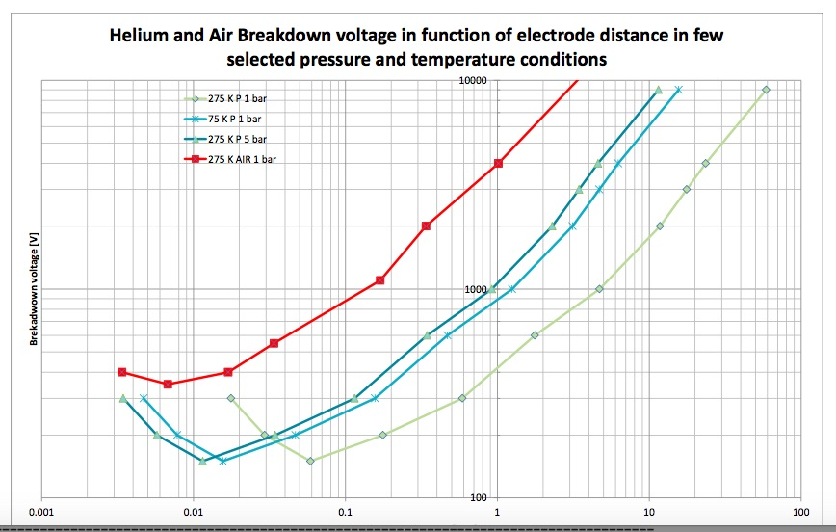
High Voltage Test ELECTRICAL
How to move in between the curves is CLEAR. What is not yet agreed WHICH is the condition of the WORST CASE SCENARIO!
First acceptance test is in AIR
( should be 3 x higher than in He gas )
After testing we should consider the presence of He gas and test coherently
Repetitive test in the same condition should not be @ the maximum voltage

Slide 11
U _{max} for the High Voltage Tests ELECTRICAL
The powering schematics is important to know exactly as the extraction system and its modus operandi ( GRD position). In case of delayed extraction the Uquench max may or may not be arithmetically summed to U _{quench}
Evaluations should be done @ I nom!!!!
U _{max} = U _{quench} + U _{EnergyExtraction} + U _{environment}
Inom* Rdump
From simulations considering the final powering circuit including the final energy extraction schematics in the IR zone ( Giorgio and Vittorio’s calculations). Is the heater discharge unit delay considered???
To be evaluated what we have in the environment: bus bars of other magnets… ect. It can be in the order of 150 V so…. not negligible
To be checked that we are not considering twice, as this is not a negligible value
( 16,5 *50 mOHM = 820 V! where is the GRD of the circuit and what is the switch opening time…3 ms, 10 ms?
Ex. U max = 800 V + 50 + 150 = 1000 V

Slide 12
U _{acceptance} for the quality assurance ELECTRICAL
The acceptance @ REAL CONDITIONS. Is Umax happening in LHe? Not….is at ? K and ? bar?
ALL derives from that so is important to get an agreement on the value but also on the condition!!!!! dT _{test} = 120 s and l_{eak} = 20 μA acceptance leakage current
(In the case of the LHC dipole the condition was finally considered to be LHe)
U _{acceptance} = 2 x U_{max} + 500
This is in on the individual magnets or cold masses
This is in the tunnel , performed on the complete circuit
2 x U accep
Delivery in air
U accep
This is test for problem intercept
This is a repetitive test : 1.2 x Umax
ACCEPTANCE test before powering in LHe
U accep / 5
In the circuit in Hegas
In the circuit LHe
Aftre cold test
5000 V
2500 V
500 V
xxxx V
1200 V
Ex. U acceptance= 2x1000 + 500 = 2500 V

Slide 13
INTERTURN SHORT ELECTRICAL
5 KV discharge showed no problem??? … so a sound coil can go up to that level of V…..
INFO: Discharge test for LHC dipoles : 900 V, 7 mF

Slide 14
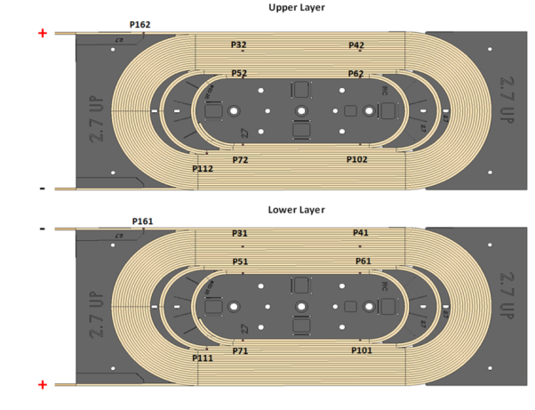
JOINT RESISTANCE ELECTRICAL
Each individual splice should respect the condition… which would imply an adequate instrumentation scheme or
We should rely on a experience gained on the R&D phase and admit that several splices measured together (between terminal A and B of the example) and resistances are distributed equally…..
A
SP 1 NbTi –Nb₃Sn
SP 2 NbTi –Nb₃Sn
SP 3 NbTi -NbTi
Coil 2
SP 4 NbTi –Nb₃Sn
R < 1 nOHM
SP 5 NbTi –Nb₃Sn
For LHC dipole :
R internal 1.2 nOHM
R external 0.6 nOHM
R total = 7 nOHM
Based on the recent experience this is feasible on both NbTi-NbTi and Nb₃Sn-NbTI
B

Slide 15
TRAINING, MEMORY PERFORMANCE GUIDLINES
PERFORMANCE
Training
Memory
Protection
Iss
( 22 kA )
TC
Iaccept= 108% Inominal
( 20 kA )
During the TRAINING
I accept SHOULD be attained
and kept for 1h CONTINOUSE powering without quench
After Thermal Cycle to RT
MEMORY should be proven by 2nd quench > I nominal
Inominal= 75% Iss
( 16.5 kA )
First cool down to 1.9K
Second cool down to 1.9K
No CRITERIA is defined for:
a. the level of the FIRST QUENCH( @ % Inom) nor for
b. the NUMBER of QUENCHES to attain I accept. ……….It is too EARLY for this

Slide 16
PROTECTION PERFORMANCE, ELECTRICAL
PERFORMANCE
Training
Memory
Protection
All instrumentation serving the PROTECTION of the magnet by its combined signal analysis should be ok
ELECTRICAL
Continuity and instrumentation
High Voltage
Joint resistance
All quench heaters should be having the correct electrical resistance value at warm and at cold (RRR of SS)
QH to GRD @ U _{acceptance for} dT _{test} = 120 s and I l_{eak} = 20 μA
QH to COIL should be pass successfully the discharge test.
QH should work properly and proven by dedicated test trough provoked quench its EFFICENCY

Slide 17
PRESSURE TEST MECHANICAL
MECHANICAL
Pressure test
Leak test at cold
Cold mass DESIGN is done for 20 bar ( as for the MB of the LHC).
For MB it was 1.25 factor
( old regulation), so 26 bar
PRESSURE TEST is 1. 43 * 20 bar= 28.5
This test should be done at the end of the fabrication process ( including the end cover and final integration of cold bore tubes and all ancillary lines ( X line, M lines) and before cold test!
LEAK TEST is performed at cold.

Slide 18
ALIGNMENT ? GEOMETRICAL
GEOMETRICAL
Alignment of interface
Geometry of the magnet ( seen trougth the CBT?)
Cold mass alignment to be discussed ( as for the MB and MQ of the LHC).
To be discussed…
Tolerances in order of : 1 mm localization max wrt the virtual axes of the machine, interfaces max. 0.5 mm localization
This measurements are done during assembly of the cold mass and at CERN will be only checked while cryostating and transferring the fiducials from cold mas to cryostat.

Slide 19
MAG MEAS ?
MAGNETIC
Integrated field
Harmonics

Slide 20
ACTIONS
HV test should be defined with definitive electrical circuit and protection schematics ( or to make several studies for the different schematics) taking into account the impact on the test infrastructure design!!!
This has been started at CERN. Giorgio will joint us soon for the discussions…
Protection schematics : with or without EE is also important for the infrastructure ( can be 1 FTE and 200 kCHF the price of a 20 kA switch!!!and no space , no time….
This is planned by Ezio to start discussions soon…
The training in terms of number of quenches to I accept should be defined taking into account test facility capability and schedule!
What we do with a magnet needing for ex. 3 quenches more than the one defined??????

