Slide 1
MICE RF Module Design and Vacuum System
MICE RF Module Fabrication Readiness Review
April 30 and May 1, 2015

Slide 2
Overview
Previous Review Recommendations
Requirements, Specifications
Vacuum System
Components, Evacuation Procedure, Overpressure relief
Cavity
Top Port
RF Coupler
Chamber
Components, Ports, Dimensions
Stress Analysis
Configurations, Shipping
Stand
Geometry
Fiducials

Slide 3
Previous Review Recommendations
Bypass line, Conductance calculations
Explore whether a pop-off valve will provide a more viable option than a burst disk. If a burst disk remains in the design, test burst disk.
Test Be window strength
Confirm whether re-arrangement of vessel ports can accommodate having the cavity water lines exit the vessel vacuum volume without any internal brazes in the vessel.
Operational Requirements

Slide 4
System Components
Each RF module comprises:
Vacuum Vessel (chamber).
Vessel Support Stand.
Water cooled RF cavity with two Beryllium Windows.
Support and alignment struts for mounting Cavity within Vessel. CMM fiducials on Vessel exterior.
Tuner arms and Feedthrough Actuators.
RF couplers.
Vacuum Pump system, Valves, Gauges, etc. (Pneumatic?)

Slide 5
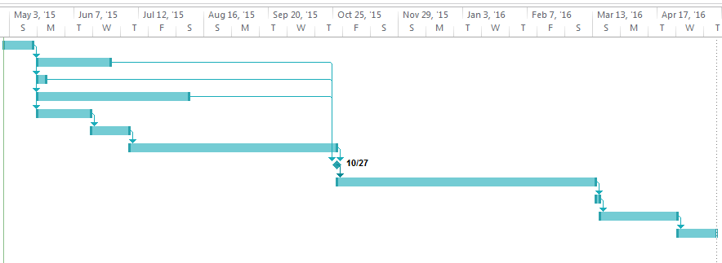
Broad Timeline
Task Name | Duration | Start | Finish | Predecessors
Readiness review and follow up | 12 days | Thu 4/30/15 | Fri 5/15/15
RF Coupler materials ordered | 30 days | Mon 5/18/15 | Fri 6/26/15 | 1
Complete Cavity and Be Window selection | 5 days | Mon 5/18/15 | Fri 5/22/15 | 1
Actuator lifecycle testing then production | 60 days | Mon 5/18/15 | Fri 8/7/15 | 1
RFQ to vendor | 21 days | Mon 5/18/15 | Mon 6/15/15 | 1
Contracts and Pos | 15 days | Tue 6/16/15 | Mon 7/6/15 | 5
Vendor fabrication | 80 days | Tue 7/7/15 | Mon 10/26/15 | 6
All hardware components ready | 0 days | Tue 10/27/15 | Tue 10/27/15 | 2,3,4,7
RF Module assembly | 100 days | Tue 10/27/15 | Mon 3/14/16 | 8
CMM Measurements | 2 days | Tue 3/15/16 | Wed 3/16/16 | 9
Low level RF and vacuum tests at LBL | 30 days | Thu 3/17/16 | Wed 4/27/16 | 10
Modules prepared for shipping and delivered to RAL | 15 days | Thu 4/28/16 | Wed 5/18/16 | 11

Slide 6
Select Vessel Requirements
Integrate with MICE Experimental Hall and beamline.
Maintain approx. 10⁻⁸ Torr inside RF cavity.
Hold approx. 10⁻⁶ to 10⁻⁷ Torr in shared MICE cooling channel beamline.
Limit differential pressure across Beryllium windows to less than 1 psi.

Slide 7
Vacuum Vessel (Chamber)

Slide 8
New Designs and Features
Extra access ports for RF Coupler to Cavity joint.
RF Coupler Modifications, Rotation Support
Cooling tube slots covered
Coupler Flange lip captures Cavity Flange
Rotation Support
New vacuum vessel design
Isolate cavity vacuum from the external channel
Direct cavity port-pump connection with bellows
Burst disc/pressure valve to protect Be windows
ASME Pressure Vessel treatment unnecessary

Slide 9
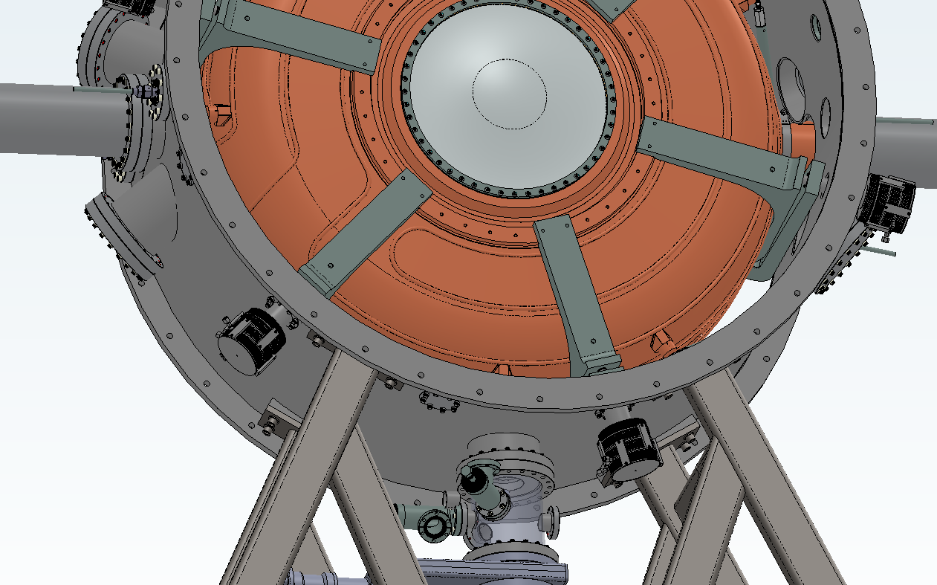
Chamber Interfaces: Ports
RF Module Vacuum Vessel Ports
12x RF Tuner Actuators
2x RF Couplers
4x RF Coupler Access
4x Cooling Water Feedthrough
2x Pumping Spool & Pressure Relief
1x TDC Access & Misc

Slide 10
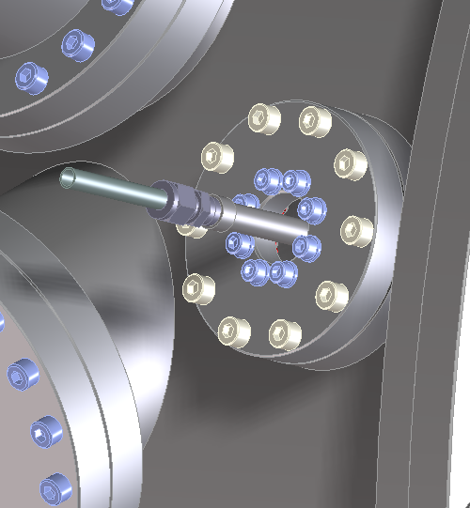
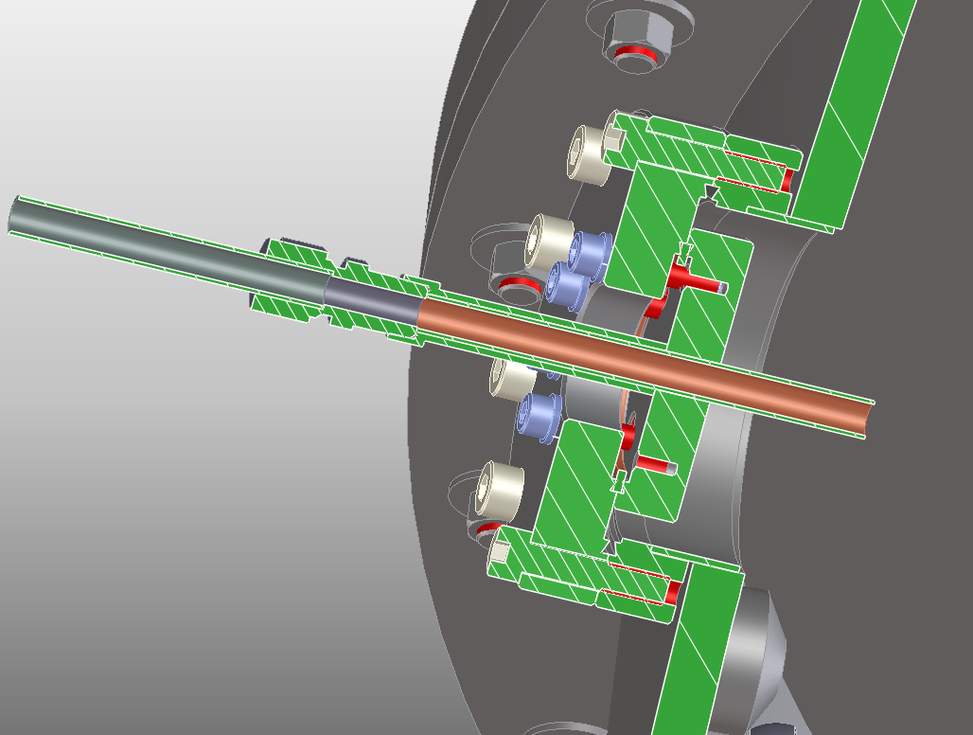
Cooling Water Feedthroughs

Slide 11
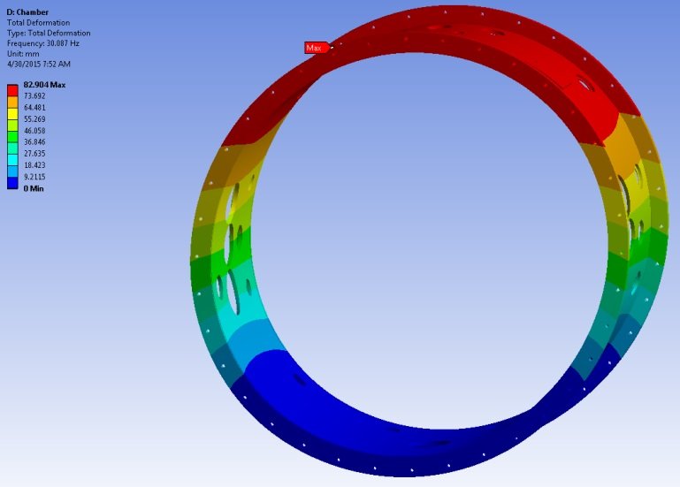
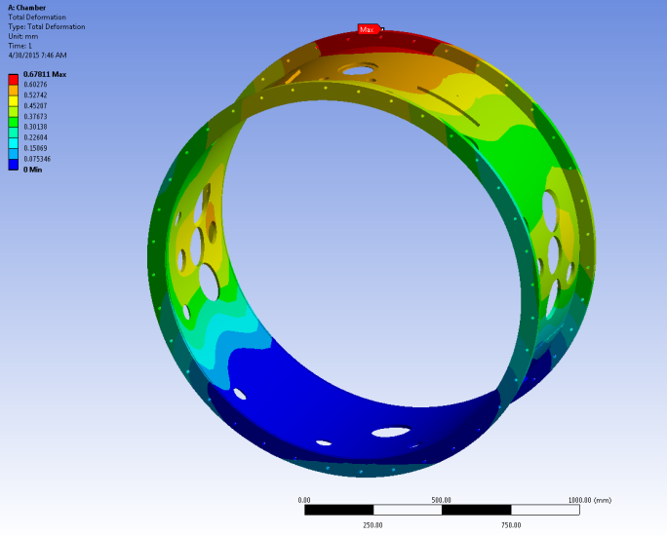
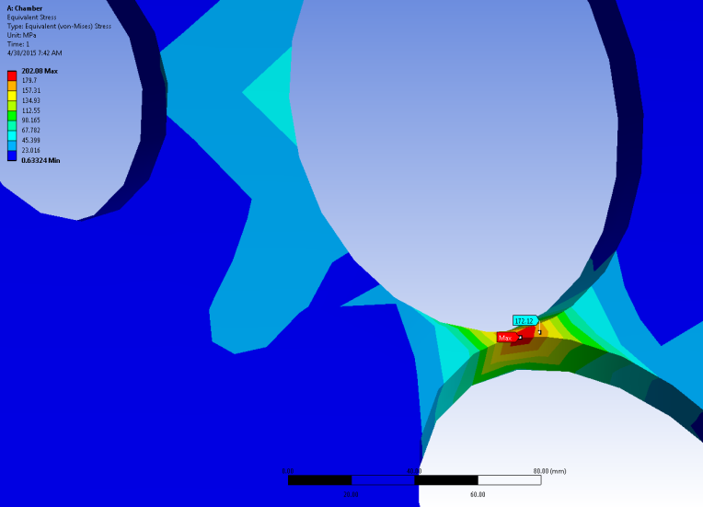
Chamber FEA Analysis
Chamber Vibration Modes
Vacuum Pressure, 50mT Magnetic Force, Gravity
Mode 1: 30 Hz
Mode 2: 51 Hz
Mode 3: 69 Hz
Mode 4: 120 Hz
Max Deflection = 680 µm
Local Max Yield Stress n≈ 1.06

Slide 12
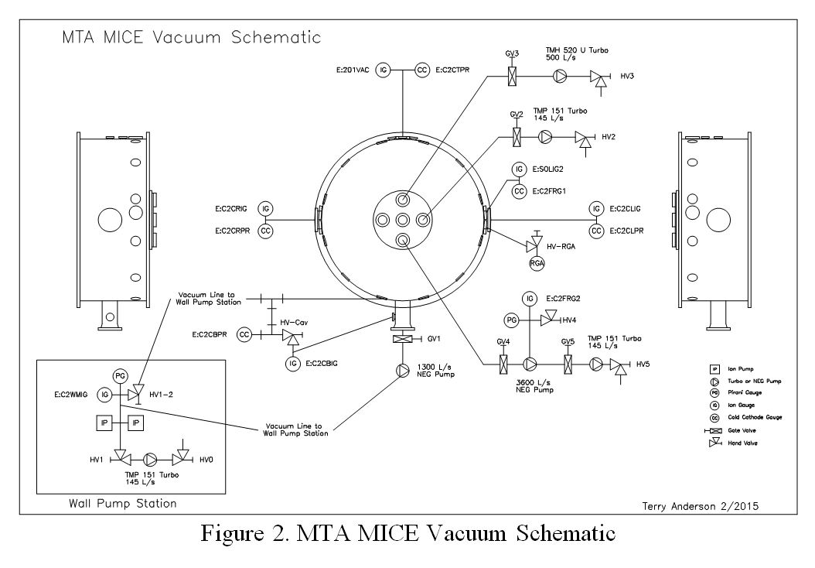
Vacuum System Procedures
MICE Hall Vacuum Schematic
3500 l/s NEG Pump

Slide 13
Fabrication Prints
Draw on heritage from MTA SCTS
Incorporate design updates to related systems
New UHV cleaning note #M20013
Tolerance strategy for performance/cost balance: vendor dialogue

Slide 14
UHV Cleaning Note

Slide 15
Vessel Acceptance Criteria
Material Certifications
CMM Inspection Report
Welds Inspection Report
Interfacing Features: Actuator Ports, Beamline Flanges, etc.
Evaluate any fabrication errors on a case by case basis
Other

Slide 16
Vacuum Pressure System

Slide 17
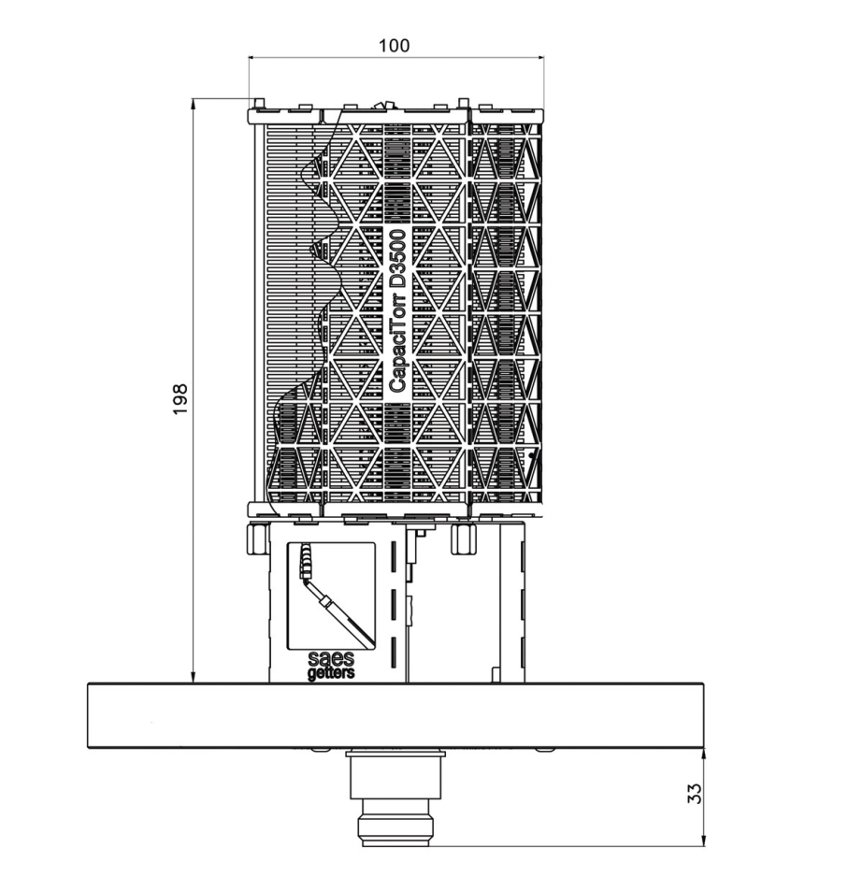
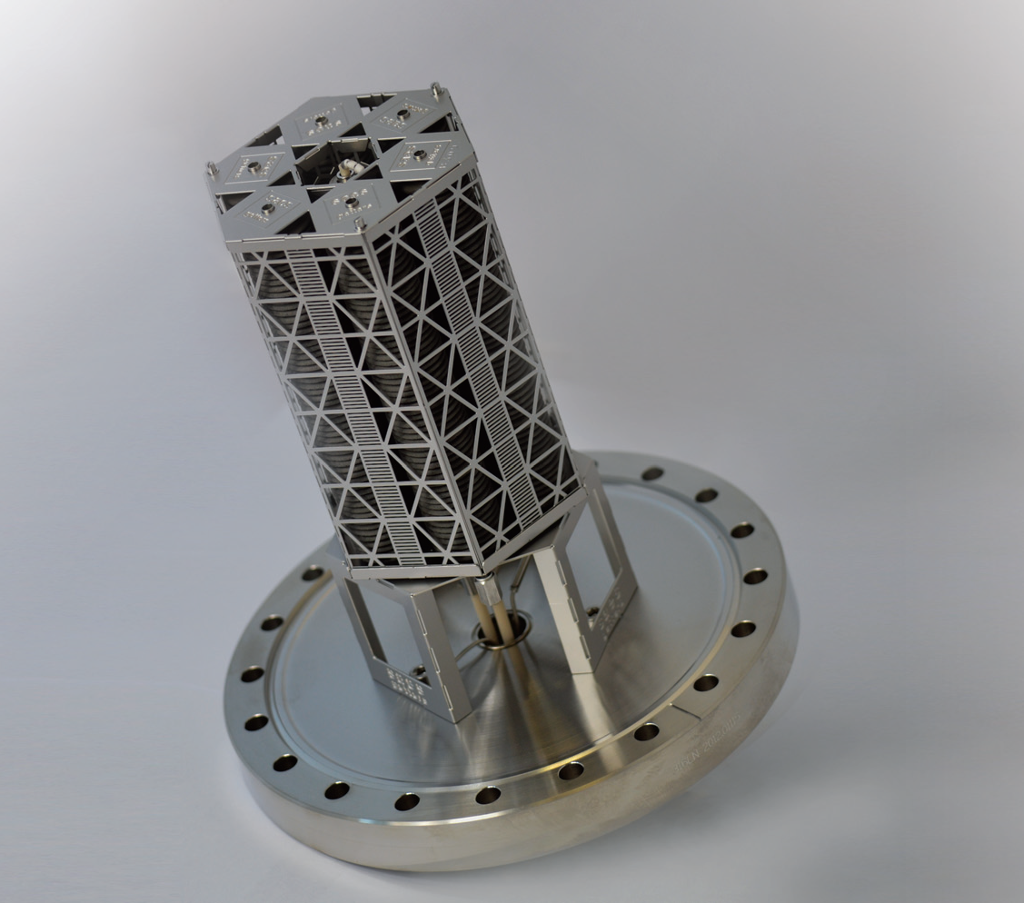
NEG Vacuum Pump
SAES CapaciTorr D3500

Slide 18
Vacuum System Procedure
MICE Hall Vacuum Schematic
3500 l/s NEG Pump

Slide 19
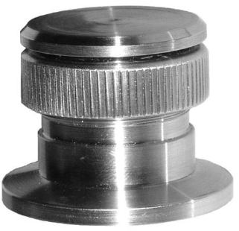
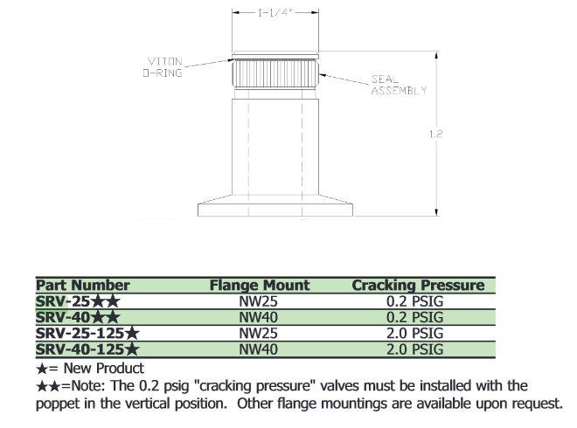
Vacuum System Pressure Relief

Slide 20
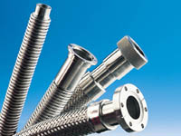
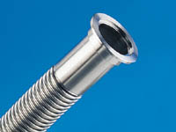
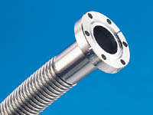
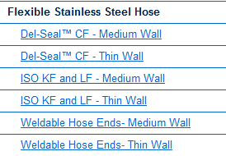
Chamber Interfaces: Vacuum Component Flange Types
KF
CF

Slide 21
Interface to MICE Beamline

Slide 22
Stand Geometry, Access

Slide 23
MICE Beamline Vacuum at RAL
Performance of the cavity is dependent on the MICE beamline pressure.
If beamline pressures are maintained in the 2E-6 to 5E-7 Torr range, Cavity pressures should be maintained in the low E-7 to high E-8 Torr range if coupler conductance is limited to around 20 L/s.
Assuming that the beamline gas load is similar to that of the MICE RF module vessel being tested at Fermilab the gas load would be about 5.27E-5 Torr-L/s-m. This would require that Pumping speeds of 105 L/s-m to maintain a pressure of 5E-7 Torr in the beamline. This would require the turbo to be magnetically shielded.
Further modeling of the gas flow between the two volumes would be needed to specify the actual size of the conductance needed.

Slide 24
Differential Pressure Evolution
Pumpdown Roughing*:
$$P=P_{o}e^{\frac{−St}{V}}$$
(excluding outgassing)
Input:
Case 1 | Cavity | Vessel | Cavity | Vessel | Cavity | Vessel | Cavity | Vessel
 | Pic | Piv | Pfc | Pfv | Seffc | Seffv | Vc | Vv
 | 760 | 760 | 1.00E-08 | 1.00E-06 | 500 | 30 | 500 | 300
P (Torr)
ΔP (psi)
Time (s)
Time (s)
* p. 305, Basic Vacuum Practice 3rd Edition, Varian Vacuum Products

Slide 25
Differential Pressure Evolution
 | Cavity | Vessel | Cavity | Vessel | Cavity | Vessel | Cavity | Vessel
 | Pic | Piv | Pfc | Pfv | Seffc | Seffv | Vc | Vv
Case 1 | 760 | 760 | 1.00E-08 | 1.00E-06 | 500 | 30 | 500 | 300
Case 2 | 760 | 760 | 1.00E-08 | 1.00E-06 | 60 | 30 | 500 | 300
ΔP (psi)
Time (s)

Slide 26
Additional Slides
RFM integration into MICE beamline
Vessel fiducials and CMM measurement
Additional FEA results
Vessel stand (new design?)
Vacuum System components, SS 304 budget
Tradeoffs between relief valves and burst disks
Vacuum fault analysis
Inner and Outer configurations

