Slide 1
TESLA SRF Cavities (as used for LCLS-II)
LCLS-II Production Cryomodule Final Design Review
F. Marhauser
13-May-2014

Slide 2
Outline
Why TESLA cavities?
Technical specifications used for solicitation and project responsibilities
Brief cavity development history
Design and operational parameters
Performance goals
Cavity process flow recipes (LCLS-II vs. X-FEL)
Higher Order Mode (HOM) damping
How well does cavity industrialization work? – X-FEL status
LCLS-II cavity procurement status

Slide 3
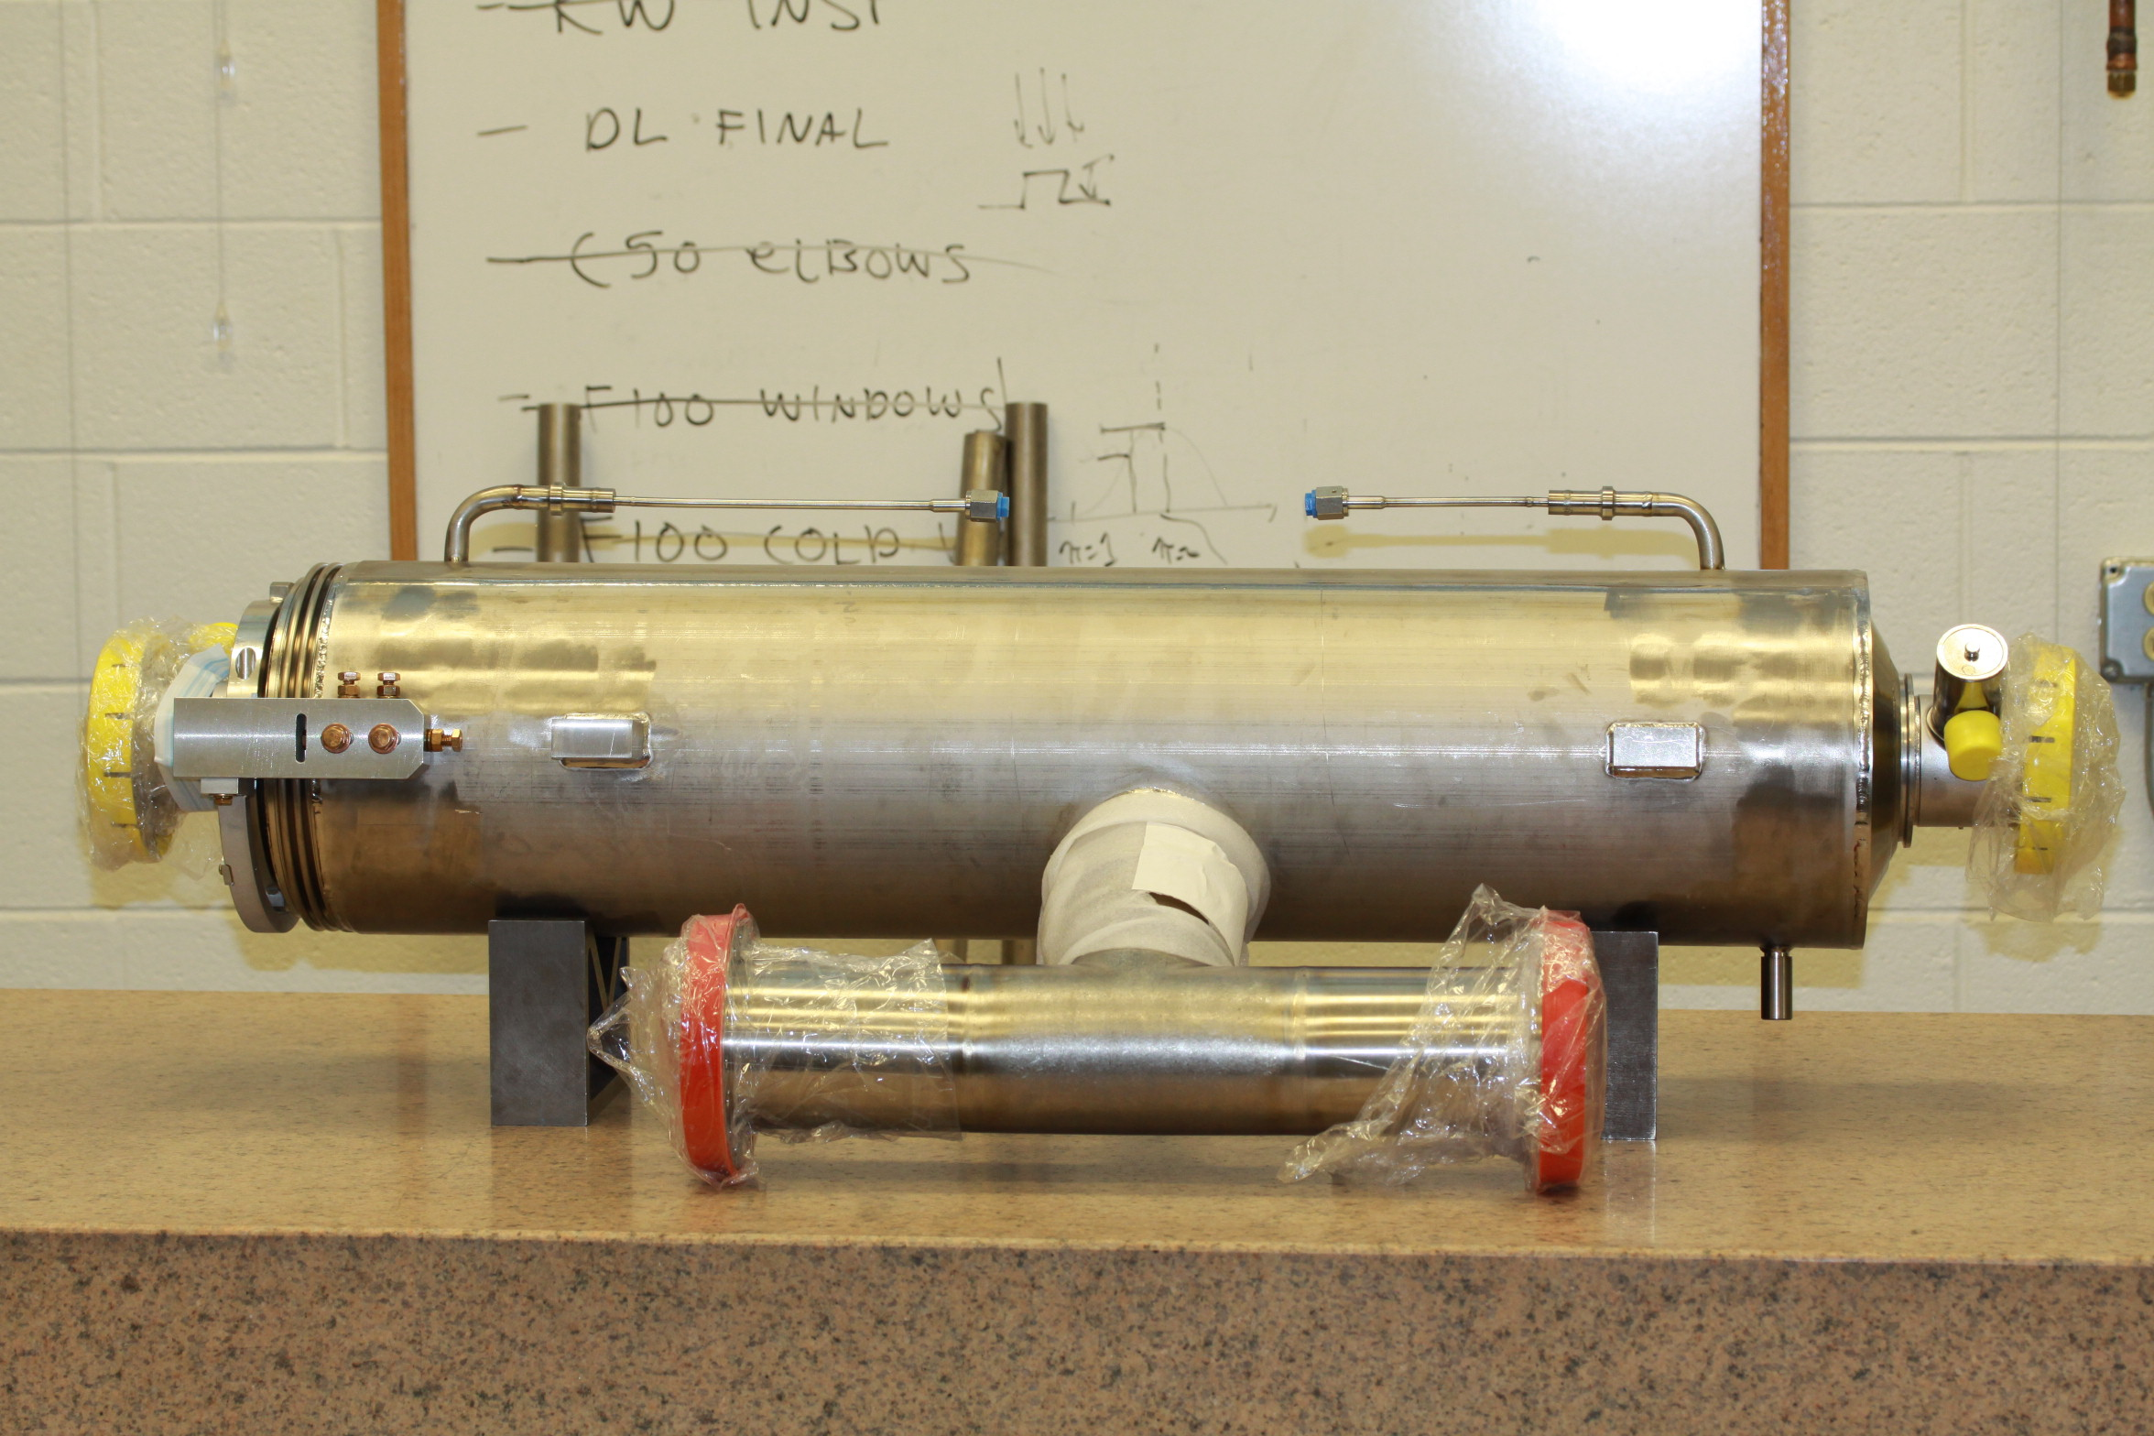
Tesla Cavities
Why TESLA cavities for LCLS-II ?
Long history at DESY: TTF, FLASH, now utilized for European X-FEL under construction > 20 years experience
Cavities employed successfully worldwide: > 1000 TESLA cavities produced
DESY successfully transferred SRF technology to industry
Cavities can be delivered fully dressed in Helium vessels ready to test
LCLS-II relies on ‘Build-to-Print’ manufacturing
Production follows precise specifications (heavily based on X-FEL)
LCLS-II bears responsibility for cavity performance (like X-FEL)
LCLS-II prototype CM cavity
courtesy of DESY

Slide 4
Technical Specifications (LCLSII-4.6-TS-0092)
With permission from DESY, the technical specifications as currently employed for the manufacturing of the XFEL (mostly created 2008/2009) have been used as reference and modified for LCLS-II
Sufficient for vendor proposals (scheduling and cost assessment)
Number | Modified XFEL Documents
XFEL/002 | Technical Specifications for the Series Mechanical Fabrication Superconducting 1.3 GHz Cavities for LCLS-II
XFEL/003 | Quality Assurance and Quality Control Specifications (modified for LCLS-II)
XFEL/004 | Descriptions, Abbreviations, Drawing and EDMS numbers (modified for LCLS-II)
XFEL/005 | Helium Leak Tests (modified for LCLS-II)
XFEL/006 | Special Tools and Equipment (modified for LCLS-II)
XFEL/009 | Flow Chart Dumb-Bell Production (modified for LCLS-II)
XFEL/010 | Recommendations for the Machining of Niobium and Niobium-Titanium (modified for LCLS-II)
XFEL/011 | Recommendation for the Treatment of Niobium Parts (Handling, Cleaning, Etching, Welding)
XFEL/012 | Overview List and Detailed Inspection List of Tests and Demonstrations
XFEL/014 | Frequency Measurement on Dumb-Bell, Half Cell, End Group and Cavity (modified for LCLS-II)
XFEL/015 | Technical Specifications for the Series Production of Helium Tanks (modified for LCLS-II)
XFEL/016 | Technical Specifications for Welding the Helium Tank to the Cavity (modified for LCLS-II)
XFEL/017 | DESY Work Instructions for Welding a Cavity into a Helium Tank (modified for LCLS-II)
XFEL/018 | Standards
XFEL/A-D | Series Surface and Acceptance Test Preparation of Superconducting Cavities for the LCLS-II Project
Number | Additional LCLS-II documents
LCLS-II-4.6-TS-0092 | LCLS-II Nitrogen Doping Processing Procedure
LCLS-II-4.6-TS-0092 | LCLS-II Cavity Process Flow
LCLS-II-4.6-TS-0092 | LCLS-II Frequency Tuning Recipe

Slide 5
Cavity Design Efforts and Responsibilities
FNAL leads the design effort
JLab leads the procurement effort for the production cavities
Description | JLab | FNAL | Vendor
Cavity design drawings |  | X
Cavity specification |  | X
QC and supply of cavity fabrication materials (Nb, NbTi) | X | X
Cavity procurement (266 cavities + 32 optional) | X
Government furnished material & equipment | X
Manufacturing drawings |  |  | X
Labor, equipment, facilities, all other materials |  |  | X
Fabricate, assemble, process, document, deliver cavities |  |  | X
Cavity inspection upon delivery | X | X
Cavity final acceptance | X

Slide 6
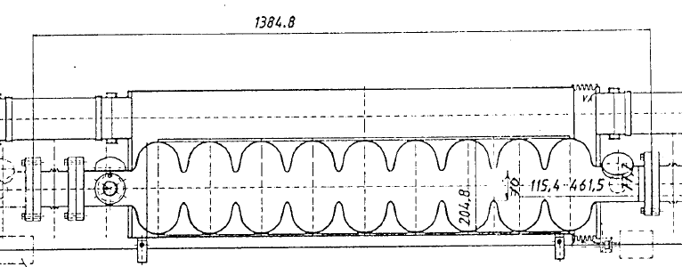
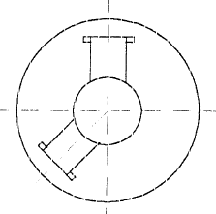
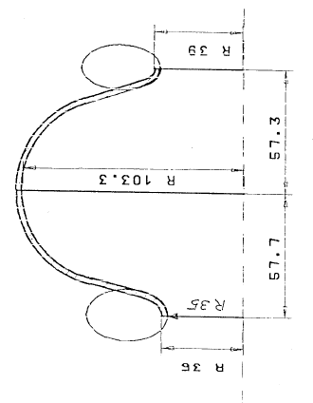
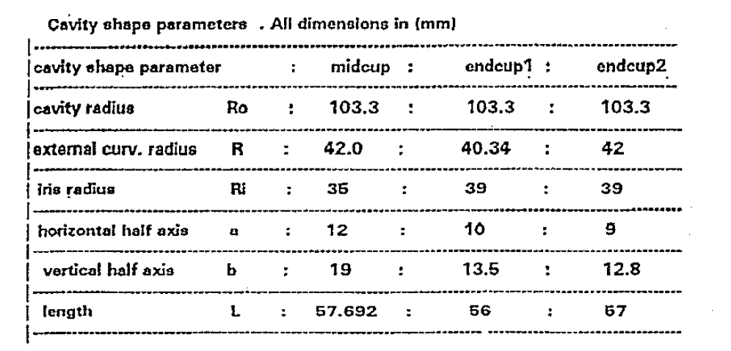
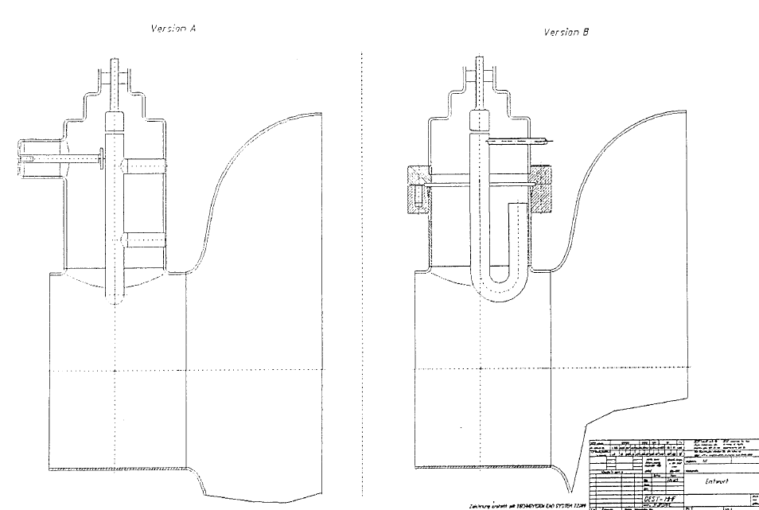
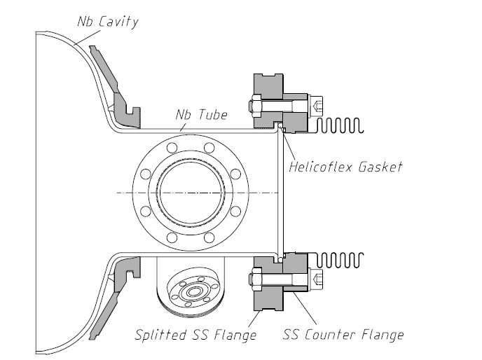
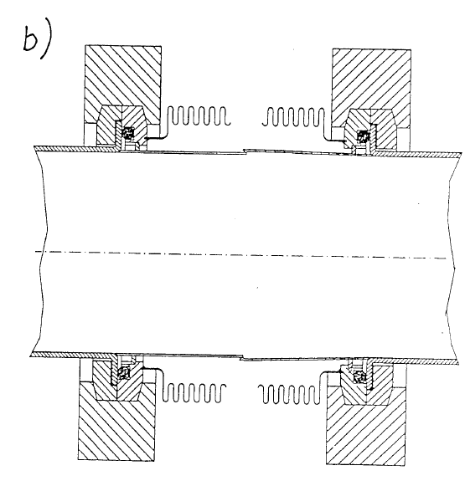
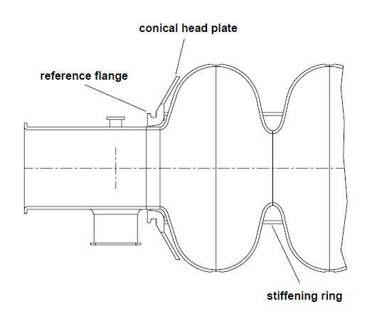
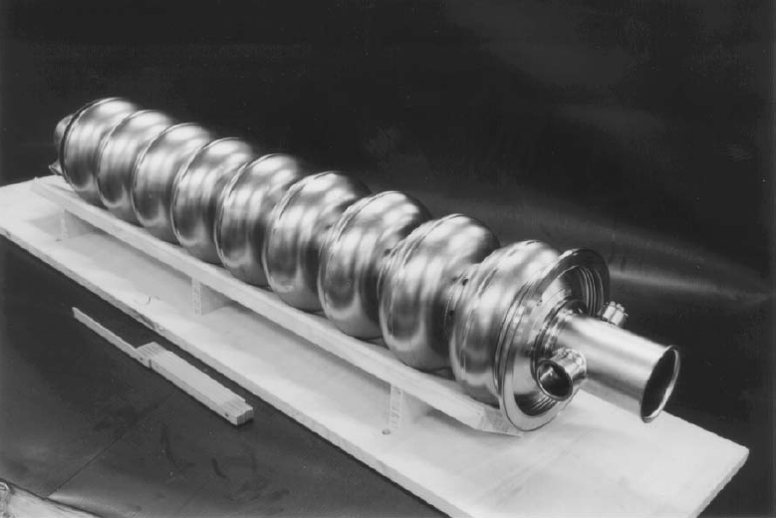
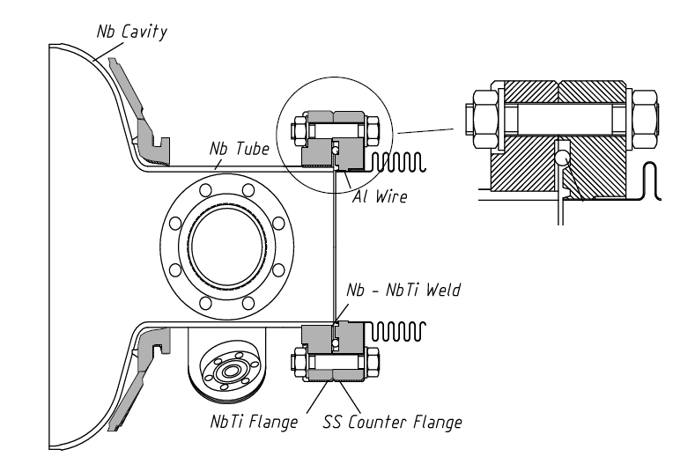
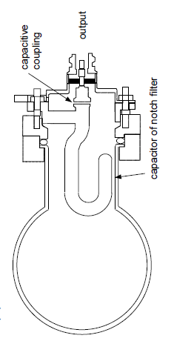
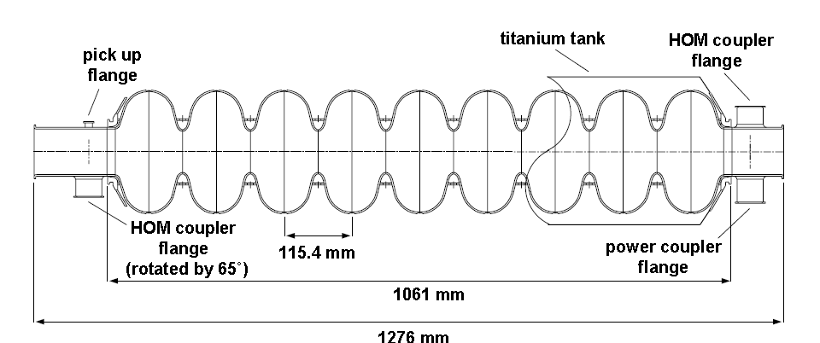
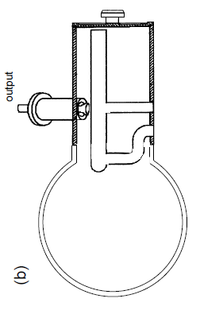
Brief TESLA Cavity Design History
1990 – Cavity design work started by 1st TESLA workshop at Cornell
1992
Ti transition ring to SS collar at end for SS helium vessel
Nb reinforcement bars for stiffening
tube steps down for TM012, TE121 HOM damping, but 20% higher loss factor
Nb weight ~20 kg
1993
cell geometry finalized (URMEL code)
asymmetric design (different end cups)
to untrap HOMs
HOM coupler concepts
welded
HOM coupler
(conduction
cooled)
demountable
HOM coupler
(LHe cooled)
cell stiffeners
1993/94 1st series fabrication
3 mm Nb sealing flanges
bent over tubes
cavity flange connection
(Nb, Helicoflex gaskets)
Ti helium vessel
1997
new flange material proposed:
NbTi (45/55 by weight) flanges
with O-ring type Al gaskets
(maintains hardness after high-T
treatment, gaskets cleaned in ISO 4)
HOM coupler options

Slide 7
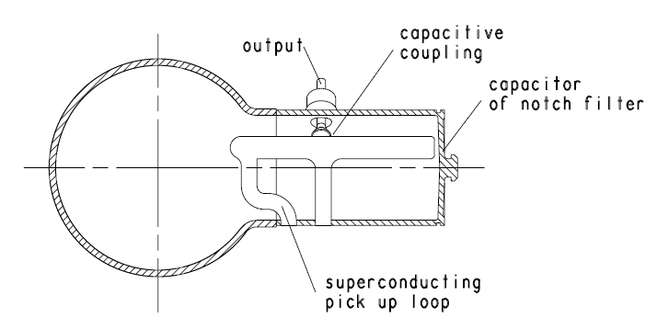
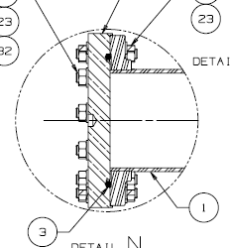
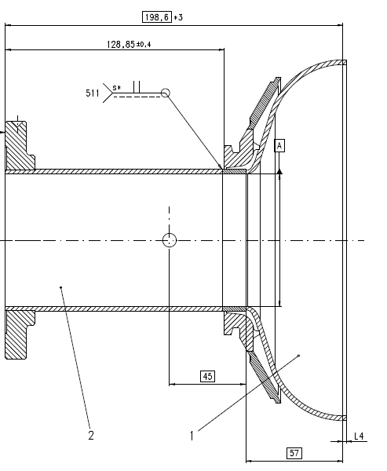
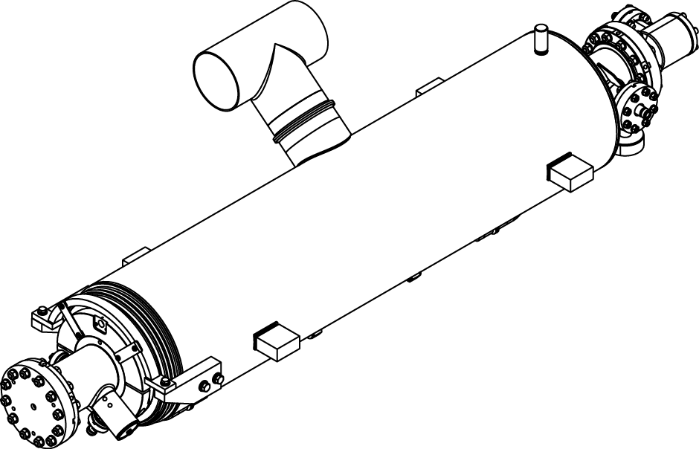
Brief TESLA Cavity Design History
2001
The angle between the 2 HOM coupler is not 90°but 115 °to provide also damping of quadrupole modes
Present
LCLS-II
AlMg hexagonal gasket
Prototype CM cavities: “Short-Short” L = 1247.4 mm
Production CM cavities: “Short-Long” L = 1283.4 mm
LCLS-II prototype CM cavity

Slide 8
Cavity RF and Mechanical Parameters
Parameter | Unit | Value
frequency | GHz | 1.3
N (# of cells) |  | 9
L_{act} (nominal) | m | 1.036
R/Q = V_{eff}²/(ω*W) | Ω | 1036
G | Ω | 270
R/Q∙G/cell | Ω² | 31080
Iris ID | mm | 70
Beam tube ID | mm | 78
k_{cc} (cell-to-cell coupling) | % | 1.87
E_{pk}/E_{acc} |  | 2.0
B_{pk}/E_{acc} | mT/(MV/m) | 4.26
wall thickness (before chemistry) | mm | 2.8
LFD w. stiffeners (Lorentz Force Detuning) | Hz/(MV/m)² | ≤ 1.5
Δf/ΔL | kHz/mm | 315
# of HOM couplers |  | 2
R_{BCS} ~ f² key deciding factor. Thermal instability limit (option to reach higher fields), exact f=1.3 GHz originally motivated by availability of high power klystrons, cavity surface area ~1/f² → capital costs, also likelihood to sustain higher fields with smaller area based on statistical model of defects
max. number mainly determined by HOM requirements (trapped modes, HOM Q_{ext}, δA_{cell} ~ N²/k_{cc}* δf_{cell,error}), ancillary components (power/HOM couplers, tuners, He vessels) ~1/N → capital costs
real estate L~N~1/f, beam loading ~ (E_{acc}∙L_{act}(N))² → RF generator power/cavity
cell geometry → acc. efficiency, tradeoff with HOM impedance/loss factors ~R/Q
cell geometry → R_{s}=Q₀/G
Cryogenic RF losses in wall ~ 1/(R/Q∙G) → capital/operational costs
wakefields (κ_{ǁ}~1/ID³, κ⊥~1/ID⁴), confined HOMs
cutoff → trapped HOMs
fundamental field flatness (δA_{cell} ~ N²/k_{cc}* δf_{cell,error})
field emission/dark current
thermal breakdown
Nb stock → capital costs, impacts stiffness of cavity
cavity stiffness (LFD static in CW mode), tuner force/motor
tuner range
Minimum # of couplers to damp different polarizations of HOMs

Slide 9
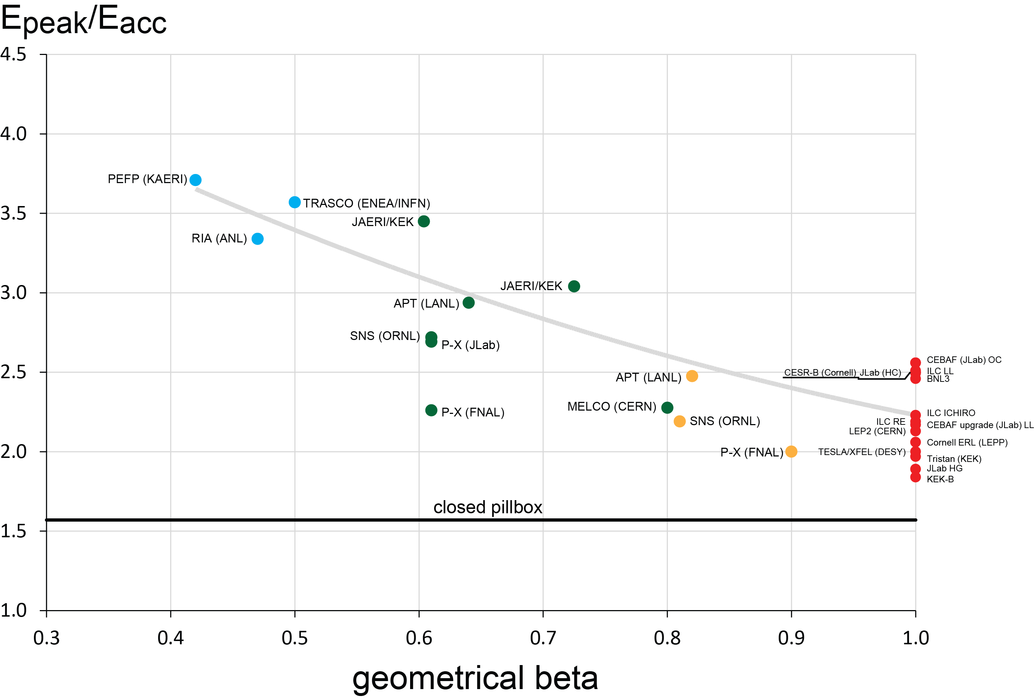
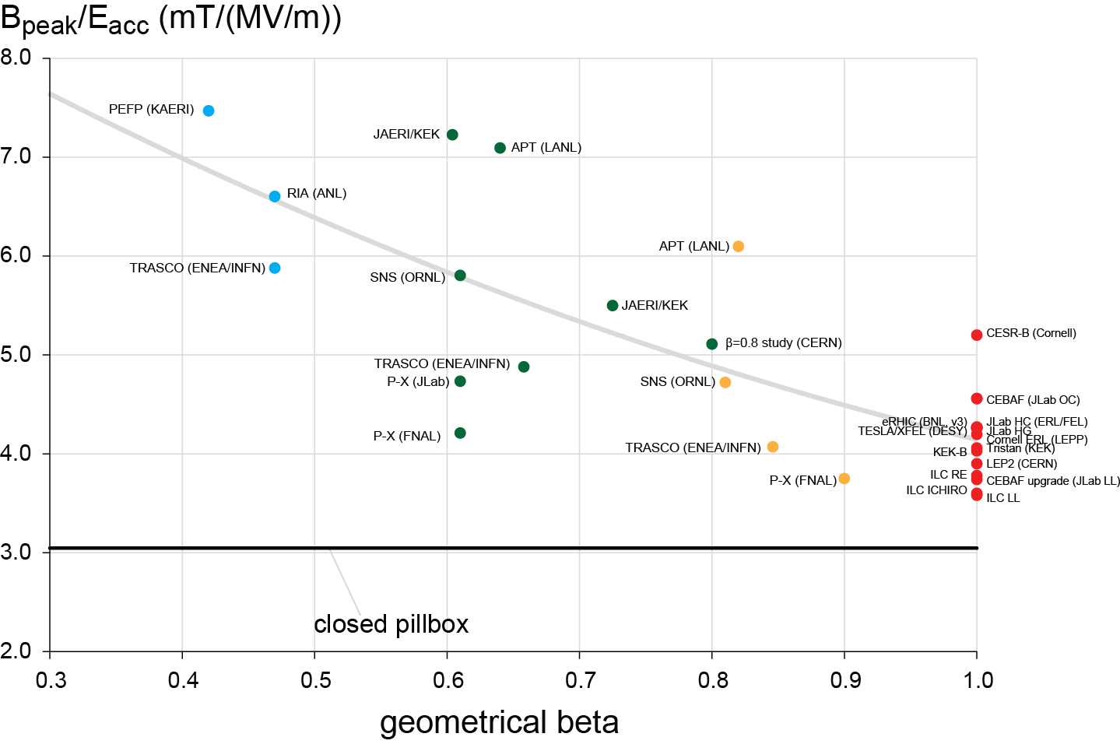
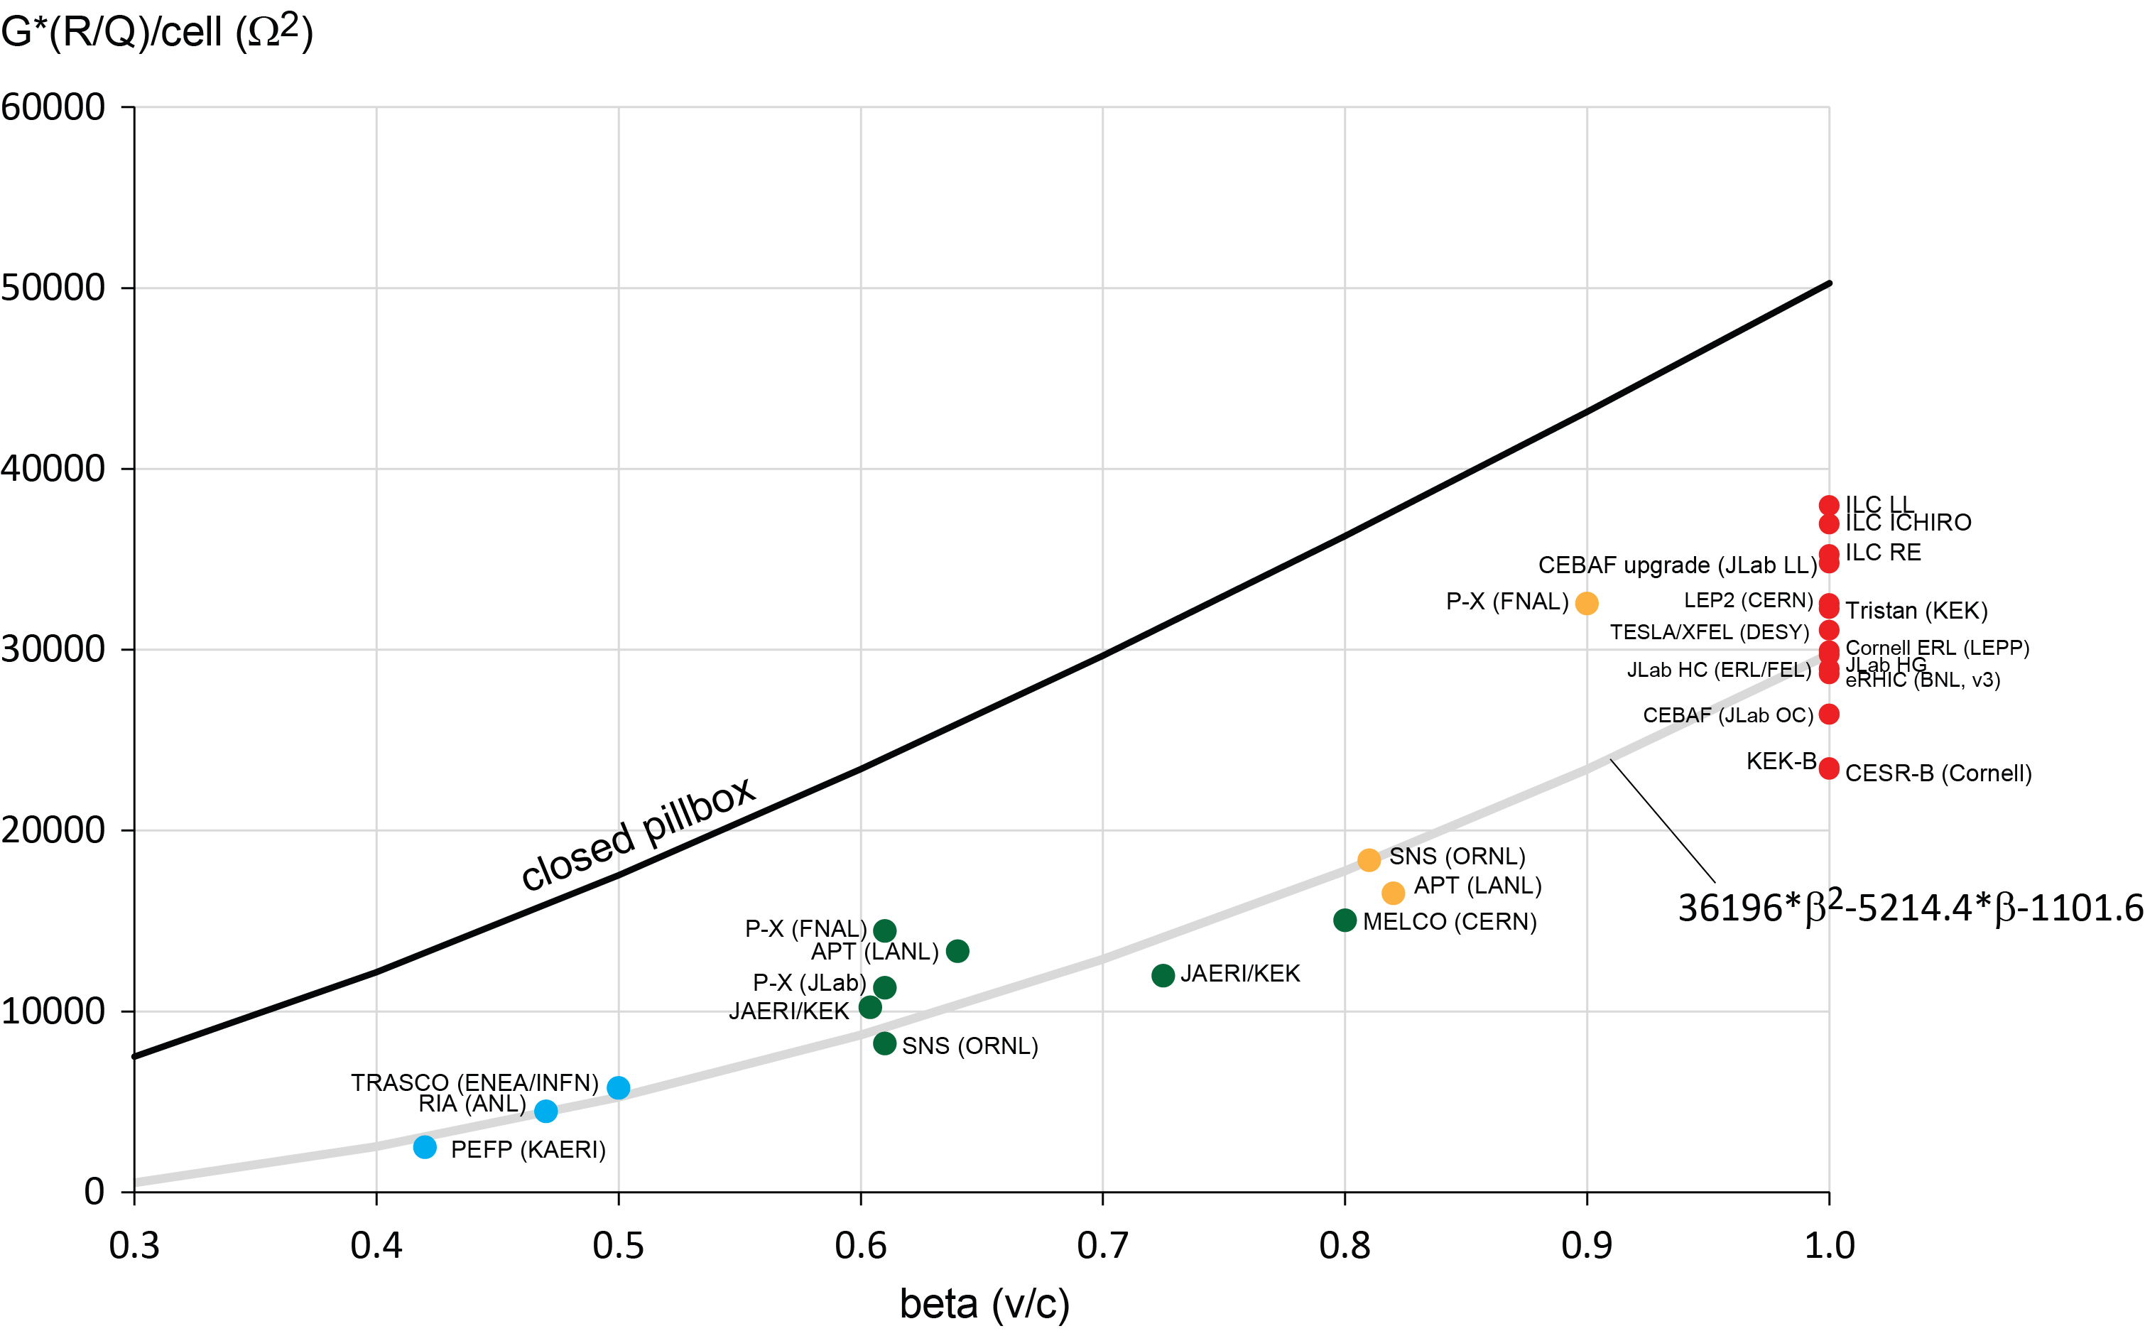
Relevant Geometrical Parameter (Design Comparisons)
Field Emission- relevant
Quench-relevant
Cryogenic loss-relevant

Slide 10
Operational Parameters Main Linac Cavities (vs. CEBAF cavities)
Parameter | Unit | LCLS-II TESLA cavities | CEBAF C100 LL cavities
Frequency | GHz | 1.3 | 1.497
Mode of operation |  | CW
Material |  | Fine grain RRR ≥ 300
E_{acc} | MV/m | 16*/18** | 19.2
T | K | 2.0 | 2.07
E_{pk} | MV/m | 32/36 | 41.7
B_{pk} | mT | 68.2/76.7 | 71.8
<Q₀> |  | 2.7e10 | 7.2e9
R_{s} | nΩ | 10.0 | 38.9
P_{wall} | W | 9.8/12.4 (when same Q0) | 29
* <E_{acc}> rounded, slightly less than 16 MV/m, yields 4.14 GeV with nominal phasing for 100 pC and 6% cavities unpowered
** max. (14-18 MV/m range)

Slide 11
Tesla Cavity Design Changes (LCLS-II vs. XFEL)
Hardware:
No geometrical design changes to TESLA cavity itself
Modifications concern cavities’ ancillary components (He vessel, tuner, HOM RF feedthroughs, magnetic shielding <5mG) and cryomodule component design (e.g. adaption to CW operation, magnetic flux expulsion)
Surface post-processing:
Nitrogen-doping as part of high-T baking process added
High-Q₀ recipe developed at FNAL yields consistent results among partner labs
Goal was to develop robust recipe that can be transferred to industry achieving Q₀=2.7e10 at 16 MV/m for production cavities
Slower (temperature-controlled) Electropolishing

Slide 12
Cavity Process Flow (LCLS-II vs. XFEL Recipes)
LCLS-II Recipe
XFEL Recipe
Cavity after mechanical fabrication
Cavity after mechanical fabrication
Ship to DESY
Ship to FNAL/JLab
HOM Tuning
External 20 um BCP
HOM Tuning
EP 110 or
EP 140 um
X
120C bake
Leak Check
Short HPR
US Degrease
Leak Check
Final Assembly
External 20 um BCP
EP 110 um (temperature controlled)
Final Assembly
Long HPR
X
Ethanol Rinse
Long HPR
US Degrease
VT Assembly
VT Assembly
Short HPR
Long HPR
800C HT Bake
Helium Tank Welding
Procedure
Helium Tank Welding Procedure
RF Tuning
800C HT Bake + N2 Doping
EP 40 um or
Flash BCP 10 um
Long HPR
RF Tuning
Standard HPR
X
Ethanol Rinse when final EP applied
EP 5 um
US Degrease
Standard HPR

Slide 13
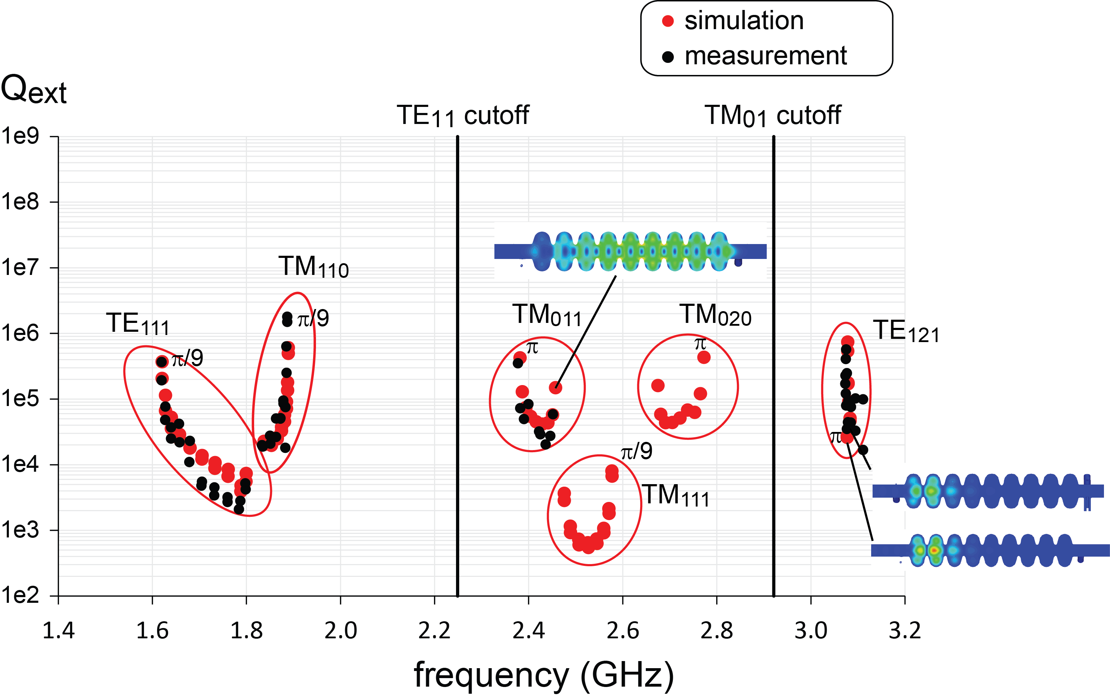
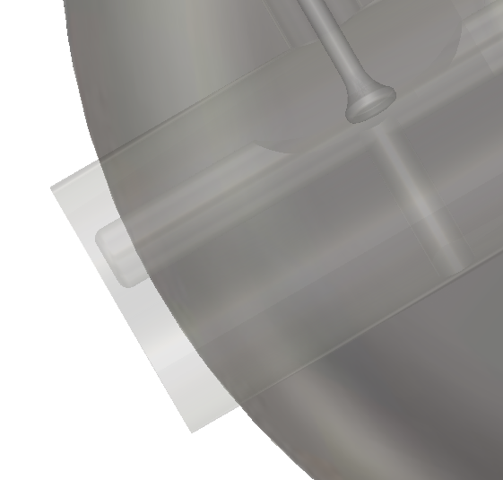
HOM Damping
HOM damping requirements: Q_{ext} < 10⁶ -10⁷ for high impedance HOMs (no hard limit) (LCLSII-1.1-DR-0251-R0, Table 6-5)
Damping requirements rather relaxed (I_{avg,max} =0.3mA at Q=300 pC, f_{rep}=1 MHz) compared to X-FEL
Probability of HOMs close to spectral lines is small
Boundary conditions above tube cutoff matter, more HOM couplers can contribute to damp critical propagating modes (e.g. TM₁₁₁, TE₁₂₁)
LCLS-II probe tip used

Slide 14
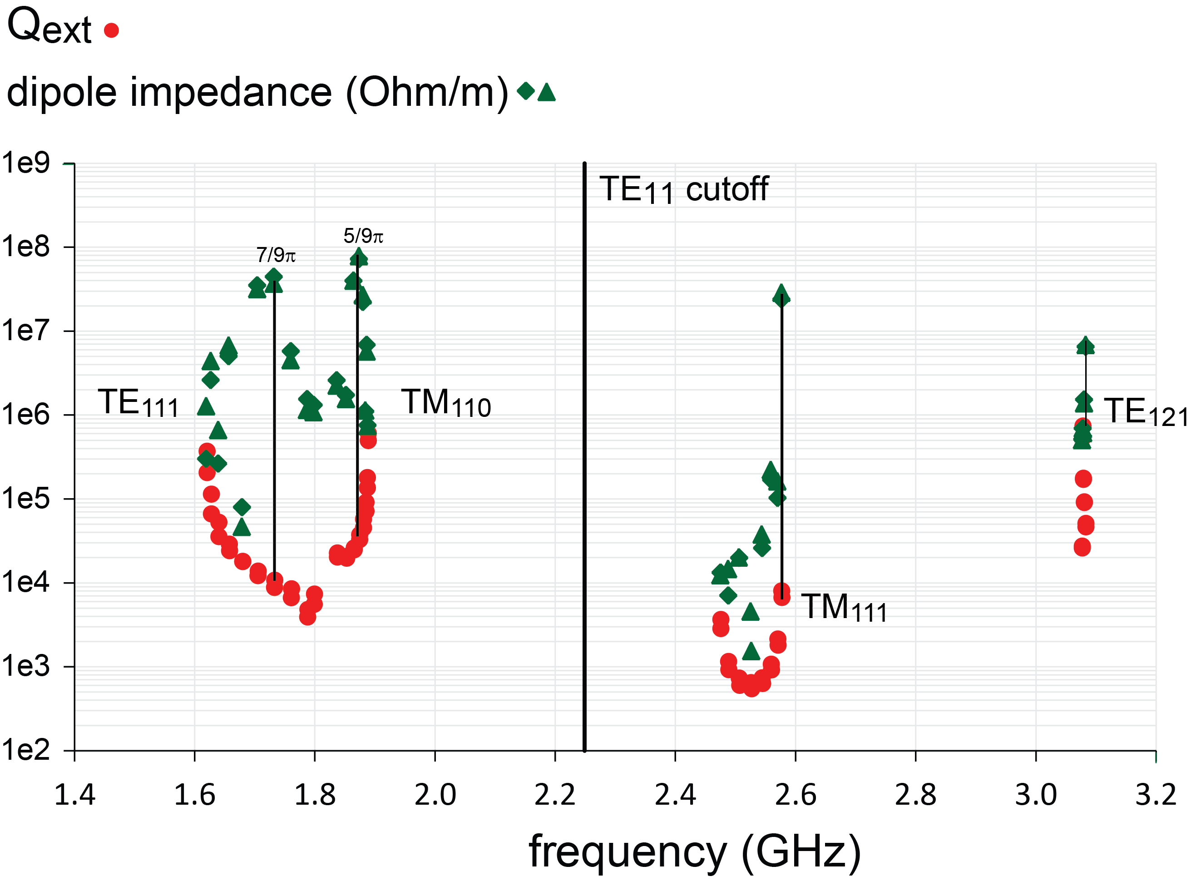
HOM Damping – Dipole Modes only

Slide 15
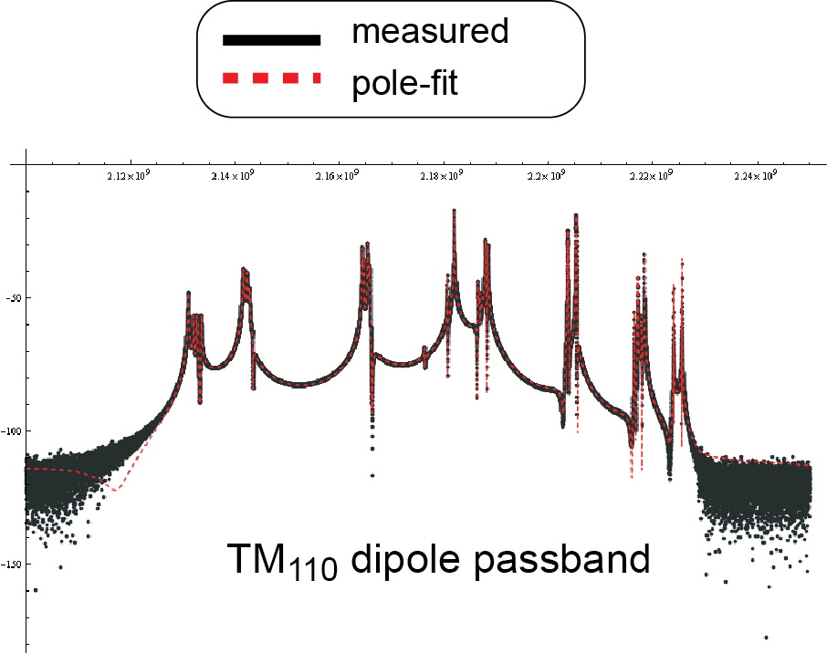
HOM Damping QC
External/loaded Qs can be measured in vertical Dewar to check integrity of cavities
Time-saving pole-fit routine enables HOM QC check of all cavities during production phase
F. Marhauser, C. Potratz, “Automatization of Quality Factor Measurements in RF Structures”, JLAB-TN-11-008

Slide 16
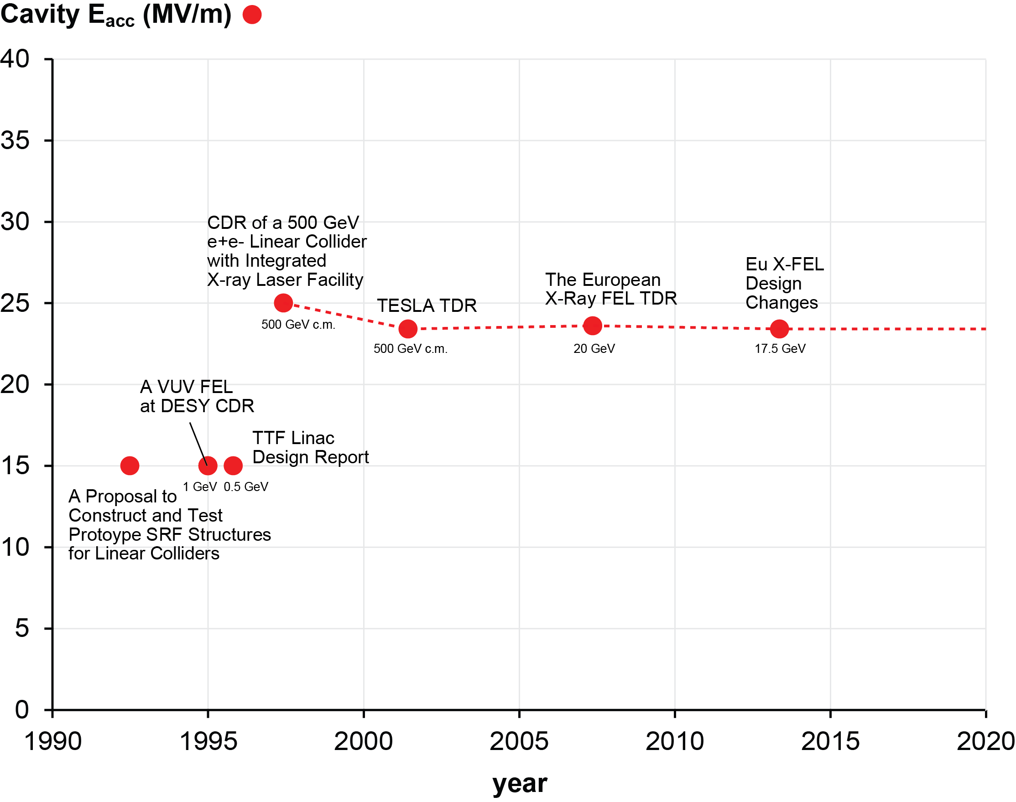
History – Cavity Performance Goals at ~2K

Slide 17
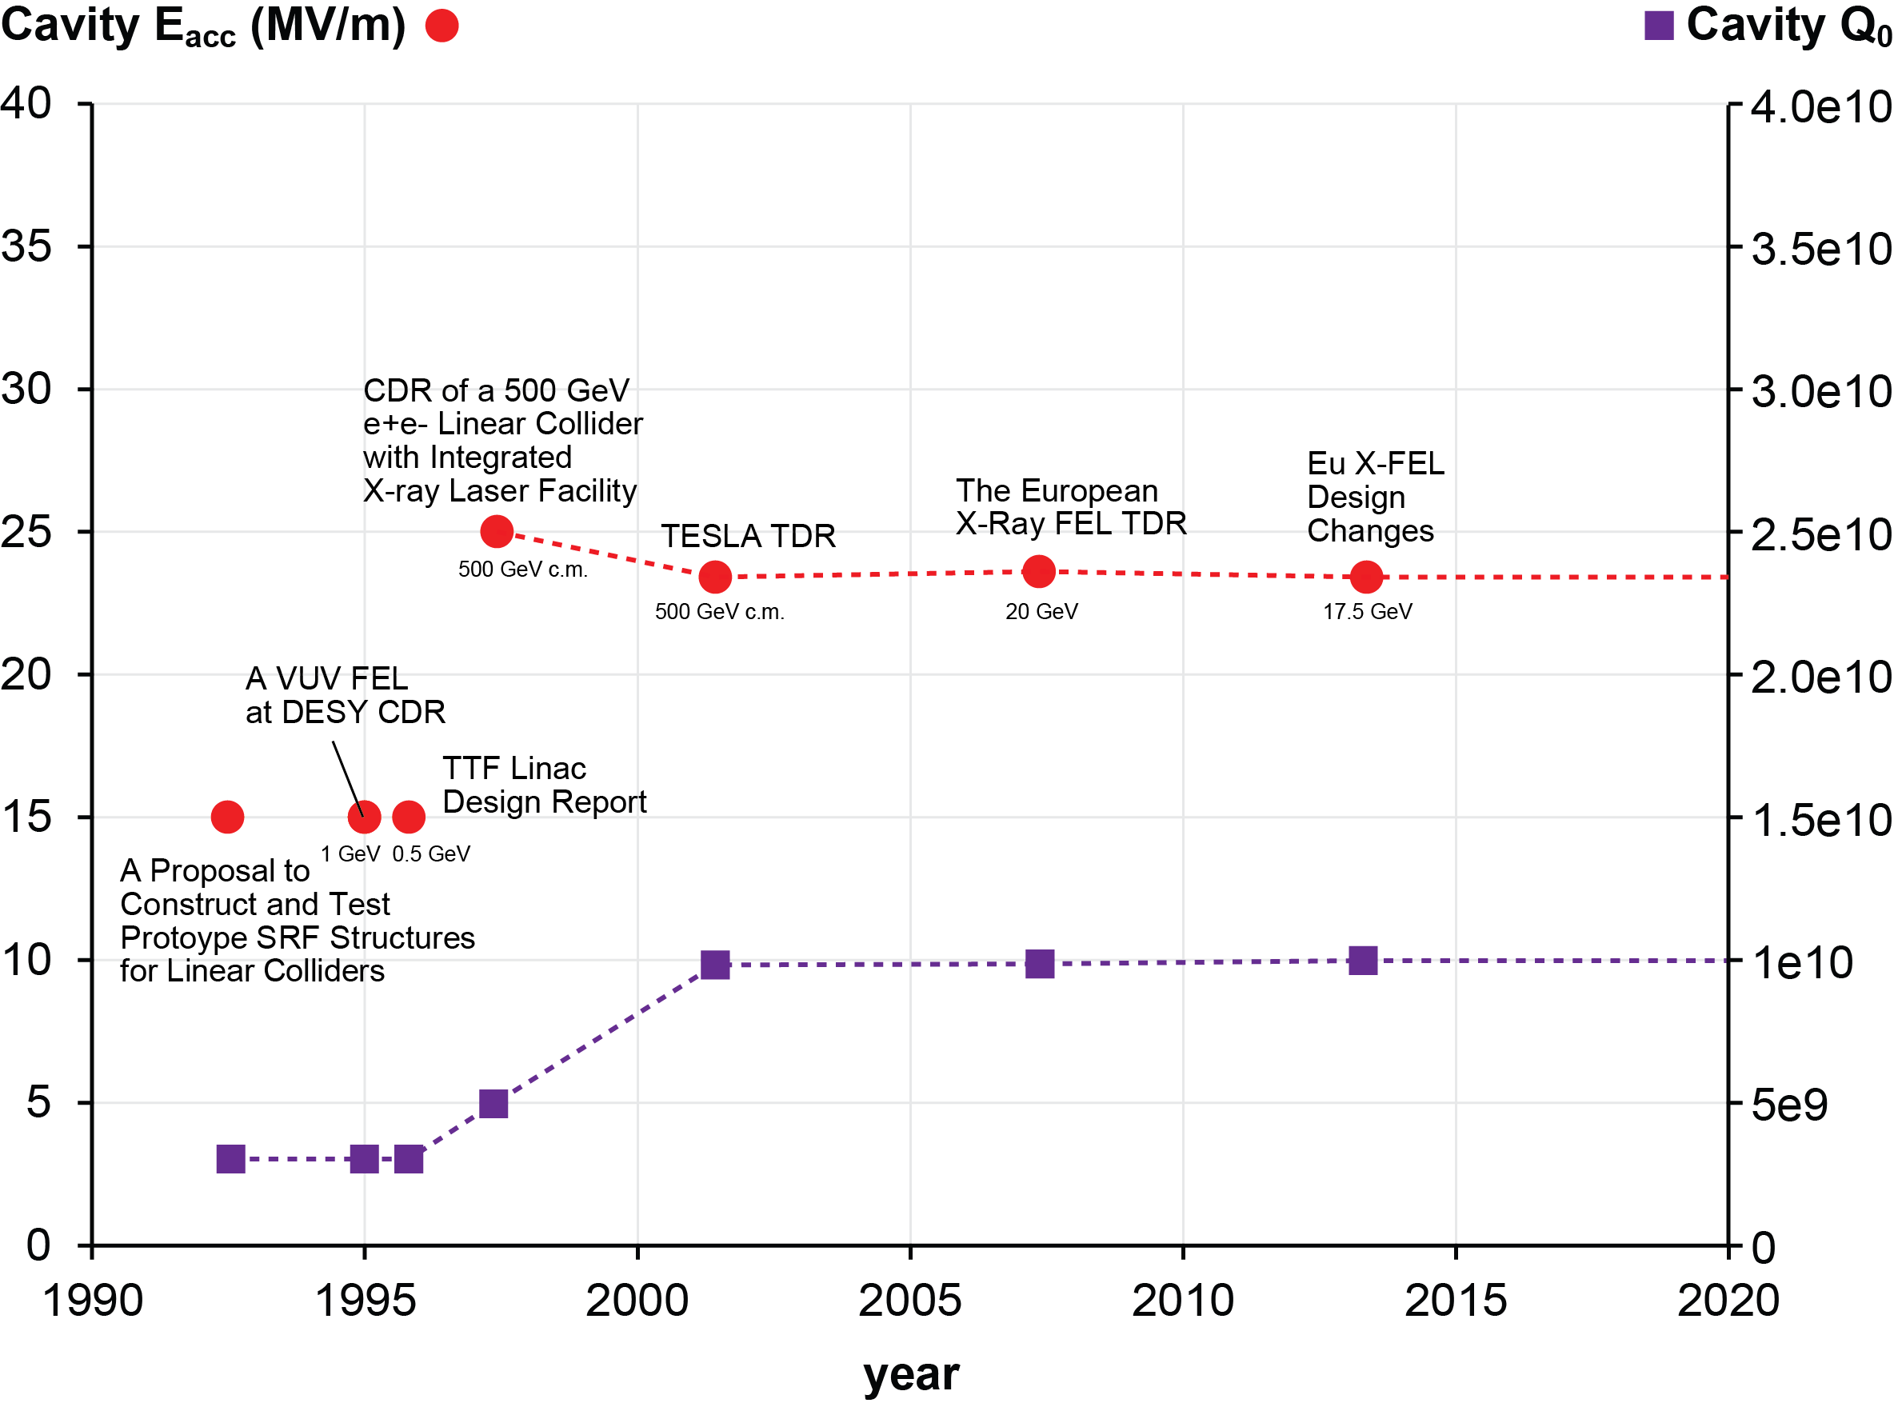
History – Cavity Performance Goals at ~2K

Slide 18
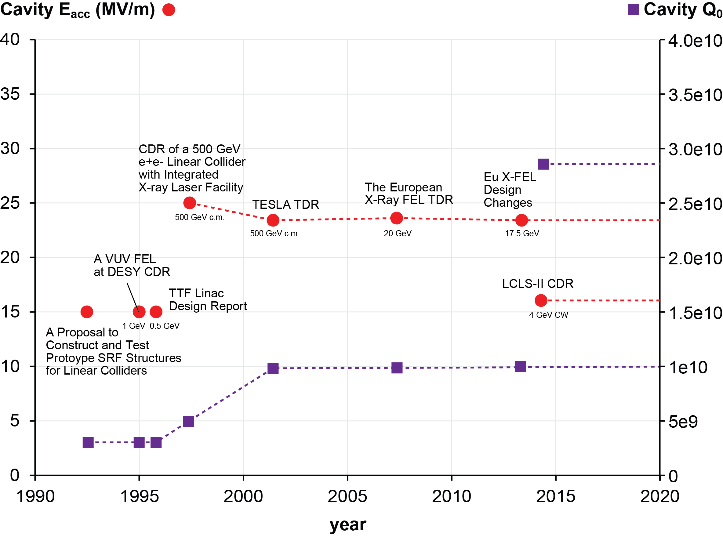
LCLS-II high-Q₀ “Revolution”
N-doping

Slide 19
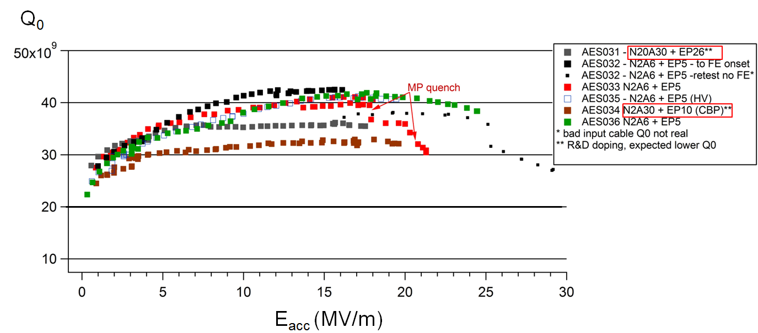
JLab’s Vertical Tests Results for Prototype Cryomodule
6 cavities qualified, 2 not yet tested
Result for cavities obeying present LCLS-II doping recipe (N2A6 EP5):
<Q₀> = 4e10 at 16 MV/m (FNAL graphs missing here, all Lab’s data combined in slide 24 )
at 2K - results corrected for NbTi flanges (-1.4 nΩ from SS)
LCLS-II spec
A. D. Palczewski et al., Proc. of IPAC 2015, WEPWI029.

Slide 20
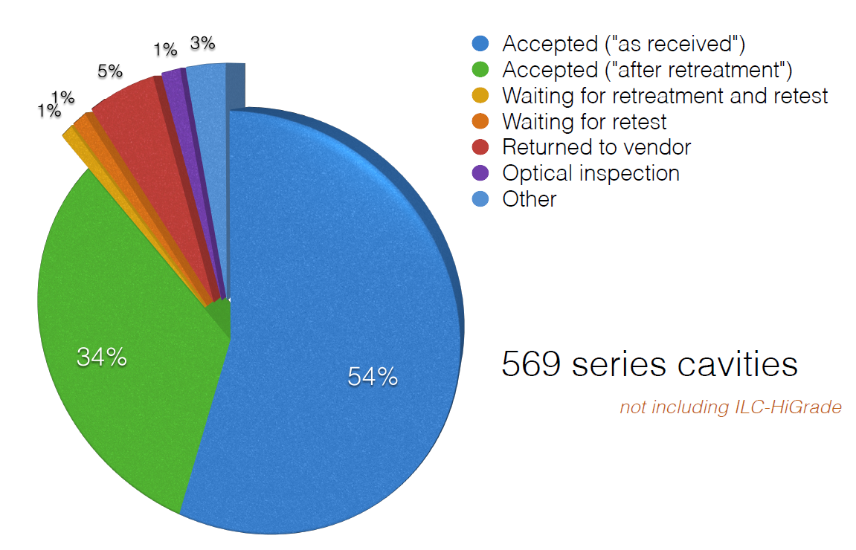
How well does industrialization work?
XFEL status and state-of-the-art of vendor-delivered cavities
71 CMs worth of cavities (~2x LCLS-II = 35 CMs)
courtesy of Nick Walker – DESY
from LLC-PAC meeting - LAL -, April 2015

Slide 21
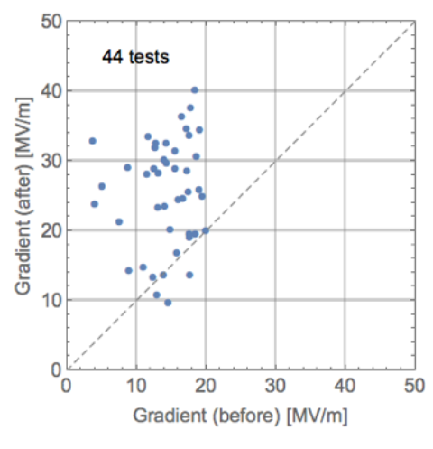
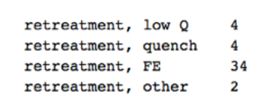
How well does industrialization work?
XFEL status and state-of-the-art of vendor-delivered cavities
In general:
1st retreatment is a standard High-Pressure Rinse (HPR)
2nd (if required) is BCP
courtesy of Nick Walker – DESY
from LLC-PAC meeting - LAL -, April 2015

Slide 22
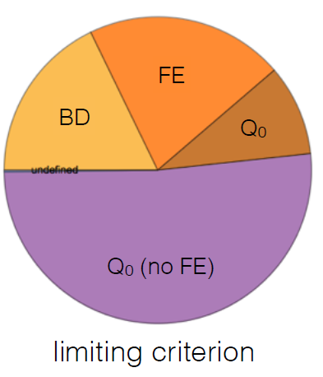
How well does industrialization work?
XFEL status and state-of-the-art of vendor-delivered cavities
As “received” test
Usable gradient, i.e. minimum of the following gradient values:
a) Max (i.e. quench)
b) Q₀ = 1e10
c) X-ray 1 (top) threshold
d) X-ray 2 (bottom) threshold
courtesy of Nick Walker – DESY
from LLC-PAC meeting - LAL -, April 2015

Slide 23
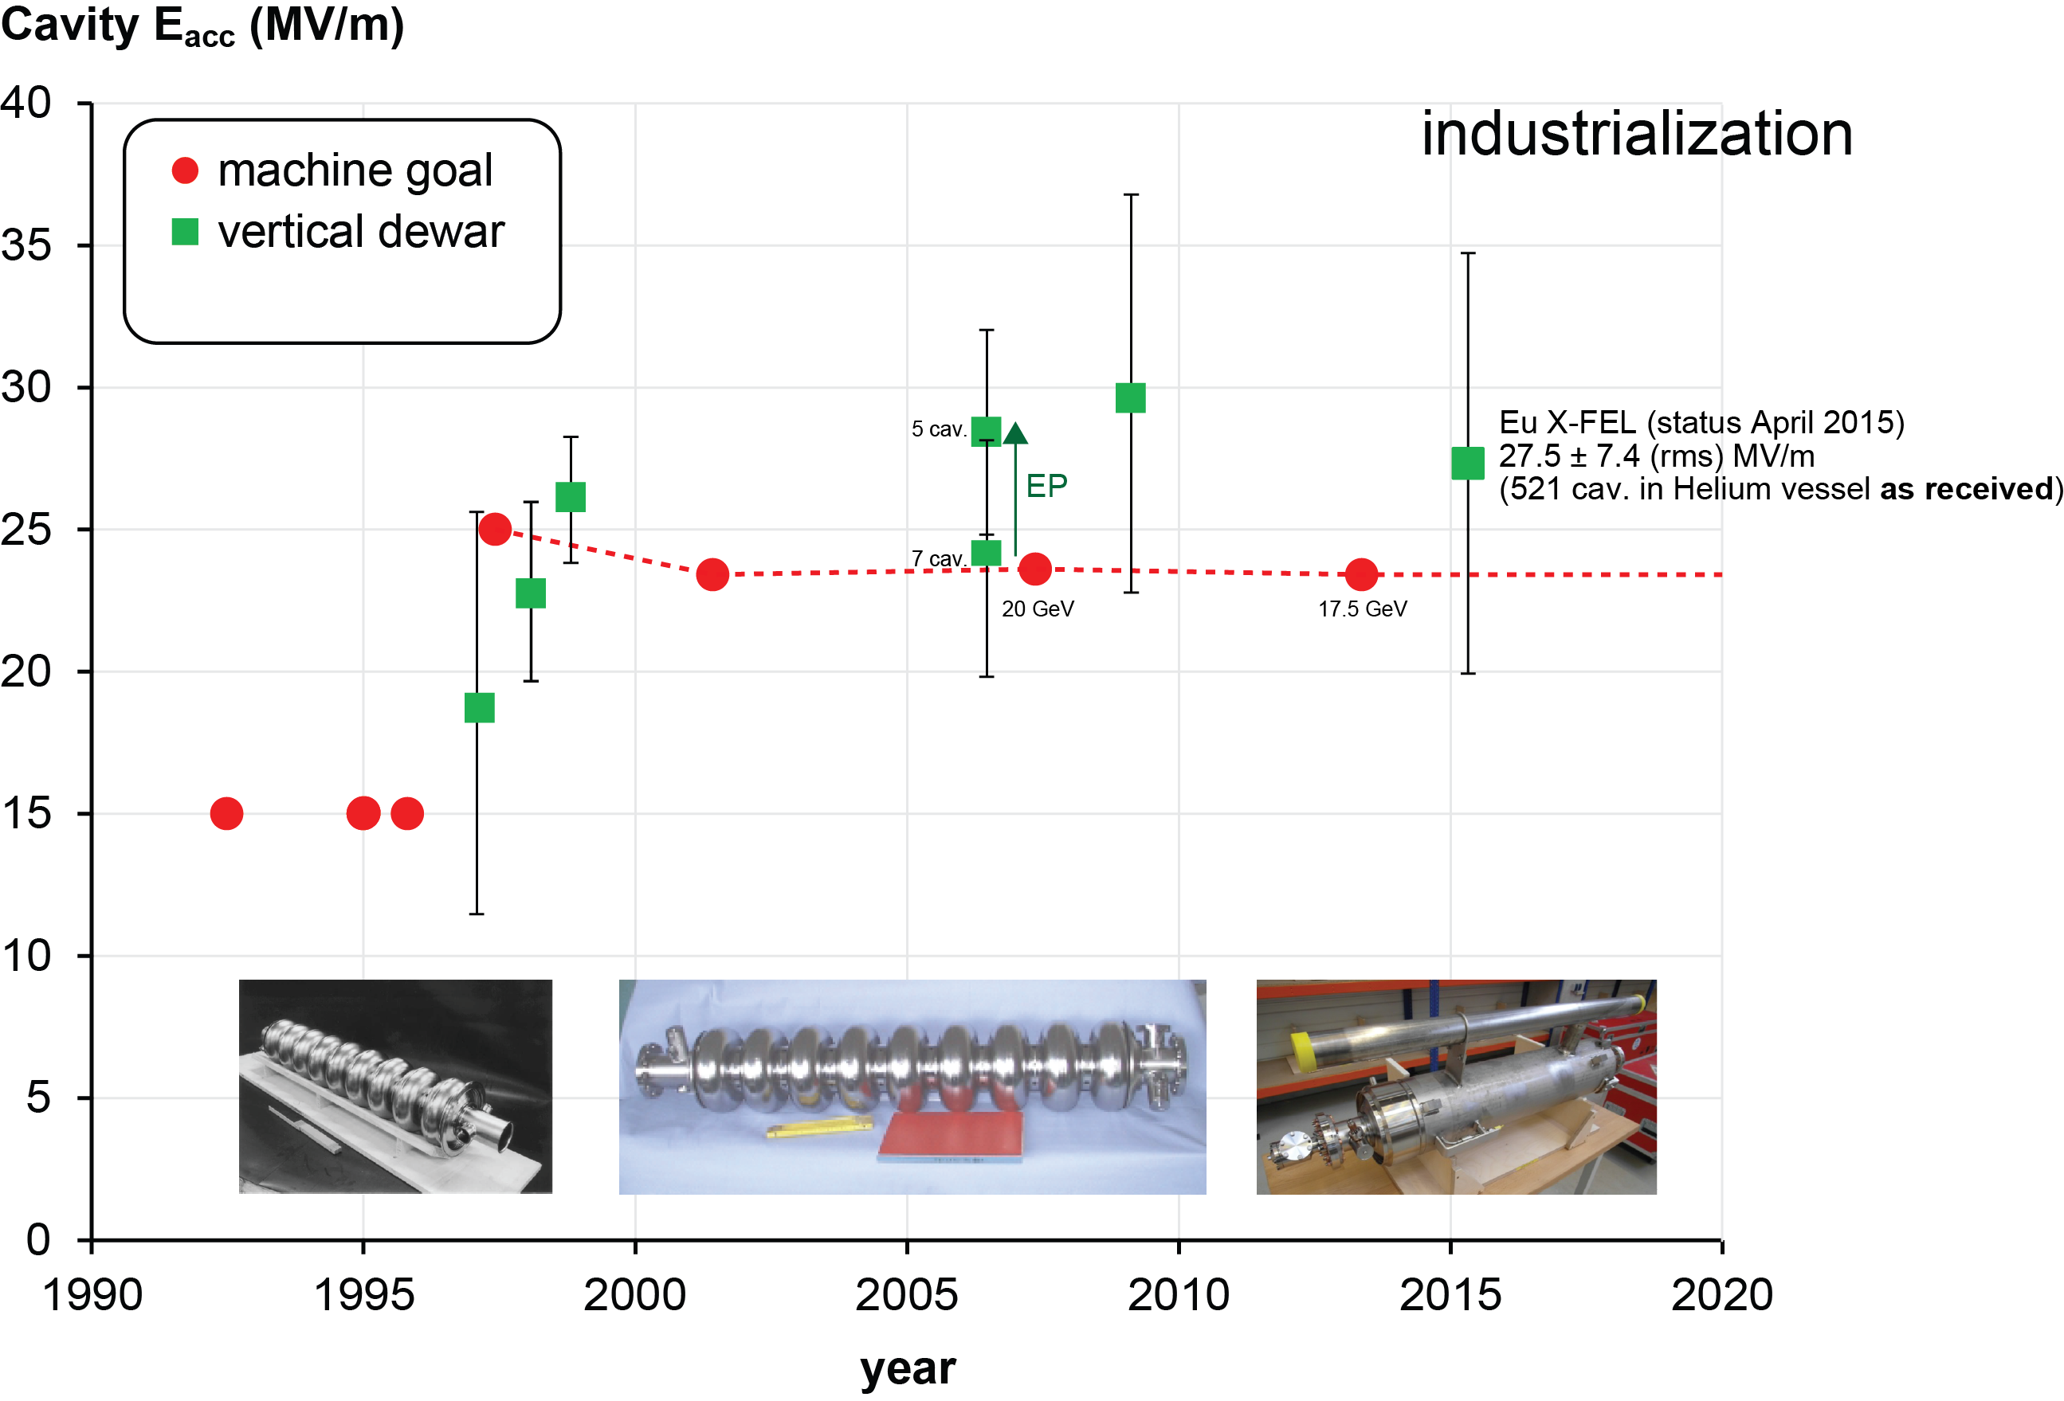
History – Vertical Cavity Performance Milestones at ~2K
note : only data included as published/presented by DESY

Slide 24
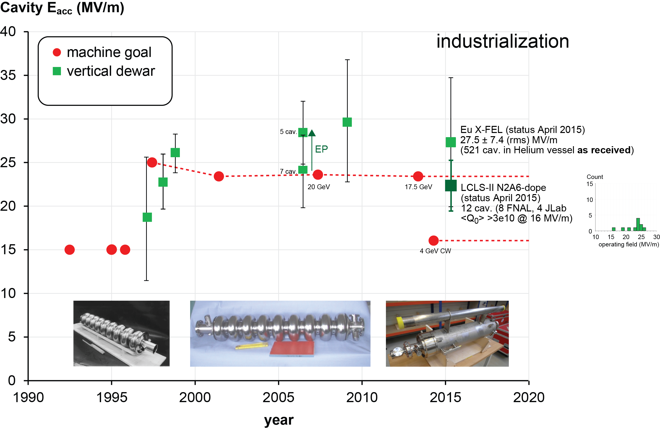
History – Vertical Cavity Performance Milestones at ~2K

Slide 25
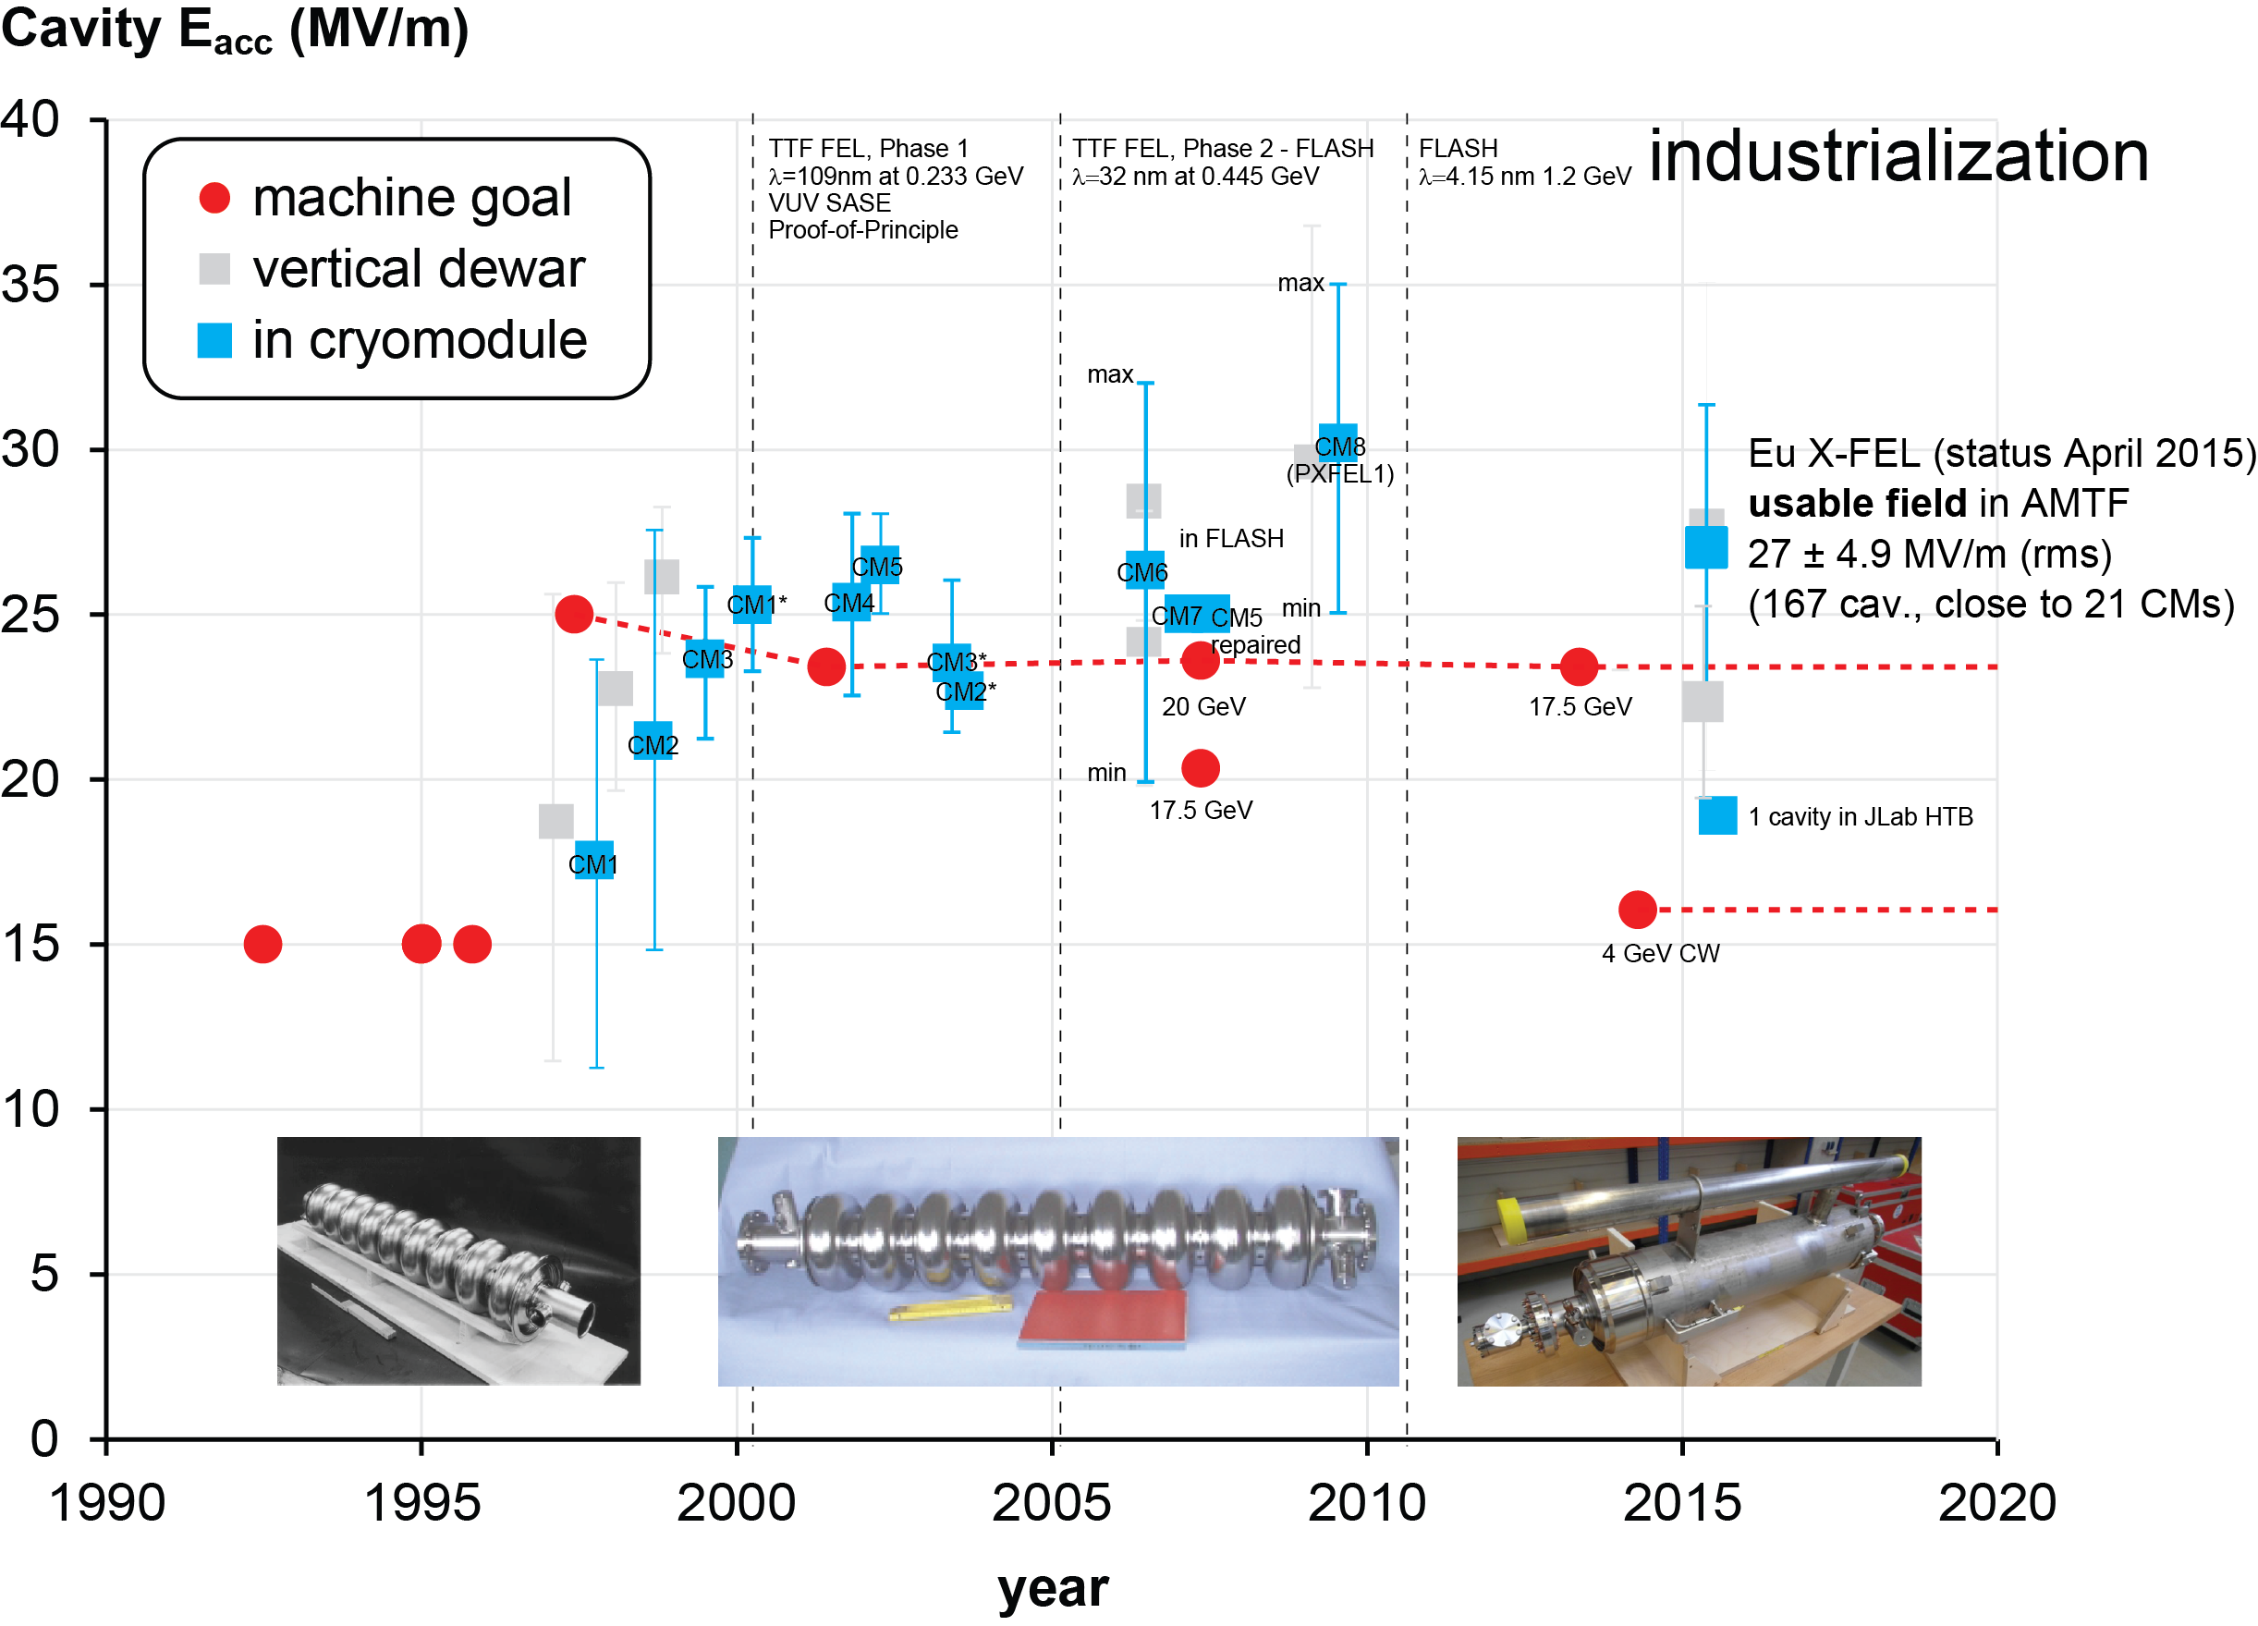
Performance Preservation in Cryomodule
4 old
cavities
used

Slide 26
Performance Preservation in Cryomodule
4 old
cavities
used
prototype CM work in progress

Slide 27
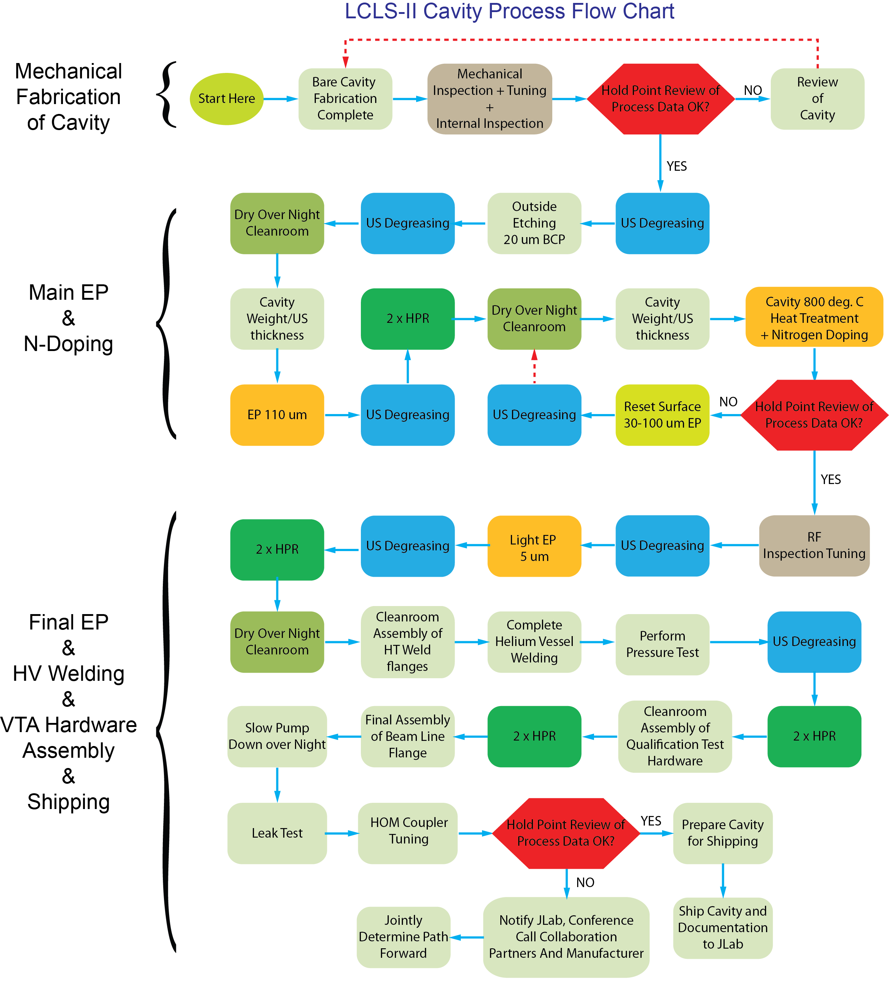
Quality Assurance and Quality Control
Hold Points: Red
After cavity mechanical fabrication
Check of all fabrication and inspection data prior to release for chemical/heat treatment processing
After chemical/heat treatment processing
Check of all process and inspection data prior to release for final chemistry, welding of helium vessel and assembly for vertical test qualification
After all cavity steps are complete
Check of all data prior to release for shipping to FNAL & JLab
This process chart was developed by the cavity procurement team and the High-Q₀ team (Rev. 3)

Slide 28
Procurement Timeline and Status
✓
Phase | Purpose | Duration (months) | Cavity count
 | Prototype CMs | in progress | 16*
I | Vendor Qualification | ~6 | 2 x (# of vendors)*
II | 1st Articles | ~6 | 16
III | Full Production | ~13 | 250
IV | Optional units |  | 32
Order: 266 cavities (FNAL 137, JLab 129), 264 required for 33 CMs, 2 spares Optional: 32 cavities if required for up to 298 cavities * From FNAL inventory
✓
✓
✓
✓
✓
✓
✓
✓
approval pending
cavities = 2 x # vendors
16 cavities
250 cavities

Slide 29
Summary
LCLS-II leverages from industrialized cavity fabrication
More than 35 X-FEL CMs have been built and cavities tested exceed specifications in the cryomodules (on average)
X-FEL technical specifications used for production with only slight modifications
QA/QC implemented to inspect cavities and process data at ‘hold points’
Present N-doping recipe yields cavities with vertical performance beyond LCLS-II specification
Margin to horizontal specs similar to X-FEL, which yields some confidence that CM performance specifications can be met for LCLS-II
First horizontal test of dressed cavity in ‘demonstration’ ¼ cryomodule successful
We are prepared for Phase I (vendor qualification)
Approval pending at DoE
Prototype activities heavily in progress at labs

Slide 30
Backup Slides

Slide 31
Procurement Status
Date | Milestone
2014/09/26 | - Source Selection Plan (SSP) established to evaluate vendor proposals and capabilities in the competitive acquisition for the LCLS-II production cavities - SSP the Source Selection Board (SSB) officially appointed to evaluate vendor proposals including the voting members of the Technical Evaluation Team (TET)
2014/10/01 | Request for Proposal (RFP) released (solicitation JSA-14-R346481 LCLS-II Production Cavities)
2014/10/08 | Pre-proposal/vendor outreach conference - briefed prospective vendors before proposal submission
2014/12/01 | Bidders’ proposals received
2015/02/26 | Technical evaluation summary completed by TET – price proposal released
2015/03/04 | Vendor scenario recommendation presented to SSB Request for Final Proposal Revision to each vendor (FPR)
2015/03/11 | FPRs received
2015/03/12&19 | DOE presentations (JLab and Oak Ridge)
2015/03/31 | TET award recommendation completed
2015/04/07 | Proposal Analysis Report (PAR) approved by SO, TET chairperson, SSO and SSOA
2015/05/04 | PAR submitted to DOE for approval

Slide 32
Best Value Evaluation
Permits tradeoffs among cost and non-cost factors
Multiple vendors scenarios analyzed
Acceptability → based on whether all required documentation in place
Capability → Based on technical evaluation criteria factors and subfactors
Factor 1: Experience & Past Performance
Subfactor A: Experience
Subfactor B: Past Performance
Factor 2: Resources: Facilities, Planning, & Management
Subfactor A: Production Facilities & Equipment
Subfactor B: Manufacturing Planning & Management
Subfactor C: Production & Delivery Schedule
Subfactor D: Commitment to R&D Technology
Factor 3: Understanding of the Requirement
Subfactor A: Conformance with Specification
Subfactor B: Change Suggestions are useful & well supported
Factor 4: Quality Assurance
Subfactor A: QA Plan assures quality product:
Subfactor B: Methodology for Problem Avoidance & Resolution
Subfactor C: Approach to Documentation, Calibration & Inspections
Price and price-related factors:
Total price weighed against apparent advantages of individual technical proposals (e.g. determine if superior technical proposals, excluding price considerations, are worth increased price differentials (if any)). Buy American Act applied for non-domestic vendors

